Slide 1
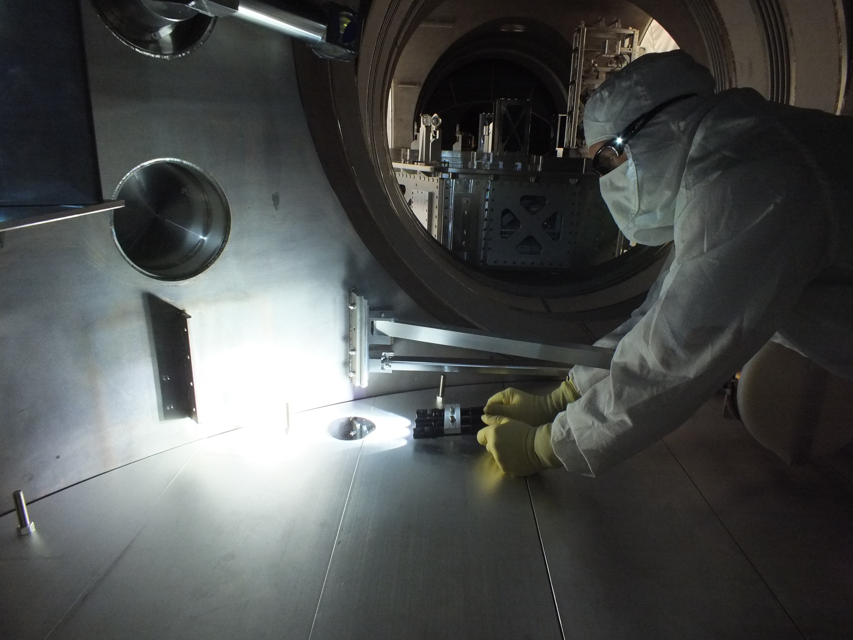
SUMMARY OF 4” WAFER DATA
Contamination Control Working Group
February 26, 2014

Slide 2
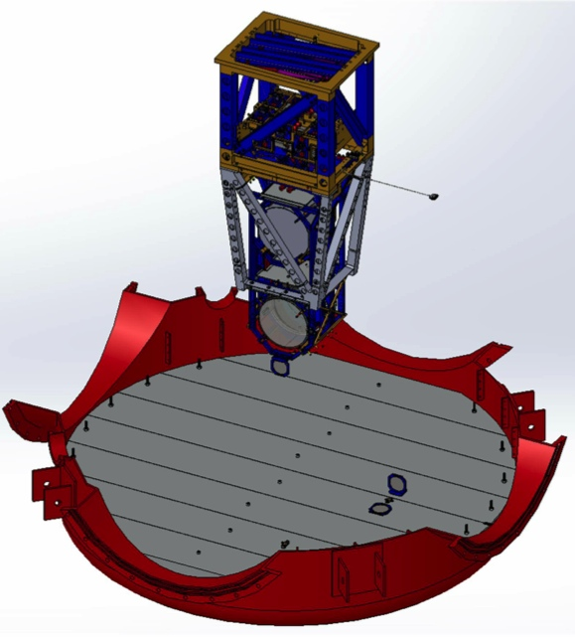
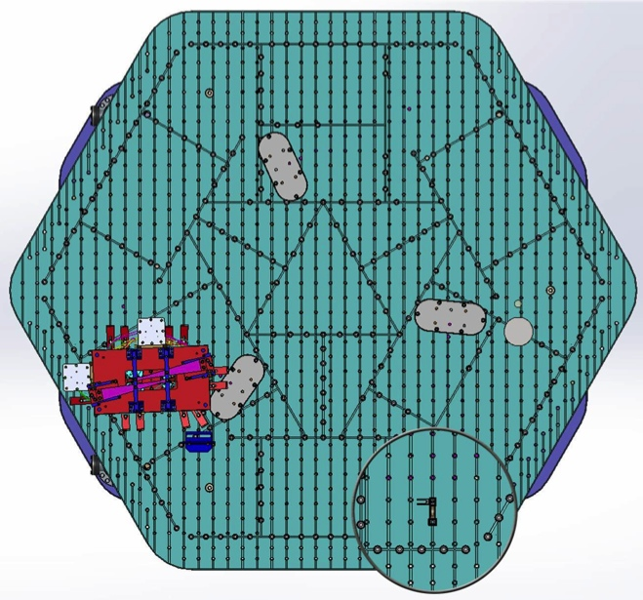
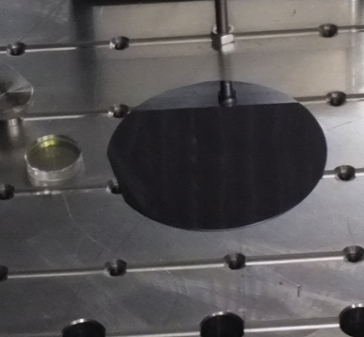
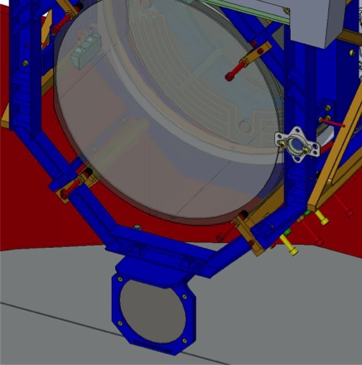
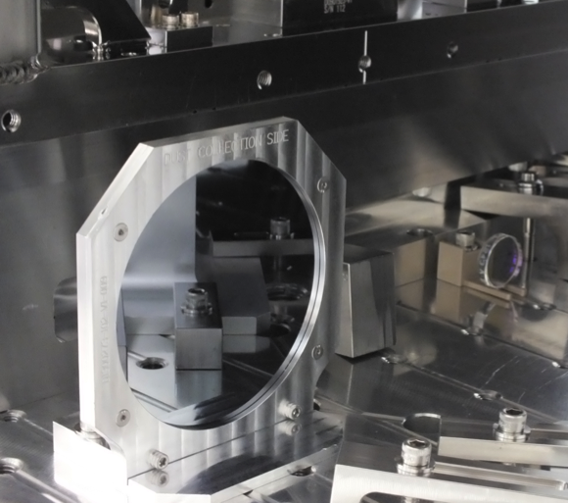
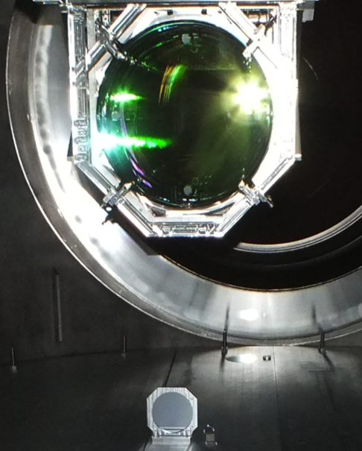
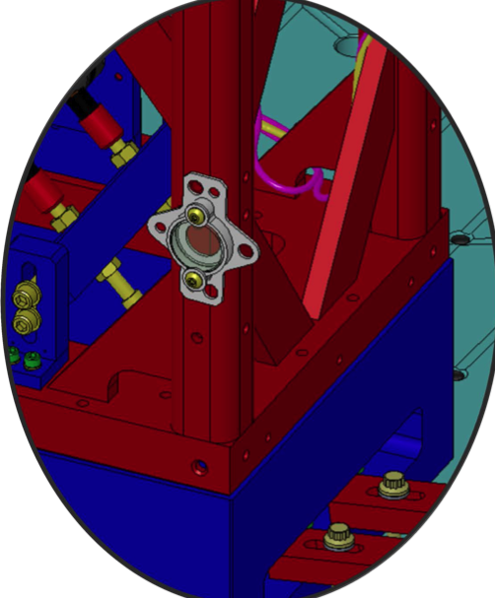
4” Wafer & 1” Optic Placement

Slide 3
Total Wafers Collected

Slide 4
Total Wafers Collected
Need more samples for analysis.

Slide 5
Analysis Progress
Counting microscope setup altered & upgraded.
Must re-scan older wafers.
Good start, there’s more work to do.

Slide 6
LBSC1 PCLs
June – Sept 2013
1 cycle (pump down & vent)
No work
Sept – Nov 2013
1 cycle
*Work is unknown*
log vs log² graph
+Y edge of chamber
Floor below ITMY (Vertical)
Goal for vertical surfaces
Floor below ITMY (Vertical)
Floor below ITMY
Goal for horizontal surfaces
502
166
200
344

Slide 7
LBSC2 PCLs
Mar – June 2013
0 cycles
Heavy work & foot traffic
June – Sept 2013
1 cycle
No work
Sept – Nov 2013
1 cycle
*Work is unknown*
Floor below BS
Floor below BS
-Y edge of chamber
-Y edge of chamber
Floor below BS (Vertical)
Floor below BS (Vertical)
-Y edge of chamber
-Y edge of chamber
Floor below BS
Floor below BS
Floor below BS (Vertical)
Floor below BS (Vertical)
233
233
830
830
1,958
218
1,958
218
276
276
491
491

Slide 8
LBSC3
June – Sept 2013
1 cycle
No work
Sept – Nov 2013
1 cycle
*Work is unknown*
+X edge of chamber
Floor below ITMX (Vertical)
Floor below ITMX (Vertical)
Floor below ITMX
395
153
402
337

Slide 9
WBSC Chambers
Feb – Oct 2013
1 cycle
Work in adjacent chambers
April – Oct 2013
1 cycle
Heavy work over wafer
Oct – Nov 2013
1 cycle
No work?
Need more samples to determine trends.
WBSC1 – Floor below ITMY
WBSC2 – Floor below baffle?
WBSC3 – Floor below ITMX
230
598
316

Slide 10
LHAM2 History
First clean – basic wipe down.
Estimated ~ 1 hour.
1-1.5 hrs per chamber. Wiped all horizontal & vertical surfaces, top & inside of ISI, underneath support tubes, etc.
Pump down #1
(doors close)
Vent (doors open)
Big clean – multiple wipe downs over a 2 week period.
Pump down #4
Vent
Pump down #2
Vent
Pump down #3
Vent
1 cycle
Light work
(IO baffles installed)
1 cycle
No work
Med. work
Medium work
(PRM, ISS PD array, PR3 gluing)
1 cycle
Minimal work
1 cycle
Light work
(PR2/PR3 baffles)
1 cycle
Medium work
(PRM, ISS PD array, PR3 gluing)
First clean – basic wipe down.
Estimated at 1 hour.

Slide 11
LHAM2
In front of PR3
In front of PR3
In front of PR3
In front of PR3
In front of PR3
In front of PR3
In front of MC1 & MC3
In front of PR3
In front of PR3
+X end of table, on mass
Near PR3, N door (Vertical)
+X end of table, on mass
NW corner of table
+X end of table, on mass
*not sealed
N side of table (Vertical)
192
105
218
218
218
188*
424
322
293
268
268
817
280
817
280

Slide 12
LHAM2 Story
Pump down #1
(doors closed)
Vent (doors open)
Pump down #4
Vent
Pump down #2
Vent
Pump down #3
Vent
1 cycle
Light work
322
1 cycle
No work
293
Med. Work
188*
Medium work
218 - 268
1 cycle
Minimal work
105
1 cycle
Light work
192 - 218
1 cycle
Medium work
280 - 817

Slide 13
Summary
Cleaning as you go works!
Refer to LIGO-G1301249
Upcoming…
Compiling WHAM data
1” optic counts & damage plan
Trips to LHO to continue CC support
Opportunity for another round of data when ITM’s open in April at LHO

Slide 14
Relevant Documents
LIGO-F1200021 Advanced LIGO Particulate Sample Form (updated)
LIGO-T1300014 Aligo, BSC Flooring + HAM ISI, Witness Sample Placement Guidelines
LIGO-E1201096 Contamination Sample Handling – How to receive, use, send, buy, and store samples

