Slide 1
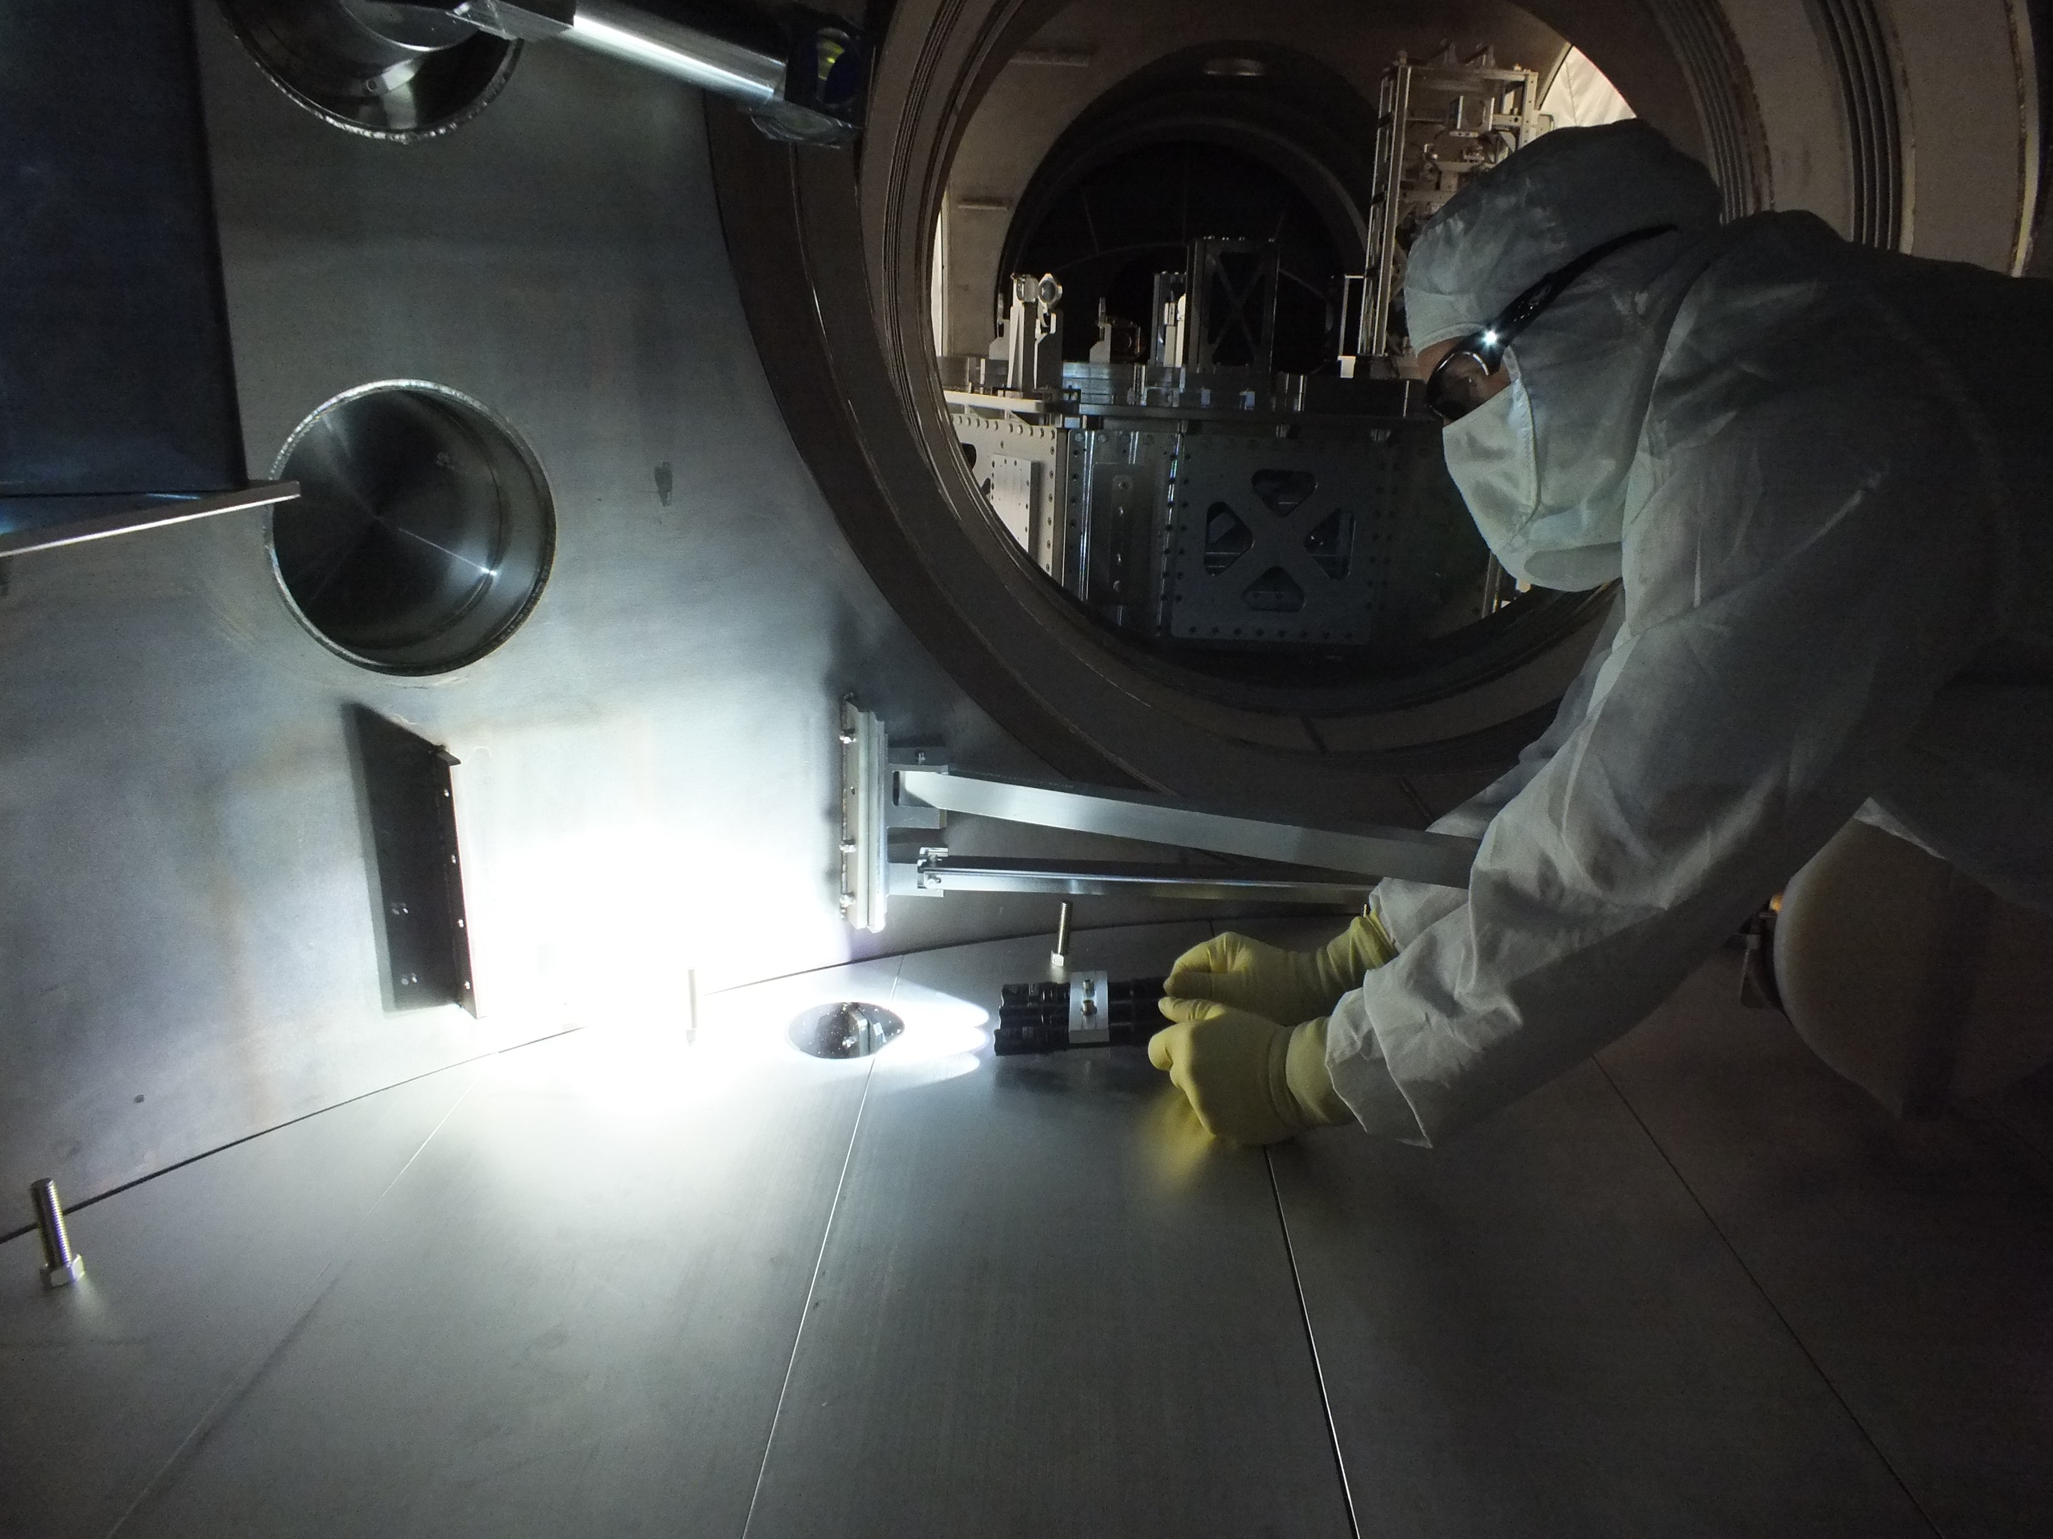
SUMMARY OF 4” WAFER DATA
Contamination Control Working Group
February 26, 2014

Slide 2
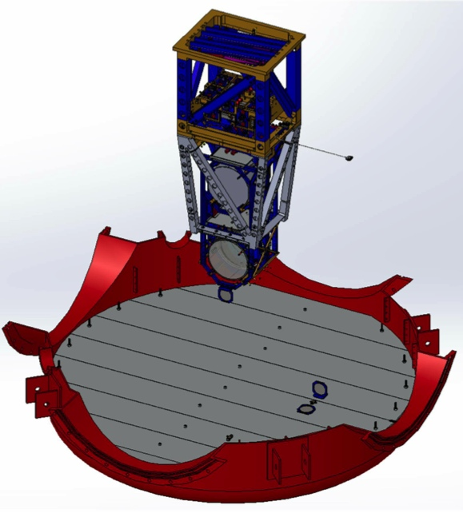
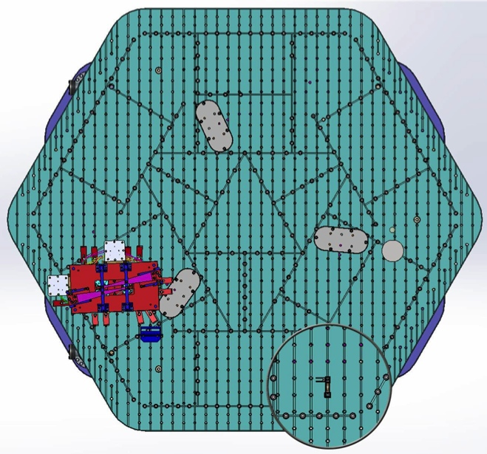
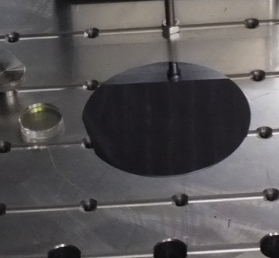
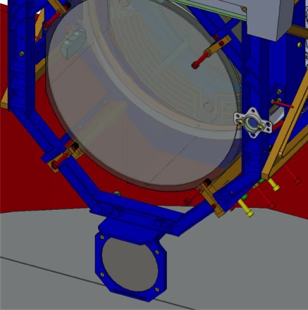
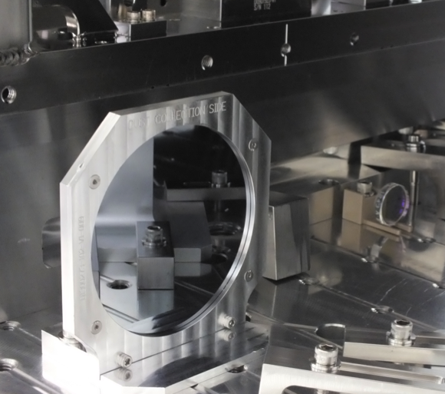
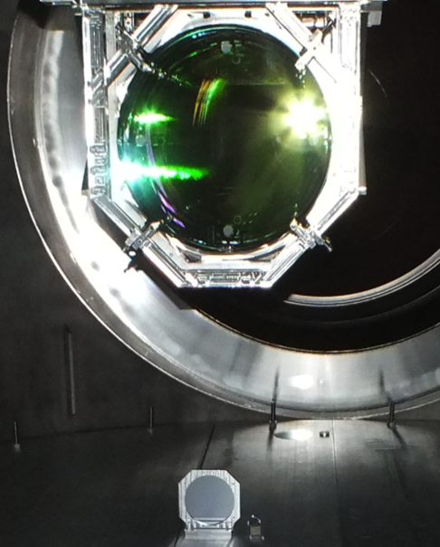
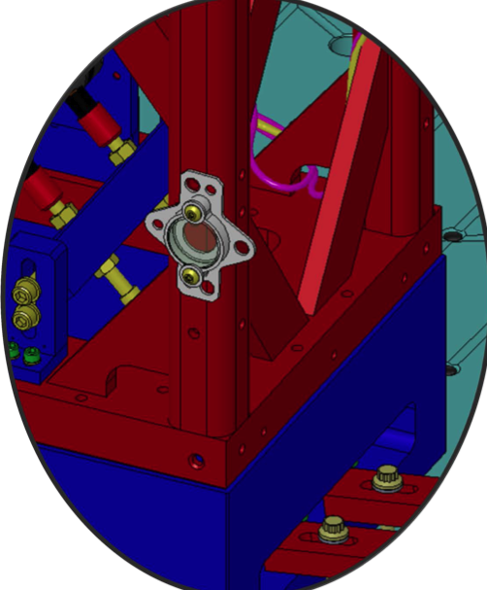
4” Wafer & 1” Optic Placement

Slide 3
Total Wafers Collected

Slide 4
Total Wafers Collected

Slide 5
Total Wafers Collected
Need more samples for analysis.

Slide 6
Analysis Progress
Counting microscope setup altered & upgraded.
Must re-scan older wafers.

Slide 7
Analysis Progress
Counting microscope setup altered & upgraded.
Must re-scan older wafers.

Slide 8
Analysis Progress
Counting microscope setup altered & upgraded.
Must re-scan older wafers.
Good start, there’s more work to do.

Slide 9
LBSC1 PCLs
log vs log² graph
Goal for vertical surfaces
Goal for horizontal surfaces

Slide 10
LBSC1 PCLs
June – Sept 2013
1 cycle (pump down & vent)
No work
+Y edge of chamber
Floor below ITMY (Vertical)
502
344

Slide 11
LBSC1 PCLs
June – Sept 2013
1 cycle (pump down & vent)
No work
Sept – Nov 2013
1 cycle
*Work is unknown*
+Y edge of chamber
Floor below ITMY (Vertical)
Floor below ITMY (Vertical)
Floor below ITMY
502
166
200
344

Slide 12
LBSC2 PCLs
Mar – June 2013
0 cycles
Heavy work & foot traffic
Floor below BS
276

Slide 13
LBSC2 PCLs
Mar – June 2013
0 cycles
Heavy work & foot traffic
June – Sept 2013
1 cycle
No work
Floor below BS
Floor below BS (Vertical)
276
1,958

Slide 14
LBSC2 PCLs
Mar – June 2013
0 cycles
Heavy work & foot traffic
June – Sept 2013
1 cycle
No work
Sept – Nov 2013
1 cycle
*Work is unknown*
Floor below BS
Floor below BS (Vertical)
Floor below BS
Floor below BS (Vertical)
233
218
276
1,958

Slide 15
LBSC2 PCLs
Mar – June 2013
0 cycles
Heavy work & foot traffic
June – Sept 2013
1 cycle
No work
Sept – Nov 2013
1 cycle
*Work is unknown*
Floor below BS
-Y edge of chamber
Floor below BS (Vertical)
-Y edge of chamber
Floor below BS
Floor below BS (Vertical)
233
218
276
491
830
1,958

Slide 16
LBSC2 PCLs
Mar – June 2013
0 cycles
Heavy work & foot traffic
June – Sept 2013
1 cycle
No work
Sept – Nov 2013
1 cycle
*Work is unknown*
Floor below BS
Floor below BS
-Y edge of chamber
-Y edge of chamber
Floor below BS (Vertical)
Floor below BS (Vertical)
-Y edge of chamber
-Y edge of chamber
Floor below BS
Floor below BS
Floor below BS (Vertical)
Floor below BS (Vertical)
233
233
830
830
1,958
218
1,958
218
276
276
491
491

Slide 17
LBSC3
June – Sept 2013
1 cycle
No work
Sept – Nov 2013
1 cycle
*Work is unknown*
+X edge of chamber
Floor below ITMX (Vertical)
395
402

Slide 18
LBSC3
June – Sept 2013
1 cycle
No work
Sept – Nov 2013
1 cycle
*Work is unknown*
+X edge of chamber
Floor below ITMX (Vertical)
Floor below ITMX (Vertical)
Floor below ITMX
395
153
402
337

Slide 19
WBSC Chambers
Feb – Oct 2013
1 cycle
Work in adjacent chambers
April – Oct 2013
1 cycle
Heavy work over wafer
Oct – Nov 2013
1 cycle
No work?
WBSC1 – Floor below ITMY
WBSC2 – Floor below baffle?
WBSC3 – Floor below ITMX
230
598
316

Slide 20
WBSC Chambers
Feb – Oct 2013
1 cycle
Work in adjacent chambers
April – Oct 2013
1 cycle
Heavy work over wafer
Oct – Nov 2013
1 cycle
No work?
Need more samples to determine trends.
WBSC1 – Floor below ITMY
WBSC2 – Floor below baffle?
WBSC3 – Floor below ITMX
230
598
316

Slide 21
LHAM2 History
Pump down #1
(doors close)
Vent (doors open)
Pump down #4
Vent
Pump down #2
Vent
Pump down #3
Vent
First clean – basic wipe down.
Estimated at 1 hour.

Slide 22
LHAM2 History
Pump down #1
(doors close)
Vent (doors open)
Pump down #4
Vent
Pump down #2
Vent
Pump down #3
Vent
1 cycle
Light work
(IO baffles installed)
1 cycle
No work
Med. work
Medium work
(PRM, ISS PD array, PR3 gluing)
1 cycle
Minimal work
1 cycle
Light work
(PR2/PR3 baffles)
1 cycle
Medium work
(PRM, ISS PD array, PR3 gluing)
First clean – basic wipe down.
Estimated at 1 hour.

Slide 23
LHAM2 History
First clean – basic wipe down.
Estimated ~ 1 hour.
1-1.5 hrs per chamber. Wiped all horizontal & vertical surfaces, top & inside of ISI, underneath support tubes, etc.
Big clean – multiple wipe downs over a 2 week period.
1 cycle
Light work
(IO baffles installed)
1 cycle
No work
Med. work
Medium work
(PRM, ISS PD array, PR3 gluing)
1 cycle
Minimal work
1 cycle
Light work
(PR2/PR3 baffles)
1 cycle
Medium work
(PRM, ISS PD array, PR3 gluing)
First clean – basic wipe down.
Estimated at 1 hour.

Slide 24
LHAM2

Slide 25
LHAM2
In front of MC1 & MC3
+X end of table, on mass
+X end of table, on mass
+X end of table, on mass
*not sealed
188*
424
322
293

Slide 26
LHAM2
In front of PR3
In front of PR3
In front of PR3
In front of MC1 & MC3
In front of PR3
+X end of table, on mass
+X end of table, on mass
+X end of table, on mass
*not sealed
218
188*
424
322
293
280
268
817

Slide 27
LHAM2
In front of PR3
In front of PR3
In front of PR3
In front of PR3
In front of PR3
In front of PR3
In front of MC1 & MC3
In front of PR3
In front of PR3
+X end of table, on mass
Near PR3, N door (Vertical)
+X end of table, on mass
NW corner of table
+X end of table, on mass
*not sealed
N side of table (Vertical)
192
105
218
218
218
188*
424
322
293
268
268
817
280
817
280

Slide 28
LHAM2 Story
Pump down #1
(doors closed)
Vent (doors open)
Pump down #4
Vent
Pump down #2
Vent
Pump down #3
Vent
1 cycle
Light work
322
1 cycle
No work
293
Med. Work
188*
Medium work
218 - 268
1 cycle
Minimal work
105
1 cycle
Light work
192 - 218
1 cycle
Medium work
280 - 817

Slide 29
Summary
Cleaning as you go works!
Refer to LIGO-G1301249

Slide 30
Summary
Cleaning as you go works!
Refer to LIGO-G1301249
Upcoming…
Compiling WHAM data

Slide 31
Summary
Cleaning as you go works!
Refer to LIGO-G1301249
Upcoming…
Compiling WHAM data
1” optic counts & damage plan

Slide 32
Summary
Cleaning as you go works!
Refer to LIGO-G1301249
Upcoming…
Compiling WHAM data
1” optic counts & damage plan
Trips to LHO to continue CC support
Opportunity for another round of data when ITM’s open in April at LHO

Slide 33
Relevant Documents
LIGO-F1200021 Advanced LIGO Particulate Sample Form (updated)
LIGO-T1300014 Aligo, BSC Flooring + HAM ISI, Witness Sample Placement Guidelines
LIGO-E1201096 Contamination Sample Handling – How to receive, use, send, buy, and store samples

