Slide 1
LLO PRMI Contrast Defect simulation > data
Hiro Yamamoto / LIGO lab @ Caltech
200ppm is the measured best contrast defect.
ITM substrates are approximated by lens, and the RoC of ITMX is changed by RH, the contrast defect comes down to be
  200ppm when beam splitter baffles are NOT attached,
  7ppm when BS baffles are attached. I.e., the effect of the difference of the ITM substrates can be fully compensated by RH.
1300ppm when all maps, ITMs, CPs and BSs, are included.
  Just ITM8 (ITMY) transmission map alone is enough to make CD as bad as 600ppm. This map has a nice plateau within an aperture of 10cm and changes rapidly outside. This is one cause of the large CD in the simulation.
Beam pointing etc seems to be reasonably OK.
I would like to hear any suggestions to find the cause of this big discrepancy.

Slide 2
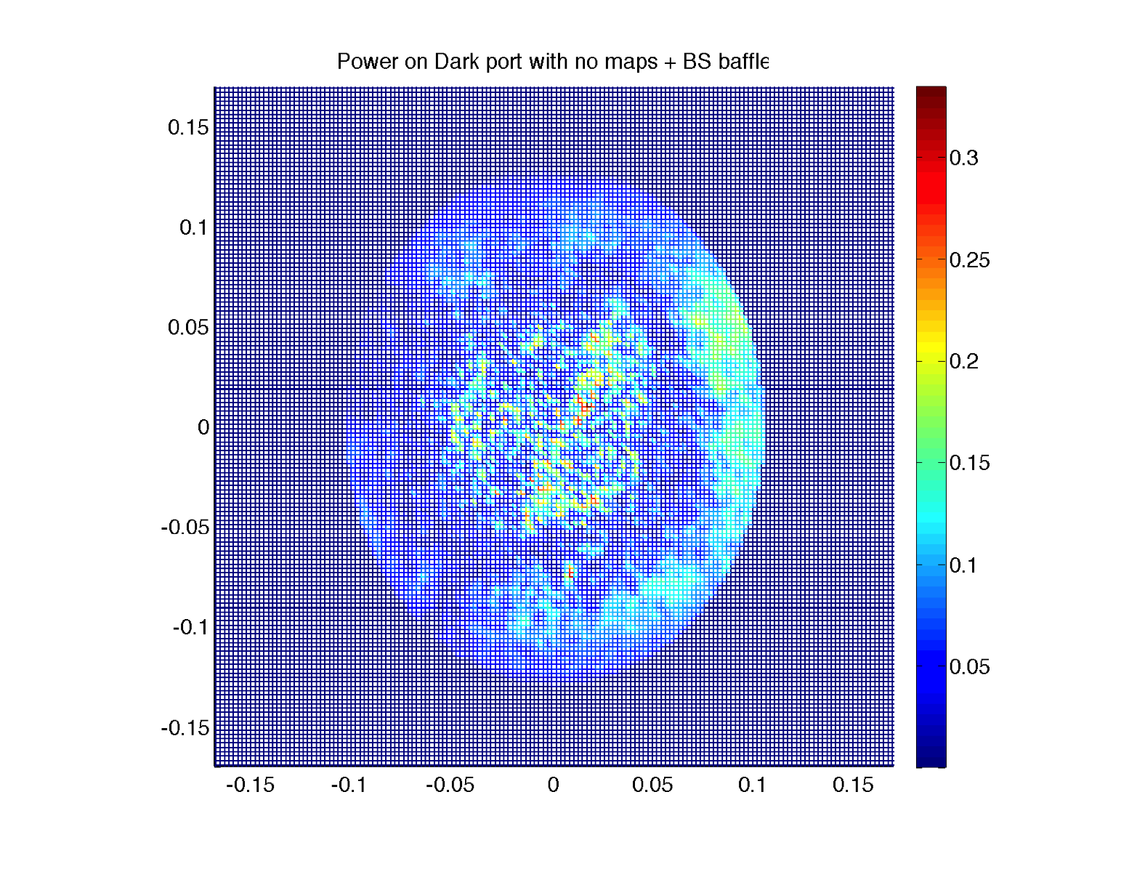
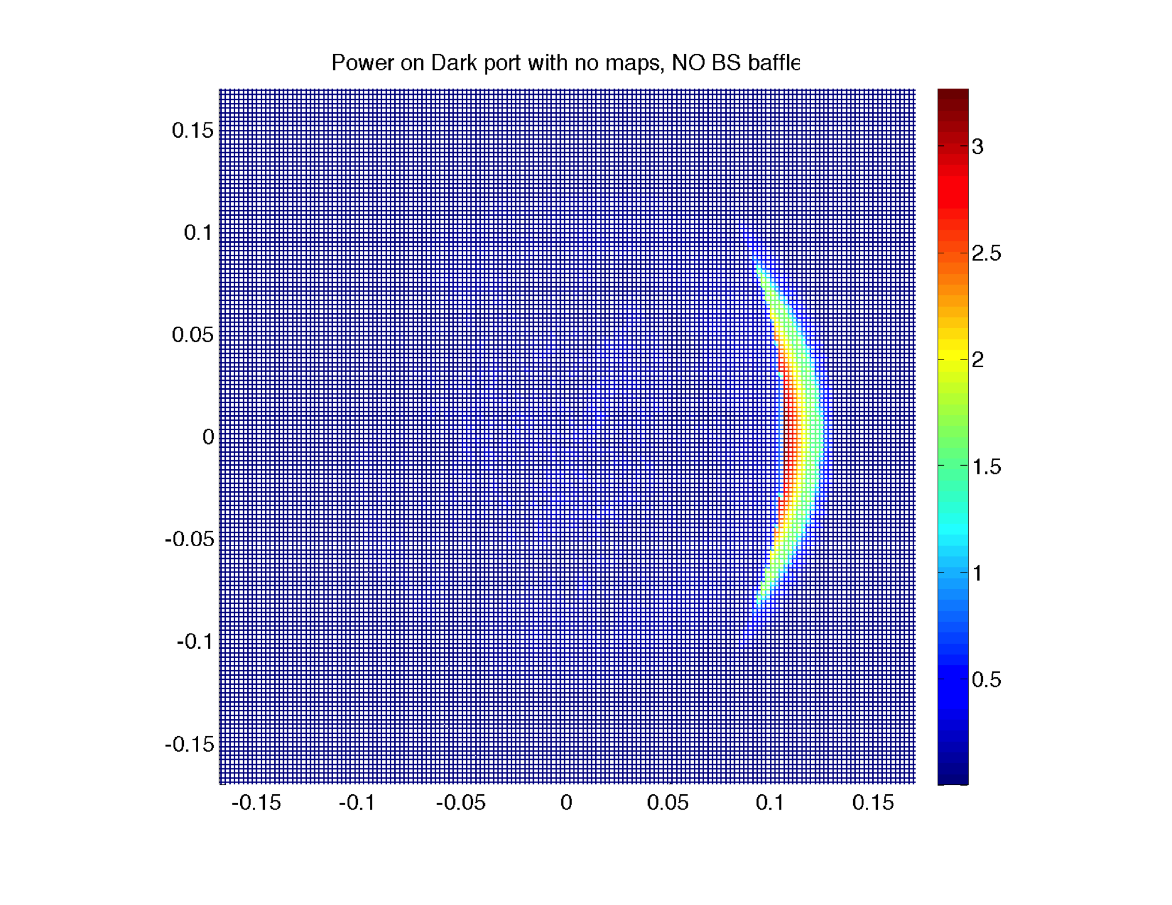
Ideal case : ITM=lens
ITMx:RoC=302km, ITMy:-82km
With BS baffle 7ppm
Without BS baffle 210ppm

Slide 3
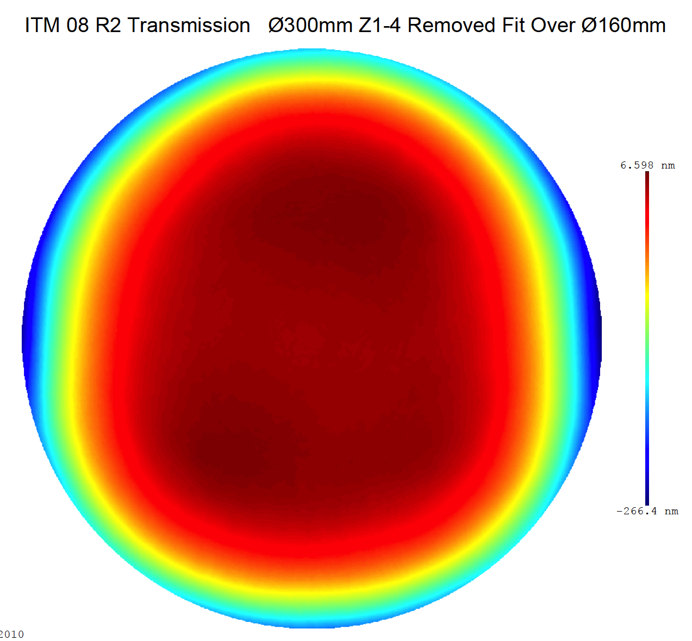
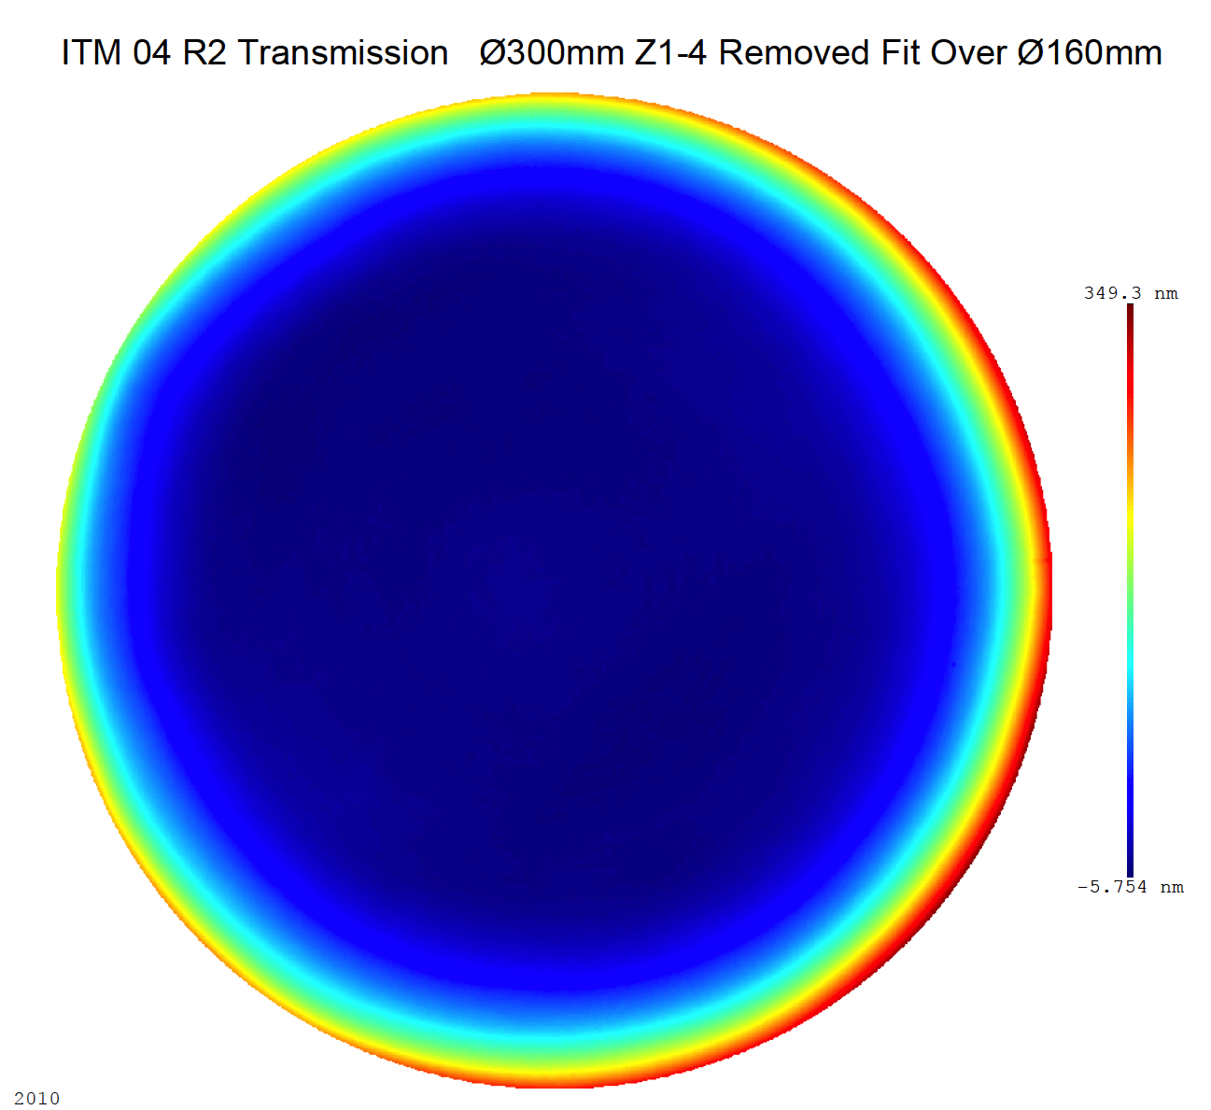
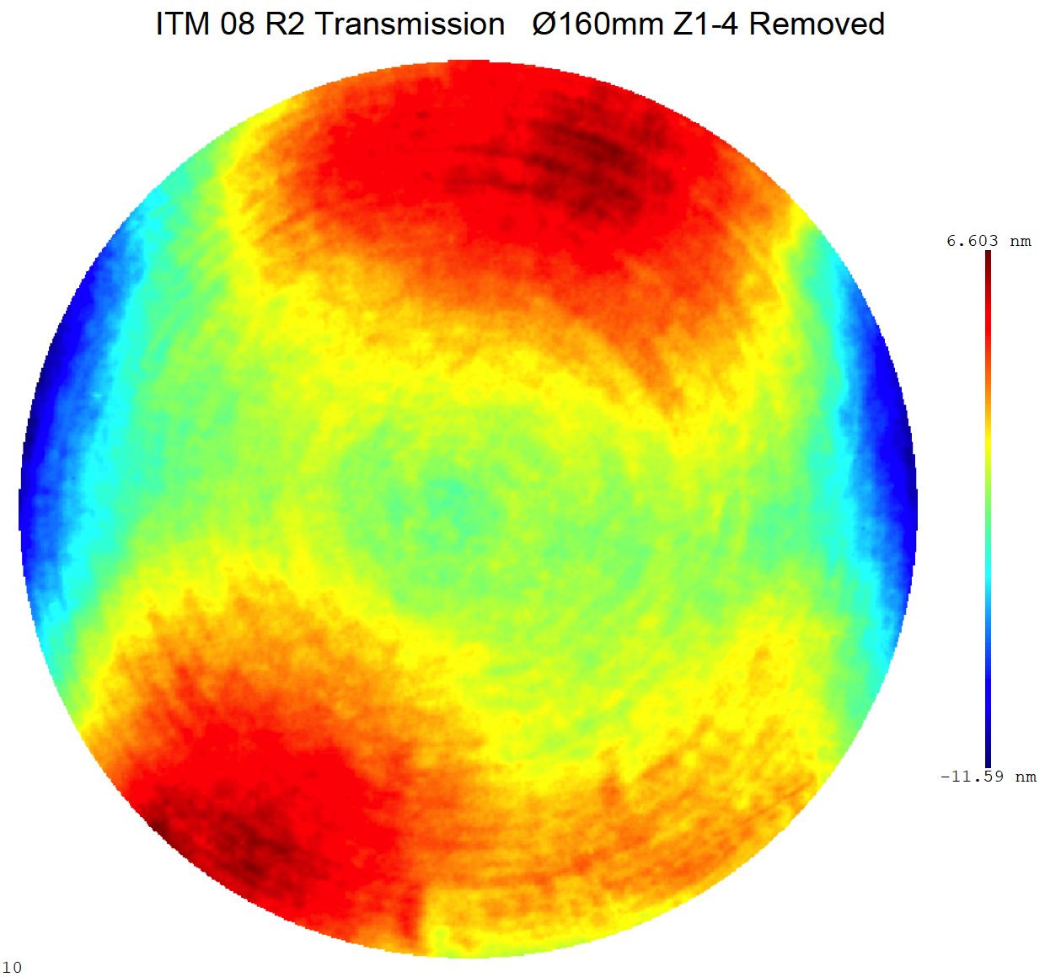
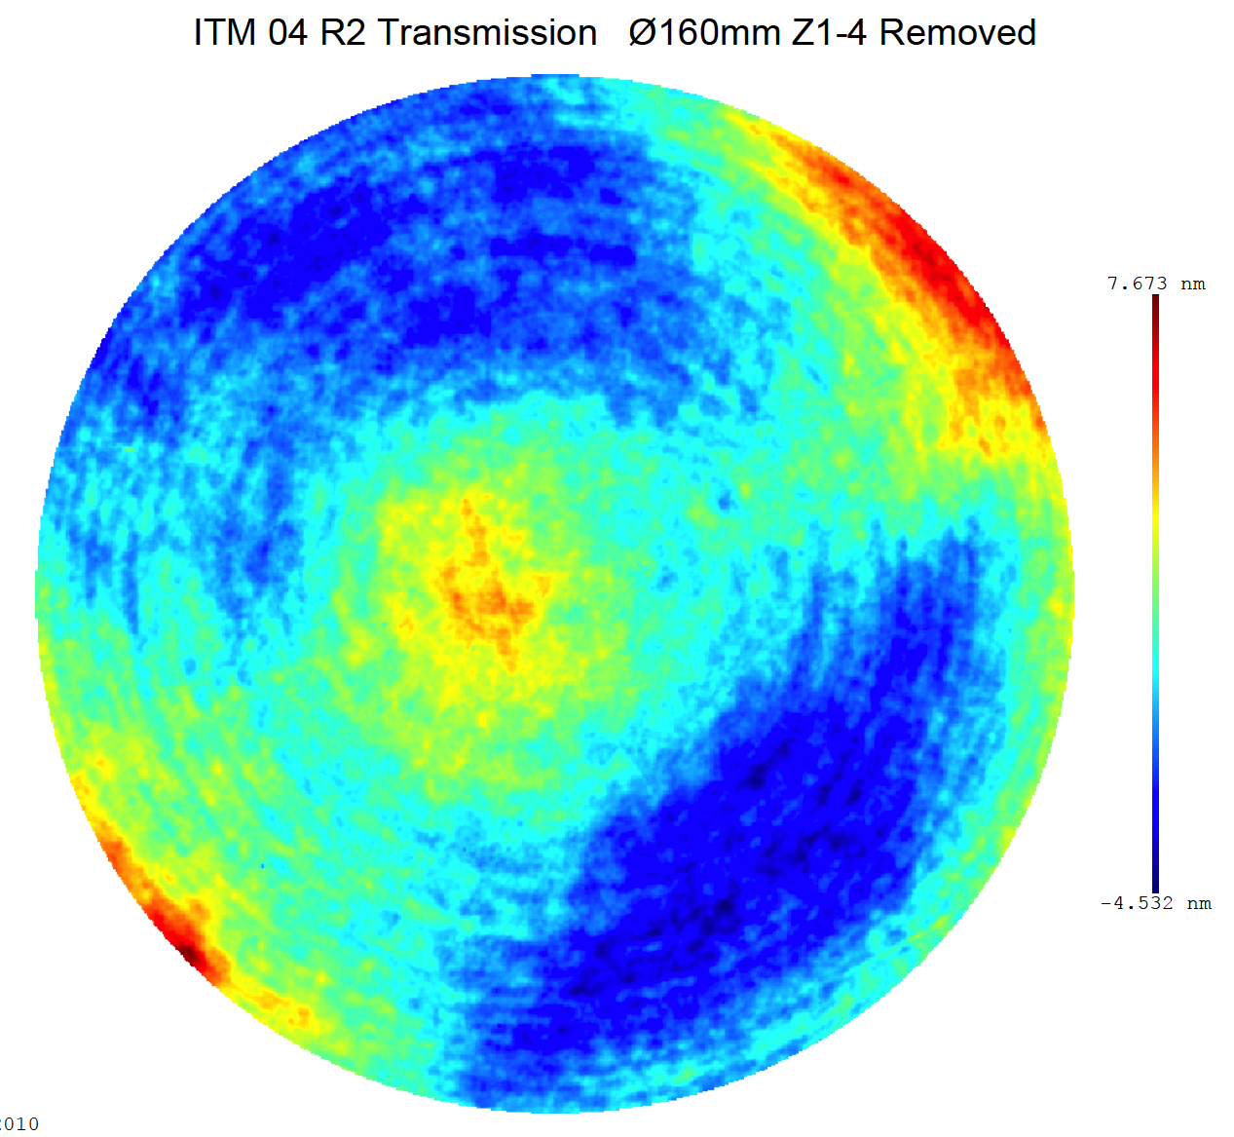
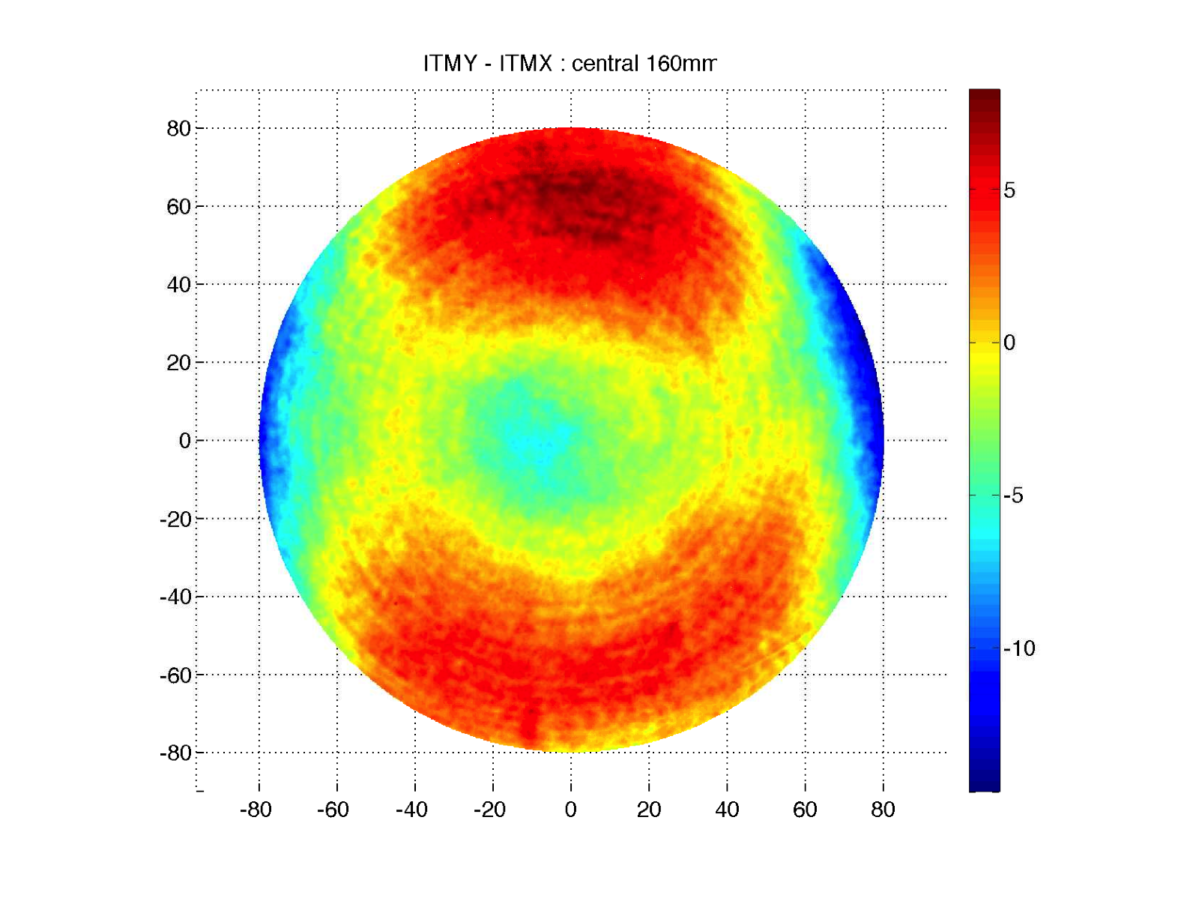
ITM transmission maps
ITM08 / ITMY
ITM04 / ITMX
ϕ=300mm
ITMY-ITMX
ϕ=160mm

Slide 4
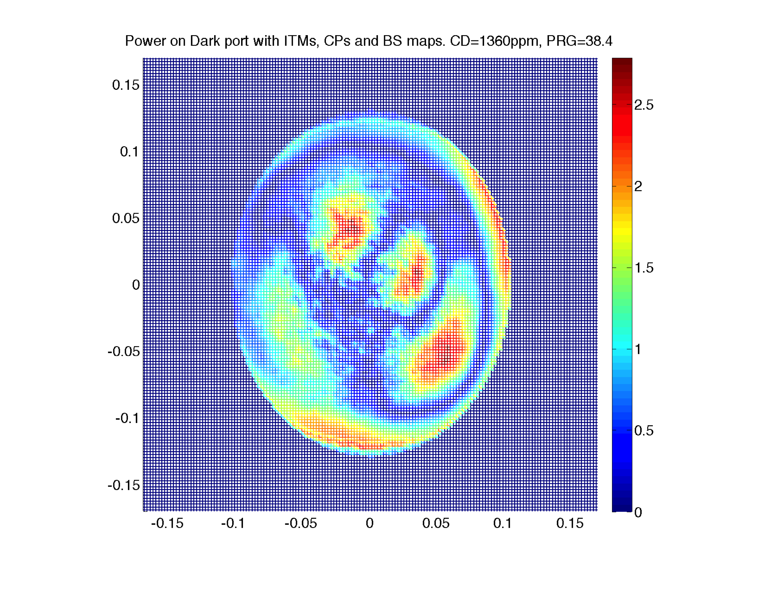
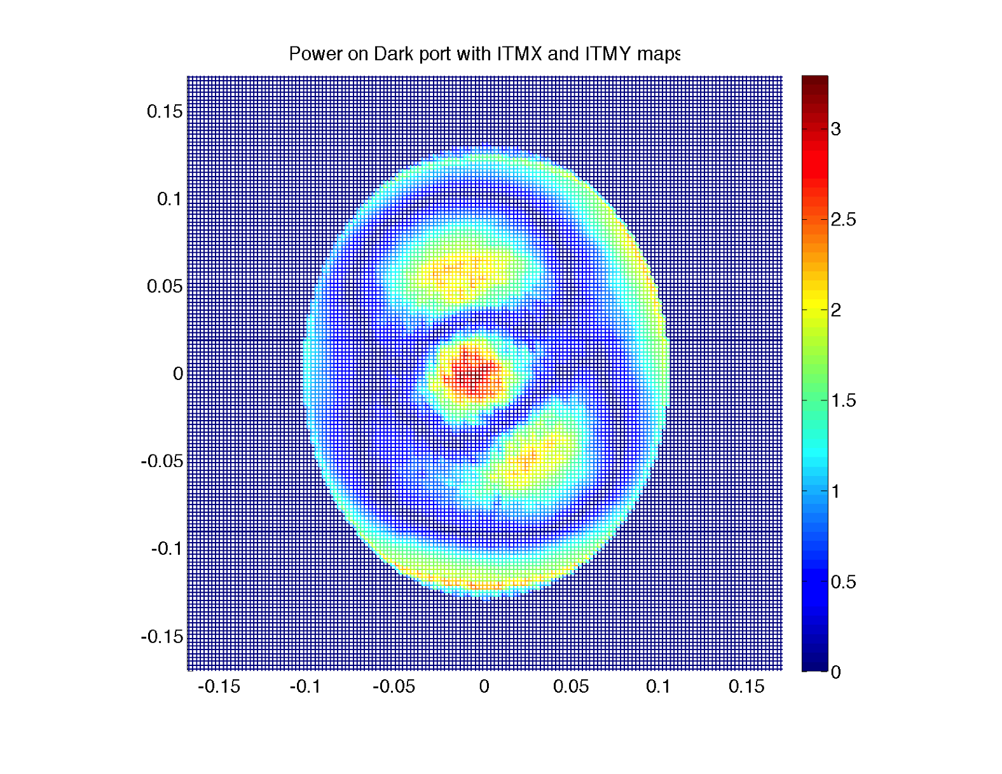
Back of the envelope vs FFT
 | W=7cm ITMX | W=7cm ITMY | W=7cm ITMX&Y | W=5.3 ITMX&Y
simple | 1200 | 1900 | 5500 | 440
FFT | 320 ppm | 570 | 1370 | 120
FFT w/ ITMx/y maps
FFT with all maps (1300ppm)

Slide 5
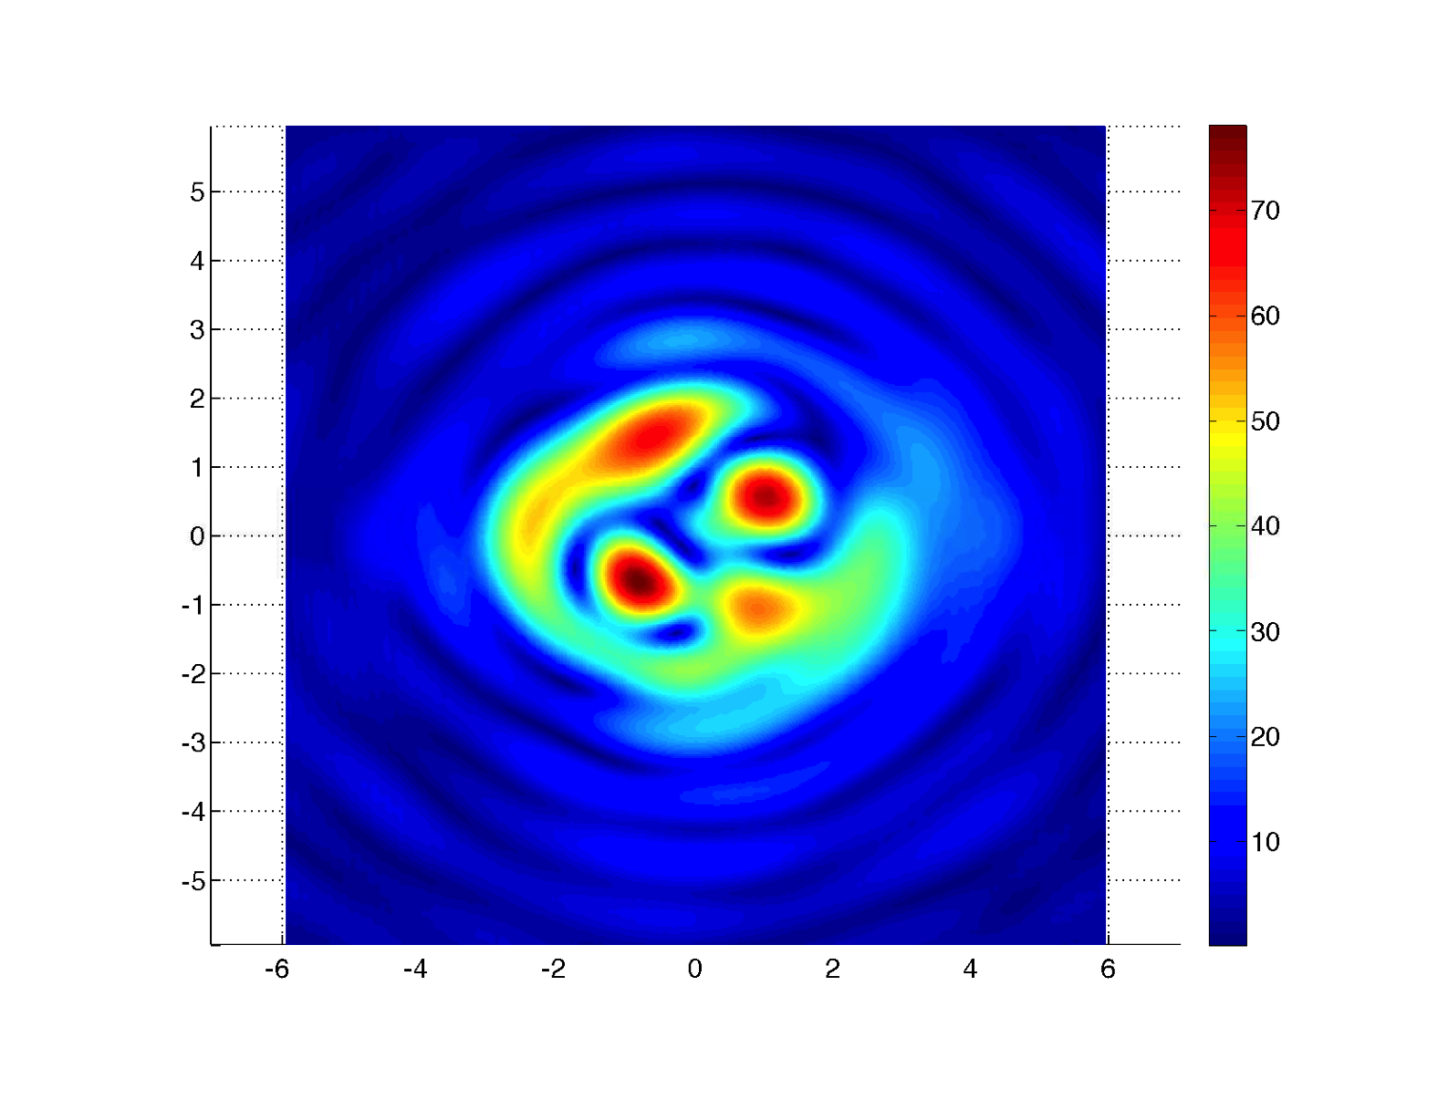
High order modes and spreading
Modes at the dark port of BS
Cold case field is dominated by lower order modes due curvature mismatch
Fraction of energy in a circle
Field with RH on ITMX spreads more

Slide 6
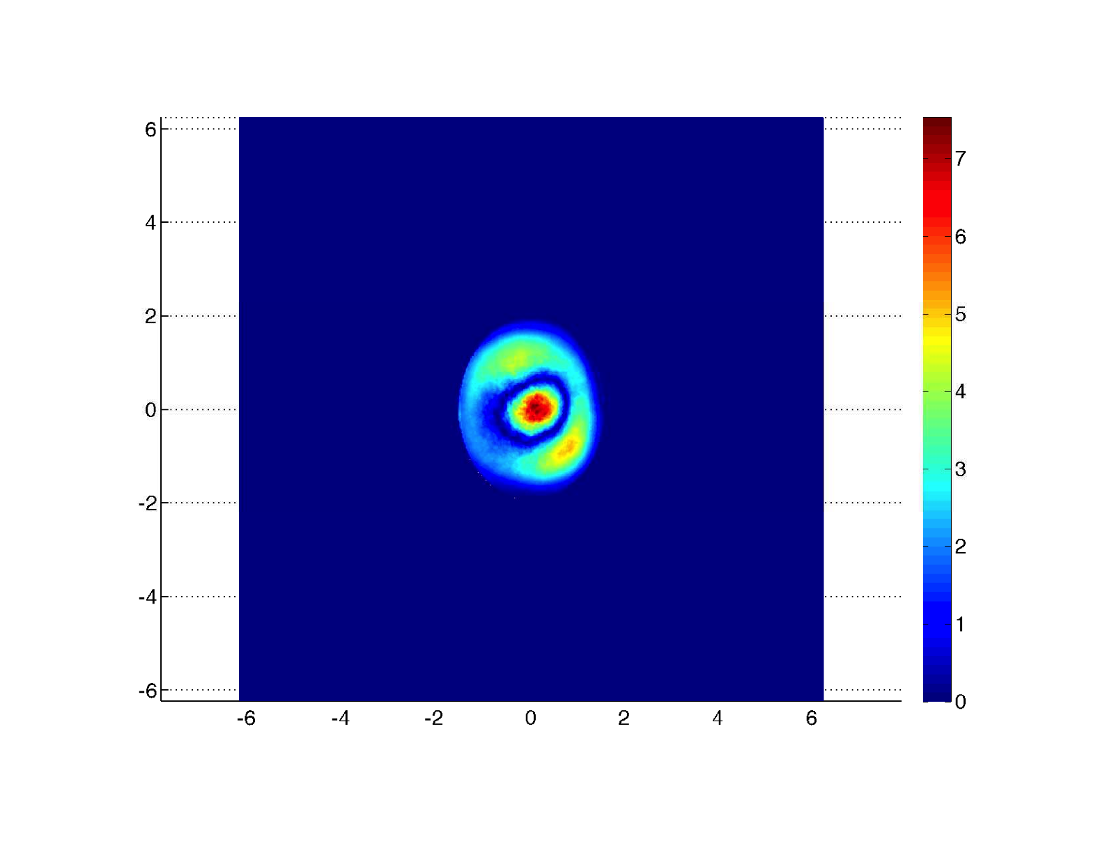
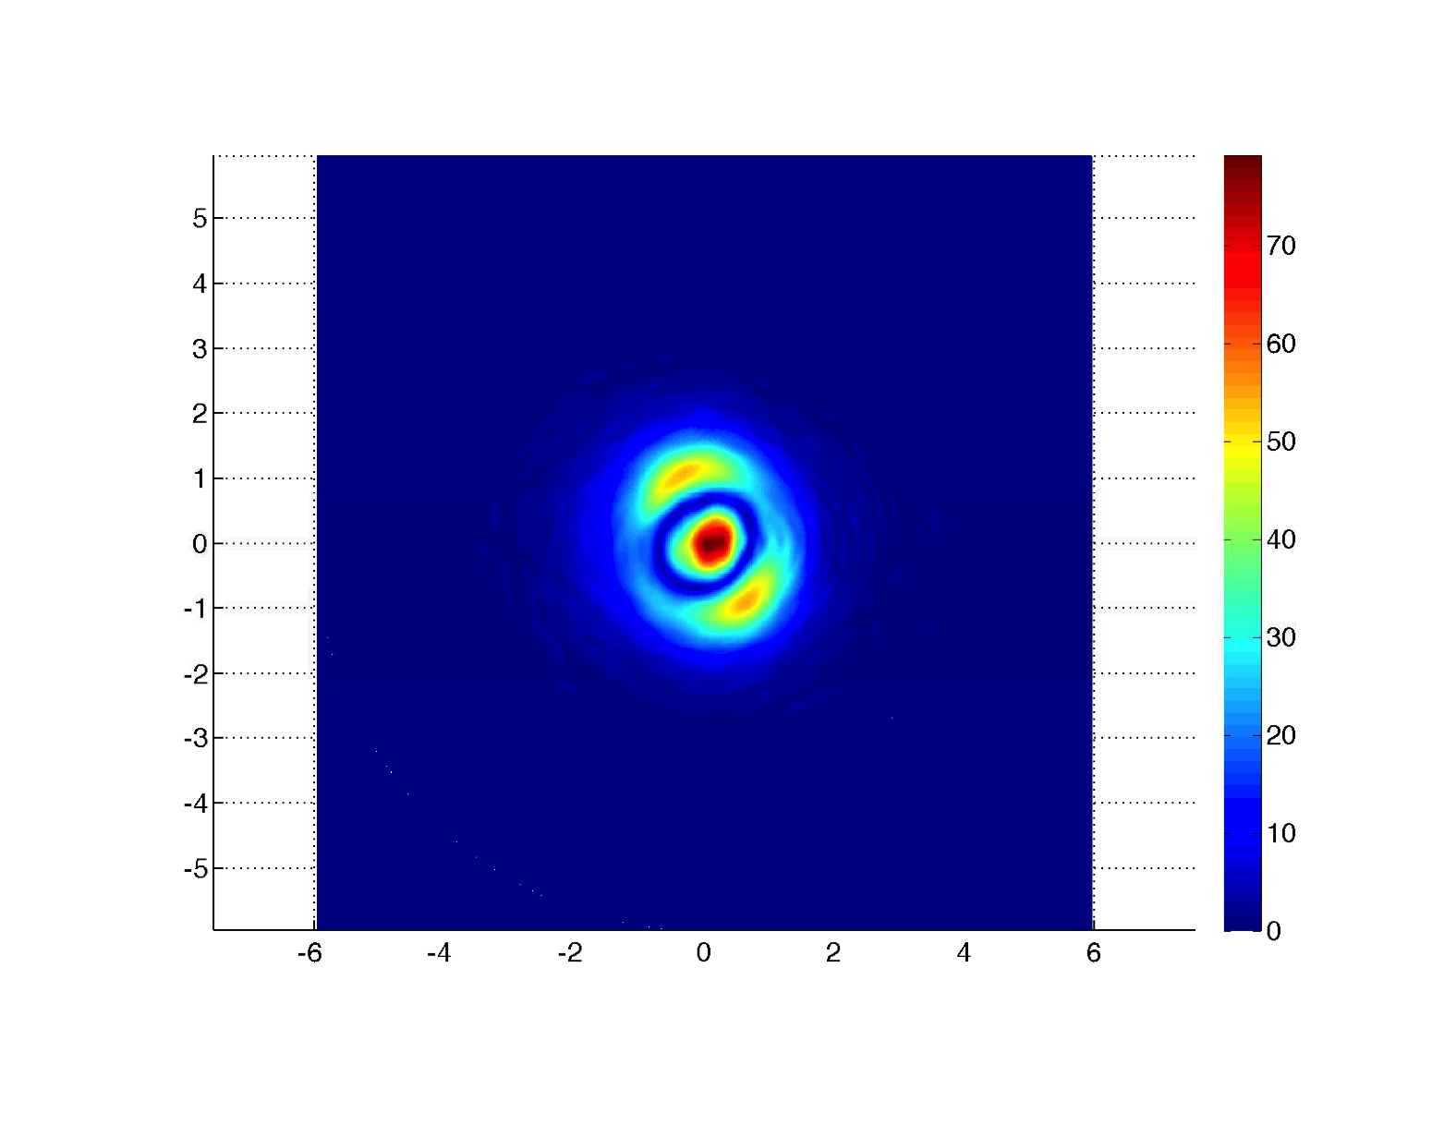
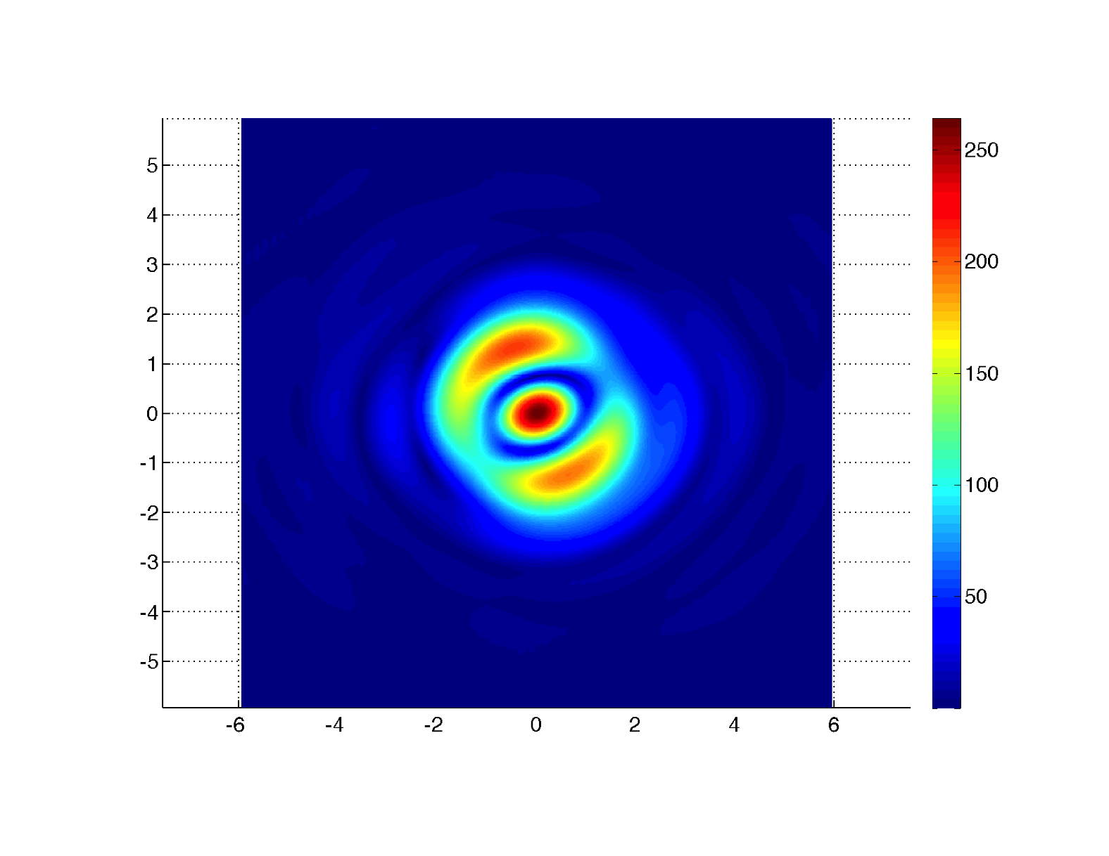
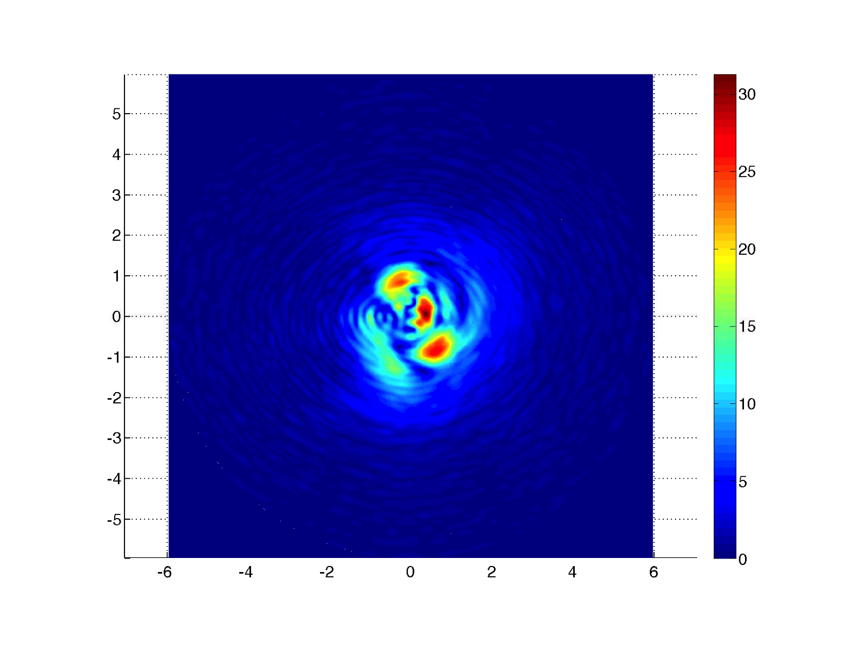
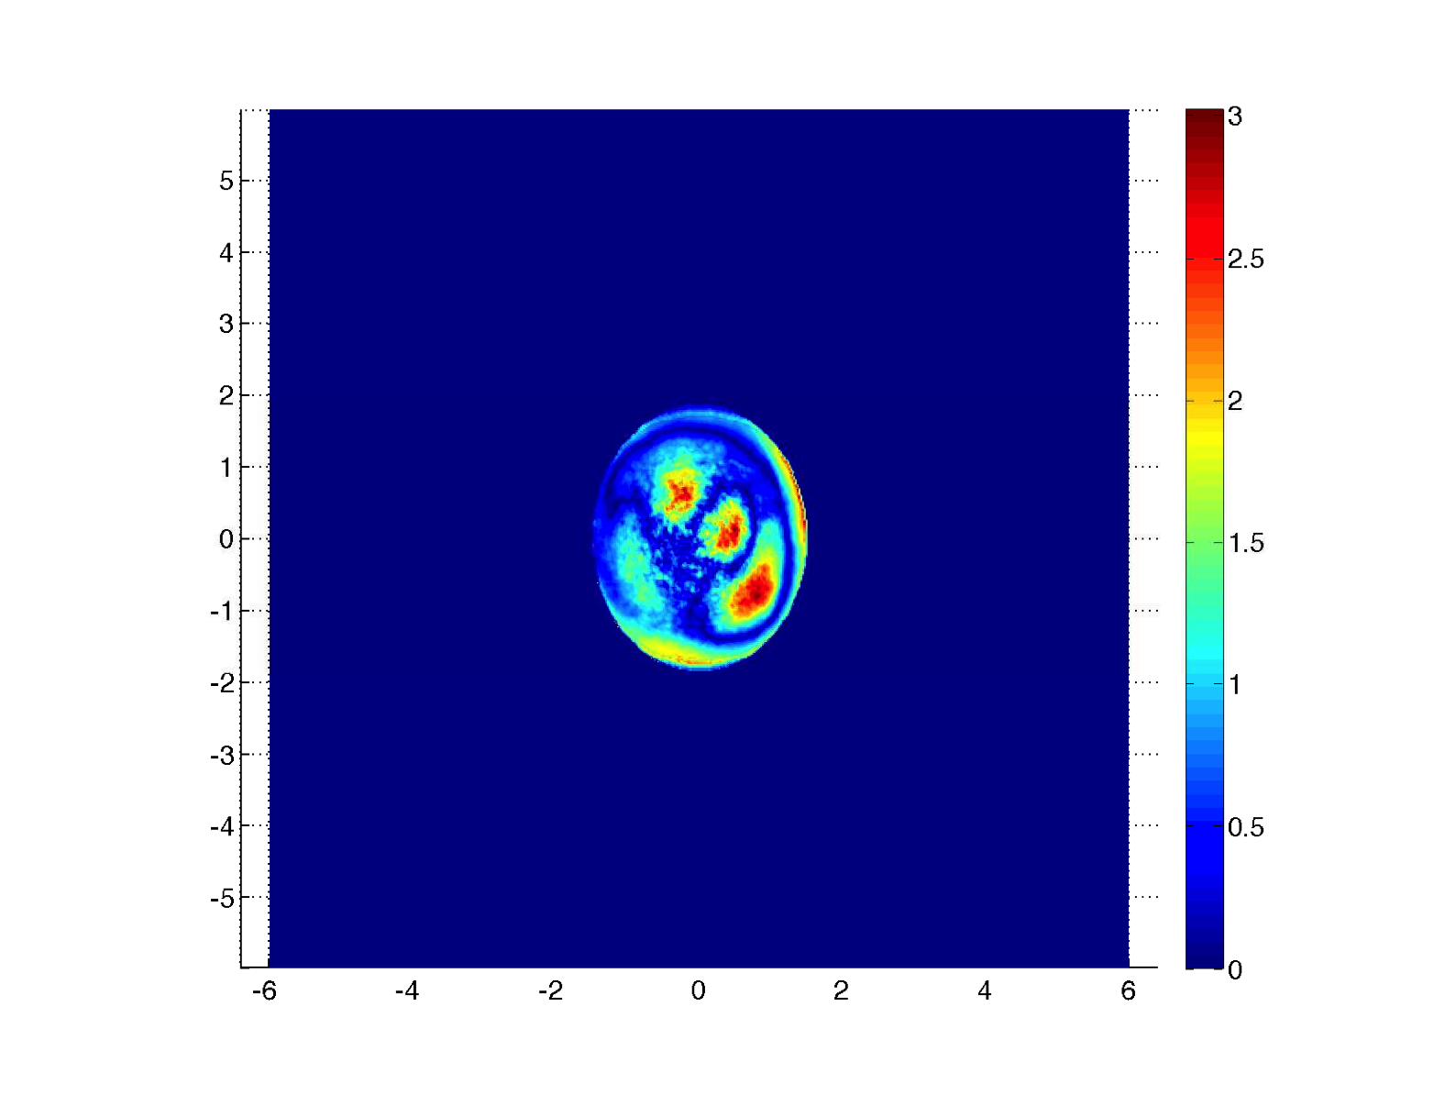
Spreading of the dark port field axis : in units of beam size (6w x 6w)
BS dark port
SRM
3.5m from SRM AR
Cold case : CD=8760
Optimal RH : CD=1340

