Slide 1
TCS installation & results at LLO
Update: Systems Telecon
8th Jan 2014
Aidan Brooks (for the TCS Team)
G1400018-v1

Slide 2
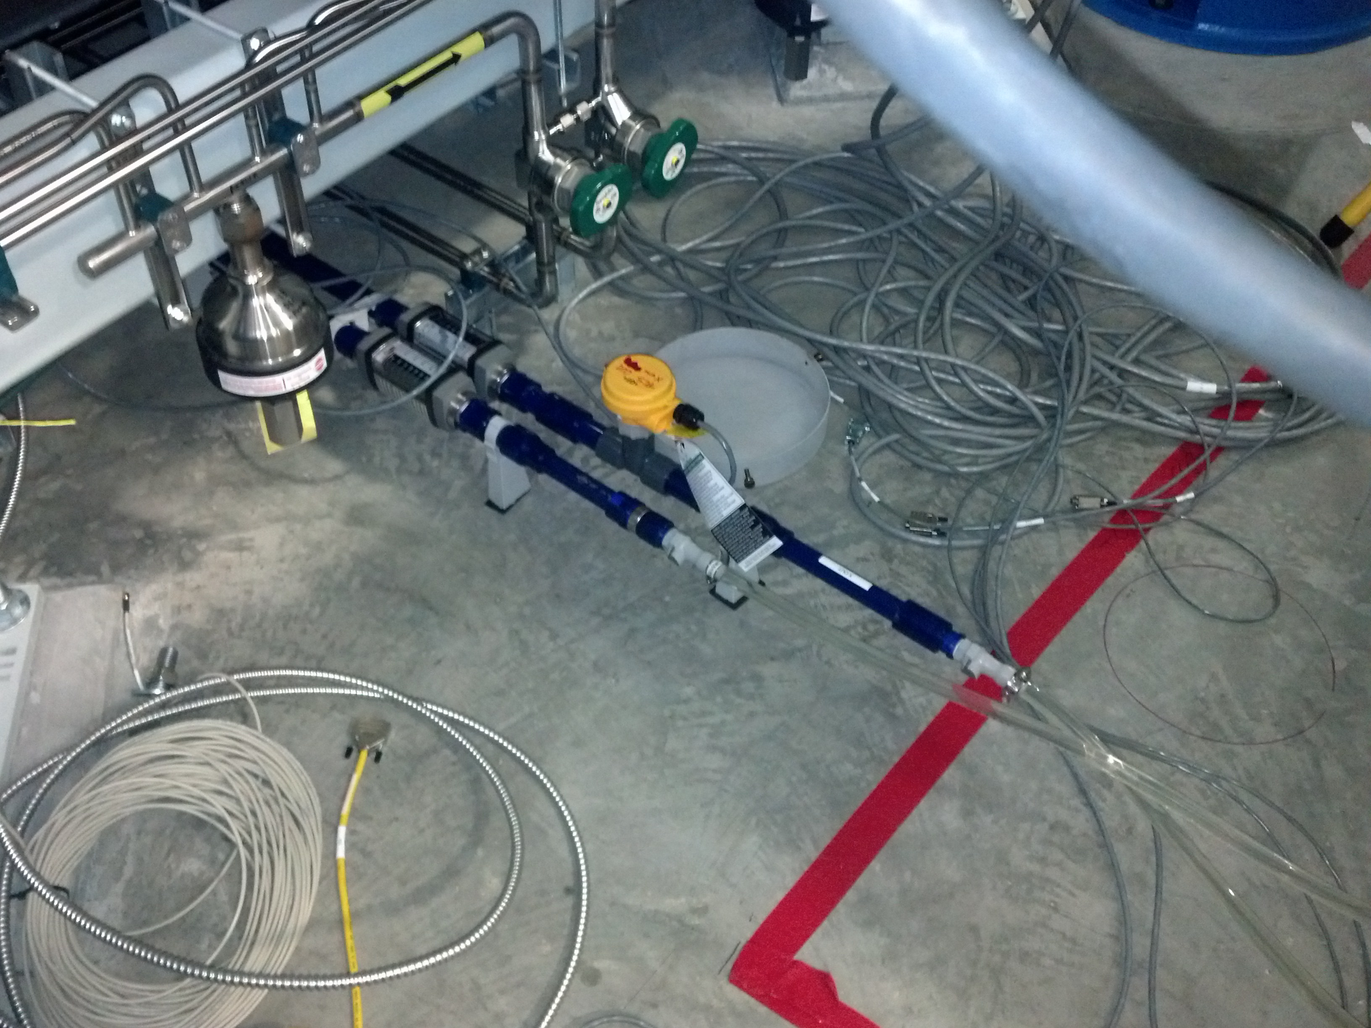
CO2 Laser Status
Enclosures installed
Lasers plumbed
Phase I (central heating) optics to be installed in January

Slide 3
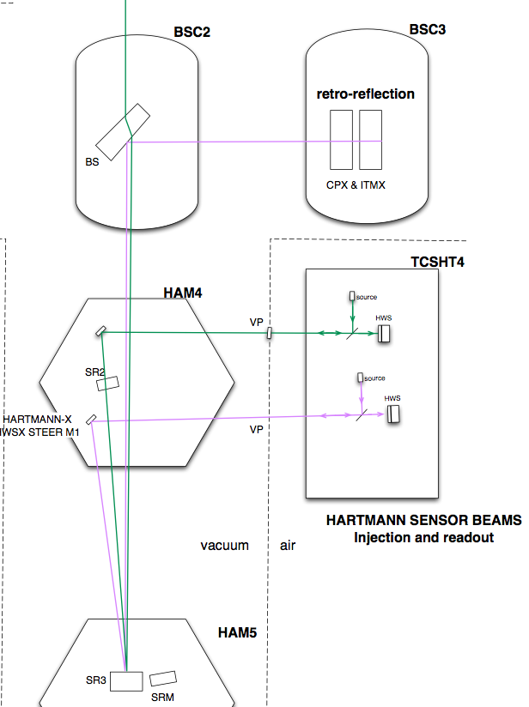
HWS cartoon layout
Hartmann in-air table
Next to HAM4
Probe beams injected
Into main optical axis
Retro-reflected from ITMX and ITMY
Accumulated wavefront distortion is readout by HWS on return beam
In-vacuum optics in HAM4
Must match in-vacuum and in-air optical axes

Slide 4
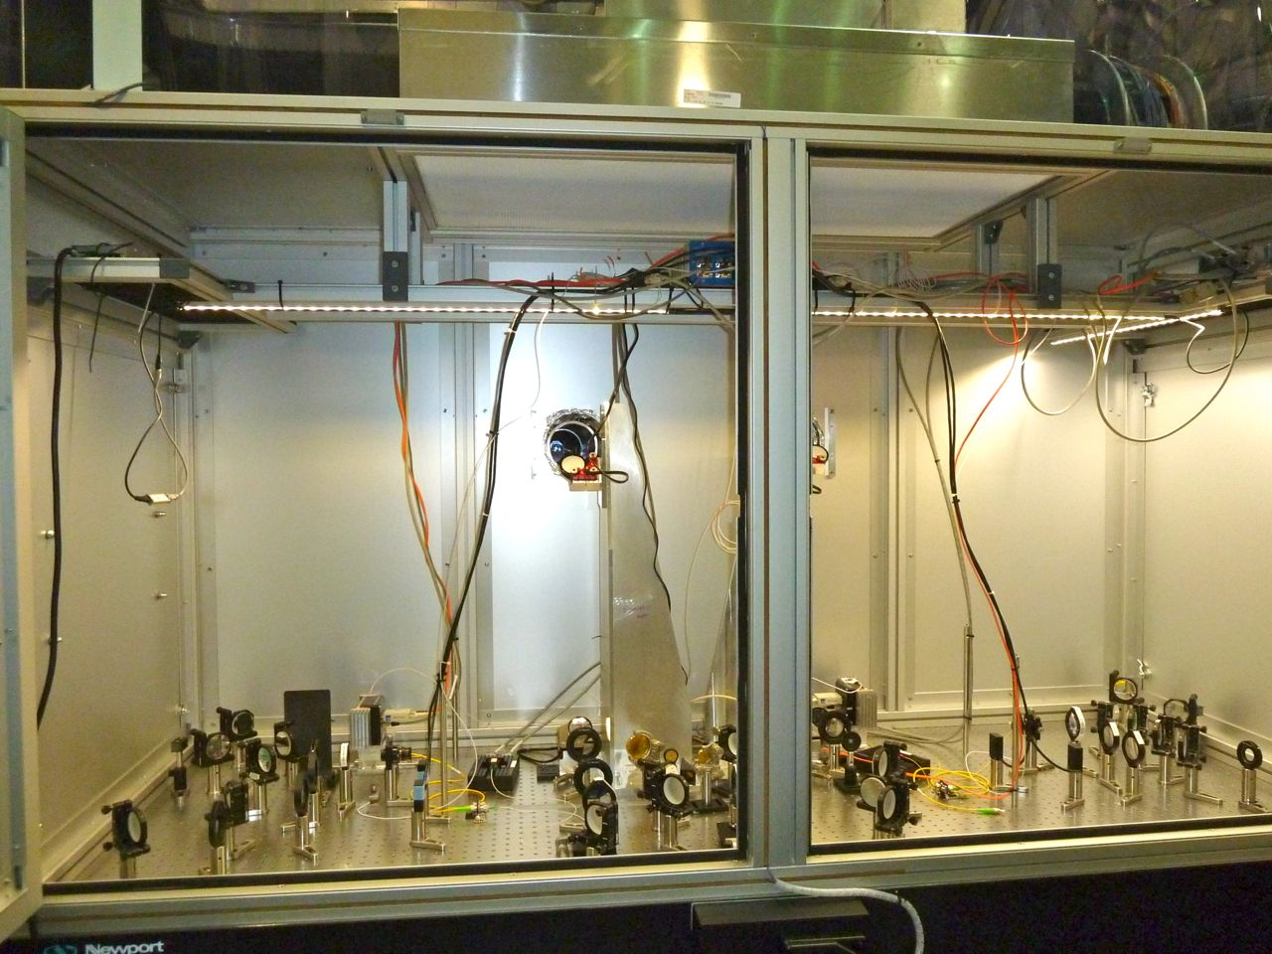
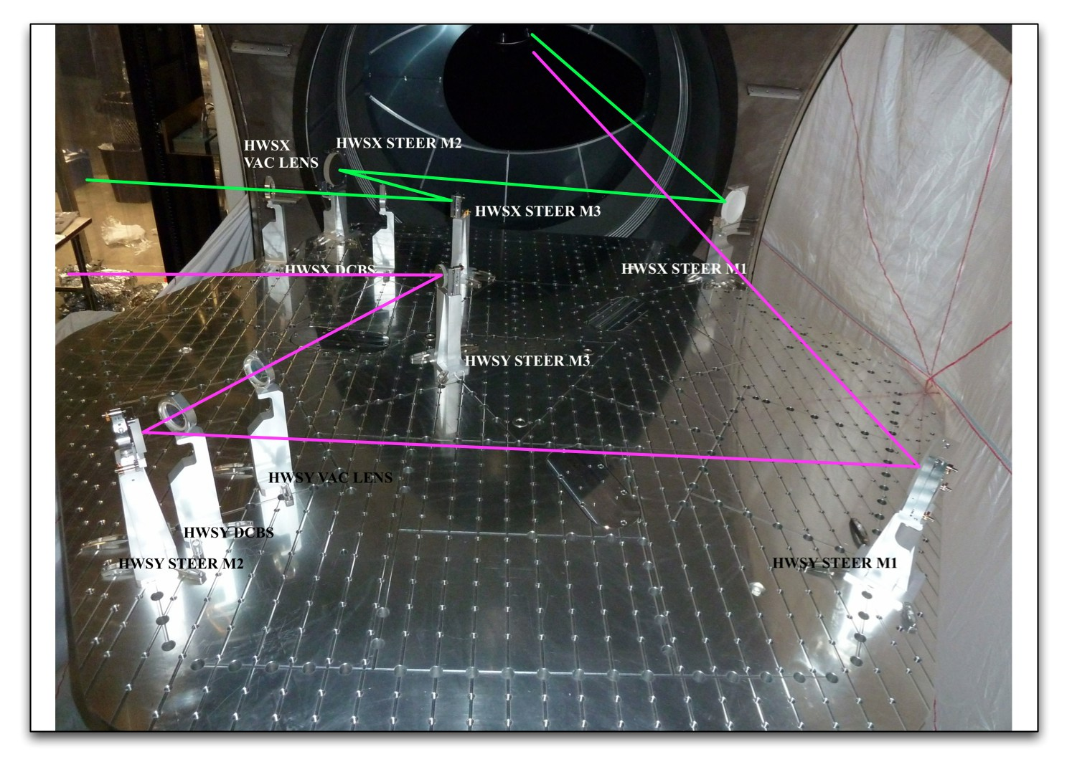
HWS installation
In-air optics
All optics installed
In-air and in-vacuum optics aligned separately
In-air and in-vacuum axes mated
Took some effort
Currently out of alignment following December vent
Calibrated
HWS lever arm
Magnification
In-vacuum optics

Slide 5
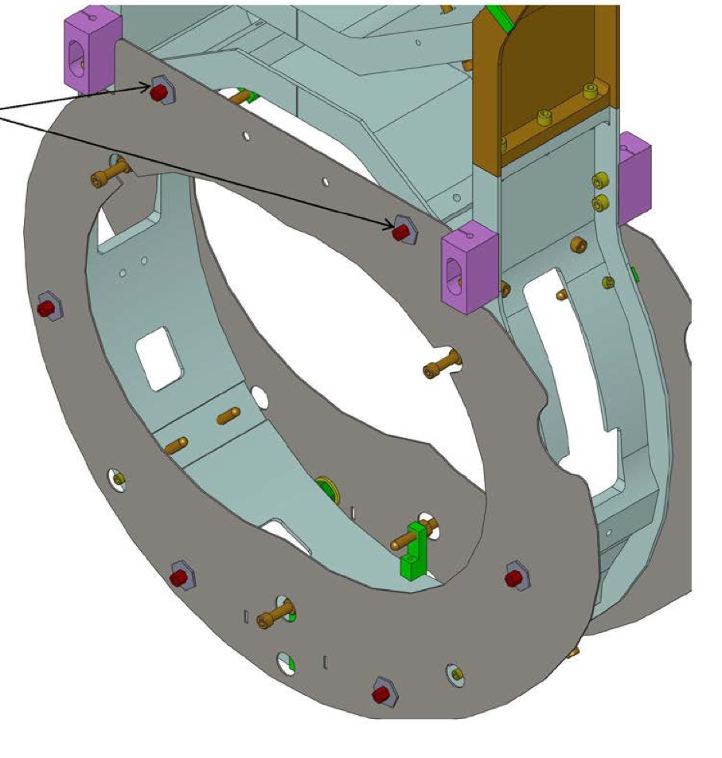
Injected HWS-X beam BS baffle is limiting aperture
Earthquake stop
HWS-X beam

Slide 6
Transmitted HWS-X beam Mostly clean
Earthquake stop shadow
Edge of baffles
Diffraction from dust on an optic

Slide 7
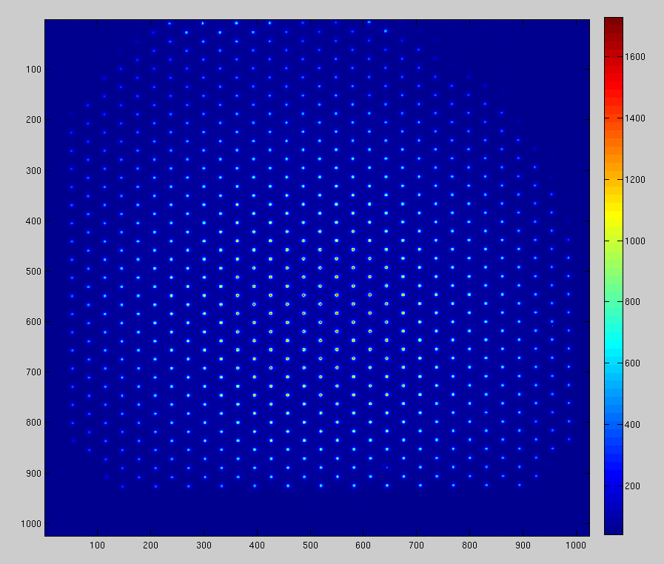
With Hartmann Plate HWS-Y

Slide 8
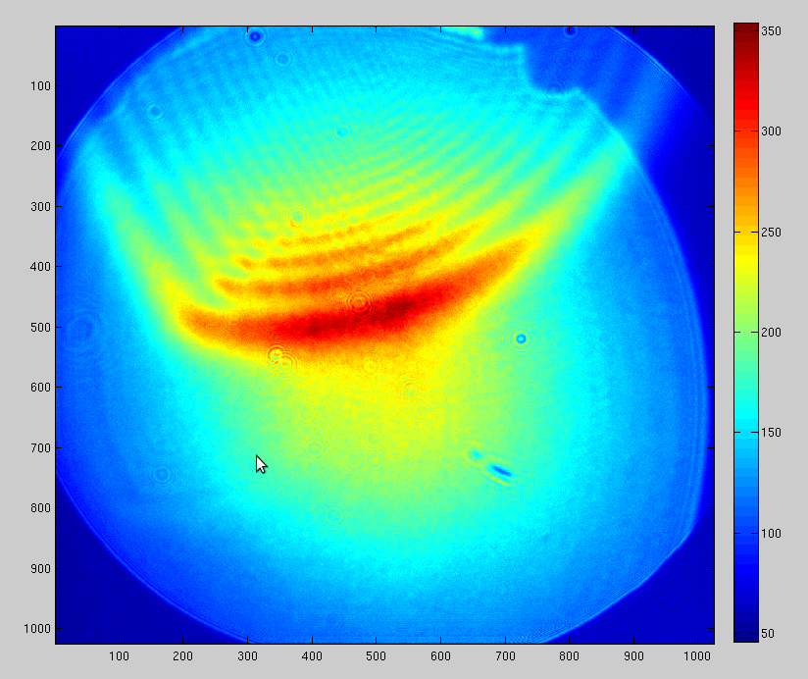
Stray reflections from in-vacuum optics
We see stray reflections from optics within HAM4
These can be mostly spatially filtered out.
Example of unfiltered reflection is shown here
Possibly require tweaking alignment of in-vacuum optics at a later date
If determined that these introduce significant noise

Slide 9
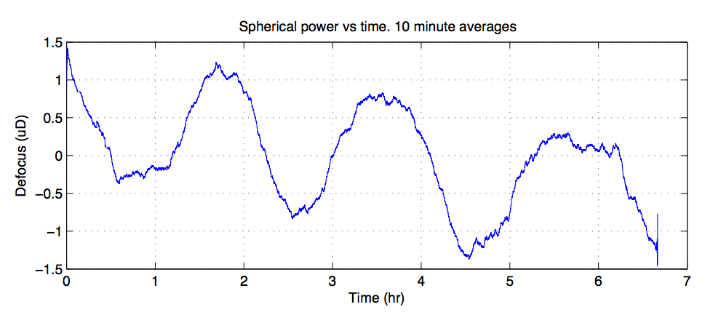
HWS-Y background noise measurements
Shows background defocus over time
Equivalent Power Absorbed ~ 1.2mW
0.3% of maximum expected
Fluctuation is correlated with temperature variation by HWS
Expect to be able to remove some of temperature fluctuations

Slide 10
Recall: Indirect Ring Heater measurement Measured 1064nm beam size

Slide 11
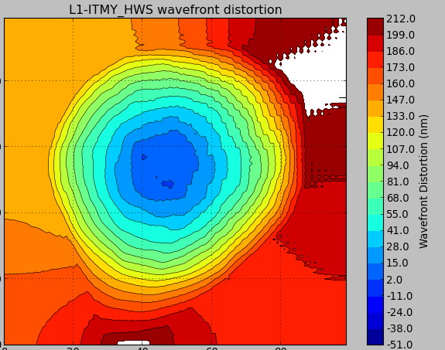
Directly observed RH thermal lens
Step 1: Apply ring heater
Step 2: See thermal lens form at glacial speed
Still need to characterize this lens. Need to measure astigmatism.
http://youtu.be/GcoqCn8Ytds
No data points outside ring
Ring heater
ITM
HWS beam
-105 mm 0mm +105mm
X coordinate

Slide 12
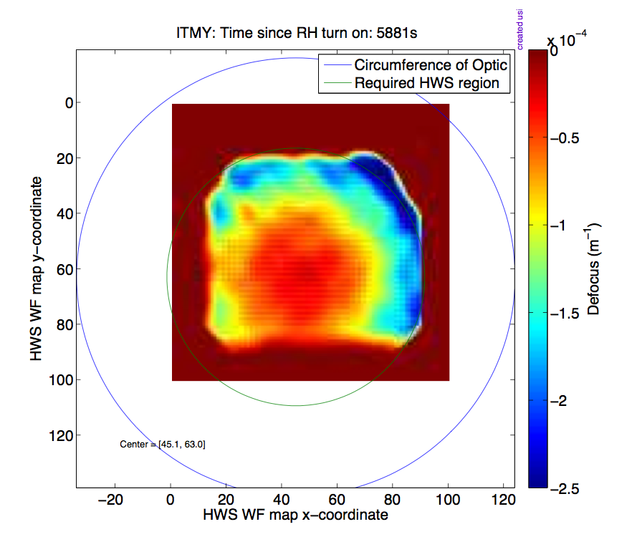
HWS beam position on test mass
Located the center of the test mass
Relative to the center of the HWS beam
Used the ring heater thermal lens
Ring heater
ITM
HWS beam

Slide 13
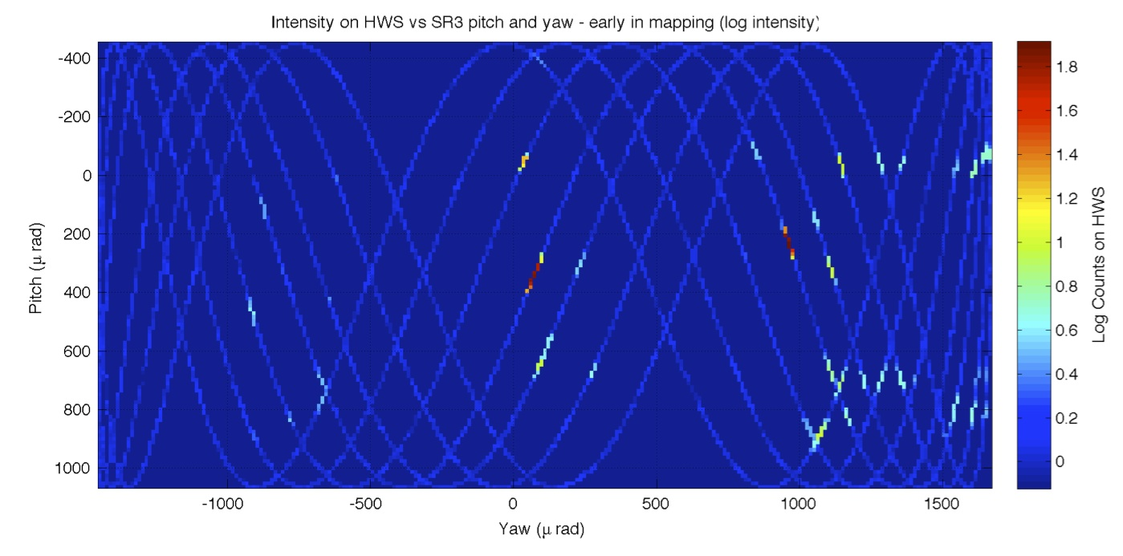
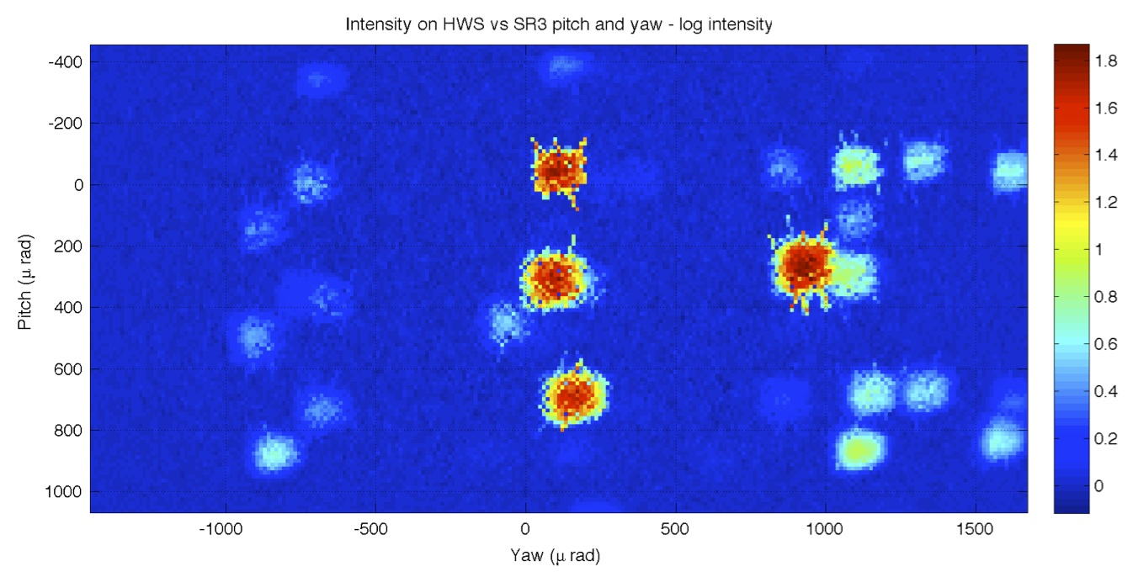
Appendix: HWS alignment
Located return beams by swinging SR3
Identified 2 reflections from ITM and 2 from CP
Once correct beam is identified:
Misalign SR3 to return beam to HWS
Adjust HWS input periscope until no misalignment is required on SR3

