Slide 1

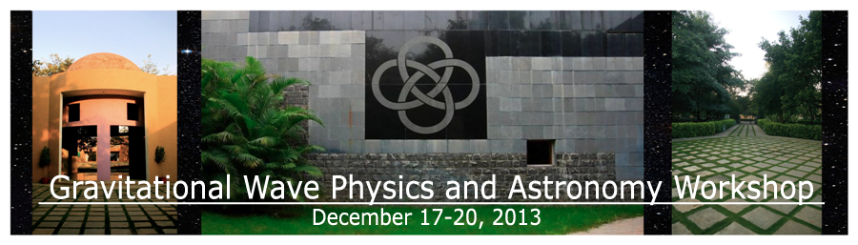
Advanced LIGO
and the bright future of
Gravitational Wave Observation
Lisa Barsotti (LIGO-MIT)
on behalf of the
LIGO Scientific Collaboration
Sunrise on Kerala’s backwaters
LIGO - G1301287

Slide 2

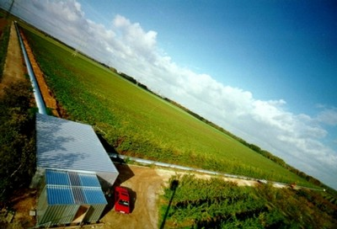

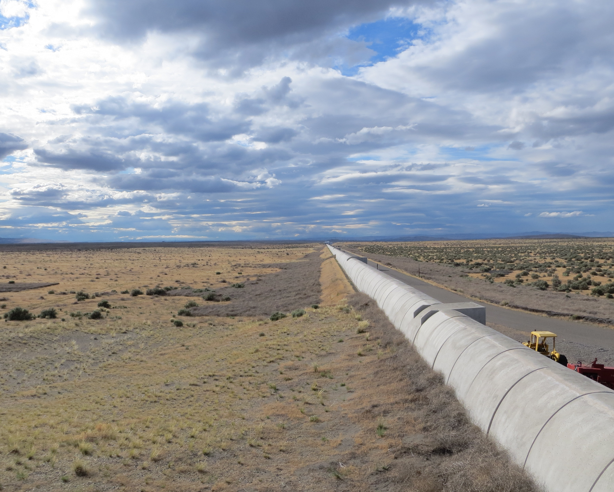
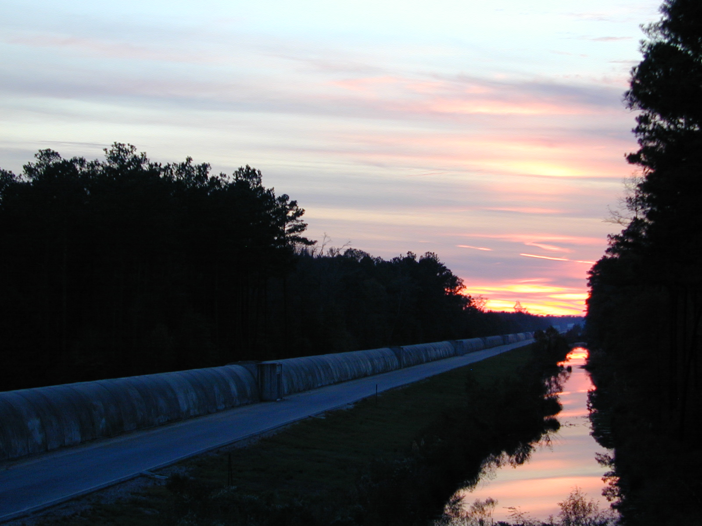
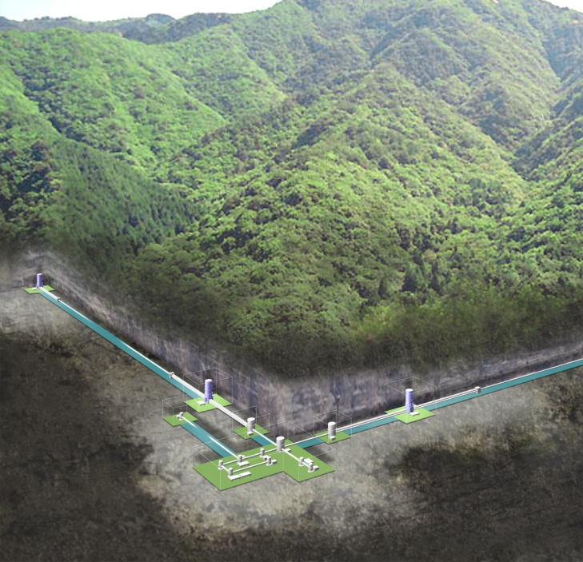

Upcoming Network in the
Advanced Detector Era
GEO
VIRGO
KAGRA
LIGO H1
LIGO L1
LIGO-India
2
Credit: C. Mayhew & R. Simmon (NASA/GSFC), NOAA/ NGDC, DMSP Digital Archive

Slide 3
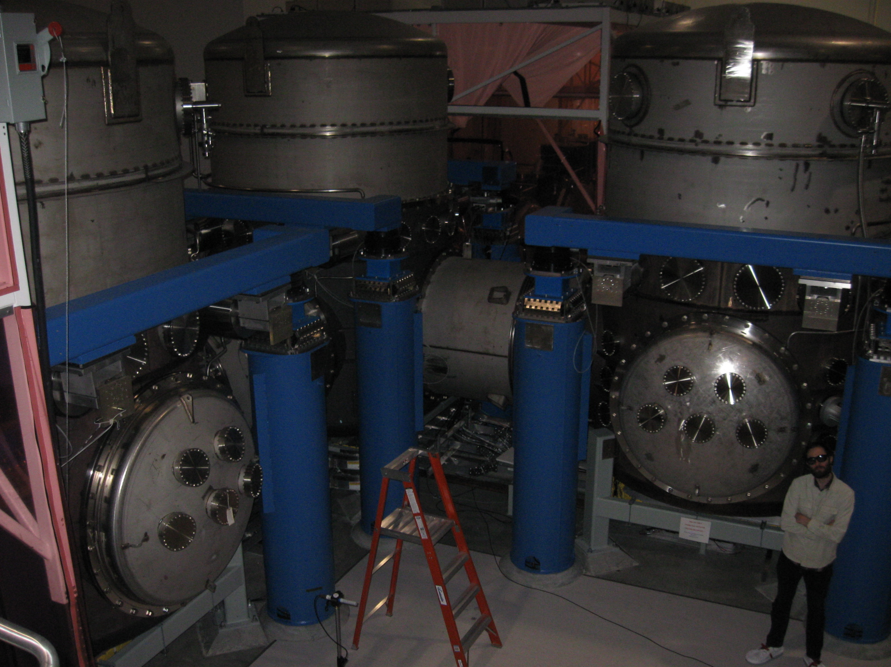
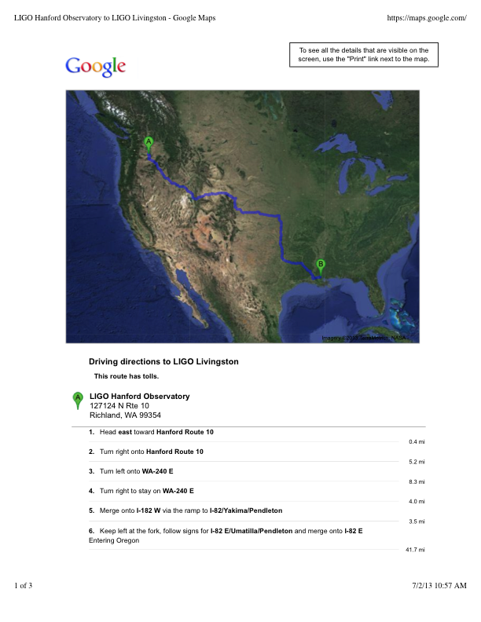
LIGO Hanford Observatory (WA)
H1 – in the desert
LIGO Livingston Observatory (LA)
L1 – in the jungle
36 hours drive
10 ms if traveling at the speed of light

Slide 4
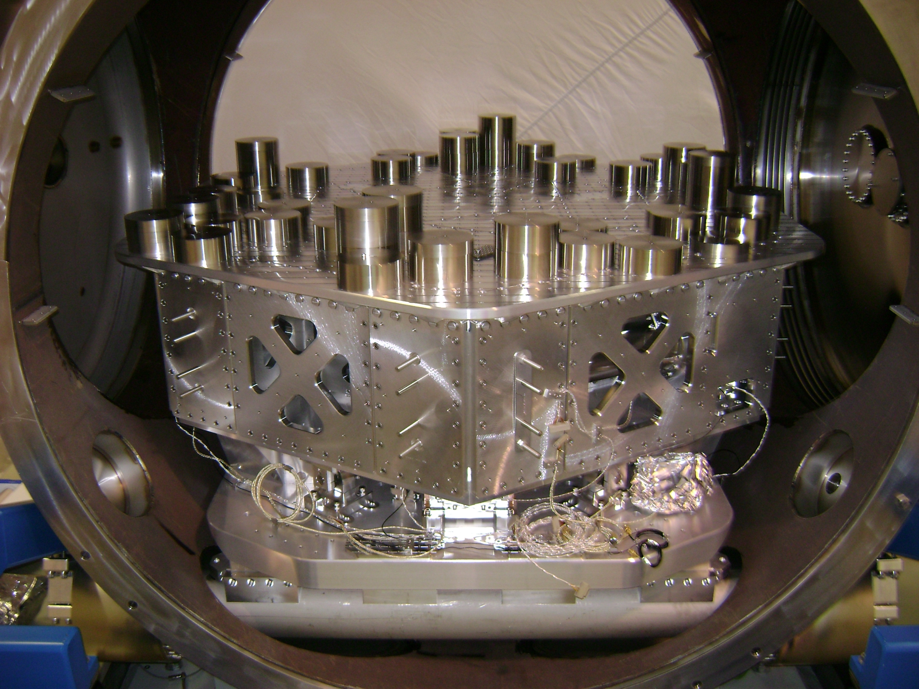
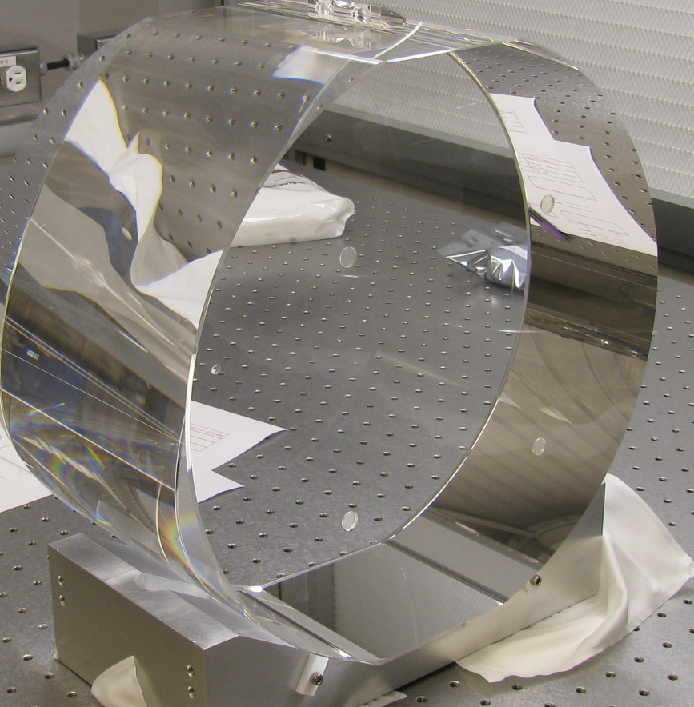
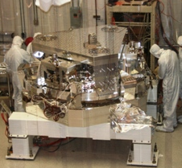
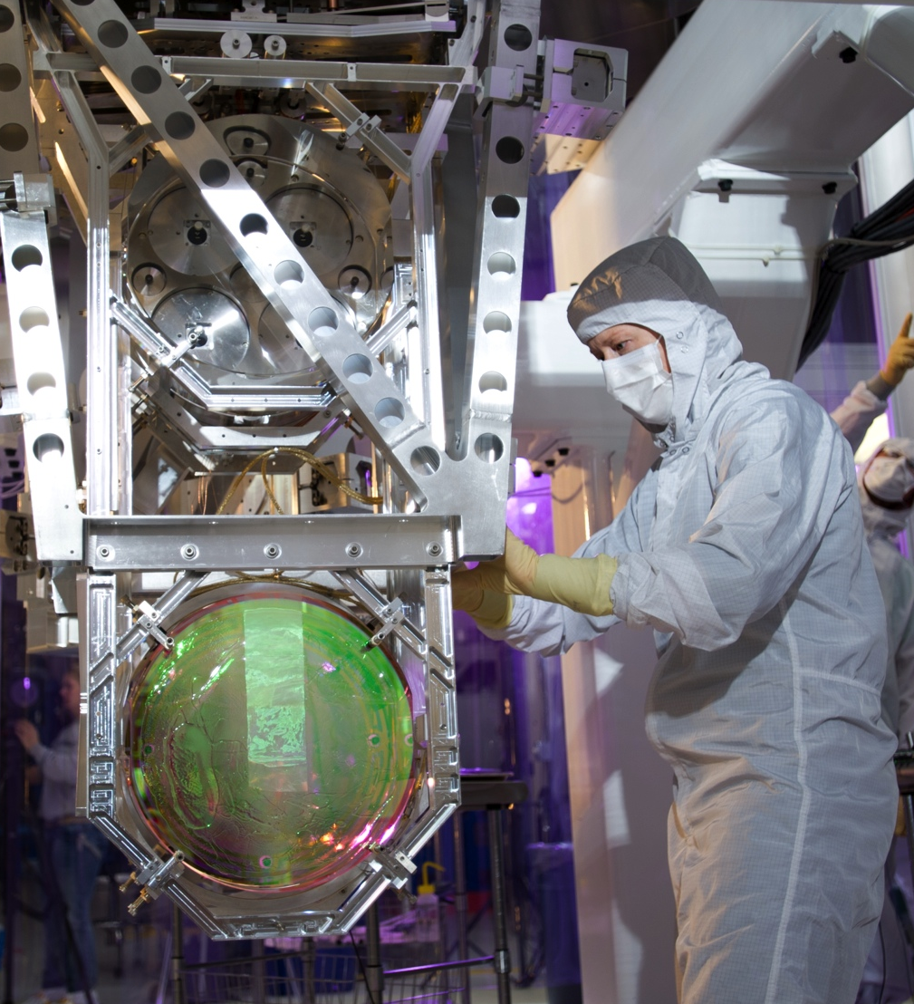
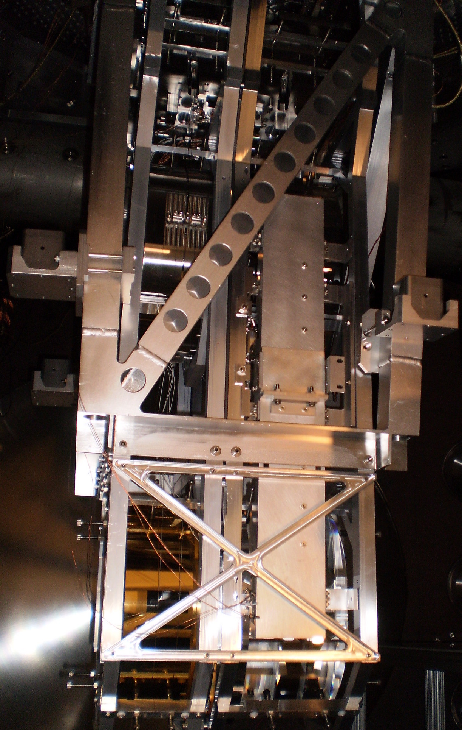
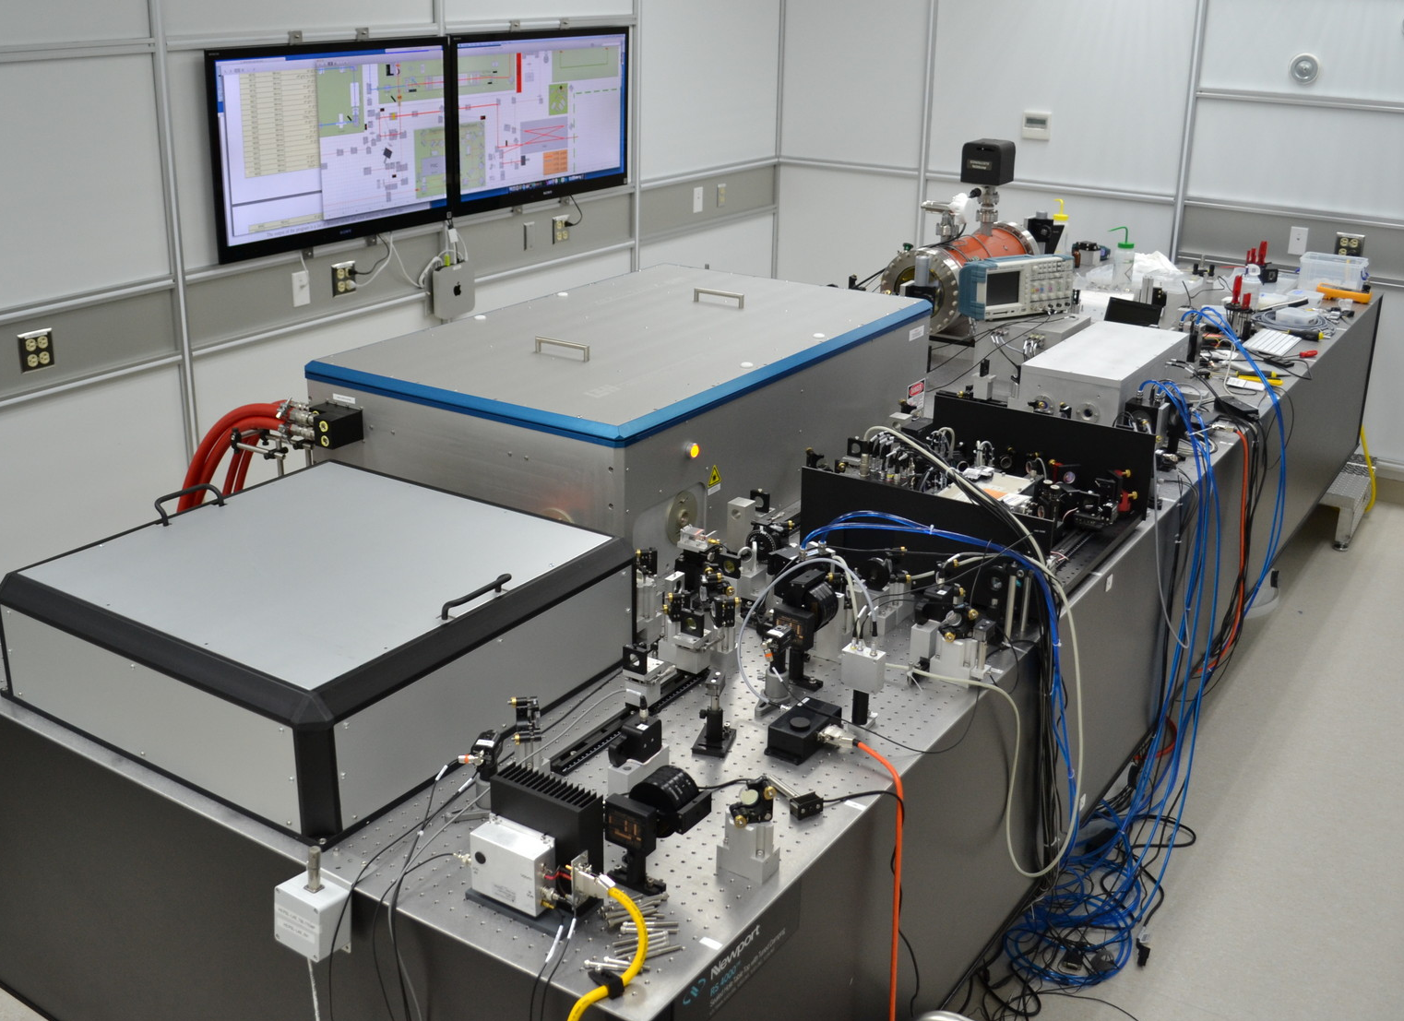
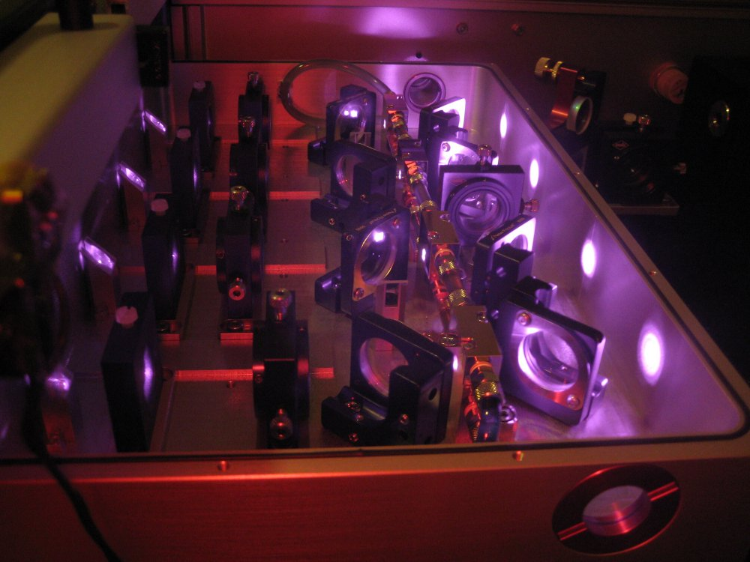
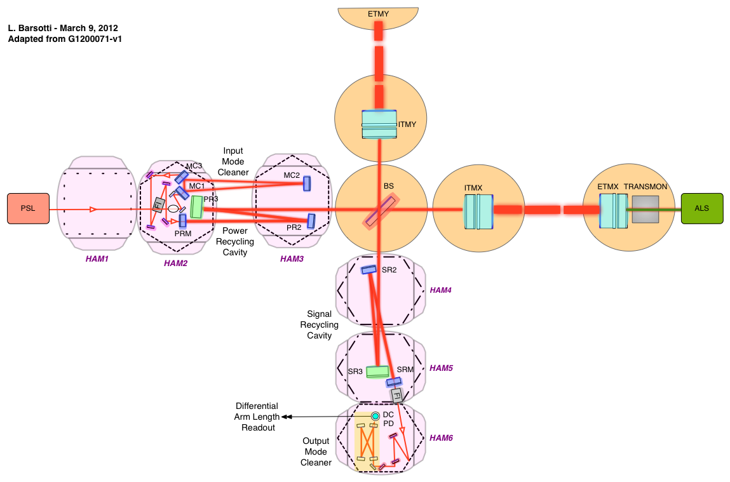
Advanced LIGO: L1 & H1

Slide 5
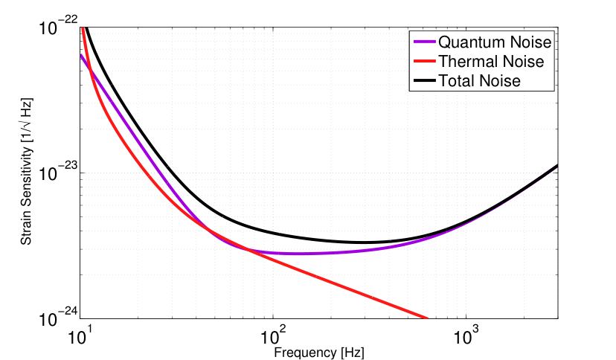
Advanced LIGO Design Sensitivity..
S
E
I
S
M
I
C
W
A
L
L
..but what about technical noises? How about data quality?
And, by the way…how do we get to the design sensitivity?

Slide 6
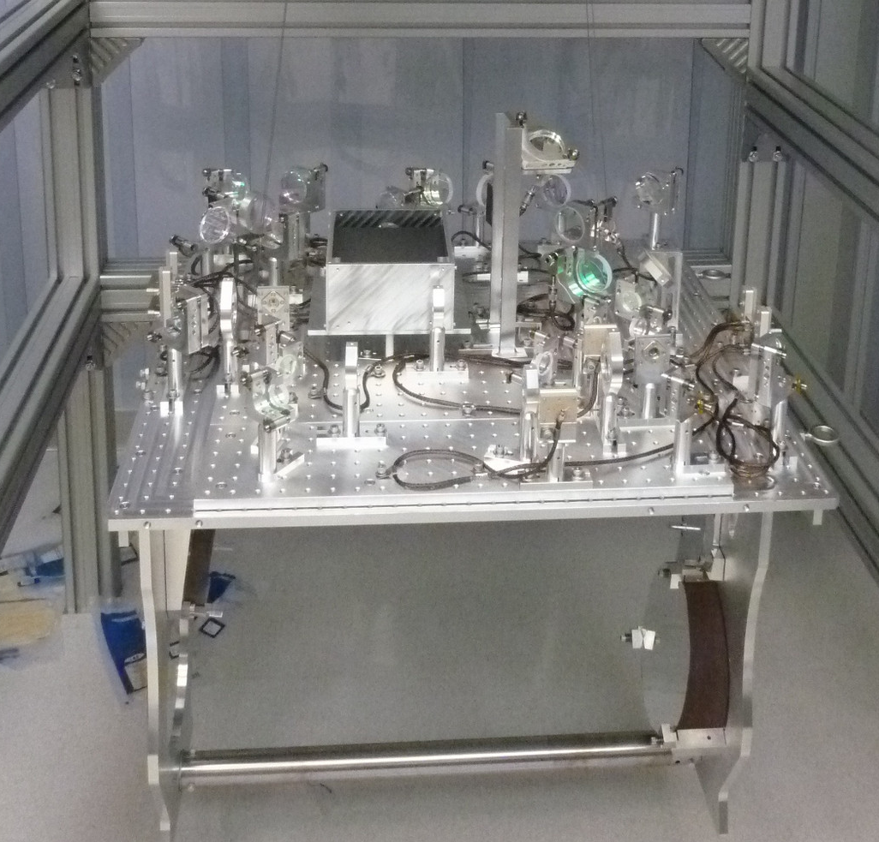
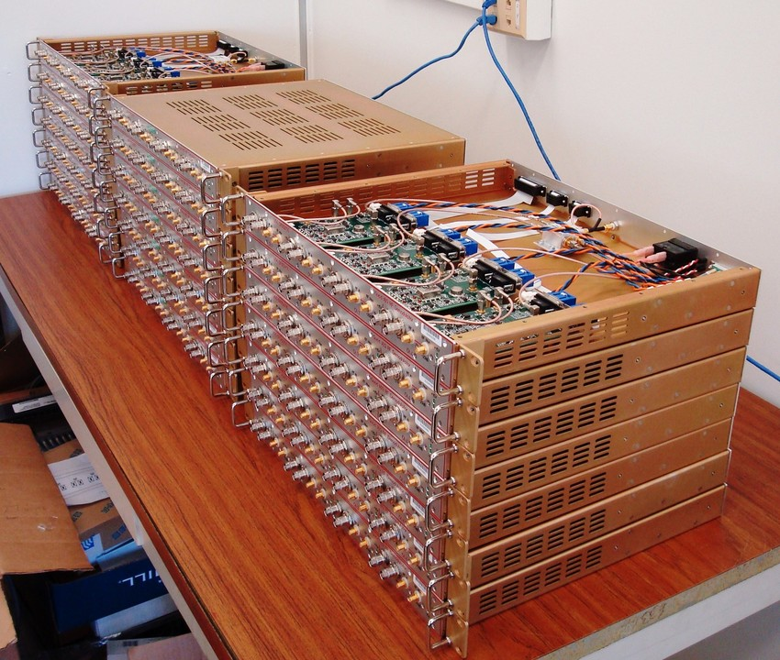
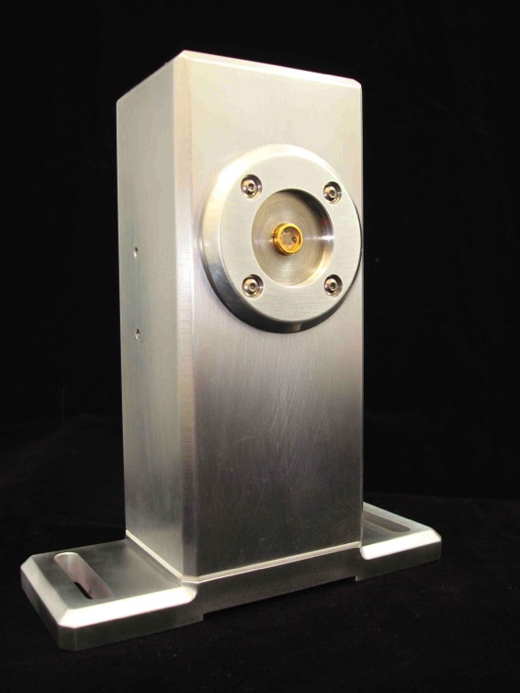
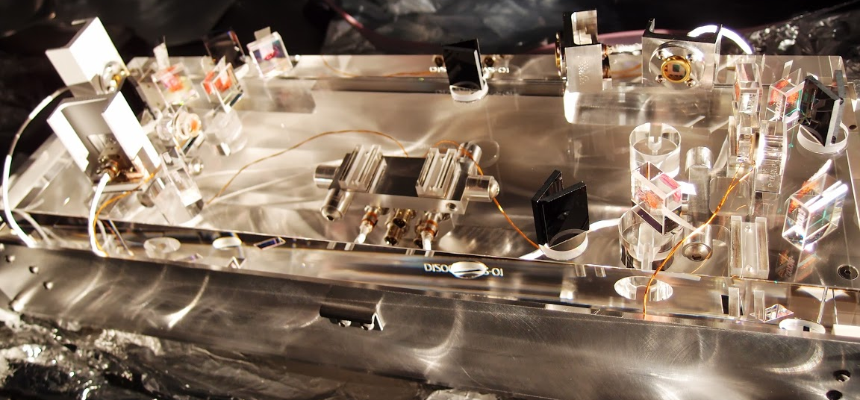
“EVERYTHING is better in Advanced LIGO!”
Incorporated lessons learned from initial detectors to:
reduce impact of technical noises
reduce causes of glitches
reduce commissioning time
TRANSMISSION MONITOR
ELECTRONICS
OUTPUT MODE CLEANER

Slide 7
Advanced LIGO
Status
Installation and integration inspiring “principles”:
Parallel effort between Hanford and Livingston
Installation of “new” things as soon as possible
Test configurations of increased complexity

Slide 8
Advanced LIGO
Status
HANFORD
LIVINGSTON
LHO
Completed first tests on one arm
Other arm + central interferometer under installation
Completed first tests on central interferometer
Both arms under installation

Slide 9
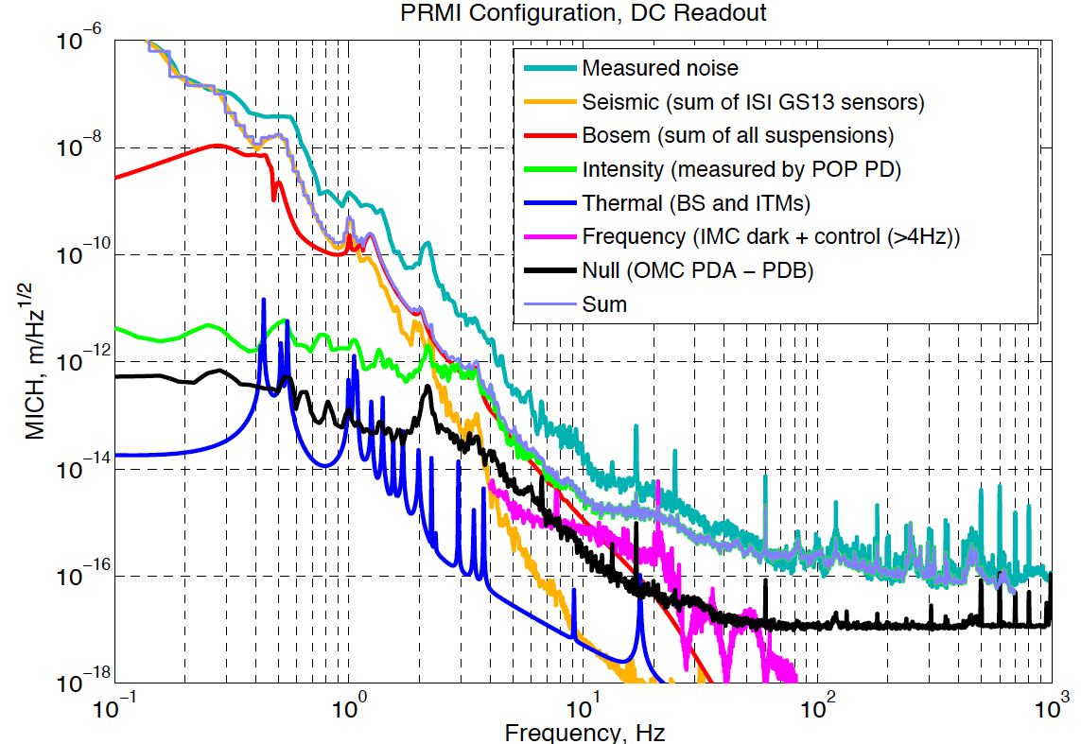
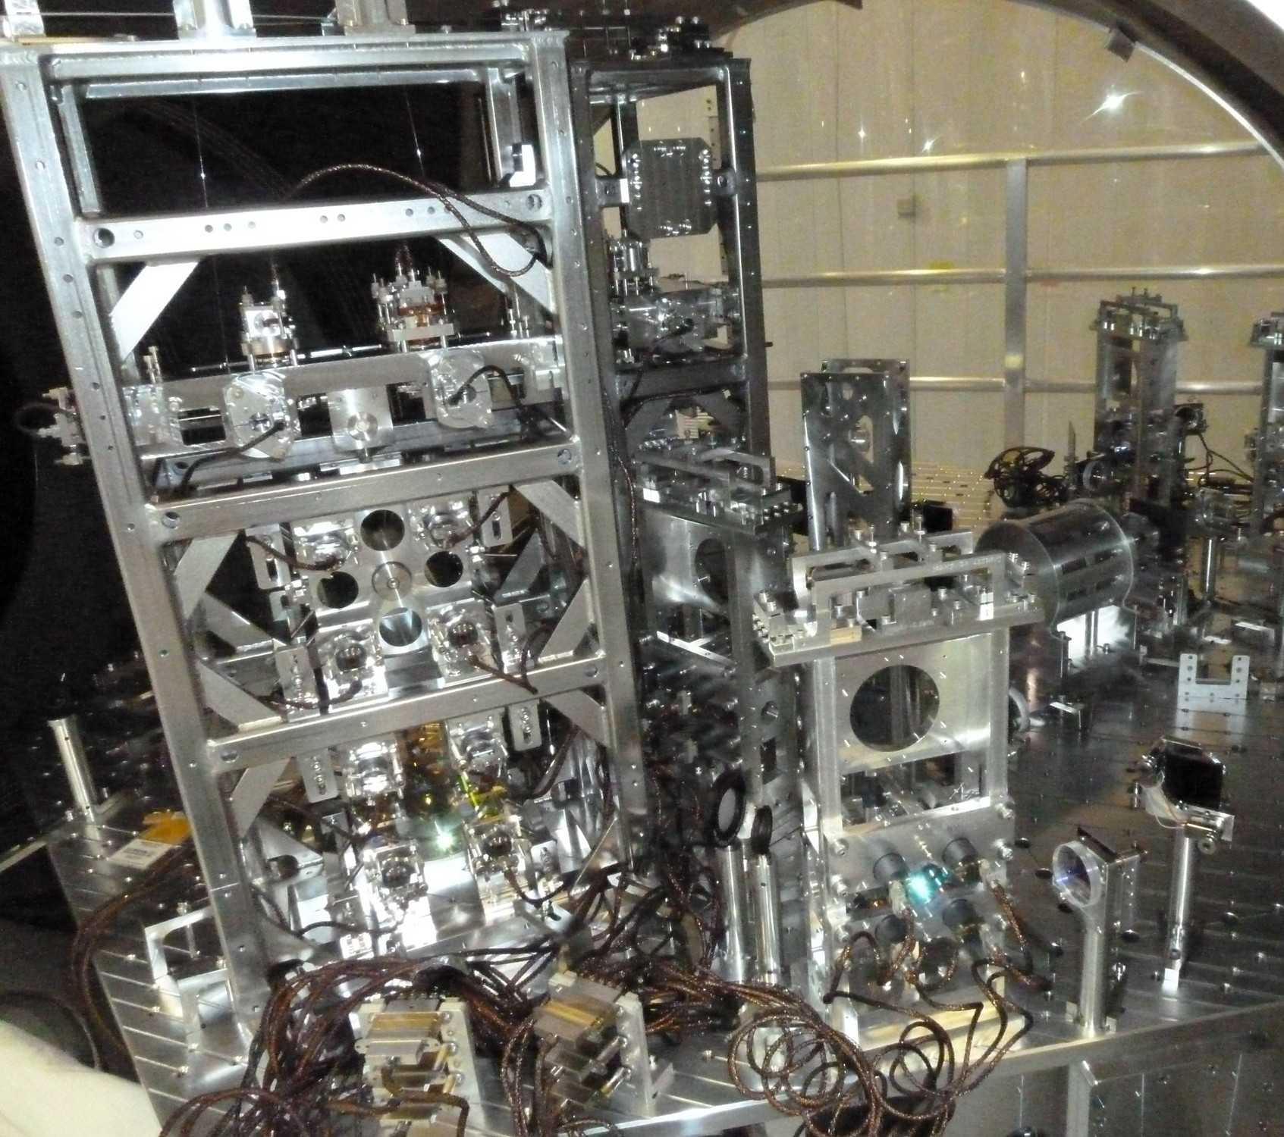
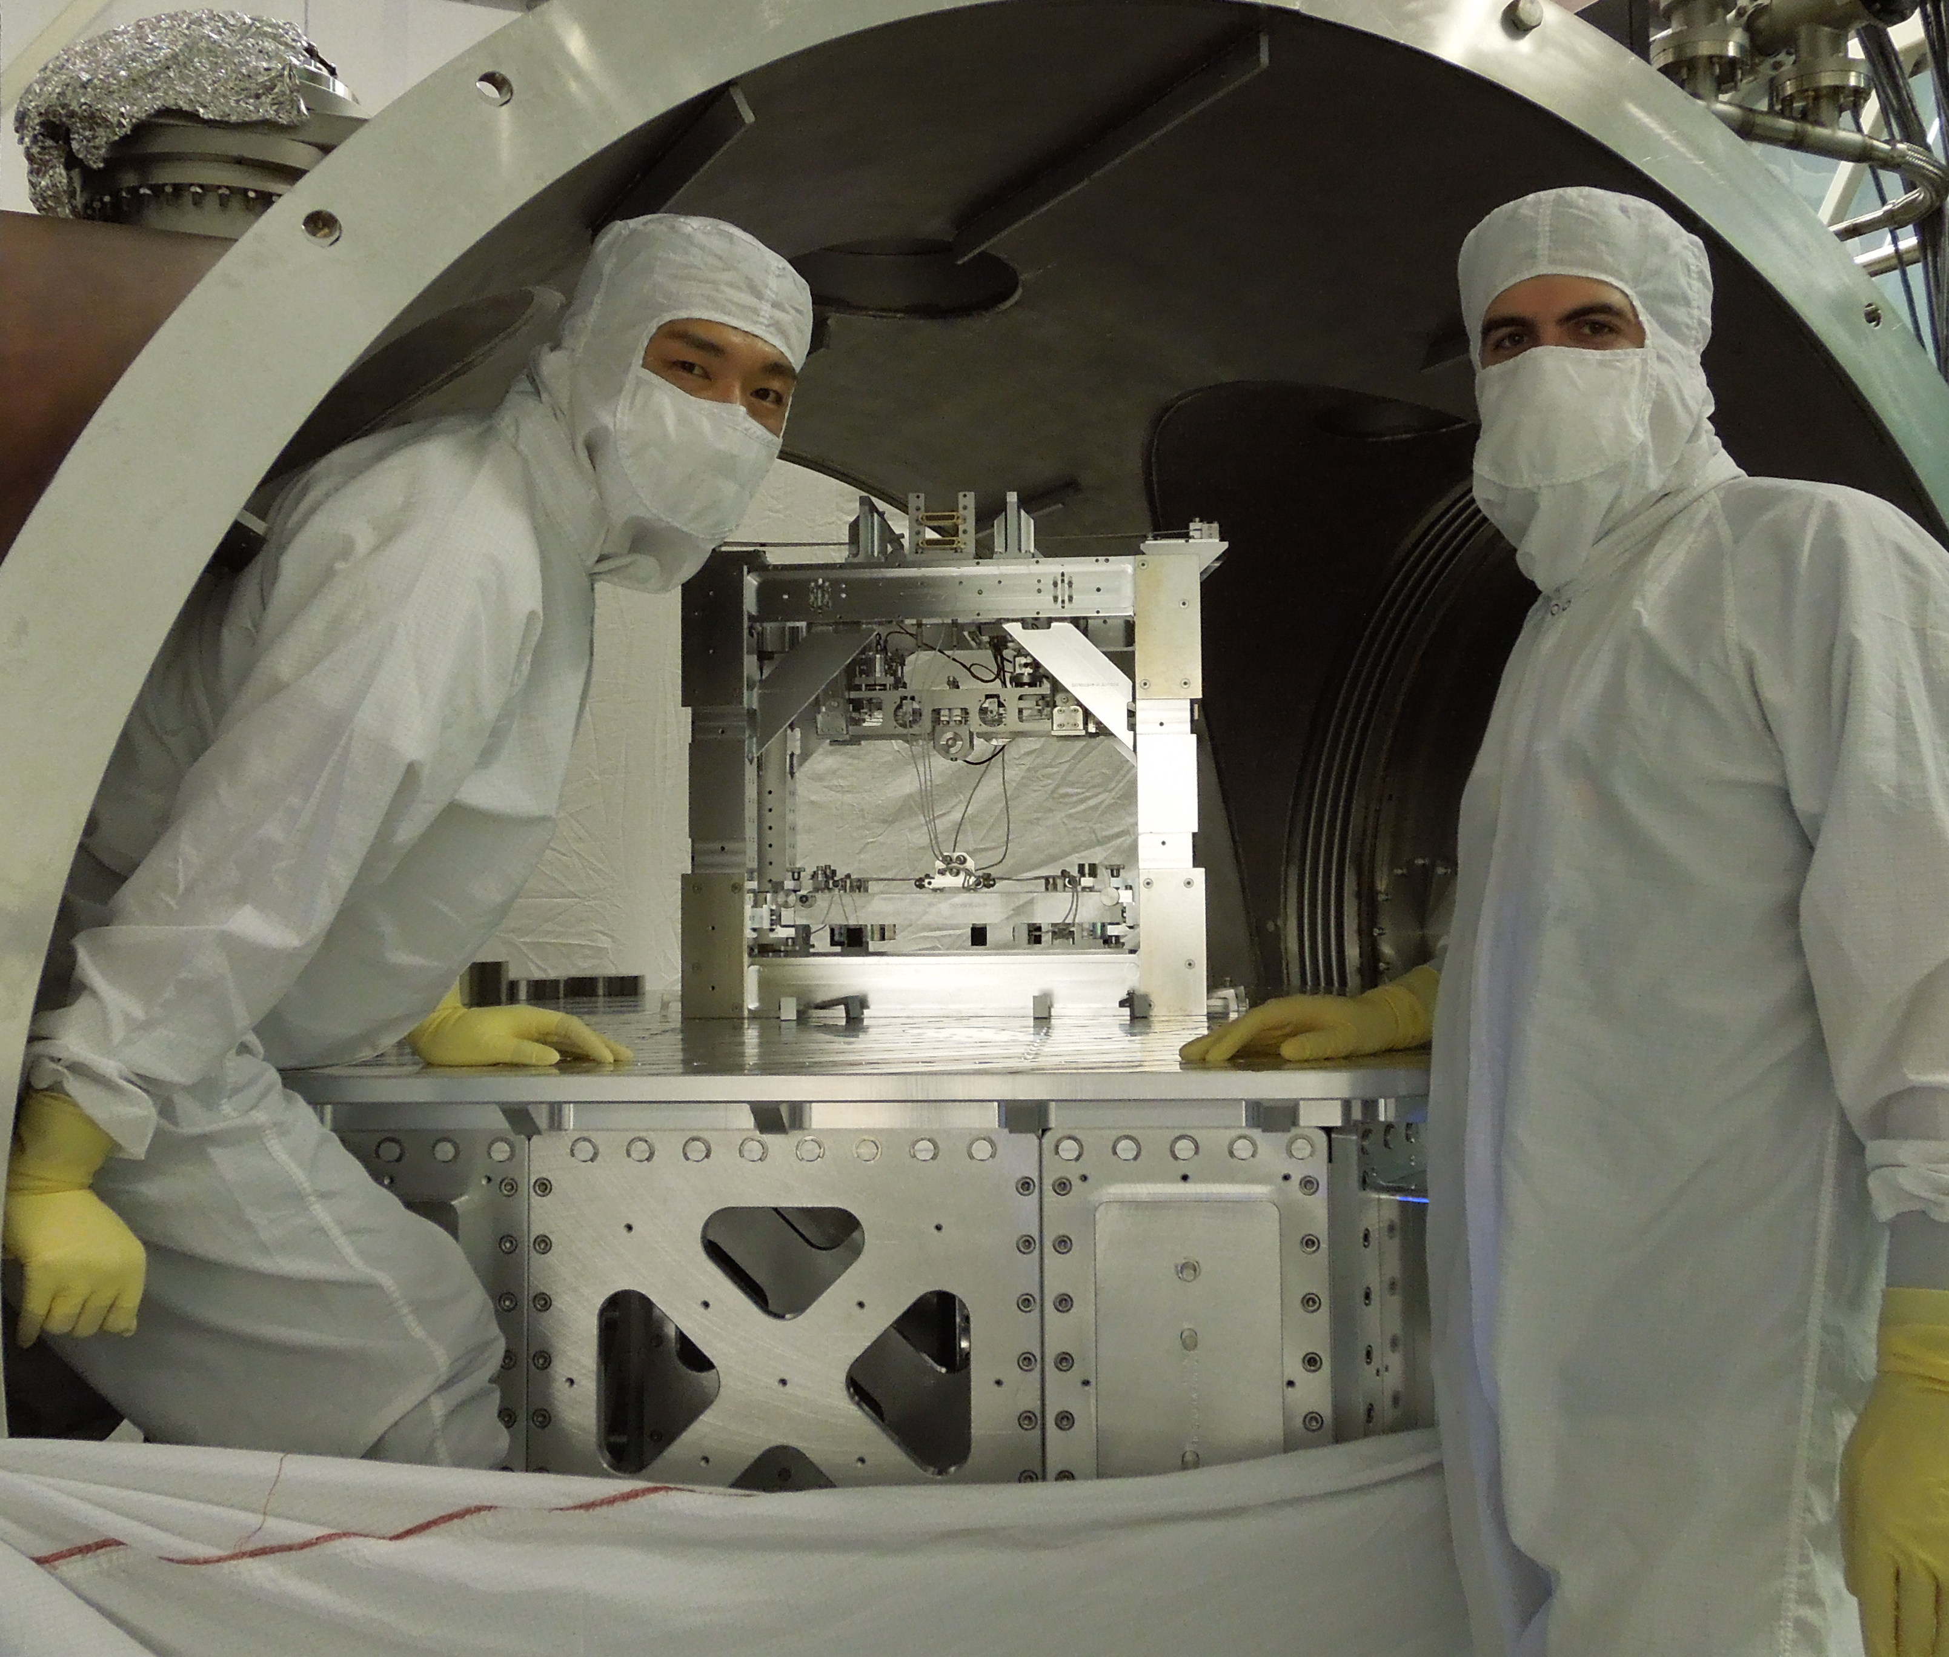
Advanced LIGO Status: LIVINGSTON
Noise Budget for the central part of the interferometer (no arms)
Courtesy of
Denis Martinov & L1 team

Slide 10
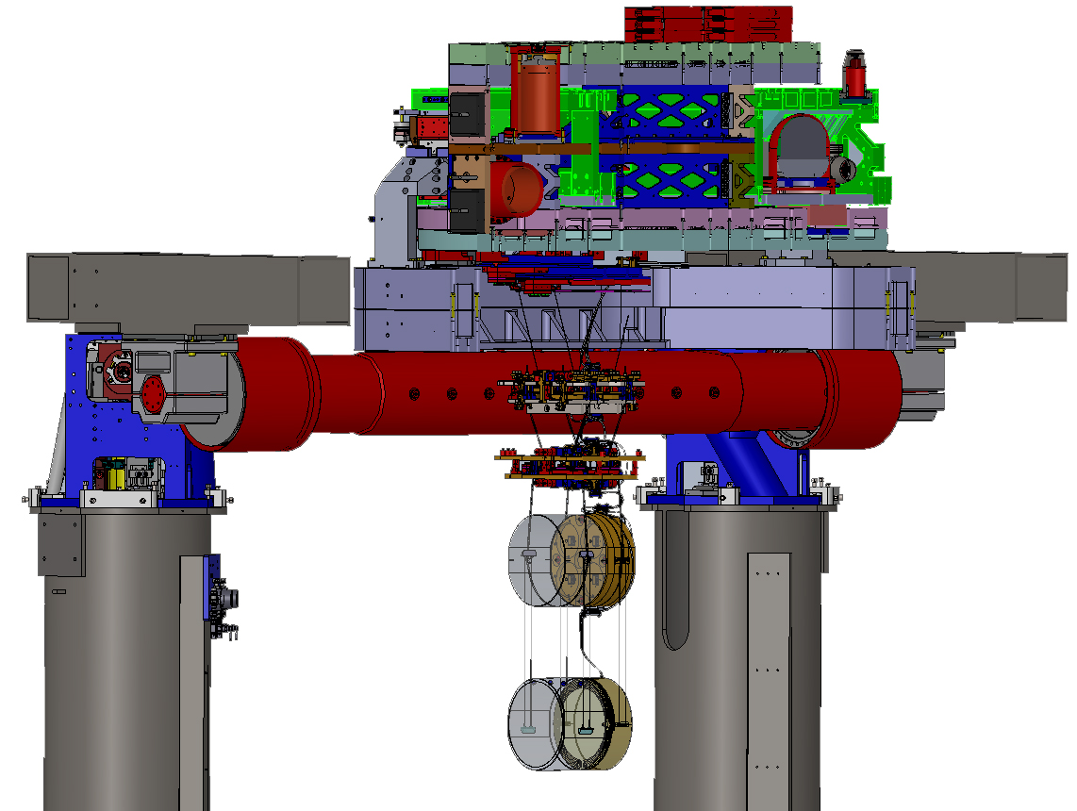
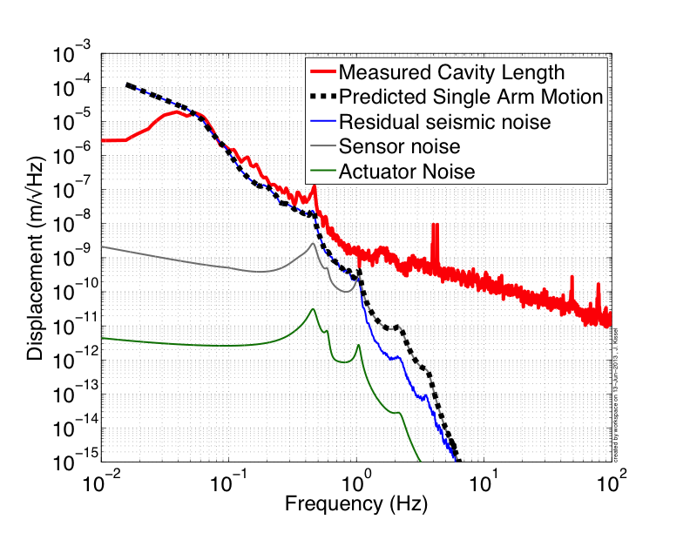
Advanced LIGO Status: HANFORD
First measurement of 4 km arm cavity motion with new seismic isolation
New “Arm Length Stabilization System” for lock acquisition tested for one arm, performing as expected
Beat Signal
Courtesy of
Jeff Kissel & H1 team

×
MAIN LASER
Auxiliary LASER

Slide 11
Advanced LIGO Timeline
2014
--- both detectors “locked” on operating point
--- “commissioning phase”: noise reduction
2015
2016
2017
Strategize between
“observing” and
sensitivity improvements
2018
2019

Slide 12
Potential complications
Required displacement noise levels not verified directly
(for a good reason… essentially impossible to test in subscale setups!)
High power operations
  Up to 1 MW stored inside the arm cavity (absorption, thermal compensation, etc)
Increased complexity
  Number of control loops x10 larger than in initial LIGO
  Mechanical systems have many more degrees-of-freedom
  (Test Mass suspension has 48 DOF vs. 6 in initial LIGO)
S
E
I
S
M
I
C
W
A
L
L

Slide 13
Potential complications
(according to me, today)
Required displacement noise levels not verified directly
(for a good reason… essentially impossible to test in subscale setups!)
High power operations ➔ Still true, but less scary than before
  Up to 1 MW stored inside the arm cavity (absorption, thermal compensation, etc)
Increased complexity ➔ Acted on, a lot of work happening
  Number of control loops x10 larger than in initial LIGO
  Mechanical systems have many more degrees-of-freedom
  (Test Mass suspension has 48 DOF vs. 6 in initial LIGO)
S
E
I
S
M
I
C
W
A
L
L

Slide 14
Summary & Outlook
H1 & L1 are being installed and tested, problems are found and fixed, so far no showstoppers
Goal is to go as quickly as possible to two interferometers locked: on target for end of 2014 at both sites
All the 2015+ projected curves that you see are “plausible”, they won’t be exactly like that
Good data are coming, be ready! ☺

Slide 15
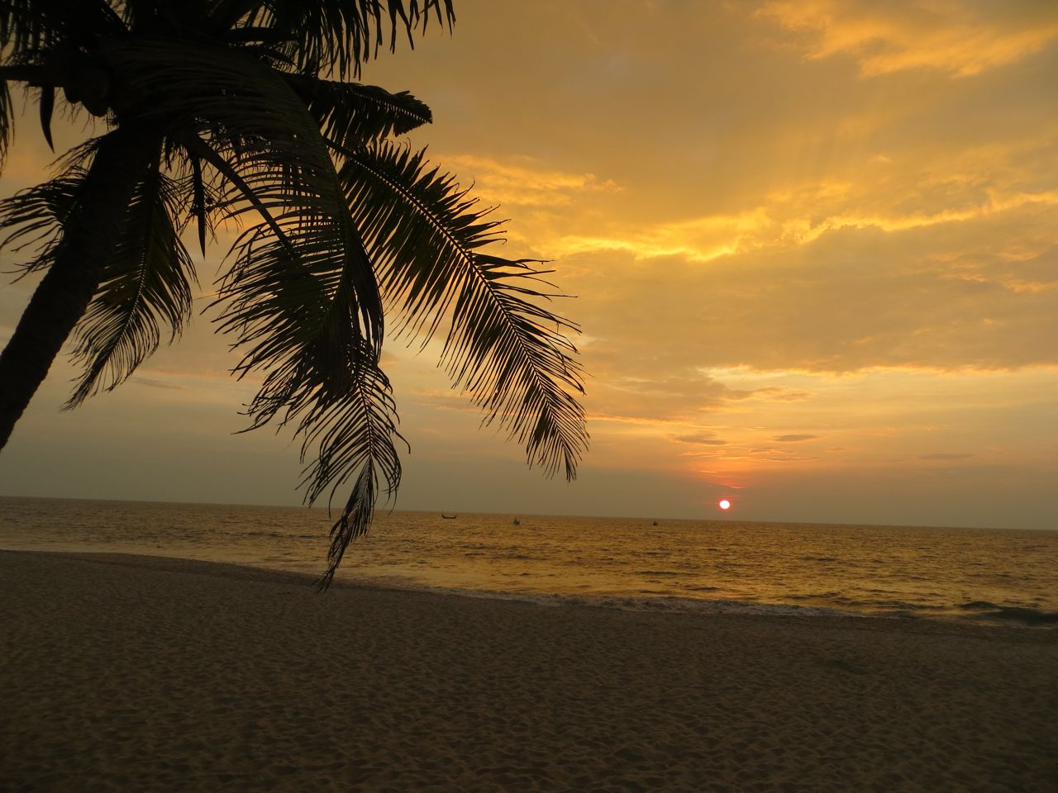
Thanks!
Sunset on Marari Beach

Slide 16
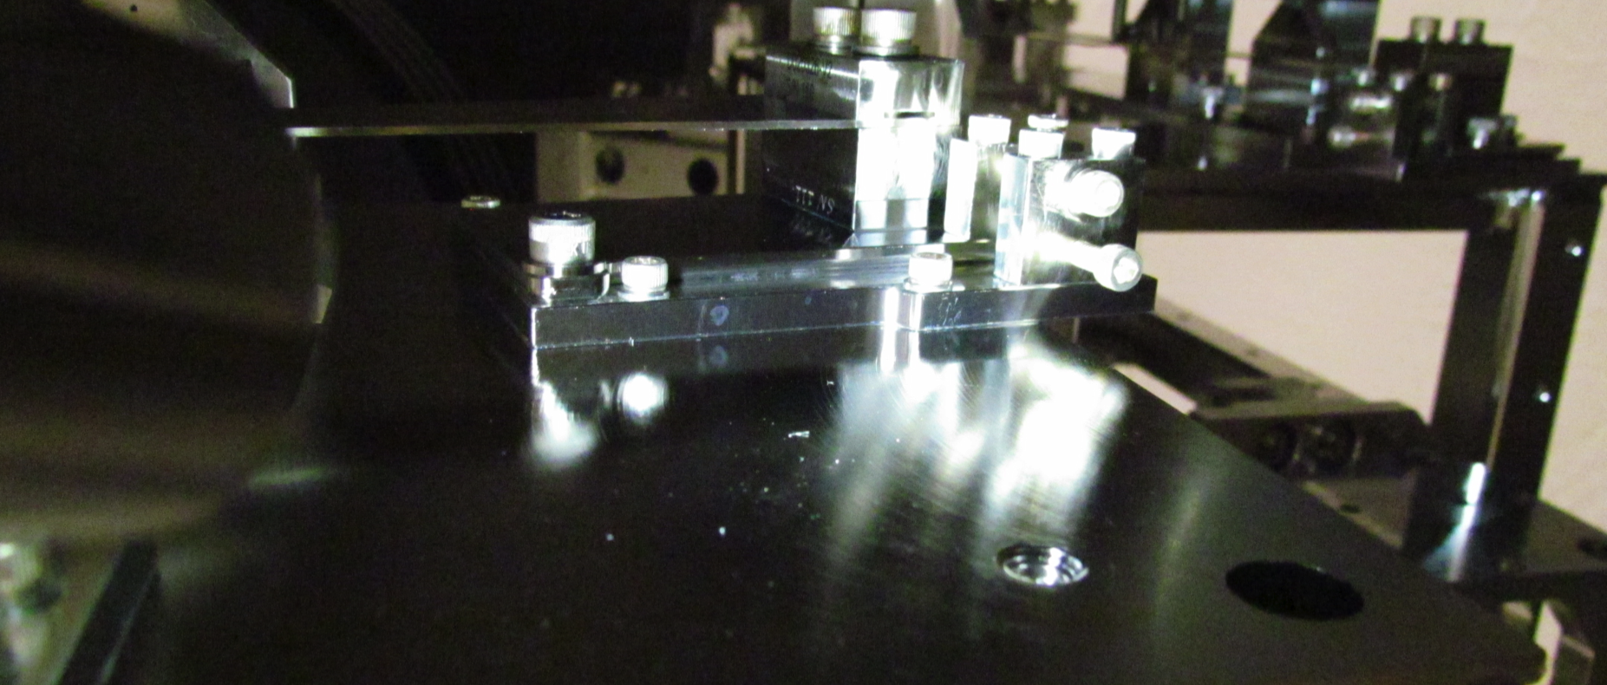
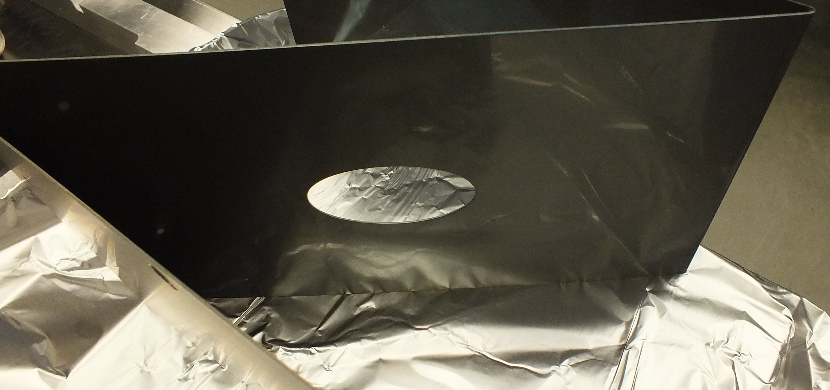
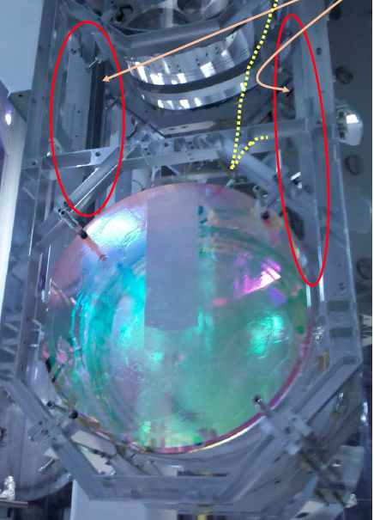
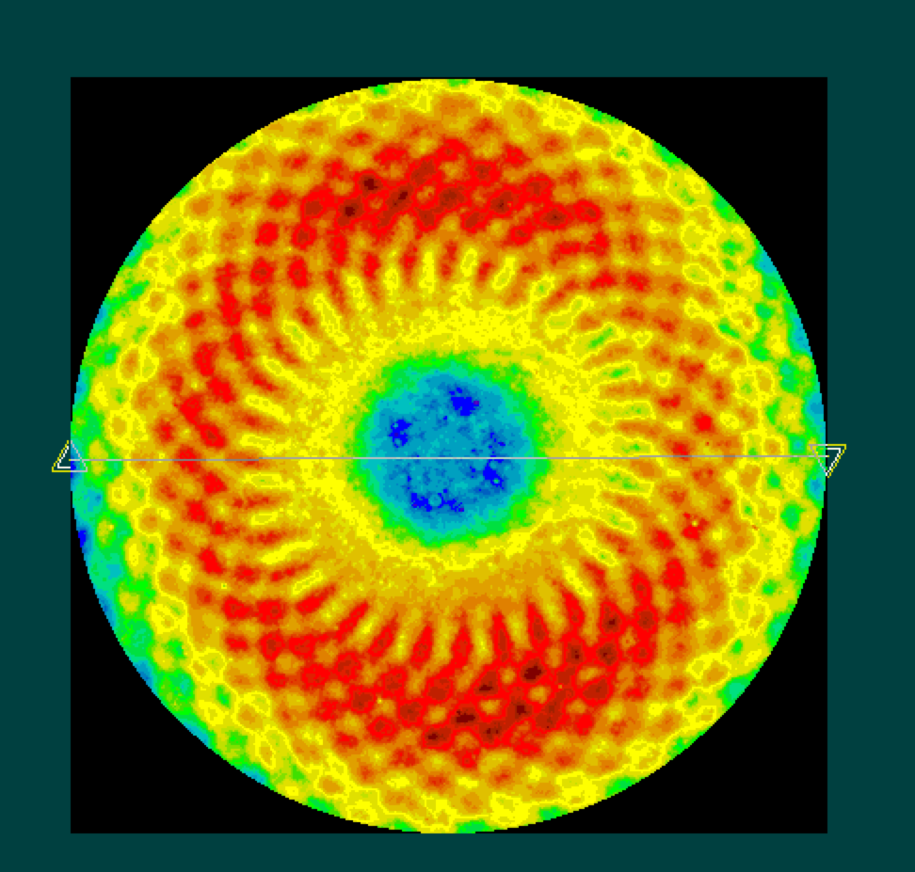
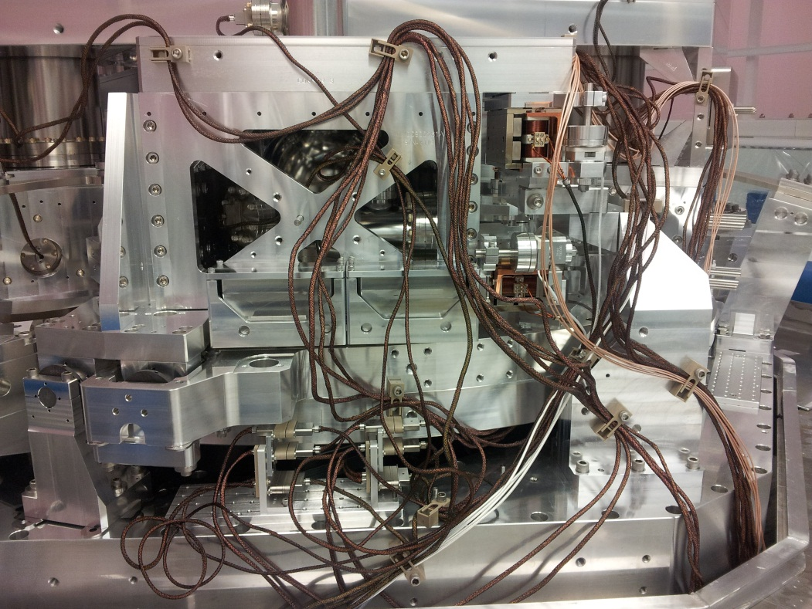
Several bumps in the road, no showstoppers so far
Pick your favorite “bump”!

Slide 17
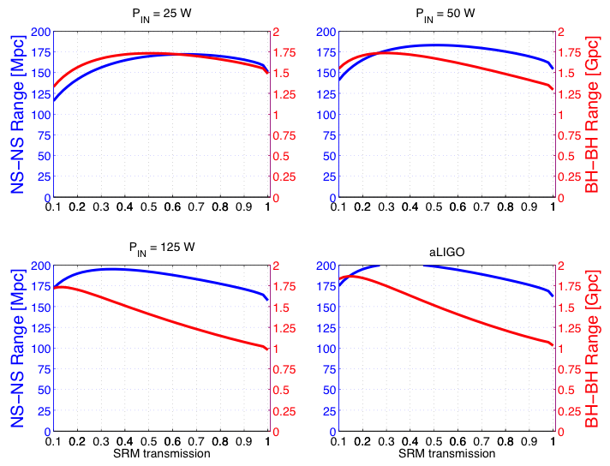
Optimization of SRM transmission

Slide 18
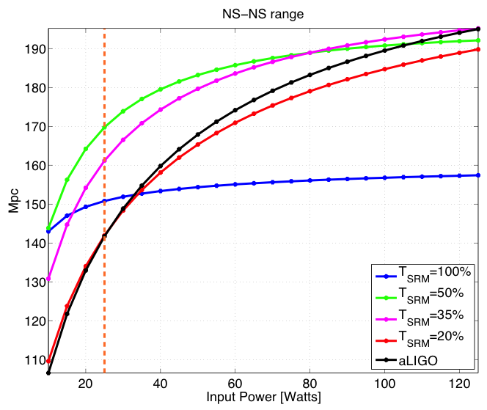
Optimization of SRM transmission

Slide 19
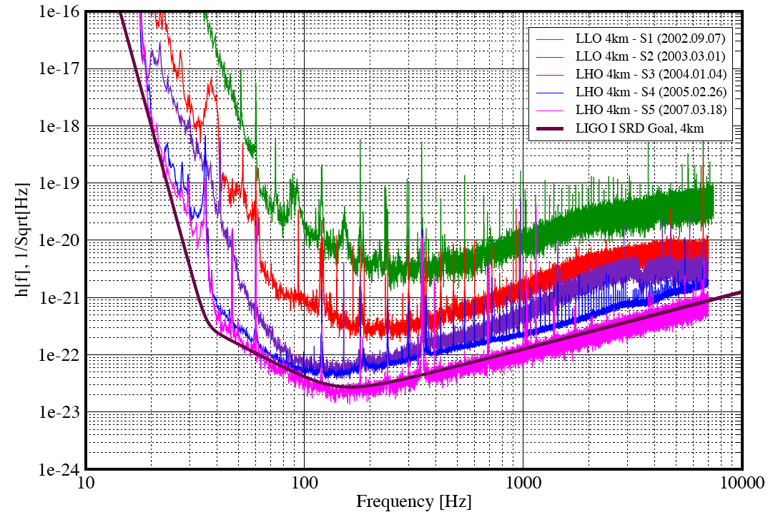
Initial LIGO Sensitivity improvement
LIGO: First lock at the end of 2000…
Technical Noise!
2002
2003
2004
2005
2007
Design
Fundamental Noises

Slide 20
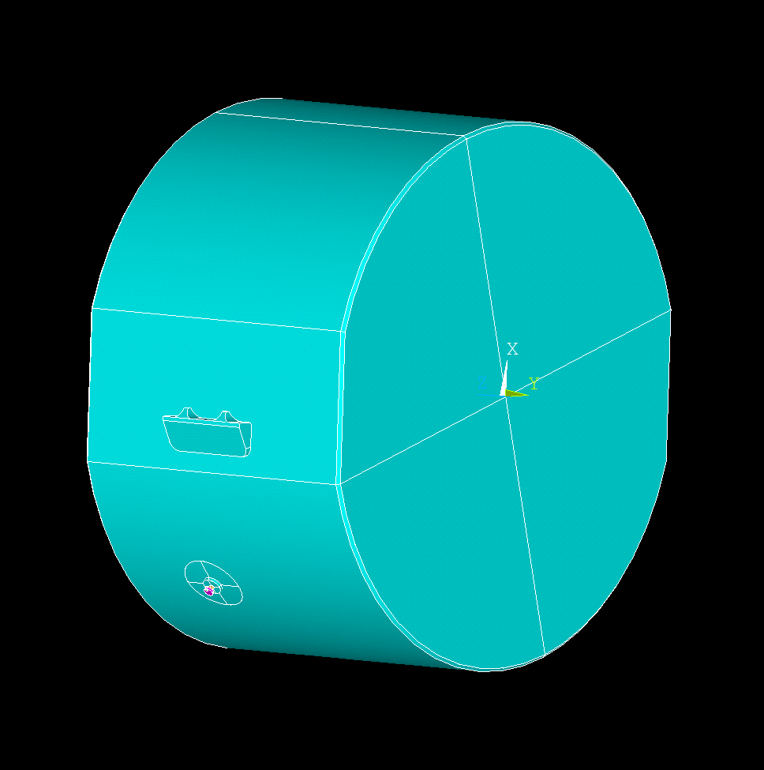
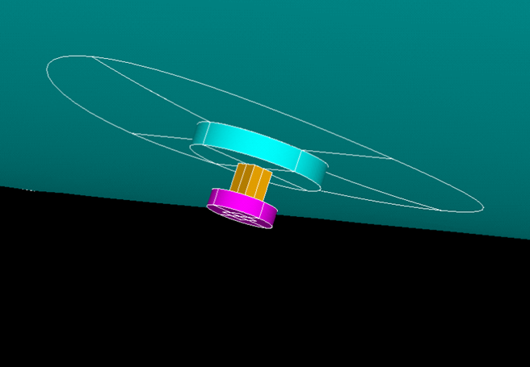
Parametric Instabilities
Slawek Gras (LIGO-MIT)
2. After round trip scattered mode returns to the test mass and couples via radiation pressure into the mechanical mode
1. Test mass mechanical mode scatters fundamental mode (pump) into the higher order mode

Slide 21
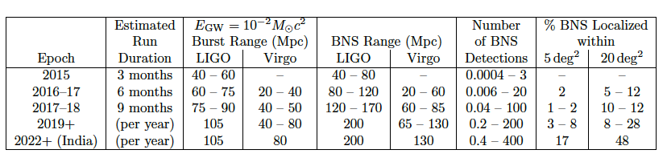
Detection Rates
Neutron Star Binaries:
  Advanced LIGO: ~ 200 Mpc
  “Realistic rate” ~ 40/year
  Class. Quant. Grav. 27, 173001 (2010)
  (Initial LIGO: ~15 Mpc, Rate ~1/50years)
21
Notes:
P0900125-v8

Slide 22
What we call “commissioning”:
Understand and fix an entanglement of noise coupling mechanisms
Example from Enhanced LIGO
HIGH POWER
ALIGNMENT
OPTICS QUALITY
STRAY LIGHT
Noise
THERMAL EFFECTS
Output
Mode-Cleaner
22

Slide 23
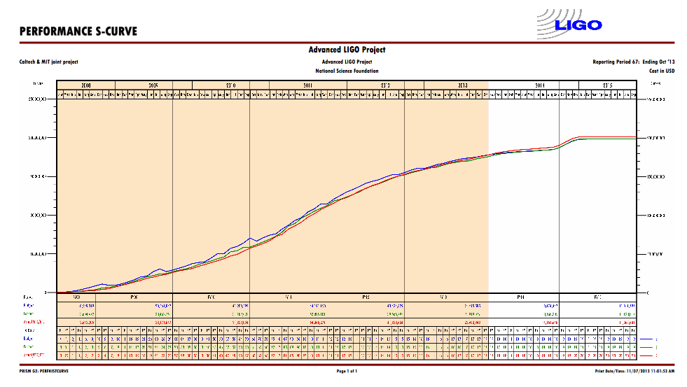
Advanced LIGO is 85.4% complete
(@ July 2013)
23

Slide 24

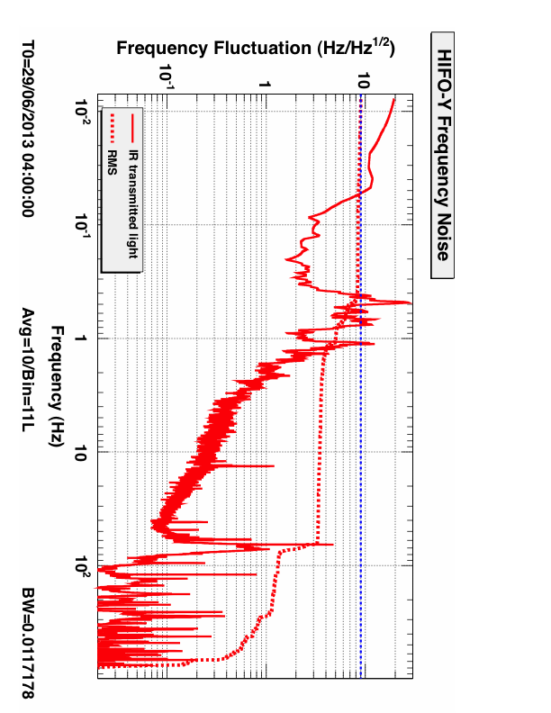
“Arm Length Stabilization” System
LHO
Frequency fluctuations of main laser light is already “good enough”
(1/10 of the cavity linewidth), “noise hunting” still in progress
GOAL < 10 Hz RMS

Slide 25
Seismic isolation performance
iLIGO
1000x
aLIGO so far
aLIGO target
25

