Slide 1
Advanced LIGO Suspensions
Quick Start Guide
J. Romie, B. Shapiro, M. Barton

Slide 2
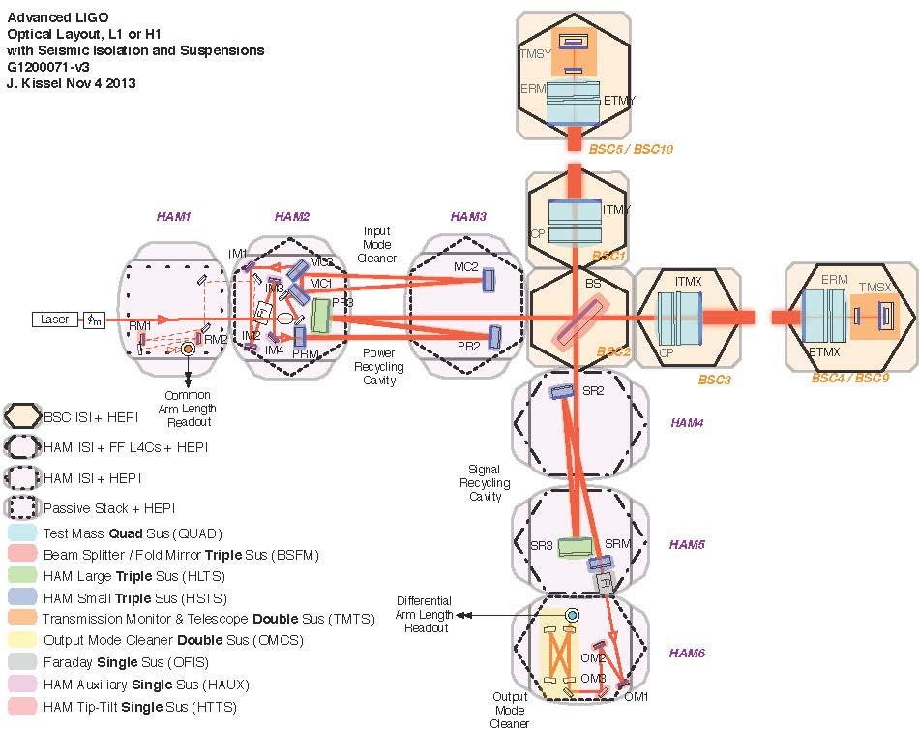

Slide 3

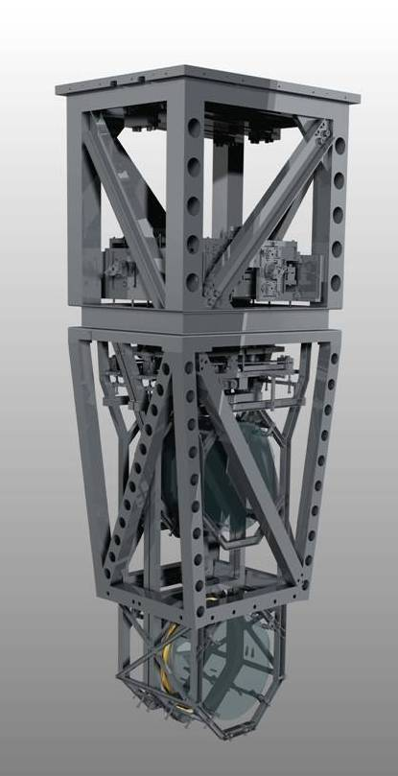
Quadruple Suspension (Quad)
Reaction Chain
Main (test) Chain
Purpose
Input Test Mass (ITM, TCP)
End Test Mass (ETM, ERM)
Location
H1 - BSC 1, 3, 9, 10
L1 – BSC 1, 3, 4, 5
R0, M0
Control
Local – damping at M0, R0
Global – LSC & ASC at all 4
Sensors/Actuators
BOSEMs at M0, R0, L1
AOSEMs at L2
Optical levers and IFO signals at L3
Electrostatic drive (ESD) at L3
L1
L2
L3

Slide 4
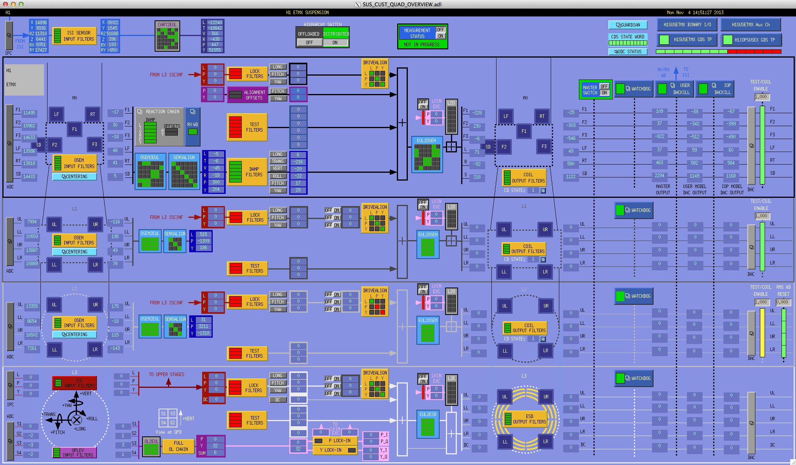
Quad MEDM Overview Screen

Slide 5
Quad MEDM
R0=top mass Bosems
IFO odds and ends
Which suspension
M0=top mass Bosems
1
L1=UIM Bosems
PenRe Aosems
ESD
Input
Sensor/
actuators
OpLev
Watchdogs & DACkill
Local > Cartesian & sensor corrections
Output filters
Actuator corrections & Cartesian > local
Input filters

Slide 6
Quad MEDM
Coil/drive: enable or
disable
Green=enabled
Red=disabled
Yellow=intermediate
Damping Filter-click on this for damping loops
Check state of IFO:
Acquire (locking)
Low Noise (running)

Slide 7
Suspension Isolation Performance
1/f²
1/f⁴
Each stage provides 1/f² isolation
1/f⁶
1/f⁸

Slide 8
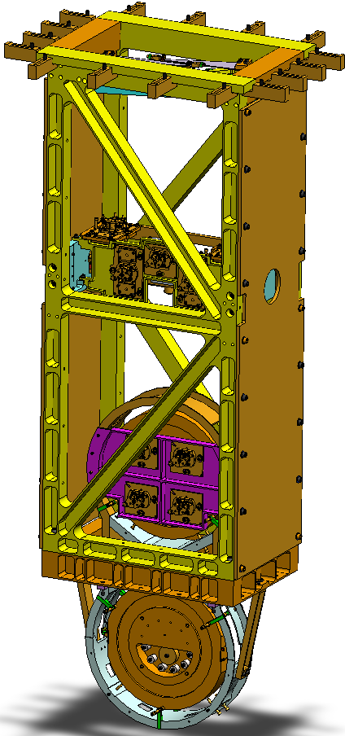

Beamsplitter/Folding Mirror (BSFM)
Purpose
BS, (FMX and FMY)
Location
Beamsplitter – BSC 2, (4)
(Fold Mirror – BSC 6, 8)
RT
LF
F1
SD
F2
F3
M1
Control
Local – damping at M1
Global – LSC & ASC at M2
Sensors/Actuators
BOSEMs at M1 and M2
Optical levers and interferometric signals on M3
Naming: L1:SUS-FMX_M1…
Documentation
Final design review - T080218
Controls arrangement – E1100108
UL
UR
M2
LL
LR
M3
V
T
L

Slide 9
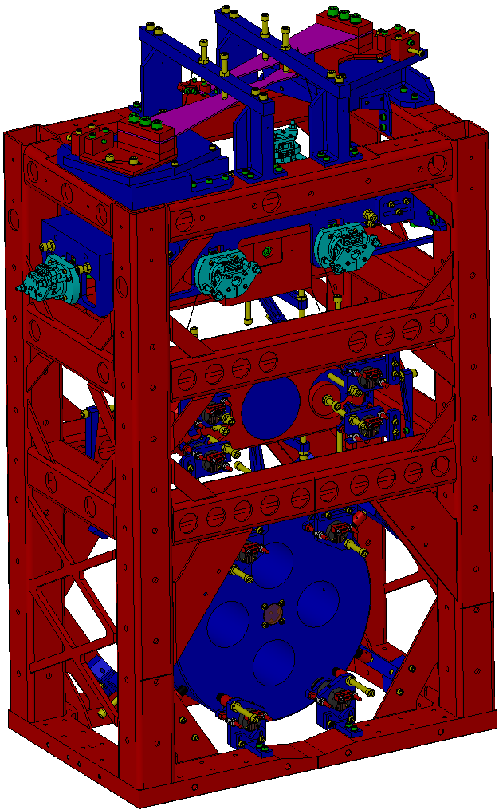
HAM Large Triple Suspension (HLTS)
Purpose
PR3, SR3
Location
HAM 2, 5, (8, 11)
M1
Control
Local – damping at M1
Global – LSC & ASC at all 3
Sensors/Actuators
BOSEMs at M1
AOSEMs at M2 and M3
Optical levers and interferometric signals on M3
Naming: L1:SUS-SR3_M1…
Documentation
Final design review – T1000012
Controls arrangement – E1100109
UL
UR
M2
LL
LR
UL
UR
M3
LL
LR
V
T
L

Slide 10
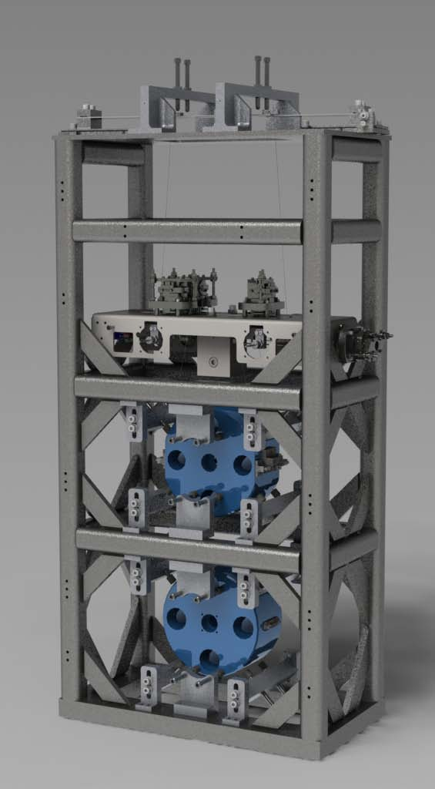
HAM Small Triple Suspension (HSTS)
Purpose
PRM, PR2, SRM, SR2
MC1, MC2, MC3
Location
HAM 2, 3, 4, 5, (8, 9, 10, 11)
T1
T2
T3
SD
LF
M1
RT
Control
Local – damping at M1
Global – LSC & ASC at all 3
Sensors/Actuators
BOSEMs at M1
AOSEMs at M2 and M3
Optical levers and interferometric signals on M3
Naming: L1:SUS-PRM_M1…
Documentation
Final design review - T0900435
Controls arrangement – E1100109
UL
UR
M2
LL
LR
UL
UR
M3
LL
LR
V
T
L

Slide 11
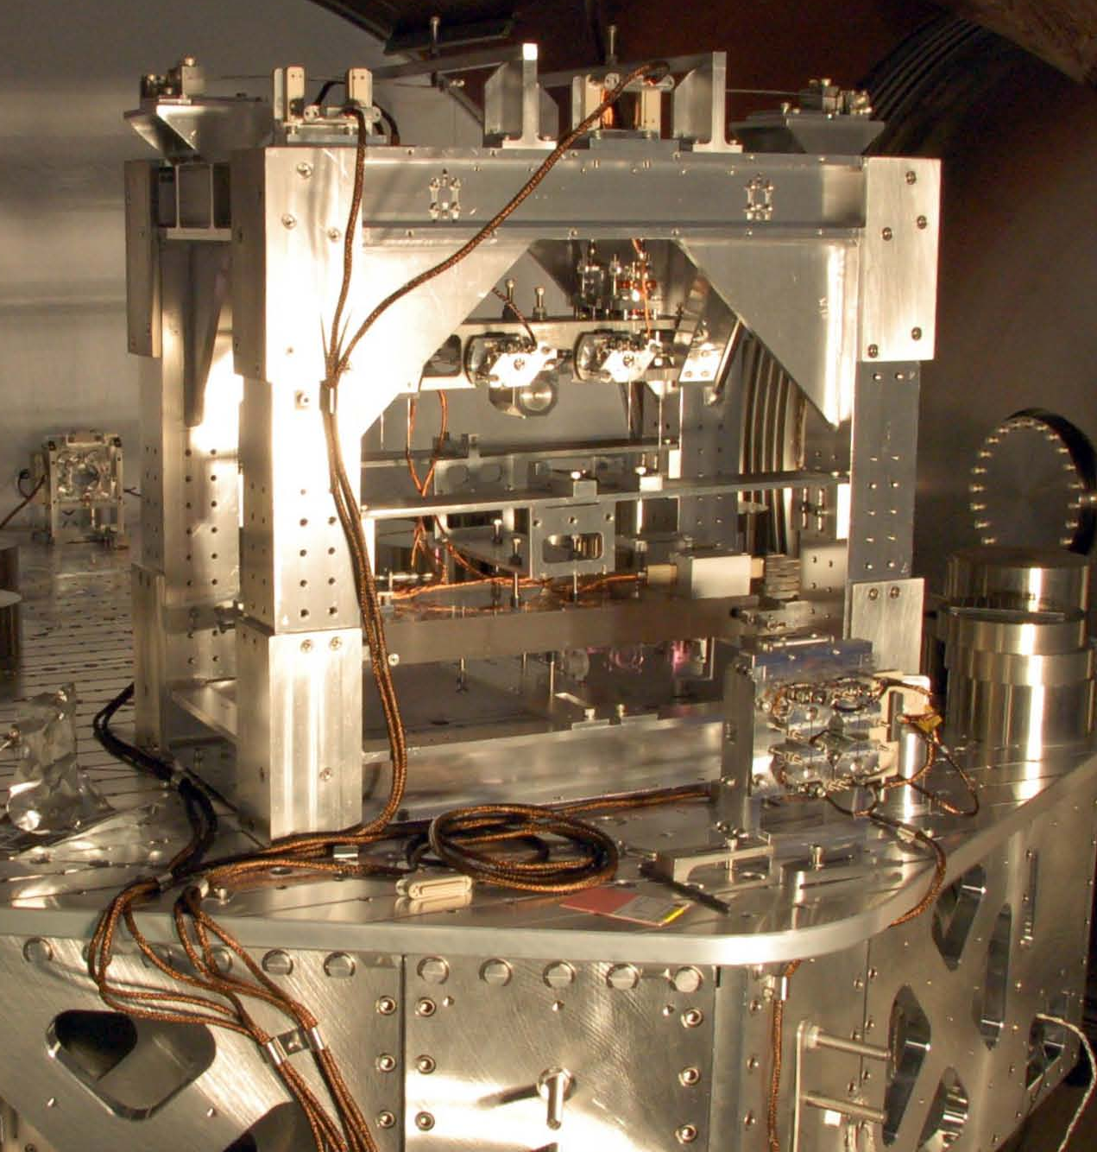
Output Mode Cleaner Double (OMCS)
Location
HAM 6, (12)
Control
Local – damping at M1
(true for all SUS’s)
Sensors/Actuators
BOSEMs at top mass
Top mass naming convention
L1:SUS-OMC_M1…
In use during S6
T3
T1
T2
SD
LF
M1
RT
M2
Optics
site subsystem unit stage
2
3
3,4
2
Documentation
Final design review - T0900060
HAM SUS controls arrangement – E1100109
V
Local coordinates
T
L

Slide 12
Global Cavity Control (LSC)
C₄
C₃
Each stage has limited range, so the control is distributed up the chain with:
Increasing control force
Lower frequency control
C₂
Cavity Length
C₁
ITM
ETM

Slide 13
Parallel Control of Cavity Length
With parallel feedback, changing one loop requires changing the others to account for changes in gain and stability.
The stability of all stages are coupled
C₂
Cavity Length
C₁
ITM
ETM

Slide 14
Hierarchical Control of Cavity Length
If each stage’s input is the output of the previous stage, any feedback change is automatically registered by the rest of the loop.
The stability at each stage is independent from the others.
Detailed discussion in T1000242 & G1200632.
C₂’
Cavity Length
C₁
ITM
ETM

