Slide 1
Gravitational Wave Astronomy
Institute of Physics
October 2013
The Violent Universe
Bernard Schutz
Albert Einstein Institute (Potsdam)
and
Cardiff University
for the LIGO Scientific Collaboration

Slide 2
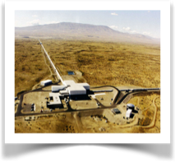
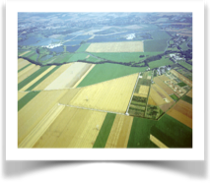
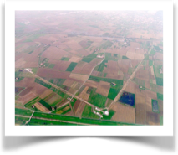
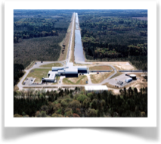
Gravitational Wave Detection
GEO600
LIGO/H
LSC
Virgo
LIGO/L
LSC and Virgo share data,
do all analysis jointly.

Slide 3
Capabilities
Initial detectors (1G)
h_{burst} ~ 10⁻²¹
BNS <mean range> ~ 20 Mpc
Advanced detectors (2G): Shoemaker’s talk
h_{burst} ~ 10⁻²²
BNS <mean range> ~ 200 Mpc
Beyond advanced (2.5-3G): Rowan’s talk
h_{burst} ~ 10⁻²³
BNS <mean range> ~ z = 1+

Slide 4
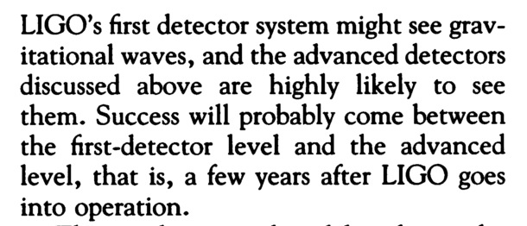
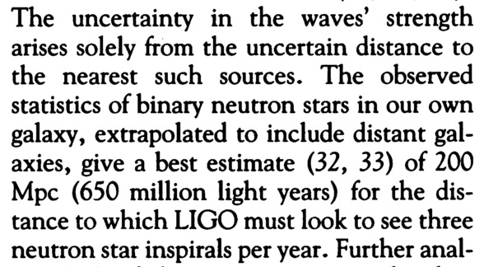
Then and now
LIGO’s 1992 “definition”paper: Abramovici et al, Science 256, 325-333. (Shoemaker an author!)
LV “Observing Scenarios” paper arXiv:1304.0670, subm. Living Reviews Relativity.
Initial detectors made no detections; advanced detectors very likely to do so.
Advanced detectors will increase sensitivity in stages. By 2019 the mean range should be 200 Mpc and the expected number of binary neutron star detections will be 0.2-200 per year, with a best estimate of 40 per year.

Slide 5
The GW Spectrum
(B. S. Sathyaprakash)

Slide 6
Three Pillars of GW Detection
Data:
LIGO
Virgo
Kagra
eLISA
PTA
ET
Source
Modeling
Signal
Analysis

Slide 7
Binaries with LIGO-Virgo
Binaries all merge within a few minutes
BNS: best estimate rate 40/yr at 200 Mpc
BBH: very uncertain, rate maybe 50% of BNS
NS-BH: maybe rare?
Initial detectors have set upper limits
BNS: none to 20 Mpc, rate < 1.3x10⁻⁴ Mpc⁻¹ yr⁻¹, for Adv LIGO ~ 10³ yr⁻¹. [Phys. Rev. D 85, 082002 (2012)]
BBH: none to 300 Mpc, rate < 3.3x10⁻⁷ Mpc⁻¹ yr⁻¹, for Adv LIGO ~ 10³ yr⁻¹. [Phys. Rev. D 87, 022002 (2013)]

Slide 8
GW Pulsars with LIGO-Virgo
Spinning NSs are long-lived, so GWs must be weak. Need to integrate months of data.
Searches for known pulsars use radio timing. See arXiv:1309.4027.
Crab: h < 2.3x10⁻²⁵, dE/dt_{GW} < 0.01 dE/dt_{tot}
Vela: h < 1.1x10⁻²⁴, dE/dt_{GW} < 0.1 dE/dt_{tot}
All-sky searches(Einstein@Home): no detections, limits around 10⁻²⁴, depends on f. [Phys. Rev. D 87, 042001 (2013)].

Slide 9
Burst searches with LIGO-Virgo
There have been many searches with data 2005-10:
Untriggered all-sky searches set upper limits around 10⁻²¹ in 1 year: Phys. Rev. D 85, 122007 (2012).
Searches triggered by gamma-ray bursts have found no GW counterparts. See arXiv:1309.6160, Astrophys. J. 760 (2012) 12, Astrophys. J. 755 (2012) 2.
Swift did searches triggered by GW candidate events, also with no positives: Astrophys. J. Suppl. 203 (2012) 28
Searches for coincidences between GW and neutrino events with Antares: JCAP 1306 (2013) 008.
Searches for optical counterparts to GW candidate events: arXiv:1310.2314, Astron. Astrophys. 541 (2012) A155
These have prepared software, techniques, protocols for searches with advanced detectors.

Slide 10
Other LIGO-Virgo Searches
Many other searches have been performed:
Stochastic background (isotropic and directed)
Cosmic strings
GWs from pulsar glitches (NS ringdown modes)
GWs from pulsars near Galactic Center
Ringdowns of black holes

Slide 11
Einstein@Home Finds Radio and Gamma-ray Pulsars
Volunteer computing system Einstein@Home delivers 470 Tflops continuously.
GW software was developed for deep searches for periodic signals.
Bruce Allen and team (AEI) applying similar techniques and finding pulsars in data from Aricebo [Astrophys. J. Lett. 732, i.d. L1 (2011)] and Fermi/LAT [Astrophys. J. 744, i.d. 105 (2012)].
Recent Parkes analysis found 24 pulsars, including 6 in binaries[Astrophys. J. 774, i.d. 93 (2013)]

Slide 12
Advanced Detector Observing
From 2015 onward, LIGO will have periods of observing alternating with periods of improving sensitivity.
If all goes well and the “best estimate” rates are correct, first detection should happen 2016-17. (Shoemaker talk)
Multimessenger should be a feature of the observing scenario from the start.
Patrick Sutton reviewed our preparations and expectations.
The promise of GW detection is now very close to being realised.

Slide 13
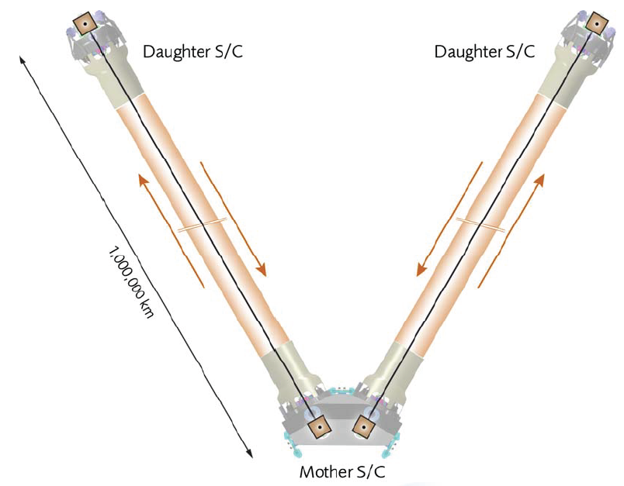
GW Sources for eLISA
eLISA seems likely to be adopted for ESA’s L3 launch around 2034.
Long arms mean high amplitude SNR: 50-1000+.
Important sources include
MBH binary mergers out to redshifts of 20, tracers of beginning of galaxy formation.
EMRI: a MBH swallows an “ordinary” BH, strong test of GR, probe of clusters around central BHs.
WD-WD binaries: with thousands of systems, mapping the Galaxy and examining a principal end phase of stellar evolution.

Slide 14
LISA/eLISA Sensitivity
(B. S. Sathyaprakash)

Slide 15
Pulsar Timing
Worldwide IPTA collaboration of three main groups: EPTA, NANOGRAV, PPTA.
Accumulating good data on more and more millisecond pulsars, closing in on predictions.
First detection of an astrophysical stochastic background due to SMBH binaries could happen as early as 2016.
Pulsar timing comes into its own with SKA: possibility of identifying individual systems.
Remember: at frequencies 1/yr, we only get a few cycles of each waveform. Principal pay-off likely to be the statistics of SMBH systems 10⁸-10¹⁰ M๏.

Slide 16
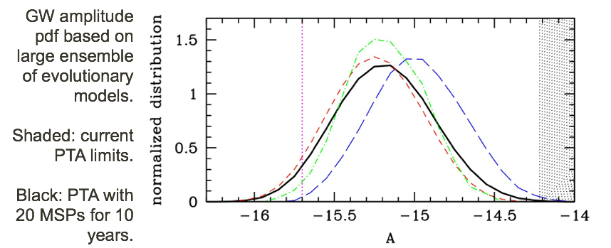
PTA: Predictions vs Sensitivity
Sesana, MNRAS 433, L1-L5 (2013)

Slide 17
Expanded Network
The advanced interferometer network will be increased by KAGRA in Japan (2018+) and LIGO-India (after 2020).
Brings many benefits:
longer baselines leading to better positions, easier follow-up, more counterpart identifications;
better sky-coverage;
better time-coverage (duty cycle);
better vetoes against instrument “glitches” because of redundancy of GW data with 3+ detectors.

Slide 18
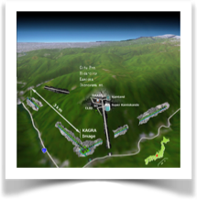
Worldwide Network 2020+
GEO600
LIGO/H
LSC
Virgo
KAGRA
LIGO/L
LIGO/India

Slide 19
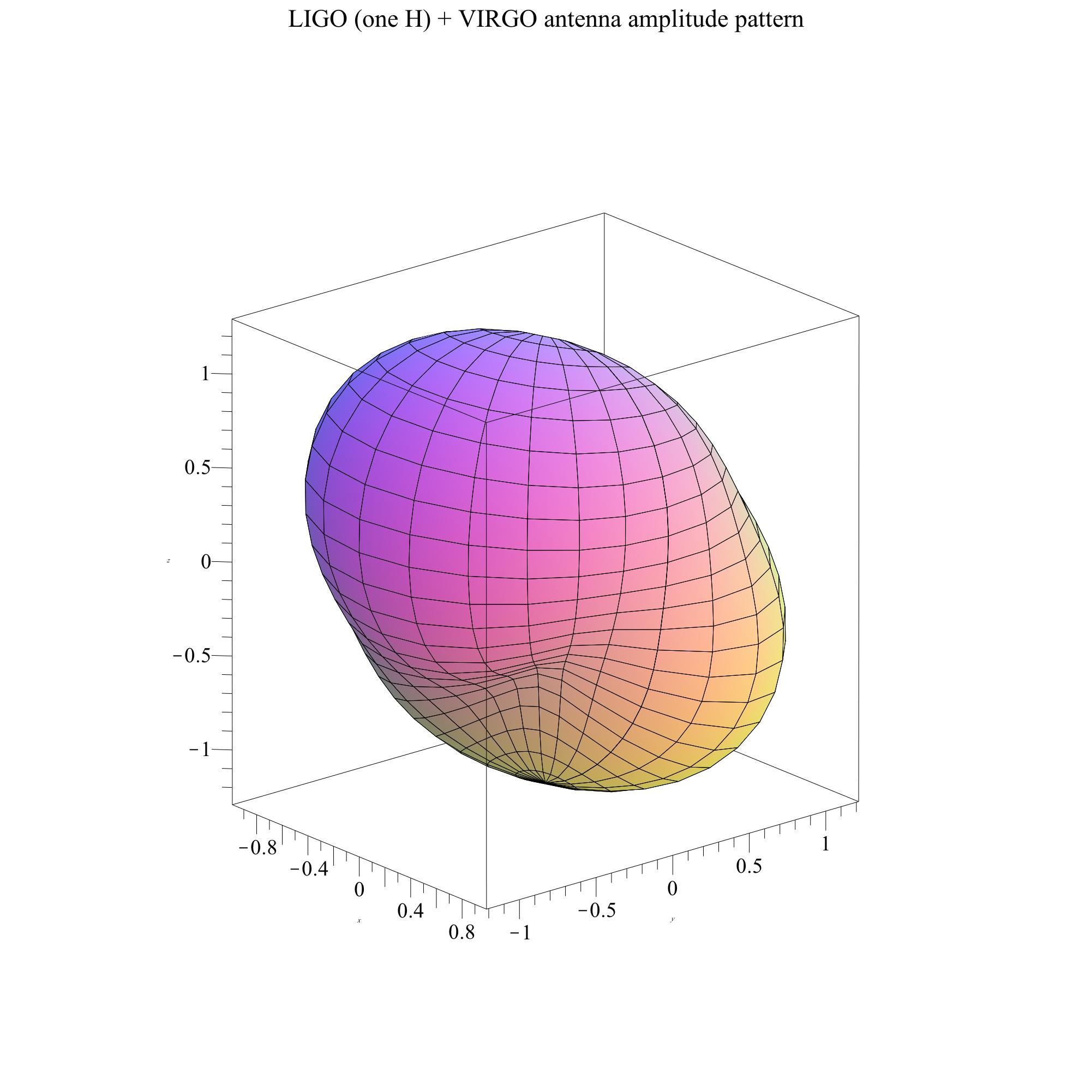
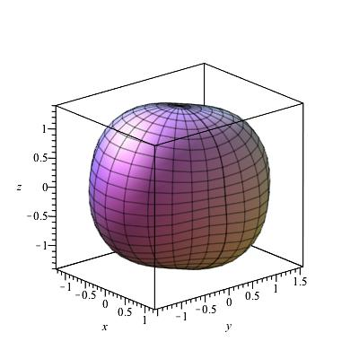
Antenna Amplitude Patterns
Hanford-Livingston-Virgo
5 Advanced Detectors
Viewpoint over
North Atlantic

Slide 20
Expected Event Rate
Horizon
(B S Sathyaprakash)

Slide 21
Worldwide Network Science 2023
With 100s of BNS, BBH events per year:
GRB-BNS association – look directly into engine.
Statistics of BNS masses, BBH masses & spins
Strongest signal per year amplitude SNR ~ 60
Tests of GR, evidence about NS EOS
Good positions, identifications – precise distances, measure local H₀ to better than 1%.
Discovery space: enough sensitivity to identify something completely unexpected.

Slide 22
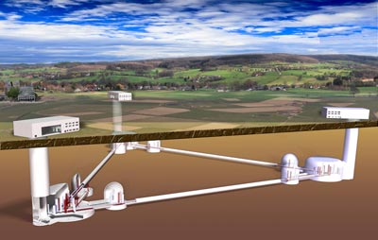
And after that …
Third generation detectors like ET can finally extend the reach of BNS detection out to cosmological distances, z > 1. (Talk by Rowan)

Slide 23
eLISA and ET Work Together at z = 0.5
eLISA
ET
(B. S. Sathyaprakash)

