Slide 1
Simulink/Front Model & MEDM Screen Mods from ECR E1300578 (For SUS’ in BSC Chambers)
J. Kissel for the SUS and ISC Team
G1301192-v3

Slide 2
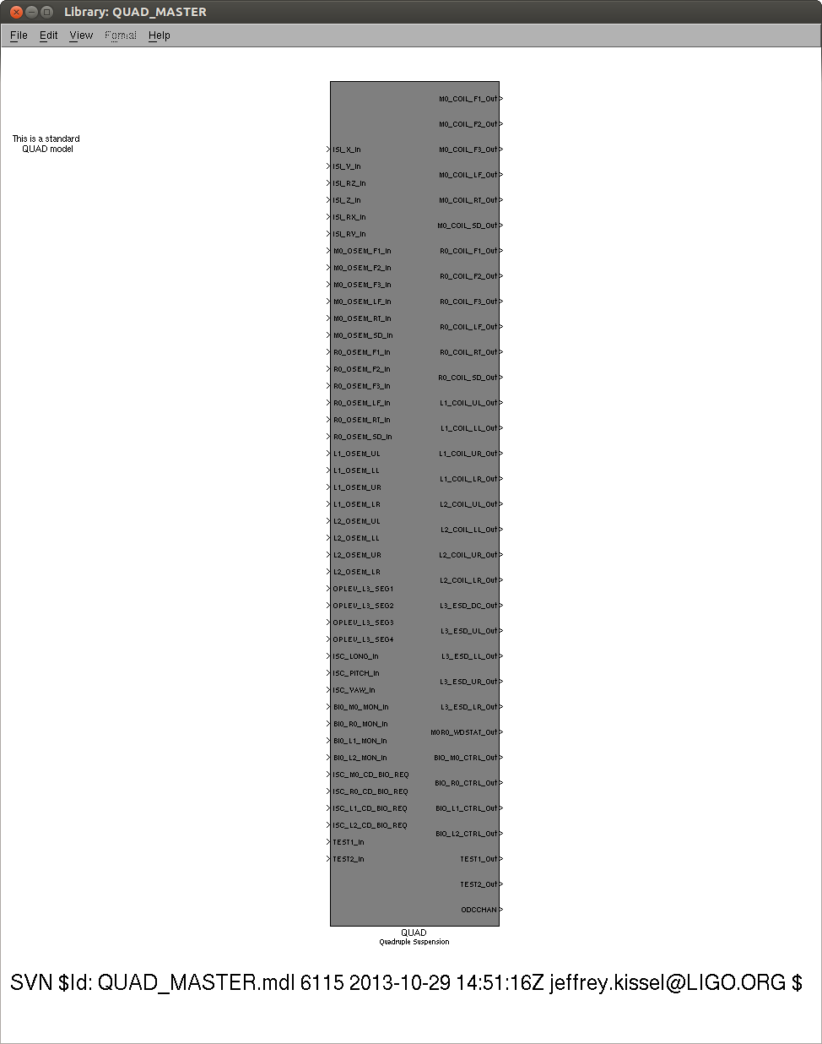
Added SVN $Id$ String to All Parts
Added to all top level models and library parts
Great for visual assessment of version control
Must be added to each top-level model (but comes for free with library parts)
See instructions / description here:
<https://awiki.ligo-wa.caltech.edu/aLIGO/InsertingSvnVersionStringIntoSimulinkModels>

Slide 3
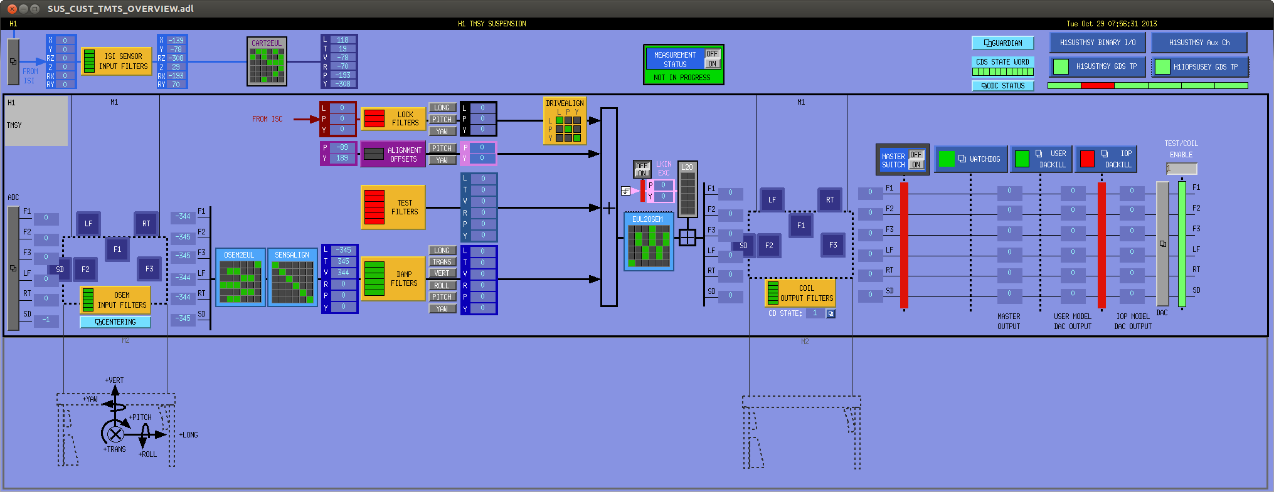
Removal of ISI OFFLOAD
A part of reducing wasted computation cycles
Experience has shown that ISC offloading is only needed up to TOP mass of each suspension
Affects top-level of models, so every model must be reconnected and IPCs senders removed
SEI needs to get rid of their IPC receivers
No longer anything here (for every suspension type)

Slide 4
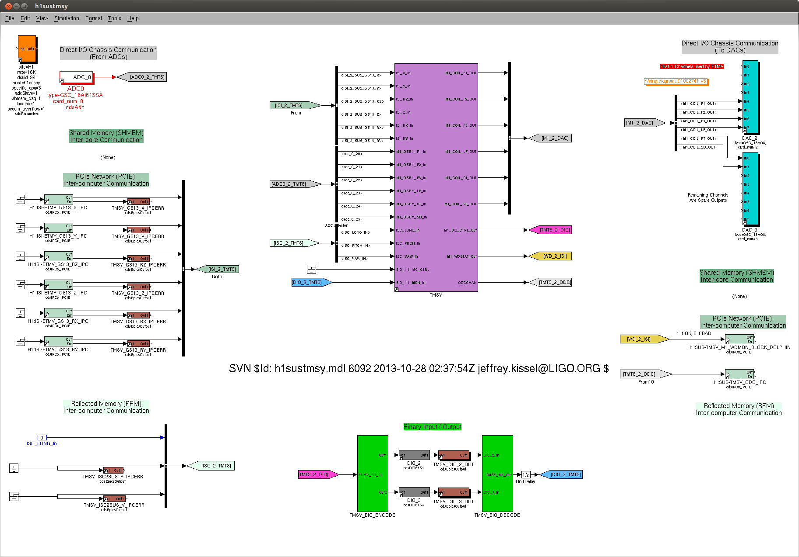
Removal of ISI OFFLOAD
Nothing up here any more,
So you have to move up and reconnect everything

Slide 5
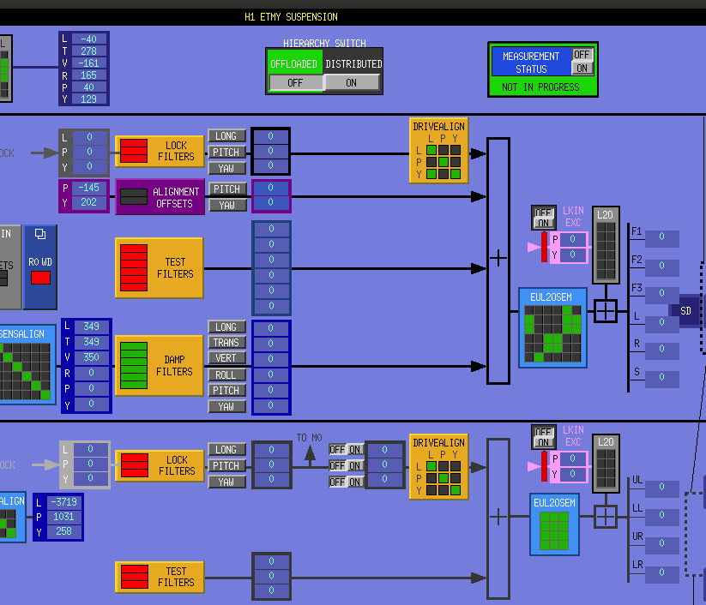
DRIVEALIGN Mods
Move drive align to only affect ISC / “LOCK” Filters
DRIVEALIGN designed to decouple L, P, and Y force and torque at each stage from L of the optic (the main chain on the QUAD), so it doesn’t make sense to include these filters in, say the damping path
The means
Move it up to only affect LOCK path at every stage
Reduce the size of M0 M1 matrix from 6x6 to 3x3
Totally removed from R0
Only involves library parts => Comes for free with update

Slide 6
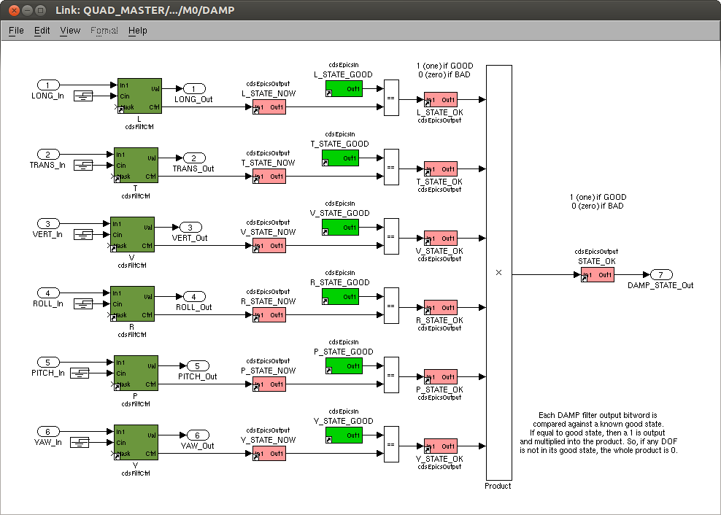
Added ODC Bits
(Actually ECR E1300740)
Added to all
LOCK,
DAMP,
OLDAMP,
etc

Slide 7
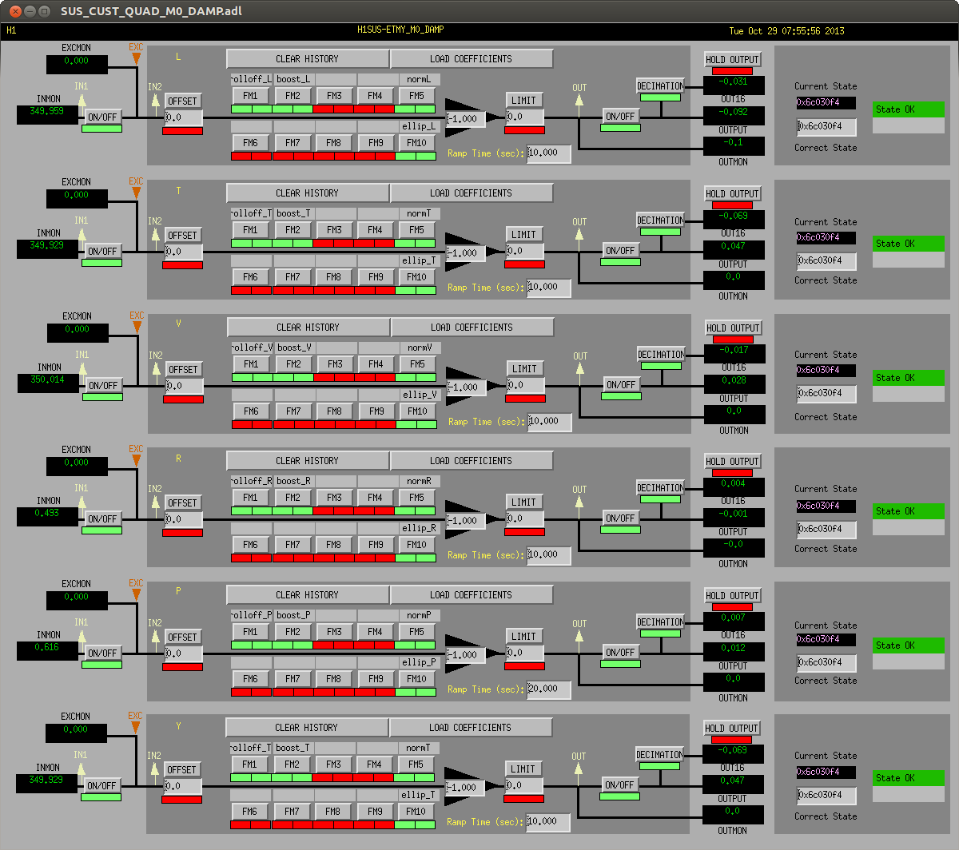
Added ODC Bits
State logic is now on every one of the DAMP, LOCK, OLDAMP filter screens
Only includes filter modules in the state, no gains ☹
Thought about doing this for OSEMINFs, but they need unique gain number for every OSEM, so not compatible with library parts

Slide 8
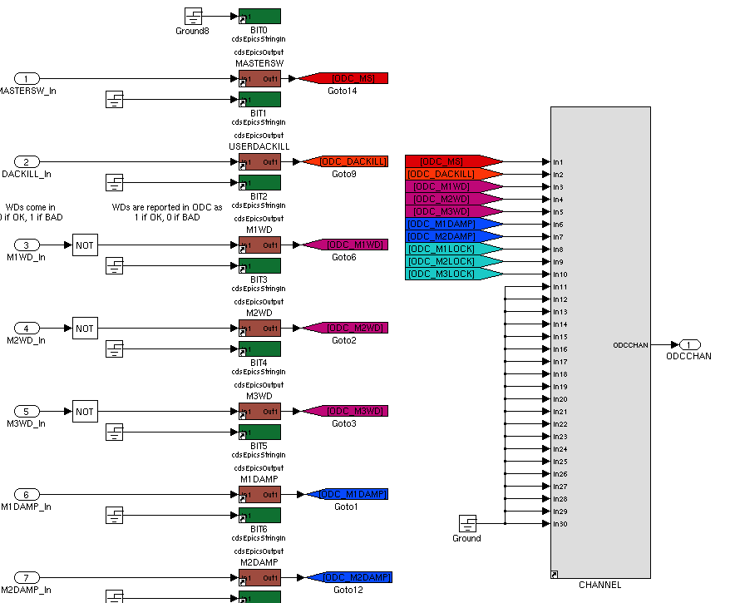
Added ODC Bits
(Actually ECR E1300740)
All bits get piped into new ODC V2 Block which is much cleaner
QUADs have 13 bits,
BSFMs have 10 bits,
TMTSs have 5 bits,
Etc. depending on how many stages of LOCKing and DAMPing
Channel is now spit out to the top level to be collected by ODC master

Slide 9
Added ODC Bits
(Actually ECR E1300740)
Affects top models!
IPC “channel” is
$(IFO):SUS-$(OPTIC)_ODC_IPC
(one per model)

Slide 10
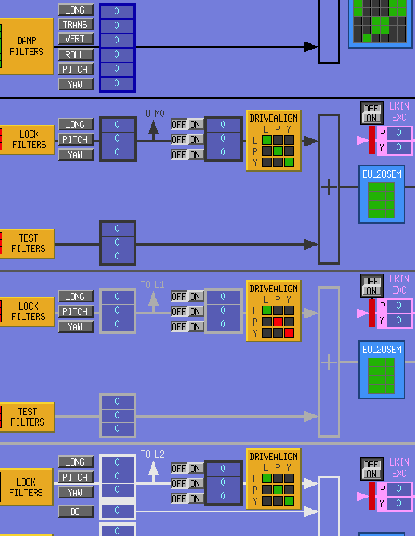
Added switch after ISC (internal) OFFLOAD
Added independent on/off switch between offload to upper stages and the DRIVEALIGN matrix
This is so when we use “offloaded” (as opposed to “distributed”) hierarchy, we can pipe the ASC signals up to only the TOP mass, as opposed to LSC which needs to go to every stage

Slide 11
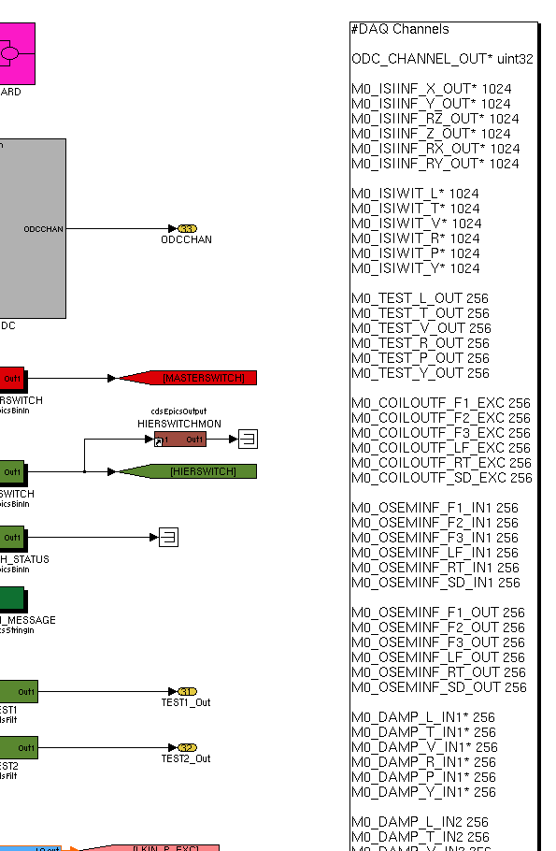
Divided up Commissioning vs. Science Frames
Chose to store forever:
One SUS/BSC-ISI’s worth of Calibrated Cartesian Basis in [nm / nrad] ($(IFO):SUS-$(OPTIC)_$(M0/M1)_ISIINF_$(DOF)_OUT_DQ) i.e. the QUADs and the BSFMs are in charge of storing this
Every SUS’ Calibrated suspension point motion [nm / nrad]
Only one version of OSEM / Oplev / ISC sensor signal at each stage – Euler basis, Calibrated into [um / urad]
Only one version of control signal at each stage – OSEM basis, (uncalibrated) DAC counts

Slide 12
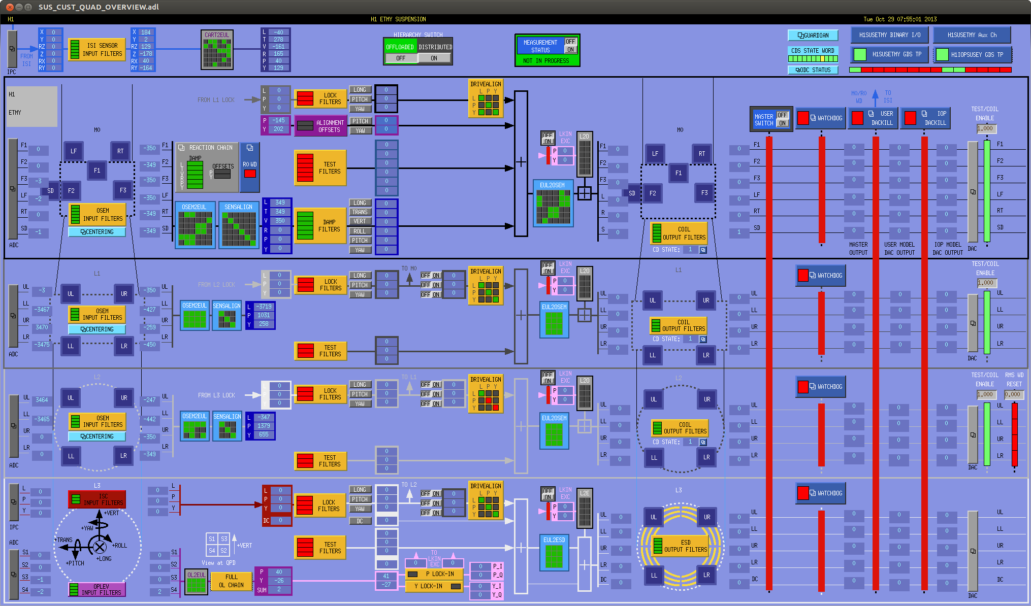
Removed QUAD lower stage damping
No longer needed now that ISIs are commissioned
Means $(IFO):SUS-$(OPTIC)_$(L1/L2)_DAMP_$(DOF)_IN1_DQ becomes
$(IFO):SUS-$(OPTIC)_$(L1/L2)_WIT_$(DOF)_DQ

Slide 13
Added Optical Lever LOCK-IN
1) drive suspensions longitudinally and minimize the coupling to angle. Should we minimize coupling of M1_L to M1_A or M1_L to M3_A? The latter seems to make sense, but I haven't modeled what the effect will be for both cases.
2) balance the coil gains of all stages. here we want to use the logic of the old f2pRatio script written by Vuk/Matt which makes three measurements to find 3 of 4 coil gains (the remaining one is set to 1). The old way to do this was to use the OL for the readout. Naturally, we cannot do this for the M1/M2 stages anymore. And we can't use the OSEM readbacks at high frequency because of the pickup between the drive coil and the osem sensor.
3) Do a FD balance of P2Y and Y2P using something as the reference sensor. But what's the sensor?
4) Also, how do we do the A2L balancing for low frequencies (below the GW band)? For the GW band, we want to do this in the regular scalar way by just driving angle of each stage and minimizing the IFO readout. What's the harm in just punting on the f < 10 Hz FD part?
5) In cases where we don't have OL on the mirror we can use the WFS DC. In case #4, we want to use the LSC signal. Both require some communication between SUS/ISC. I don't want to add a bunch of IPC to handle this. Perhaps for the cases where we use WFS_DC to balance SUS we can utilize the ASC lockins. Not sure how to do #4.

Slide 14
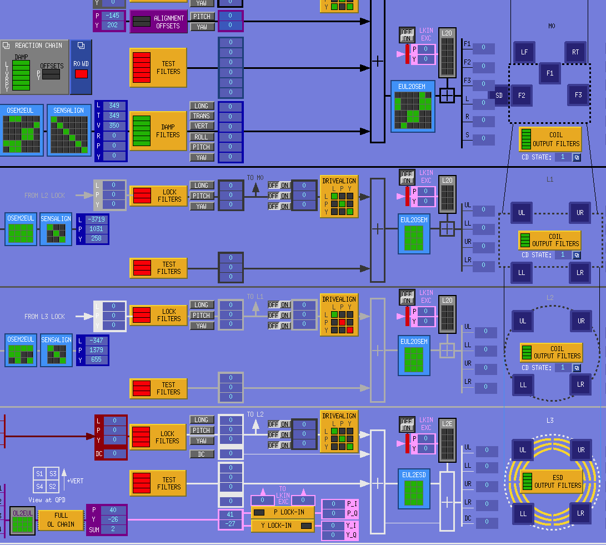
Added Optical Lever LOCK-IN
Sent directly to coil basis, so we can do any configuration we want
Sent to every stage
One for PITCH, and one for YAW

Slide 15
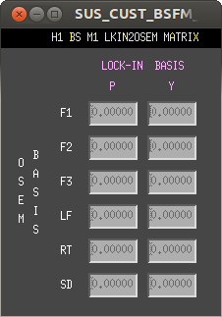
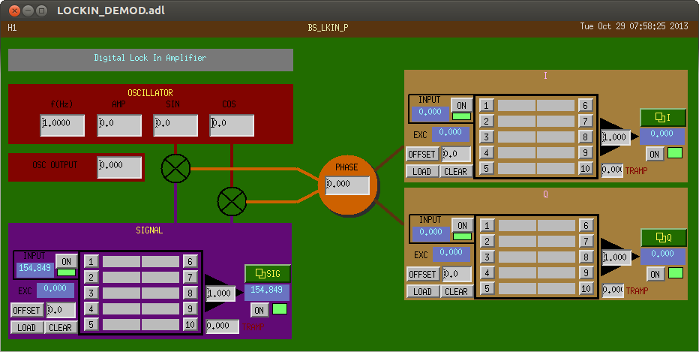
Added Optical Lever LOCK-IN
Sent directly to coil basis, so we can do any configuration we want
Uses ISC library part
Needs new $(SUBSYSTEM) and $(INSTANCE) variables in macro files

Slide 16
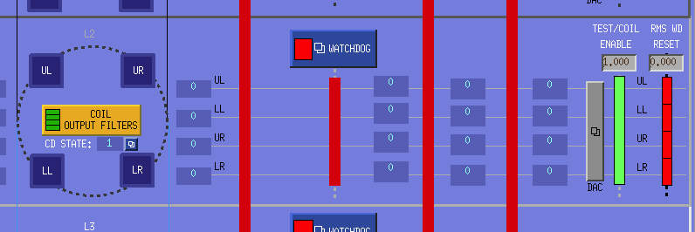
Added CD State and PUM WD to OVERVIEW

Slide 17
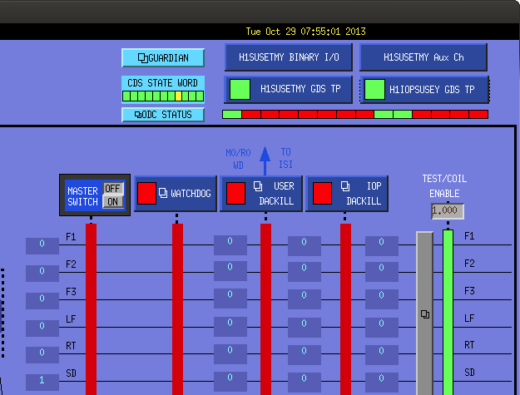
Added CDS STATE Word and ODC Screen Link
Shows the health of the CDS system
(which is *not* on the GDS_TP screen!)

Slide 18
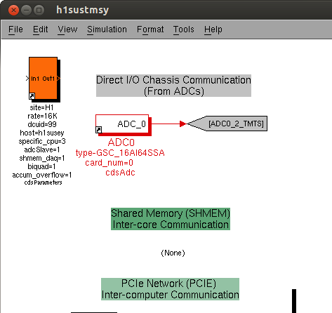
Accumulate Individual Overflows
changes the overflow counters for each DAC and ADC channel to accumulate until the reset button is hit (as opposed to clearing once a second)
Affects top models!
So can find *which* channel saturated, as opposed to just finding that "there has been a saturation" from the overall counter on the GDS_TP screen.

Slide 19
Left to do
Fix filter files
Take new safe.snaps
The HAM SUS.

