Slide 1
LIGO Characterization ITM09 AR “milky” appearance

Slide 2
ITM09 AR Dark Field Examination
Circular; some are not resolvable by our microscope so ~1 µm or smaller
Larger defects, ~ 2 to 4 micrometers appeared with a density of roughly 30/mm²
Smaller defects: density from 50x10³/mm2 to 150x10³/mm²
There were no areas observed to be free of defects.
The uncoated edge was not examined.

Slide 3
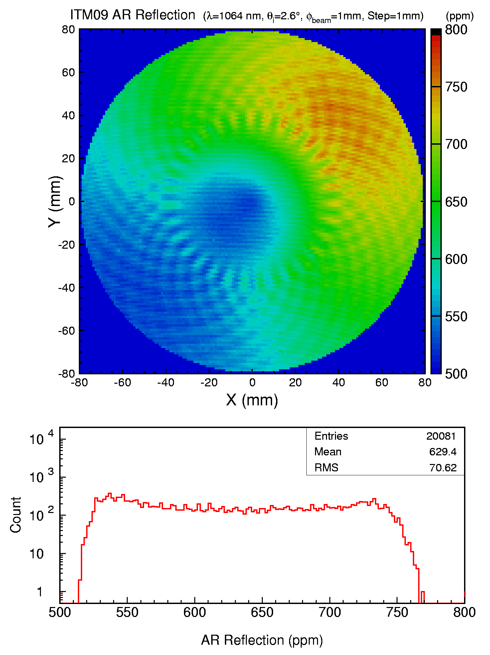
AR Reflection

Slide 4
Looking for a correlation with the milky pattern and AR Reflection

Slide 5
AR Absorption

Slide 6
Scatter
We had no schedule opportunity to measure scatter
We have arranged with Joshua Smith to use his imaging system to measure the scatter when ITM06 arrives.

Slide 7
For the Record HR Absorption

Slide 8
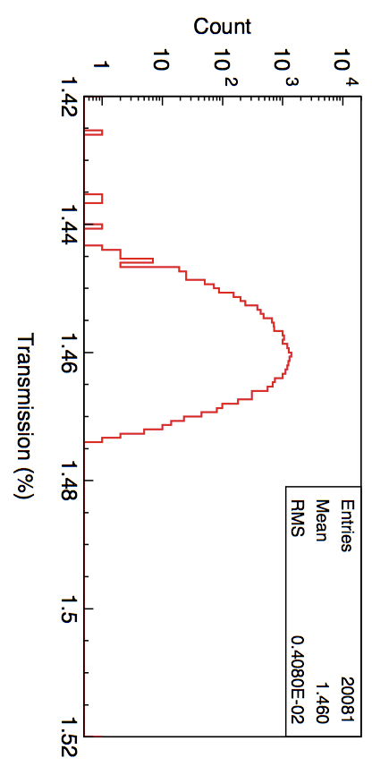
For the Record HR Transmission

