Slide 1
Mode matching investigations @ LLO
Chris, Lisa
LLO Team, Peter, Hiro

Slide 2
Measurements - I
Mode matching to the OMC (1W):
Bright Michelson: 74%
Single Bounce X arm: 79%
Single Bounce Y arm: 71%
The matching is bad
X and Y Michelson arms are different
https://alog.ligo-la.caltech.edu/aLOG/index.php?callRep=8559

Slide 3
Measurements - II
Direct measurement of the beam profile at the AS port, right after SRM (before OMC):
Indeed X/Y are different
Propagation of this beam to the OMC “explains”
mode mismatch
https://alog.ligo-la.caltech.edu/aLOG/index.php?callRep=8182

Slide 4
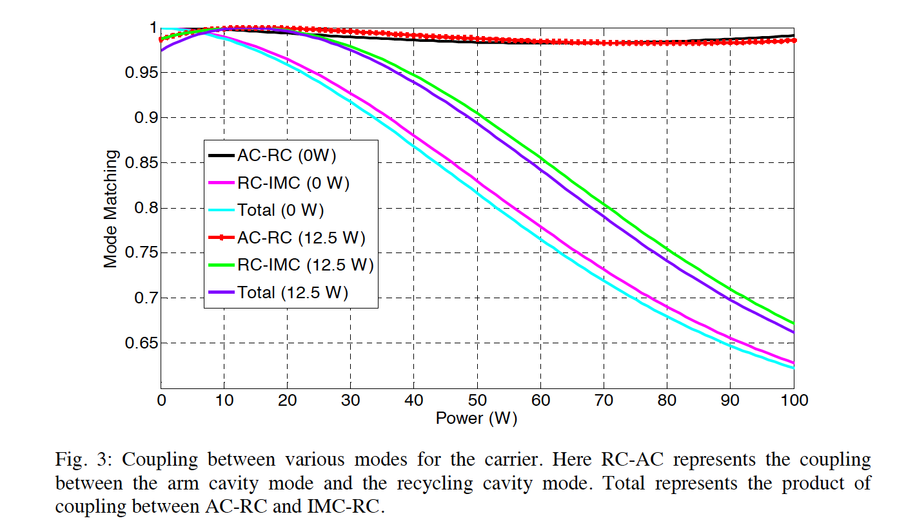
Confusion… Isn’t T0900043 telling us that we don’t need TCS up to 25W?

Slide 5
Model of recycling cavities with as built parameters (optimized for 12.5W, 50 km lens in ITMs)
Predicted mode matching Single Bounce X: 90%
Predicted mode matching Single Bounce Y: 85%
Asymmetry understood!
It is due to ~ 27 meters difference between ITMs:
R_ITMX = 1934 + 5.86 m
R_ITMY = 1934 - 21.2 m
…but still, we are looking for X 79%, Y 71%

Slide 6
With optimal parameters for cold state, difference in ITMX/ITMY ROCs is negligible
Because the optimal state for 12.5W is not optimal for cold state, sensitivity to ROCs/lengths of recycling cavities is much higher
Measured DRMI lengths ➔ no serious error analysis, but we believe they are right
(“not very wrong”)
ROCs of PR3/SR3 becomes critical (ROC~36m),
sensitivity at the ~cm level

Slide 7
Tolerances on measured ROCs
Optic Installed | Measured ROC (m) | ROC Tolerances | Design ROC (m) | Design Tolerance (m)
PRM-02 | -11.0086 | +15.9 mm, -15.2 mm | -11.00 | 0.11
PR2-02 | -4.5443 | +/- 4.2 mm | -4.56
SRM-08 | -5.677 | +6.1 mm, -5.9 mm | -5.69 | 0.06
SR2-04 | -6.4057 | +5.6 mm, -5.9 mm | -6.43 | 0.03
PR3 | +36.0276 | +-15 mm ? | +36.00 | 0.18
SR3 | +39.973 (v) | +-15 mm ? | +36.00 | 0.18
Rodica, GariLynn

Slide 8
Caveat
My model and Chris’s model agree for the
“as built” parameters, but they don’t predict the same sensitivity to the ROCs/Lengths
➔I guess this is a proof that we are very sensitive!?
The message of the following slides is correct, but the actual numbers might be slightly different

Slide 9
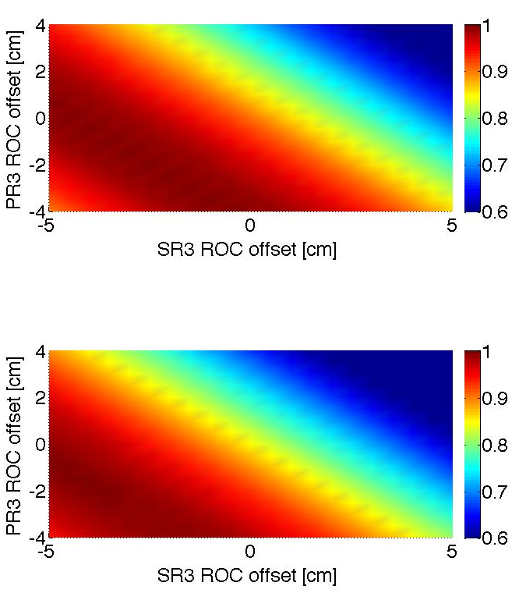
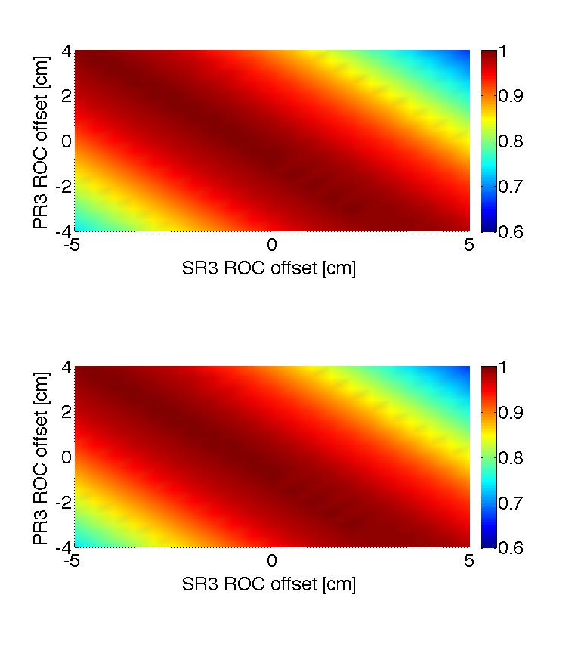
As built parameters
Cold state, with optimal at 12.5W
Optimal parameters for cold state
X
X
Y
Y

Slide 10
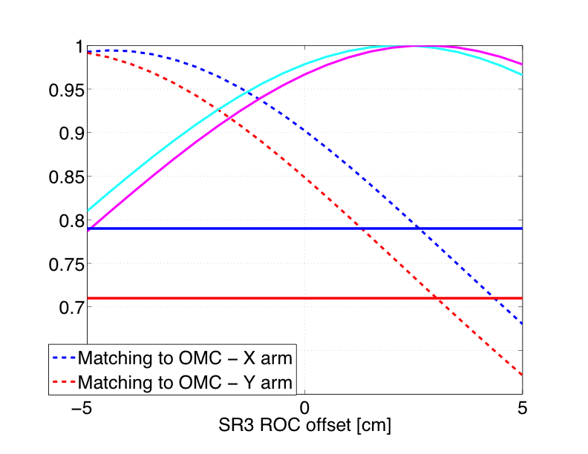
Where are we?
Overlap with measured beam profile after SRM
Measured mode matching with OMC

Slide 11
Where are we?(PR3 ROC as built)
Overlap with measured beam profile after SRM
Measured mode matching with OMC

Slide 12
On the wrong side!

Slide 13
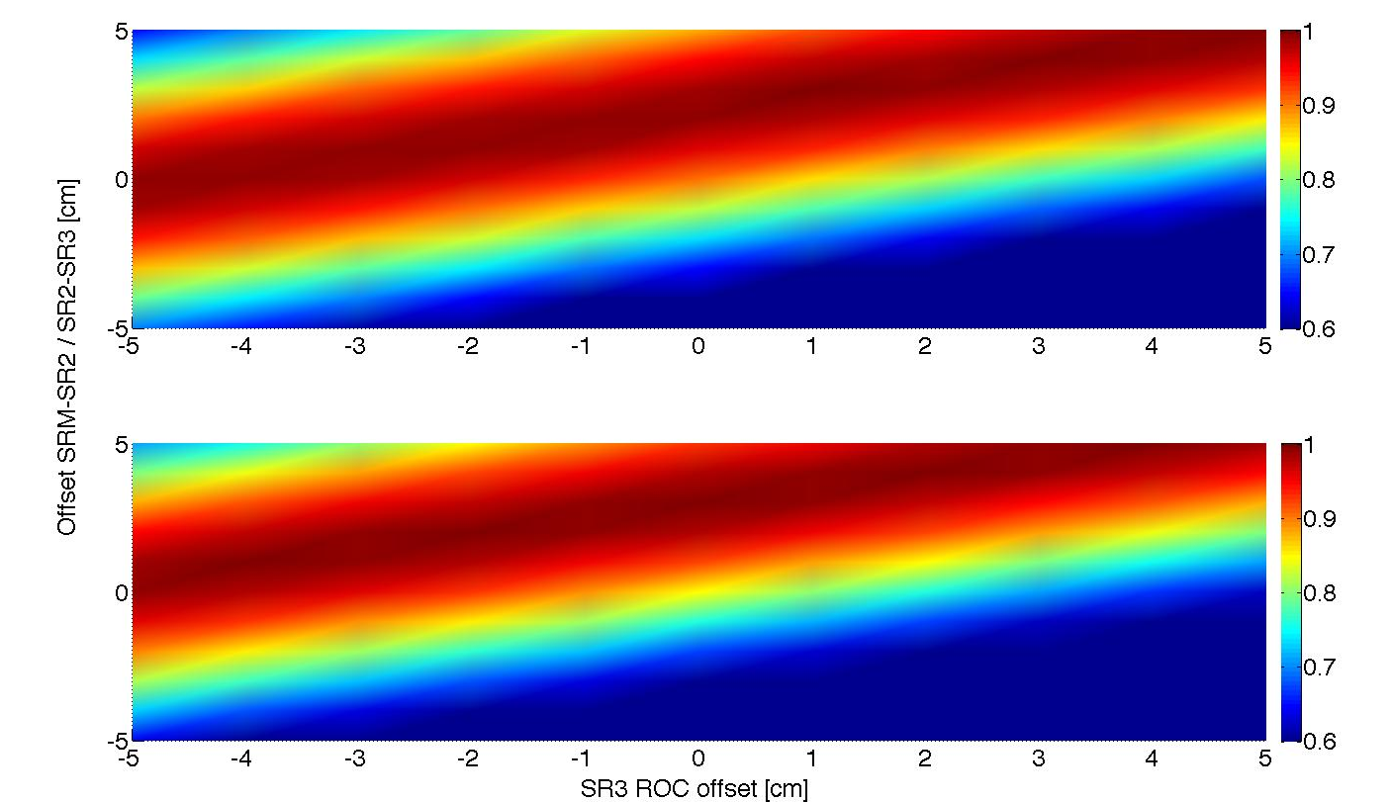
With our tolerances we can’t predict correct lengths
But “correct lengths” do exist! For instance, we can change relative distances SRM-SR2/ SR2-SR3 (total SRC remain the same)

Slide 14
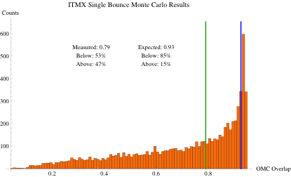
Unlucky? Not particularly, 50% chance

Slide 15
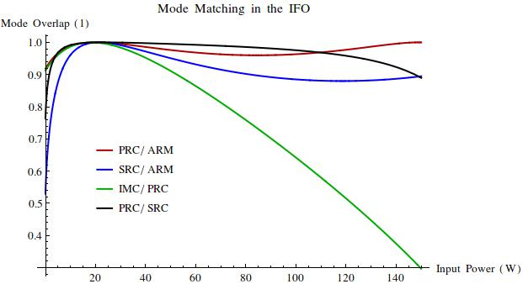
The current parameters are not optimal for 12.5W, but for higher power

Slide 16
Slope in cold state is much steeper

Slide 17
Message
Our recycling cavities are not what we thought we had..
They have been (not intentionally) tuned for being optimally matched at higher power
They are much more sensitive to changes of the optical parameters in the cold state

