Slide 1
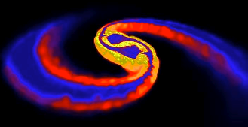
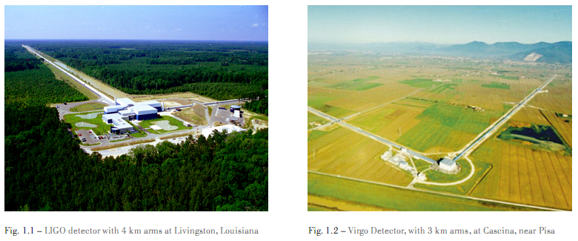
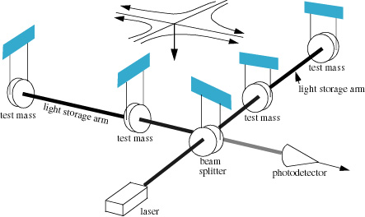
Sources of
Gravitational Waves
TAUP School, September 2013
Gravitational waves
Survey of
astrophysical sources
and signal morphologies
Compact Binary Coalescences
What we can learn:
physics and astrophysics
“Merging Neutron Stars“ (Price & Rosswog)
No discovery
to report here!
Alan Weinstein, Caltech
for the LIGO Scientific Collaboration
LIGO-G1300902

Slide 2
Gravitational wave science
The Study of gravitational waves is at the frontiers of science in at least four different fields:
General Relativity (GR) – physics at the extremes: strong (non-linear) gravity, relativistic velocities
Astrophysics of compact sources – neutron stars, black holes, the big bang – the most energetic processes in the universe
Interferometric gravitational wave detectors – the most precise measuring devices ever built
GW data analysis – the optimal extraction of the weakest signals possible out of noisy data.

Slide 3
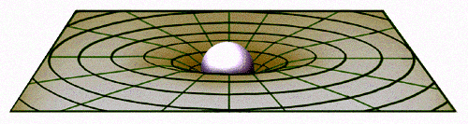
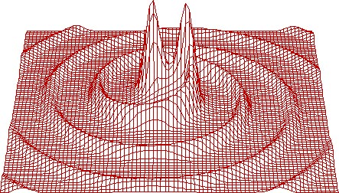
Gravitational Waves
Static gravitational fields are described in General Relativity as a curvature or warpage of space-time, changing the distance between space-time events.
G_{μν}= 8πΤ_{μν}
Shortest straight-line path of a nearby test-mass is a ~Keplerian orbit.
If the source is moving
(at speeds close to c),
eg, because it’s orbiting a companion, the “news” of the changing gravitational field propagates outward as gravitational radiation –
a wave of spacetime curvature

Slide 4
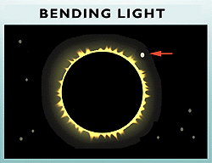
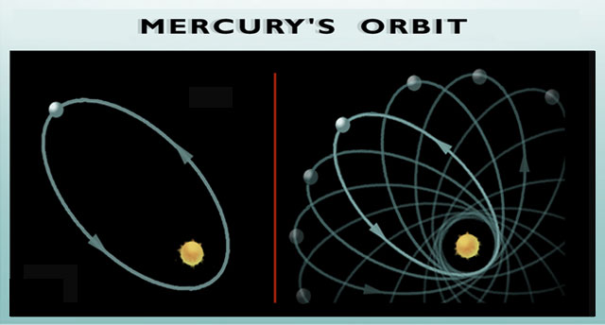
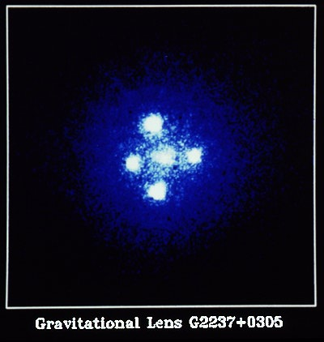
Einstein’s Theory of Gravitation experimental tests
bending of light
As it passes in the vicinity of massive objects
First observed during the solar eclipse of 1919 by Sir Arthur Eddington, when the Sun was silhouetted against the Hyades star cluster
Mercury’s orbit
perihelion shifts forward
twice Post-Newton theory
Mercury's elliptical path around the Sun
shifts slightly with each orbit
such that its closest point to the Sun
(or "perihelion") shifts forward
with each pass.
“Einstein Cross”
The bending of light rays
gravitational lensing
Quasar image appears around the central glow formed by nearby galaxy. Such gravitational lensing images are used to detect a ‘dark matter’ body as the central object

Slide 5
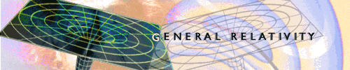
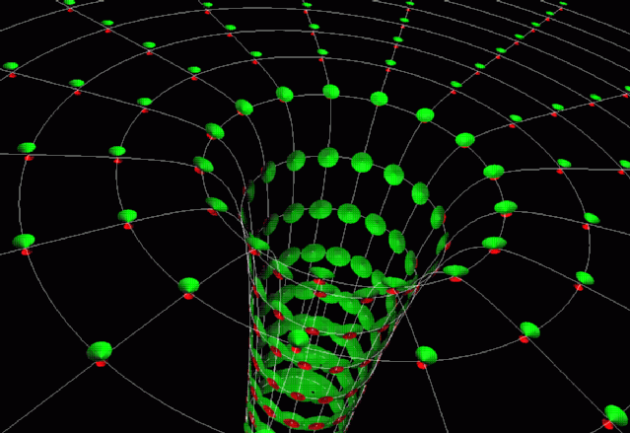
Strong-field
Most tests of GR focus on small deviations from Newtonian dynamics
(post-Newtonian weak-field approximation)
Space-time curvature is a tiny effect everywhere except:
  The universe in the early moments of the big bang
  Near/in the horizon of black holes
This is where GR gets non-linear and interesting!
We aren’t very close to any black holes (fortunately!), and can’t see them with light or other EM radiation…
But we can search for (weak-field) gravitational waves as a signal of their presence and dynamics

Slide 6
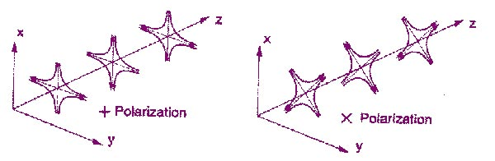
Nature of Gravitational Radiation
General Relativity predicts that rapidly changing gravitational fields produce ripples of curvature in fabric of spacetime
Stretches and squeezes space between
“test masses” – strain h = ΔL / L
propagating at speed of light
  mass of graviton = 0
space-time distortions are transverse
to direction of propagation
GW are tensor fields (EM: vector fields)
two polarizations: plus (⊕) and cross (⊗)
(EM: two polarizations, x and y )
Spin of graviton = 2
h = ΔL / L
Contrast with EM dipole radiation:
))
((
))
))

Slide 7
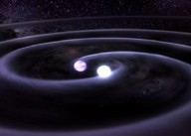

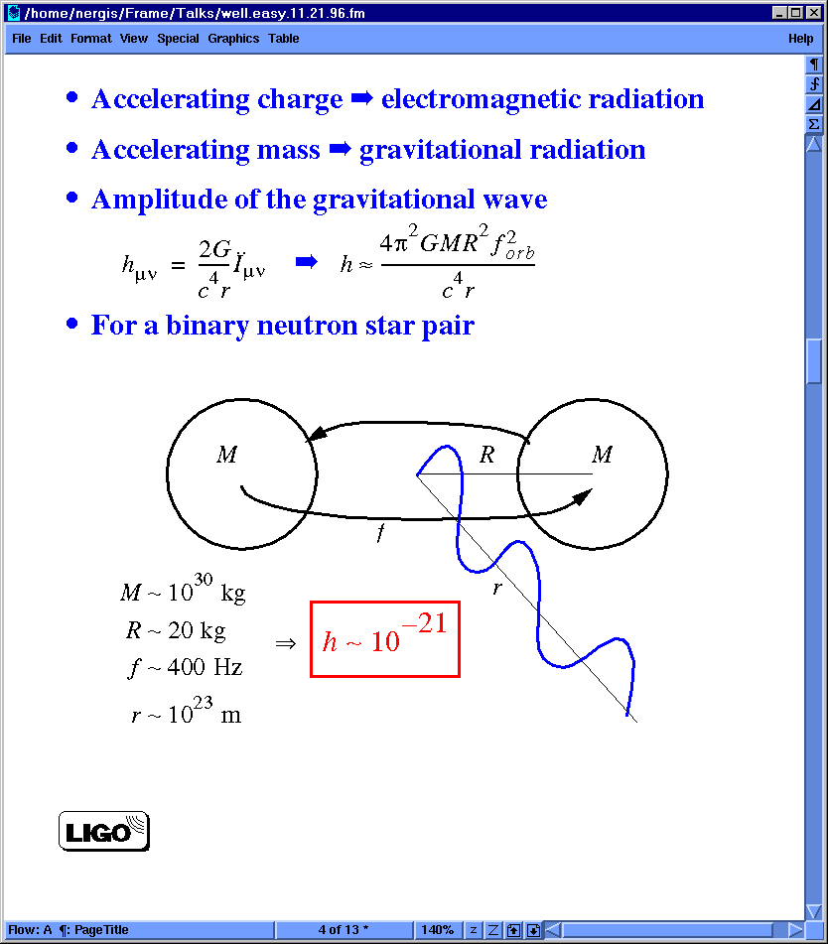

Sources of GWs
Accelerating charge ⇒ electromagnetic radiation (dipole)
Accelerating mass ⇒ gravitational radiation (quadrupole)
Amplitude of the gravitational wave (dimensional analysis):
= second derivative
of mass quadrupole moment
(non-spherical part of kinetic energy
– tumbling dumb-bell)
G is a small number!
(space-time is stiff).
Waves can carry huge energy
with minimal amplitude
Need huge mass,
relativistic velocities, nearby.
For a binary neutron star pair,
10m light-years away, solar masses
moving at 15% of speed of light:
Energy-momentum conservation:
energy cons ⇒ no monopole radiation
momentum cons ⇒ no dipole radiation
⇒ lowest multipole is quadrupole wave
M ~ 10³⁰ kg
R ~ 20 km
f ~ 400 Hz
r ~ 10²³ m
km
Terrestrial sources TOO WEAK!

Slide 8
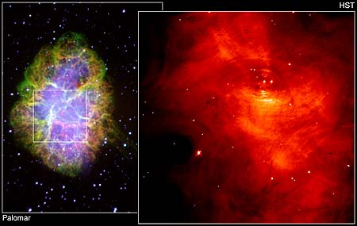
Hulse-Taylor binary pulsar
Neutron Binary System
PSR 1913 + 16 -- Timing of pulsars
17 / sec
•
A rapidly spinning pulsar (neutron star beaming EM radiation at us 17 x / sec)
Orbiting around an ordinary star with
8 hour period
Only 7 kpc away
Discovered in 1975, orbital parameters measured continuously over 25 years!
•
~ 8 hr

Slide 9
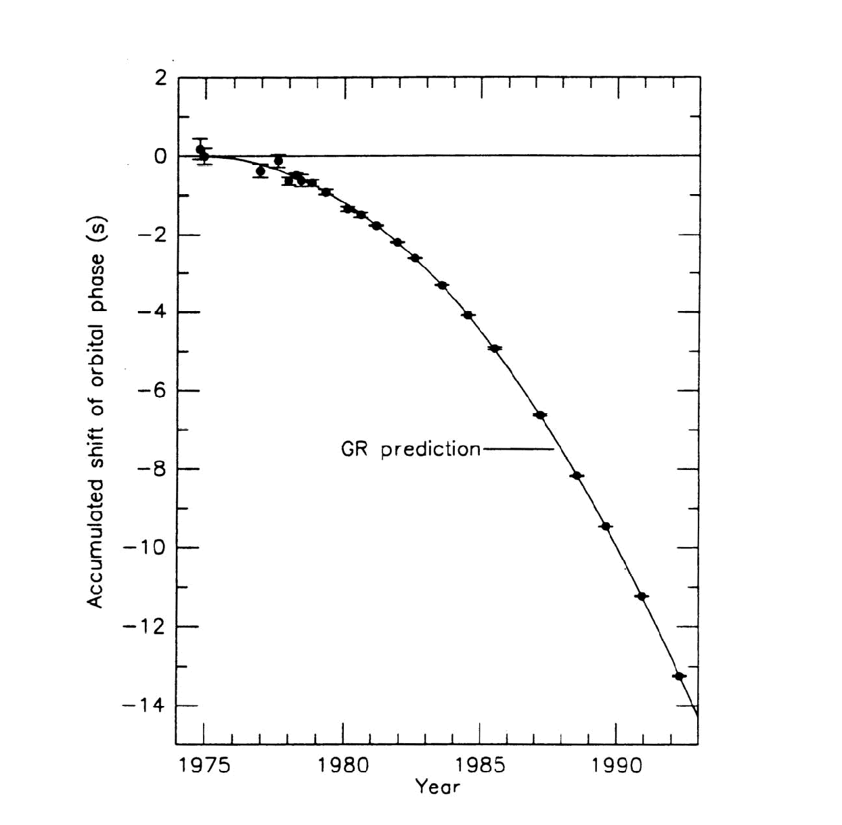
GWs from Hulse-Taylor binary
emission of gravitational waves by compact binary system
Period speeds up 14 sec from 1975-94
Measured to ~50 msec accuracy
Deviation grows quadratically with time
Merger in about 300M years
  (<< age of universe!)
shortening of period ⇐ orbital energy loss
Compact system:
negligible loss from friction, material flow
Beautiful agreement with GR prediction
Apparently, loss is due to GWs!
GW emission will be strongest near the end:
– Coalescence of neutron stars!
Nobel Prize, 1993
By 2013, there are ~8

Slide 10
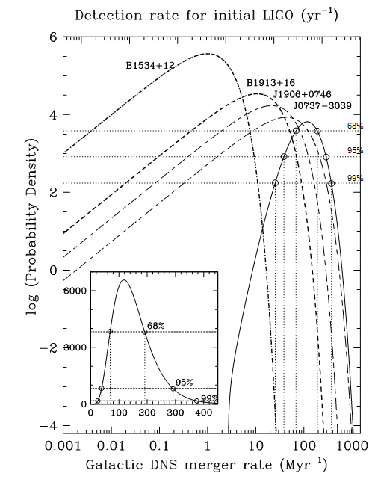
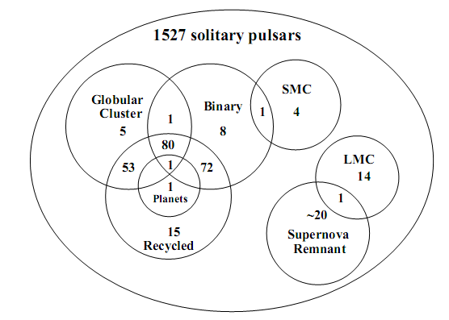

Galactic binary pulsars, and inferred merger rate

Slide 11
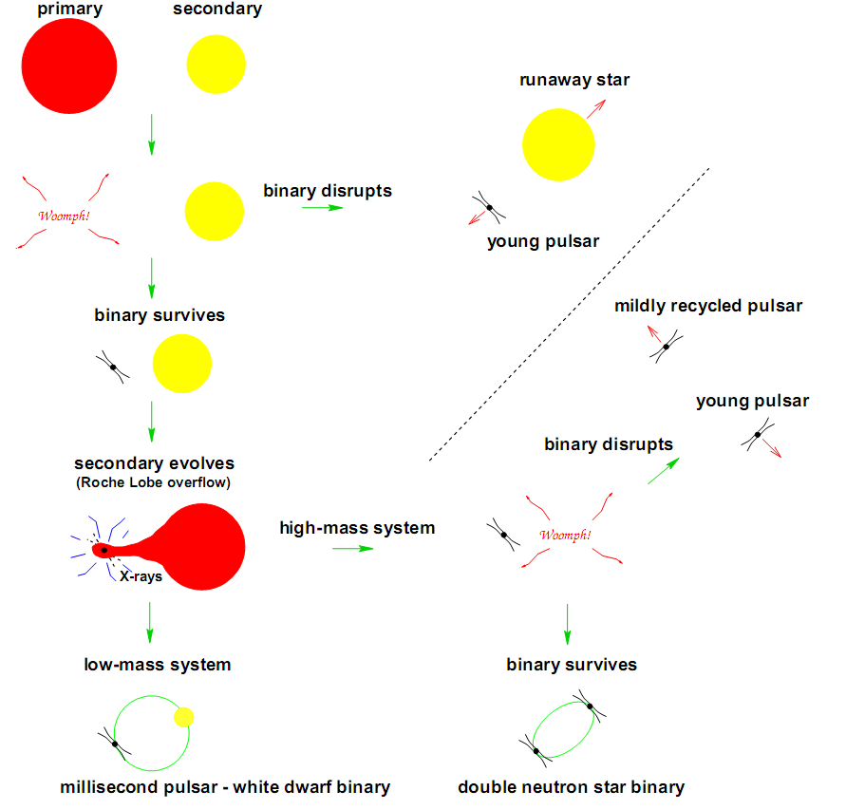
BNS formation scenario

Slide 12
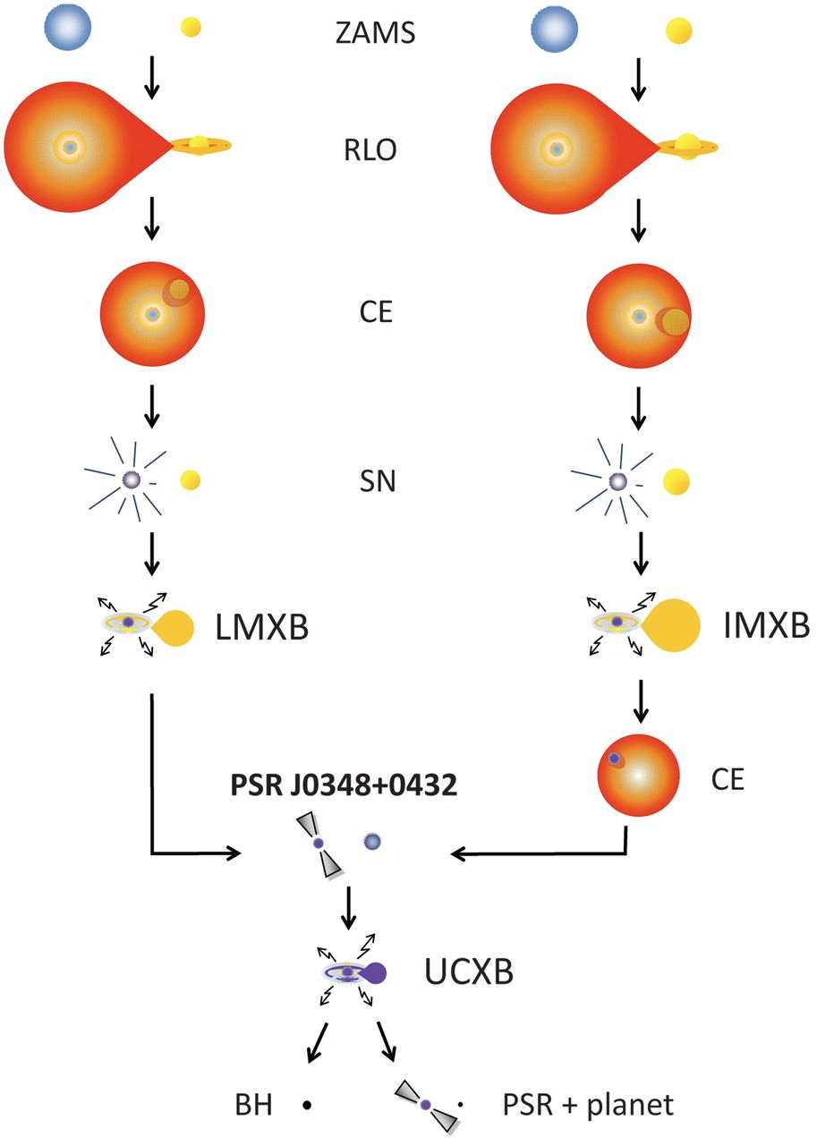
Massive Binary Evolution
These systems are the progenitors of:
Type-1a SNe
Accretion disks
Millisecond pulsars
Low-mass X-ray binaries (LMXB)
High-mass X-ray binaries (HMXB)
Binary neutron stars (BNS)
NS-BH
Binary black holes (BBH)
A Massive Pulsar in a Compact Relativistic Binary
Science 26 April 2013, vol. 340 no. 6131

Slide 13
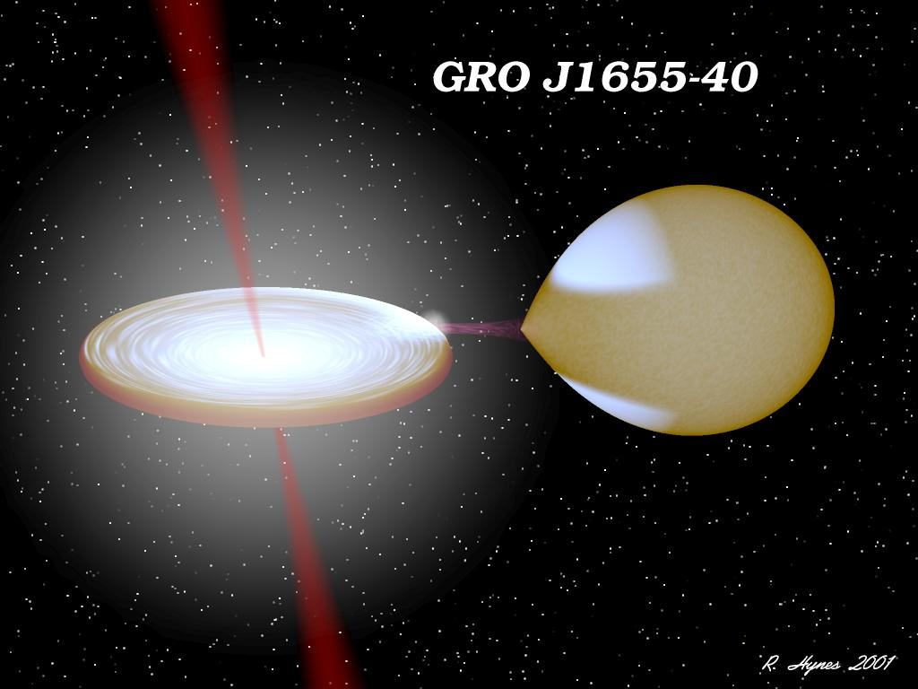
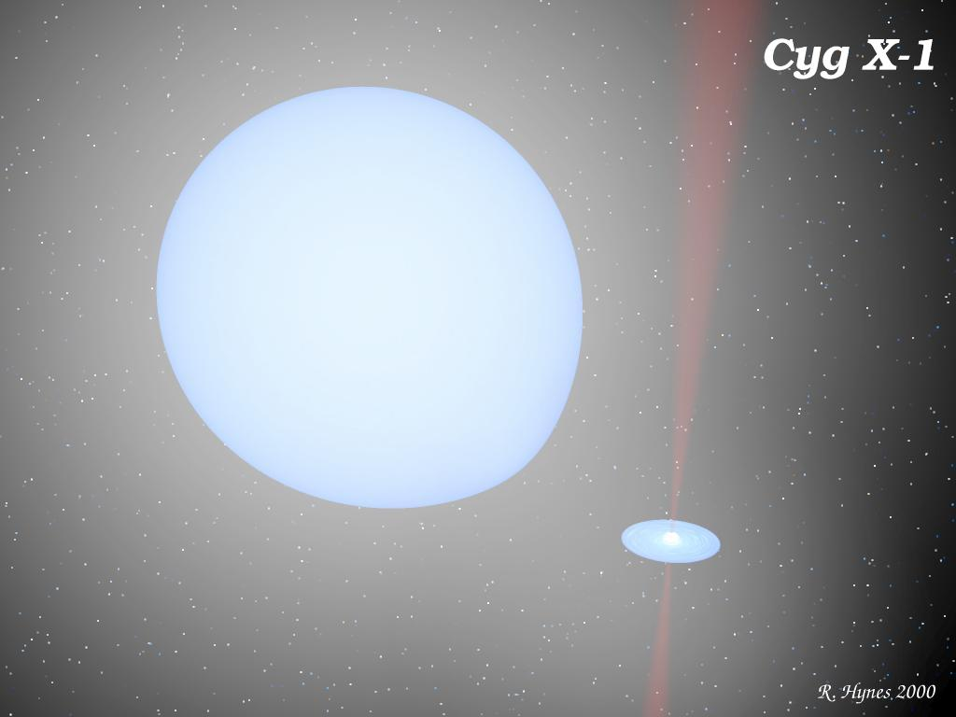
Progenitors of compact binaries
LMXB HMXB
http://www.phys.lsu.edu/~rih/binsim/gallery.html

Slide 14
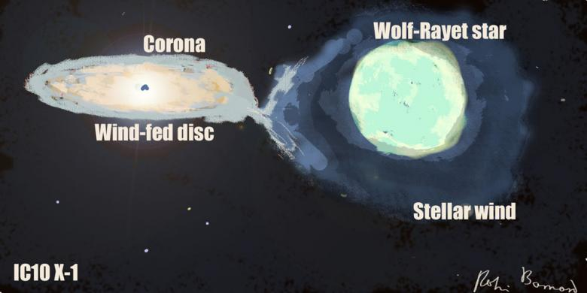
Progenitors of binary black holes
http://www.robinbarnard.com/web_images/ic10-x-1.jpg

Slide 15
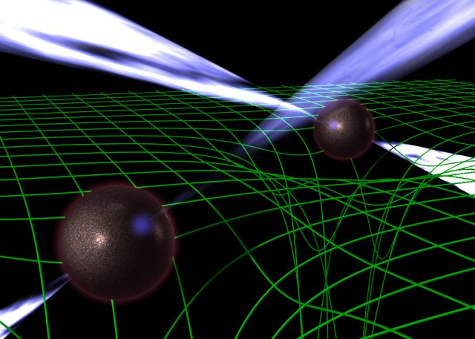
The double pulsar PSR J0737-3039
http://www.jb.man.ac.uk/~pulsar/doublepulsarcd/

Slide 16
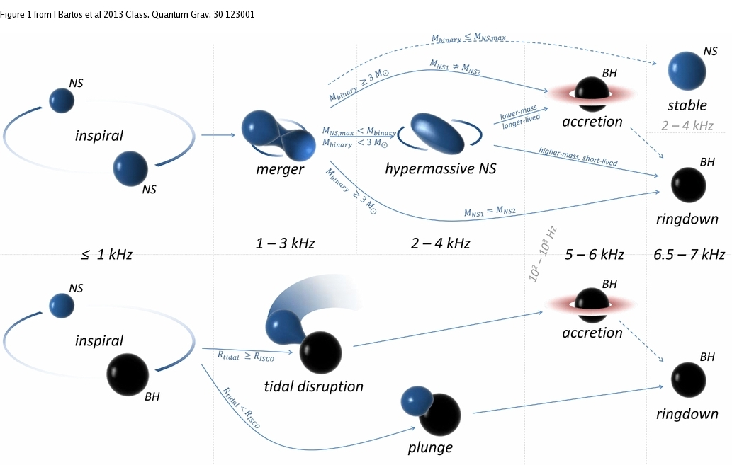
And in the end … binary mergers

Slide 17

Binary neutron star mergers
Daniel Price and Stephan Rosswog

Slide 18
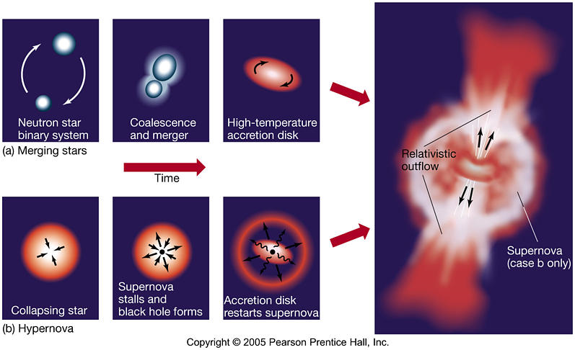
Short-hard and Long-soft GRBs

Slide 19
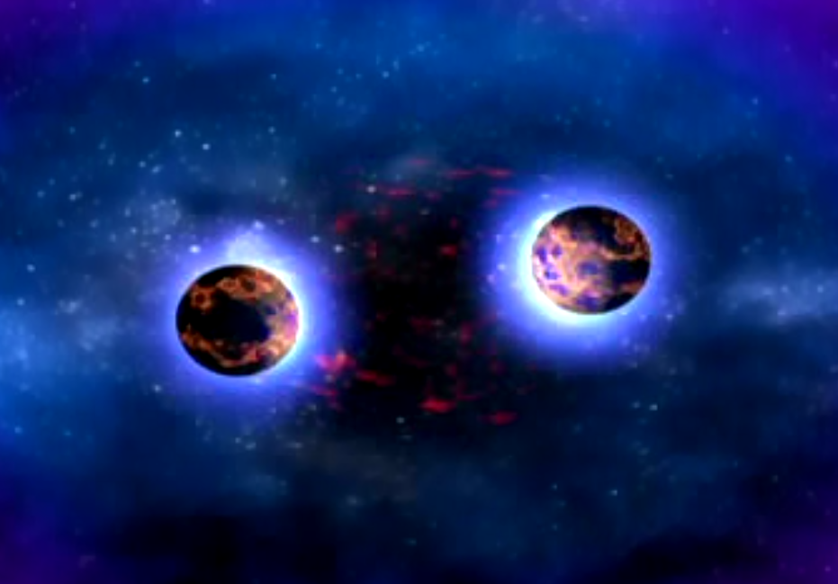
Binary neutron star merger
Dana Berry/NASA
http://www.nasa.gov/mission_pages/swift/bursts/short_burst_nsu_multimedia.html

Slide 20
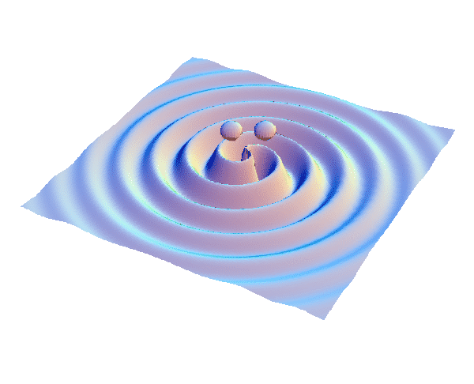
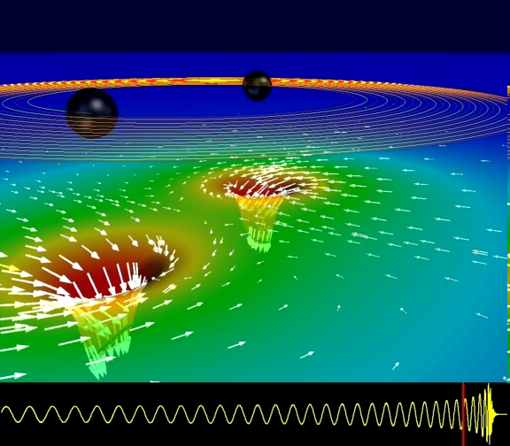
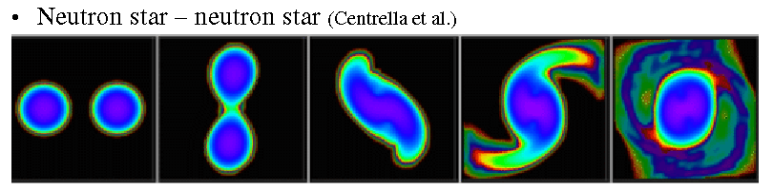
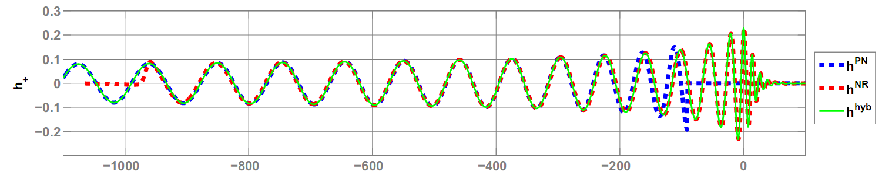
GWs from coalescing compact binaries (NS/NS, BH/BH, NS/BH)
Tidal disruption of neutron star
A unique and powerful laboratory to study
strong-field, highly dynamical gravity
and the structure of nuclear matter
in the most extreme conditions
Gravitational waveform: inspiral merger BH-ringdown
Waveform carries lots of information about binary masses, orbit, merger

Slide 21
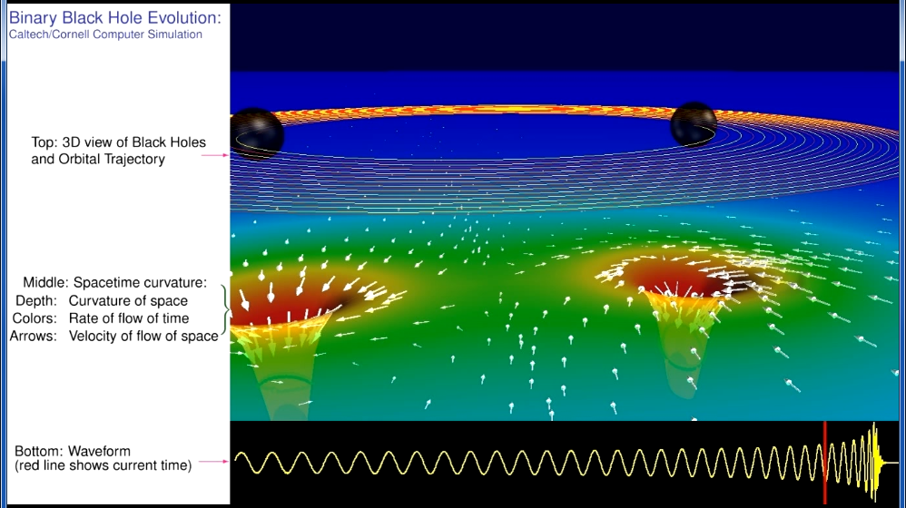
Binary black hole inspiral, merger, ringdown
http://www.black-holes.org/explore2.html

Slide 22
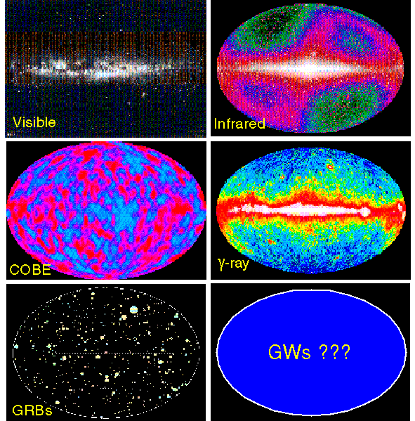
A NEW WINDOW
ON THE UNIVERSE
The history of Astronomy:
new bands of the EM spectrum opened → major discoveries!
GWs aren’t just a new band, they’re a new spectrum, with very different and complementary properties to EM waves.
Vibrations of space-time, not in space-time
Emitted by coherent motion of huge masses
moving at near light-speed;
not vibrations of electrons in atoms
Can’t be absorbed, scattered, or shielded.
GW astronomy is a totally new, unique window on the universe

Slide 23
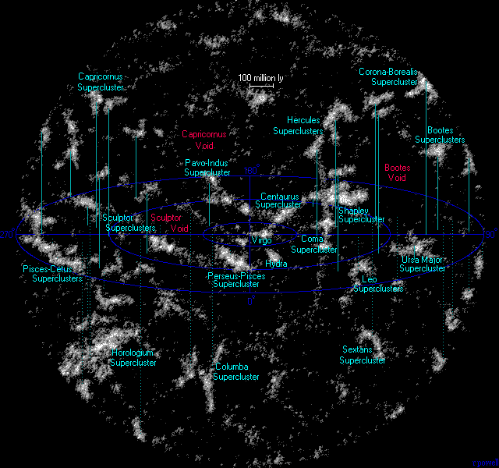
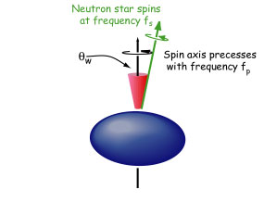
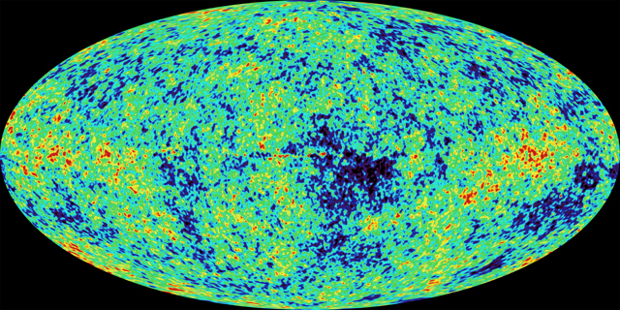
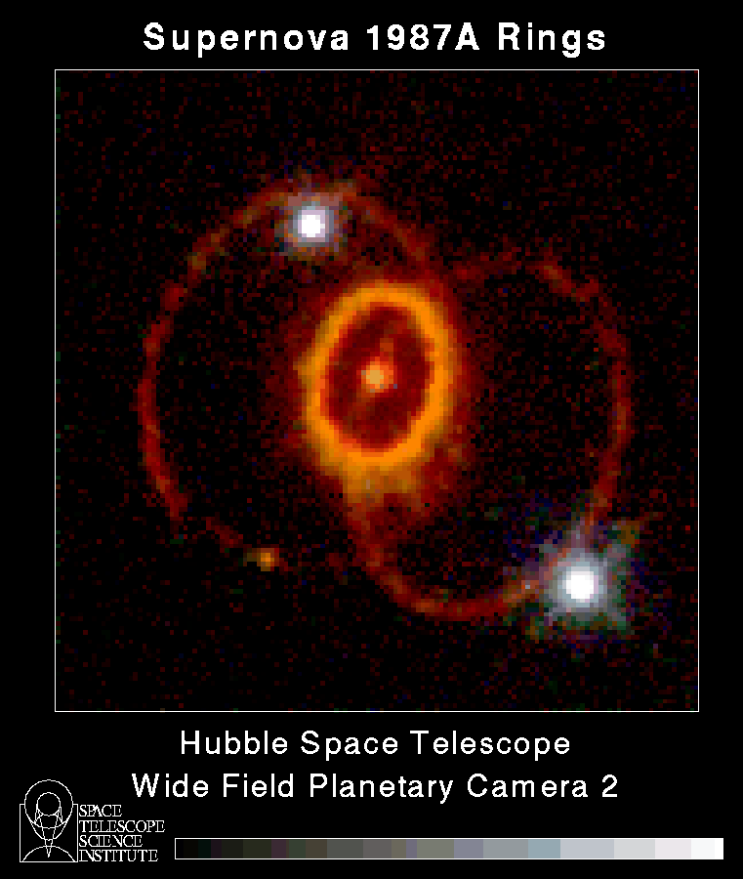
What will we see?
GWs from the most energetic processes in the universe!
Compact Binary Coalescences:
black holes orbiting each other
and then merging together
GW bursts of unknown waveform:
Supernovas, SGRs, GRB engines
Continuous waves from pulsars,
rapidly spinning neutron stars
Stochastic GW background from
vibrations from the Big Bang
Analog from cosmic microwave background -- WMAP 2003

Slide 24
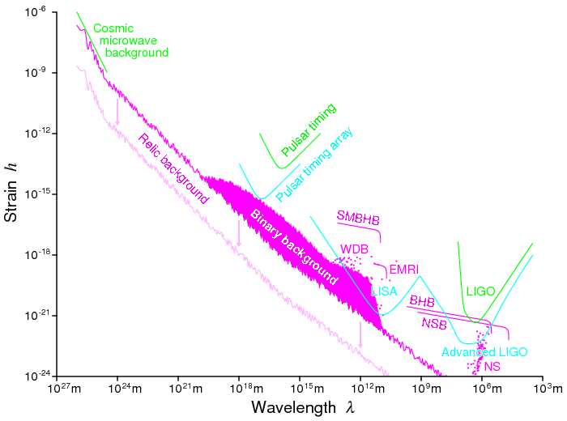
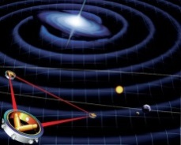
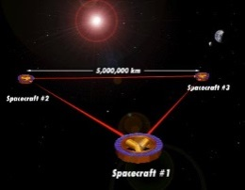
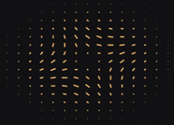
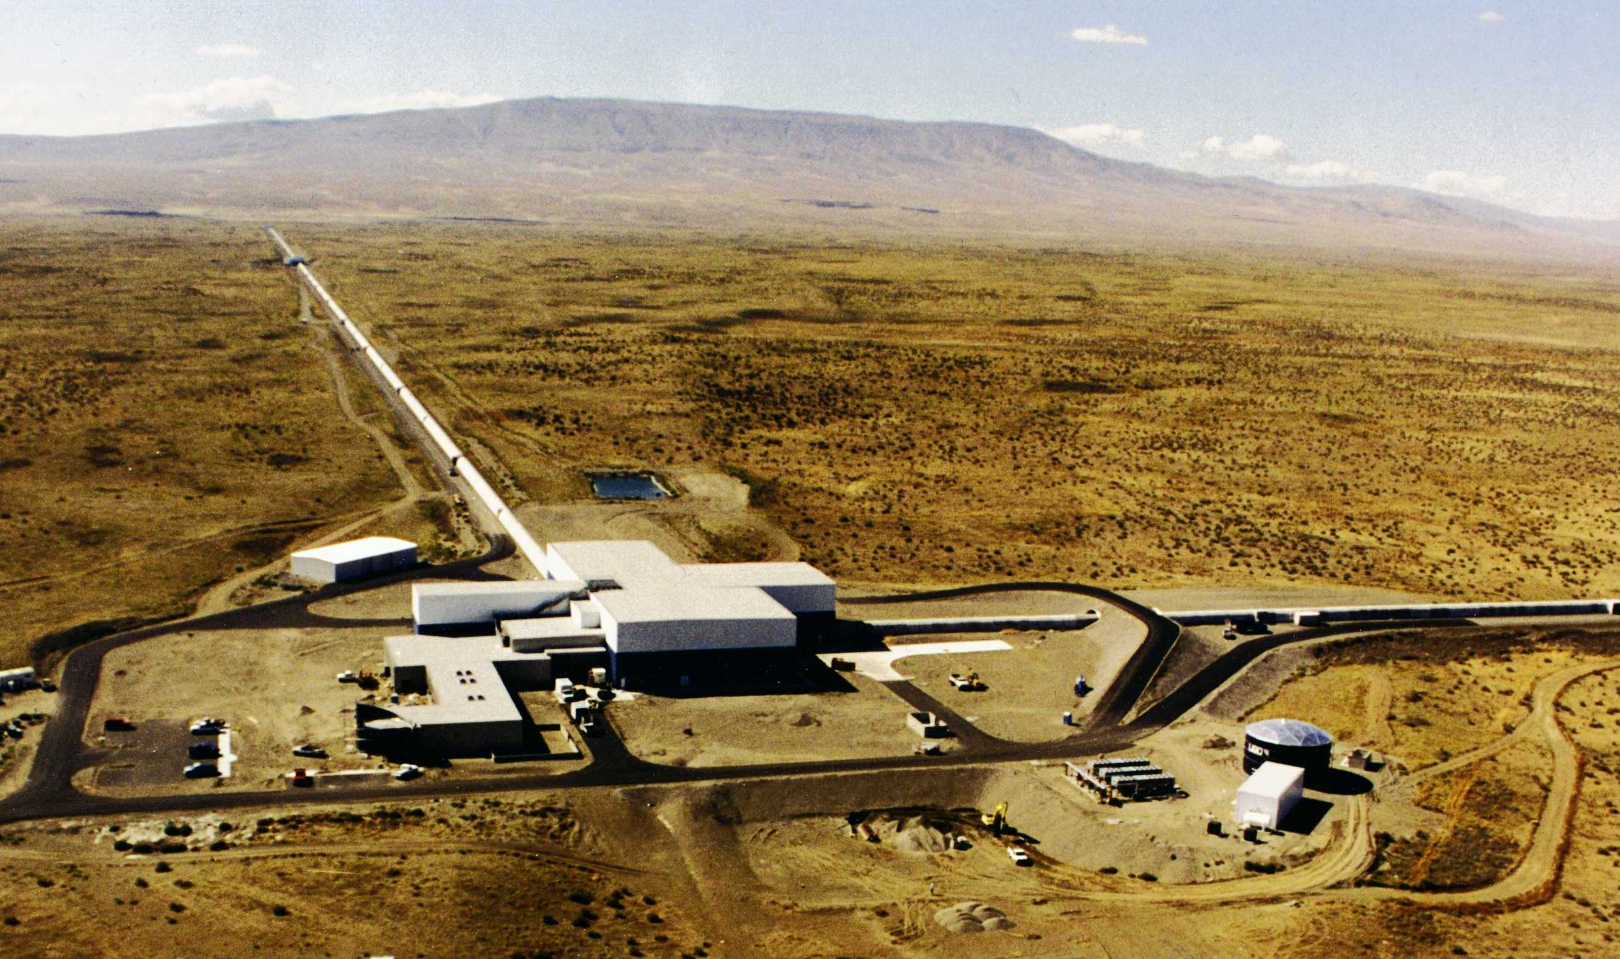
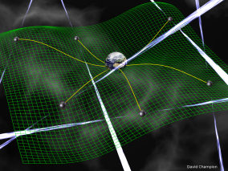
Frequency range of GW Astronomy
CMB B-pol
Space
www.elisa-ngo.org/
Terrestrial
Pulsar timing
http://www.ipta4gw.org/
http://www.tapir.caltech.edu/~teviet/Waves/gwave_spectrum.html
nHz
mHz
Audio band

Slide 25
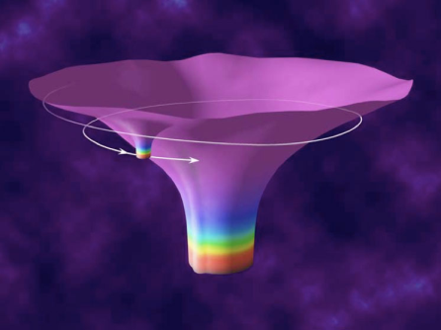
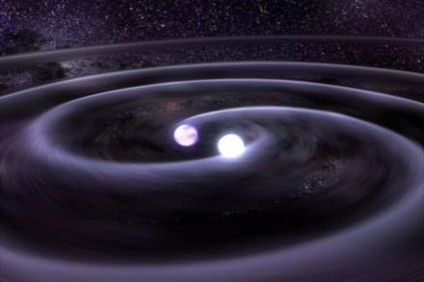

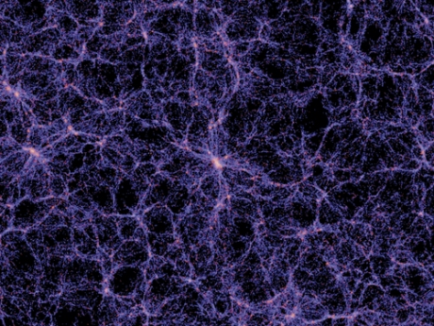

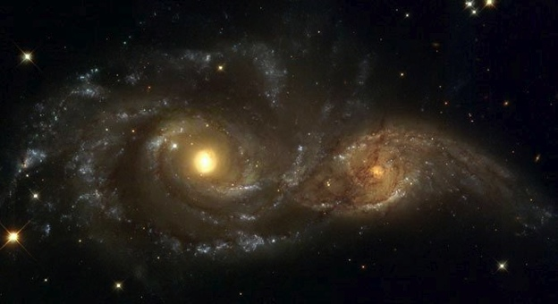
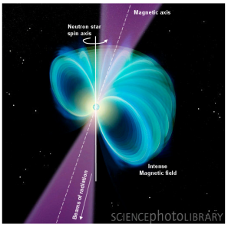

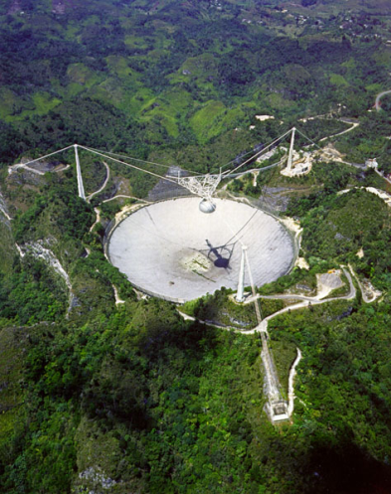
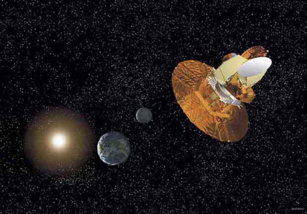
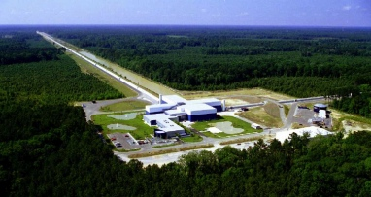




The GW Spectrum
BH and NS Binaries
Supernovae
Cosmic Strings
Relic radiation
Extreme Mass Ratio
Inspirals
Spinning NS
Supermassive BH Binaries
Binary coalescences
10⁻¹⁶ Hz
10⁻⁹ Hz
10⁻⁴ Hz
10⁰ Hz
10³ Hz
Inflation Probe
Pulsar timing
Space detectors
Ground interferometers

Slide 26




GW sources for ground-based detectors:
The most energetic processes in the universe
Coalescing Compact Binary Systems: Neutron Star-NS, Black Hole-NS, BH-BH
- Strong emitters, well-modeled,
- (effectively) transient
Asymmetric Core Collapse Supernovae
- Weak emitters, not well-modeled (‘bursts’), transient
- Cosmic strings, soft gamma repeaters, pulsar glitches also in ‘burst’ class
Credit: Chandra X-ray Observatory
Credit: AEI, CCT, LSU
Spinning neutron stars
- (effectively) monotonic waveform
- Long duration
Cosmic Gravitational-wave Background
- Residue of the Big Bang, long duration
- Long duration, stochastic background
NASA/WMAP Science Team
Casey Reed, Penn State
Notes:
LIGO is designed to be an observatory, not a one-off proof that GWs exist. What do we look for?
There are number of predicted astrophysical sources of gravitational radiation, and most of them involve cataclysmic events.
Binary systems – NSs and BHs, most likely source, theoretically well understood with known waveforms
Bursts – GW emissions that are not well modeled or understood. These include asymmetrically core collapse supernova, cosmic strings, and perhaps unknown sources
The residual GW background
Continuously emitting sources such as spinning neutron stars, which have a pure monotone emission.

Slide 27
GWs from coalescing compact binaries (NS/NS, BH/BH, NS/BH)
Tidal disruption of neutron star
A unique and powerful laboratory to study
strong-field, highly dynamical gravity
and the structure of nuclear matter
in the most extreme conditions
Gravitational waveform: inspiral merger BH-ringdown

Slide 28




Unmodeled, short-duration
(<~ 1 s) GW Bursts
Gravitational waves
Magnetar flares / storms
Core collapse supernova
High-mass
binary merger
and ringdown
Credit: Chandra
X-ray Observatory
Credit: C. Ott

Slide 29





Gravitational waves from Big Bang
Waves now in the LIGO band were produced 10⁻²² sec after the big bang
380,000
YEARS
13.7 billion
YEARS
GWs
GUT
νs
cosmic microwave background -- WMAP 2003
γs
DM,DE
NOW

Slide 30







Pulsars and continuous wave sources
Pulsars in our galaxy
  non axisymmetric: 10-4 < ε < 10-6
  science: EOS; precession; interiors
  “R-mode” instabilities
  narrow band searches best
NASA
(NASA/CXC/SAO)
R-modes
NASA

Slide 31
Frequency-Time
Characteristics of GW Sources
time
Ringdowns
Broadband Background
Bursts
frequency
CW (quasi-periodic)
Chirps
Earth’s orbit
Earth’s rotation
frequency
frequency
time
time

Slide 32



Astrophysics with joint
GW – EM observations
Short-hard GRBs, with or without the GRB
  Confirm (or rule out) merger progenitor
  Study progenitor systems, including
  orientation and beaming
  Relate GW and EM energy release
  Relate merger parameters to hosts
  (metallicity, SFR, …)
Follow-ups: detect optical afterglow, host galaxy, redshift…
  Low latency pipeline, sky localization
CBC mergers as cosmological standard sirens.
  Independent measurement of Hubble constant
  a(z), dark energy EoS
http://astro.hi.is/grb.php

Slide 33
GW and EM
Multi-messenger Astronomy
Gravitational Waves:
  Bulk motion dynamics
  Binary parameters
  Direct probe of central engine
  Progenitor mass
  GW energetics
  Luminosity distance
Light Curve & Spectrum:
  Precise sky location
  Host galaxy
  Gas environment
  Progenitor star
  EM energetics
  Red shift
more complete picture of progenitor physics
Combining these observations will also
increase detection confidence,
allow a measurement of the local Hubble constant.
Notes:
Coupled observations with GW observations can lead to refined models of the system:
GW signals directly trace the bulk motion of the mass in the source
EM signals refine source position from degrees to arcseconds and can give redshift information

Slide 34


The sound of a chirp
BH-BH collision, no noise
The sound of a BH-BH collision,
Fourier transformed over 5 one-second intervals
(red, blue, magenta, green, purple)
along with expected IFO noise (black)

Slide 35

Horizon distance for compact binary mergers
Horizon distance: Distance in Mpc at which one Advanced LIGO detector can see an optimally-located, optimally oriented binary merger with an SNR=8, as a function of total mass.
Averaging over sky location and orientation degrades this by ~2.26.
Important to use the right templates, including IMR, and spin effects!
Experience from Initial LIGO-Virgo suggests that reliable detection is possible with an average SNR/detector ~ 8.
Inspiral-merger-ringdown
EOB template (light-ring)
ringdown template
Horizon distance (Mpc)
Inspiral-only template (ISCO)
M (Msun)
P. Ajith (2009)

Slide 36

Expected detection rate:
How many sources can we see?
CBC waveforms have known amplitude
h ~ (GM/c²r) × F(α,δ,ι)
Measured detector sensitivity defines a horizon distance
This encloses a known number of sources:
MWEG = 1.7×10¹⁰ L_{s} =1.7 L₁₀
From galactic binary pulsars:
R(BNSC) ~10-170 /Myr/L₁₀
From population synthesis:
R(BBHC) ~0.1 - 15 /Myr/L₁₀
To see more than 10 events/yr,
we need to be sensitive to
10⁵ - 10⁷ galaxies!
S4
S5
aLIGO
Kopparapu etal ApJ 675 (2008) 1459

Slide 37

Expected ranges of binary merger rates
Estimates of astrophysical event rate
(mergers / Mpc³ / yr) from known NS-NS
close binaries in our galaxy, and population synthesis models.
  LVC, Class. Quant. Grav. 27 (2010) 173001
Detection range in Mpc (SNR = 8 in one detector, averaged over source sky location and orientation) based on aLIGO Mode 1b noise model (P=125 W, T_{SRM}=20%, F_{SRM}=0° )
10⁻⁷ mergers / Mpc³ / yr
Limits from Initial LIGO
Expected range
NS-NS NS-BH BH-BH
System | Masses (M_{sun}) | Range (Mpc) | Low rate est. (yr⁻¹) | Realistic rate (yr⁻¹) | High rate est. (yr⁻¹)
NS-NS | 1.4/1.4 | 200 | 0.4 | 40 | 400
NS-BH | 1.4/10 | 410 | 10 | 300
BH-BH | 10/10 | 970 | 20 | 1000

Slide 38



Astrophysical science with binary mergers
Merger rates as function of mass, mass ratio, spin
  Establish existence of black hole binaries
  Neutron star mass distribution
  Black hole number, mass, spin and location distribution
  Search for intermediate-mass black holes
Inform / constrain astrophysical source distribution models
  Extract population synthesis model parameters.
  Binary formation and evolution history
  Explore hierarchical merger scenarios
Study matter effects in waveform: tidal disruption, NS EOS.
ciera.northwestern.edu/rasio

Slide 39

Understanding
Inspiral-Merger-Ringdown
The key to optimal detection is a well-modeled waveform, especially the phase evolution
Low-mass systems (BNS) merge above ~1500 Hz, where LIGO noise is high - we see the inspiral
Higher-mass systems (BBH) merge or ring down
in-band.
These systems are unique: highly relativistic, dynamical, strong-field gravity – exactly where Einstein’s equations are most non-linear, intractable, interesting, and poorly-tested.
Numerical relativity is devoted to deriving waveforms for such systems, to aid in detection and to test our understanding of strong-field gravity.
HUGE progress in the last few years!

Slide 40


Effects of tidal disruption of neutron stars near merger
Credit: Daniel Price and Stephan Rosswog
iLIGO
aLIGO
ET

Slide 41




Testing General Relativity in the strong-field, dynamical regime
Test post-Newtonian expansion of inspiral phase.
Test Numerical Relativity waveform prediction
for merger phase.
Test association of inspiral and ringdown phases:
BH perturbation theory, no-hair theorem.
EOB-NR
www.black-holes.org
nonlocal.com/hbar/blackholes.html

Slide 42

Testing beyond-GR
Constrain beyond-GR parameters (Will, 2006)
Directly measure speed of gravitational waves,
constrain (or measure) the mass of the graviton.
Constrain (or measure) longitudinal or other polarizations.
Constrain (or measure) parity-violating effects in wave generation/propagation (Yunes et al, 2010).
Constrain “parameterized post-Einsteinian framework”
(Yunes & Pretorius, 2009)
Test specifically for scalar-tensor and other alternative-gravity theories
Beyond Einstein

Slide 43
… Fin …
We look forward to the coming advanced detector era:
the discovery and exploration of the GW sky;
unique tests of General Relativity in the strong-field, highly non-linear and dynamical regime;
joint observations and discoveries with EM and neutrino telescopes;
and a rich new branch of astrophysics.
But most of all, we look forward to …
the unexpected!

