Slide 1
Controlling Transient Thermal Effects in High-Power Gravitational-Wave Detectors
Arnaldo Rodríguez
Mentor: Dr. Aidan Brooks
California Institute of Technology
LIGO Scientific Collaboration

Slide 2
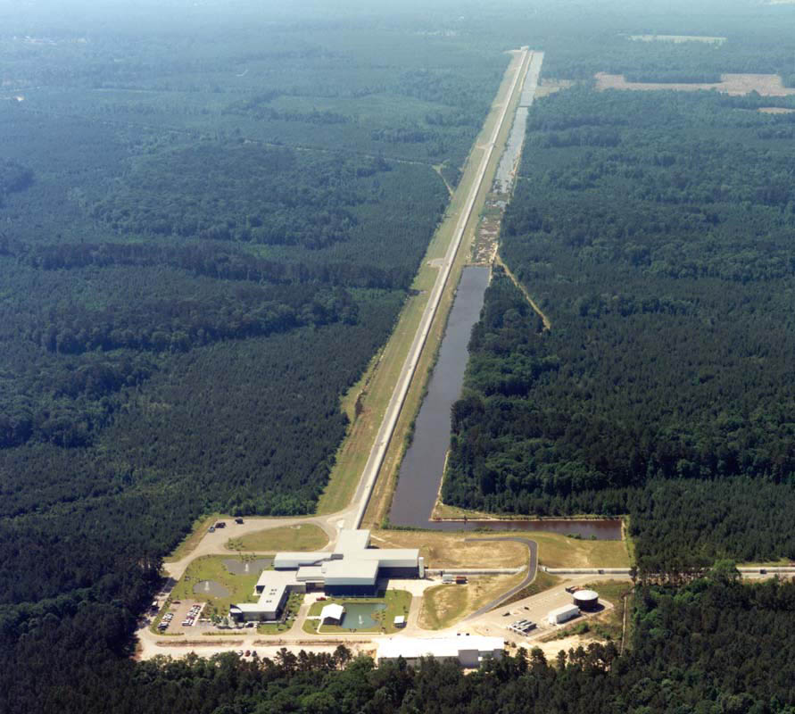
Presentation Outline
Why high power?
Transient thermal effects
The TCS
Controlling thermal effects
Models
Results

Slide 3
Why high-powered laser operation?
High-frequency gravitational-wave emitters (like compact binary mergers) could reveal interesting physics we don’t fully understand yet.
However, detecting high-frequency waves requires overcoming fundamental noise sources that affect the signal.
Credit: NASA / Goddard Space Flight Center

Slide 4
Why high-powered laser operation?
Above ~150 Hz, Advanced LIGO’s noise floor is dominated by quantum shot noise.
Increasing the laser power increases strain sensitivity, but causes self-heating in the test masses that must be addressed & controlled.
$$h∝1/\sqrt{P}$$

Slide 5
Transient thermal effects
Thermoelastic effects
Thermorefractive effects
Occur as a result of thermal expansion.
These lead to surface deformations in the test-mass.
Occur as a result of the thermo-optic effect.
These lead to spatially-dependent refractive indices.
Both induce optical wavefront aberrations.

Slide 6
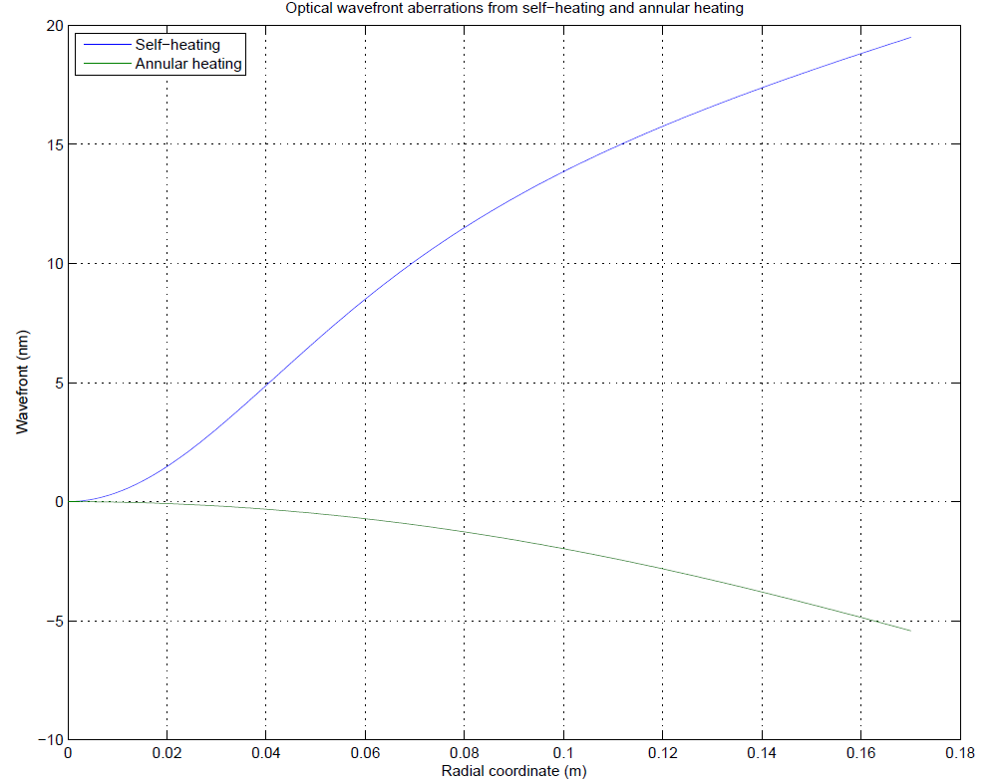
Characterizing optical aberrations
Gaussian distortion
Mostly parabolic distortion

Slide 7
The TCS: A Diagram
SLED
Corrects thermoelastic aberrations
Hartmann
Sensor
ring heater
Corrects thermorefractive aberrations
CP
ITM
Senses optical wavefront aberrations
CO2 laser projector
Credit: Dr. Aidan Brooks

Slide 8
TCS controller model
A PID (proportional-integral-derivative) controller model was developed in MATLAB using finite difference methods to minimize optical aberrations.
The controller reads an error signal (the defocus) and calculates an actuation (emitted power) which is determined by the given controller gains.
$$u\left(t\right)=K_{p}e\left(t\right)+K_{i}\int_{0}^{t}{e\left(t\right)dt}+K_{d}\frac{d(e\left(t\right))}{dt}$$
Power to be emitted
Contributes the bulk of output change
Corrects steady-state error
Decreases settling time

Slide 9
Finite element model
A finite element model was developed in COMSOL to simulate the thermal effects in the ITM/ETM.
The model includes self-heating and ring heater thermal effects.

Slide 10
Controlling optical aberrations
Combining the controller model with the finite element heating model allows for a dynamic simulation of transient thermal effects in the test mass.
COMSOL model simulates thermal effects in the test mass.
MATLAB controller model calculates defocus & actuation.
Actuation power passed to the COMSOL model; cycle repeats.
However, communication overhead between MATLAB and COMSOL limits applicability; other methods should be tried.

Slide 11
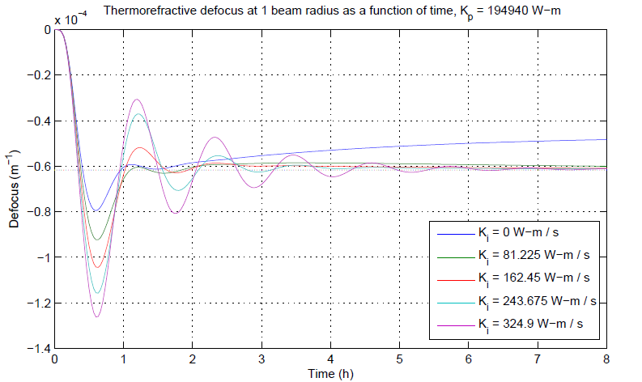
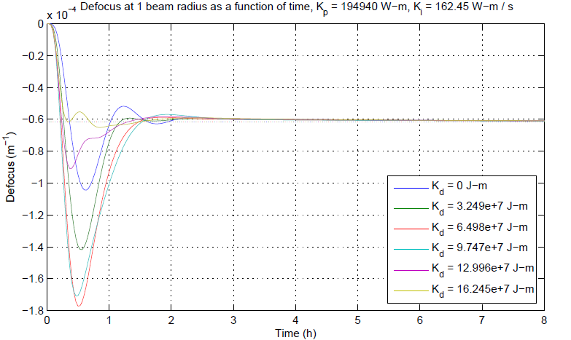
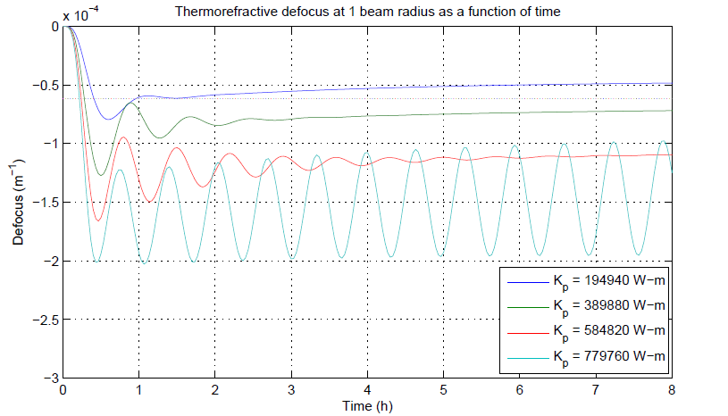
Controlling optical aberrations

Slide 12
Wavefront predictor
From a rectangle signal…
The predictor uses the principle of superposition and the digital nature of the actuation to recreate a digital signal response from unit rectangle signal response data.
It does not require finite element analysis, and is extremely time-efficient (~ 300 times faster than COMSOL+MATLAB model!)
It approximates nonlinear thermal behavior, namely radiation, as linear.
To a digital one!

Slide 13
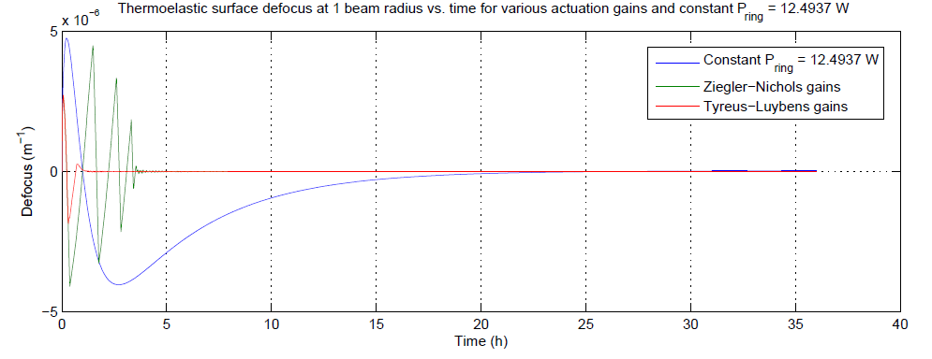
Results: Active vs. passive correction
Settles ~15 times faster!

Slide 14
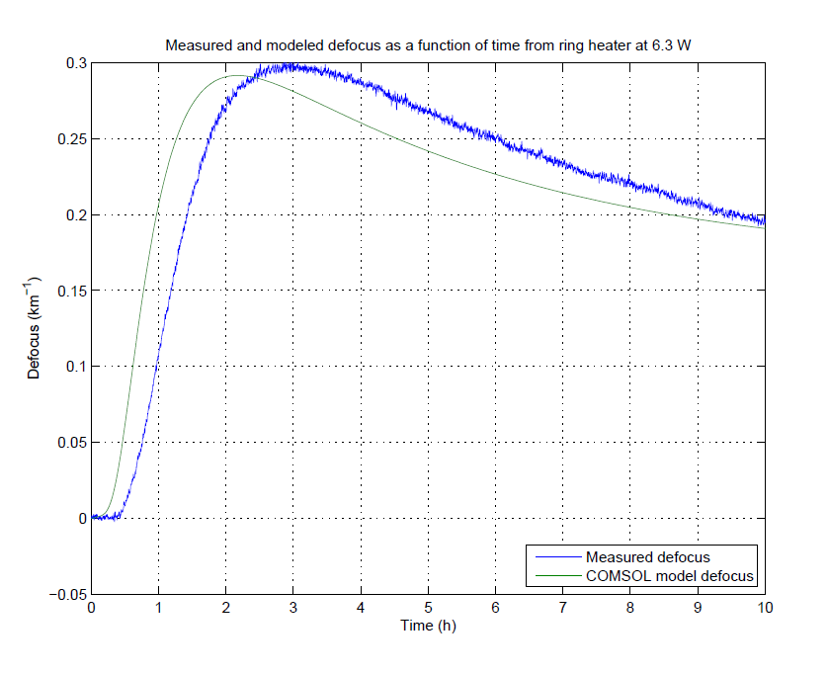
Results: Experiment vs. Models
Aidan’s model…
…and my model!
Both models show a similar deviation from experiment.

Slide 15
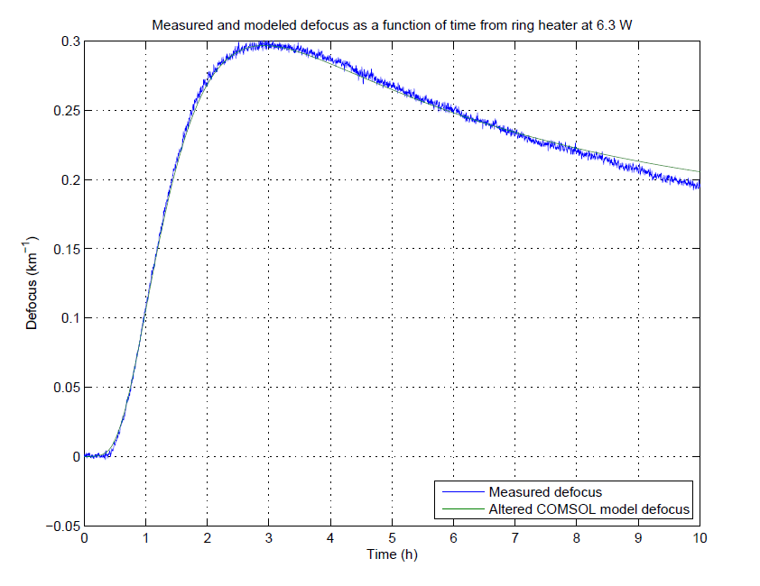
Results: Experiments vs. Models
In an attempt to diagnose the problem, a thermal parameter study was conducted to trace the root of the discrepancy.
By adding a turn-on time constant of ~1200 s to the ring heater and lowering the thermal conductivity ~5%, we get…
Non-trivial discrepancy unrelated to material thermal properties!

Slide 16
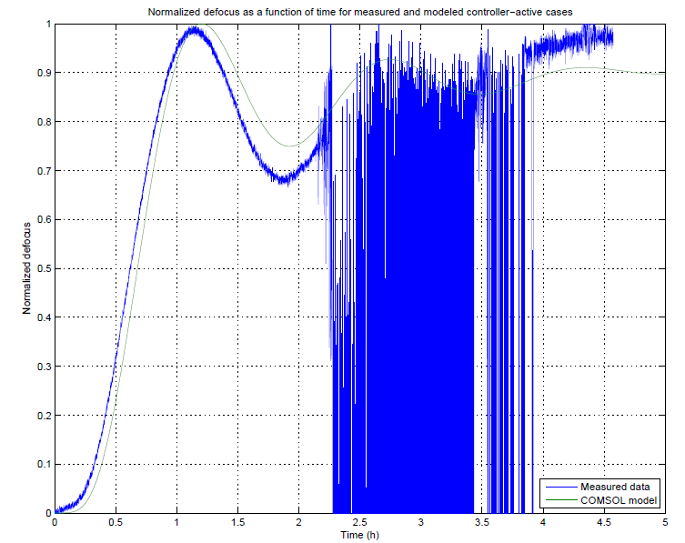
Results: Experiments vs. Models
A full comparison was done for a controller-active case.
Experiment appears to react quicker than the altered COMSOL model; some data corrupted from earthquake.
Clear discrepancy: needs to be further studied.
M 6.2 earthquake!

Slide 17
Future Work
Conclusively identify source of model/experiment discrepancy.
Include CO₂ laser projector & compensation plate into heating model; simulate full TCS.
Quantify higher-order mode losses and compare to experiment.
Investigate how TCS affects other control systems’ performance (ACS, etc.).

Slide 18
Acknowledgements
Dr. Aidan Brooks
My fellow SURFs
Caltech
LIGO Scientific Collaboration
NSF

Slide 19
References
Brooks, A., Thermal Compensation for Advanced LIGO, LIGOG1300218-v1, 2013.
Arain, M., Quetschke, V., Gleason, J., Williams, L., Rakhmanov, M., Lee, J., Cruz, R., Mueller, G., Tanner, D., Reitze, D., Adaptive beam shaping by controlled thermal lensing in optical elements, Optical Society of America, United States of America, 2007.
Hello, P., Vinet, J., Analytical models of thermal aberrations in massive mirrors heated by high power laser beams, Université Paris-Sud, France, 1990.

