Slide 1
Modeling the Calibrated Response of the Advanced Ligo Detectors
Luke Burks
2013 LIGO Caltech SURF
Mentors: Alan Weinstein, Jameson Rollins
Final Presentation

Slide 2
Project Goals
Reproduce the GW strain with noise signal as accurately as possible from the error (eD) and control (sD) signals.
Our Project: Construct R-1, the Inverse Response Function

Slide 3
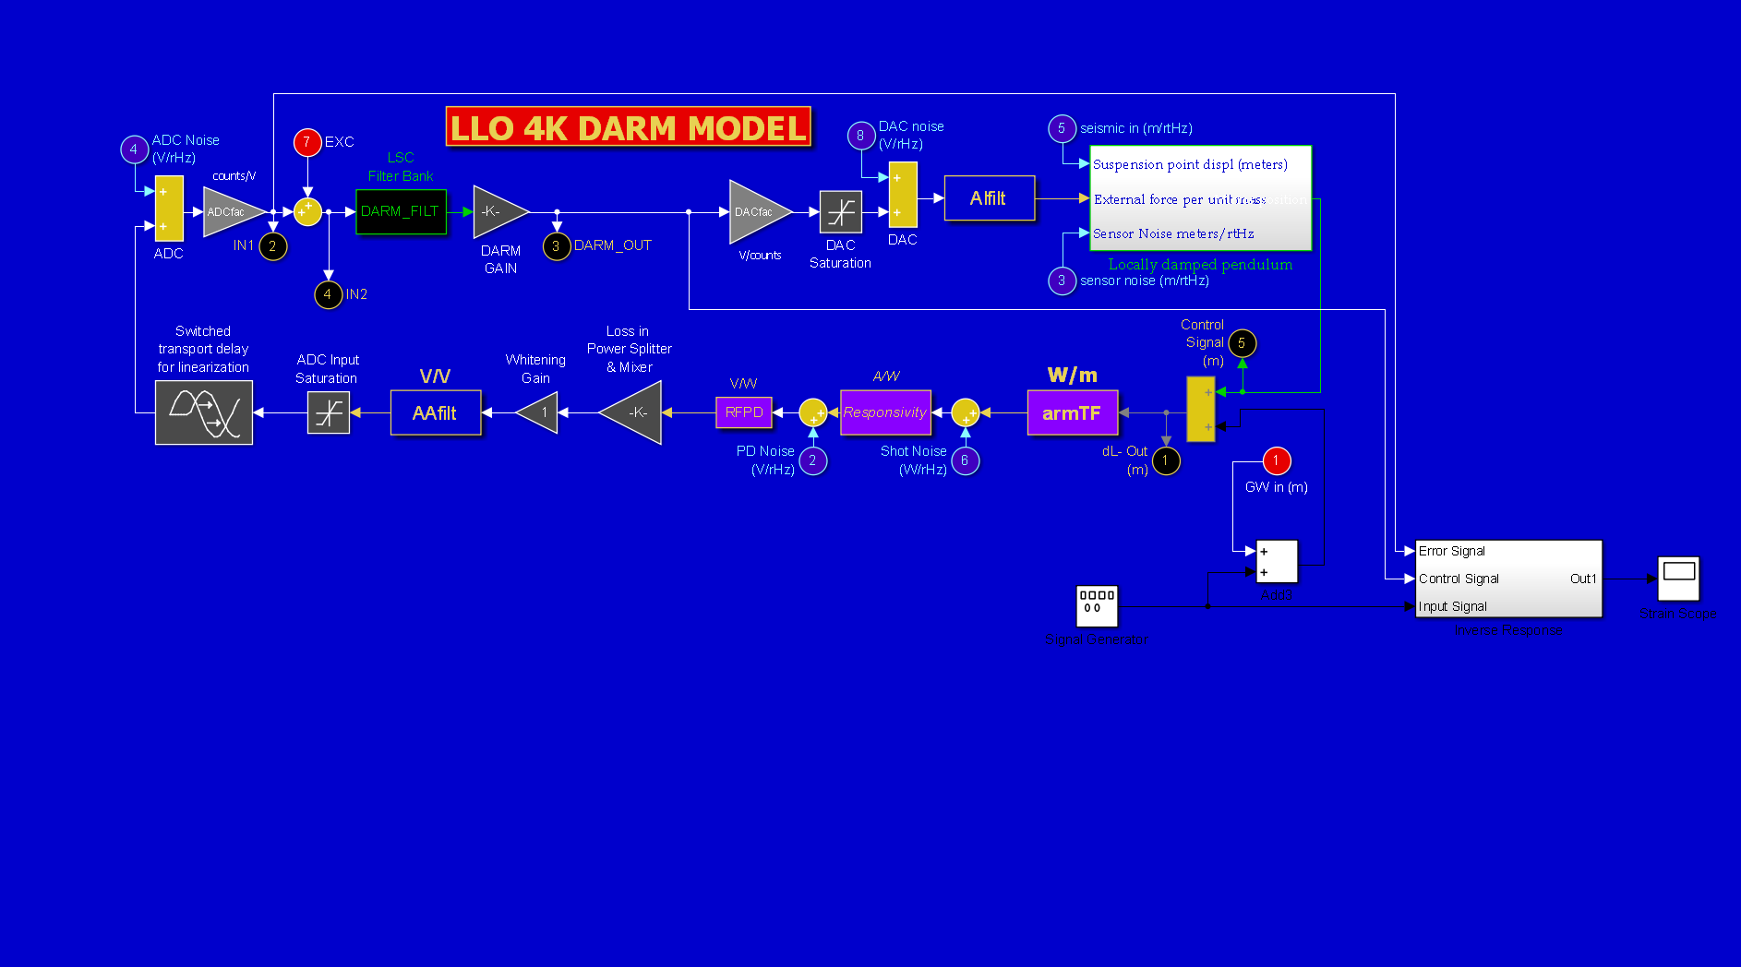
Simulink Model
$$R^{−1}$$
Essentially we treated the existing model as a black box. We put in waves, and signals came out. Formulas for the strain were explained in the previous presentation. These formulas are adapted to Simulink in the $R^{−1}$ block.

Slide 4
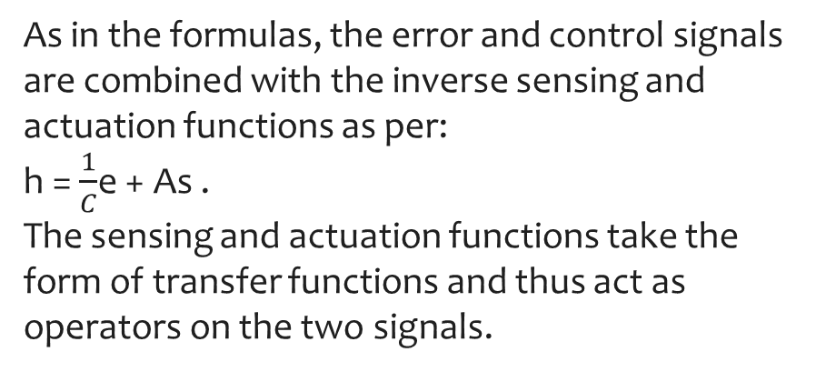
Inside The inverse Response Block
As in the formulas, the error and control signals are combined with the inverse sensing and actuation functions as per:
h = $\frac{1}{C}$e + As .
The sensing and actuation functions take the form of transfer functions and thus act as operators on the two signals.

Slide 5
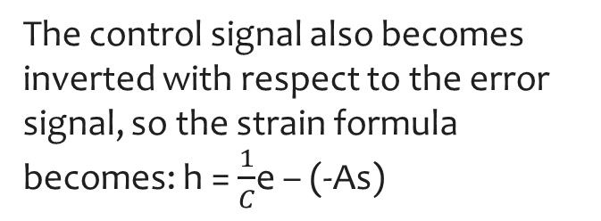
Two points of interest
The control signal is delayed due to the Digital Filters, so a compensating delay had to be input to properly set the phase of the two signals before they are combined.
The control signal also becomes inverted with respect to the error signal, so the strain formula becomes: h = $\frac{1}{C}$e – (-As)

Slide 6
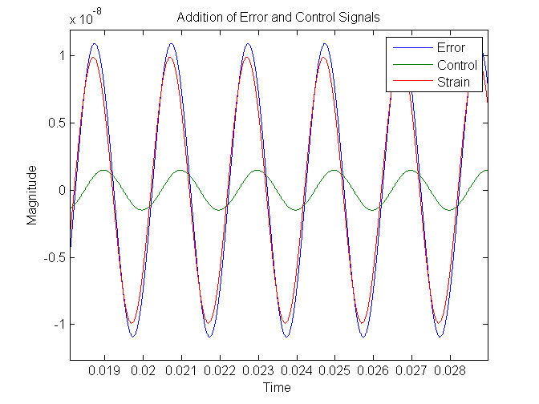
Addition of two sine waves

Slide 7
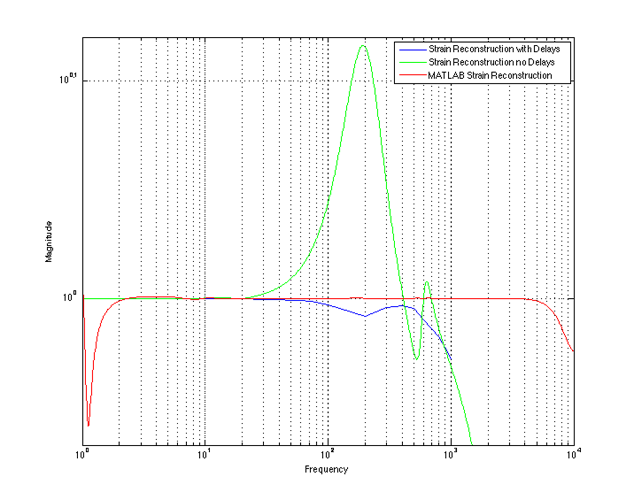
Comparison of strain reconstructions in the frequency domain

Slide 8
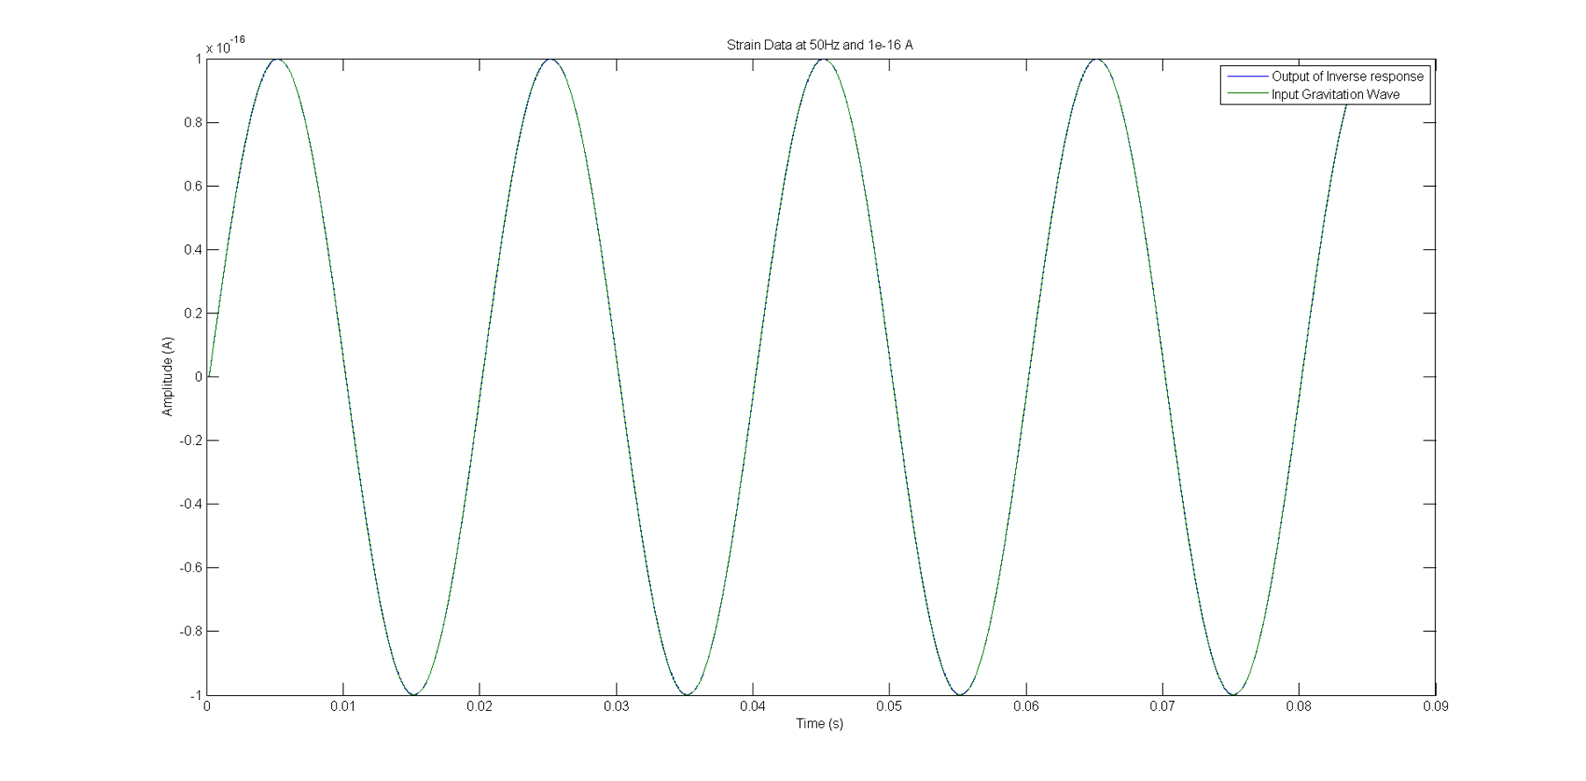
Comparison of Input and output Strain in the time domain
The reconstruction differs from the input strain by less than 1 or 2 percent in the lower frequencies of the LIGO band.

Slide 9
Varying delays according to frequency
Optimal delay times are independent of both the amplitude and phase of the incoming wave. This allows for the possibility for a variable delay to be implemented that would give better than 1% error for any given frequency.
Frequency | 50 | 100 | 200 | 300 | 400 | 500 | 600 | 800 | 1000
Delay time | 2.015e-8 | 2.015e-8 | 2e-8 | 2e-8 | 2e-8 | 2.5e-8 | 0 | 4e-8 | 5e-8
Percent Error | .017% | .15% | .6% | .34% | 1% | .15% | .2% | .3% | .6%

Slide 10
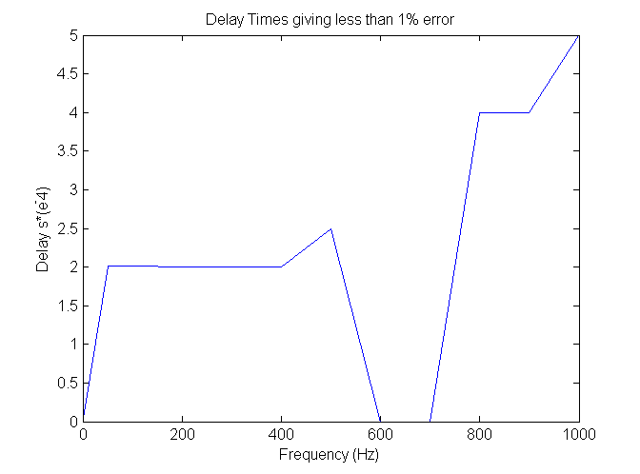
Delays currently lose effectiveness at higher frequencies than 1000 Hz.

Slide 11
Conclusion
Further improvements on high frequency strain reconstruction are needed.
The next phase of this project is to input calibration lines into the model, demodulate at those frequencies, and use the output to track changes in the optical gain, cavity pole, etc.
The next step would be to take this model and put it into the front end Real-time Code Generator (RCG) at the 40 meter laboratory at Caltech.

Slide 12
Acknowledgements
Thanks to:
Professor Alan Weinstein
Jameson Rollins
2013 Caltech LIGO SURF

