Slide 1
Calibration in the Front End Controls
Craig Cahillane
Luke Burks
LIGO Caltech SURF 2013
Mentors: Alan Weinstein, Jamie Rollins
Presentation to Calibration Group
8/13/2013

Slide 2
Calibration Goals
Reproduce the GW strain + noise signal as accurately as possible from the error (e_{D}) and control (s_{D}) signals
Our Project: Construct R⁻¹, the Inverse Response Function

Slide 3
Method of Calibration

Slide 4
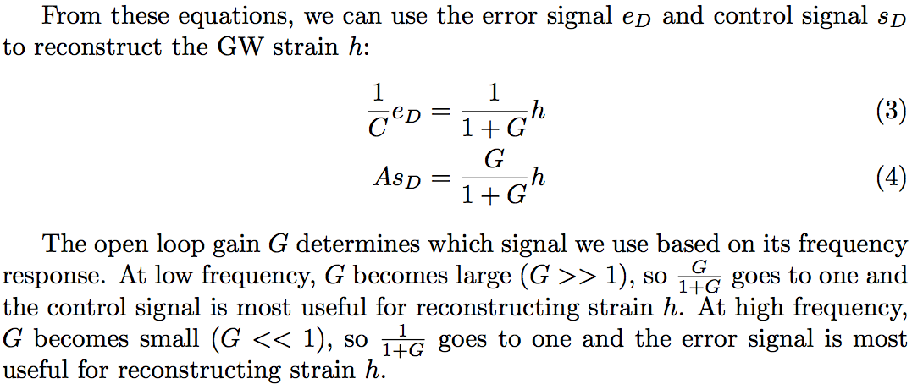
Method of Calibration
Open Loop Gain
G = C*D*A

Slide 5
Method of Calibration
Need to connect both
Error and Control Signal

Slide 6
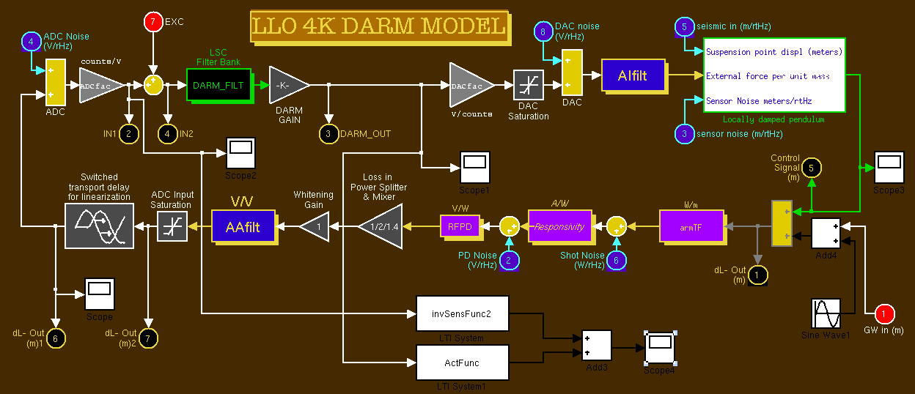
Our Project
Build such a calibrator in MATLAB and Simulink
Began with Rana Adhikari’s model + added R⁻¹ block
R⁻¹ block shown boxed in yellow

Slide 7
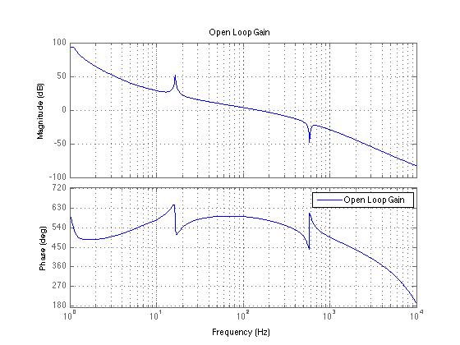
Method of Calibration

Slide 8
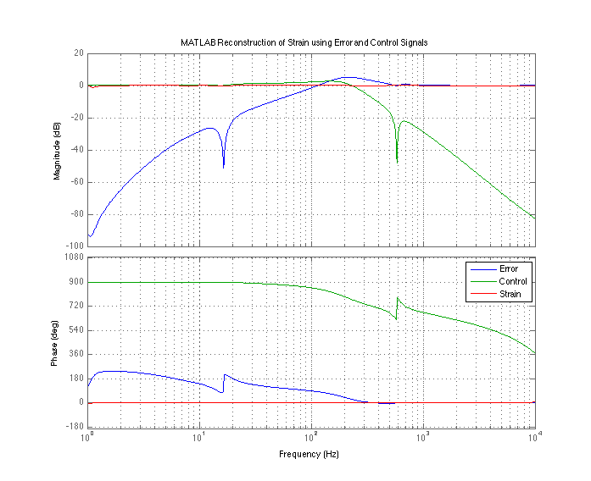
Strain
h

Slide 9
Problems: Unphysical Systems
Simulink refuses to simulate unphysical systems, i.e. systems with more zeros than poles.
The sensing function C is a physical system, but the inverse sensing function 1/C is not a physical system
Solution: Add poles at frequencies outside the LIGO band (8000 Hz) to make 1/C physical
Implication: Additional high frequency poles changes inverse sensing function

Slide 10
Problems: Exponential Growth
The inverse sensing function blows up with every simulation we run in Simulink
Cause of Problem: The inverse sensing function has poles with positive real parts. This causes exponential growth rather than decay.
Solution: I just removed the offending poles.
Implications: Our inverse sensing function is now only an approximation. Let’s see how close:

Slide 11
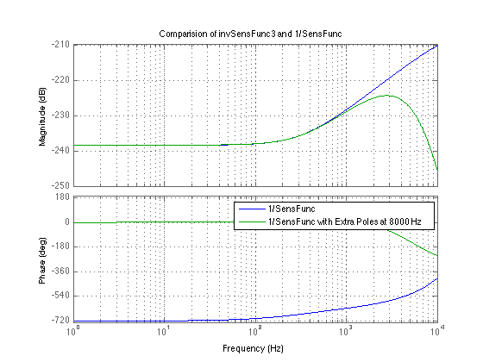
Downturn Due to Extra Poles
Outside of LIGO band

Slide 12
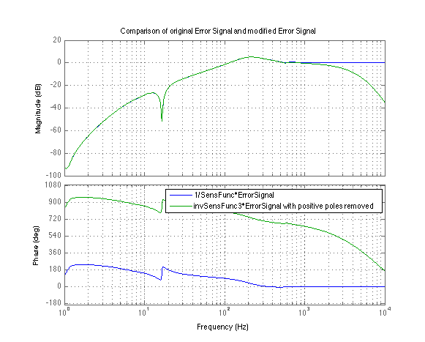

Slide 13
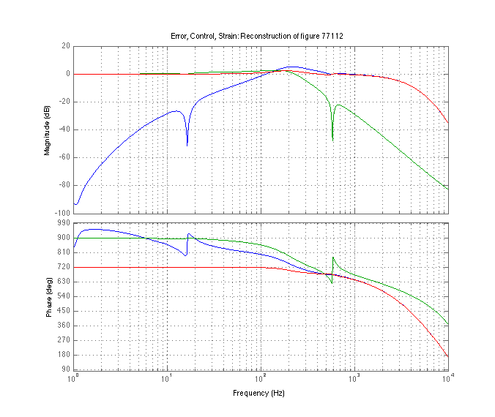
Compare MATLAB and Simulink models
Finally, let’s look at how well the inverse sensing function reconstructs GW strain:
Here, the strain (red line) looks good in LIGO band
MATLAB Strain Reconstruction
Simulink Strain Reconstruction

Slide 14
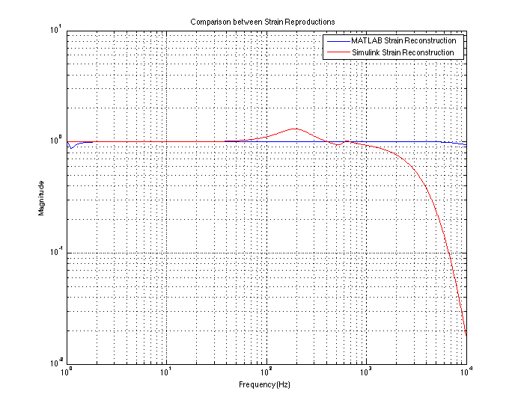
A closer look at the differences

Slide 15
Next Step
The approximated inverse sensing function seems to produce an error in amplitude with a peak at ≈ 200 Hz, and falls off above the LIGO band
Professor Weinstein has advised us to look into working with delays to bring down this error in amplitude.

Slide 16
Delays
We input delays on the Control Signal to try and produce a better strain reconstruction.
This works by basic addition of sine waves
Error ranges from .18% to 4.02% from 10 Hz to 800 Hz

Slide 17
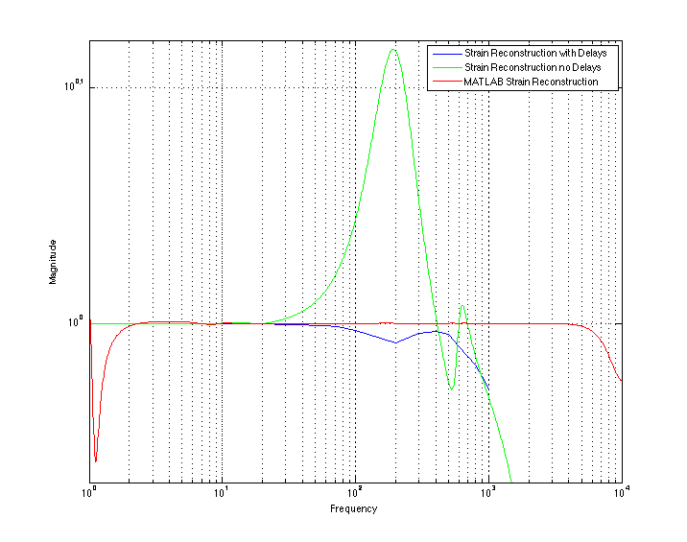
Strain Reconstructions with and without Delays

Slide 18
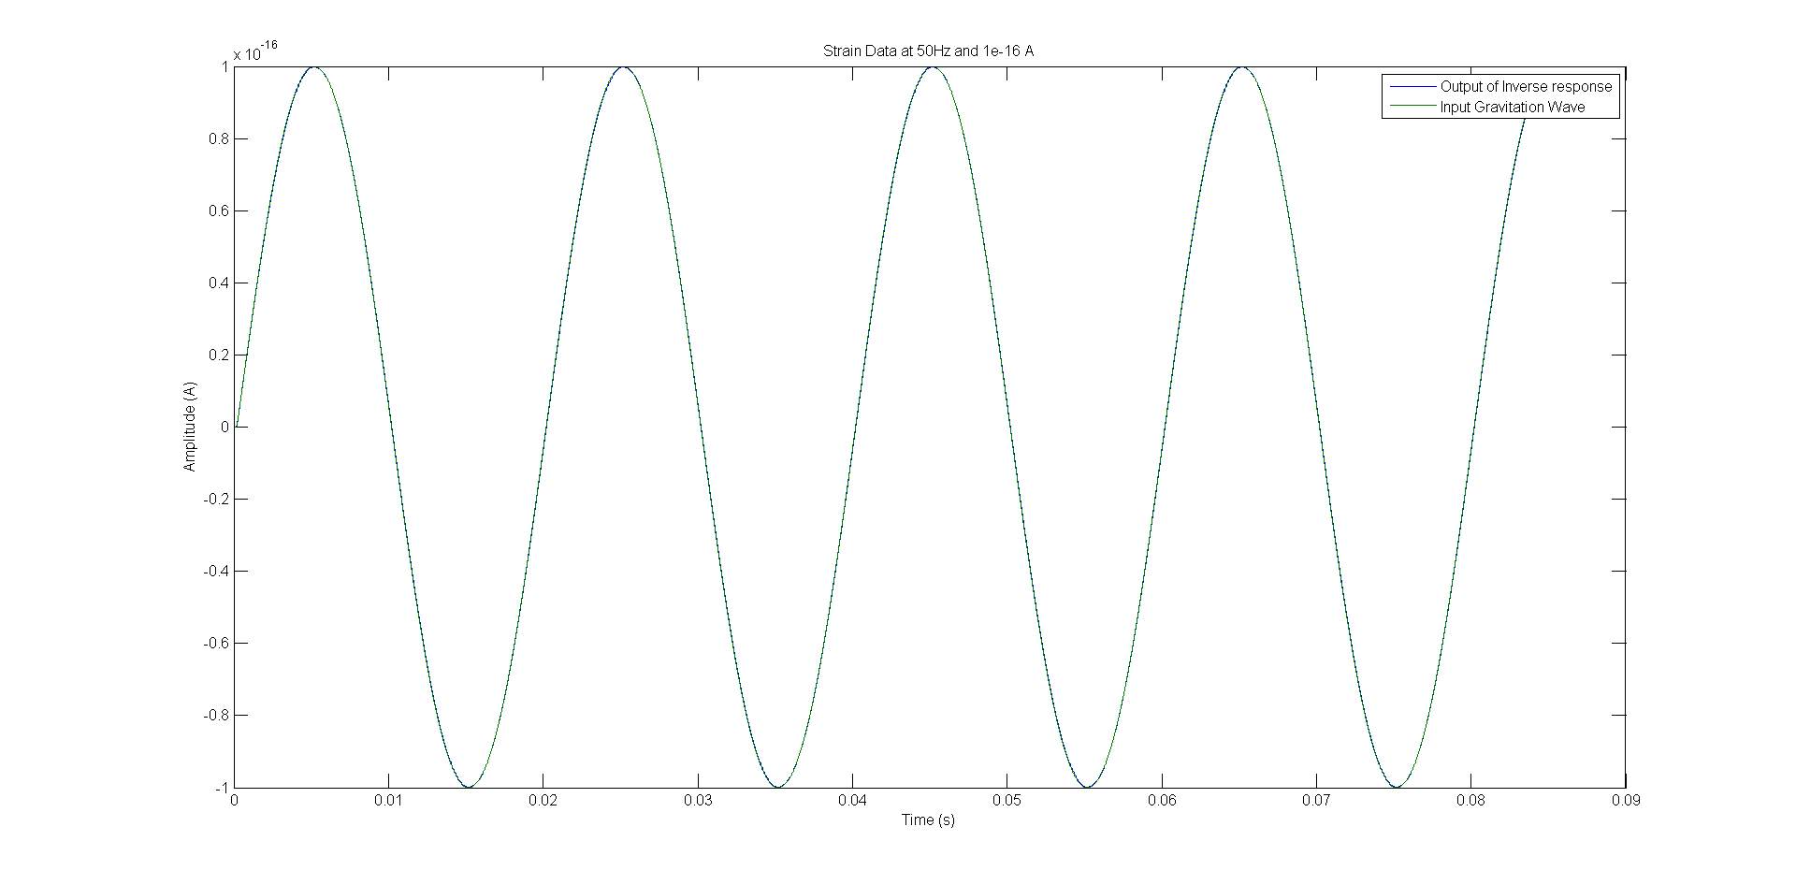
Input + (Delayed) Output Strain Superimposed
The input and output at 50 Hz is almost identical

Slide 19
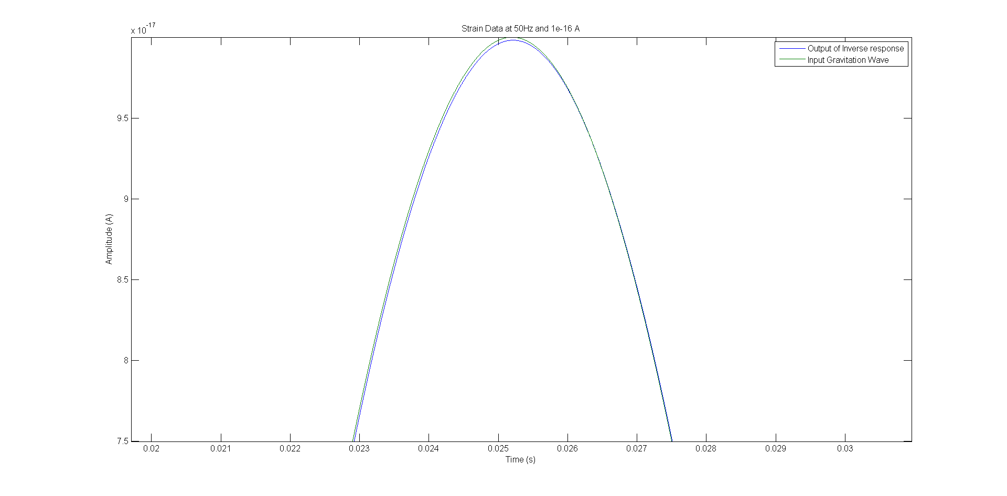
Input + (Delayed) Output Strain Superimposed (Zoomed)
You can see the two separate lines here

Slide 20
Varying delays according to frequency
Optimal delay times are independent of both the amplitude and phase of the incoming wave. This allows for the possibility for a variable delay to be implemented that would give better than 1% error for any given frequency.
Frequency | 50 | 100 | 200 | 300 | 400 | 500 | 600 | 800 | 1000
Delay time | 2.015e-8 | 2.015e-8 | 2e-8 | 2e-8 | 2e-8 | 2.5e-8 | 0 | 4e-8 | 5e-8
Percent Error | .017% | .15% | .6% | .34% | 1% | .15% | .2% | .3% | .6%

Slide 21
Conclusion
Further improvements on high frequency strain reconstruction are needed.
The next phase of this project is to input calibration lines into the model, demodulate at those frequencies, and use the output to track changes in the optical gain, cavity pole, etc.
Next, we want to take this model and put it into the front end Real-time Code Generator (RCG) at the 40 meter at Caltech.
Possibly implement such a front end calibrator at the Livingston and Hanford sites.

Slide 22
Acknowledgements
Thanks to:
Professor Alan Weinstein
Jamie Rollins
2013 Caltech LIGO SURF

