Slide 1
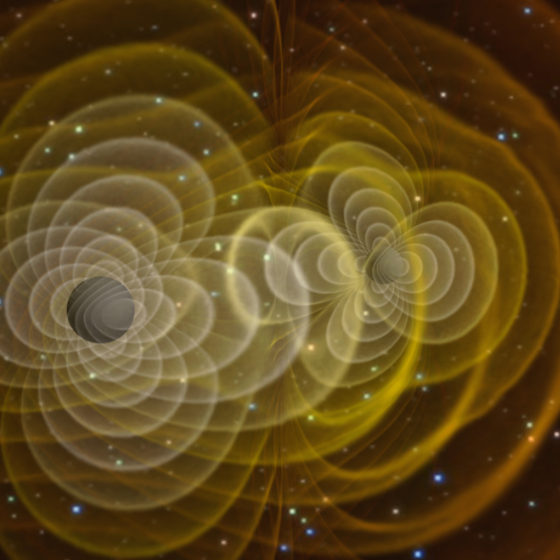
Searching for Binary Black Holes with Spin Aligned with Orbital Angular Momentum
Deborah L. Hamm – Northern Arizona University
LIGO SURF 2013
Mentors: Stephen Privitera, Alan Weinstein
DCC# LIGO-G1300854-x0

Slide 2
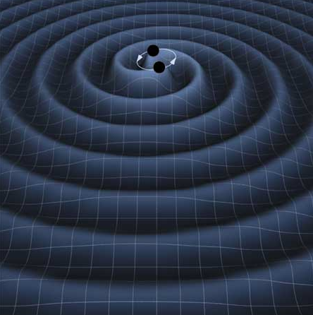
Gravitational Wave Detection from Binary Black Holes
Coalescing BBHs are a promising source of GWs.
The core technique in GW searches of compact binaries is the use of matched filtering.
BBHs are expected to have significant spin.
No previous searches of LIGO data have included the effects of spin.

Slide 3
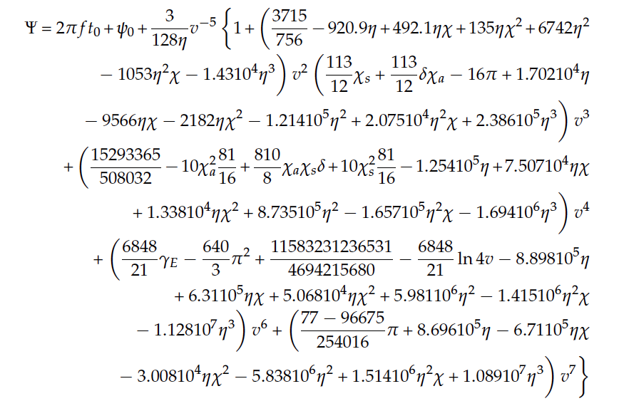
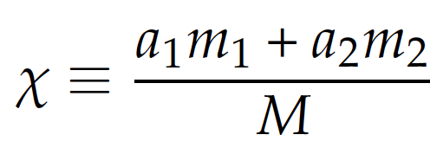
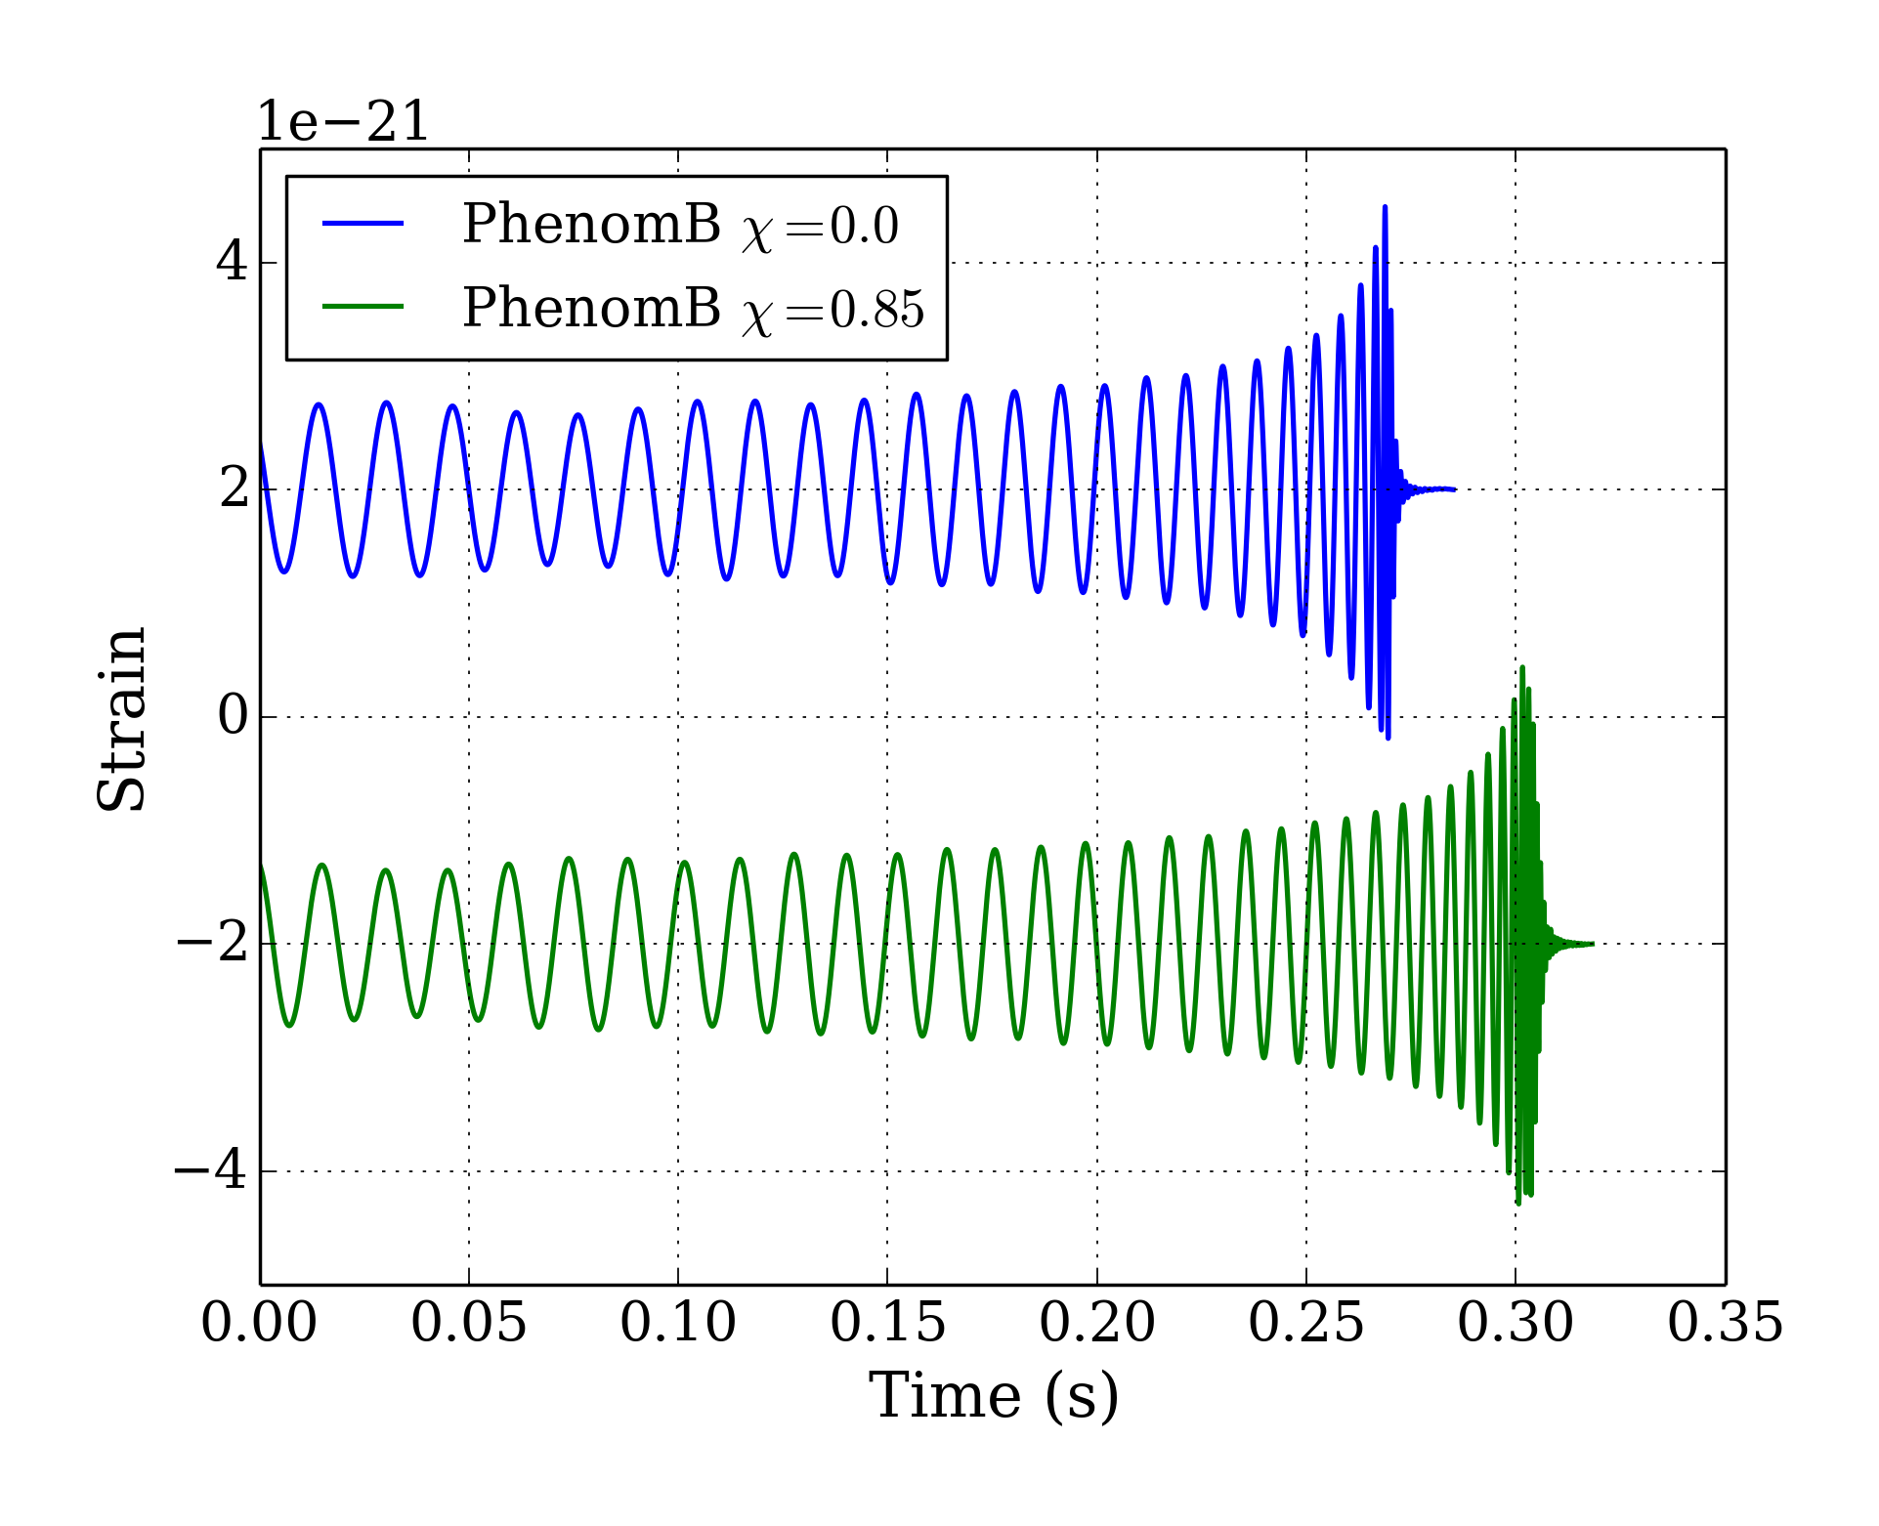
Waveforms with Spin – IMRPhenomB
  Phenomenological fit to post-Newtonian and numerical relativity hybrid waveforms.
  Includes all three phases of coalescence: inspiral, merger, ringdown.
  Spin aligned with orbital angular momentum.
IMRPhenomB with m1 = m2 = 10 Msun

Slide 4
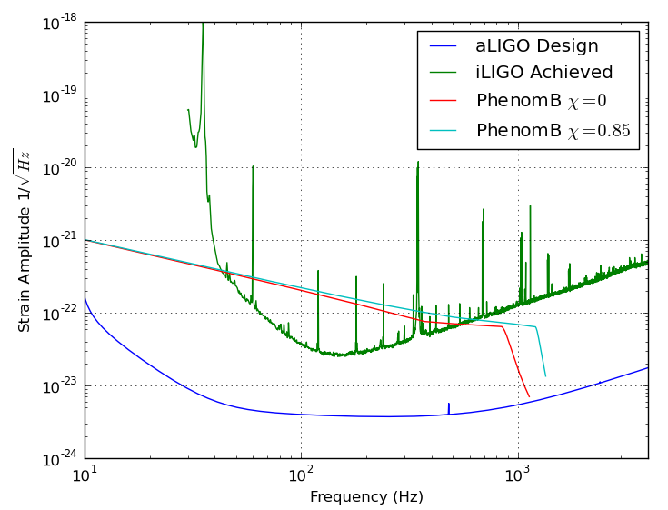
Waveforms with Spin – IMRPhenomB
  Phenomenological fit to post-Newtonian and numerical relativity hybrid waveforms.
  Includes all three phases of coalescence: inspiral, merger, ringdown.
  Spin aligned with orbital angular momentum.
IMRPhenomB with m1 = m2 = 10 Msun

Slide 5
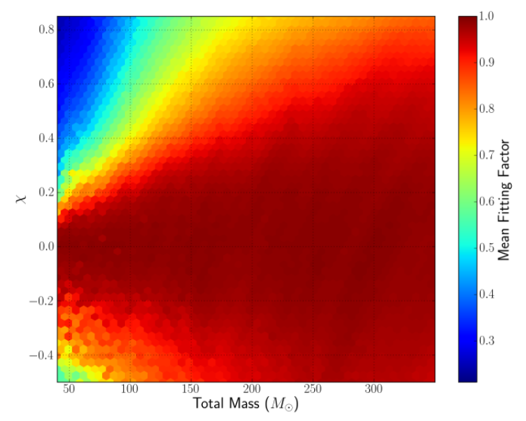
Non-Spinning Bank vs. Spinning Injections
Overlap between Non-Spinning Bank
and Spinning Injections
0.85
-0.5
Negative spin matches with higher-mass non-spinning templates.
Spin matters less for higher-mass positive spinning injections due to their shorter waveforms.
Significant loss in sensitivity to lower mass injections with positive spin.
40 350

Slide 6
Non-Spinning Bank vs. Spinning Injections
Overlap between Non-Spinning Bank
and Spinning Injections
0.85
-0.5
Negative spin matches with higher-mass non-spinning templates.
Spin matters less for higher-mass positive spinning injections due to their shorter waveforms.
Significant loss in sensitivity to lower mass injections with positive spin.
40 350
6

Slide 7
Non-Spinning Bank vs. Spinning Injections
Overlap between Non-Spinning Bank
and Spinning Injections
0.85
-0.5
Negative spin matches with higher-mass non-spinning templates.
Spin matters less for higher-mass positive spinning injections due to their shorter waveforms.
Significant loss in sensitivity to lower mass injections with positive spin.
40 350
7

Slide 8
Non-Spinning Bank vs. Spinning Injections
Overlap between Non-Spinning Bank
and Spinning Injections
0.85
-0.5
Negative spin matches with higher-mass non-spinning templates.
Spin matters less for higher-mass positive spinning injections due to their shorter waveforms.
Significant loss in sensitivity to lower mass injections with positive spin.
40 350
8

Slide 9
Non-Spinning Bank vs. Spinning Injections
Overlap between Non-Spinning Bank
and Spinning Injections
0.85
-0.5
Negative spin matches with higher-mass non-spinning templates.
Spin matters less for higher-mass positive spinning injections due to their shorter waveforms.
Significant loss in sensitivity to lower mass injections with positive spin.
40 350
9

Slide 10
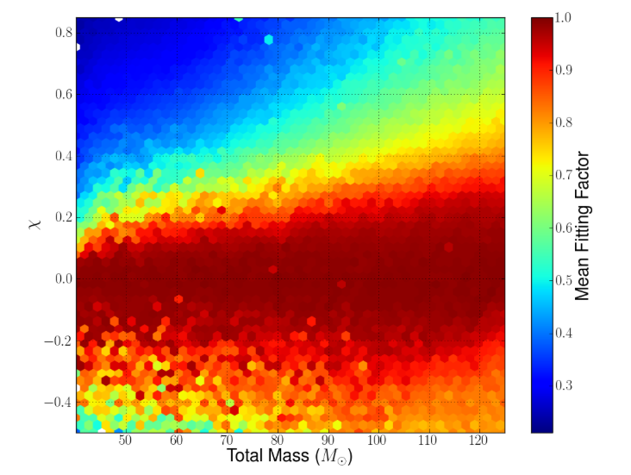
Non-Spinning Bank vs. Spinning Injections
Overlap between Non-Spinning Bank
and Spinning Injections
Negative spin matches with higher-mass non-spinning templates.
Spin matters less for higher-mass positive spinning injections due to their shorter waveforms.
Significant loss in sensitivity to lower mass injections with positive spin.
0.85
-0.5
40 125

Slide 11
Non-Spinning Bank vs. Spinning Injections
Overlap between Non-Spinning Bank
and Spinning Injections
Negative spin matches with higher-mass non-spinning templates.
Spin matters less for higher-mass positive spinning injections due to their shorter waveforms.
Significant loss in sensitivity to lower mass injections with positive spin.
0.85
-0.5
40 125
11

Slide 12
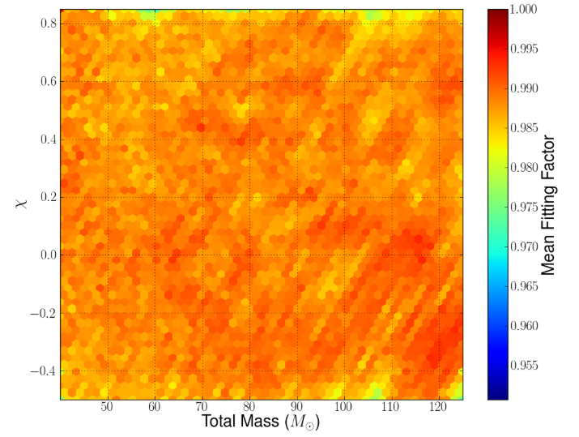
Non-Spinning Bank vs. Spinning Injections
Overlap between Spinning Bank
And Spinning Injections
0.85
-0.5
Negative spin matches with higher-mass non-spinning templates.
Spin matters less for higher-mass positive spinning injections due to their shorter waveforms.
Significant loss in sensitivity to lower mass injections with positive spin.
40 125

Slide 13
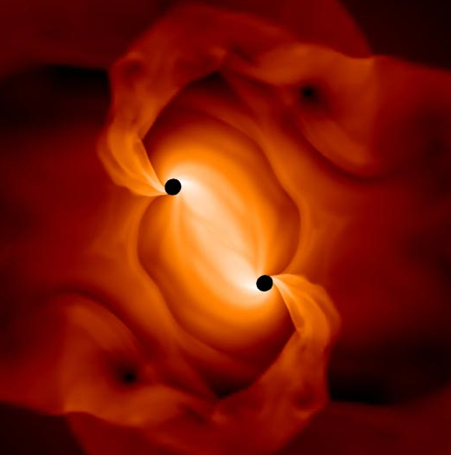
Parallel Pipeline Runs
Non-spin matched filter template bank
Positive aligned-spin matched filter template bank
Gaussian distributed background noise

Slide 14
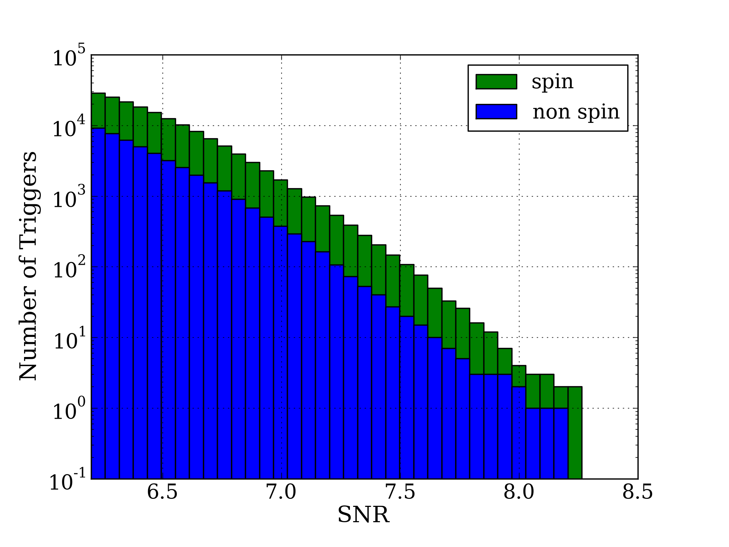
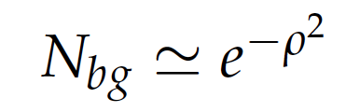
More Templates – More False Alarm Triggers
SNR not the whole story.
Spin increases the number of templates in the bank by ~5.
Number of triggers proportional to the FAR.
At fixed FAR must increase SNR threshold.
Gains in SNR offset by losses through increased false alarm triggers.
Number of Background Triggers vs SNR

Slide 15
More Templates – More False Alarm Triggers
SNR not the whole story.
Spin increases the number of templates in the bank by ~5.
Number of triggers proportional to the FAR.
At fixed FAR must increase SNR threshold.
Gains in SNR offset by losses through increased false alarm triggers.
Number of Background Triggers vs SNR
15

Slide 16
More Templates – More False Alarm Triggers
SNR not the whole story.
Spin increases the number of templates in the bank by ~5.
Number of triggers proportional to the FAR.
At fixed FAR must increase SNR threshold.
Gains in SNR offset by losses through increased false alarm triggers.
Number of Background Triggers vs SNR
16

Slide 17
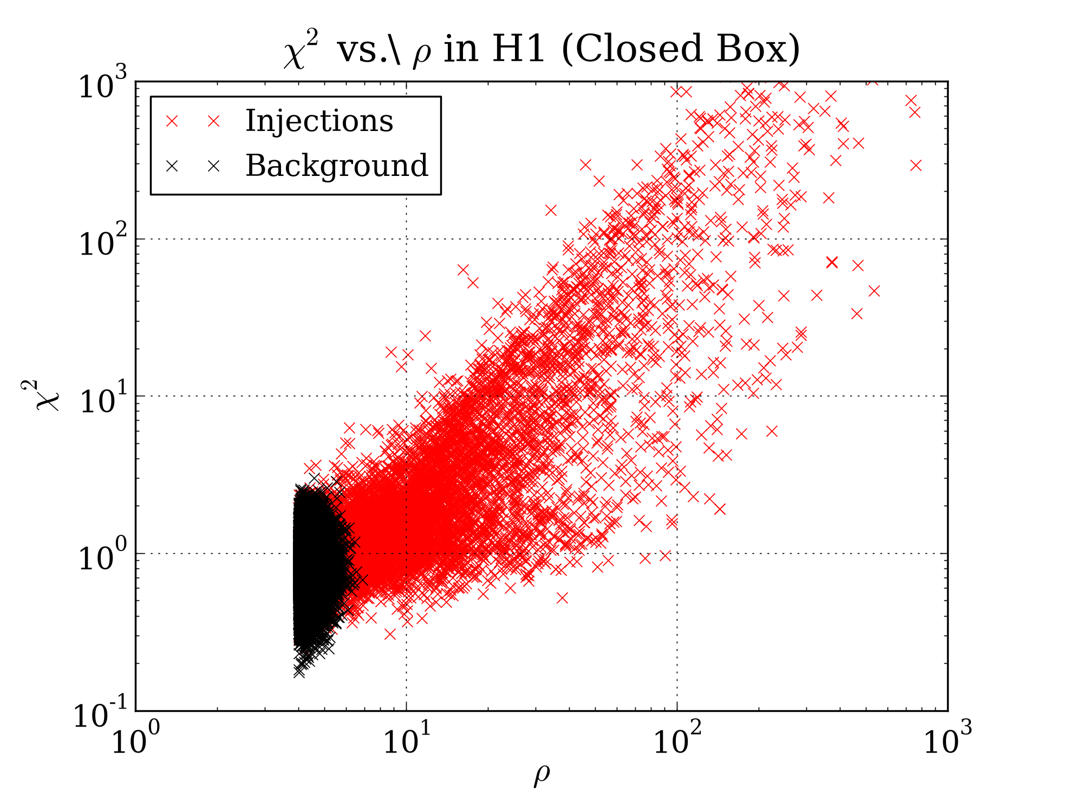
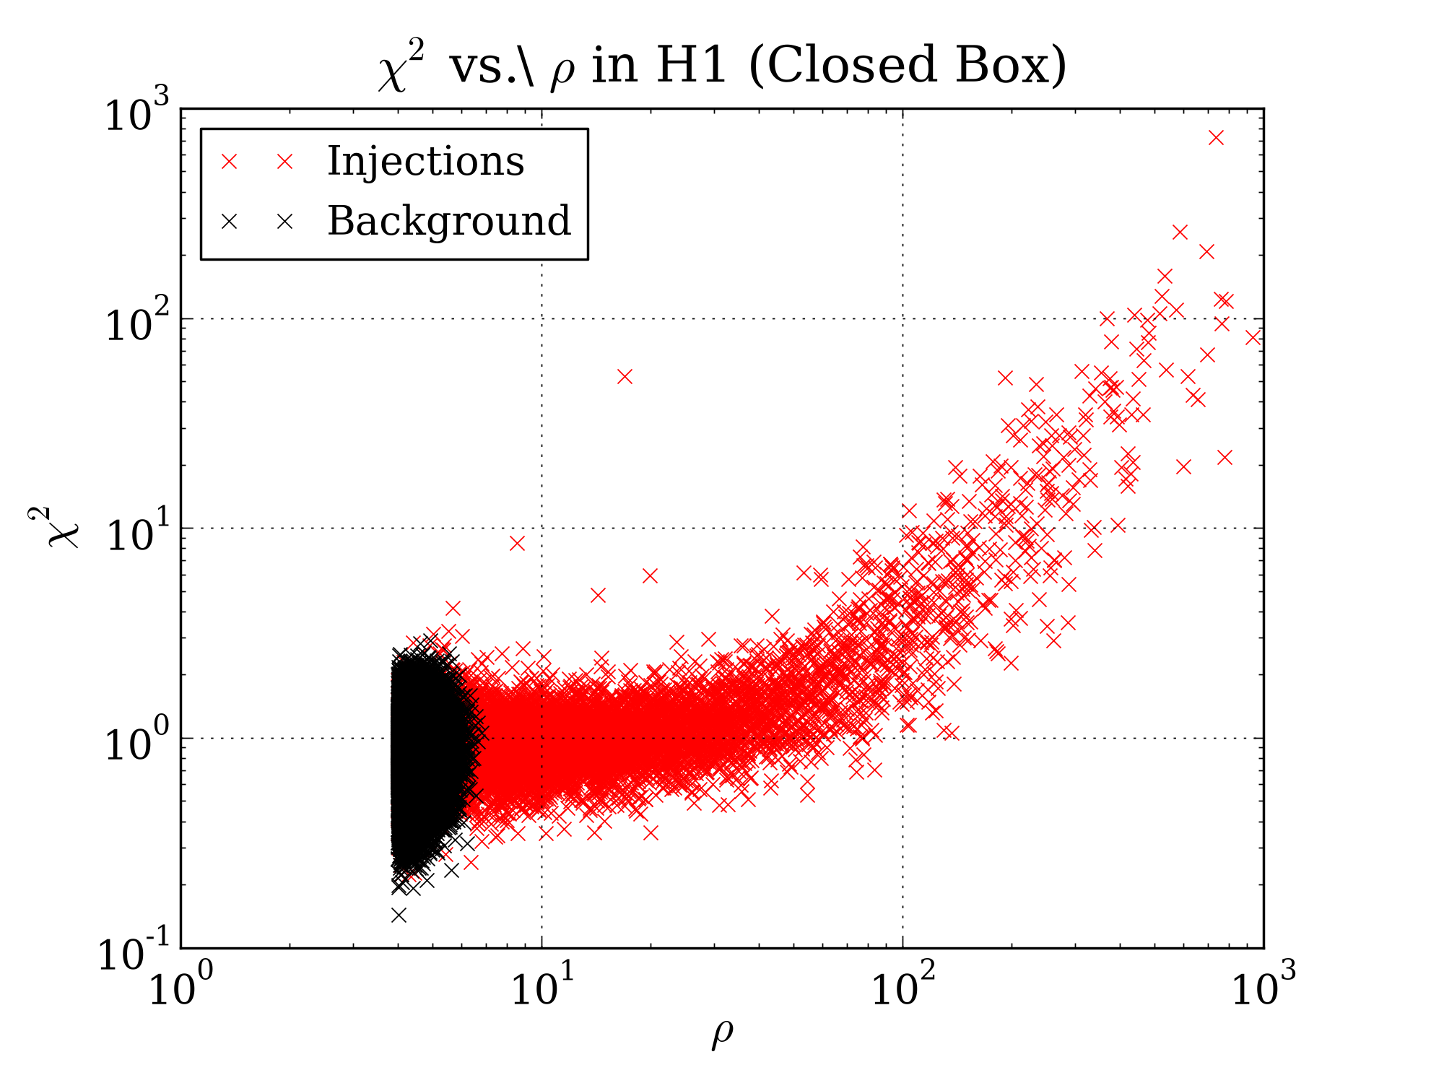
Methods for BG Rejection
Auto-correlation signal consistency test - tells us how consistent our data is with Gaussian distributed noise plus signal.
Exact mass and spin coincidence between detectors – same template must be rung up in both detectors to be considered a possible detection.
Non-Spin
Spin
0.1 1000
0.1 1000
1 SNR 1000
1 SNR 1000

Slide 18
Methods for BG Rejection
Auto-correlation signal consistency test - tells us how consistent our data is with Gaussian distributed noise plus signal.
Exact mass and spin coincidence between detectors – same template must be rung up in both detectors to be considered a possible detection.
Non-Spin
Spin
0.1 1000
0.1 1000
1 SNR 1000
1 SNR 1000

Slide 19
Methods for BG Rejection
Auto-correlation signal consistency test - tells us how consistent our data is with Gaussian distributed noise plus signal.
Exact mass and spin coincidence between detectors – same template must be rung up in both detectors to be considered a possible detection.
Non-Spin
Spin
0.1 1000
0.1 1000
1 SNR 1000
1 SNR 1000

Slide 20
Volume Sensitivity
Non-Spin
Spin

Slide 21
Volume Sensitivity
Non-Spin
Spin

Slide 22
Volume Sensitivity
Non-Spin
Spin

Slide 23
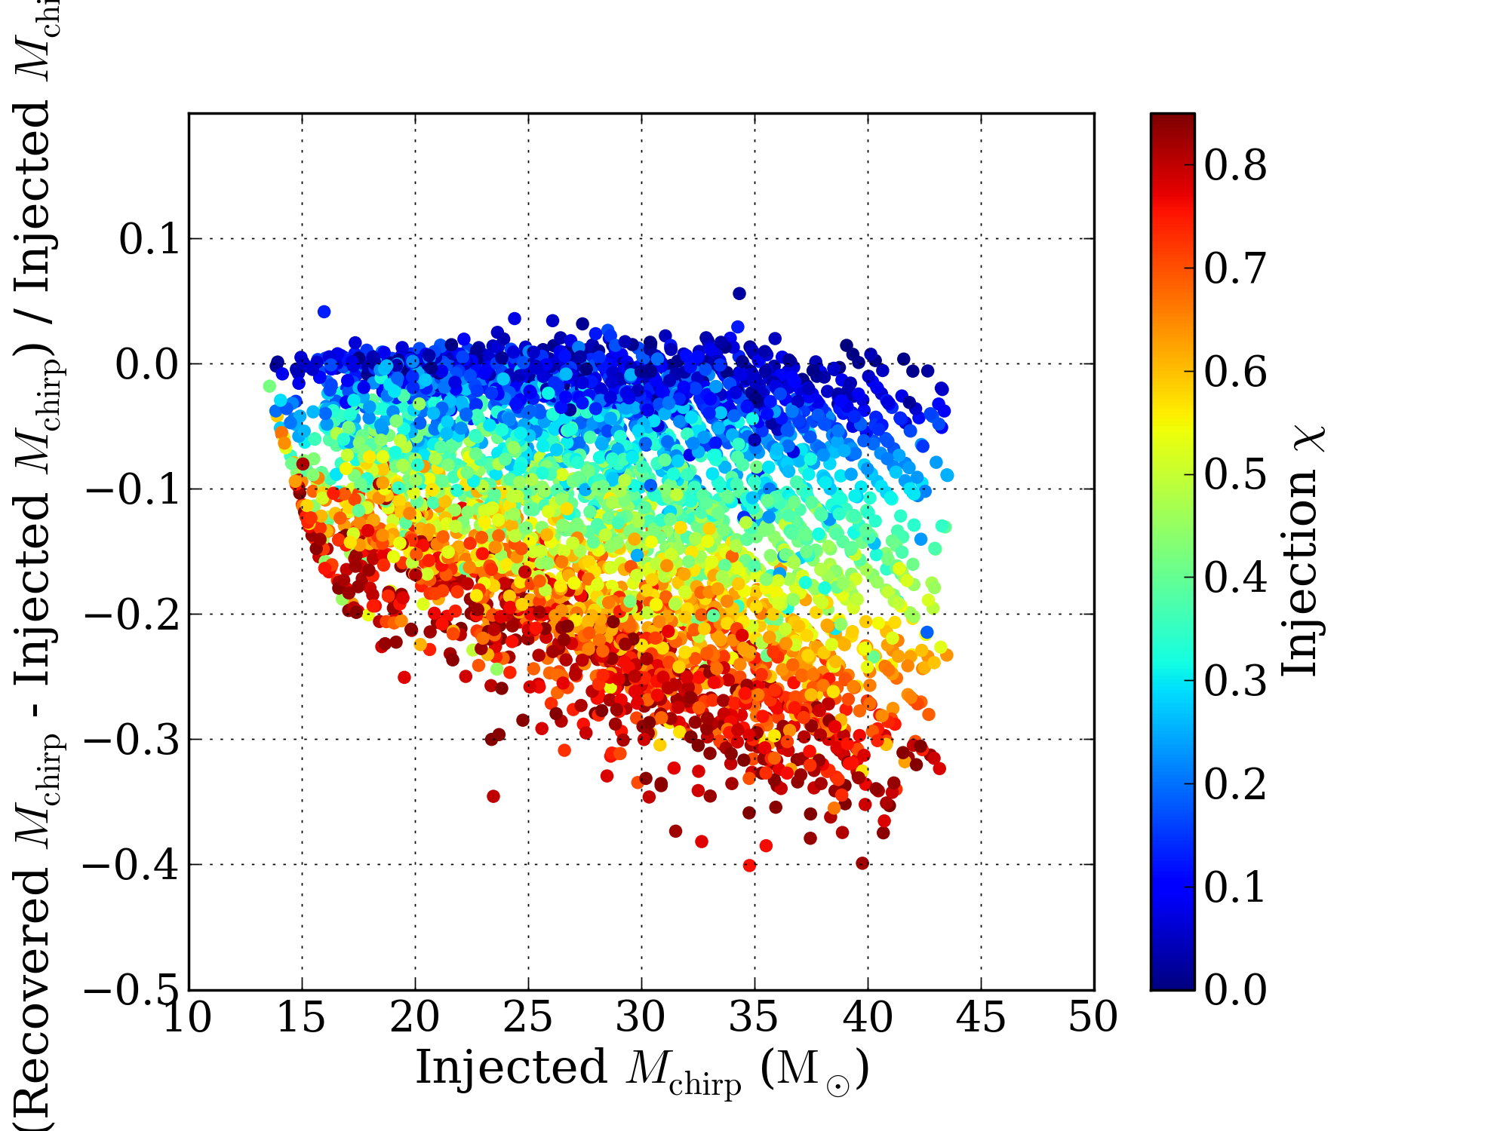
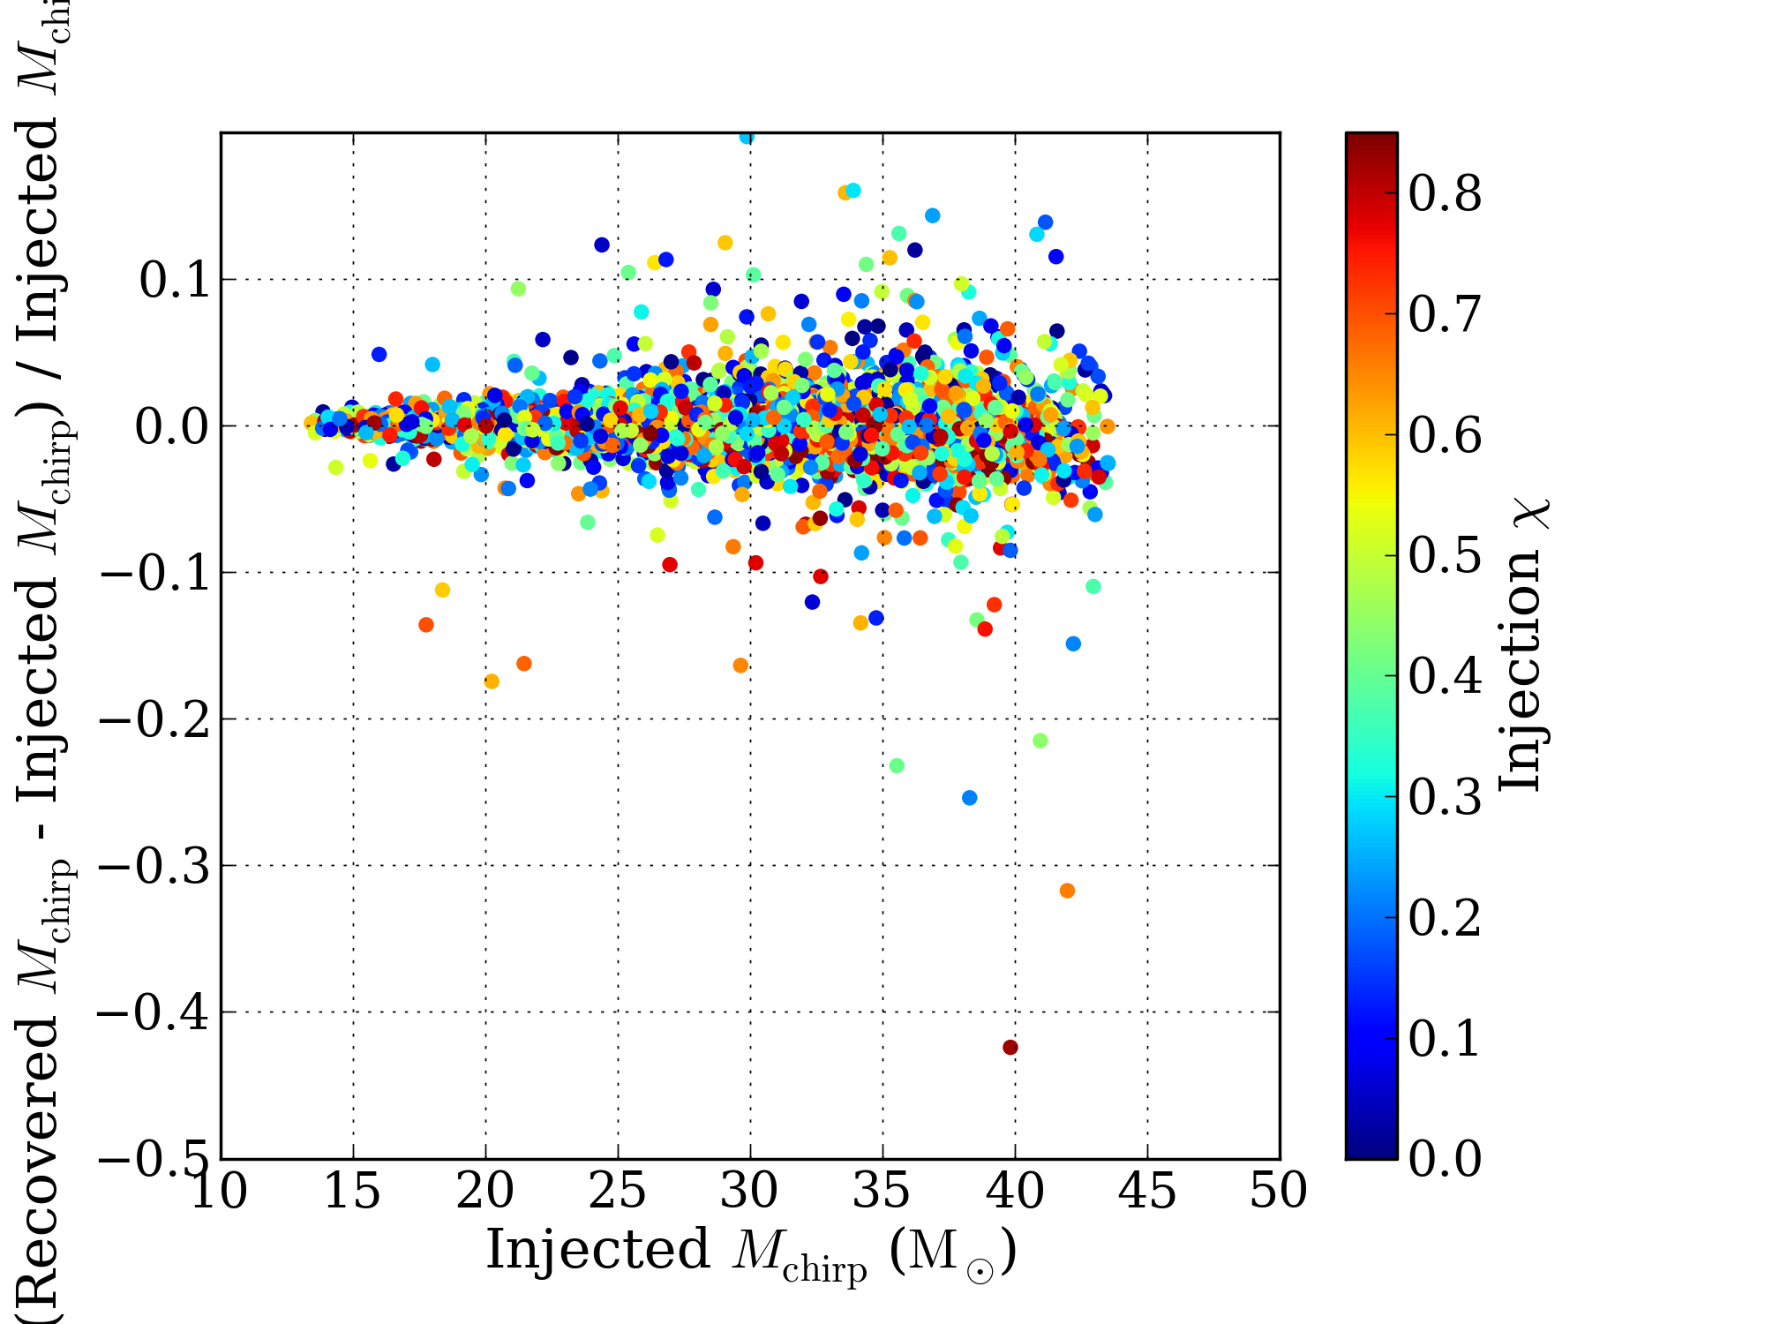
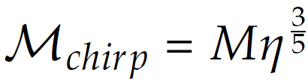
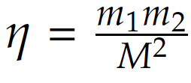
Parameter Recovery
Non-Spin
Spin
More accurate parameter recovery when spin is included.

Slide 24
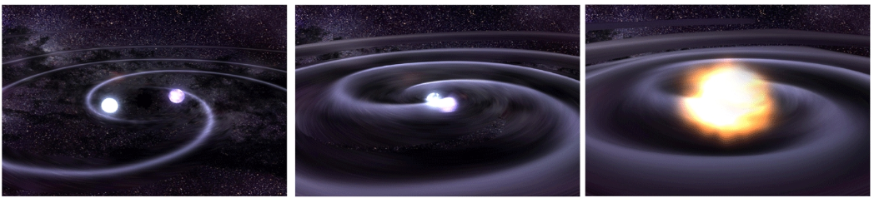
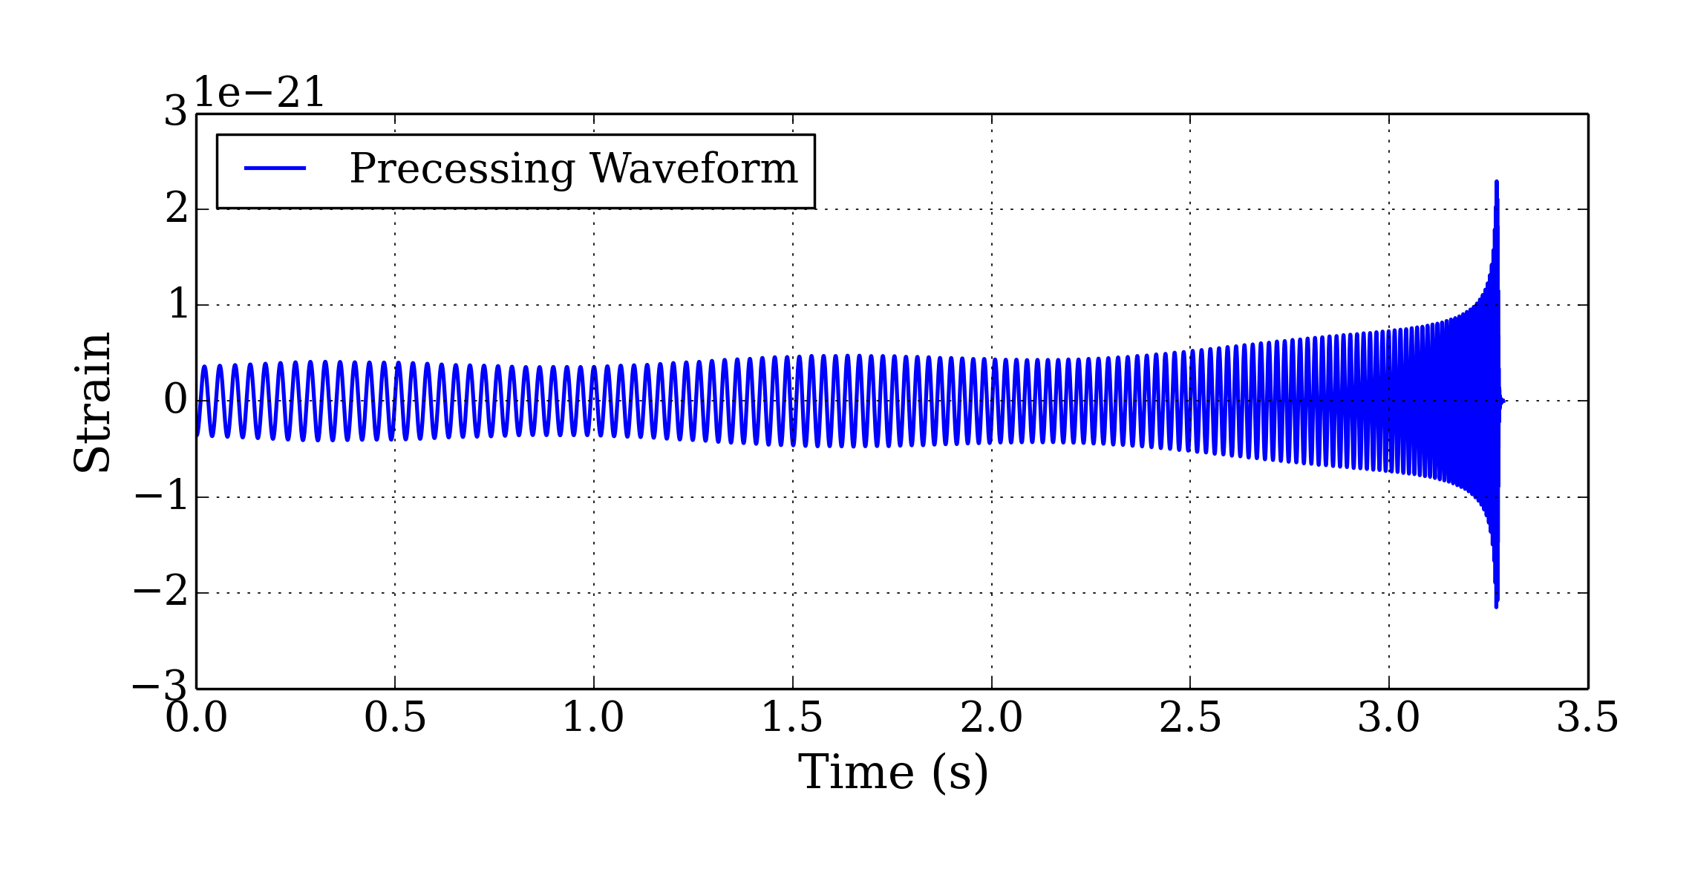
Future Work
Non-Gaussian noise
Waveforms that cover the total mass range 10-40 solar masses
Holy grail: templates with spin not aligned with orbital angular momentum.
Spin Not Aligned with Orbital Angular Momentum

Slide 25
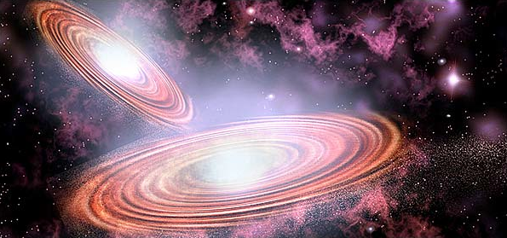
Muchas Gracias!
Special thanks to my mentors Stephen Privitera and Alan Weinstein.
Thanks to NAU mentors David Trilling, Cathy Eastwood, Mark James.
Thanks to NSF for funding, the LIGO SURF Program, and Caltech.

