Slide 1
Calibration in the Front End Controls
Craig Cahillane
LIGO Caltech SURF 2013
Mentors: Alan Weinstein, Jamie Rollins
Presentation to Calibration Group
8/21/2013

Slide 2
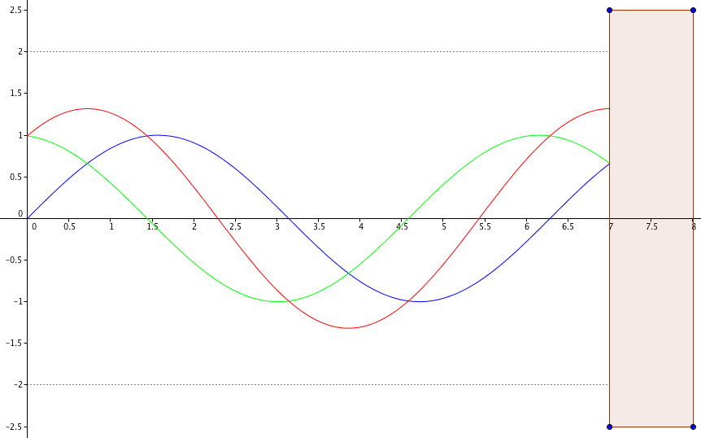
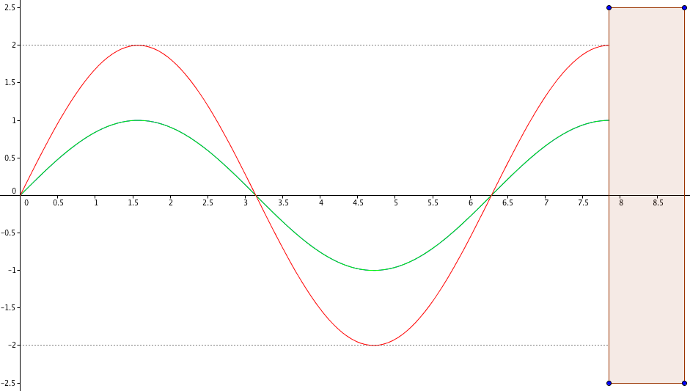
Control System Goal
Keep the Fabry-Pérot interferometer on resonance!
We want the cavity length to be an integer number of laser wavelengths to build a high optical gain
Actuate on optic using feedback loop to maintain resonance condition
Off Resonance: some destructive interference
Test Mass Optic
On Resonance: only constructive interference

Slide 3
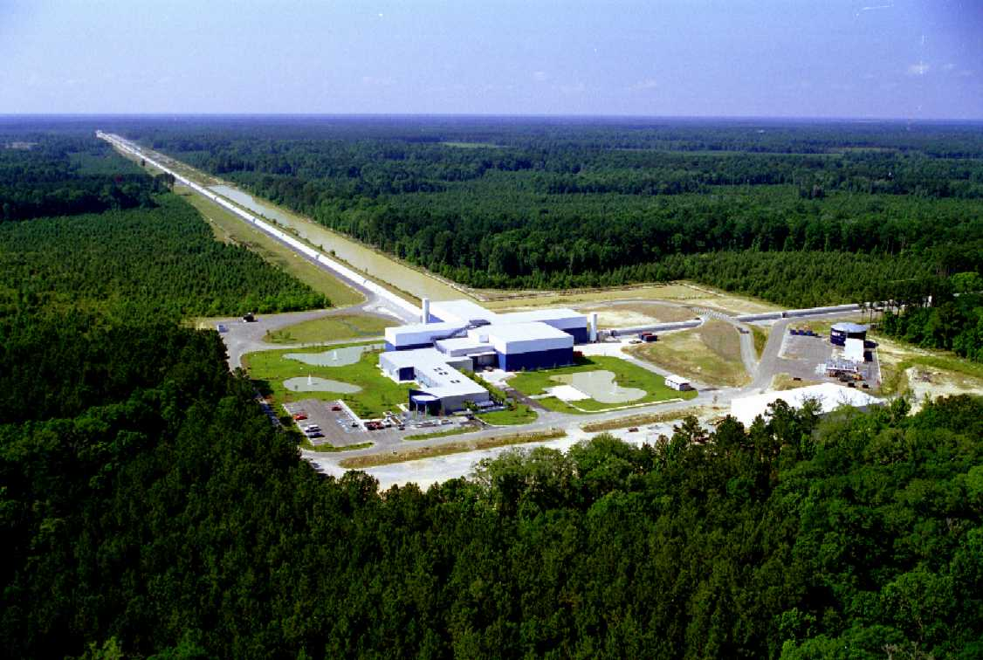
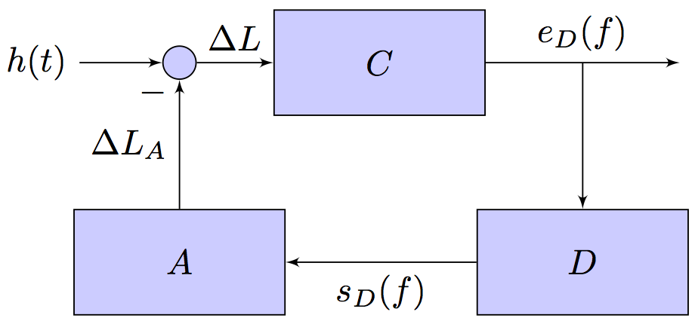
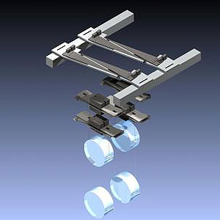
Parts of the Control System
C = Sensing Function. Represents the actual interferometer detecting incident GWs, outputs the DARM Error Signal e_{D}.
D = Digital Filters. Takes DARM Error Signal e_{D} and outputs Control Signal s_{D} that corrects mirror movement.
A = Actuation Function. Takes Control Signal s_{D} and actuates on pendulums to keep them “on resonance”.

Slide 4
Calibration Goals
Reproduce the GW strain + noise signal as accurately as possible from the error (e_{D}) and control (s_{D}) signals
Our Goal: Construct R⁻¹, the Inverse Response Function
4

Slide 5
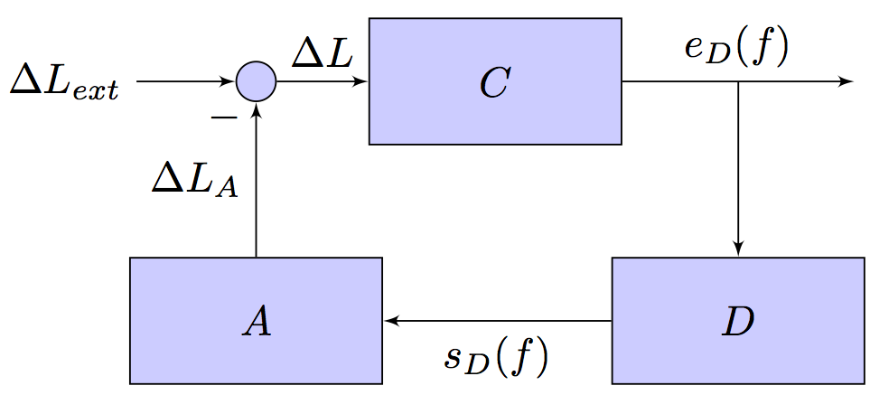
Open and Closed Loop Gain
Control System Block Diagrams: In the frequency domain, we multiply blocks in series and add blocks in parallel.
From the sum circle:
Multiply blocks in series:
Definition: Open Loop Gain
Closed Loop Gain

Slide 6
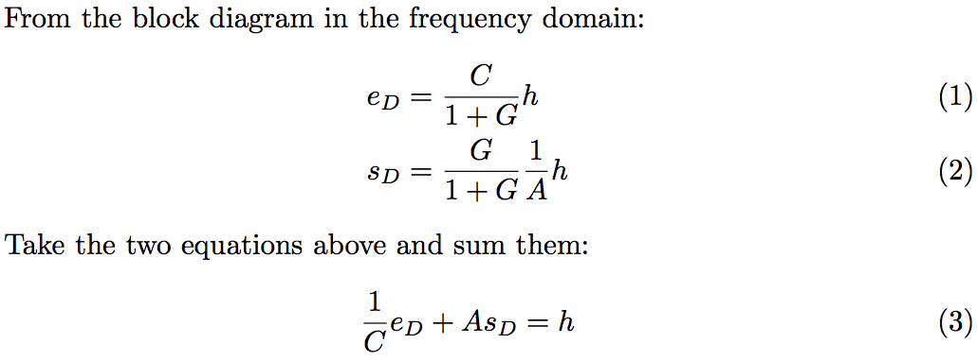
Method of Calibration
6

Slide 7
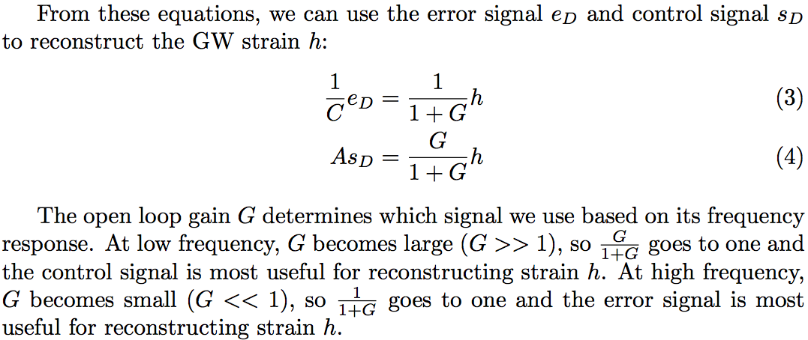
Method of Calibration
Open Loop Gain
G = C*D*A

Slide 8
Method of Calibration
Need to connect both
Error and Control Signal

Slide 9
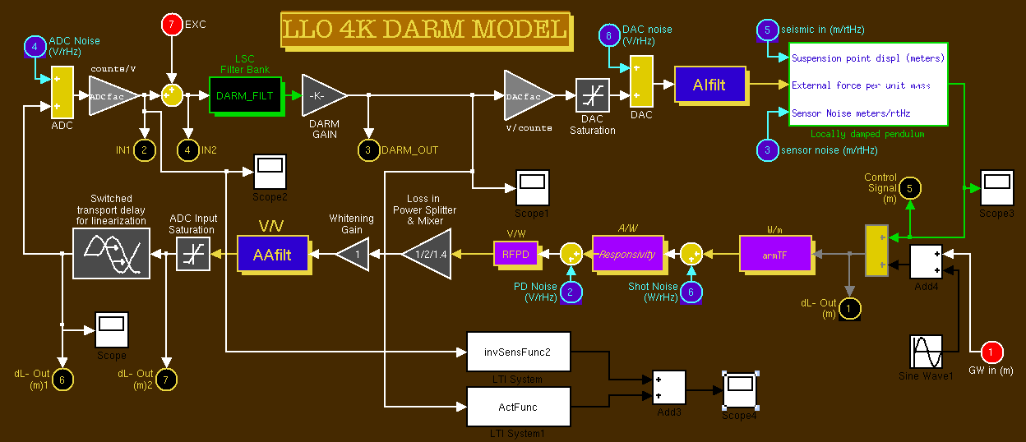
Our Project
Build such a calibrator in MATLAB and Simulink
Began with Rana Adhikari’s model + added R⁻¹ block
R⁻¹ block shown boxed in yellow

Slide 10
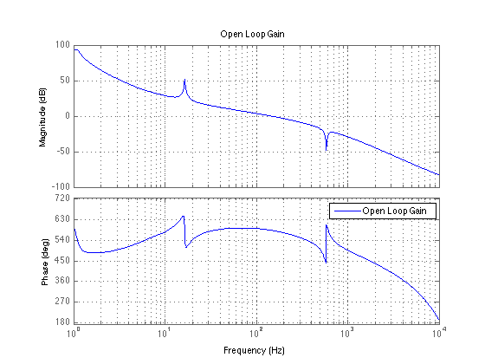
Freq ≈ 150Hz gives Open Loop Gain G = 1
Switch signal used to reconstruct strain here

Slide 11
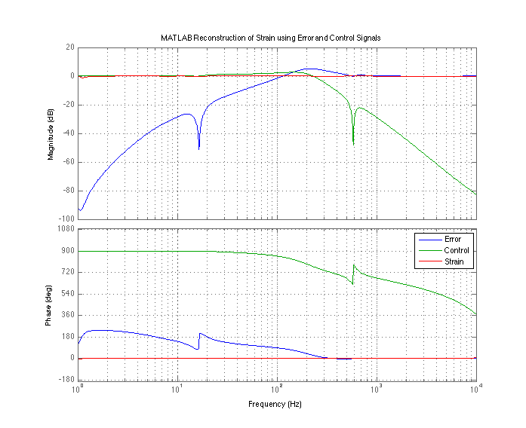
Strain
h

Slide 12
Problems: Unphysical Systems
Simulink only simulates physical, causal systems, i.e. systems with more zeros than poles.
The sensing function C is a physical system, but the inverse sensing function 1/C is not a physical system
Solution: Add poles at frequencies outside the LIGO band (8000 Hz) to make 1/C physical
Implication: Additional high frequency poles changes inverse sensing function
Sensing Transfer
Function C(s):
Roots of z(s) are called zeros
Roots of p(s) are called poles

Slide 13
Problems: Exponential Growth
The response of the inverse sensing function to a sine wave input blows up in Simulink
Cause of Problem: The inverse sensing function has poles with positive real parts. This causes exponential growth rather than decay.
Solution: I removed the offending poles.
Implications: Our inverse sensing function is now only an approximation. Let’s see how close:
$$\text{Im}\left(s\right)$$
Poles must have a negative real part
Region of stability
$$\text{Re}\left(s\right)$$

Slide 14
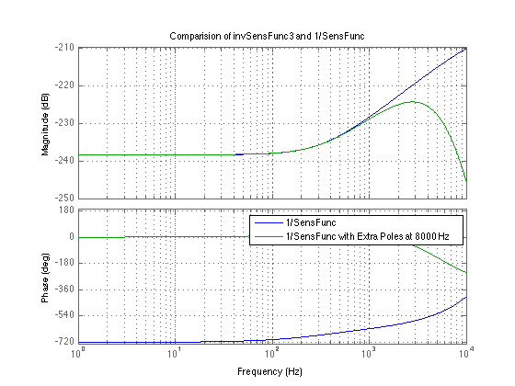
Downturn Due to Extra Poles
Outside of LIGO band

Slide 15
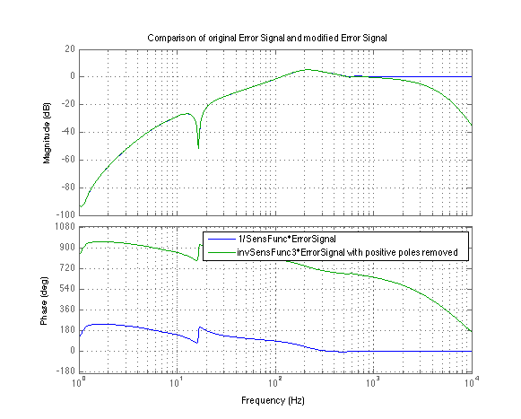

Slide 16
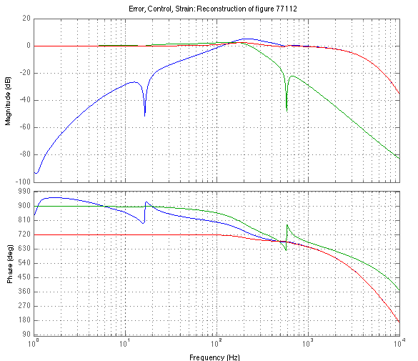
Compare MATLAB and Simulink models
Finally, let’s look at how well the inverse sensing function reconstructs GW strain:
Here, the strain (red line) looks good in LIGO band
MATLAB Strain Reconstruction
Simulink Strain Reconstruction

Slide 17
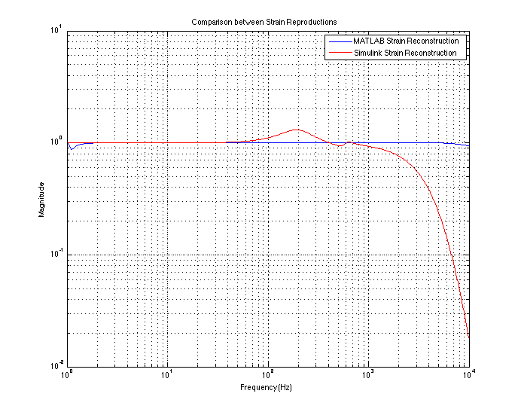
A closer look at the differences

Slide 18
Next Step
The approximated inverse sensing function seems to produce an error in amplitude with a peak at ≈ 200 Hz, and falls off above the LIGO band
We are now working with delays to bring down this error in amplitude.

Slide 19
Delays
We input delays on the Control Signal to try and produce a better strain reconstruction.
This works by basic addition of sine waves
Error ranges from .18% to 4.02% from 10 Hz to 800 Hz

Slide 20
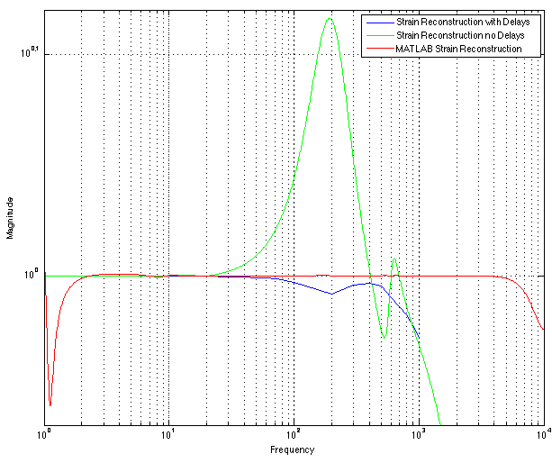
Strain Reconstructions with and without Delays

Slide 21
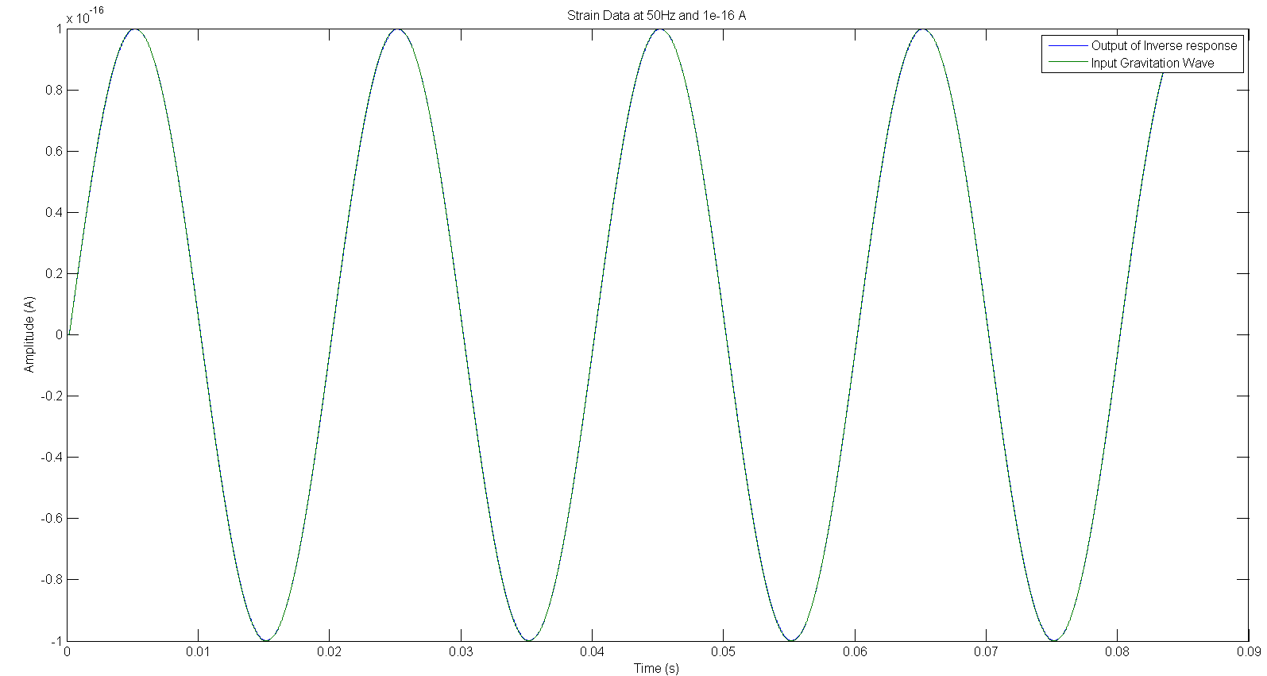
Delayed Input + Output Strain Superimposed
The input and output at 50 Hz is almost identical

Slide 22
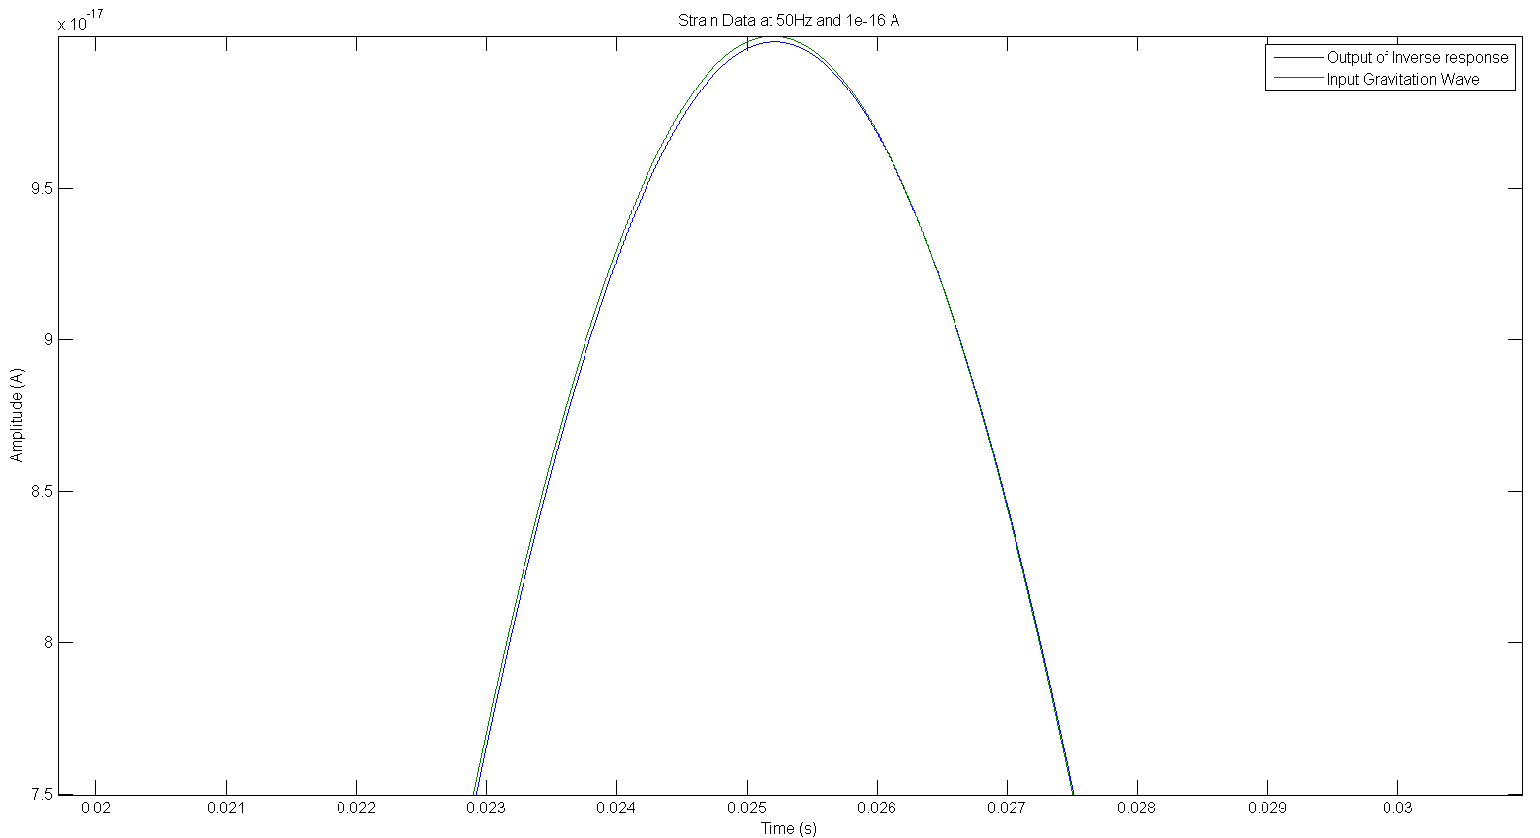
Input + (Delayed) Output Strain Superimposed (Zoomed)
You can see the two separate lines here

Slide 23
Varying delays according to frequency
Optimal delay times are independent of both the amplitude and phase of the incoming wave. This allows for the possibility for a variable delay to be implemented that would give better than 1% error for any given frequency.
Frequency | 50 | 100 | 200 | 300 | 400 | 500 | 600 | 800 | 1000
Delay time | 2.015e-8 | 2.015e-8 | 2e-8 | 2e-8 | 2e-8 | 2.5e-8 | 0 | 4e-8 | 5e-8
Percent Error | .017% | .15% | .6% | .34% | 1% | .15% | .2% | .3% | .6%

Slide 24
Conclusion
Further improvements on high frequency strain reconstruction are needed.
Move added poles to higher frequency
Add delay to error signal
The next phase of this project is to input calibration lines into the model, demodulate at those frequencies, and use the output to track changes in the optical gain and maybe even the cavity pole.
Next, we want to take this model and put it into the front end Real-time Code Generator (RCG) at the 40 meter at Caltech, and then at LHO and LLO.

Slide 25
Acknowledgements
Thanks to:
Professor Alan Weinstein
Jamie Rollins
2013 Caltech LIGO SURF
Rana Adhikari
Jeff Kissel
Luke Burks

