Slide 1
Earth Tide Prediction and Compensation for Advanced LIGO
Noah Kurinsky (Tufts University)
Mentor: Kiwamu Izumi (LHO)

Slide 2
Project Goals
Characterize the effect of solid earth tides on the aLIGO interferometers through analytical prediction
Determine whether an on-line feed-forward system is necessary to remove these effects
Provide a conceptual design and implement such a system if necessary
Develop an operational diagnostic tool to display tidal predictions if not, for direct comparison to real time feedback compensation

Slide 3
Tidal Model of the Earth
Tidal displacement of a point on earth determined in proportion to tidal potential at that point
General case for $A\left(r,φ,λ\right)$ on earth’s surface and object at $O(r,δ,α)$ of the form
$$U_{\left\{r=a\right\}}∝C_{1}\left(φ,δ\right)\cos\left(2H\right)$$
$$+C_{2}\left(φ,δ\right)\cos\left(H\right)$$
+$C_{3}\left(φ,δ\right)$
where $H=H_{0}−α−λ$

Slide 4
Elastic Earth Model (Love)
Assume isotropy and elasticity as defined by:
$$u_{r}=h\frac{U\left(A\right)}{g}$$
$$u_{θ}=\frac{l}{g}\frac{∂U\left(A\right)}{∂θ}$$
$$u_{λ}=\frac{l}{g}\frac{1}{\sin{θ}}\frac{∂U\left(A\right)}{∂λ}$$
Vertical Displacements
Horizontal Displacements

Slide 5
Computation Methods
Two methods to compute tidal deformation:
Displacement - Use tidal displacements of corner and end stations to calculate longitudinal displacement
Strain - Use tidal displacement equations to derive strain tensor, and project strain elements along arms
Which is better?
Strain simpler conceptually, makes more assumptions
Displacement more robust, more prone to computational error
Both currently implemented, for future comparison
Notes:
Both have been implemented

Slide 6
Prediction Code
Can use either method to predict tidal strains at Hanford and Livingston either for one time or a time range.
Employs high-precision simulation data to predict location of moon and sun (from JPL)
Computes YARM, XARM, CARM, and DARM
Outputs predictions either to file or terminal
Notes:
“”

Slide 7
Daily Tides
Notes:
Why so different?

Slide 8
Monthly Tides
Notes:
Mention horizontal scale, DARM, and offset

Slide 9
Tidal Power Spectrum

Slide 10
Previous Tidal Analysis
Previously discussed HIFO-Y ALS system and ongoing analysis of long-term stability
HIFO “instability” highly correlated with reference cavity temperature fluctuations
HIFO-Y ALS not designed for long-term operation, lacks ability to separate CARM and DARM
LSC system main compensation system for long-term drifts, e.g. Tidal effects
Notes:
Refcav in science mode (1-3 degrees)

Slide 11
Is Feed-Forward Necessary?
Know from HIFO analysis that HEPI feedback loop very stable at near-DC and no resonances near frequencies of interest
Can use worst case tidal predictions to set requirements for feedback system:
DARM – 100 microns peak to peak
CARM – 300 microns peak to peak
Twelve Hour Timescale

Slide 12
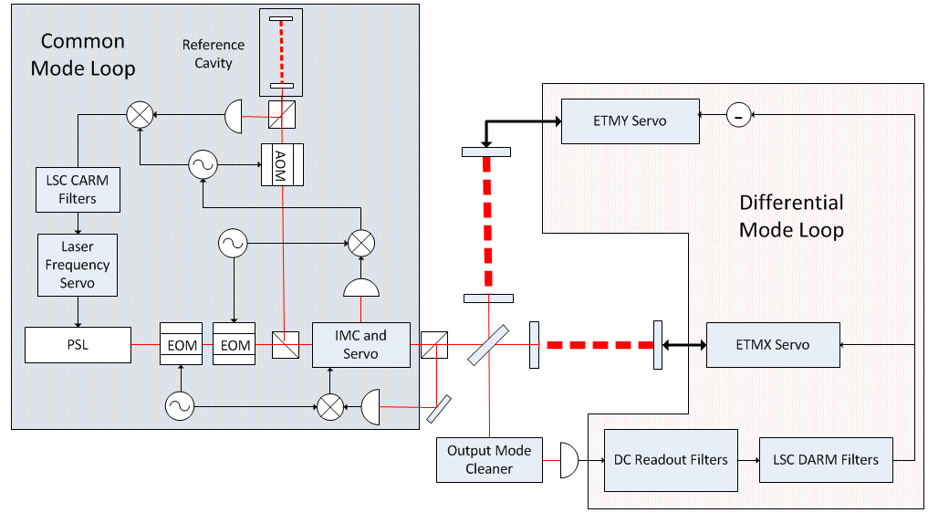
LSC Overview

Slide 13
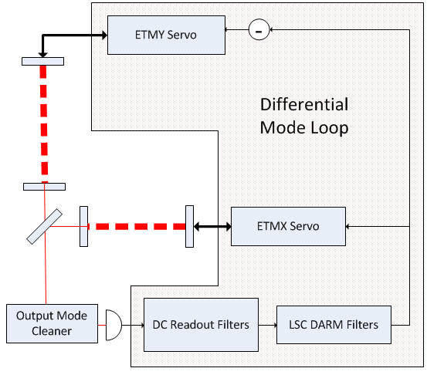
Differential Mode Compensation
DC Readout (comparison to dark port offset)
Limited by response of HEPI actuation loop
Feedback O.K.

Slide 14
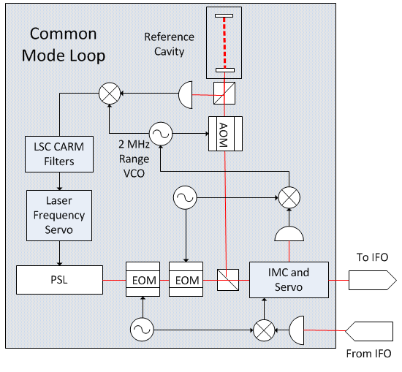
Common Mode Compensation
RF Readout (PDH)
VCO Range $≈2 MHz$ used to offset laser frequency
Tidal signals will saturate VCO range:
$$Δf=f\left(1−\frac{L}{L+ΔL}\right)≈23 MHz$$
Exiting Feedback Inadequate

Slide 15
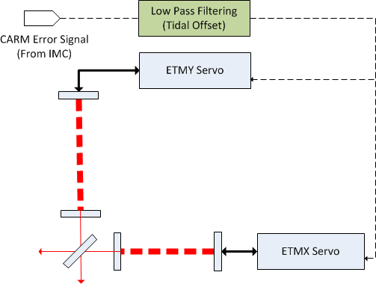
Common Mode Compensation
DC common mode signal can be fed back to HEPI actuators without saturation
Requires low pass filtering and crossover analysis
Modified feedback: O.K.

Slide 16
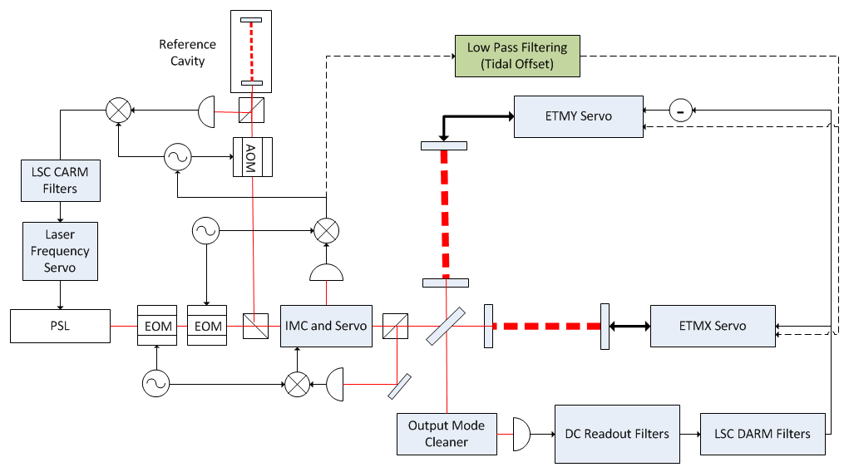
Proposed LSC Modification
1 mHz
Crossover
Notes:
Crossover frequency?

Slide 17
Is Feed-Forward Necessary?
Know from ALS analysis that HEPI feedback loop very stable at near-DC and no resonances near frequencies of interest
Can use tidal predictions to set requirements for feedback system:
DARM – 100 microns peak to peak O.K.
CARM (Modfied) – 300 microns peak to peak (worst case) O.K.
No feed-forward required

Slide 18
EPICS Tidal Prediction Integration
Tidal predictions ported to EPICS for future comparison with error signals
Tidal prediction code has been modified to run continuously, predicting tidal displacements using both methods given current system time
Device support/IOC implemented for Hanford and Livingston
Currently running on h0epics2

Slide 19
EPICS Signals
Signal Names:
H0:PEM-TIDAL_DISP_CARM
H0:PEM-TIDAL_DISP_DARM
H0:PEM-TIDAL_DISP_XARM
H0:PEM-TIDAL_DISP_YARM
H0:PEM-TIDAL_STRAIN_CARM
H0:PEM-TIDAL_STRAIN_DARM
H0:PEM-TIDAL_STRAIN_XARM
H0:PEM-TIDAL_STRAIN_YARM
H0:PEM-TIDAL_UNIXTIME
Actively updated, stored in FRAMES

Slide 20
EPICS Signals in DataViewer (STRAIN)

Slide 21
EPICS Signals in DataViewer (DISP)

Slide 22
Tidal Prediction: Future Plans
Test models, verify predictions, determine accuracy
HIFO-Y ALS system too unstable on long timescales to test tidal predictions
LSC system not operational, as only one arm fully commissioned
Is tidal prediction the chicken or the egg?
So far, models mostly un-tested against real data, aside from general comparison to past observations

Slide 23
In Conclusion
The aLIGO interferometers are capable of offloading tidal deformations through feedback alone
This will require development of ultra-low frequency bypass loop
Earth tide predictions can be monitored in real time in the control room and compared to observed longitudinal displacements
If a feed-forward system is desired for a later aLIGO system, its implementation will be very easy and efficient due to this effort

Slide 24
References
D. C. Agnew. Earth Tides, 2007.
Paul Melchior. “The Tides of Planet Earth”, 1987
R. Adhikari. Sensitivity and Noise Analysis of 4 km Laser Interferometric Gravitational Wave Antennae. PhD thesis, Massachusetts Institute of Technology, 2004.
E. Morganson. Developing an Earth-Tides Model for LIGO Interferometers. Technical Report, 1999
D. Sigg. Arm Length Stabilization at LHO. Technical Report LIGO-G1300258-v1, March 2013.
K. Somiya et. al. Length Sensing and Control for AdLIGO Technical Report LIGO-T060272, November 2006

Slide 25
Acknowledgements
Thanks to everyone at LHO for being so supportive and welcoming!
Special Thanks to:
Kiwamu Izumi
Keita Kawabe
Vincent, Hugh, Hugo and the SUS team
Dave Barker and Patrick Thomas

Slide 26
Extra Slides

Slide 27
Future Projects
Fully design and characterize proposed feedback loop, or opt to implement feed-forward
Compare tidal predictions to DARM and CARM error signals, once IFO fully commissioned
Decide whether discrepancies are due to model errors or control system inadequacies (should be based on long-term lock stability)
Determine whether strain or displacement method is more accurate, or whether numerical method should be used

