Slide 1
sustools.py, a Python module for SUS
August 13, 2013
SUS Testing Meeting
Mark Barton
LIGO Hanford Observatory
1
LIGO-G1300830-v1

Slide 2
Motivation
Guardian is now to be written in Python (replacing Perl)
Much adjustment of settings will be done with BURT, but some will be done directly in scripts.
Would be good to have a module with common operations specifically for SUS.
Many existing Matlab scripts call ezcaswitch etc via system().
Slow - would be good to have something quicker
Python is a great scripting language, will probably write other SUS-related scripts.

Slide 3
Result: sustools.py
Defines a class Sus that wraps Ezca from guardian.ezca and adds SUS-specific methods.
Each instance of Sus represents a particular suspension.
Built around a dictionary object susData with all the info from G1100968-v2 and T1000618-v3.
Can be used as a command line tool as well as a Python module.
Currently supports writing switches and settings of all the main types of filter blocks (OSEMINF, COILOUTF, DAMP, TEST, LOCK, OPTICALIGN).
Many optional arguments to allow refining operations by level ('M0', 'R0', etc) or channel/dof ('L'/'T'/'V'/etc, 'F1'/'F2'/etc).
Many additional features envisaged.

Slide 4
Usage
Can be used in a Guardian script, by passing in the ezca object that Guardian will have already defined:
import sustools; etmy = Sus(ezca)
etmy.dampOutputSwitch('ON', levels=['M0','R0'])
Can be used in a vanilla Python script, by passing an optic name:
import sustools; etmy = Sus('ETMY')
etmy.dampOutputSwitch(‘ON’, levels=['M0','R0'])
Can be used from the command line (needs chmod +x):
./sustools.py dampOutputSwitch –oETMy -1 –lM0 –lR0

Slide 5
Environment
The following or similar will be added to cdscfg soon – hot-wire for now.
Add to PATH:
/opt/rtcds/userapps/release/guardian/python – where the guardian script lives.
/opt/rtcds/userapps/release/sus/common/guardian - where sustools.py lives (also do chmod +x sustools.py).
Add to PYTHONPATH:
/opt/rtcds/userapps/release/sus/common/guardian - where sustools.py lives.
/opt/rtcds/userapps/release/guardian/python/lib – where the guardian.epics module lives.
Install the networkx module – used by other parts of Guardian.

Slide 6
Typical set of methods for a filter block type
dampOutputSwitch(enable, levels=[], dofs=[], verbose=False)
dampInputSwitch(enable, levels=[], dofs=[], verbose=False)
dampGainSet(value, levels=[], dofs=[], verbose=False)
dampOffsetSet(value, levels=[], dofs=[], verbose=False)
dampOffsetSwitch(enable, levels=[], dofs=[], verbose=False)
dampRampSet(self, value, levels=[], dofs=[], verbose=False)
dampFilterSwitch(filters, enable, levels=[], dofs=[], verbose=False)
Could possibly be a more Pythonesque convention, but functional.
Need to add support for matrix blocks, reading.

Slide 7
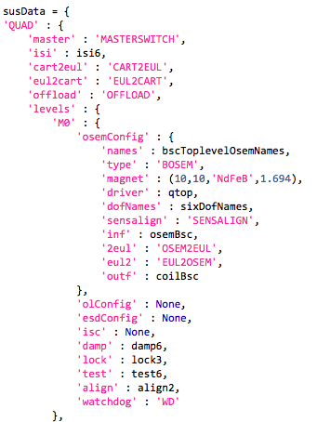
susData
Big data structure using nested dictionaries.
Incorporates all data from G1100968-v2, T1000618-v3
Makes it easy to error check, iterate.
Need to add magnet signs, DRIVEALIGN, other matrices, odds and ends.

Slide 8
Issues
The ezca module doesn't actually work reliably from h1guardian0.
Multiple requests in a batch tend to time out on about the second or third, with a connection failure message.
It does work from operator1, operator3.
Dave Barker suspects the difference is the lack of an EPICS gateway machine between h1guardian0 and the front ends.
The theory is that the added delay is helping with some sort of race condition or overload.
Cyrus is planning tests with a packet logger to diagnose.

