Slide 1

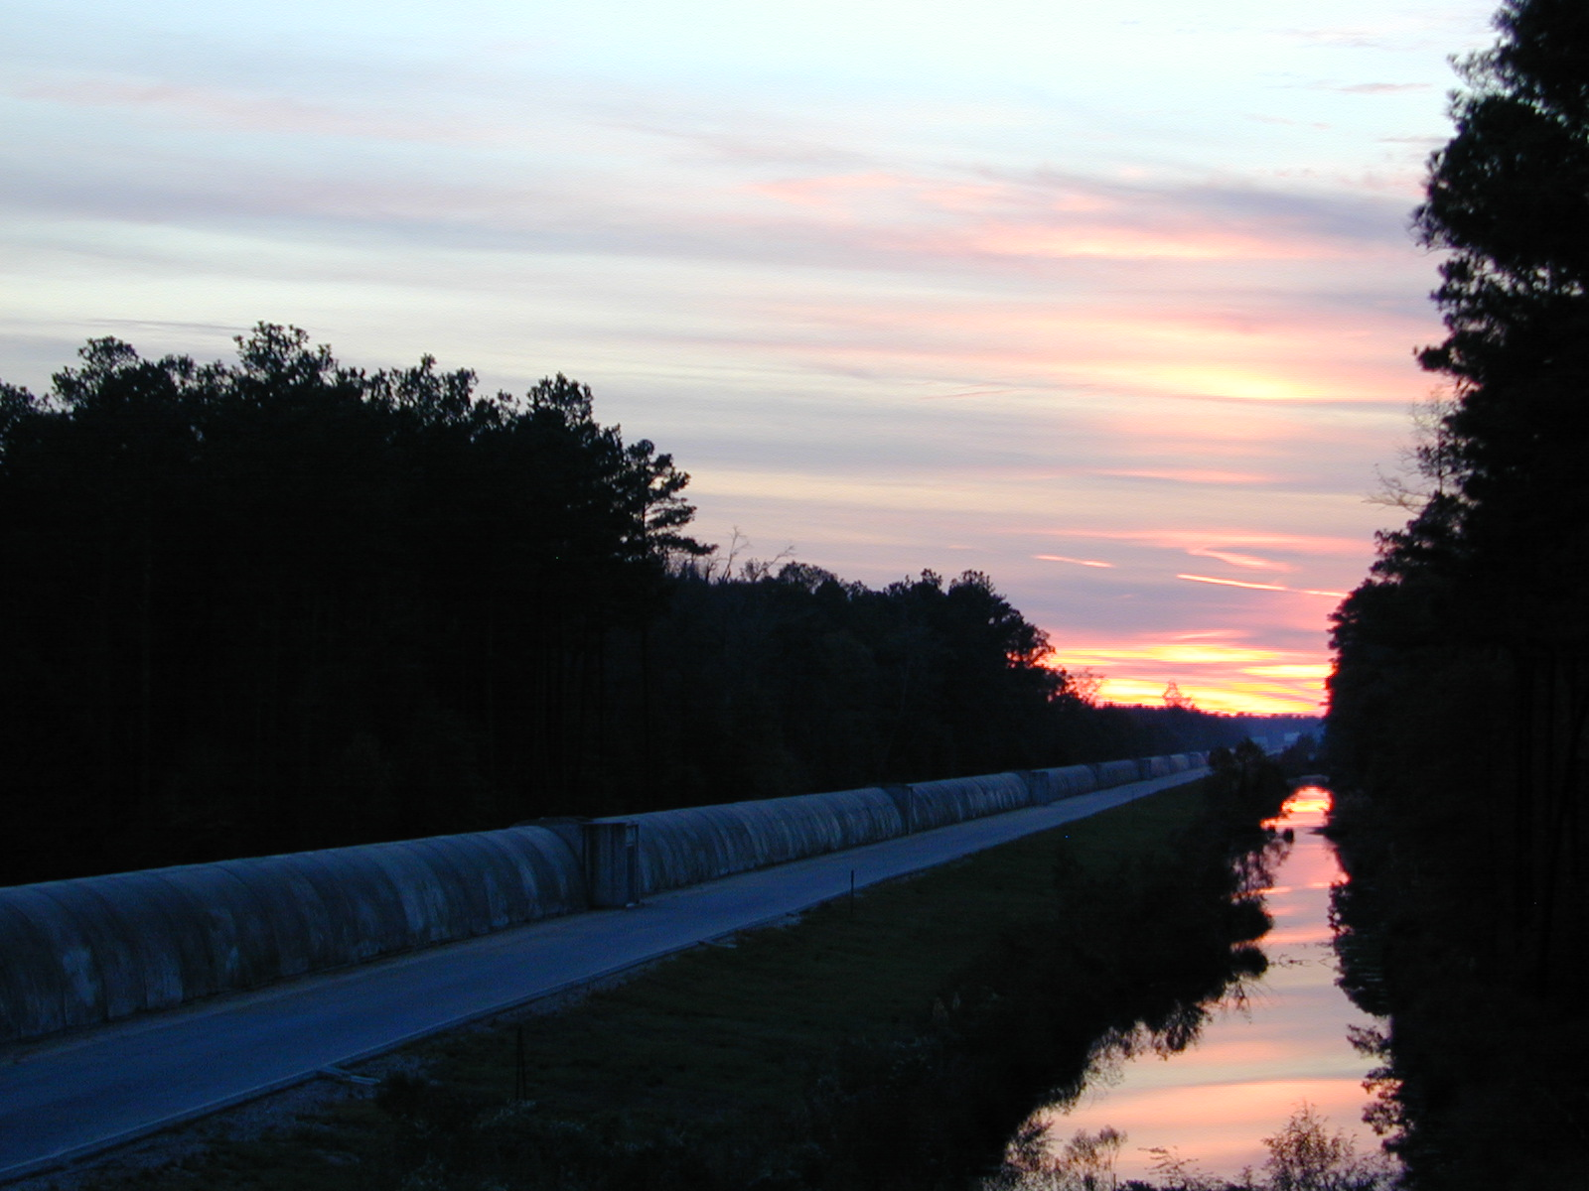

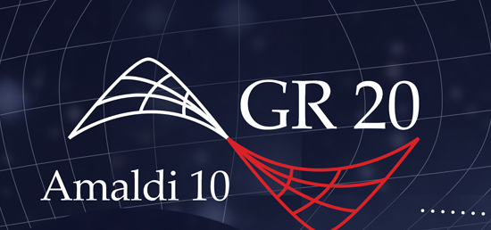
Status of
Advanced LIGO
Lisa Barsotti
MIT-LIGO Laboratory
On behalf of the
LIGO Scientific Collaboration
LIGO-G1300708
Amaldi/GR20 Conference – July 8, 2013

Slide 2

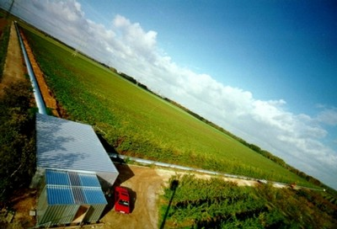

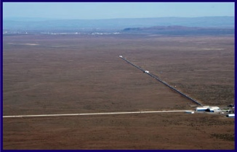
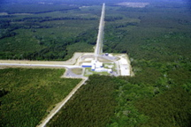
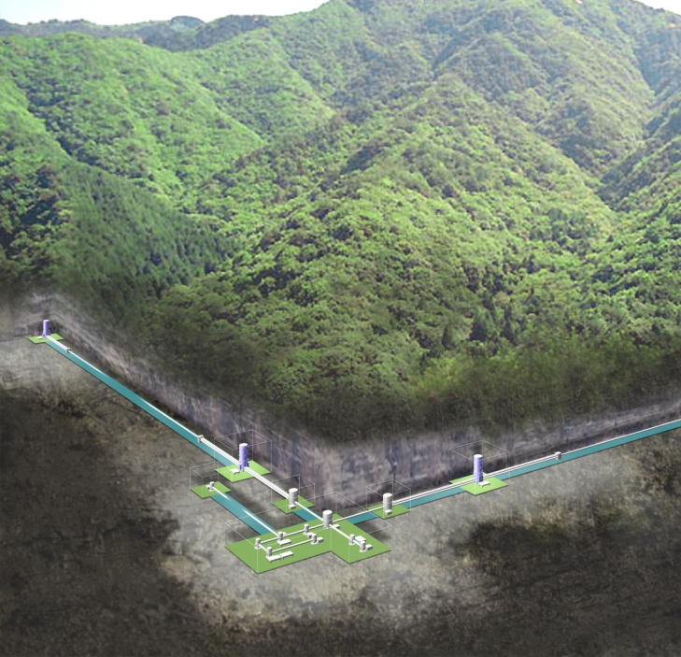

Upcoming Advanced Detector Network
GEO
VIRGO
LIGO H1
LIGO L1
KAGRA
LIGO-India
Plans for placing a third aLIGO instrument in India are well advanced, search for suitable sites underway
Credit: C. Mayhew & R. Simmon (NASA/GSFC), NOAA/ NGDC, DMSP Digital Archive

Slide 3
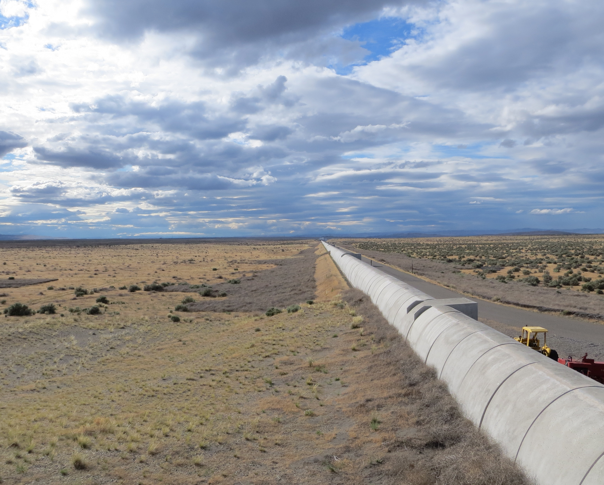
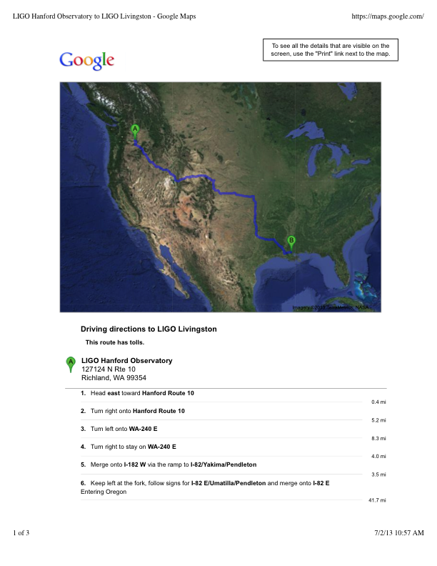
Hanford (Washington State) & Livingston (Louisiana)
4 km arms
Ultra High Vacuum:
Hanford–Livingston: 36 hours drive
10 ms if traveling at the speed of light

Slide 4
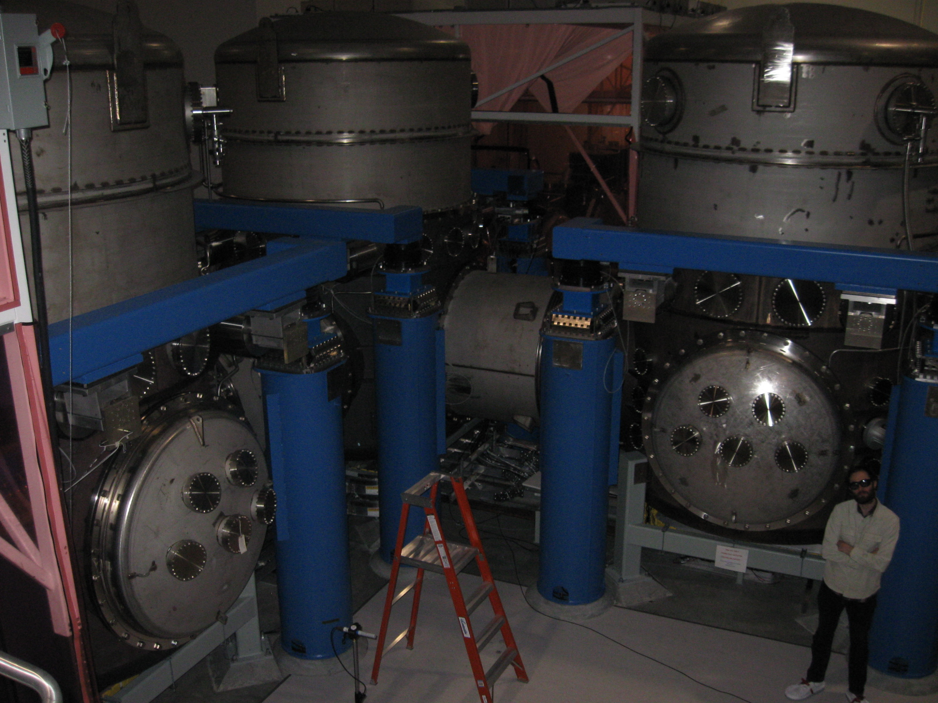
Hanford (Washington State) & Livingston (Louisiana)
4 km arms
Ultra High Vacuum:
Hanford–Livingston: 36 hours drive
10 ms if traveling at the speed of light

Slide 5
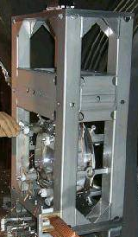
How LIGO looked like (2001-2010)
Simple Pendulum
LASER
Up to 20 W of laser power

Slide 6
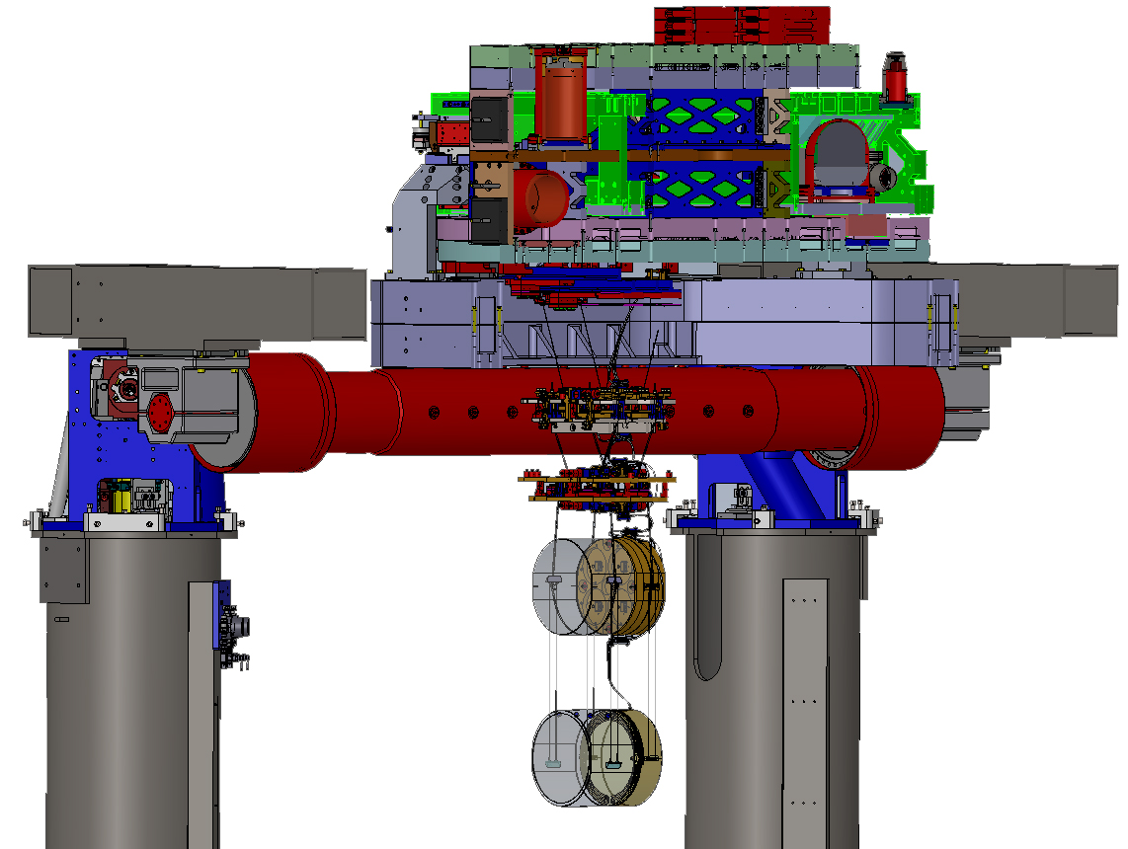
Advanced LIGO in a Nut Shell
Larger mirrors
More laser power
Less seismic noise
Better optical layout
LASER
Up to 125 W of laser power

Slide 7
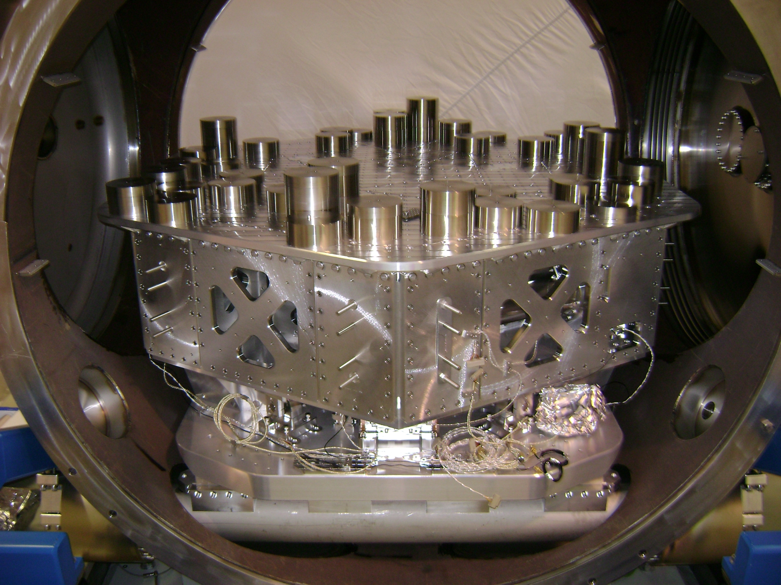
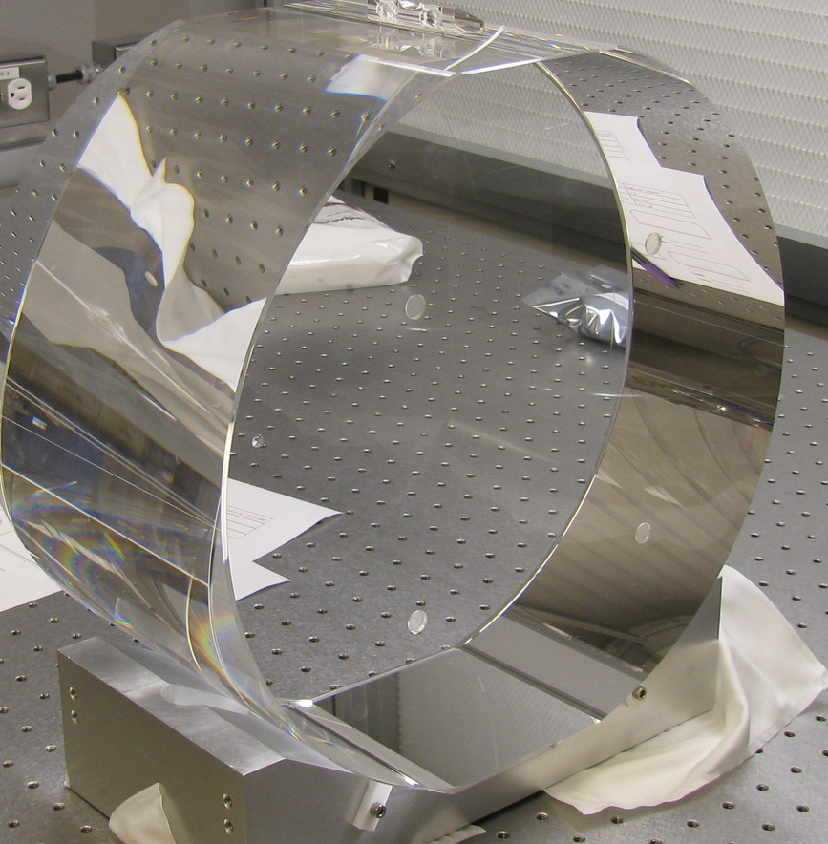
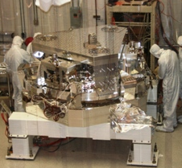
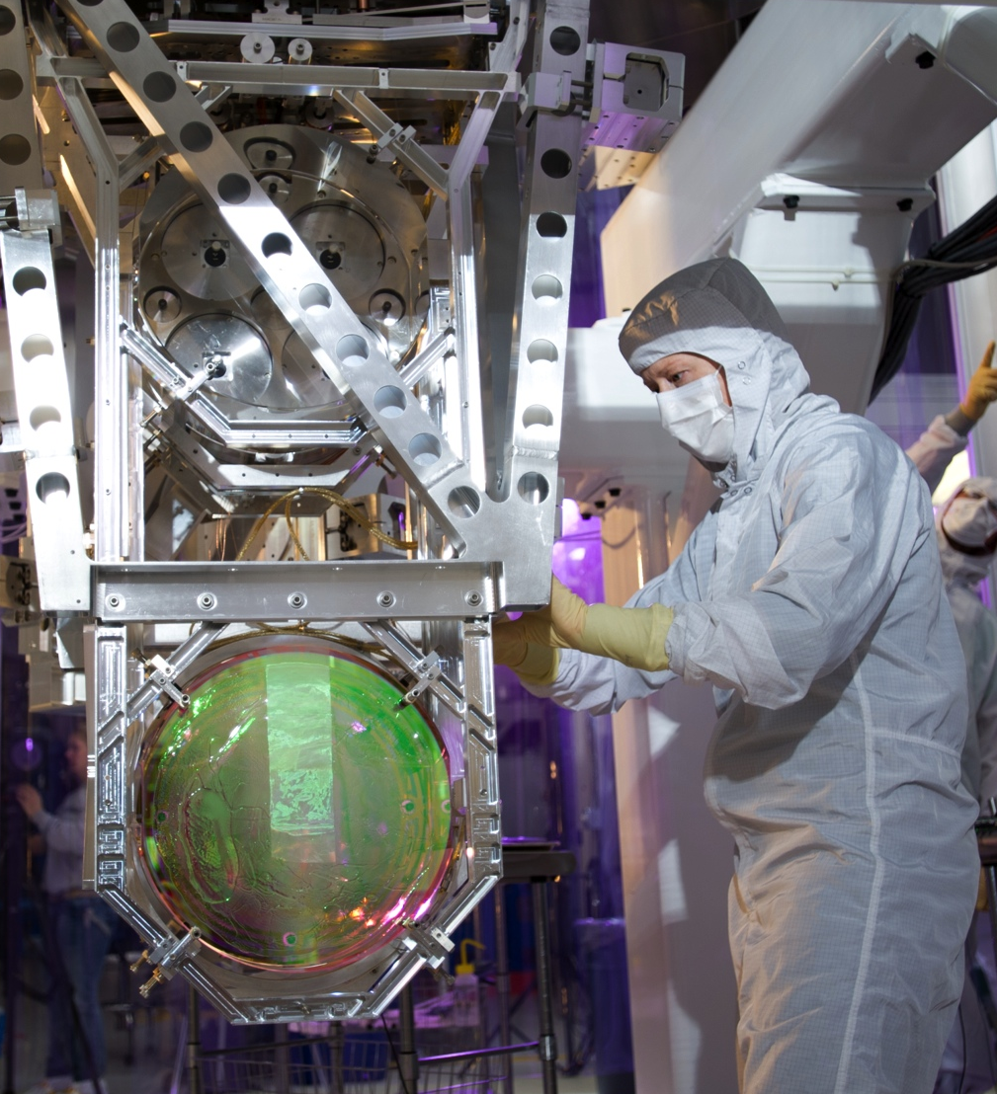
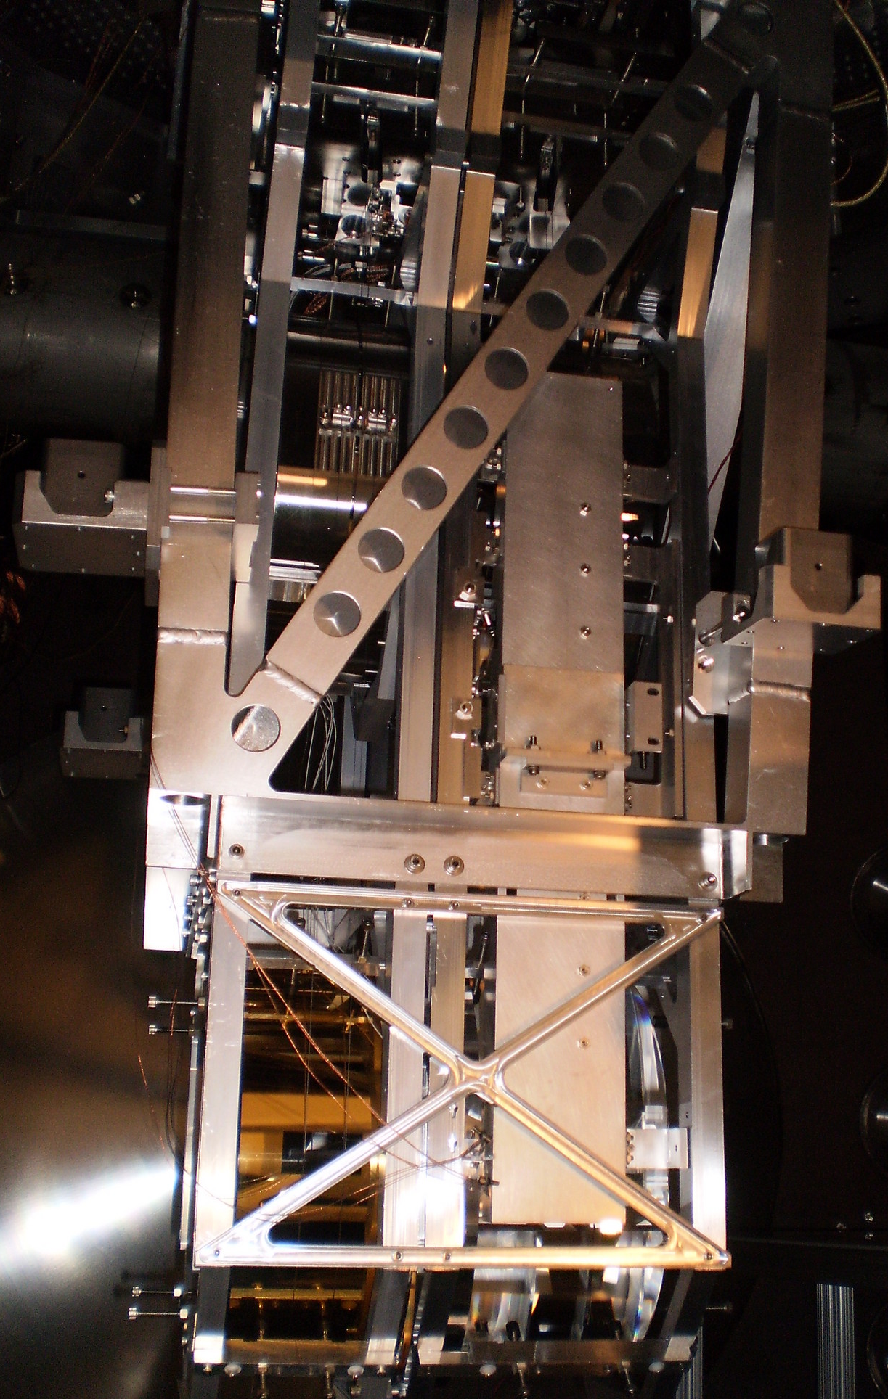
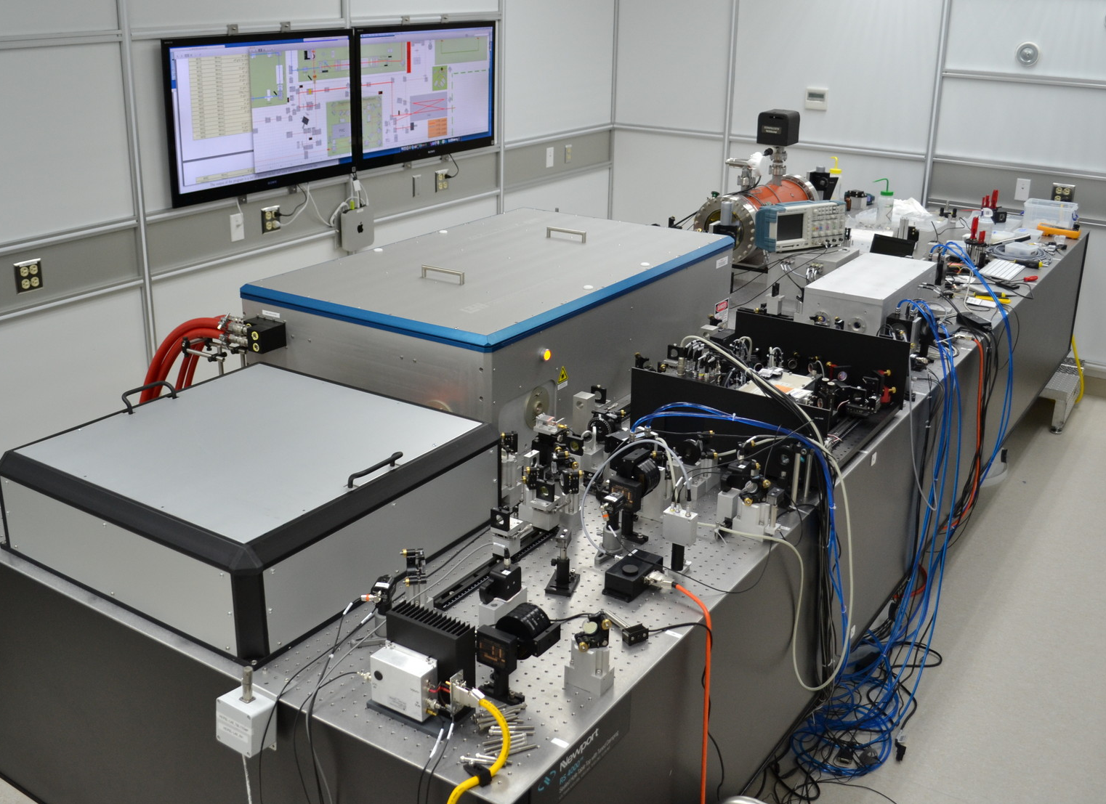
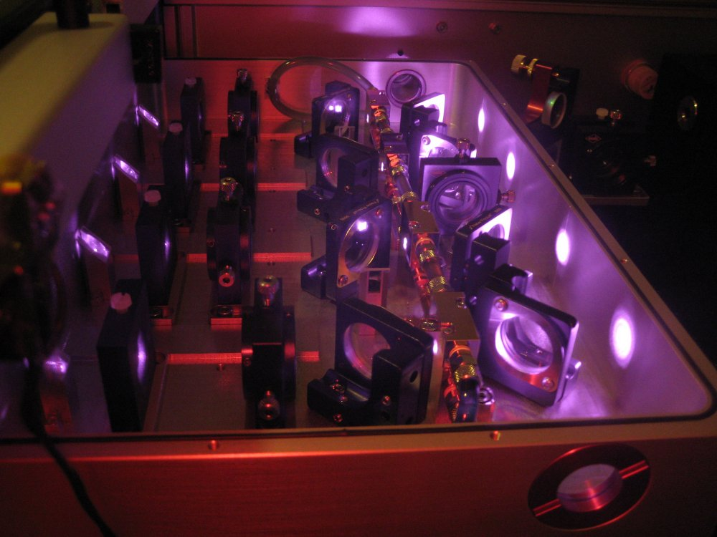
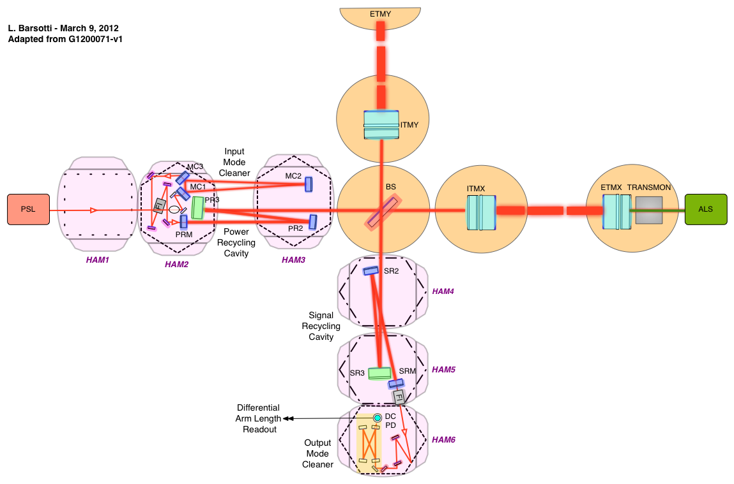
Advanced LIGO
Albert Einstein Institute
University of Glasgow

Slide 8
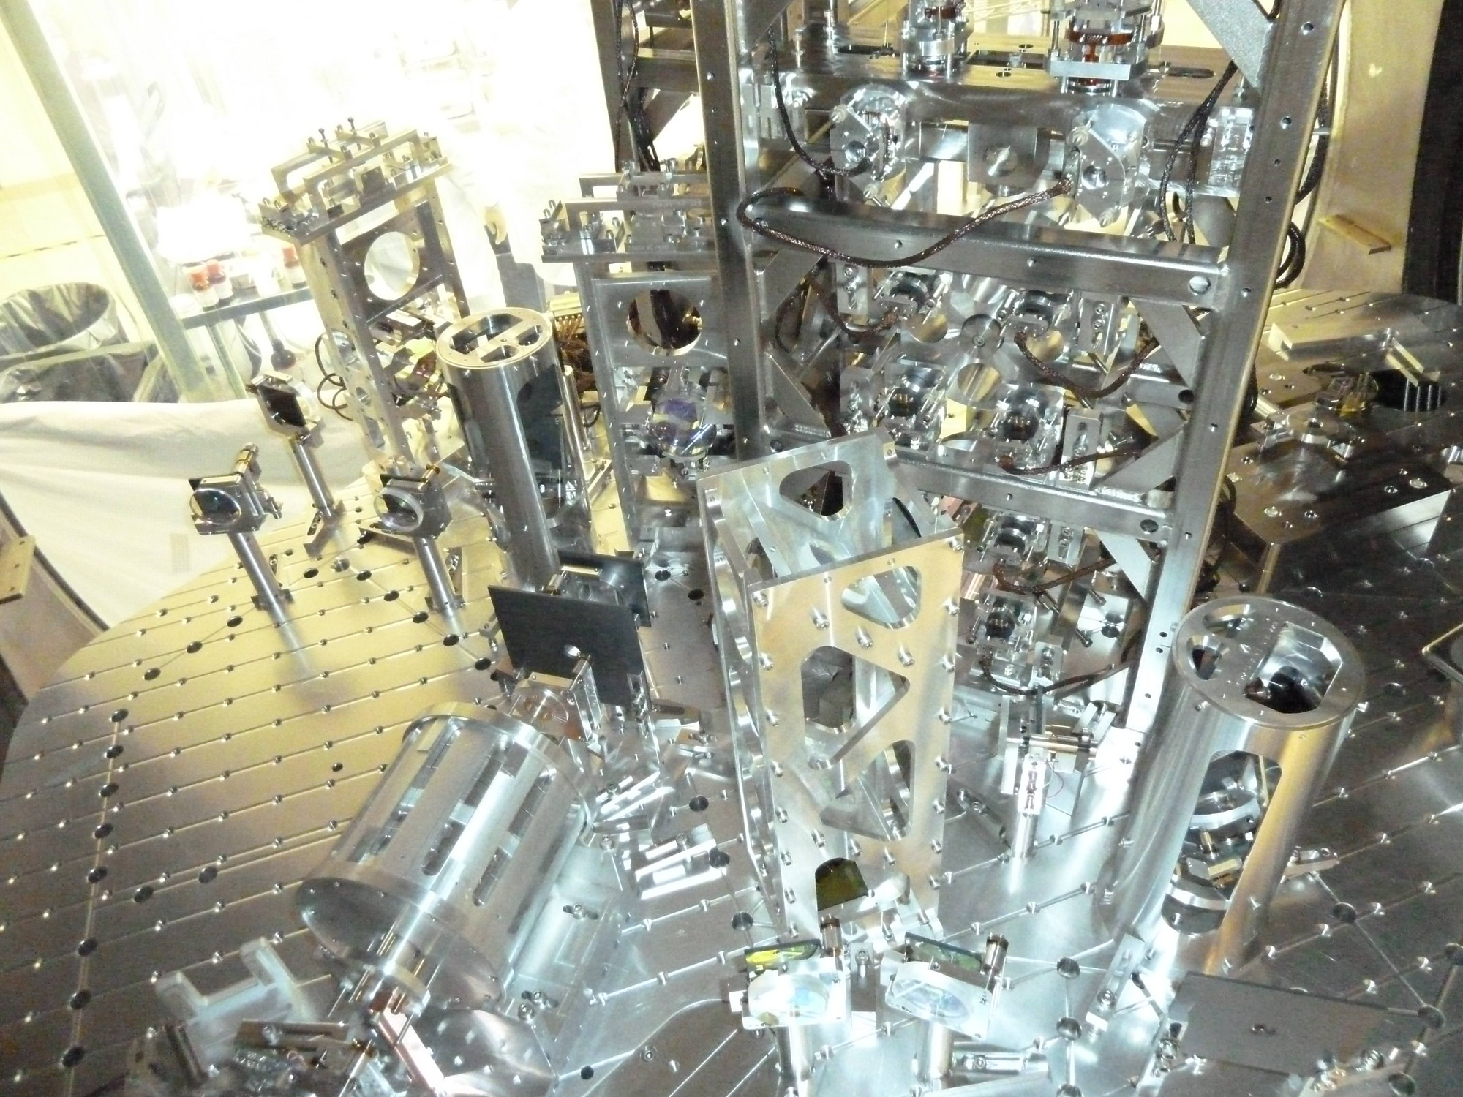
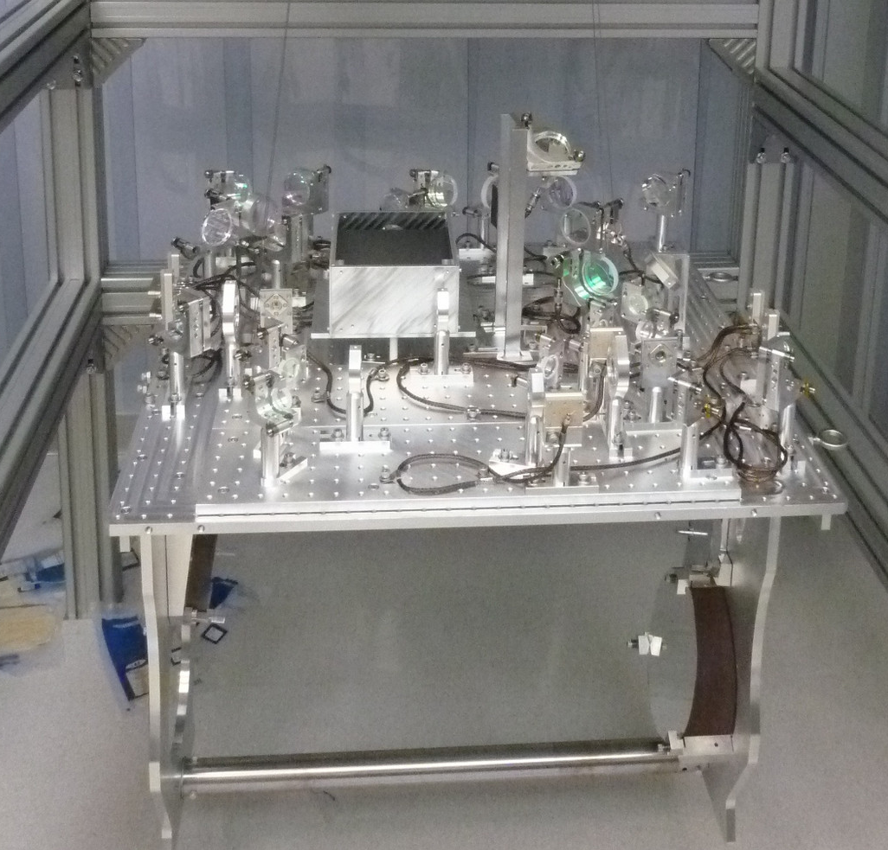
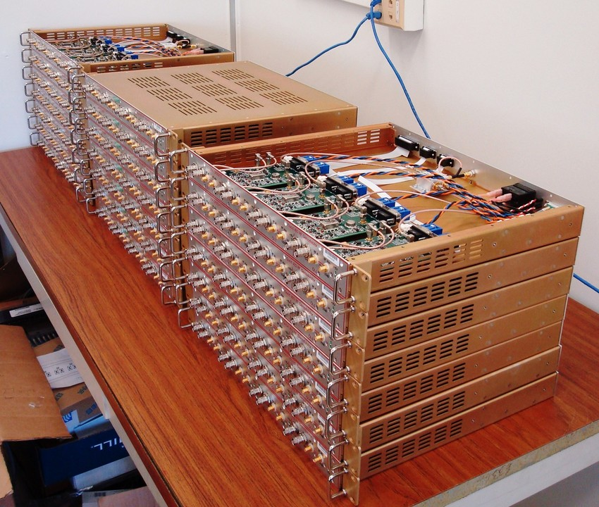
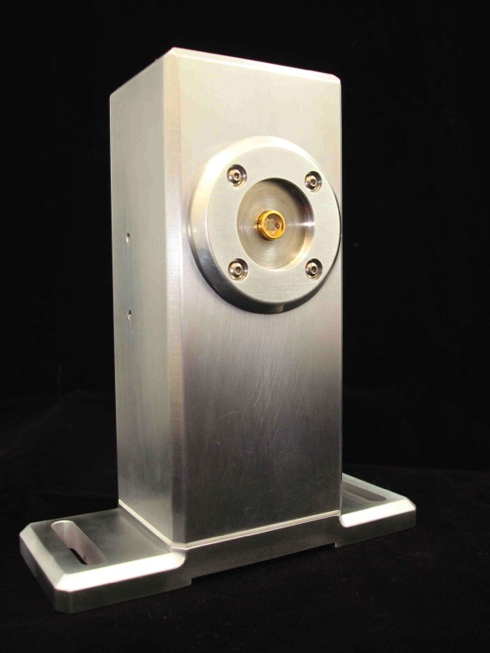
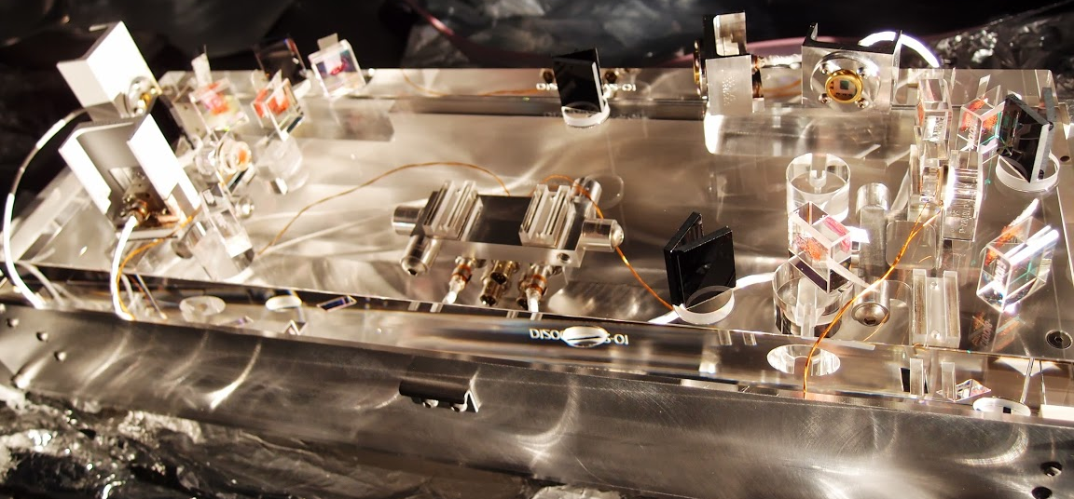
“EVERYTHING is better in Advanced LIGO!”
INPUT OPTICS
TRANSMISSION MONITOR
ELECTRONICS
OUTPUT MODE CLEANER

Slide 9
We want a scientifically interesting sensitivity as soon as possible
TENTATIVE TIMELINE:
Complete integration by 2014
(interferometer “locked”)
“Early” Science Run in 2015
(~60 Mpc)
Within a factor of 2 of design sensitivity by 2016 (~100 Mpc)
http://arxiv.org/abs/1304.0670
Does it seem slow?

Slide 10
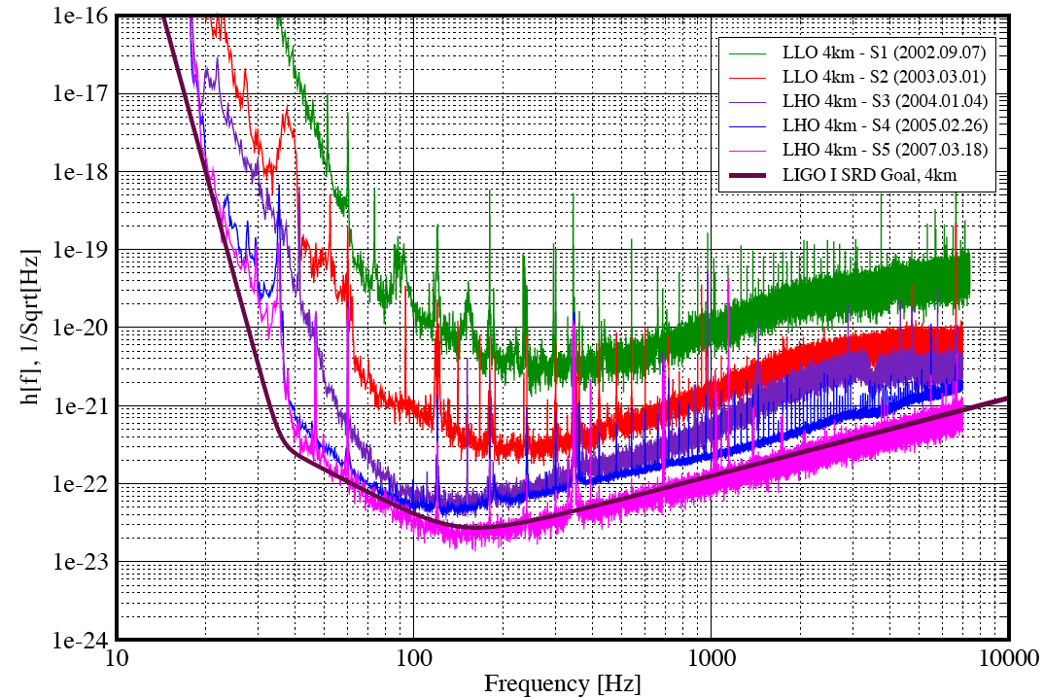
It actually took longer the first time..
LIGO: First lock at the end of 2000…
Technical Noise!
2002
2003
2004
2005
2007
Design
Fundamental Noises

Slide 11
…but this time will be different!
Advanced LIGO Installation and Commissioning Strategy:
Extensive “standalone” testing before installation
Installation of “new” things as soon as possible
Configurations of increased complexity
Parallel effort between Hanford and Livingston
Better design and engineering informed by LIGO,
more experienced staff
It took 4 months to lock the input mode cleaner cavity in LIGO,
it took less than 1 week in Advanced LIGO (the first time at Livingston), more like 1 day the second time at Hanford

Slide 12

“Half Interferometer” in progress @ Hanford
(now one arm, in the fall the other)
LHO
Auxiliary green laser to stabilize the arm cavity length
First measurement of arm cavity motion

Slide 13
“Arm Length Stabilization” System
LHO
in collaboration with the Australian National University
MAIN LASER
Auxiliary LASER
Green light follows the arm cavity
Beat signal gives us the ability of controlling the main laser frequency relative to the green laser frequency


Beat Signal
Green light won’t be used in “science mode”
but it will help us to bring the interferometer on
its working point reliably
C3: Tuesday, 17:18 - 17:36 Adam Mullavey (LIGO Livingston) The Arm Length Stabilization System for Advanced LIGO Lock Acquisition

Slide 14
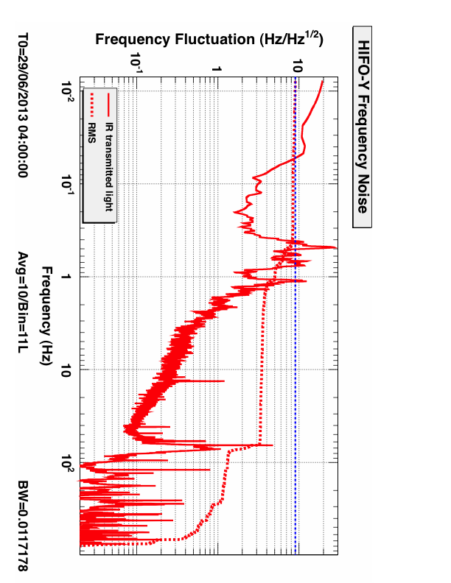
“Arm Length Stabilization” System
LHO
Frequency fluctuations of main laser light is already “good enough”
(1/10 of the cavity linewidth), “noise hunting” still in progress
GOAL: 8 Hz RMS

Slide 15
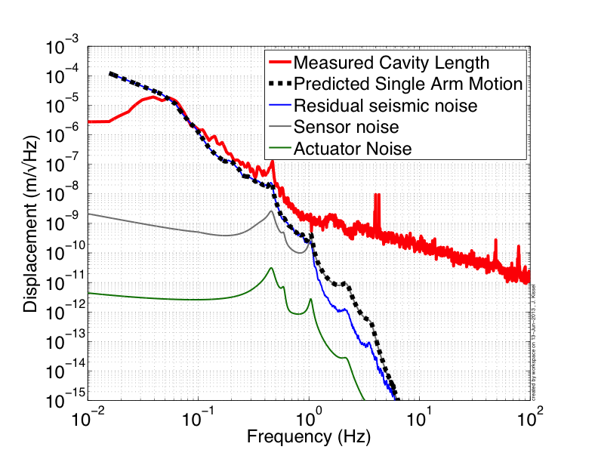
Cavity motion in good agreement with model (Jeff Kissel, MIT)
LHO
Frequency Noise
15

Slide 16

“Short” Interferometer in progress @ Livingston
(Dual Recycled Michelson Interferometer)
LLO
Lock of the central part of the interferometer
(“everything except the arms”)
First configuration with
interesting sensitivity

Slide 17
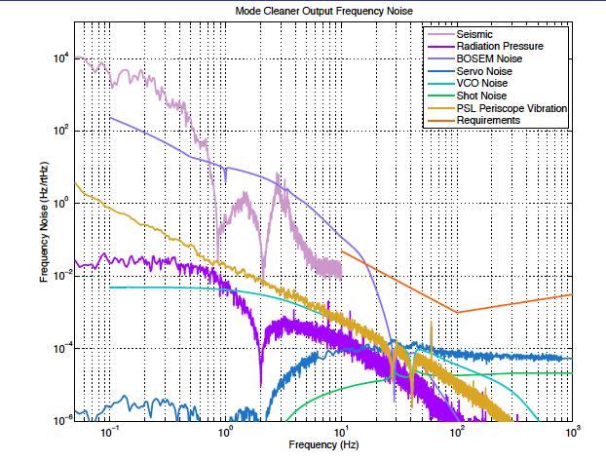
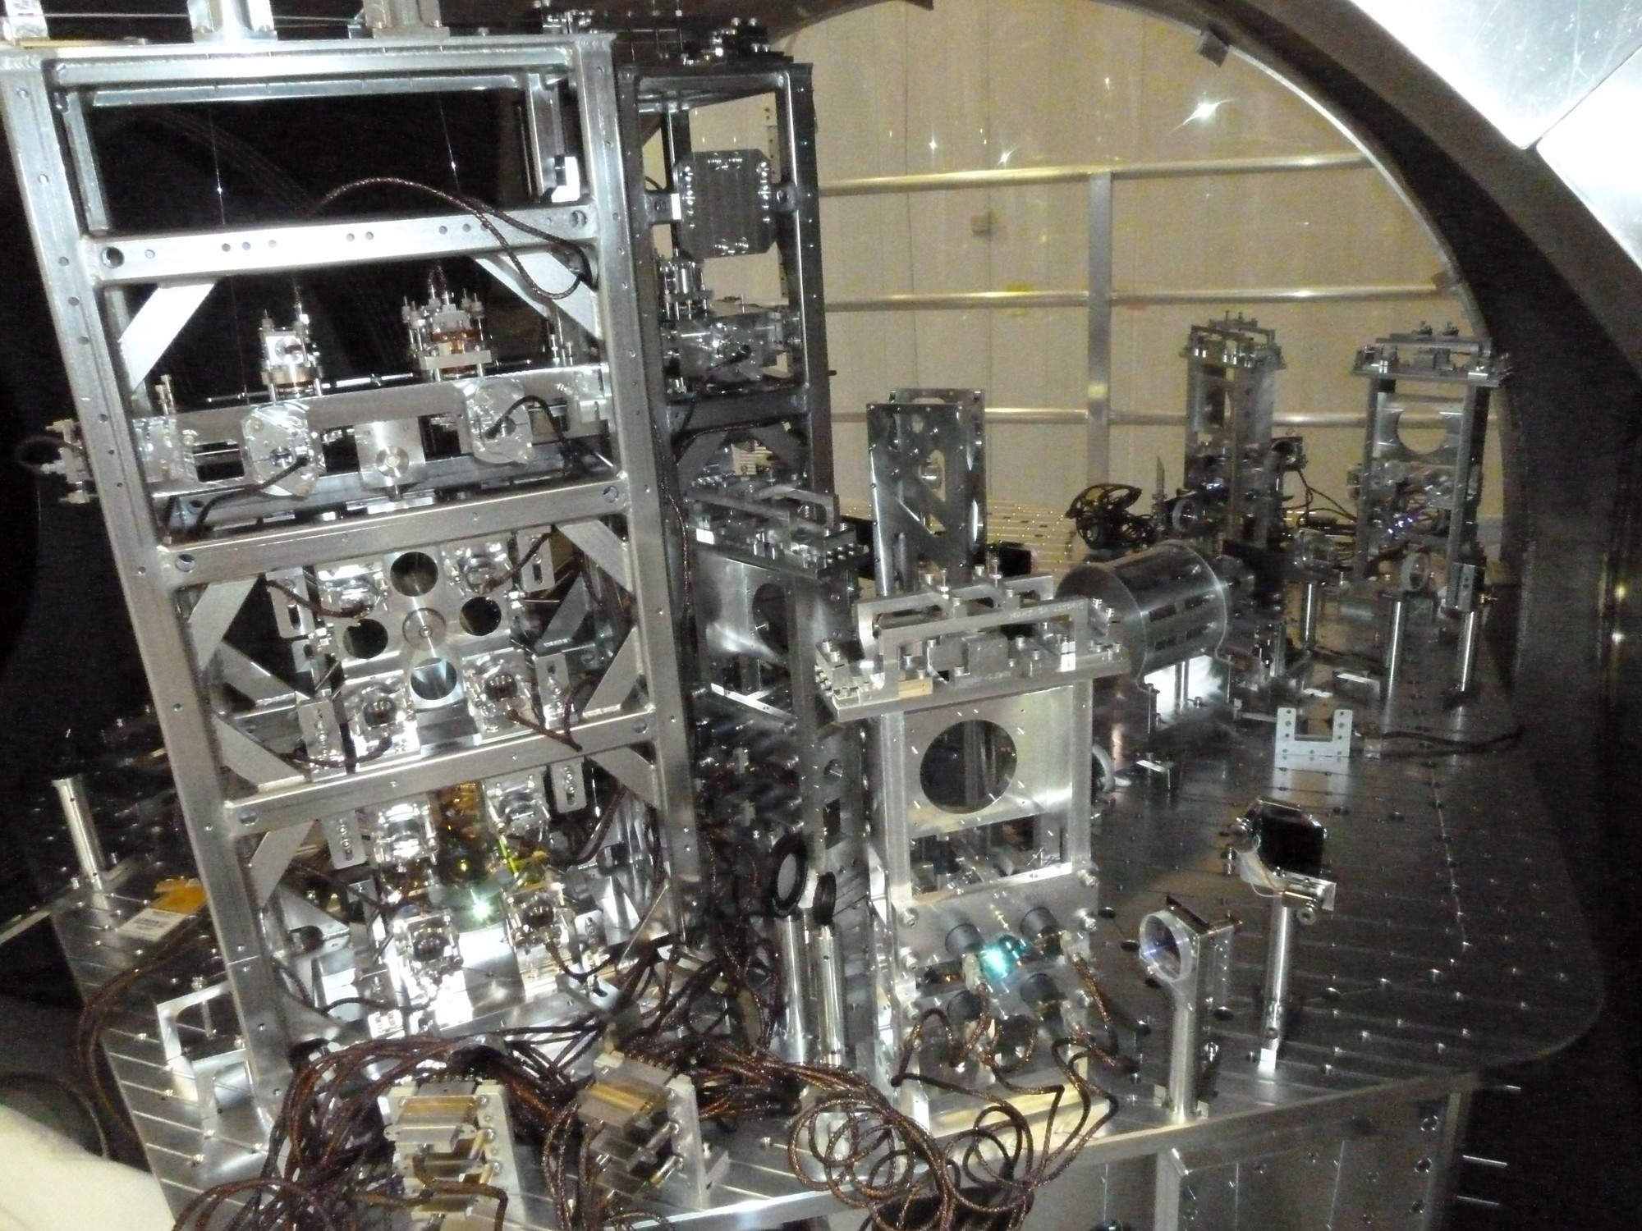
The Input Mode Cleaner
LLO
C3: Tuesday, 17:00 - 17:18 Chris Mueller (University of Florida) Characterization of the Input Optics for the Advanced LIGO Detectors
MODE CLEANER OUTPUT FREQUENCY NOISE (Hz)
17
FREQUENCY (Hz)

Slide 18
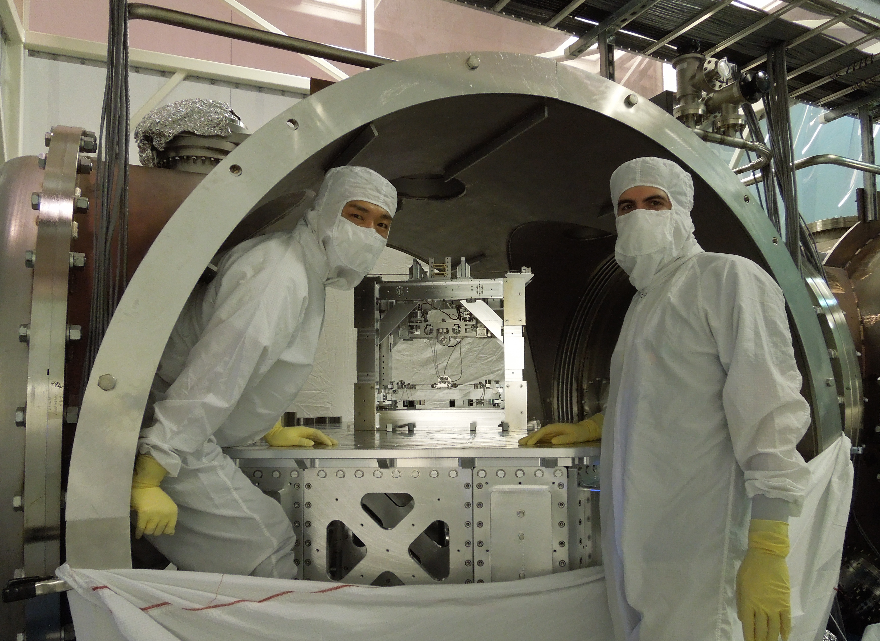
Dual Recycled Michelson Interferometer
LLO
The aLIGO Output Mode Cleaner
Installation almost completed
Commissioning just started
Short Michelson already locked
Output mode cleaner installation
18

Slide 19
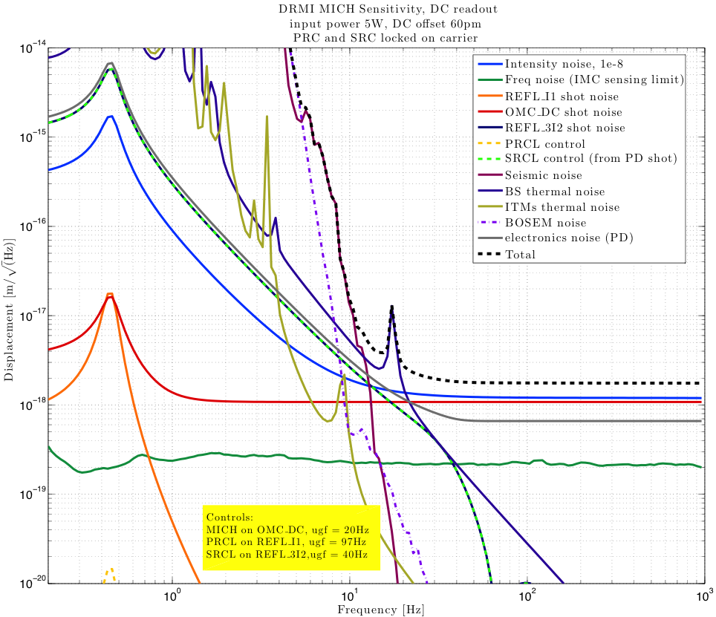
DRMI Noise Budget Model
(Anamaria Effler, LSU-LIGO Livingston)
LLO

Slide 20
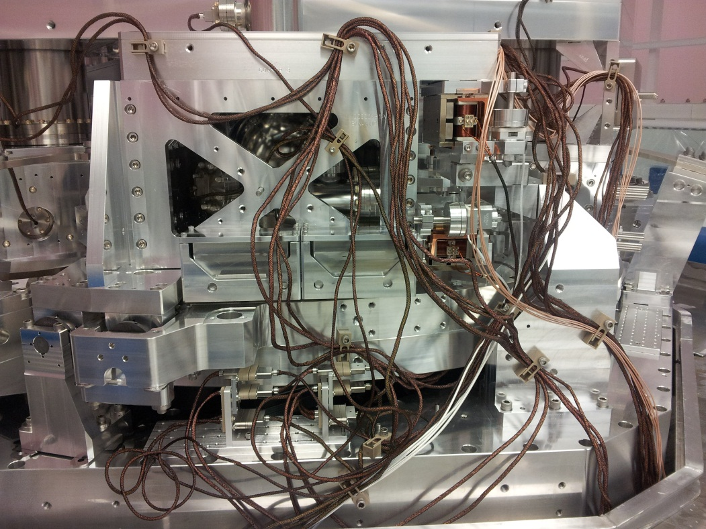
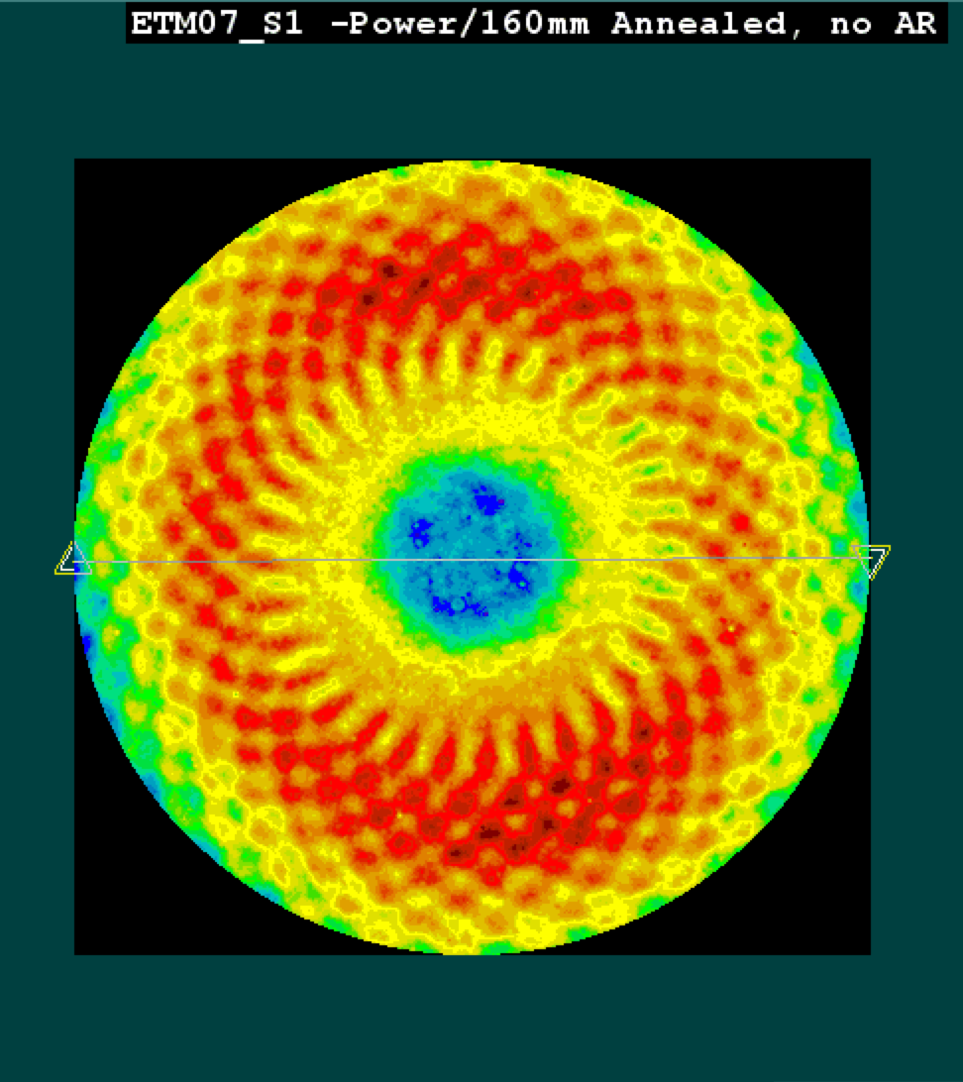
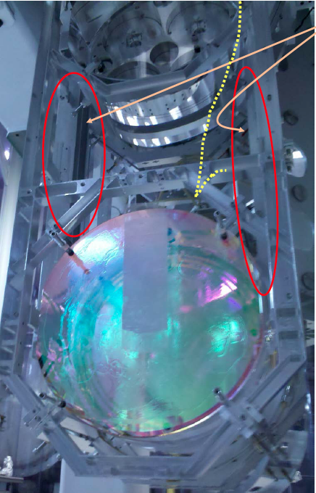
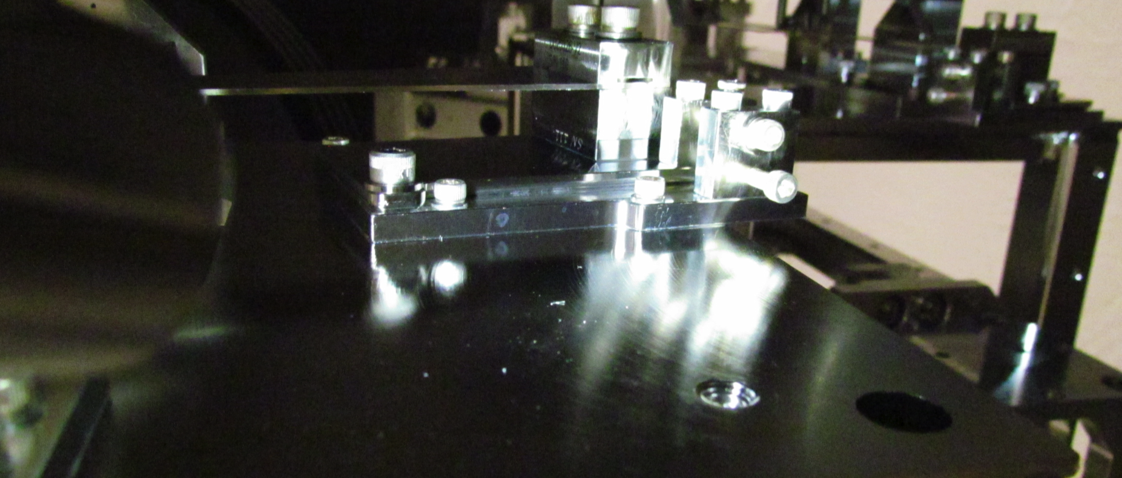
Bumps in the road, but no showstoppers

Slide 21
Outlook
Within a couple of months:
    each “type” of chamber will have been populated at least at one of the two sites
    main steps of lock acquisition sequence will have been tested, full locking in progress at the Caltech 40m prototype
“Second-site” testing to follow
(DRMI @ LHO, Arms @ LLO)
Full Interferometer Lock:
    Starting February 2014 @ LLO
    Starting May 2014 @ LHO
On track for Advanced LIGO “acceptance” target
    “2 hours of lock”, end of 2014

Slide 22
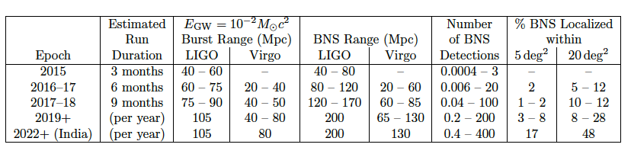
Detection Rates
Neutron Star Binaries:
  Advanced LIGO: ~ 200 Mpc
  “Realistic rate” ~ 40/year
  Class. Quant. Grav. 27, 173001 (2010)
  (Initial LIGO: ~15 Mpc, Rate ~1/50years)
http://arxiv.org/abs/1304.0670
22
Notes:
P0900125-v8

Slide 23
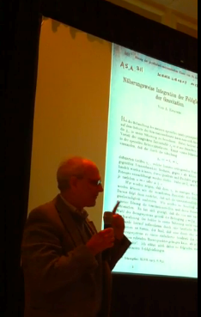
The Message
The sooner we detect gravitational waves, the better!
Advanced LIGO aims to reach a scientifically interesting sensitivity as soon as possible (~60 Mpc @ 2015, ~100 Mpc @ 2016)
Several pieces of Advanced LIGO have been already installed and commissioned...
Still a lot of work to do, but so far so good!
2016!

Slide 24
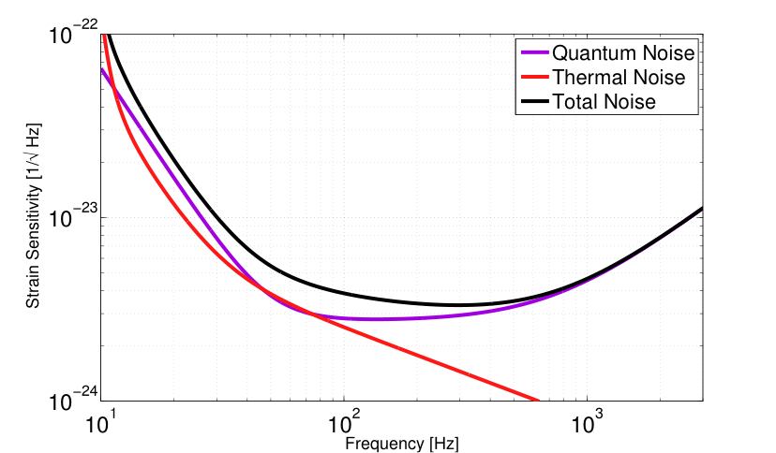
By the way, is Advanced LIGO the best that we can do?
SEISMIC
WALL
aLIGO design sensitivity
C3: Tuesday, 17:54 - 18:12 Sheila Dwyer (LIGO Hanford Observatory)
Quantum noise reduction using squeezed states in LIGO

Slide 25
Spare slides

Slide 26
Principal Technical Risks
High power operations
  Absorption & thermal compensation; potential parametric instability
Required displacement noise levels not verified directly
  Essentially impossible to test in subscale setups
  Thermal noises (suspension and mirror coating): rely on design calculations; material parameter measurements; scaled noise tests
  Technical noises
Increased complexity
  Number of control loops x10 larger than in iLIGO
  Mechanical systems have many more degrees-of-freedom: Test Mass Quad suspension has 48 DOF, vs. 6 in iLIGO

Slide 27
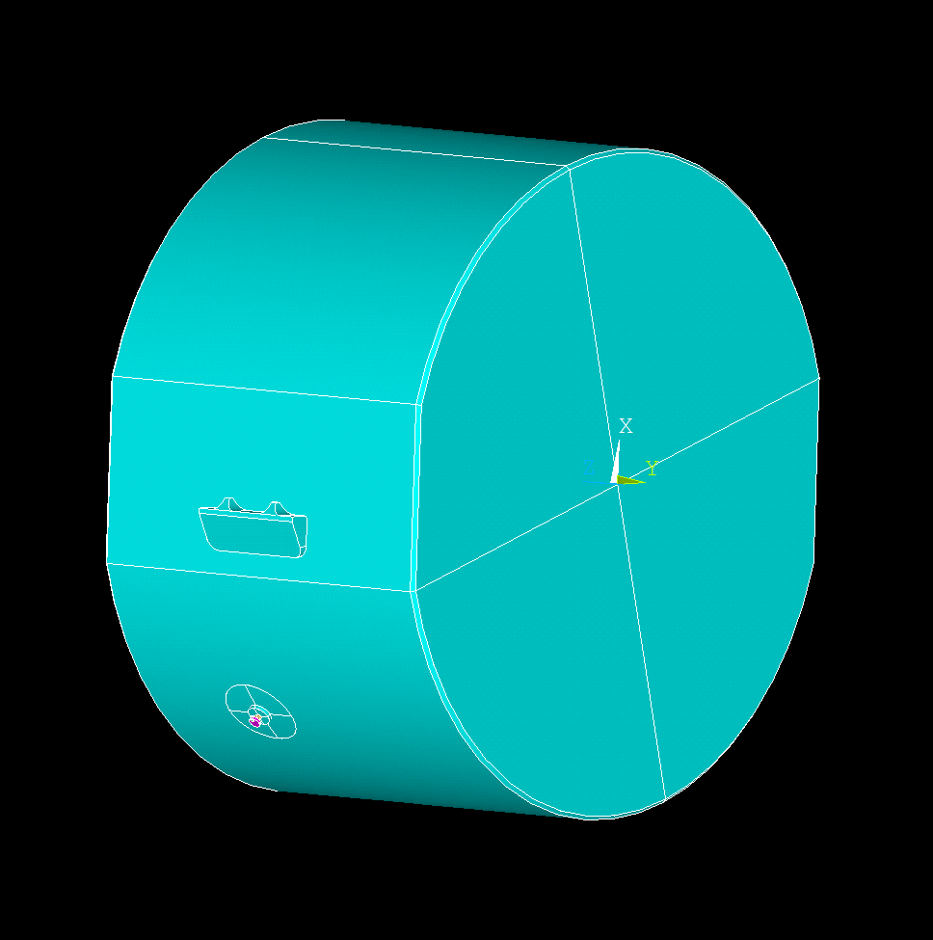
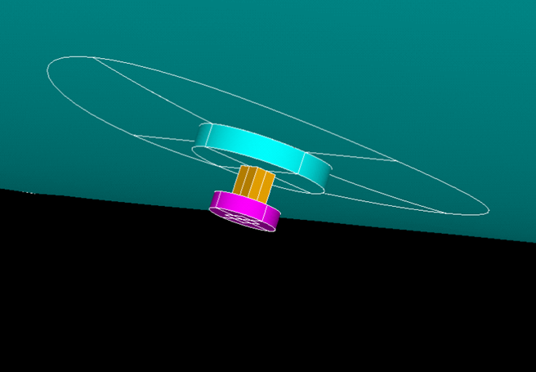
Parametric Instabilities
Slawek Gras (LIGO-MIT)
2. After round trip scattered mode returns to the test mass and couples via radiation pressure into the mechanical mode
1. Test mass mechanical mode scatters fundamental mode (pump) into the higher order mode
POSTER: Acoustic mode damper for parametric instabilities control C3.16

Slide 28
What we call “commissioning”: from installation to science data
Understand and fix an entanglement of noise coupling mechanisms
Example from Enhanced LIGO
HIGH POWER
ALIGNMENT
OPTICS QUALITY
STRAY LIGHT
Noise
THERMAL EFFECTS
Output
Mode-Cleaner
28

Slide 29
Seismic isolation performance
LHO
iLIGO
1000x
aLIGO so far
aLIGO target
29

Slide 30
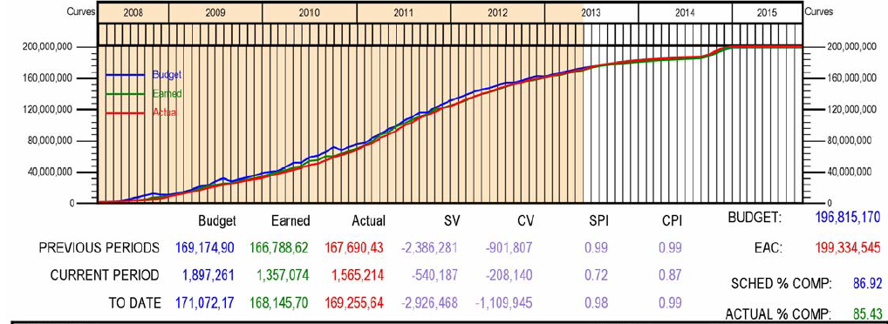
Advanced LIGO is 85.4% complete
30

Slide 31
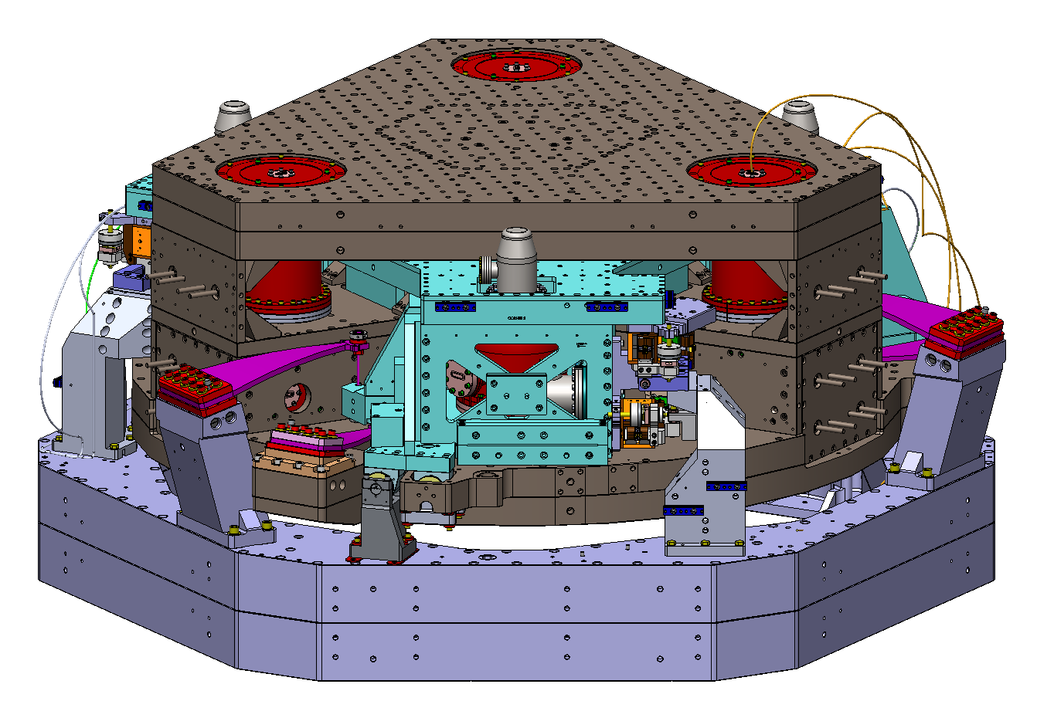
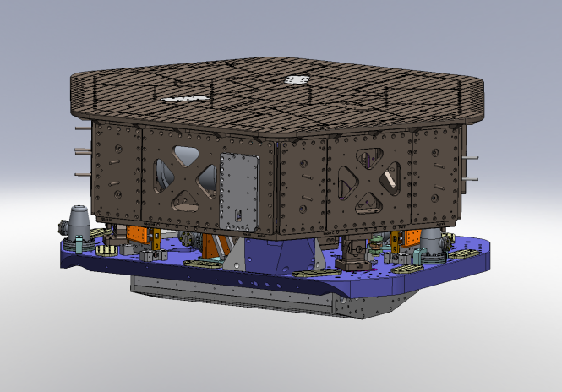
The In-vacuum Seismic Isolators (ISI)
BSC ISI (Core Optics)
HAM ISI (IOO Optics)
Two-stage system
6 DOF motion per stage
Passive isolation 2 x 3 Blade springs + wire flexure systems
Fundamental modes ~ 1Hz
Active isolation 12 and 15 on-board Displacement and Inertial Sensors, with 12 EM Coil actuators
Single-stage System
6 DOF motion single stage system
Passive isolation 3 Blade springs + wire flexure systems
Fundamental modes ~ 1Hz
Active isolation 6 and 6 on-board Displacement and Inertial Sensors, with 6 EM Coil actuators

Slide 32
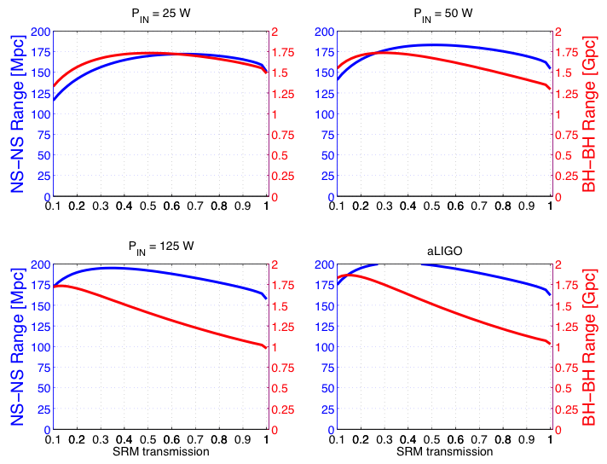
Optimization of SRM transmission

Slide 33
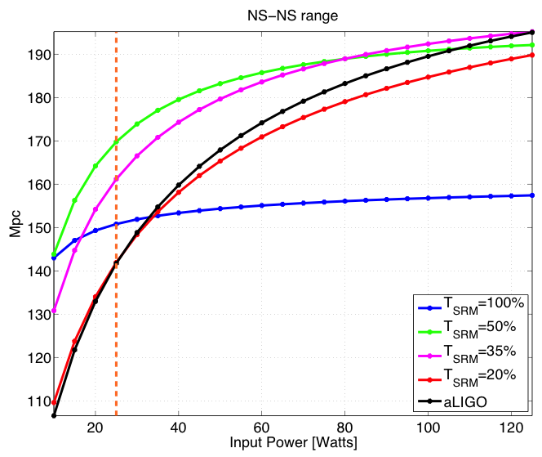
Optimization of SRM transmission

