Slide 1


Status of
Advanced LIGO
Lisa Barsotti
MIT-LIGO Laboratory
On behalf of the
LIGO Scientific Collaboration
LIGO-G1300708
Amaldi Conference – July 8, 2013

Slide 2
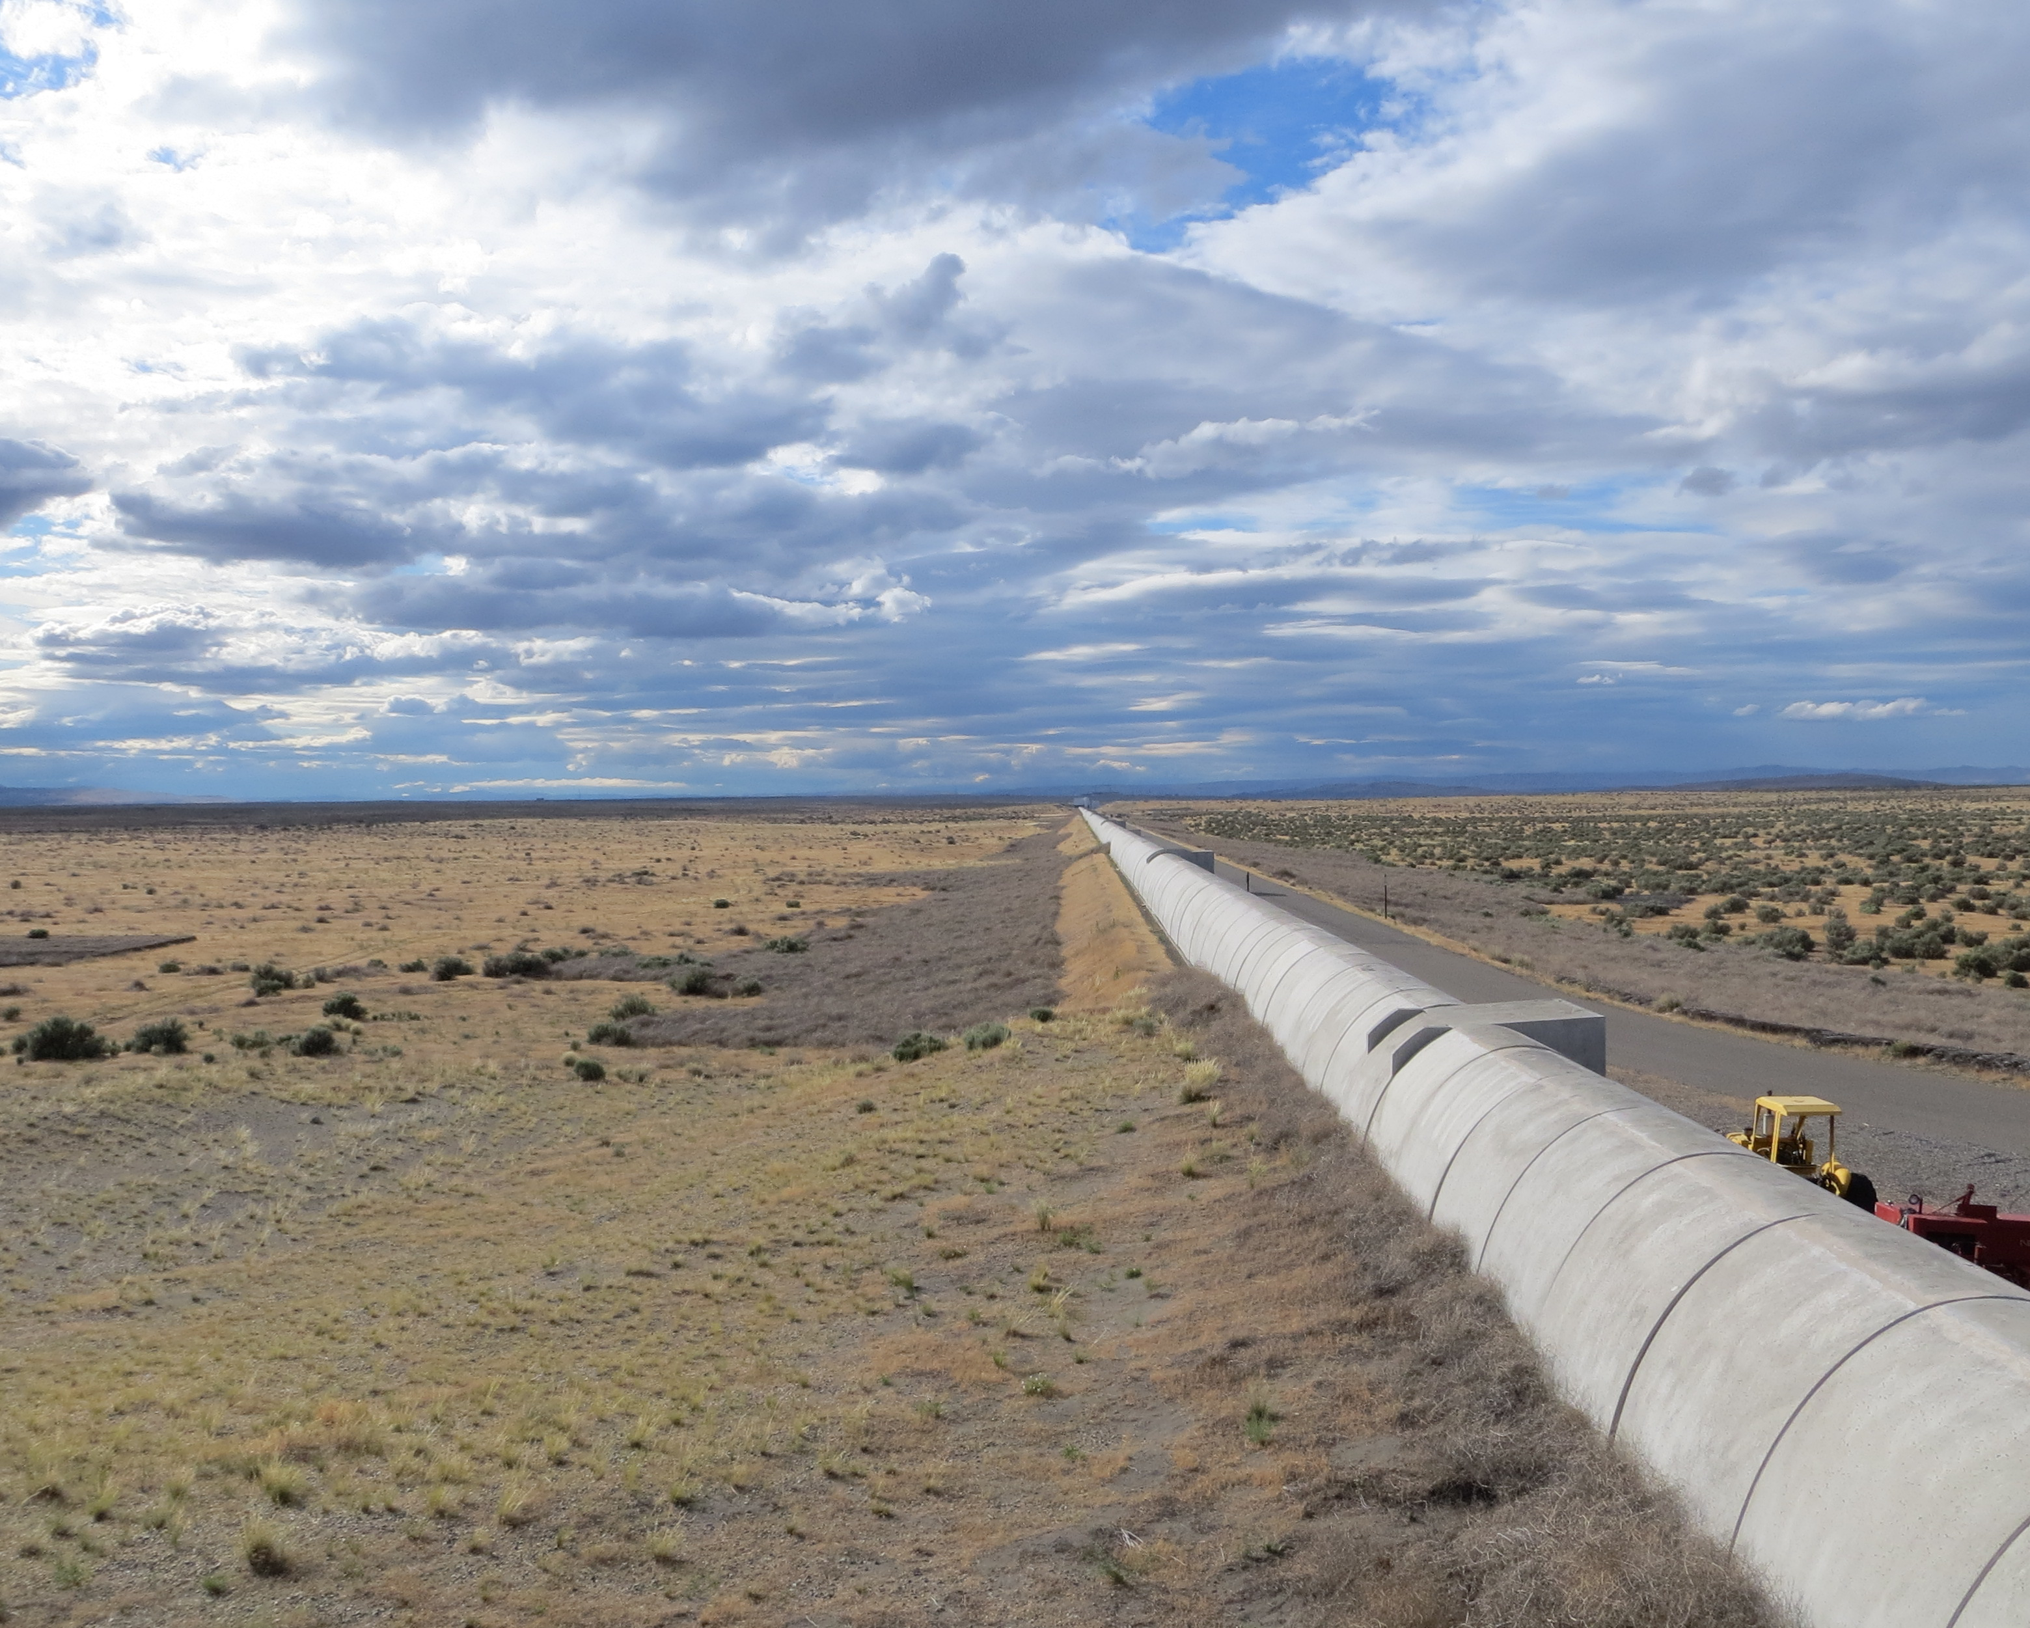
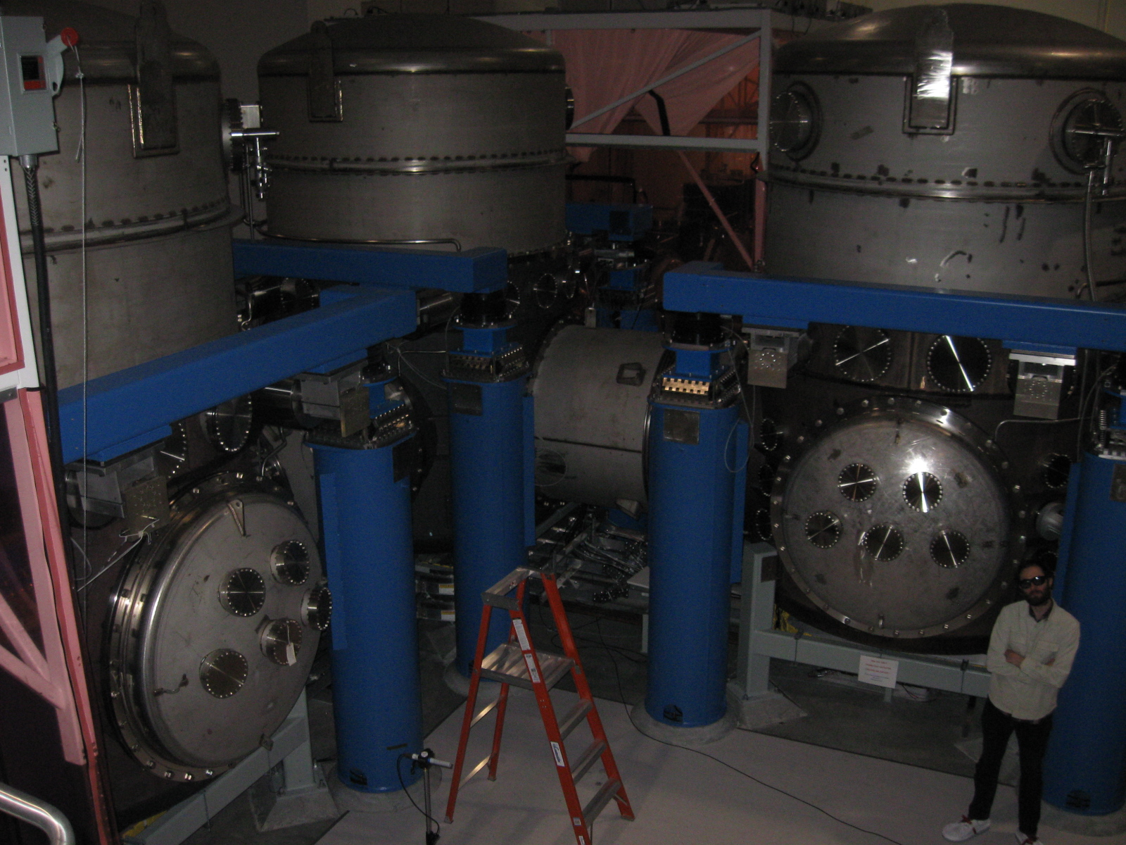
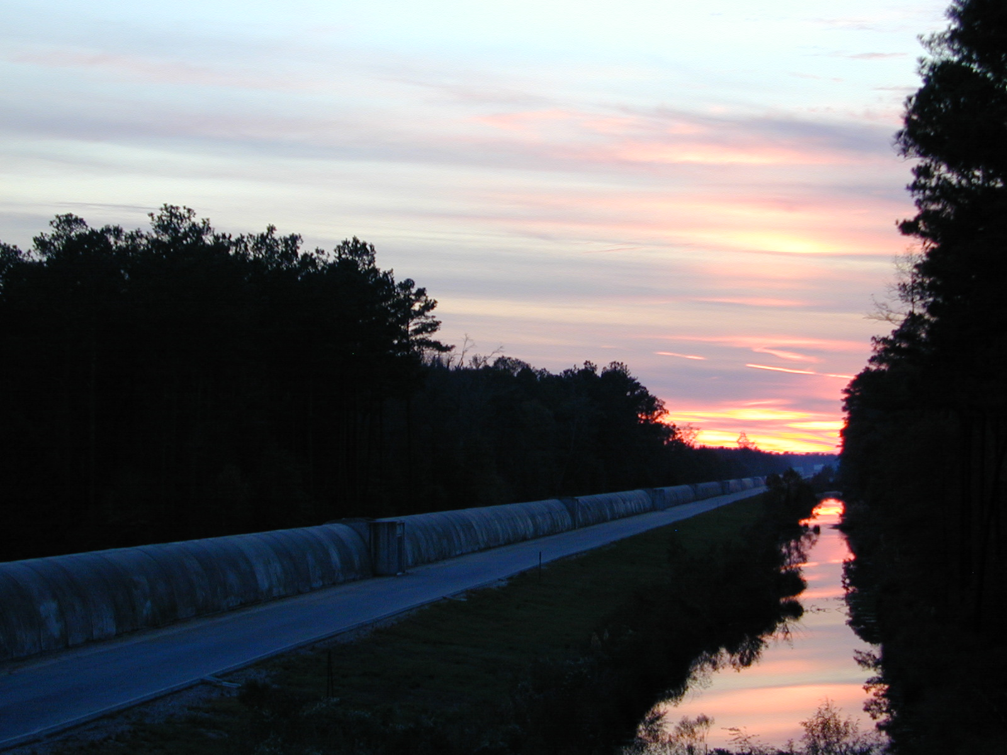
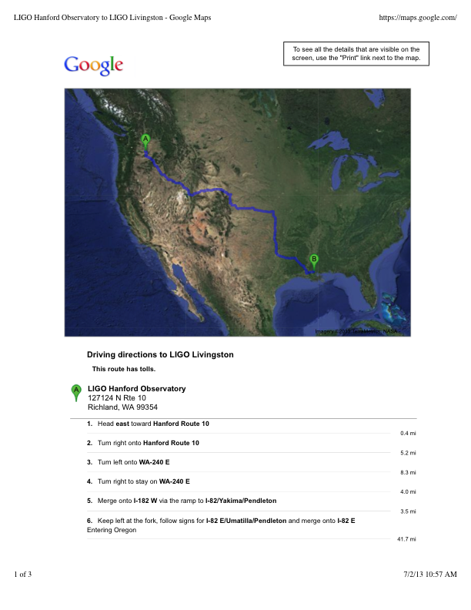
Hanford (WA) & Livingston (LA), 4 km arms

Slide 3
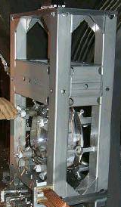
How LIGO looked like (2001-2010)
Simple Pendulum
LASER
Up to 20 W of laser power

Slide 4
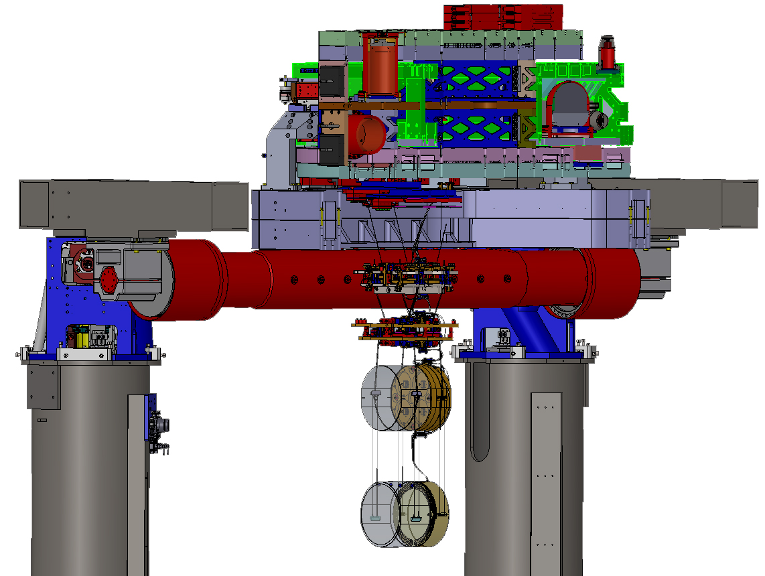
Advanced LIGO in a Nut Shell
Larger mirrors
More laser power
Less seismic noise
Better optical layout
LASER
Up to 125 W of laser power
4

Slide 5
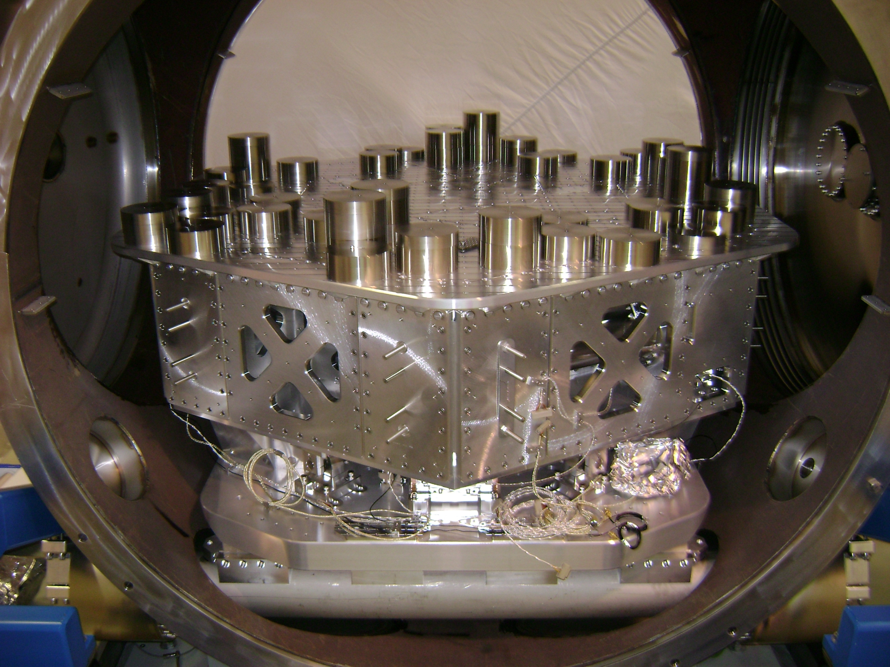
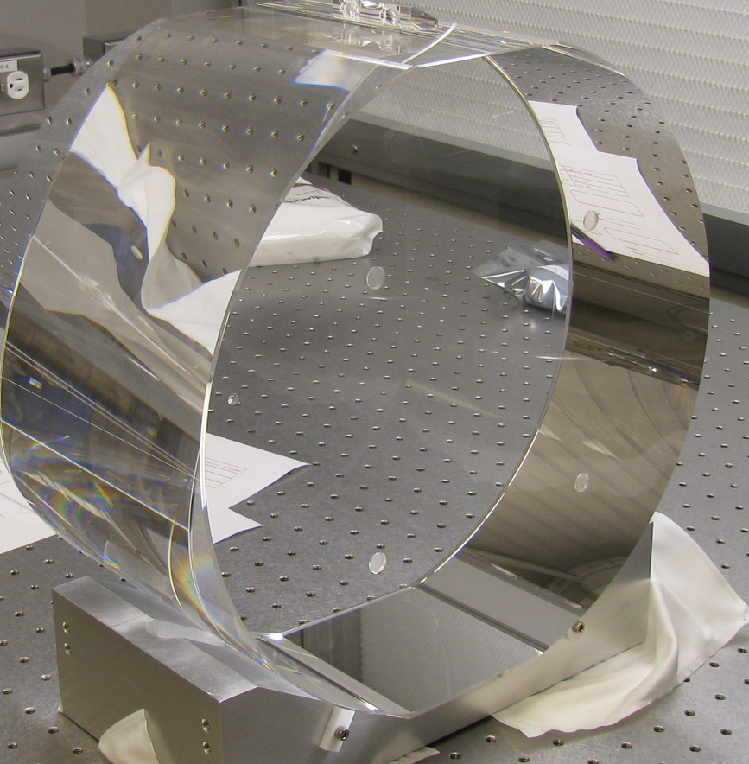
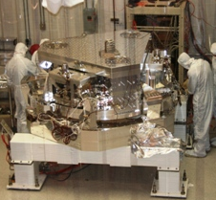
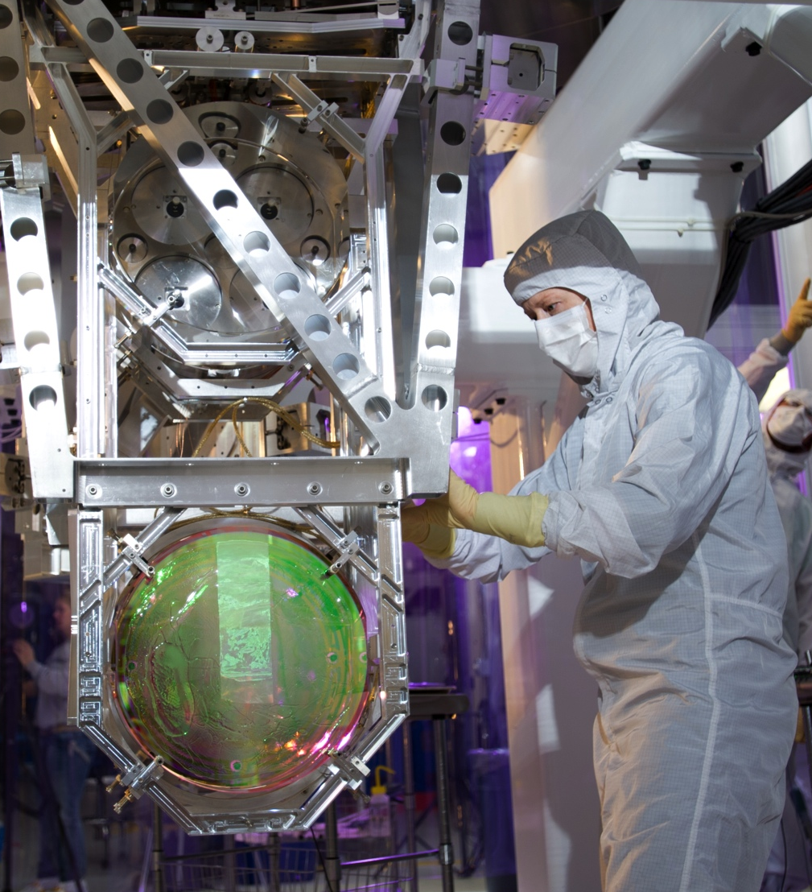
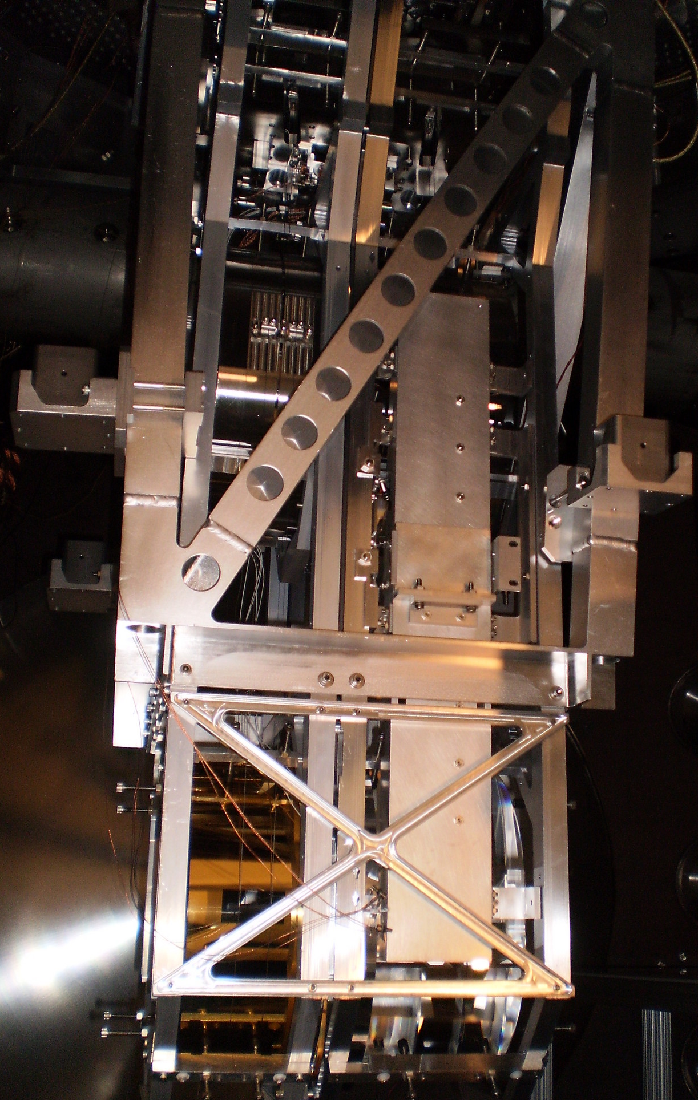
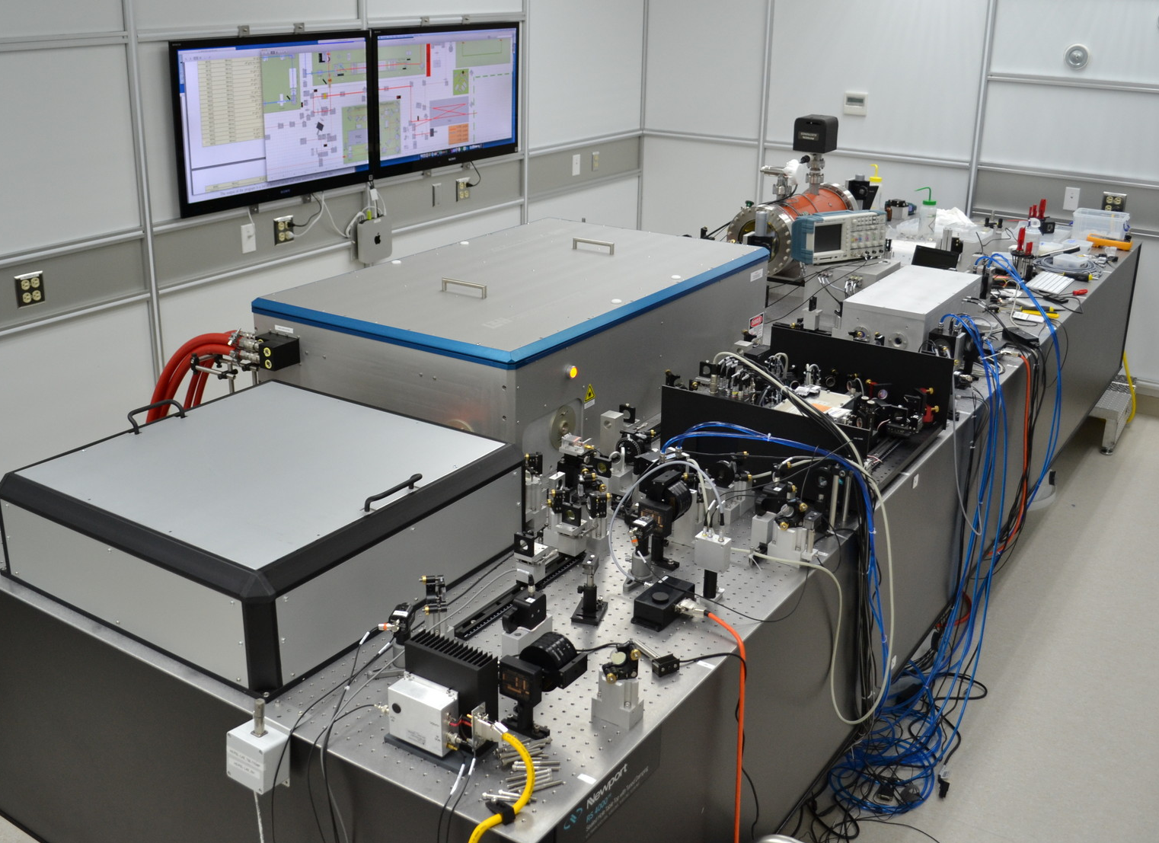
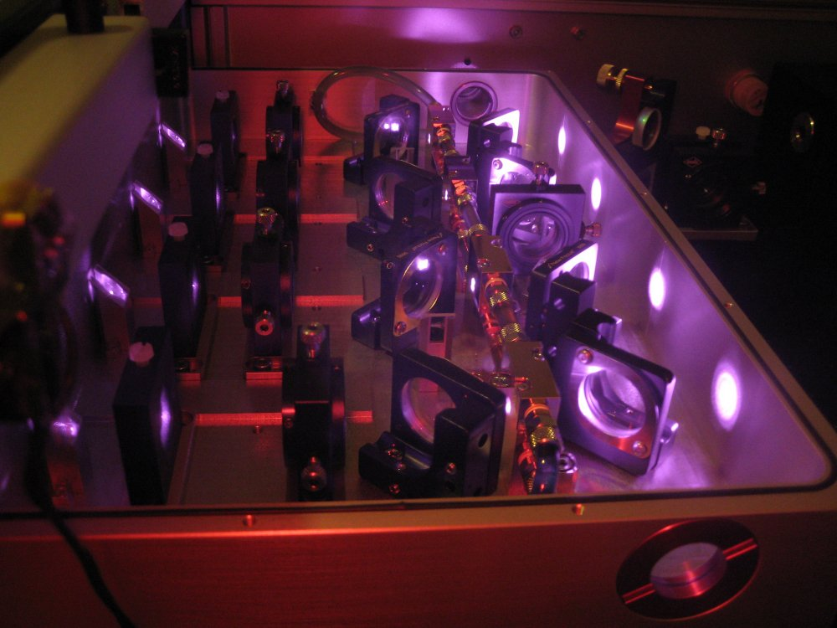
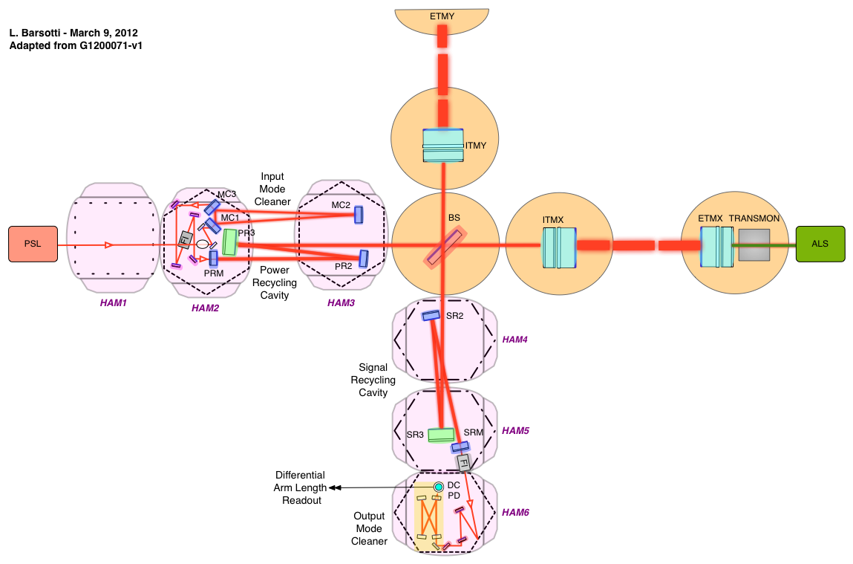
Advanced LIGO
Albert Einstein Institute

Slide 6
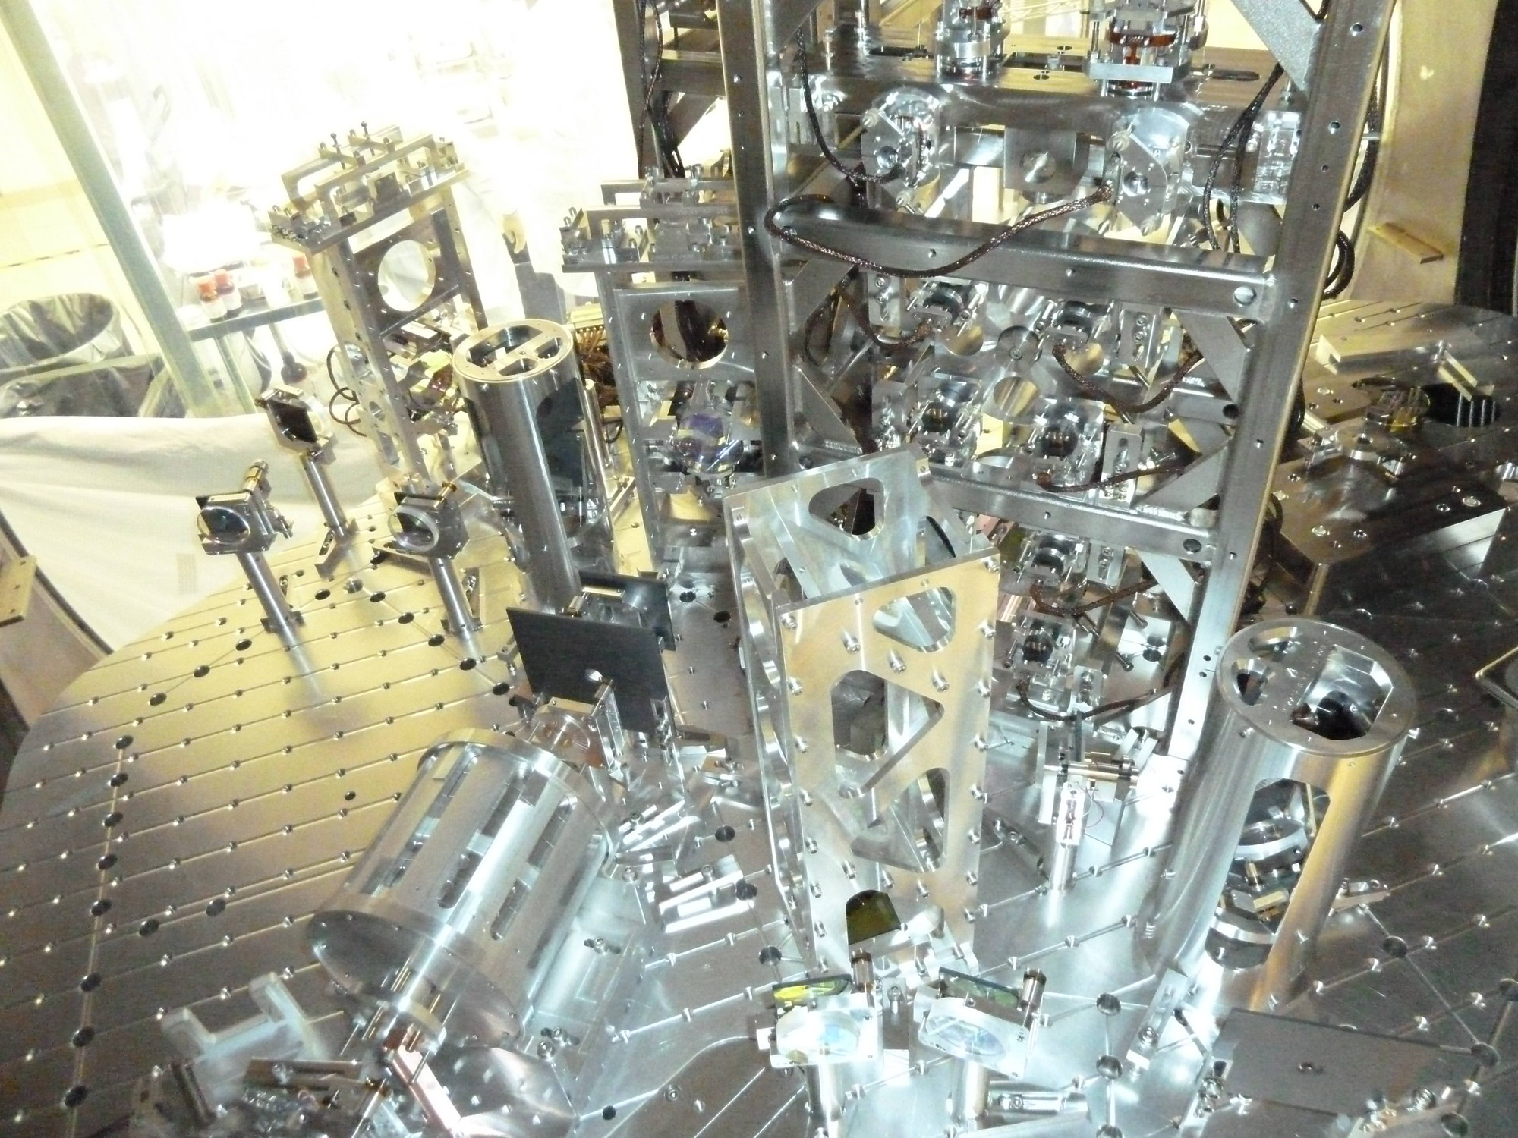
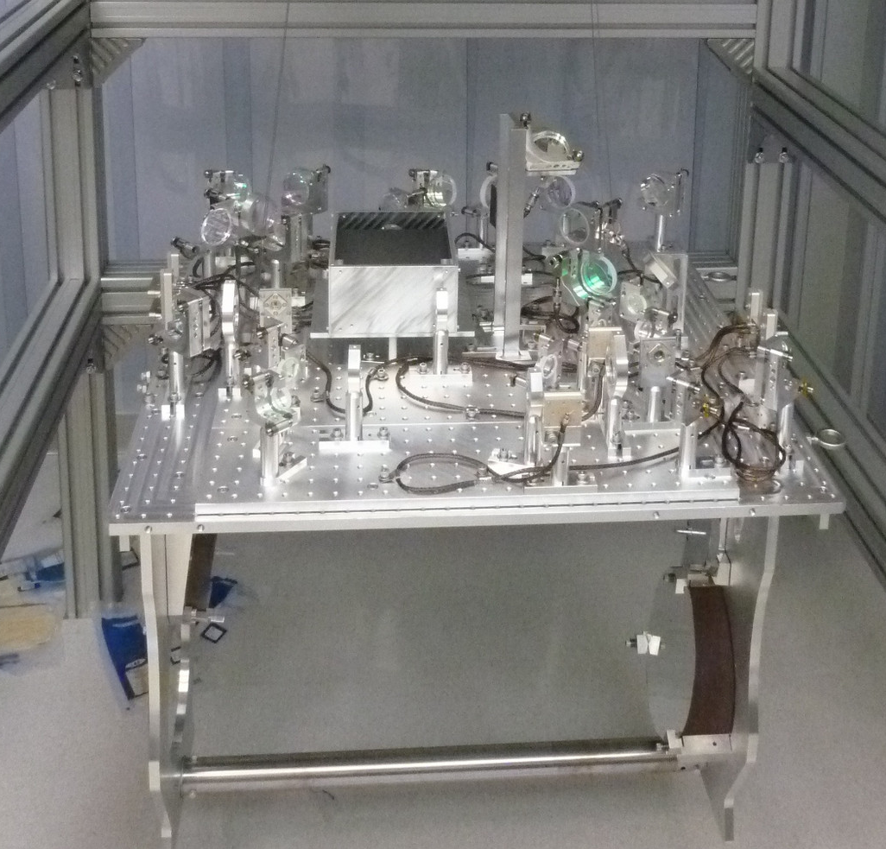
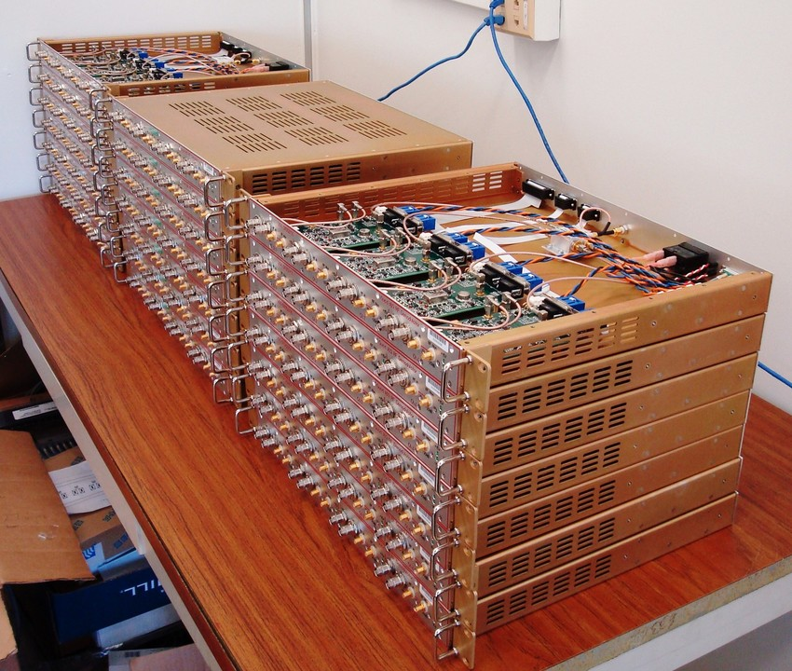
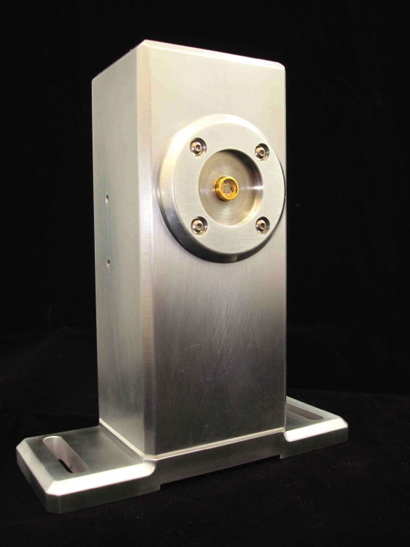
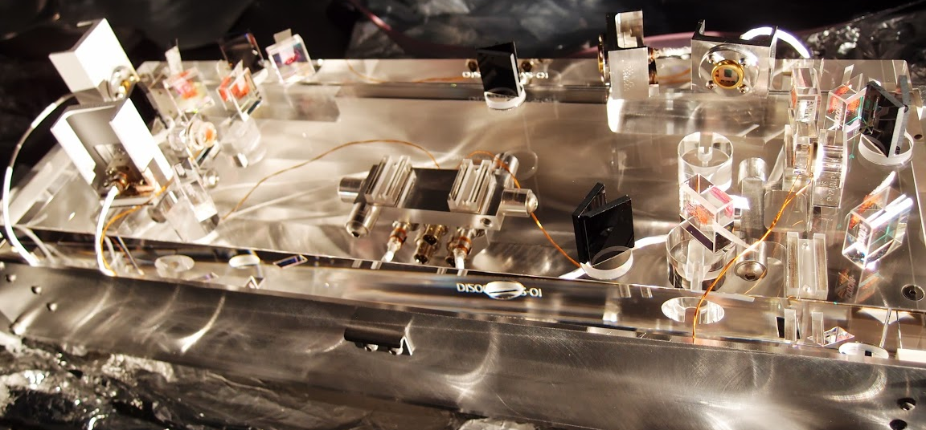
“EVERYTHING is better in Advanced LIGO!”
INPUT OPTICS
TRANSMISSION MONITOR
ELECTRONICS
OUTPUT MODE CLEANER

Slide 7
GOAL: reach a scientifically interesting sensitivity as soon as possible
TENTATIVE TIMELINE:
Complete integration by 2014
(interferometer “locked”)
“Early” Science Run in 2015
(~60 Mpc)
Within a factor of 2 of design sensitivity by 2016 (~100 Mpc)
http://arxiv.org/abs/1304.0670

Slide 8
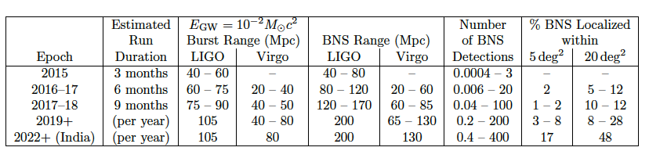
Detection Rates
Neutron Star Binaries:
  Initial LIGO: ~15 Mpc → rate ~1/50years
  Advanced LIGO: ~ 200 Mpc “Realistic rate” ~ 40/year
Class. Quant. Grav. 27, 173001 (2010)
http://arxiv.org/abs/1304.0670
Notes:
P0900125-v8

Slide 9
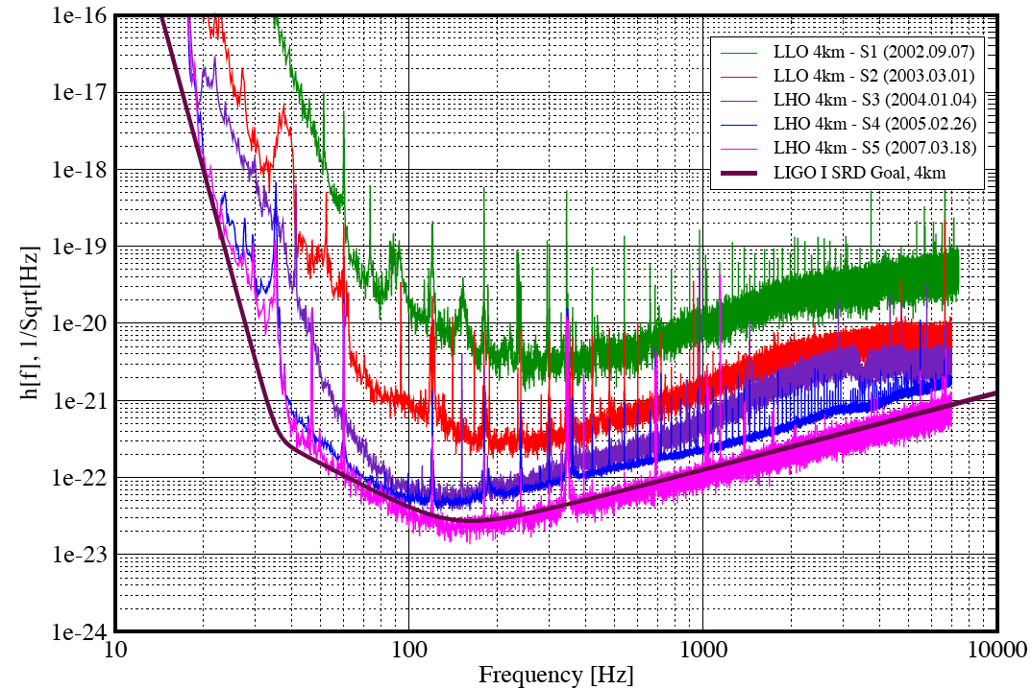
It took longer the first time..
LIGO: First lock in 2001…
Technical Noise!
2002
2003
2004
2005
2007
Design
Fundamental Noises

Slide 10
…but this time will be different!
Advanced LIGO Installation and Commissioning Strategy:
Extensive “standalone” testing before installation
Installation of “new” things as soon as possible
Configurations of increased complexity
Parallel effort between Hanford and Livingston
Better design and engineering informed by LIGO,
more experienced staff
Results are already visible:
It took 4 months to lock the input mode cleaner cavity in LIGO,
it took less than 1 week in Advanced LIGO (the first time at Livingston),
more like 1 day at Hanford

Slide 11

“Half Interferometer” in progress @ Hanford
(now one arm, in the fall the other)
LHO
Full test of the new
“Arm Length Stabilization” system: auxiliary green laser to stabilize the arm cavity length

Slide 12
Seismic isolation performance
LHO
iLIGO
1000x
aLIGO so far
aLIGO target

Slide 13
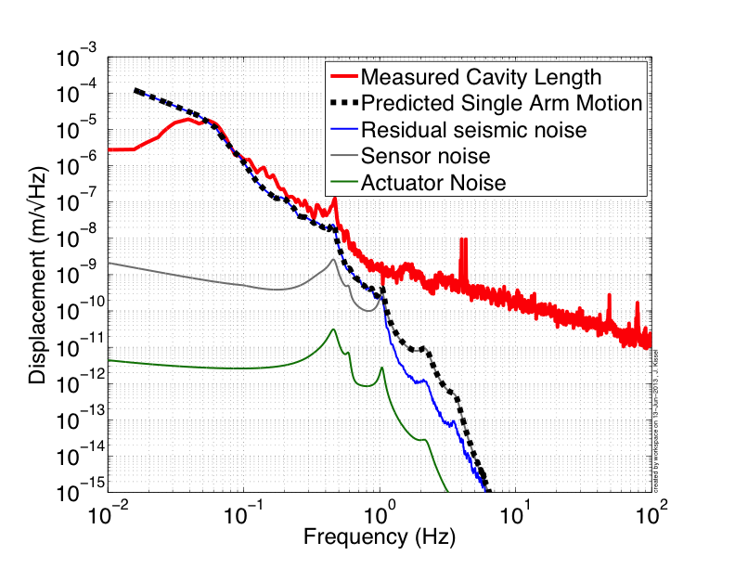
Cavity motion in good agreement with model (Jeff Kissel, MIT)
LHO
Frequency Noise

Slide 14
“Arm Length Stabilization” System
LHO
in collaboration with the Australian National University
MAIN LASER
Auxiliary LASER
Green light follows the arm cavity
Beat signal gives us the ability of controlling the main laser frequency relative to the green laser frequency


Beat Signal
Green light won’t be used in “science mode”
but it will help us to bring the interferometer on
its working point reliably
C3: Tuesday, 17:18 - 17:36 Adam Mullavey (LIGO Livingston) The Arm Length Stabilization System for Advanced LIGO Lock Acquisition

Slide 15
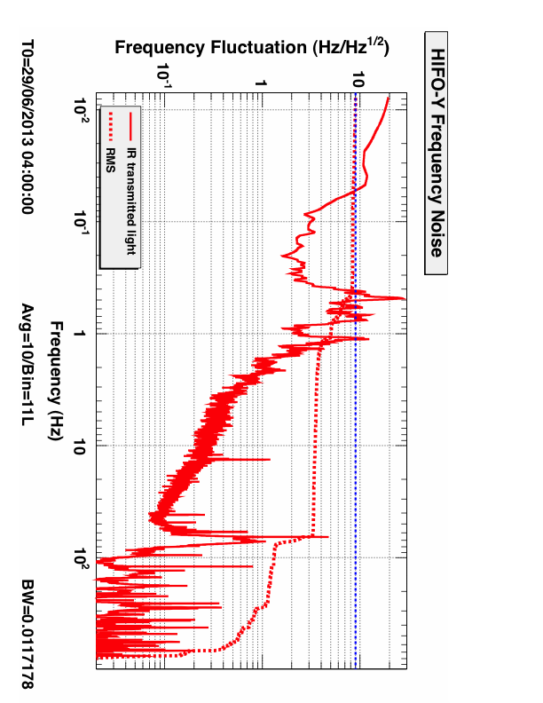
“Arm Length Stabilization” System
LHO
Frequency fluctuations of main laser light is already “good enough”
(1/10 of the cavity linewidth), “noise hunting” still in progress
GOAL: 8 Hz RMS

Slide 16

Corner Interferometer in progress @ Livingston
(Dual Recycled Michelson Interferometer)
LLO
Lock of the central part of the interferometer
(“everything except the arms”)
First configuration with
interesting sensitivity

Slide 17
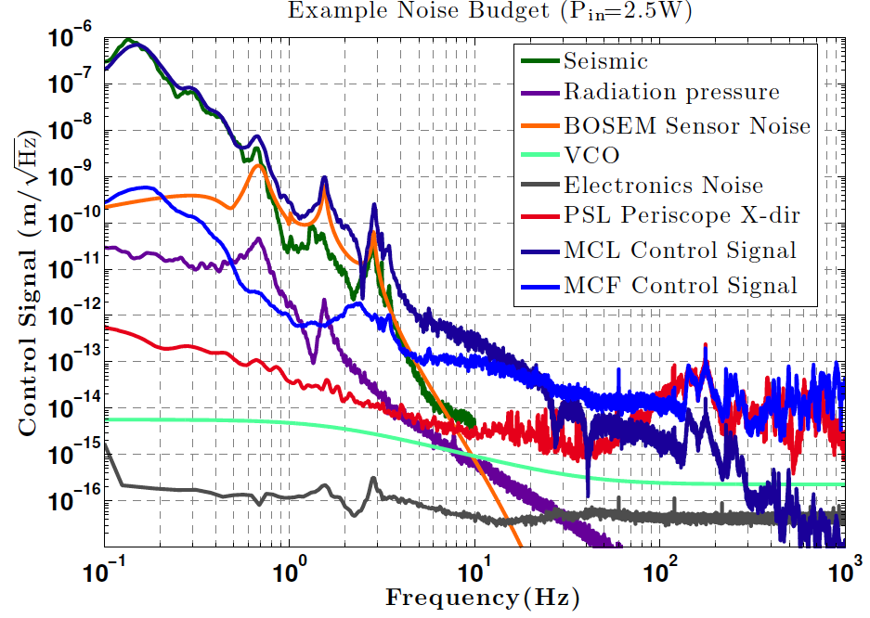
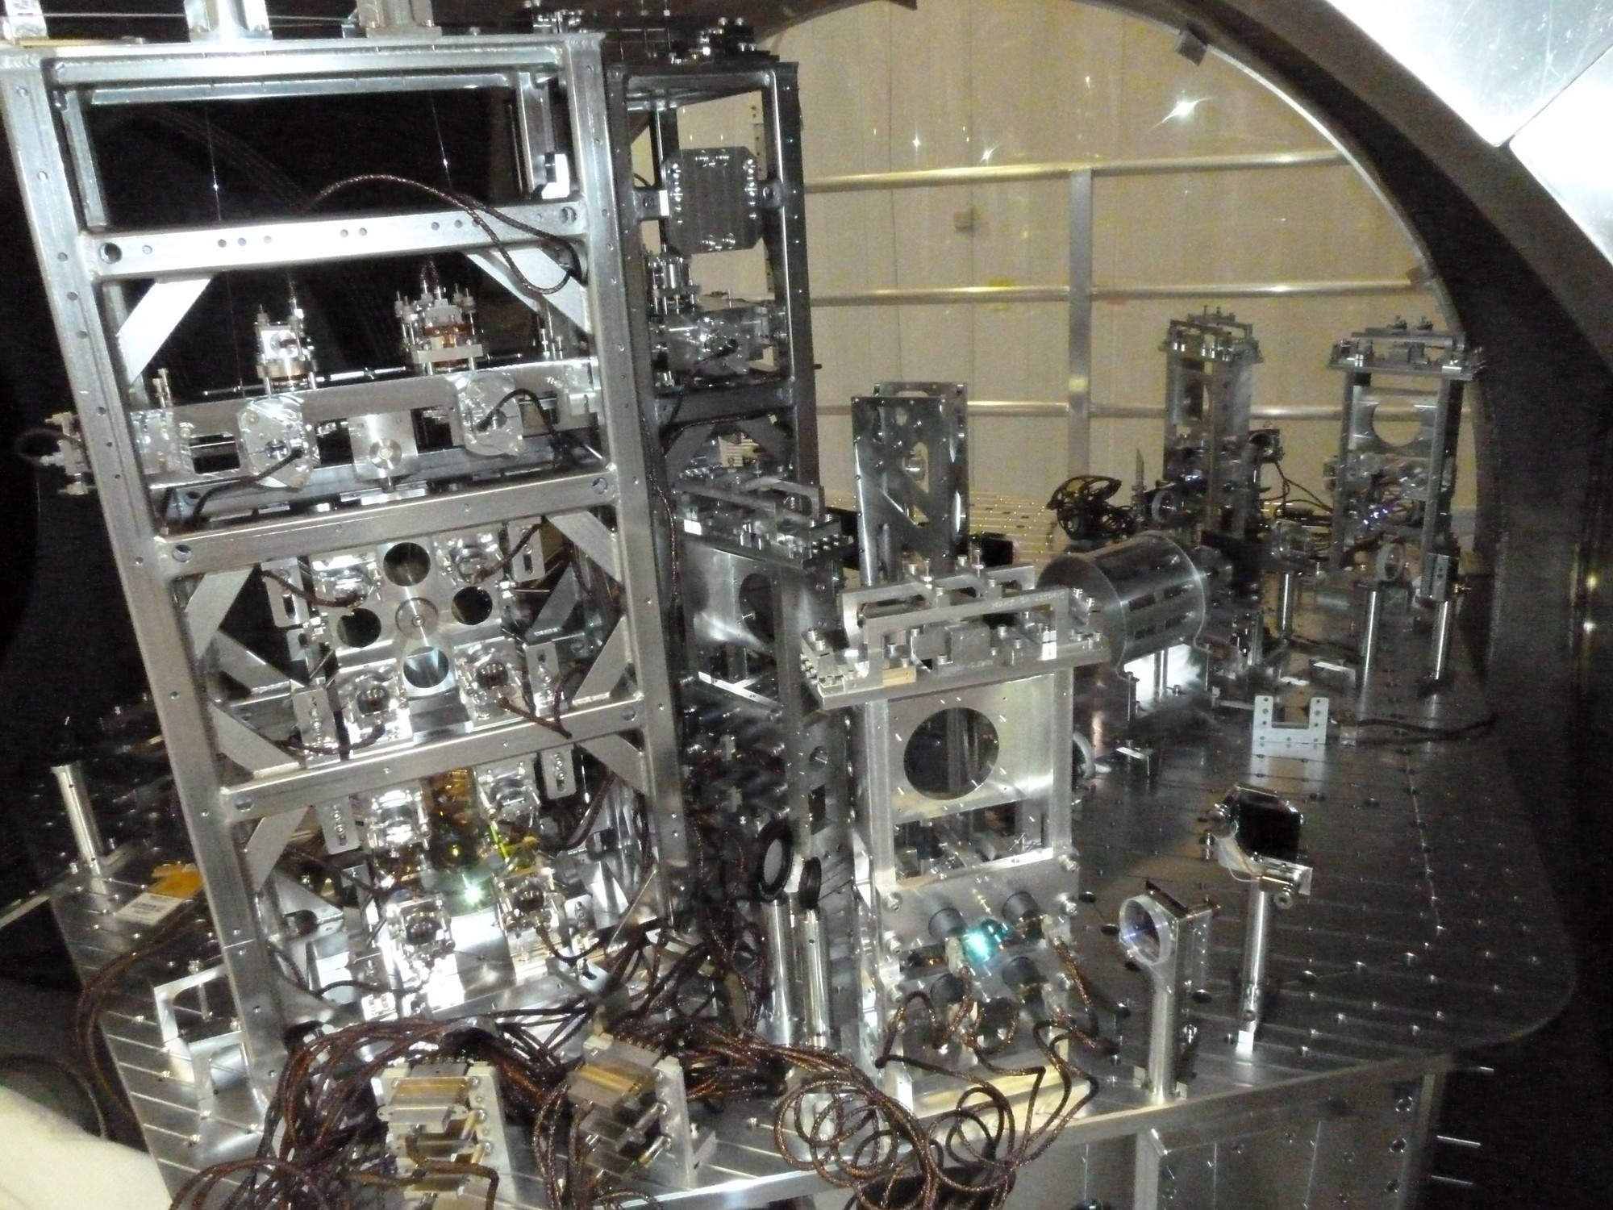
The Input Mode Cleaner
LLO
C3: Tuesday, 17:00 - 17:18 Chris Mueller (University of Florida) Characterization of the Input Optics for the Advanced LIGO Detectors
To be updated with new plot from Chris

Slide 18
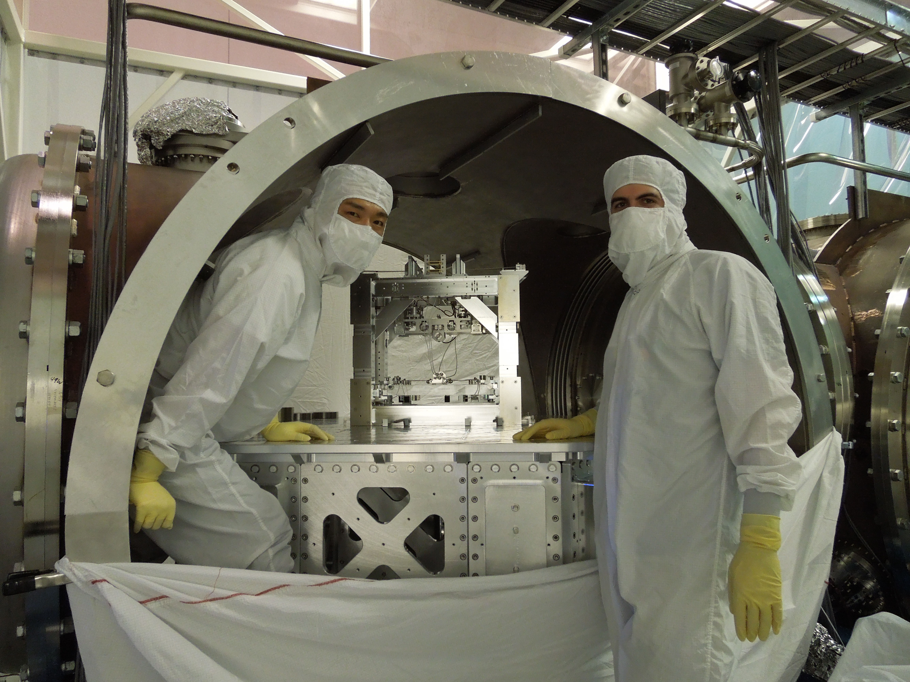
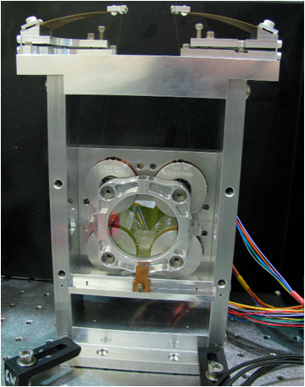
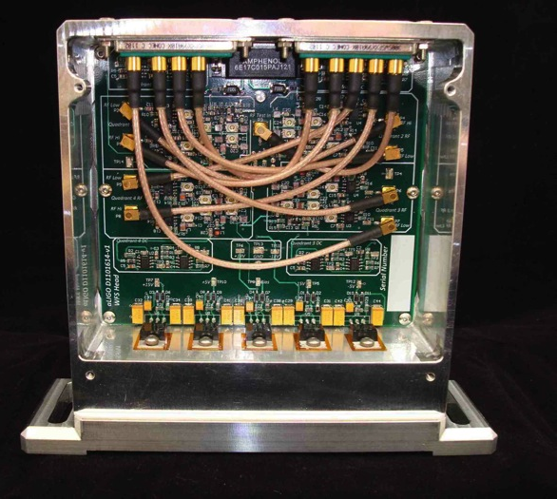
Dual Recycled Michelson Interferometer
(Almost) everything installed, integration started
LLO
Small suspensions for steering the beam into the OMC (ANU)
Output mode cleaner installation
(more pictures from Zach)
RF Wave Front Sensors
(for in vacuum use)

Slide 19
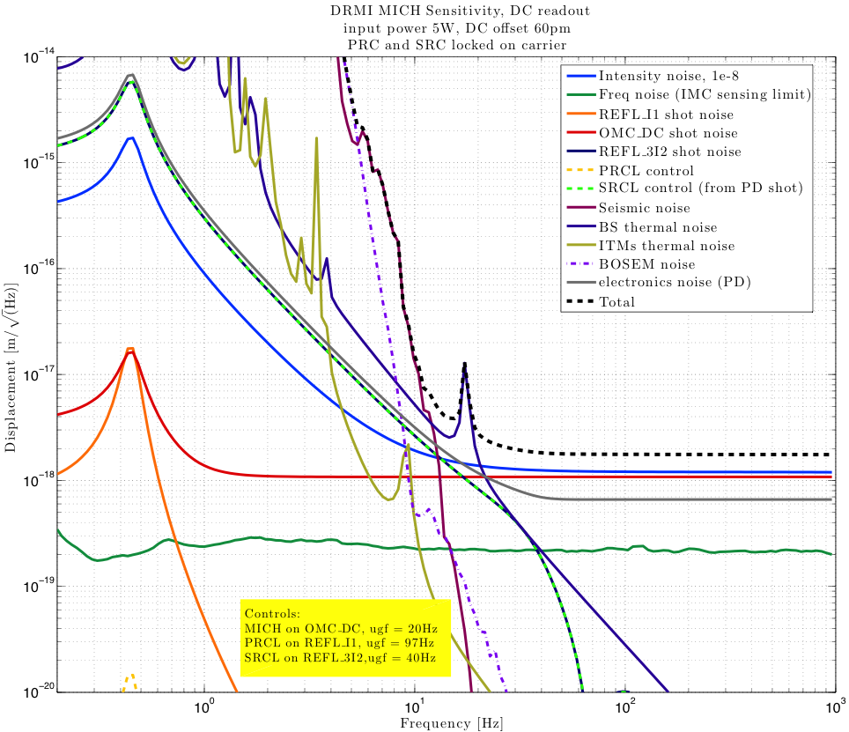
DRMI Noise Budget Model
(Anamaria Effler, LSU-LIGO Livingston)
LLO

Slide 20
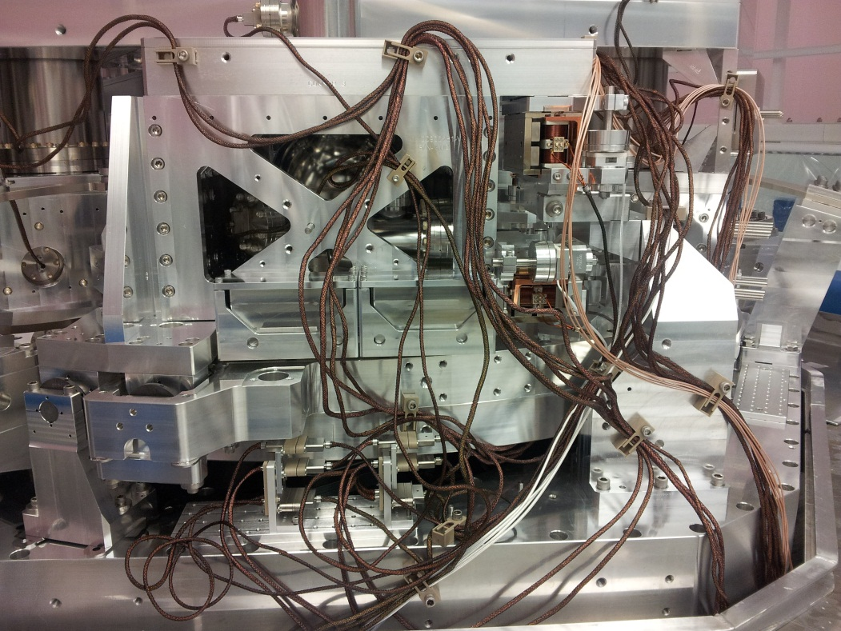
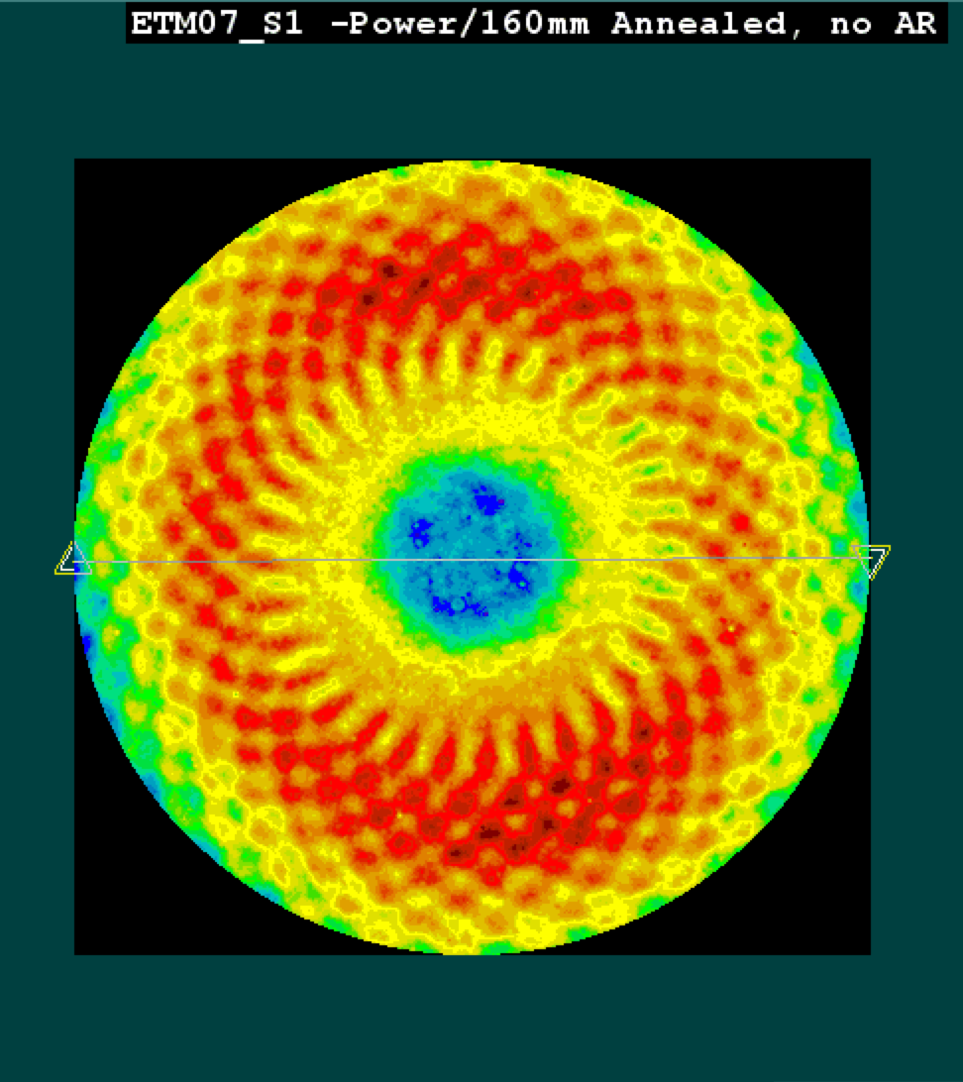
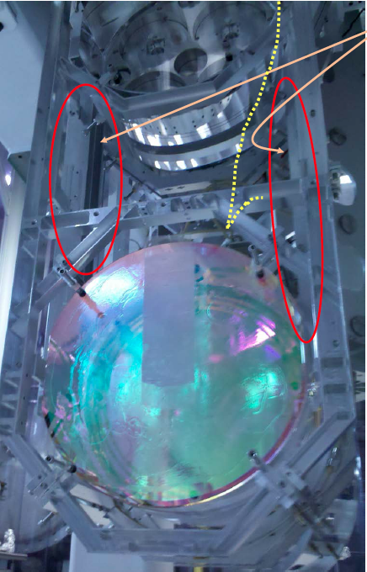
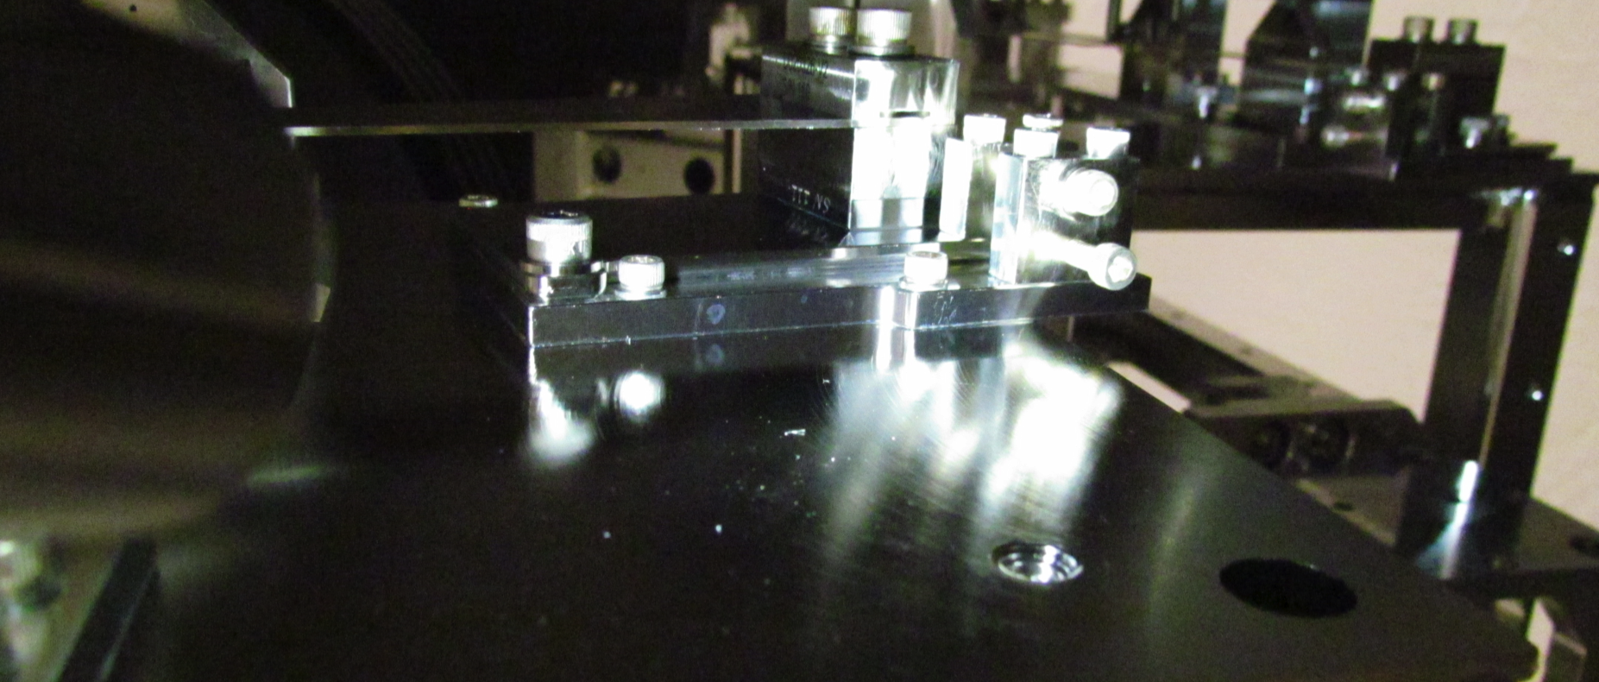
Bumps in the road, but no showstoppers

Slide 21
Outlook
Within a couple of months:
    each “type” of chamber will have been populated at least at one of the two sites
    main steps of lock acquisition sequence will have been tested full locking in progress at the Caltech 40m prototype
“Second-site” testing to follow
(DRMI @ LHO, Arms @ LLO)
Full Interferometer Lock:
    Starting February 2014 @ LLO
    Starting May 2014 @ LHO
On track for Advanced LIGO “acceptance” target
    “2 hours of lock”, end of 2014

Slide 22
The Message
Main goal of Advanced LIGO is to reach a scientifically interesting sensitivity as soon as possible (~ 60 Mpc@2015, ~100 Mpc@2016)
Installation and commissioning strategy designed with this goal in mind
So far so good!

Slide 23
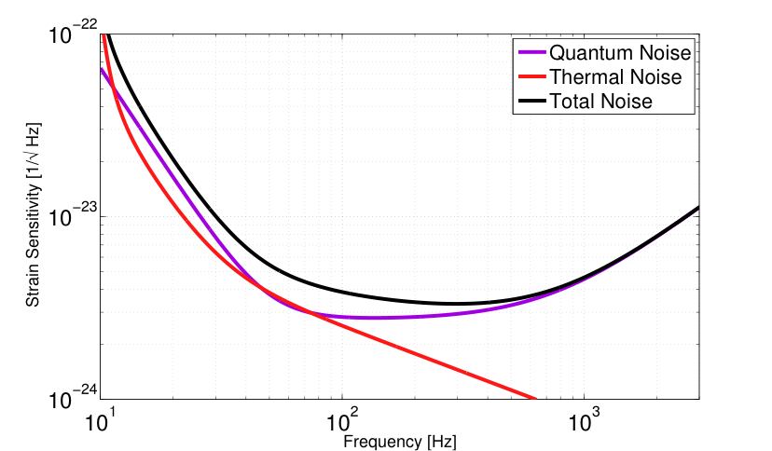
By the way, is Advanced LIGO the best that we can do?
C3: Tuesday, 17:54 - 18:12 Sheila Dwyer
Quantum noise reduction using squeezed states in LIGO
SEISMIC
WALL
aLIGO design sensitivity

Slide 24
Spare slides

Slide 25
What we call “commissioning”: from installation to science data
Understand and fix an entanglement of noise coupling mechanisms
Example from Enhanced LIGO
HIGH POWER
ALIGNMENT
OPTICS QUALITY
STRAY LIGHT
Noise
THERMAL EFFECTS
Output
Mode-Cleaner

