Slide 1
Identity & Access Management for Scientific Organizations
Definitions, design principles, tool overviews, and tips to help scientific organizations deliver efficient infrastructure for collaboration LIGO-G1300690-v1

Slide 2
Identity & Access Management (IAM)
Your electronic identity
Information set about you
Used for
authentication (who are you)
authorization (what allowed to do)
scott.koranda@ligo.org Scott Koranda Scott F Koranda 14145550208 staff PO Box 413 Milwaukee, WI LIGOVirgoLSCMember

Slide 3
Identity & Access Management (IAM)
Access Management is about who can access which online resources.
Who is allowed which privileges at which times.
scott.koranda@ligo.org has privileges VIEW, EDIT, RENAME for topic AuthProject/WebHome in wiki.ligo.org from January 1, 2013 through January 31, 2013

Slide 4
Identity & Access Management (IAM)
Most people find they collect multiple identities over time, each with its own credentials and privileges.
scott.koranda@ligo.org skoranda@uwm.edu skoranda skoranda@gmail.com scott_koranda@yahoo.com scott_koranda_ligo (Skype) skoranda000 (AIM) 6310907720 (Delta) ScottKoranda (Foswiki.org) skoranda (github) scott_koranda (NYTimes) Scott Koranda (Facebook)

Slide 5
IAM for Scientific Organizations
Focus here is IAM for scientific organizations.
A primary goal is enabling efficient and secure collaboration to support the science mission of the project.

Slide 6
Why bother with IAM?
Larger, even medium size, science projects have tendency to evolve organically rather than by design.
And the user experience often shows it…

Slide 7
Begins innocently enough…
“We need an email list to make it easier to communicate. Let’s deploy mailman.”

Slide 8
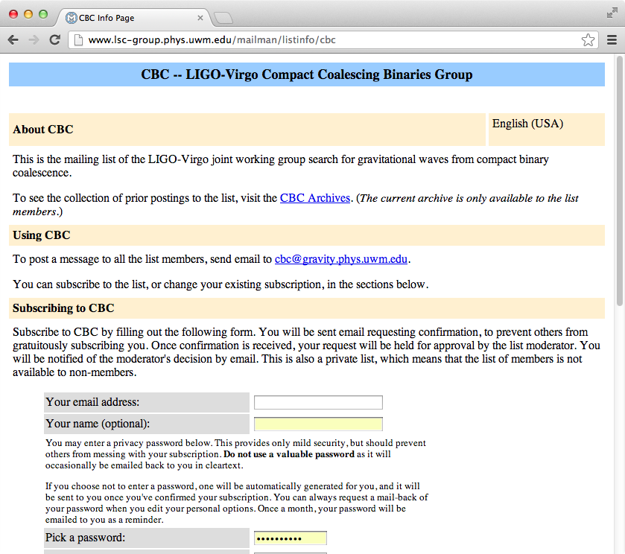

Slide 9
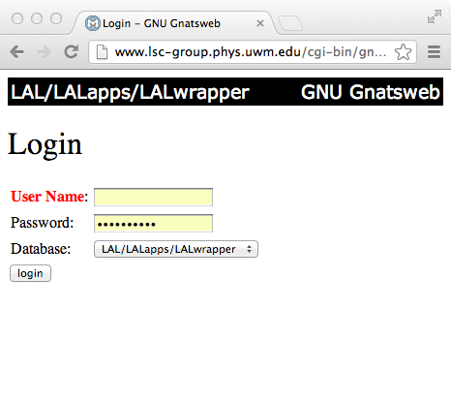
More tools follow…
“We need a bug tracking system to track all these issues!”

Slide 10
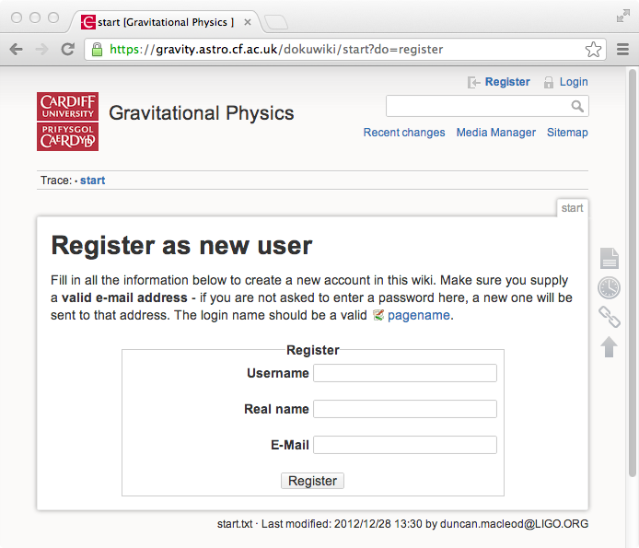
Still more tools…
“Editing HTML is too hard. We need a wiki.”

Slide 11
Geographic Issues
Dispersed groups makes the issue worse.
“We don’t like Moin, we like Twiki”
“We don’t like Twiki, we like Dokuwiki”
“We don’t like Dokuwiki, we like MediaWiki”
“We don’t like MediaWiki, we wrote our own!”

Slide 12
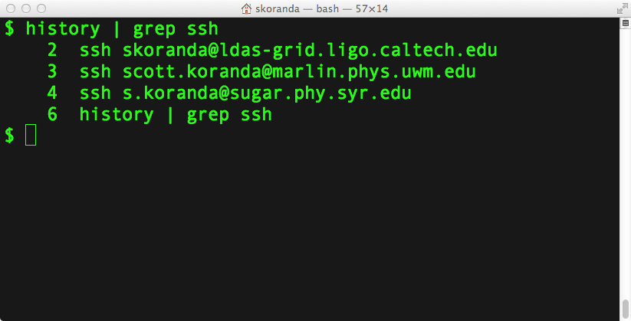
Command Line Tools
This is not just a “web” problem…

Slide 13
Access Management
Eventually access privileges are no longer “flat.”
Some things some people can see or do… …other things other people can see or do.

Slide 14
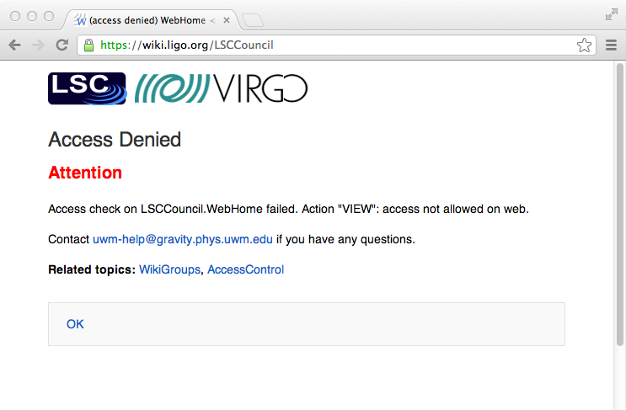

Slide 15
Users Frustrated
Eventually the burden is too high on users.
Too many accounts/logins/passwords.
Too many places to manage them.
Drives insecure online behavior.
Collaboration efficiency suffers.
Copyright unknown

Slide 16
Organization Dysfunction
“I need a list of all people in the collaboration!”
No such list exists
List is not up to date
List is inaccessible to people that need it

Slide 17
Organization Dysfunction
From: admin@bigproject.org
To: users@bigproject.org
Subject: Fwd: where do I login?
Anybody know who this person is? Should she have an account?
> From: jane.scientist@university.edu
> To: admin@bigproject.org
> Subject: where do I login?
>
> I just joined Big Project and was told that you could help me get > an account?

Slide 18
Organization Dysfunction
From: jane.scientist@univeristy.edu To: admin@bigproject.org Subject: Fwd: minutes from last meeting Please remove me from this list. I have not been a part of Big Project for over 2 years now! > From: dyoung@somewhere.edu > To: users@bigproject.org > Subject: minutes from last meeting > > The minutes from the last meeting are attached. Sorry about > the size. I don't know how to make the imported diagrams > any smaller. Let me know if your email can't handle attachments > more than 2 gigabytes.

Slide 19
The "Quick Fix"
“Well-known login and password”
Shared account for all users
“We will only use it for low risk resources”
What’s low risk?
Who decides?

Slide 20
Common Problems
What makes IAM for science projects unique?
Mixture of web and command line tools.
Often geographically distributed.
Often decentralized organizational structure.
Often less lines of authority.
Underfunded and not enough people resources.
“Let’s just do it and get it done” culture.
Smart and technology savvy people + little structure = infrastructure “challenges”

Slide 21
IAM for Science
Good news is that there is help.
Good open source standards-based tools with strong communities available.
Technology can help.
Flexible, loosely coupled design goes long way.
Leverage experience from other organizations.
especially campuses

Slide 22
IAM for Science
Bad news is that technology can only do so much.
Policy drives the technology.
Organizations need to articulate policies that can be implemented and expressed by the tools.
Scientists do not like to spend time thinking through and enumerating the fine details of policy.
Physicists particularly bad because they want to abstract and find universal expressions.
Most often policy is complex and ugly.

Slide 23
IAM for Science
Need to begin policy discussions early in parallel with technology design.
Drive conversations with use cases.
Iterate quickly, stand up demonstration services, help busy scientists focus on policy questions.

Slide 24
IAM for Science
Different views into IAM
Component: which tools compose infrastructure
Concepts: IAM trends and technologies
Process: how policies are expressed
Spaces: where the users and applications live
Principles: tips for surviving IAM build out

Slide 25
IAM for Science
Different views into IAM
Component: which tools compose infrastructure
Concepts: IAM trends and technologies
Process: how policies are expressed
Spaces: where the users and applications live
Principles: tips for surviving IAM build out

Slide 26
IAM Components
User registry
Directory
Authentication store
Identity provider
Service provider
Group, role, and privilege manager
Attribute authority

Slide 27
IAM Components
User registry
Directory
Authentication store
Identity provider
Service provider
Group, role, and privilege manager
Attribute authority

Slide 28
IAM Component: User Registry
Holds records of users or members
Portal for users self-manage identity
Portal for credential (password) management
Enrollment or “onboarding” new members
“Offboarding” management
Often reporting functions
Often interface into other components

Slide 30
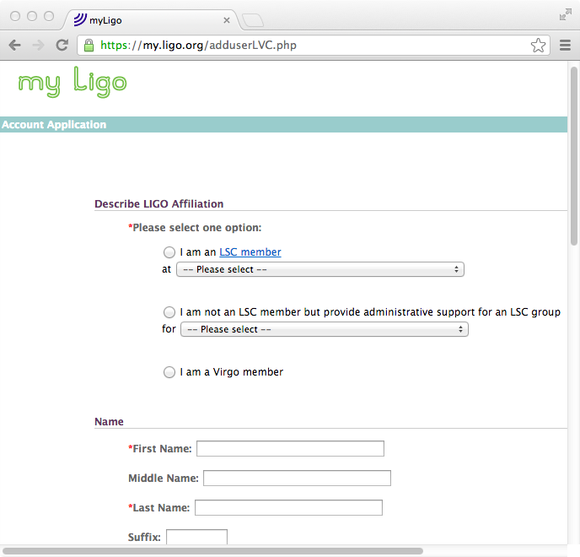

Slide 31
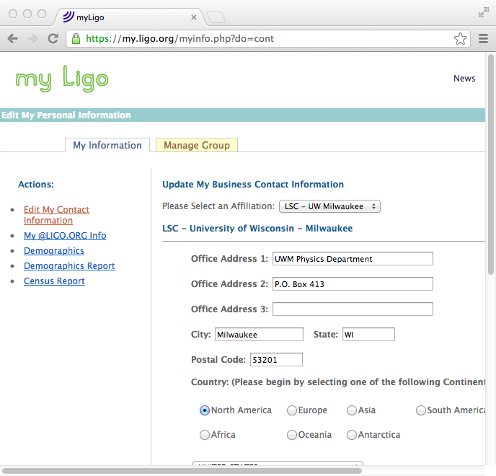

Slide 32
LIGO-India User Registry?
Should LIGO-India have its own user registry or use the existing MyLIGO registry?

Slide 33
Case: LIGO-India has its own user registry
Pros:
More customized infrastructure.
Better help desk support locally.
Opportunity to evolve.
Cons:
Extra effort required.
Sets LIGO-India apart from LHO,LLO, CIT, MIT.

Slide 34
Case: LIGO-India leverages MyLIGO
Pros:
Use existing infrastructure.
Less initial effort required.
Fully integrated LIGO Laboratory experience.
Cons:
Somewhat less flexibility.
Need to implement coordinated help desk.
Single LIGO IAM infrastructure may change anyway.
Future not certain for division between Lab and LSC.

Slide 35
User Registry Design
Design?
Are there not all-in-one tools to download and use?
No (mostly). Existing enterprise solutions too heavyweight and inflexible for science organizations.

Slide 36
Projects to Watch

Slide 37
Projects to Watch

Slide 38
Projects to Watch

Slide 39
User Registry Design
What data will be stored?
What backend data store?
What are the onboarding flows?
What are the offboarding flows?
What type of reporting is needed?

Slide 40
User Registry Design Data Types
What data does your project need?
givenName
familyName (sn)
common name (cn)
displayName
preferredName honorific
suffix
mail
mailForwardingAddress
mailAlternateAddress
address
telephone
eduPersonPrincipalName
eduPersonOrgDN
eduPersonAffiliation
eduPersonEntitlement
isMemberOf
title
openID
uid
gid
...

Slide 41
User Registry Design Data Types
Only collect and store the data you need to accomplish the organization’s mission.
Do not collect data because you “might use it someday”.
Rather design flexibility to add data types as needed.
IAM design principle

Slide 42
User Registry Design Data Types
Be sure to look at the eduPerson LDAP schema Other resources:
Other science projects
CIFER, Kuali IdM, COmanage
Your campus IT staff

Slide 43
User Registry Design Data Types
Whether your registry provisions (is a source of) identity or consumes (federated) identity affects which data types to collect and store.

Slide 44
User Data Registry Data Store
First question is usually SQL or LDAP?

Slide 45
User Data Registry Data Store
SQL:
More flexibility—create the tables you need.
Integrates easily with MVC web frameworks.
model, view, controller
Django, CakePHP, Catalyst
Versioning and history
Solid open source choices

Slide 46
User Data Registry Data Store
LDAP:
More standards—leverage existing schemas.
Easy replication for redundancy.
Easy integration with large number of tools.
pam_ldap for integration into shell
Solid open source choices

Slide 47
User Data Registry Data Store
SQL or LDAP?
For small projects with limited IAM needs LDAP more likely for bootstrapping infrastructure. For larger projects use both SQL and LDAP:
SQL as the primary data store.
Reflect into LDAP for replication, consumption by other tools including attribute stores.

Slide 48
MyLIGO Data Store
Current: hybrid SQL (MySQL) and LDAP approach
Future: COmanage (SQL) reflected into LDAP

Slide 49
User Registry Onboarding
Onboarding: how people enter into the IAM infrastructure.
Usually coming new into the project.
Sometimes returning to the project.
May have different policies:
per person affiliation (faculty, staff, student, ...)
per organization unit
as project grows and matures

Slide 50
User Registry Offboarding
Offboarding: how people leave the IAM infrastructure.
Always last part considered and designed!
Usually involves decrease in privileges over time.
May have different policies:
per person affiliation (faculty, staff, student, ...)
per organization unit
as project grows and matures
“We need postdocs to have read and write permissions to the paper database for one year after they leave the project.”

Slide 51
User Registry Reporting
As size of project grows management will ask for increasingly complex views of the user registry. Demographics, especially in the US, important to funding agencies. “How many female graduate students joined the project between 2010 and 2012?”

Slide 52
IAM Components
User registry
Directory
Authentication store
Identity provider
Service provider
Group, role, and privilege manager
Attribute authority

Slide 53
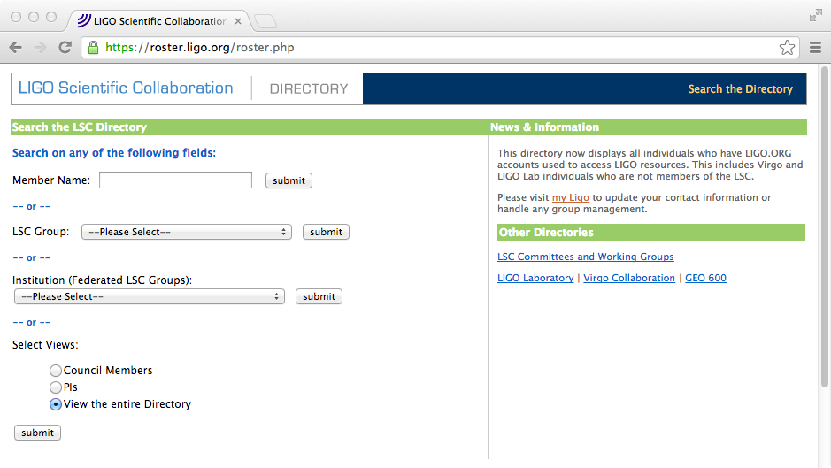
IAM Component: Directory
Directory/Roster often first reporting from registry.

Slide 54
Directory/Roster
Although a “view” of the registry consider making a distinct component.
Use a separate data store.
Provisioned by the registry.
Only provision subset data needed.
Help protect against PII leaks.
Personally Identifiable Information.

Slide 55
IAM Components
User registry
Directory
Authentication store
Identity provider
Service provider
Group, role, and privilege manager
Attribute authority

Slide 56
IAM Component: Authentication Store
If you provision identity and with it an identifier (login) and a credential (e.g. password) used for authentication you need an authentication store.
Usual candidates:
SQL
LDAP
Kerberos KDC
Active Directory
Shadow files

Slide 57
Authentication Store
Choice for authentication store depends on:
Tools and services that need to leverage it.
web apps, shells, thick client, ...
Organizational security tolerances.
Can passwords go over the network?
Over protected channels?
Operational team experience and depth.

Slide 58
Authentication Store: SQL
Flexible.
Assumed by many (web) frameworks.
Easy integration with web applications.
Not so easy integration with shells.
Build your own tooling for management.
Check hashing and salting!
Not all frameworks do this correctly.
Get advice from security specialists.

Slide 59
Authentication Store: LDAP
Flexible.
Easy integration with shells (pam_ldap).
Not so easy integration with web apps.
Build your own tooling for management.
Some existing user tools satisfactory.
Probably not user-friendly enough.
Choose hashing carefully.
Old techniques (MD5, CRYPT) no longer acceptable.
Get advice from security specialists.

Slide 60
Authentication Store: Kerberos
Somewhat less flexible.
More demanding operational expertise required.
Straightforward integration with web apps.
Straightforward integration with shells.
User-friendly tools for UNIX-like systems.
Significant security advantages.
Passwords do not go out over the network.
Get advice from security professionals.

Slide 61
LIGO Authentication Store
LIGO chose Kerberos
MIT implementation.
Single master KDC with many slave replicas.
Standard ports (88) and 80/443
Firewall traversal out of hotels for example.
Integrated with DNS
Clients need no special configuration.
Use web interface to manage password.
More friendly for most users.
Some users use command line.

Slide 62
LIGO Authentication Store
Kerberos principal is the primary LIGO identifier
albert.einstein@LIGO.ORG
LIGO.ORG is the Kerberos realm.
LHO (soon LLO, CIT) have their own realms.
Use cross-realm trust configuration for smooth integration.

Slide 63
Authentication Store
Get input from a real security expert! IAM and security complimentary but distinct.
Security officer has skills, training, and experience IAM architects should leverage.
Cultivate a working relationship early in design phase with your security expert.

Slide 64
IAM Components
User registry
Directory
Authentication store
Identity provider
Service provider
Group, role, and privilege manager
Attribute authority

Slide 65
IAM Component: Identity Provider
Identity Provider (IdP) asserts identity:
To a third-party service provider (SP).
Usually after an authentication event.
Usually across a security or identity domain.
Still useful concept within an identity domain.
Most often used in web context.
But the concept applies more generally.

Slide 66
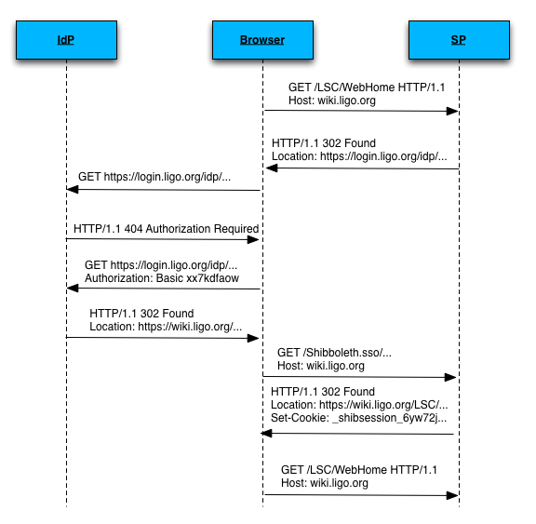

Slide 67
IdP
IdP authenticates the user and sends back to SP.
IdP asserts that the user has authenticated.
Often includes some details about how.
Often includes some details about when.
Usually asserts an identifier for the user.
may be opaque and/or targeted.
Sometimes asserts attributes about user.
Details depend on format chosen by IdP and SP.

Slide 68
Web Authz Formats
OpenID:
Relatively simple.
Supported by Google, FB, Twitter, Yahoo, ...
Good adoption in web 2.0 spaces.
Not focused on preserving privacy.
Not focused on rich attribute exchange.
OpenID Authentication 2.0 and OpenID Attribute Exchange 1.0 helped improve that.

Slide 69
Web Authz Formats
OAuth:
Focused on authorization, not authentication.
Type of limited delegation.
Allow site A (Facebook) to access site B (Instagram) on your behalf.

Slide 70
Web Authz Formats
OpenID Connect:
Next generation OpenID.
Builds on top of and incorporates OAuth 2.
More complex but delivers more functionality.
Tension between enterprise needs and “simple”.
Slow uptake at this moment...

Slide 71
Web Authz Formats
WS-Federation:
Primarily used in large enterprise systems.
Developed by BEA Systems, BMC Software, CA Inc., IBM, Layer 7 Technologies, Microsoft, Novell, Ping Identity, and VeriSign.
Part of WS-Security framework:
WS-SecureConversation, WS-Authorization, WS-Policy, WS-Trust, WS-Privacy

Slide 72
Web Authz Formats
SAML:
More complex than OpenID.
Strong privacy preserving.
Strong attribute exchange.
Good adoption in higher education.
Little adoption outside of higher education.
More uptake in research space recently.

Slide 73
LIGO Chose SAML
Strong support from higher education.
Strong support from Internet2.
Strong support from InCommon.
Rich attribute assertion mechanisms.
Less concerned with privacy preserving.
Straightforward path away if necessary:
“Social2SAML” gateways.
Allow slow transition if necessary.

Slide 74
LIGO SAML & Shibboleth
LIGO has significant investment in Shibboleth.
IdP is Shibboleth 2.3.x.
Over 60 Shibboleth SPs now.
Member of the Shibboleth consortium.
Currently 5+ staff with Shibboleth training.

Slide 75
Shibboleth is an implementation of SAML.
Originally started by Internet2 in US.
Now funded by its own consortium.
Support both in Europe and US.
Identity Provider (Java servlet).
Service Provider (Native C Apache module).
Centralized Discovery Service.
Embedded Discovery Service.

Slide 76
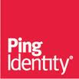
SAML Tools
SimpleSAMLphp.
open source.
both IdP and SP functionality.
primarily a European project.
OpenAM
IdP.
evolution of OpenSSO from Sun/Oracle.
open source with support from ForgeRock.
Ping Identity
private company.
IdP.

Slide 77
IAM Components
User registry
Directory
Authentication store
Identity provider
Service provider
Group, role, and privilege manager
Attribute authority

Slide 78
IAM Component: Service Provider
Term “service provider” (SP) most often used in web context.
Any service or tool (resource) users or their delegates access.
Usually access to the SP requires authentication and authorization.

Slide 79
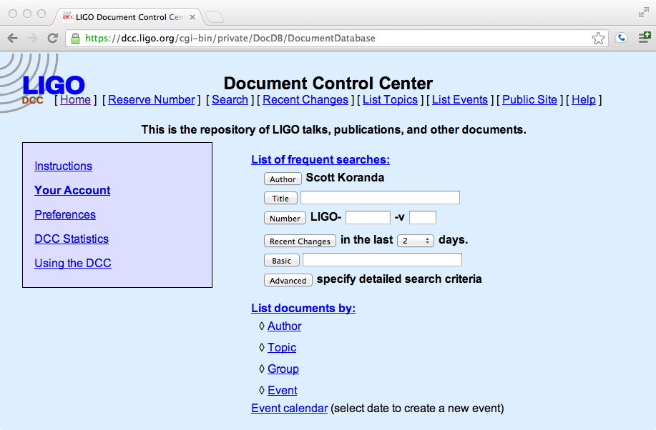

Slide 80
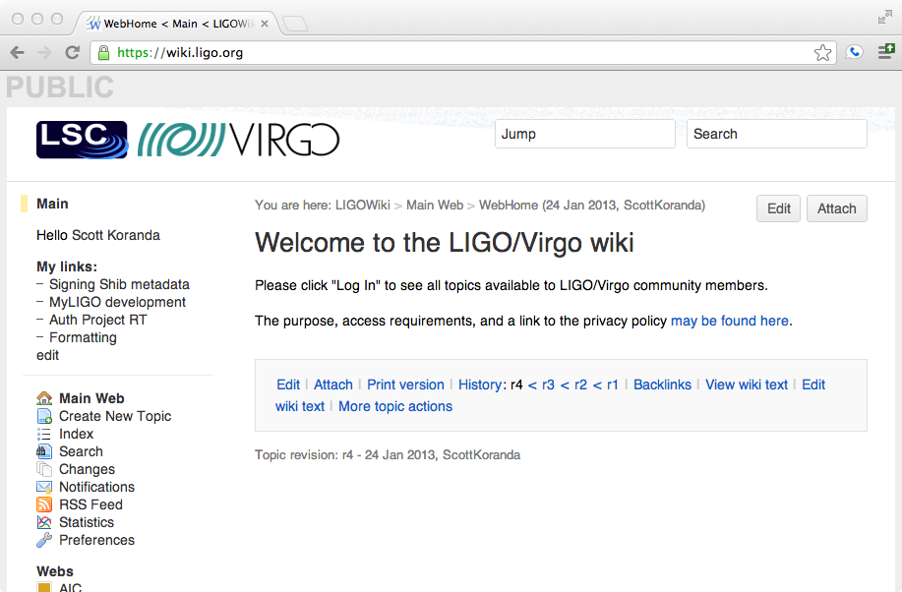

Slide 81
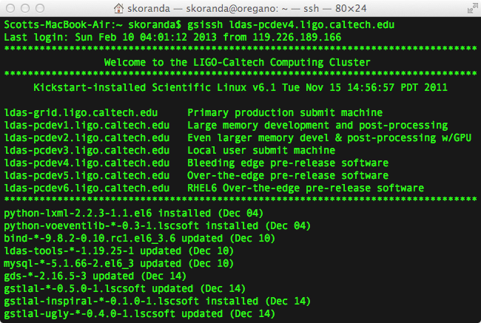

Slide 82
IAM Components
User registry
Directory
Authentication store
Identity provider
Service provider
Group, role, and privilege manager
Attribute authority

Slide 83
IAM Component: Groups, Roles, Privileges Manager
Access management often based on groups.
“Only members of the ‘executive committee group’ may read and edit the ExComm web at wiki.ligo.org”
Set ALLOWWEBVIEW = Communities:LVC:LSC:ExecComm:ExecCommGroupMembers

Slide 84
Groups, Roles, Privileges Manager
Access management also often based on roles.
Role-Based Access Control (RBAC).
“The Director of LIGO and the LIGO Scientific Collaboration Spokesperson may download this document from the document control center (DCC).”

Slide 85
Groups, Roles, Privileges Manager
Many tools include their own groups, roles, and privileges management capabilities.
Often these offer only limited functionality.
Not possible to share across organization.
Centralized (specialized) tools for group, role, privilege management:
LDAP (and tools built on top of it)
VOMS
Grouper

Slide 86
Groups, Roles, Privileges Manager
Look for in centralized groups/roles/privileges tool:
Set math.
compose, complement.
No imposed hierarchy.
Should not assume a tree hierarchy.
No assumptions about organizational structure.
Time management.
Effective dates and times.
Auditing (point-in-time).
Manage entities and objects—not just people.

Slide 87
LDAP: Group Management
Standards—leverage existing schemas.
Easy replication for redundancy.
Easy integration with large number of tools.
pam_ldap for integration into shell
Solid open source choices.
Default tools not user friendly.
Requires developing interfaces.
Tree structure hard to avoid.
Limited support for set math (dynamic groups).
Little support for managing effective time/date.

Slide 88
LDAP: Group Management
dn: employeeNumber=882,ou=people,dc=ligo,dc=org
cn: Scott Koranda
uid: scott.koranda
krbPrincipalName: scott.koranda@LIGO.ORG
sn: Koranda
givenName: Scott
isMemberOf: Communities:LVC:LSC:CompComm:CompCommGroupMembers
isMemberOf: Communities:LVC:LSC:LDGSysAdmin:LDGSysAdminMail
isMemberOf: Communities:LVC:LSC:DASWG:DASWGGroupMembers
isMemberOf: Communities:LVC:LSC:MOU:UWM:UWMGroupMembers
isMemberOf: Communities:LVC:LVCGroupMembers
isMemberOf: Communities:LSCVirgoLIGOGroupMembers
isMemberOf: Communities:LVC:LSC:LSCGroupMembers

Slide 89
LDAP: Group Management
dn: cn=CompCommGroupMembers,ou=CompComm,ou=LSC,ou=LVC,ou=Communities,
ou=grouper,dc=ligo,dc=org
description: Communities:LVC:LSC:CompComm:CompCommGroupMembers
member: employeeNumber=762,ou=people,dc=ligo,dc=org
member: employeeNumber=145,ou=people,dc=ligo,dc=org
member: employeeNumber=147,ou=people,dc=ligo,dc=org
member: employeeNumber=329,ou=people,dc=ligo,dc=org
member: employeeNumber=769,ou=people,dc=ligo,dc=org
member: employeeNumber=882,ou=people,dc=ligo,dc=org
cn: CompCommGroupMembers
hasMember: stuart.anderson
hasMember: warren.anderson
hasMember: stephen.fairhurst
hasMember: abe.singer
hasMember: duncan.brown
hasMember: scott.koranda

Slide 90
LDAP: RBAC
dn: rbacName=LSC Spokesperson, ou=roles, dc=ligo,dc=org
objectClass: rbacRole
rbacName: LSC Spokesperson
rbacPerformer: gabriela.gonzalez@ligo.org
rbacPerformerDN:employeeNumber=11,ou=people,dc=ligo,dc=org

Slide 91
Grouper
Internet2 in the United States.
Support for set math.
both composition and complement.
No imposed structure.
Reflection (provisioning) into LDAP.
Manage groups, roles, and privileges.
RBAC support.

Slide 92
Grouper
Support for time management:
Effective dates/times.
Point-in-time auditing.
Strong support for delegation.
Let group leaders manage their own memberships.
Java servlet with relational database backend.
Significant learning curve.

Slide 94
IAM Components
User registry
Directory
Authentication store
Identity provider
Service provider
Group, role, and privilege manager
Attribute authority

Slide 95
IAM Component: Attribute Authority
Attribute Authority (AA) asserts attributes and attribute values.
scott.koranda@ligo.org: givenName: Scott
sn: Koranda
eduPersonAffiliation: member
isMemberOf: LIGO

Slide 96
Attribute Authority
Most often attributes that people have.
Could be attributes about other entitites.
Question of which source is authoritative for which attributes is an open research question.

Slide 97
Attribute Authority
Question of which source is authoritative for which attributes is an open research question:
LIGO AA asserts scott.koranda@ligo.org is a member of LIGO group
KAGRA AA asserts yoichi.aso@kagra.org is a member of KAGRA group
Who asserts scott.koranda@ligo.org and yoichi.aso@kagra.org are members in the joint LIGO-KAGRA working group?

Slide 98
Attribute Authority
Common AA stores or services:
LDAP
Easy integration with spectrum of clients.
Solid open source implementations.
Shibboleth IdP
Attribute assertion with authentication event.
Attribute assertion without authentication event.
Standalone AA functionality.

Slide 99
IAM for Science
Different views into IAM
Component: which tools compose infrastructure
Concepts: IAM trends and technologies
Process: how policies are expressed
Spaces: where the users and applications live
Principles: tips for surviving IAM build out

Slide 100
Concept: Federated Versus “Local” Identity
“Local” identity is the identity provisioned for you within a single identity or security domain.
Often the identity provisioned for you by some existing application, service, or tool.
Want to access (login) our project’s resources? Create an account!

Slide 101
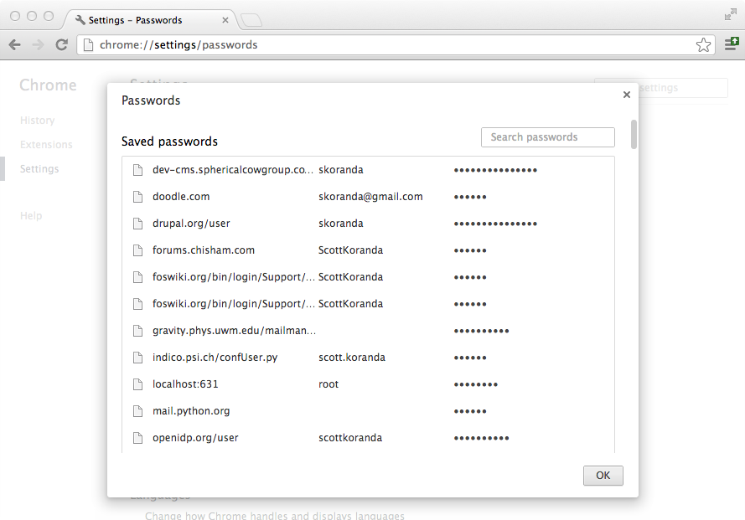

Slide 102
Federated Identity
Federated identity is an identity you can use across multiple security or identity domains.
Related to, but not the same as, single sign-on (SSO).
“Login with your Google/Facebook/Twitter account”

Slide 103
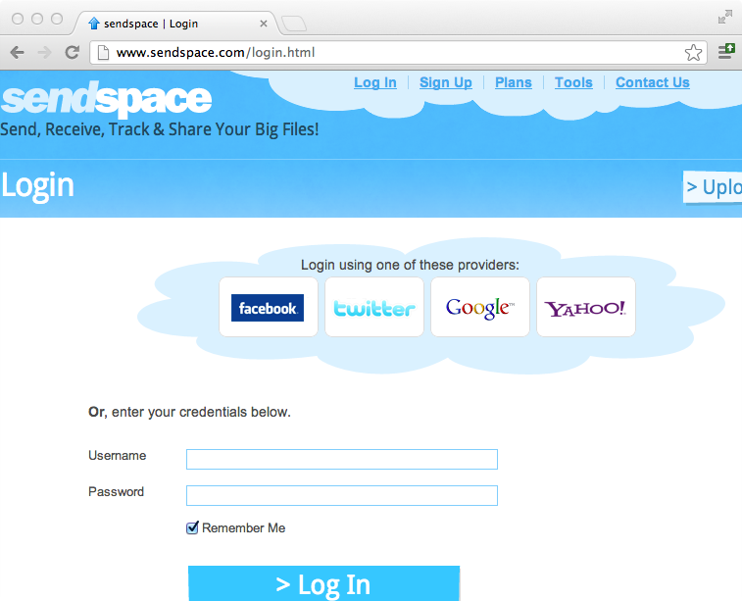

Slide 104
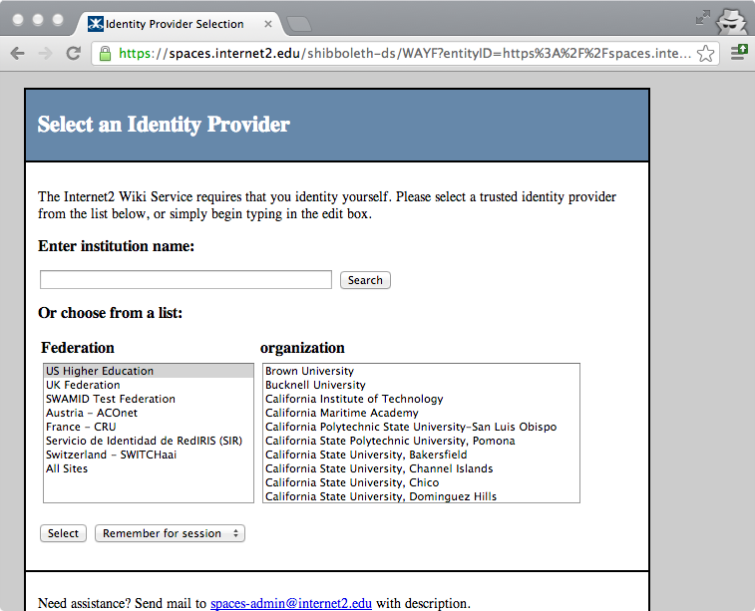

Slide 106
Federated Identity
Pros:
Users do not have to create new account.
“Yet another new account”
Faster for users to access resource.
Easier for users to access resource.
Single credential often protected better.
One account so manage it well!

Slide 107
Federated Identity
Cons:
New experience for users.
More clicks just to login to service.
More complexity for service and infrastructure.
Single credential when compromised is disaster.
Bad actors have access to multiple services instead of just one.

Slide 108
Federated Identity: LIGO Use Cases
Consume federated identity and get out of business of providing identity.
Save substantial help desk support effort.
Save substantial infrastructure support effort.
Goal, but will be long time coming.
Need excellent command line support.
Need high levels of assurance from remote IdPs.

Slide 109
Federated Identity: LIGO Use Cases
Streamline collaboration with partners.
KAGRA
Virgo
LIGO-India?
Prevent members in each collaboration from having to request and manage identities and credentials provisioned by other collaborations.

Slide 110
Federated Identity: LIGO Use Cases
Streamline collaboration with astronomers, astrophysicists, and other scientists.
Share, when appropriate, access to analysis results, data, and other scientific work product with colleagues.

Slide 111
Federated Identity: LIGO Use Cases
Ease processes for review committees, funding agency representatives, and other VIPs.
Prevent VIPs from having to create a LIGO identity or account just to participate on a review panel.

Slide 112
Trust?
How do I know I can trust a remote IdP?
How does the remote IdP know it can trust the SP?
Doesn’t want to allow any service to use it for authenticating users.
Substantially harder when IdP and SP not part of the same organization or security domain.

Slide 113
Trust the Hard Way
Each IdP, SP negotiates trust in a point-to-point model:
What identifier is exchanged?
How information is encrypted and signed?
Which attributes are asserted?
How attributes are asserted?
How attributes are consumed?
Which privacy policies are in effect?
Legal and policy ramifications cannot be ignored, even for science projects.

Slide 114
Need Scalable Trust Model
Framework for IdPs and SPs to agree to common policies and operating procedures in order to bootstrap trust efficiently across the participants.
IdPs and SPs using SAML as web Authz framework rely on SAML Identity Federations.

Slide 115
SAML Identity Federation
IdP and SP participants agree on:
Policies for operating IdPs and SPs.
Establishing trust through exchange of SAML metadata.
Details about each IdP and SP, their service endpoints, and how assertions will be signed and encrypted.
Policies for how metadata is managed.

Slide 116
SAML Identity Federations
Most SAML identity federations established and operated by national research and education network (NREN) providers.
In the United States Internet2 established and operates the InCommon Federation.

Slide 117
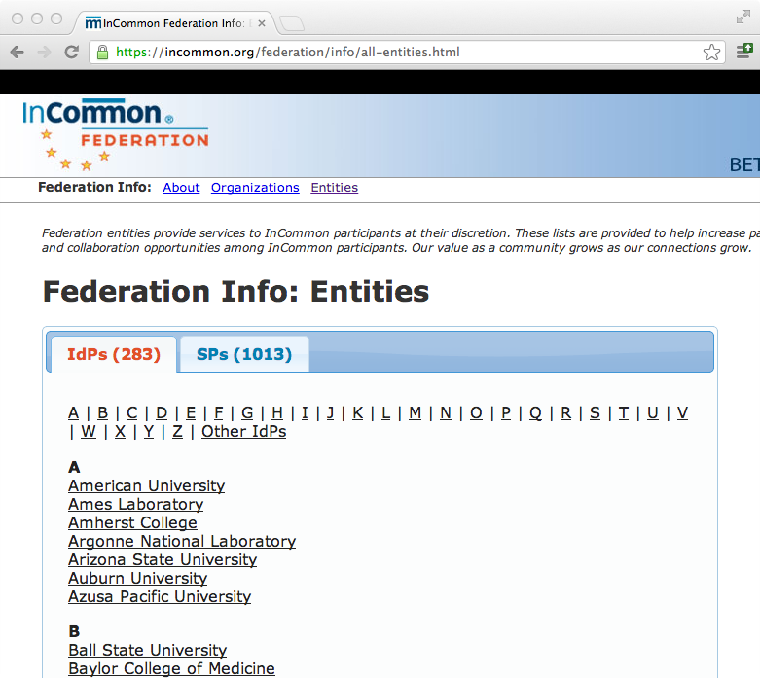

Slide 118
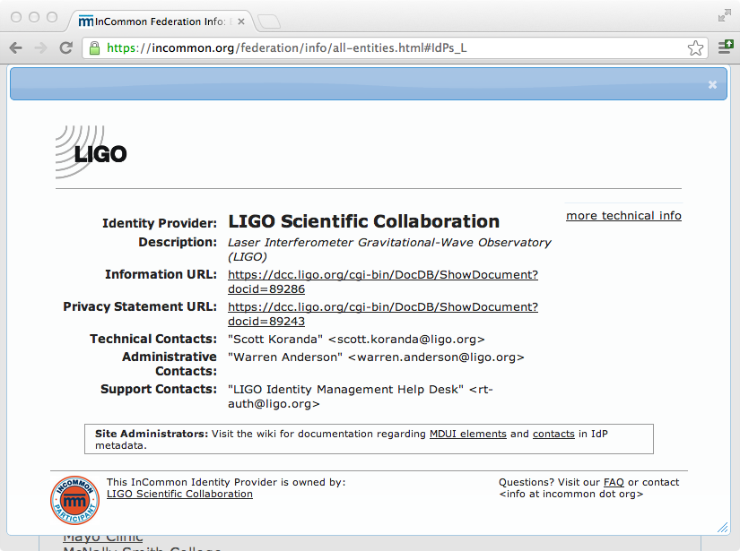

Slide 119
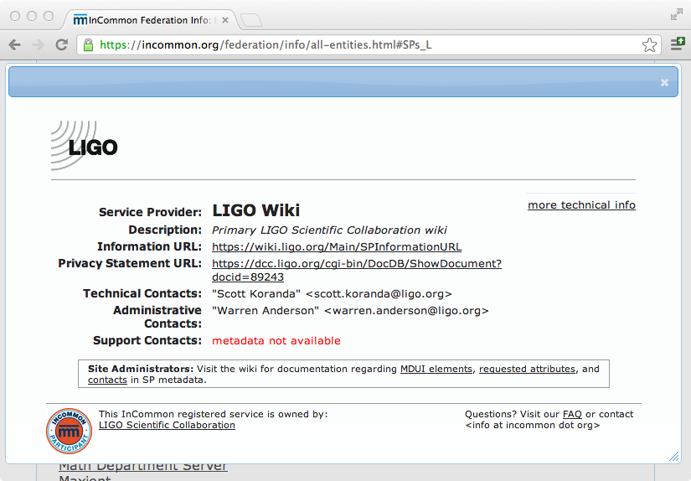

Slide 120
Other SAML Identity Federations
Most European countries, Canada, and Japan have well established SAML identity federations with high coverage in academia and research.
“The mission of REFEDS is to be the voice that articulates the mutual needs of research and education identity federations worldwide. The group represents the requirements of research and education in the ever-growing space of access and identity management...”

Slide 121
