Slide 1
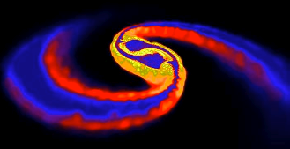
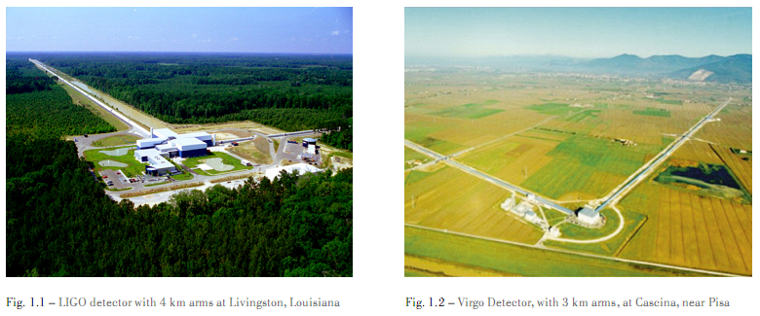
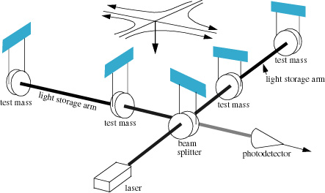
Exploring the Universe with
Gravitational Waves
Gravitational waves
Global network of GW detectors
Source localization
Advanced LIGO
Astrophysical sources
Opening the GW sky
“Merging Neutron Stars“ (Price & Rosswog)
No discovery
to report here!
Alan Weinstein, Caltech
for the LIGO Scientific Collaboration
LIGO-G1300642
Lepton-Photon, SF, 24-29 June 2013

Slide 2
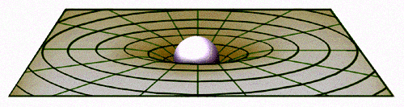
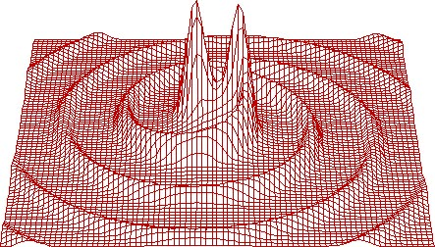
Gravitational Waves
Static gravitational fields are described in General Relativity as a curvature or warpage of space-time, changing the distance between space-time events.
G_{μν}= 8πΤ_{μν}
Shortest straight-line path of a nearby test-mass is a ~Keplerian orbit.
If the source is moving
(at speeds close to c),
eg, because it’s orbiting a companion, the “news” of the changing gravitational field propagates outward as gravitational radiation –
a wave of spacetime curvature

Slide 3
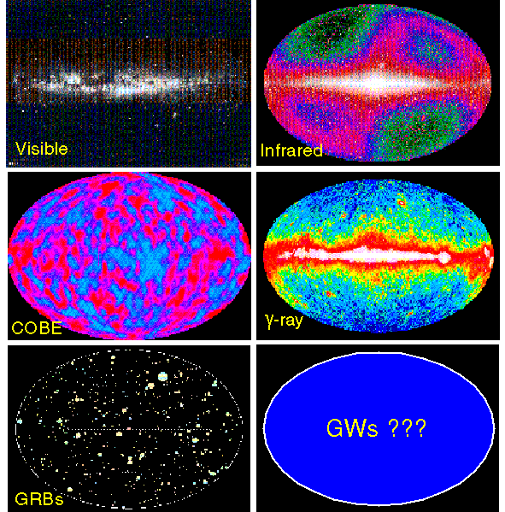
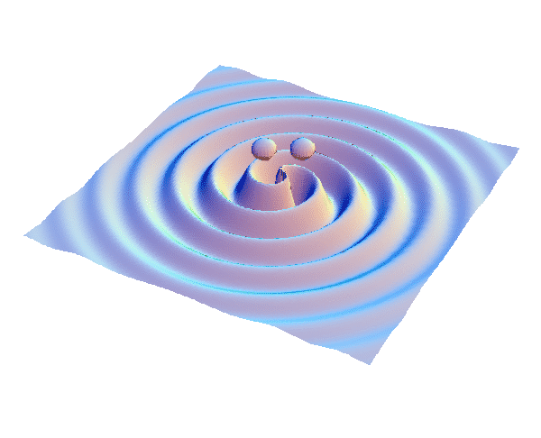
A NEW WINDOW
ON THE UNIVERSE
The history of Astronomy:
new bands of the EM spectrum opened → major discoveries!
GWs aren’t just a new band, they’re a new spectrum, with very different and complementary properties to EM waves.
Vibrations of space-time, not in space-time
Emitted by coherent motion of huge masses
moving at near light-speed;
not vibrations of electrons in atoms
Can’t be absorbed, scattered, or shielded.
GW astronomy is a totally new, unique window on the universe

Slide 4
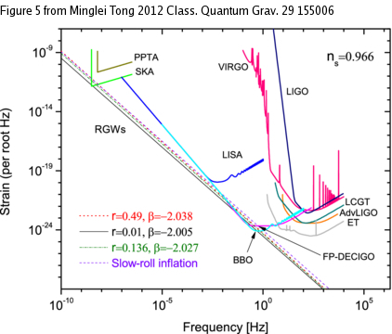
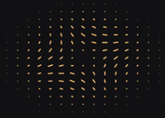
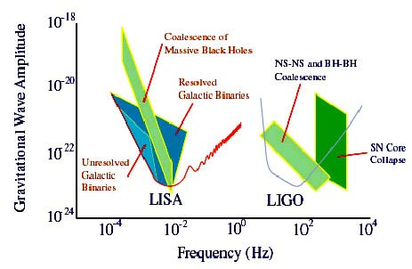
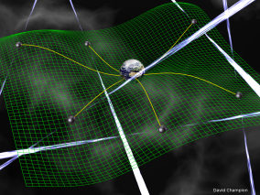
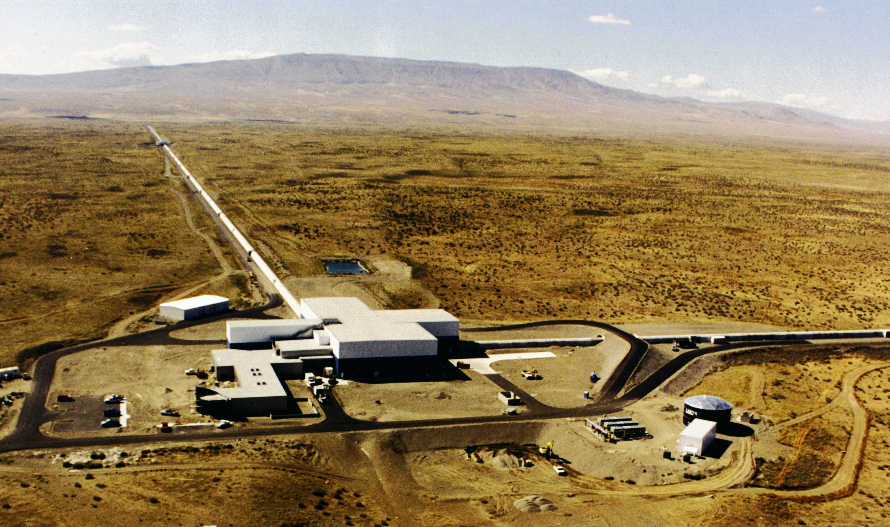
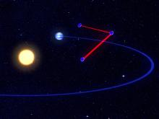
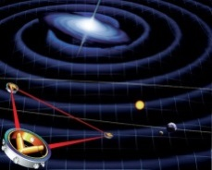
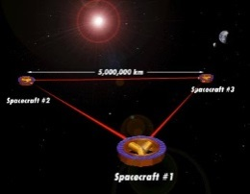
Frequency range of GW Astronomy
CMB B-pol
nHz
Audio band
Pulsar timing
http://www.ipta4gw.org/
Space
www.elisa-ngo.org/
Terrestrial

Slide 5
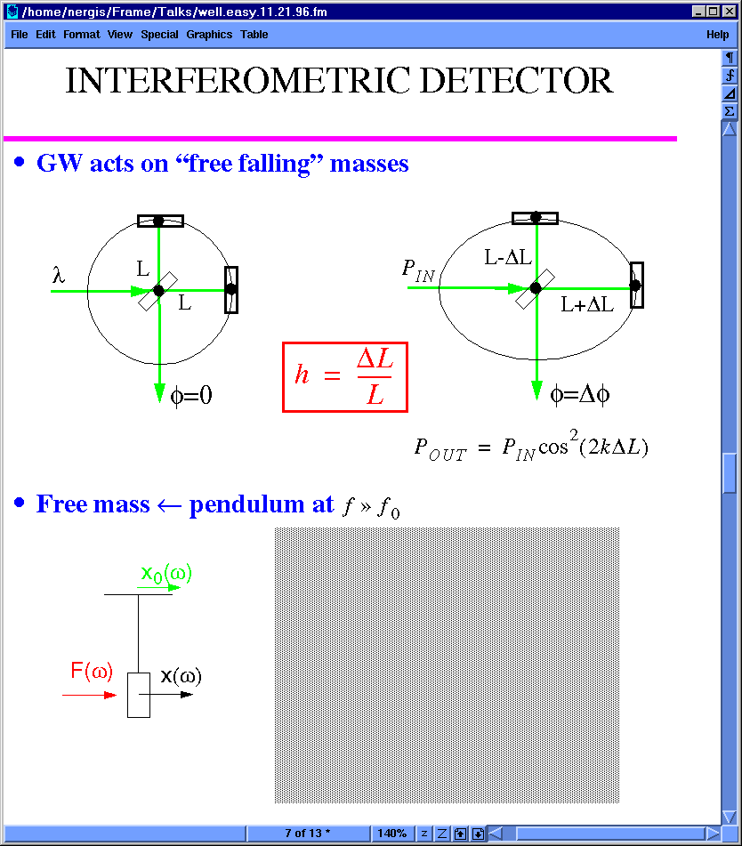
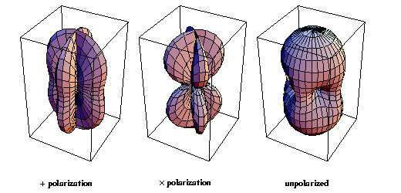
Interferometric detection of GWs
GW acts on freely falling masses:
mirrors
laser
Beam splitter
For fixed ability to measure ΔL, make L as big as possible!
Dark port photodiode
Antenna pattern: (not very directional!)

Slide 6

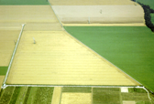


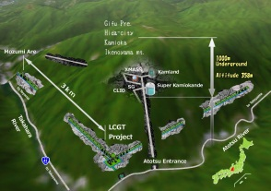



The Advanced GW Detector Network
GEO600 (HF)
Advanced LIGO
Hanford
KAGRA
Advanced LIGO
Livingston
Advanced
Virgo
LIGO-India
6
6

Slide 7
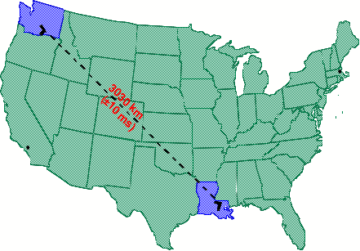
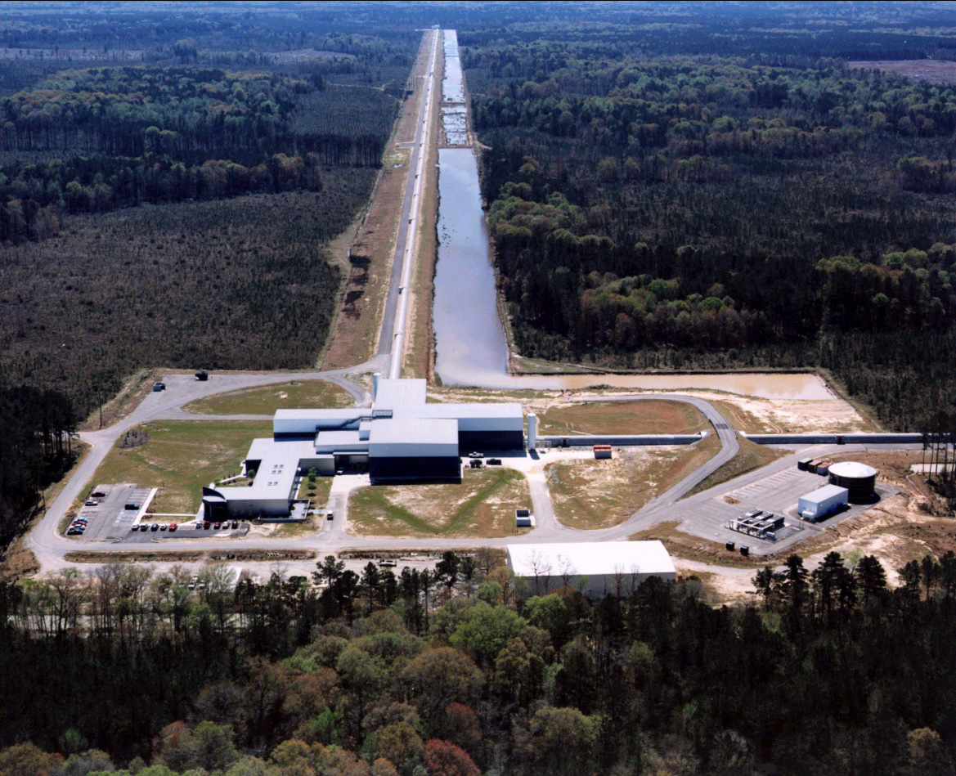


LIGO: Laser Interferometer Gravitational-wave Observatory
LHO
MIT
Hanford, WA
4 km (H1)
+ 2 km (H2), c.2010
Caltech
Plan for ~2015:
aLIGO 4km H2 to India
LLO
4 km
L1
Livingston, LA

Slide 8






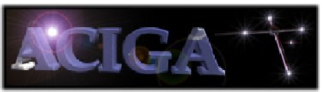

































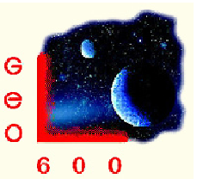

















LIGO Scientific Collaboration

Slide 9
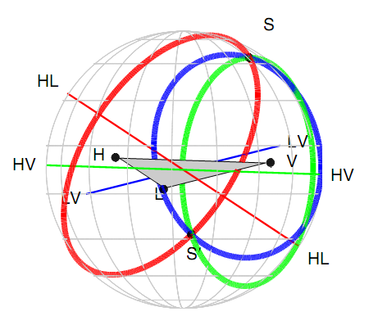
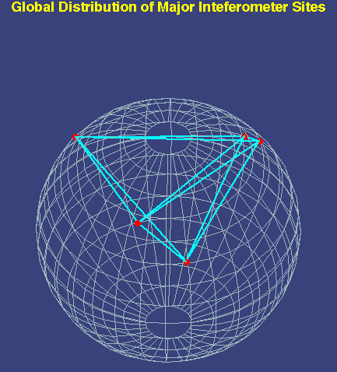
Event Localization With An
Array of GW Interferometers
Gravitational-wave astronomy is greatly enhanced by having a multiplicity of interferometers distributed over the globe.
  GW interferometry, ‘Aperture synthesis’
Advantages include:
  Source localization in near real time
  Enhanced network sky coverage
  Maximum time coverage – a fraction of the detectors are‘always listening’
  Detection confidence - coincidence
  Source parameter estimation
  Polarization resolution
TAMA
GEO
VIRGO
LIGO
Hanford
LIGO
Livingston
cosθ = δt / (c D₁₂)
Δθ ~ 0.5 deg
ΔL = δt/c
θ
1
D
2

Slide 10
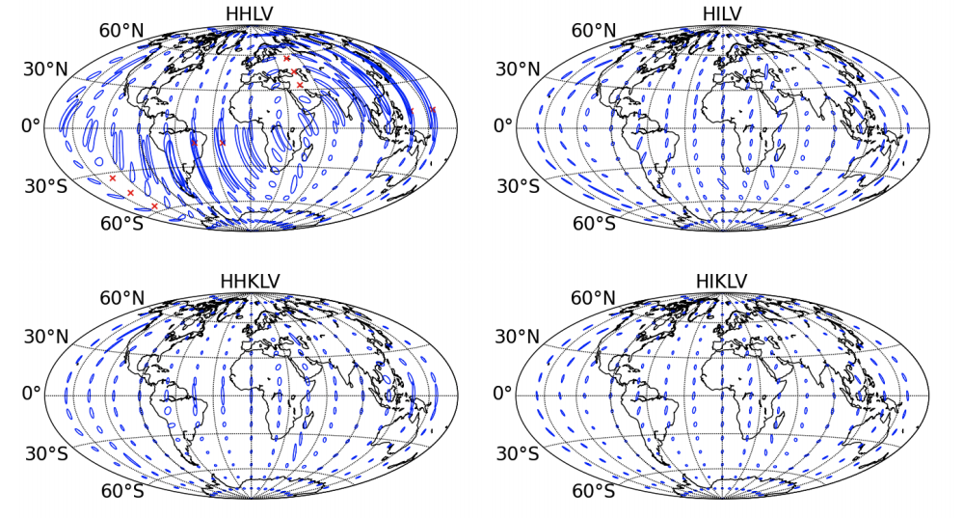
Source localization with
LIGO-India
Determination of source sky position: NS-NS binary inspirals @ 160 Mpc
Without LIGO-India With LIGO-India
S. Fairhurst (2012); LSC - arXiv:1304.0670v1(2013)

Slide 11
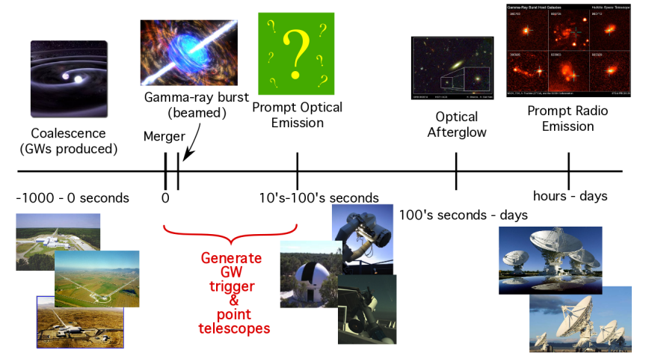
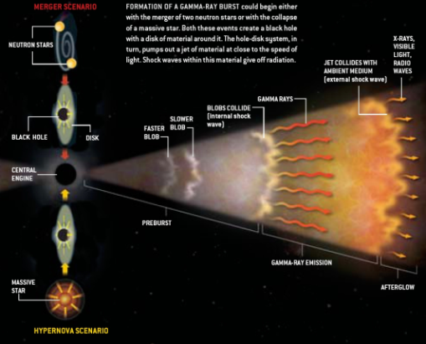
Low-latency identification of transients for rapid (< ~100s) followup
EM counterparts to GW sources (if any) are short-lived and faint
Call for partnerships with EM, ν observers: http://www.ligo.org/science/GWEMalerts.php

Slide 12
EM and GW
Multi-messenger Astronomy
Light Curve & Spectrum:
  Precise sky location
  Host galaxy
  Gas environment
  Progenitor star
  EM energetics
  Red shift
Gravitational Waves:
  Bulk motion dynamics
  Binary parameters
  Direct probe of central engine
  Progenitor mass
  GW energetics
  Luminosity distance
more complete picture of progenitor physics
Combining these observations will also
increase detection confidence,
allow a measurement of the local Hubble constant.
Notes:
Coupled observations with GW observations can lead to refined models of the system:
GW signals directly trace the bulk motion of the mass in the source
EM signals refine source position from degrees to arcseconds and can give redshift information

Slide 13
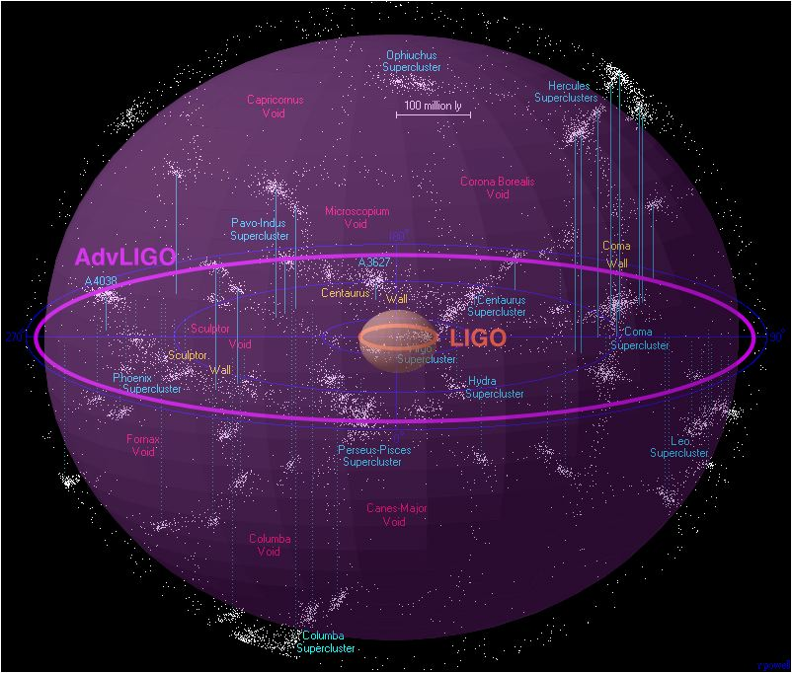
Initial, Enhanced, and
Advanced LIGO schedule
now
₂₀₀₆
₂₀₀₇
₂₀₀₈
₂₀₀₉
₂₀₁₀
₂₀₁₁
₂₀₁₂
₂₀₁₃
₂₀₁₄
₂₀₁₅
_{S5 data run}
_{e-LIGO installation}
_{and commissioning}
_{S6 data run}
_{Dark period}
S6 data analysis & preparations
for Advanced LIGO commissioning and open data
_{Advanced LIGO Project}
_{Commissioning & initial data}
_{With Advanced LIGO}
_{Adv LIGO}
_{Installation}
_{begins}
Improve amplitude sensitivity by a factor of 10x, and…
⇒ Number of sources goes up 1000x!

Slide 14
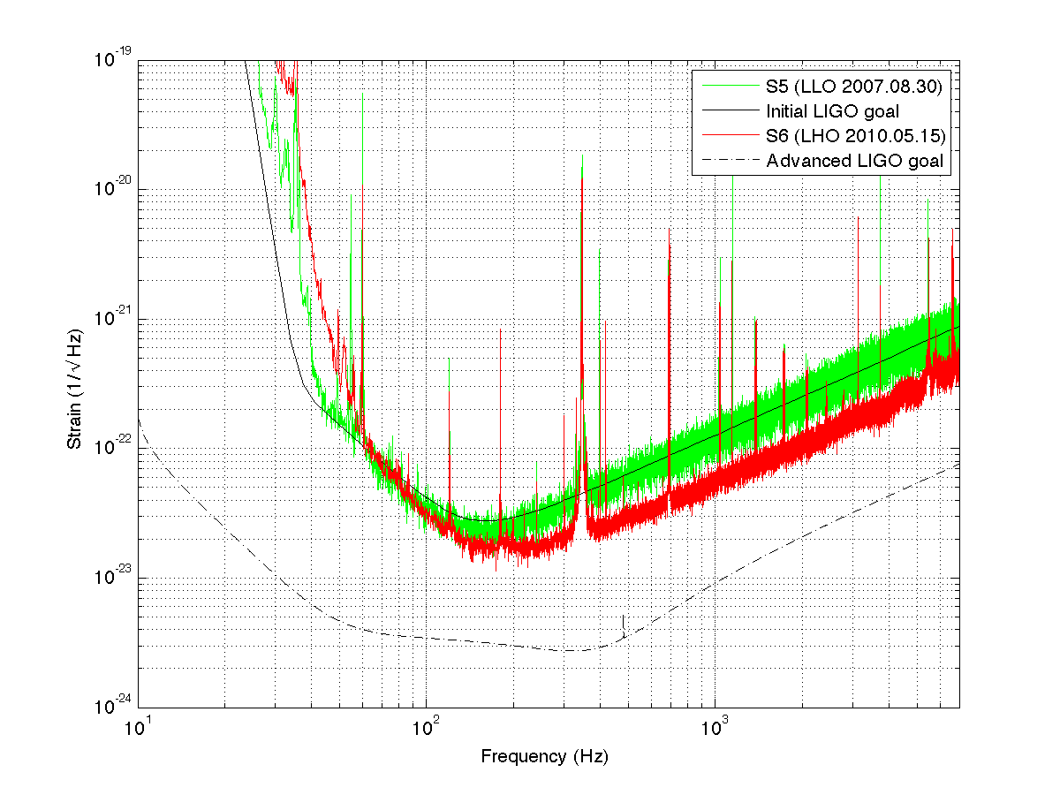
Strain sensitivity achieved by Initial LIGO, Enhanced LIGO
10⁻¹⁹ m/rtHz
Initial LIGO reach ~20 Mpc
Advanced LIGO reach ~200 Mpc
10⁻²⁰ m/rtHz
Advanced LIGO goal
Notes:
We made INITIAL LIGO. Now we’re installing for ADVANCED LIGO.

Slide 15
Better
seismic
isolation
Higher
power
laser
Better
test masses
and
suspension

Slide 16
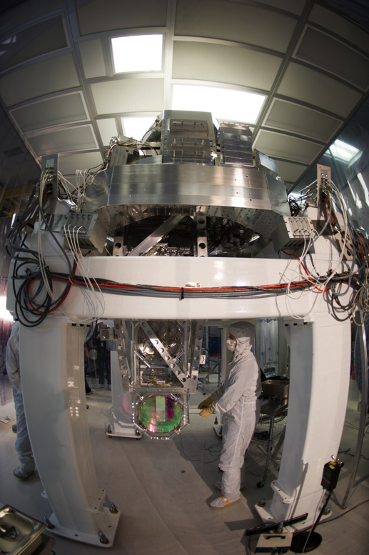
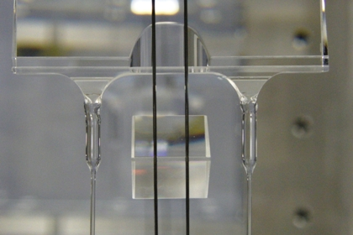
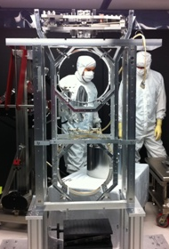
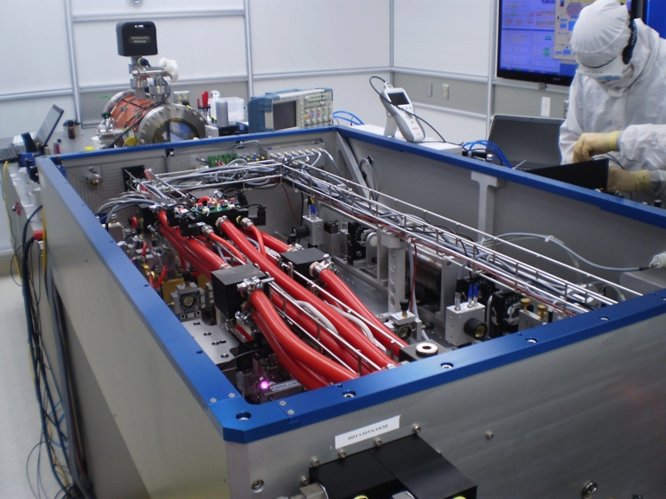
Better
seismic
isolation
Higher
power
laser
Better
test masses
and
suspension

Slide 17
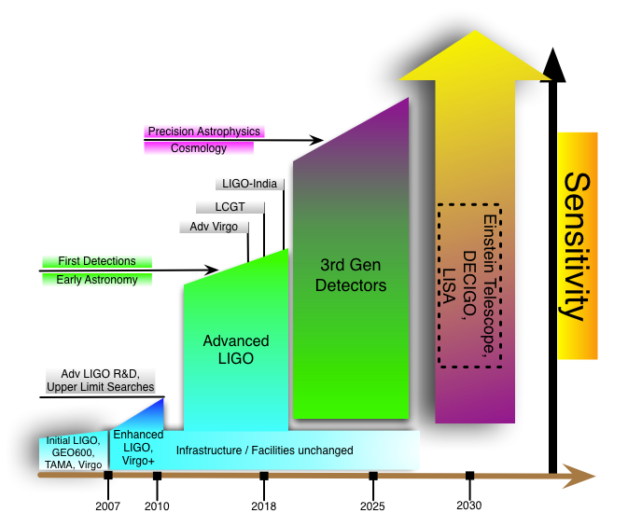
Beyond Advanced LIGO
KAGRA

Slide 18

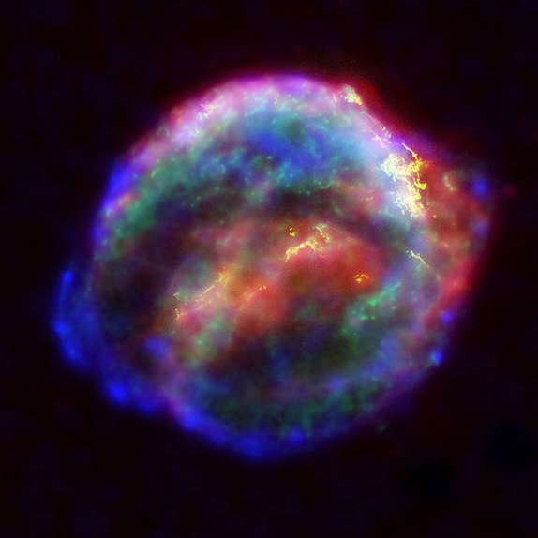

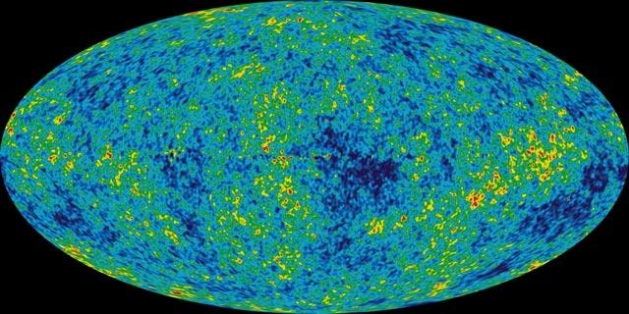
GW sources for ground-based detectors:
The most energetic processes in the universe
Coalescing Compact Binary Systems: Neutron Star-NS, Black Hole-NS, BH-BH
- Strong emitters, well-modeled,
- (effectively) transient
Asymmetric Core Collapse Supernovae
- Weak emitters, not well-modeled (‘bursts’), transient
- Cosmic strings, soft gamma repeaters, pulsar glitches also in ‘burst’ class
Credit: Chandra X-ray Observatory
Credit: AEI, CCT, LSU
Spinning neutron stars
- (effectively) monotonic waveform
- Long duration
Cosmic Gravitational-wave Background
- Residue of the Big Bang, long duration
- Long duration, stochastic background
NASA/WMAP Science Team
Casey Reed, Penn State
Notes:
LIGO is designed to be an observatory, not a one-off proof that GWs exist. What do we look for?
There are number of predicted astrophysical sources of gravitational radiation, and most of them involve cataclysmic events.
Binary systems – NSs and BHs, most likely source, theoretically well understood with known waveforms
Bursts – GW emissions that are not well modeled or understood. These include asymmetrically core collapse supernova, cosmic strings, and perhaps unknown sources
The residual GW background
Continuously emitting sources such as spinning neutron stars, which have a pure monotone emission.

Slide 19
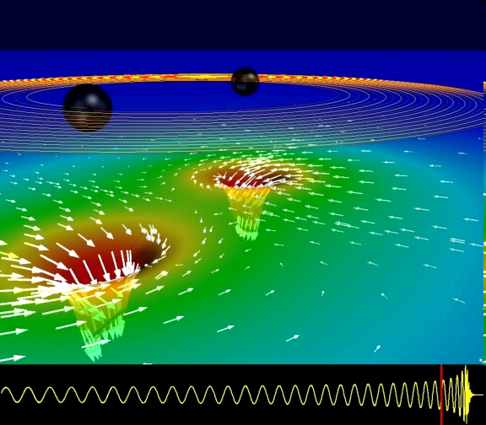
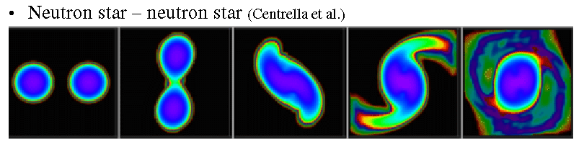
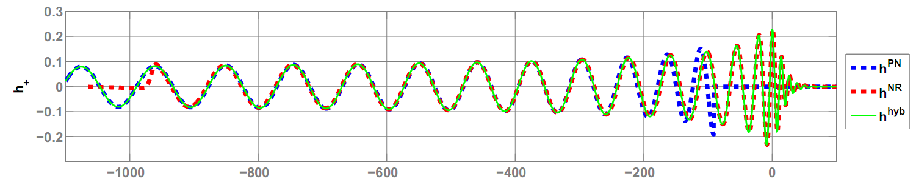
GWs from coalescing compact binaries (NS/NS, BH/BH, NS/BH)
Tidal disruption of neutron star
A unique and powerful laboratory to study
strong-field, highly dynamical gravity
and the structure of nuclear matter
in the most extreme conditions
Gravitational waveform: inspiral merger BH-ringdown
Waveform carries lots of information about binary masses, orbit, merger

Slide 20
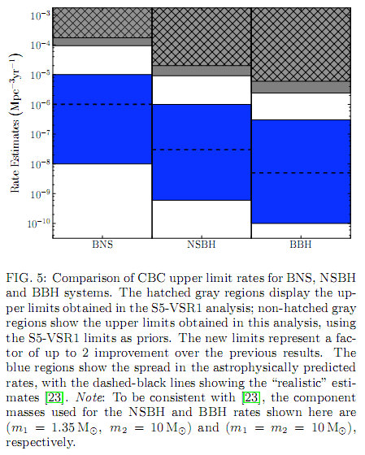
Expected ranges of binary merger rates
Estimates of astrophysical event rate
(mergers / Mpc³ / yr) from known NS-NS
close binaries in our galaxy, and population synthesis models.
  LVC, Class. Quant. Grav. 27 (2010) 173001
Detection range in Mpc (SNR = 8 in one detector, averaged over source sky location and orientation) based on aLIGO Mode 1b noise model (P=125 W, T_{SRM}=20%, F_{SRM}=0° )
10⁻⁷ mergers / Mpc³ / yr
Limits from Initial LIGO
Expected range
NS-NS NS-BH BH-BH
System | Masses (M_{sun}) | Range (Mpc) | Low rate est. (yr⁻¹) | Realistic rate (yr⁻¹) | High rate est. (yr⁻¹)
NS-NS | 1.4/1.4 | 200 | 0.4 | 40 | 400
NS-BH | 1.4/10 | 410 | 10 | 300
BH-BH | 10/10 | 970 | 20 | 1000

Slide 21
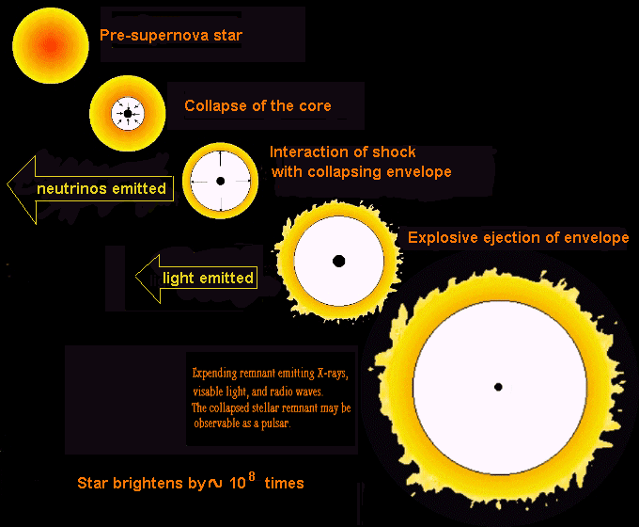
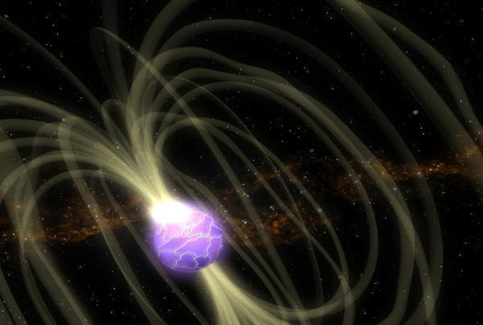

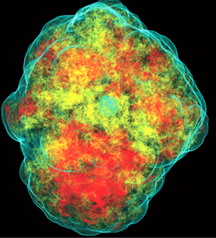
Unmodeled, short-duration
(<~ 1 s) GW Bursts
Gravitational waves
Magnetar flares / storms
Core collapse supernova
High-mass
binary merger
and ringdown
Credit: Chandra
X-ray Observatory
Credit: C. Ott

Slide 22
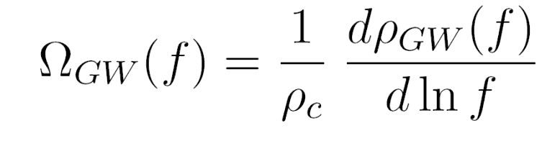
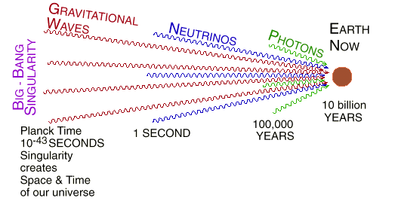
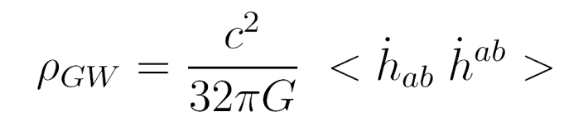
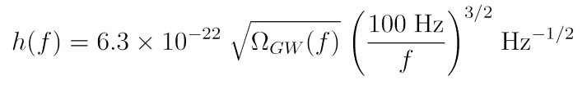
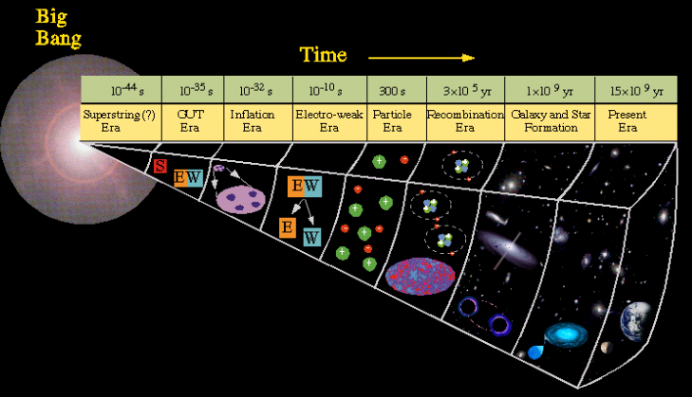
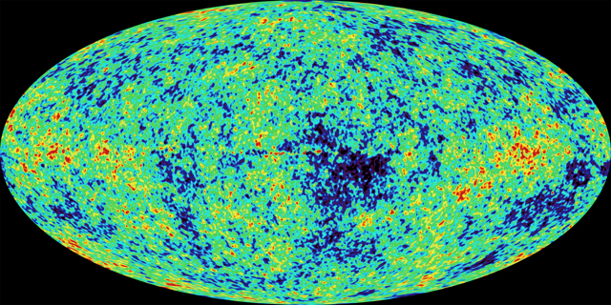
Gravitational waves from Big Bang
Waves now in the LIGO band were produced 10⁻²² sec after the big bang
380,000
YEARS
13.7 billion
YEARS
GWs
GUT
νs
cosmic microwave background -- WMAP 2003
γs
DM,DE
NOW

Slide 23







Pulsars and continuous wave sources
Pulsars in our galaxy
  non axisymmetric: 10-4 < ε < 10-6
  science: EOS; precession; interiors
  “R-mode” instabilities
  narrow band searches best
NASA
(NASA/CXC/SAO)
R-modes
NASA

Slide 24



Astrophysical science with binary mergers
Merger rates as function of mass, mass ratio, spin
  Establish existence of black hole binaries
  Neutron star mass distribution
  Black hole number, mass, spin and location distribution
  Search for intermediate-mass black holes
Inform / constrain astrophysical source distribution models
  Extract population synthesis model parameters.
  Binary formation and evolution history
  Explore hierarchical merger scenarios
Study matter effects in waveform: tidal disruption, NS EOS.
ciera.northwestern.edu/rasio

Slide 25


Effects of tidal disruption of neutron stars near merger
iLIGO
Credit: Daniel Price and Stephan Rosswog
aLIGO
ET

Slide 26




Testing General Relativity in the strong-field, dynamical regime
Test post-Newtonian expansion of inspiral phase.
Test Numerical Relativity waveform prediction
for merger phase.
Test association of inspiral and ringdown phases:
BH perturbation theory, no-hair theorem.
EOB-NR
www.black-holes.org
nonlocal.com/hbar/blackholes.html

Slide 27

Testing beyond-GR
Constrain beyond-GR parameters (Will, 2006)
Directly measure speed of gravitational waves,
constrain (or measure) the mass of the graviton.
Constrain (or measure) longitudinal or other polarizations.
Constrain (or measure) parity-violating effects in wave generation/propagation (Yunes et al, 2010).
Constrain “parameterized post-Einsteinian framework”
(Yunes & Pretorius, 2009)
Test specifically for scalar-tensor and other alternative-gravity theories
Beyond Einstein

Slide 28
Summary
An int’l network of ground-based GW detectors is taking shape.
iLIGO’s science run (S5) at design sensitivity completed in 2007
eLIGO’s science run (S6) at enhanced sensitivity completed in 2010
  No detections to report
  LIGO searches producing some interesting upper limits
Advanced LIGO construction is in progress, on time and budget;
commissioning and first observations in ~2014-15
  Sensitivity/range will be increased by a factor of 10-15
  We expect to found the field of GW astrophysics
  with advanced detectors
VIRGO, KAGRA, GEO-HF, will be online around ~2015-2016
Detections, and the exploration of the universe with GWs, will begin over the next decade!

Slide 29
… Fin …
We look forward to the coming advanced detector era:
the discovery and exploration of the GW sky;
unique tests of General Relativity in the strong-field, highly non-linear and dynamical regime;
joint observations and discoveries with EM and neutrino telescopes;
and a rich new branch of astrophysics.
But most of all, we look forward to …
the unexpected!

Slide 30
Lots of Extra slides for questions

Slide 31

Binary Black Hole (high mass)
Horizon distance: Distance in Mpc at which one Advanced LIGO detector can see an optimally-located, optimally oriented binary merger with an SNR=8, as a function of total mass.
Averaging over sky location and orientation degrades this by ~2.26.
Important to use the right templates, including IMR, and spin effects!
Experience from Initial LIGO-Virgo suggests that reliable detection is possible with an average SNR/detector ~ 8.
Inspiral-merger-ringdown
EOB template (light-ring)
ringdown template
Horizon distance (Mpc)
Inspiral-only template (ISCO)
M (Msun)
P. Ajith (2009)
BNS, 450 Mpc

Slide 32

CBC low mass, upper limits
Search for binary inspiral signals from systems with (2 < Mtot < 25 Msun), over all S6 data.
Only significant signal was a blind injection!
Major CBC / Burst / DetChar effort on data quality.
Major simulation campaign to evaluate search sensitivity: just what we expected!
  Search is near-optimal for Gaussian data.
Result: upper limits on merger rate in nearby universe (S3 – S6) as a function of system mass.
Around 2x better than from S5 data alone.
Still ~10² away from plausible expectations.

Slide 33

CBC high mass, upper limits
Search for binary inspiral signals from systems with (25 < Mtot < 100 Msun), over all S6 data – a large parameter space!
Major CBC / Burst / DetChar effort on data quality.
According to some astrophysicists, we’re already skimming relevant region of rate expectations for (10 – 20 Msun)² !

Slide 34


CBC high mass, upper limits
Templates don’t include spin, but they capture a fair amount of the spin parameter space anyway.
Future searches will improve on this with “spin-aligned” template banks.

Slide 35



Single detection confidence:
GW100916 blind injection
Threshold network SNR

Slide 36

Sources of GWs
Accelerating charge ⇒ electromagnetic radiation (dipole)
Accelerating mass ⇒ gravitational radiation (quadrupole)
Amplitude of the gravitational wave (dimensional analysis):
= second derivative
of mass quadrupole moment
(non-spherical part of kinetic energy
– tumbling dumb-bell)
G is a small number!
Need huge mass, relativistic
velocities, nearby.
For a binary neutron star pair,
10m light-years away, solar masses
moving at 15% of speed of light:
Energy-momentum conservation:
  cons of energy ⇒ no monopole radiation
  cons of momentum ⇒ no dipole radiation
  lowest multipole is quadrupole wave
M ~ 10³⁰ kg
R ~ 10 km
f ~ 400 Hz
r ~ 10²³ m
km
Terrestrial sources TOO WEAK!

Slide 37

GW detector at a glance
Attacking fundamental limits (quantum, thermal, environmental)
to precision measurement
Seismic motion --
ground motion due to natural and anthropogenic sources
Thermal noise --
vibrations due to finite temperature
want to get h ≤ 10⁻²²;
can build L = 4 km;
must measure
ΔL = h L ≤ 4×10⁻¹⁹ m
Shot noise --
quantum fluctuations in the number of photons detected

Slide 38





Slide 39
Frequency-Time
Characteristics of GW Sources
time
Ringdowns
Broadband Background
Bursts
frequency
CW (quasi-periodic)
Chirps
Earth’s orbit
Earth’s rotation
frequency
frequency
time
time

Slide 40








Advanced LIGO Seismic
Isolation
  ISI:
  Single Stage
  Internal Seismic Isolator
  HEPI:
  Hydraulic External
  Pre Isolator
  HAM Chambers Equipment
  ISI:
  Two-Stage Internal Seismic Isolator
  HEPI:
  Hydraulic External
  Pre Isolator
  BSC Chambers Equipment
40

Slide 41











Advanced LIGO Suspensions

Slide 42



Advanced LIGO Pre-stabilized Laser

Slide 43


Advanced LIGO Core Optics

Slide 44



Advanced LIGO Installation going well!

Slide 45
Advanced LIGO Sensitivities in 2015-2018
Advanced LIGO Sensitivity: 2015-2018
2018
2017
2016
2015
Initial LIGO

Slide 46



Sketch of possible progression for Advanced LIGO sensitivity
Reaching LF target
sensitivity is challenging…
Early short run:
25w laser input, no signal recycling
~10x excess low frequency noise
BNS Inspiral Range: 60 Mpc
BBH Inspiral Range: 227 Mpc
Stochastic Omega: 1.5e-7
Preliminary
DRAFT
… so this is not an official plan for the configuration evolution, rather, an educated guess at how aLIGO might evolve
Preliminary
D. Shoemaker, 2011
First extended run:
25w laser input, no signal recycling
BNS: 142 Mpc
BBH: 1400 Mpc
Stochastic Omega: 3e-9
125w laser input, signal recycling
BNS Inspiral Range: 200 Mpc
BBH Inspiral Range: 1640 Mpc
Stochastic Omega: 2.25e-9
DRAFT

Slide 47



What will we see?
GWs from the most energetic processes in the universe!
black holes orbiting each other
and then merging together
Supernovas, GRB engines
rapidly spinning neutron stars
Vibrations from the Big Bang
The unexpected!
A NEW WINDOW
ON THE UNIVERSE
WILL OPEN UP
FOR EXPLORATION.
Analog from cosmic microwave background -- WMAP 2003

Slide 48


Astrophysics with joint
GW – EM observations
External triggers: Short-hard GRBs:
  Confirm (or rule out) merger progenitor
  Study progenitor systems, including orientation and beaming
  Relate GW and EM energy release
  Relate merger parameters to hosts (metallicity, SFR, …)
Follow-ups: detect optical afterglow, host galaxy, redshift…
  Low latency pipeline, sky localization
CBC mergers as cosmological standard sirens.
  Independent, self-calibrating measurement of Hubble constant
  a(z), dark energy EoS
http://astro.hi.is/grb.php

Slide 49



GRB triggers for GW searches
Identified by space-based GR telescopes
with wide (good fraction of the sky) acceptance.
Short-hard GRBs – extra-galactic
  possible binary merger progenitors.
  In that case, known (NS-BH inspiral) waveform
  (Strongly?) beamed.
  Produce high energy neutrinos via
  internal shocks accelerating electrons
  and protons ⇒
Long-soft GRBs – extra-galactic
  possible “Collapsar” progenitor
  poorly-modeled waveform
  strongly beamed.
  Produce copious low energy neutrinos.
Ott et al (2010)

Slide 50

Reducing quantum noise in interferometric measurement by squeezing the EM vacuum
One can reduce quantum noise by injecting squeezed light into Advanced LIGO
  3 dB injected squeezed light = 2x reduction in power
Recently demonstrated on GEO600
On LIGO, the goal was to understand noise couplings, locking techniques, losses
Successfully injected squeezed light into Hanford H1 interferometer and demonstrated > 2 dB reduction in shot noise
Squeezer source (Australian National University design)

Slide 51

Gravitational waveforms and tidal disruption
Talk by Kenta Kiuchi
(Sunday, NRDA)

Slide 52

S5 search for compact binary signals
3 months of data analyzed- no signals seen
For 1.4-1.4 M_{o} binaries, ~ 200 MWEGs in range
For 5-5 M_{o} binaries, ~ 1000 MWEGs in range
Plot- Inspiral horizon for equal mass binaries vs. total mass
  (horizon=range at peak of antenna pattern; ~2.3 x antenna pattern average)
Peak- 130 Mpc
at total mass ~ 25M_{sun}
Notes:
Slide #1 (suggested): plot shows expected number of events from a search (red points) and 1 sigma variation as function of combined snr^2 based on time-slides. Blue dots are zero lag points.

Slide 53
Supernova collapse sequence
Within about 0.1 second, the core collapses and gravitational waves are emitted.
After about 0.5 second, the collapsing envelope interacts with the outward shock. Neutrinos are emitted.
Within 2 hours, the envelope of the star is explosively ejected. When the photons reach the surface of the star, it brightens by a factor of 100 million.
Over a period of months, the expanding remnant emits X-rays, visible light and radio waves in a decreasing fashion.
Gravitational waves

Slide 54

Search for known pulsars
  Joint 95% upper limits for 97 pulsars using ~10 months of the LIGO S5 run. Results are overlaid on the estimated median sensitivity of this search.
  For 32 of the pulsars we give the expected sensitivity upper limit (red stars) due to uncertainties in the pulsar parameters .
Pulsar timings provided by the Jodrell Bank pulsar group
Lowest GW strain upper limit:
  PSR J1802-2124
  (f_{gw} = 158.1 Hz, r = 3.3 kpc)
  h₀ < 4.9×10⁻²⁶
Lowest ellipticity upper limit:
  PSR J2124-3358
  (f_{gw} = 405.6 Hz, r = 0.25 kpc)
  ε < 1.1×10⁻⁷
Preliminary
Notes:
Collaboration with Kramer and Lyne for timing solutions and starting a collaboration with RXTE team for timing data for objects which are visible in Xray (e.g. j0537). Note that these results (except the Crab pulsar result) will remain preliminary until the post-run pulsar timing solutions are generated. These timing solutions check that each pulsar signal has not drifted outside the sensitivity window.

Slide 55

Initial LIGO Sensitivity Goal
Strain sensitivity
< 3x10⁻²³ 1/Hz^{1/2}
at 200 Hz
Displacement Noise
  Seismic motion
  Thermal Noise
  Radiation Pressure
Sensing Noise
  Photon Shot Noise
  Residual Gas
Facilities limits much lower
BIG CHALLENGE:
reduce all other (non-fundamental, or technical) noise sources to insignificance

Slide 56
LIGO limits and expectations on Ω_{GW}
S1 result: Ω_{GW} < 23
S2 result: Ω_{GW} < 0.02
S3 result: Ω_{GW} < 8×10⁻⁴
S4 result: Ω_{GW} < 6.5×10⁻⁵
LIGO design, 1 year:
Ω_{GW} <~ 10⁻⁵ - 10⁻⁶
Advanced LIGO, 1 year:
Ω_{GW} <~ 10⁻⁹
Challenge is to identify and eliminate noise correlations between H1 and H2!

Slide 57

Upper limit map of a stochastic GW background
S4 data- 16 days of 2 site coincidence data
Get positional information from sidereal modulation in antenna pattern and time shift between signals at 2 separated sites
No signal was seen.
Upper limits on broadband radiation source strain power originating from any direction.
(0.85-6.1 x 10⁻⁴⁸ (Hz⁻¹) for min-max on sky map; flat source power spectrum)
Point Spread Function (calculated)
Preliminary

Slide 58
Event Localization With An
Array of GW Interferometers
SOURCE
SOURCE
TAMA
GEO
VIRGO
LIGO
Hanford
LIGO
Livingston
SOURCE
SOURCE
cosθ = δt / (c D₁₂)
Δθ ~ 0.5 deg
ΔL = δt/c
θ
1
D
2

Slide 59


Science
Binary neutron stars
Initial LIGO reach: 15Mpc; rate ~ 1/50yrs
Advanced LIGO ~ 200Mpc
‘Realistic’ rate ~ 40 events/yr
Rates paper: Class. Quant. Grav,
27 (2010) 173001

Slide 60



Pulsars and continuous wave sources
Pulsars in our galaxy
  non axisymmetric: 10⁻⁴ < ε < 10⁻⁶
  science: EOS; precession; interiors
  “R-mode” instabilities
  narrow band searches best

Slide 61


The Crab pulsar
PSR B0531+21; SN 1054AD; ~2 kpc away ; spinning at 29.8 Hz.
Spinning down rapidly; energy loss ~ 4 × 10³¹ W
  A significant fraction of that could be going into GWs @ 59.6 Hz
  Searched for signal in first 9 months of LIGO S5 data.
  using timing data from Jodrell Bank Observatory
  Assuming that GW signal is locked to EM pulses,
  null search result implies that no more than
  4–6% of the spin-down energy is in GW emission
  Crab pulsar is spherical; ε < 1.4 × 10⁻⁴
  (1/10 of Mt Everest)
Chandra image
Spin-down limit:
Abbott et al., ApJL 683, L45
61
Notes:
61
Collaboration with Kramer and Lyne for timing solutions and starting a collaboration with RXTE team for timing data for objects which are visible in Xray (e.g. j0537). Note that these results (except the Crab pulsar result) will remain preliminary until the post-run pulsar timing solutions are generated. These timing solutions check that each pulsar signal has not drifted outside the sensitivity window.

Slide 62

Search for known pulsars- preliminary
  Search for signals from 116 pulsars (including binaries) with f_{GW} > 40 Hz.
  NO SIGNALS SEEN above Gaussian noise in 3 LIGO detectors.
  Joint 95% upper limits using data from the LIGO S5 run:
Pulsar timings provided by Jodrell Bank, Green Bank, and Parkes Telescopes
Lowest GW strain upper limit:
  PSR J1603-7272
  (f_{gw} = 135 Hz, r = 1.6 kpc)
  h₀ < 2.3×10⁻²⁶
Lowest ellipticity upper limit:
  PSR J2124-3358
  (f_{gw} = 405.6 Hz, r = 0.25 kpc)
  ε < 7×10⁻⁸
Notes:
Collaboration with Kramer and Lyne for timing solutions and starting a collaboration with RXTE team for timing data for objects which are visible in Xray (e.g. j0537). Note that these results (except the Crab pulsar result) will remain preliminary until the post-run pulsar timing solutions are generated. These timing solutions check that each pulsar signal has not drifted outside the sensitivity window.

Slide 63
All sky searches
Most spinning neutron stars are not observed pulsars;
EM dim and hard to find.
But they all emit GWs in all directions (at some level)
Some might be very close and GW-loud!
Must search over huge parameter space:
  sky position: 150,000 points @ 300 Hz, more at higher frequency or longer integration times
  frequency bins: 0.5 mHz over hundreds of Hertz band, more for longer integration times
  df/dt: tens(s) of bins
Computationally limited! Full coherent approach using a fraction of the available data requires ~100,000 computers (Einstein@Home)

Slide 64

Einstein@Home: the Screensaver
GEO-600 Hannover
LIGO Hanford
LIGO Livingston
Current search point
Current search coordinates
Known pulsars
Known
supernovae remnants
User name
User’s total credits
Machine’s total credits
Team name
Current work % complete
}

Slide 65
Wide Parameter Space Searches
Method: matched filtering with a bank of templates
Parameters:
  Sky position
  Spin axis inclination and azimuthal angle
  Frequency, spindown, initial phase
  Binary orbit parameters (if in a binary system)
Can use a detection statistic, F, which analytically maximizes over spin axis inclination & azimuthal angle and initial phase
  Even so, computing cost scales as ~T ⁶
  Detection threshold also must increase with number of templates
Check for signal consistency in multiple detectors
Problem: huge number of templates needed
Even using clever semi-coherent analysis methods

Slide 66

The second-largest distributed computing project in the world!

Slide 67


Horizon distance is a strong function of mass
Horizon distance (Mpc)
versus mass (M_{sun})
Inspiral-Merger-Ringdown
Initial LIGO
Horizon distance (Mpc)
versus mass (M_{sun})
for ringdowns
iLIGO ⇒ eLIGO ⇒ aLIGO

Slide 68


Einstein@Home results from early-S5 “all sky” search
Results:
No significant signals
in full frequency band
and sky location
Strain sensitivity of search
arXiv:0905.1705v1

Slide 69

LIGO limits and expectations on Ω_{GW}
S4 result: Ω_{GW} < 6.5×10⁻⁵
S5 preliminary result:
Ω_{GW} < 9 × 10⁻⁶
Advanced LIGO, 1 year:
Ω_{GW} <~ 10⁻⁹

Slide 70

Response to chirps
Chirp signals
BHBH, 20M
NSNS
Low-P, 0-detune
(BHBH)
high-P, detuned
(NSNS)

Slide 71




The Laser Interferometer Space Antenna
LISA
Three spacecraft in orbit about the sun, with 5 million km baseline
The center of the triangle formation will be in the ecliptic plane
1 AU from the Sun and 20 degrees behind the Earth.
LISA (NASA/JPL, ESA) may fly in the next 10 years!

