Slide 1
aLIGO TMTS “Level 2” Damping Loop Design (Supplemental to LHO aLOG 6668)
J. Kissel

Slide 2
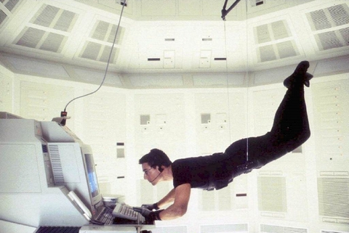
aLIGO TMTS "Level 2" Damping Loop Design
Mission Statement
The damping loops installed during the SUS testing phase
Commissioned by M. Evans
Design was reasonably good, but was shooting for the most damping
little-to-no regard to re-injection of sensor noise
The mission here was to design a set of loops, that
doesn’t take you years to design and tweak
isn’t on the hairy edge of instability
doesn’t require any “Brett Shapiro” trickery (damping in Modal, Global bases)
doesn’t require and new infrastructure (which Modal and Global damping would),
but still
designed with what modeling experience we’ve gained
gets us close to what we’ll need for aLIGO, primarily focusing on Pitch and Yaw
will be sufficient for the first several stages of integrated testing
Level 1
Level 2

Slide 3
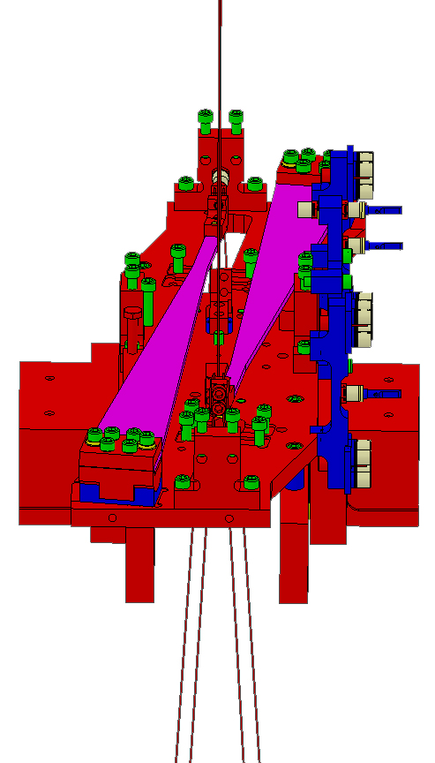
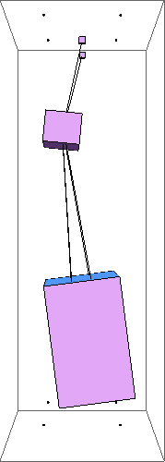
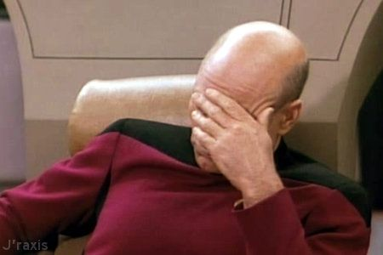
Yet another set of unique suspension dynamics…
The TMTS suspension is unique in that the lower wire break-off points are not vertically aligned in either the T *or* L directions (all other SUS’s have at least the L break-offs vertically aligned)
Also, the TMTS top mass is a copy of the QUAD top mass, so it’s got the same principle axes not-aligned with control axes problem, which causes P to couple with R (and therefore T)
The small separation at the upper blades and large separation at the bench means T is highly coupled to R at high frequency.
4.2 Hz “Transverse”
Mode Shape
+V
+T
+L
+V
+V
+V
+L
+T
+L
+T
+T
+L

Slide 4
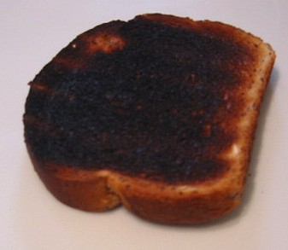
Yet another set of unique suspension dynamics…
+V
Also: The cross-moments of inertia for R is large and two of the principle axes of inertia (I1,I3) are ~30 [deg] rotated about the T axis because of the heavy off-axis parabolic in the bottom corner
So, T drive at the top mass tries to displace the bench in R (fundamental R/T of a pendulum), but it pulles the bench in an R/Y combo about (I1), which has a significant Y component, and less in Y because the MoI is smaller for Y than R.
(I1)
(I3)
+L
+T
(I2)
+V
+T
The largest Top-mass T to payload mass Y of any suspension by far
+L
Mode shape at 0.35 [Hz]
in response to M1 +T Drive

Slide 5
Requirements
Original target for total displacement noise was based on preliminary, SISO model of *only* residual seismic noise (unclear why Roll was ignored)
Requirements for R, P and Y are set at
“a few” e-15 [rad/rtHz]
above ~8 [Hz]
(see appendix for discussion on R requirements)
Other DOFs (L, T, and V) “don’t matter” so they’re set very loosely at
“a few” e-12 [m/rtHz]
above ~8 [Hz]
Question: do we really care down to 8 [Hz], or is meeting the Req’s. at 10 [Hz] fine?
(I assumed meeting at 10 [Hz] is good enough for the rest of the talk / design)

Slide 6
Other Noise Sources?
Here’s the reason I focus on the sensor noise alone:
In the translation degrees of freedom, the ~10 [Hz] requirements are met by orders of magnitude.
In rotation, noises other than sensor noise, meet requirements as is.
Residual Seismic in Roll (dominated by the T input, of course) is the only one that needs a little work, but only off by a factor of 2-3, and only below 9 [Hz]

Slide 7
The Level 1 Filters
A smarter out-of-the-gates design:
lower frequency, lower Q elliptic filter
some shaping at low frequency to tackle higher RMS modes
(Actually, original better than this, included res-gain boosts but design was lost with poor configuration control)
BUT this smarter design still isn’t good enough:
Sensor noise still a factor ~10-100 away from requirements at 10 [Hz]
Some high-frequency modes are left virtually undamped
“Non-obvious” R to P, T to Y, cross-coupling not considered

Slide 8
The Level 1 Filters
An aside –
because of an initial scare as a result of a bug in my usual MIMO model techniques,
I took the time to measure some Level 1 OLG TFs in detail.
Now model agrees very well with measurement:
Only remaining discrepancies:
Over-estimate of gain by ~50% (an uncertainty that seems common to all SUS models)
~1% (at MOST) level mis-match in resonant frequencies (“ideal” model parameters vs “real” as-built parameters)
Phase lag of a few degrees (source, as of yet, still unknown, but also seen elsewhere in other SUS)
So – we can believe the model to be accurate

Slide 9
Level 2 Loop Design the answer…
In Pitch,
I got *some* damping on the 4.2 Hz “T” mode
and managed to sneak in under the requirements
But had to put some effort into L, P, and T loops

Slide 10
Level 2 Loop Design the answer…
While in Yaw,
The requirements are also met (just barely) at 10 [Hz], but miss by a factor of 10 at 8 [Hz]

Slide 11
Level 2 Loop Design the answer…
And in Roll,
There’s just no hope of meeting req’s. in R, because of T cross-coupling. I got as close as I could.

Slide 12
Level 2 Loop Design That darn 4.2 [Hz] Mode!
+V
+L
+T
With other suspensions, one can take advantage of the fundamental T & R coupling, and damping the highest-frequency modes in R and T.
In the TMTS the 4.2 [Hz] just doesn’t couple to the R plant
Usual Boost on low-frequency modes to reduce RMS
4th order elliptic
a little gain peaking
So, as with the vertical DOF in the Beam Splitter, I increased the order of the elliptic, and even added another (real) zero-pole pair at [0.6:25] to the roll-off to squeeze out as much phase as I could get…
There’s a little more gain-peaking than I would like (still only about a factor of 2), but still unconditionaly stable and get a Q of ~10 on all modes!

Slide 13
Level 1 vs.Level 2
In Roll,
Now with some damping on the 4.2 Hz mode
A factor of 10-20 improvement at 10 [Hz]
by sacrificing a little a higher frequency

Slide 14
Level 1 vs.Level 2
In Pitch,
Now with some damping on the 4.2 Hz mode
A factor of 100
improvement at 10 [Hz]
with the same high- frequency performance

Slide 15
Level 1 vs.Level 2
In Yaw,
A factor of 30
improvement at 10 [Hz]
by sacrificing a little a higher frequency but still well below requirements

Slide 16
Level 1 vs.Level 2
Improvements have been confirmed by the usual control signal spectra

Slide 17
Concluding Remarks
TMTS Level 2 damping design meets aLIGO requirements at 10 [Hz], except for Roll which only misses by a few (assuming we don’t really need to meet 8 [Hz] requirements as currently defined)
Do we need to re-assess Roll requirements? (See Appendix)
Top stage principle axes of inertia misalignment with L & T control axes couples R and P (similar to QUAD), and optical bench principle axes of inertia misaligned with L & V control axis about couples R and Y
Lots of cross coupling at high-frequency makes loop design tough.
Transverse is the toughest because of 4.2 Hz mode, and we care about it because T couples to R, P, and Y
Similar design choices as BSFM
Absorbed overall gain into boost filter (so EPICs gain is -1.0 for all DOFs)
some degrees of freedom a little more complicated that others
Proof of design measurements
the experience with the QUAD and BSFM has shown the measurements confirm the cross-coupled MIMO model predicts motion well, so we can differ to later.
Will get closed loop transfer functions and spectra over the course of phase 3 testing.

Slide 18
Appendix: Roll Requirements
Keita Says:
I don't understand why the Roll requirement is the same as P and Y. I think the reason why P and Y are important is because they strongly couple to the ASC error signals provided by the IR QPDs. Roll around the arm axis will not change the beam path on the table and particularly the spot position on QPDs. There will be an amplitude change due to polarization change but that shouldn't couple to the QPD P and Y output. Roll of the TMS is a linear combination of the roll around the arm axis and the displacement in T direction. If anything, I'd think that the requirement for the Roll should come from the requirement for T.
Later, after having discussed with Matt:
As for Roll, I talked with Matt briefly and he agrees that Roll should be an equivalent of T displacement. The distance from the center of roll rotation to the arm axis should be 1 [m]-ish, so you multiply 1 [m] to your total roll curve in [rad/rtHz] on page 13, and that seems somewhat smaller than L, T and V curve on page 5, so it's indeed small.
To be continued…
See T1300599

