Slide 1


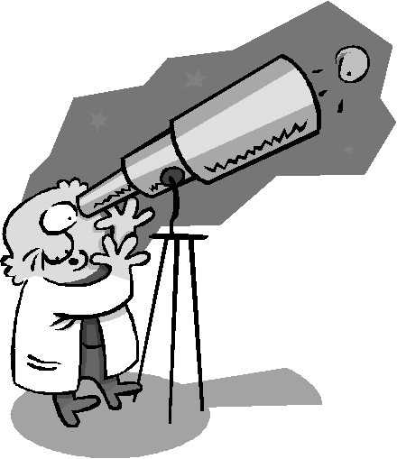
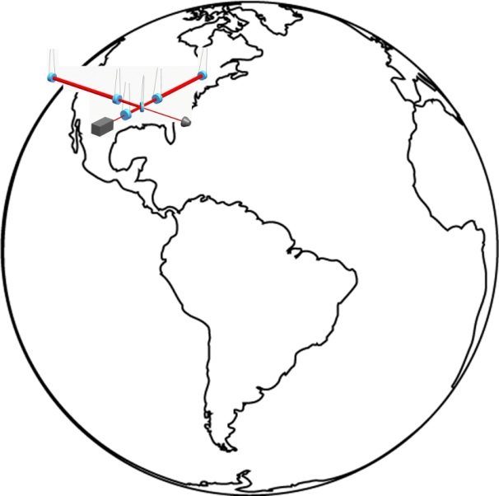
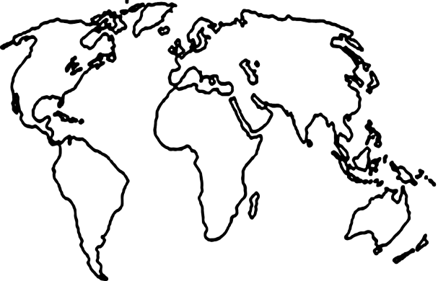
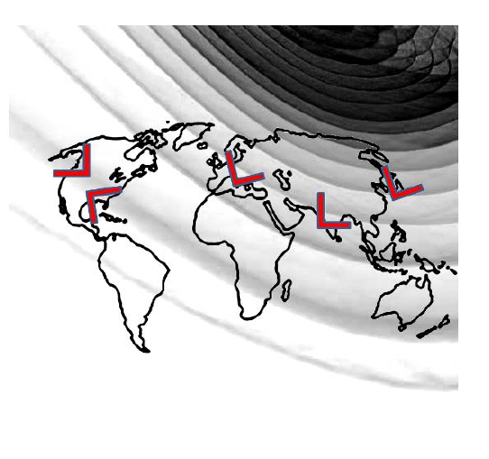
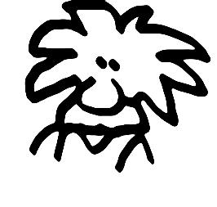
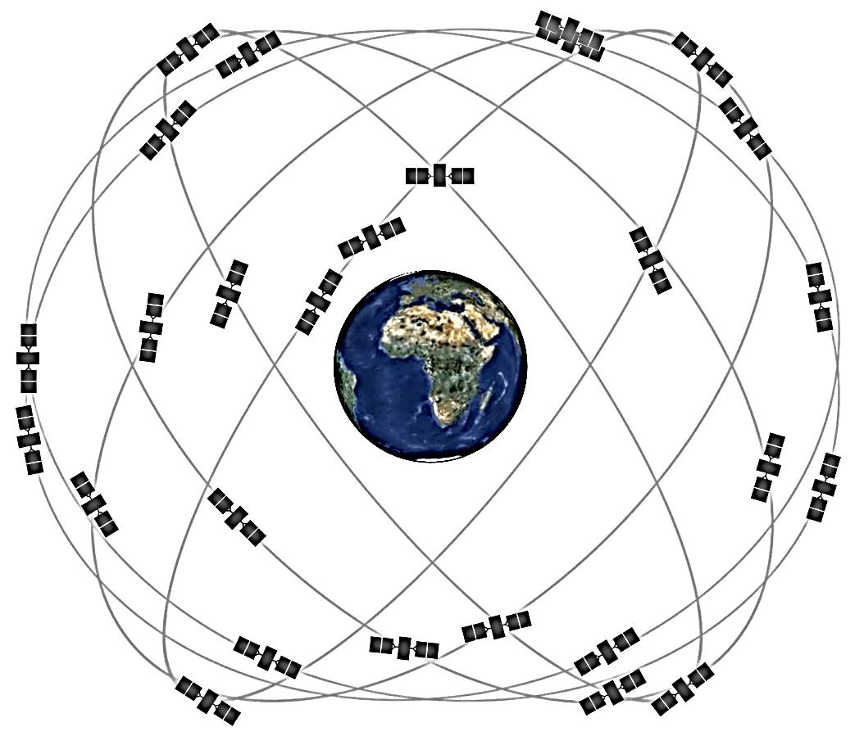
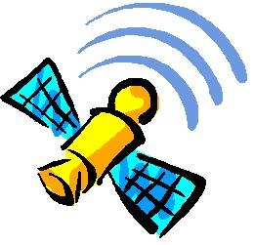
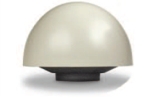

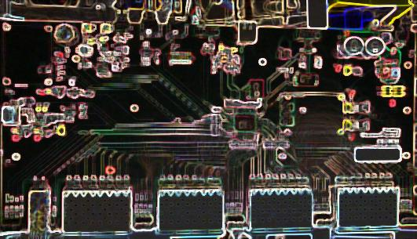
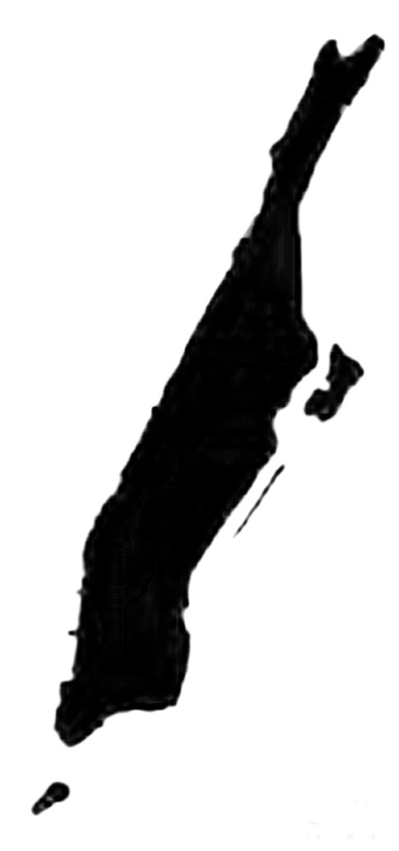
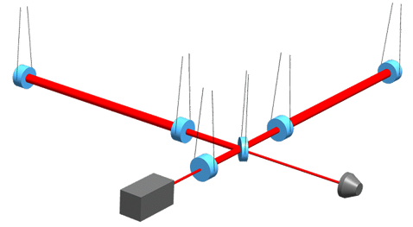

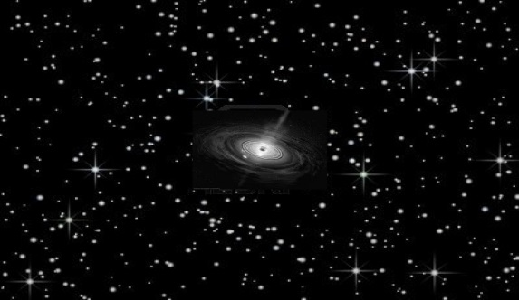
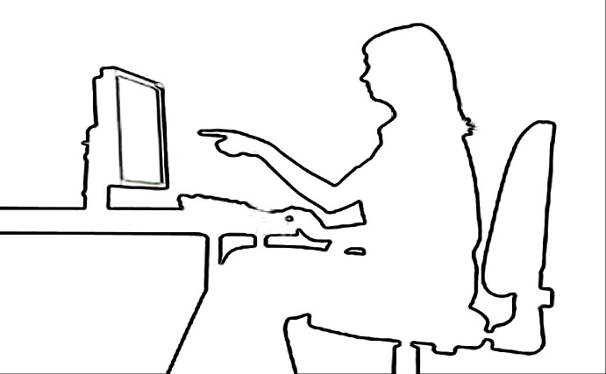

TIME is the key!
Which Galaxy Did the Gravitational Wave Come from?
When you look into a telescope, you see a tiny portion of the sky..
while a gravitational wave detector listens to the songs of the Universe from all directions.
Let’s build more detectors!
The gravitational wave arrives at a slightly different time to the different detectors.
Scientists need to know the time very precisely at each detector site. GPS satellites send very accurate time information.
At the detector site a GPS antenna receives the precise time.
Then special electronics is used to ‘time-stamp’ the collected data at accuracy of one-millionth of a second.
The detectors are a pretty large size, one arm is longer then the width of Manhattan.
Optical fibers distribute the precise time to each and every corner of the detector, in order to control delicate instruments.
photodetector
The data collected by the detector also receives a timestamp.
These timestamps are compared when detectors around the world detect a gravitational wave.
From the time difference scientists and YOU can find where in the sky a new black hole may have formed!
Image credits: lifeofearth.org, Columbia University, NASA, AEI, gps.gov, teachengineering.org

