Slide 1
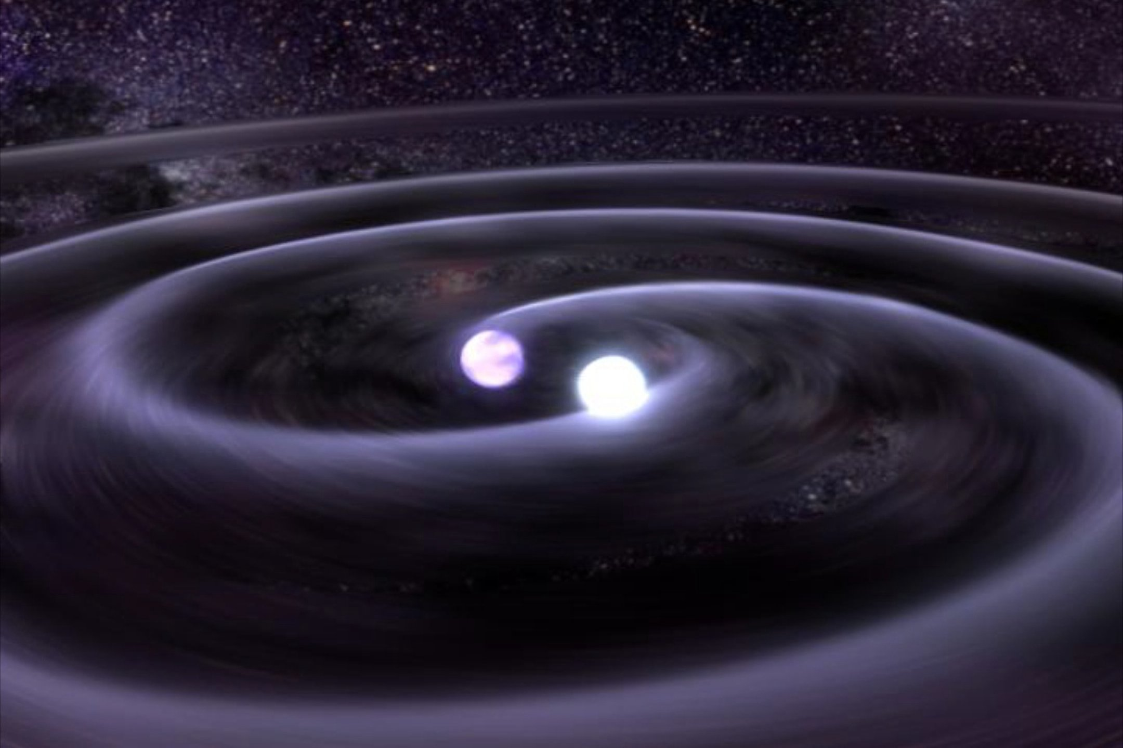
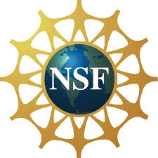
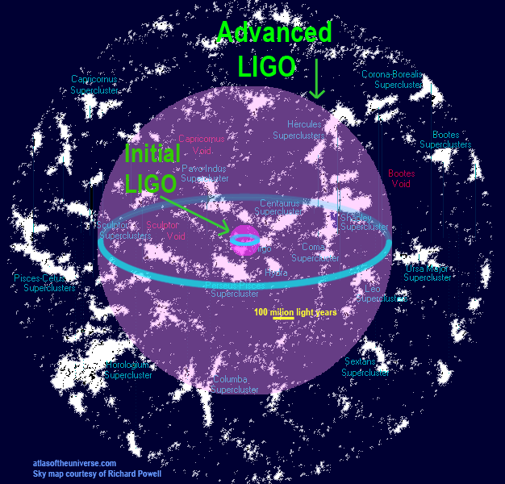
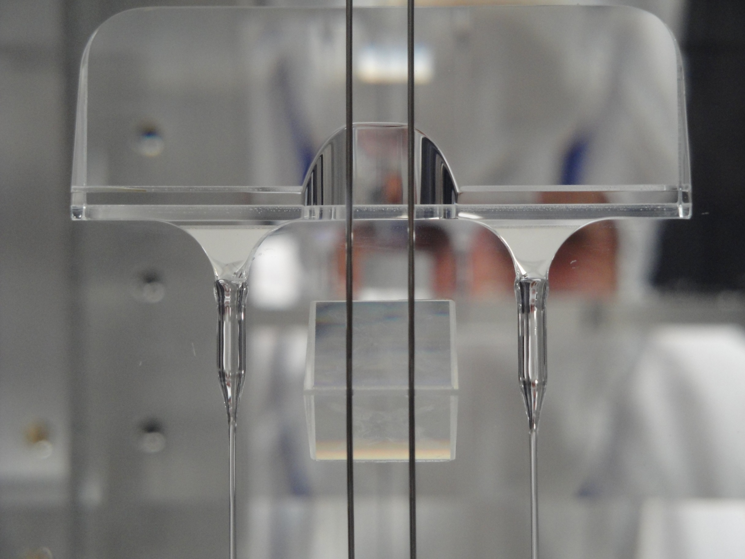
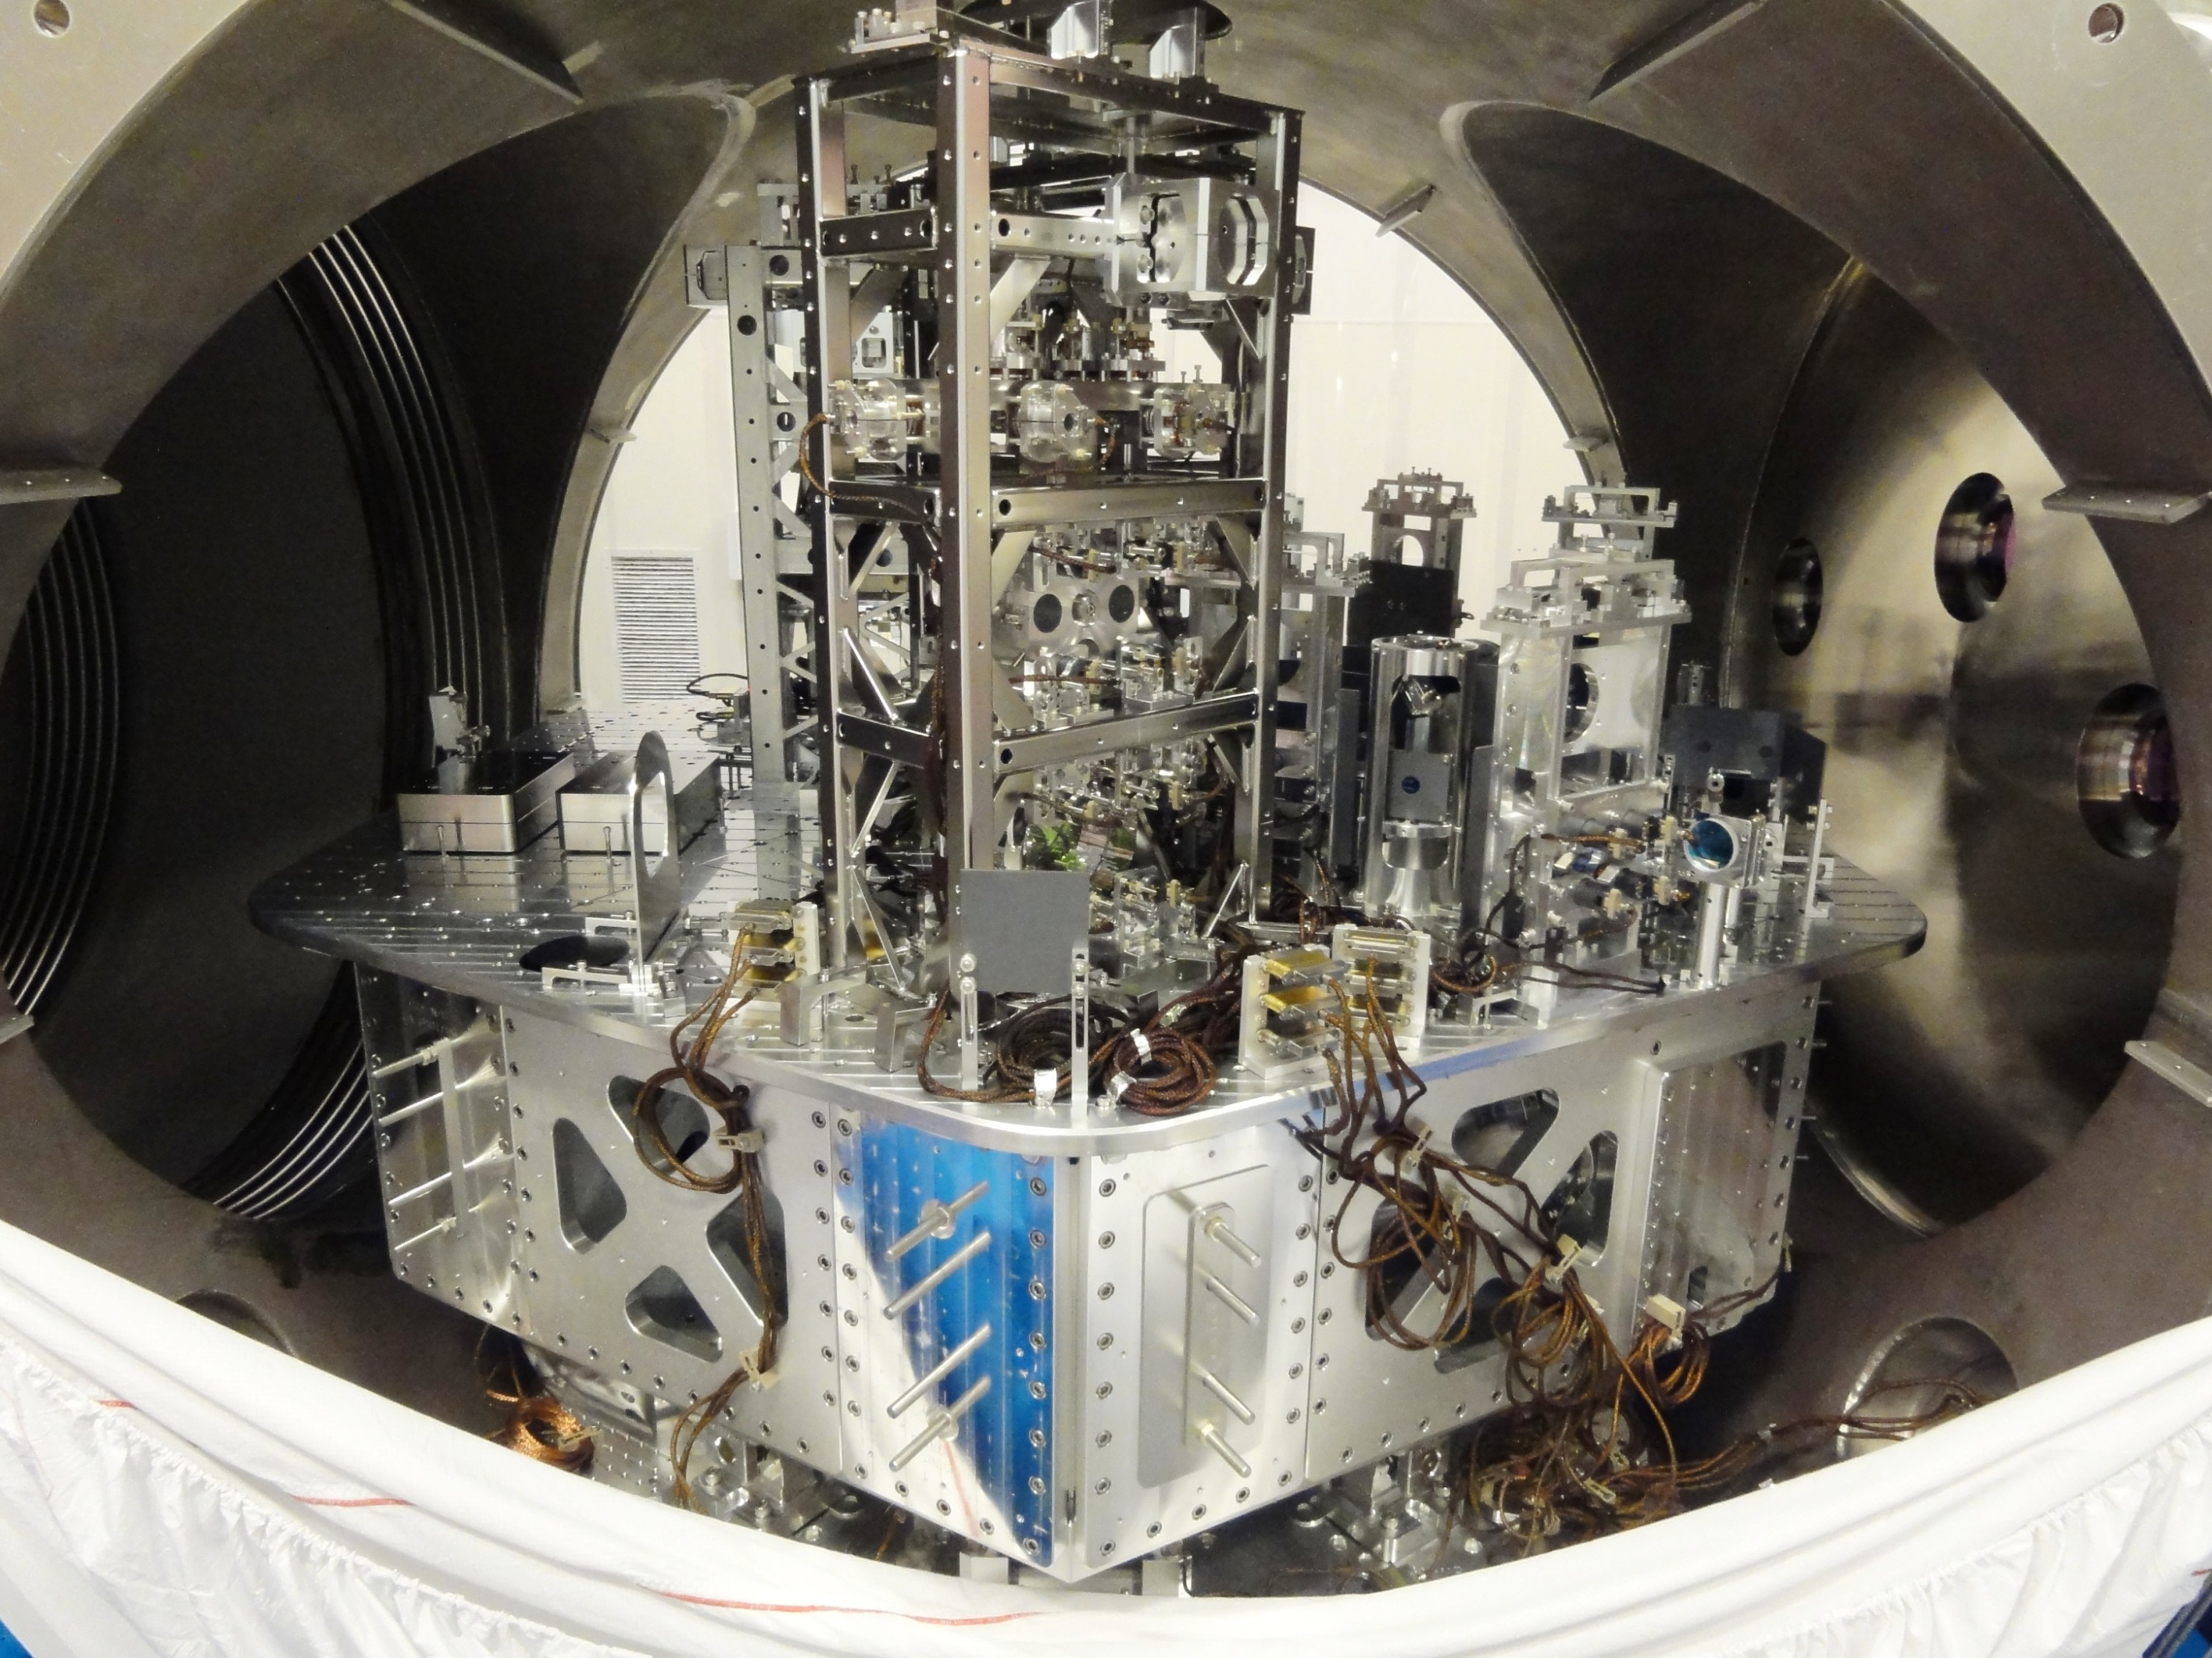
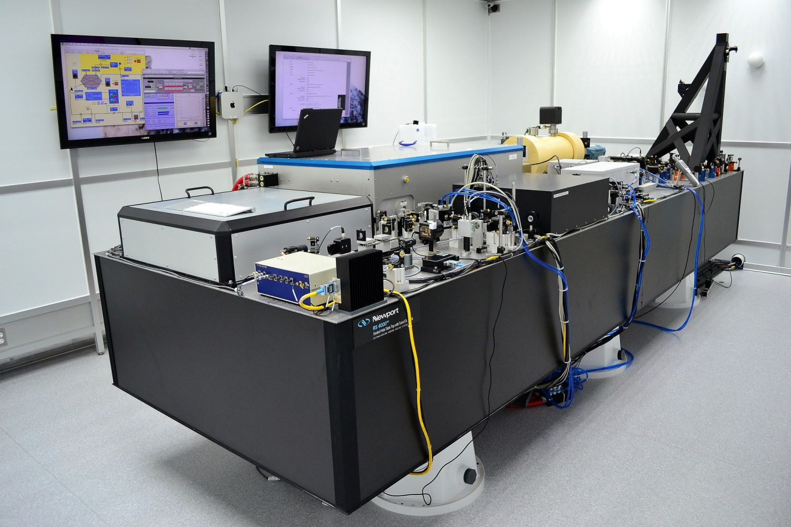
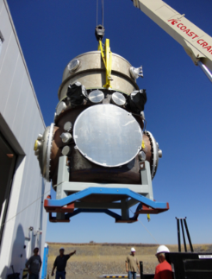
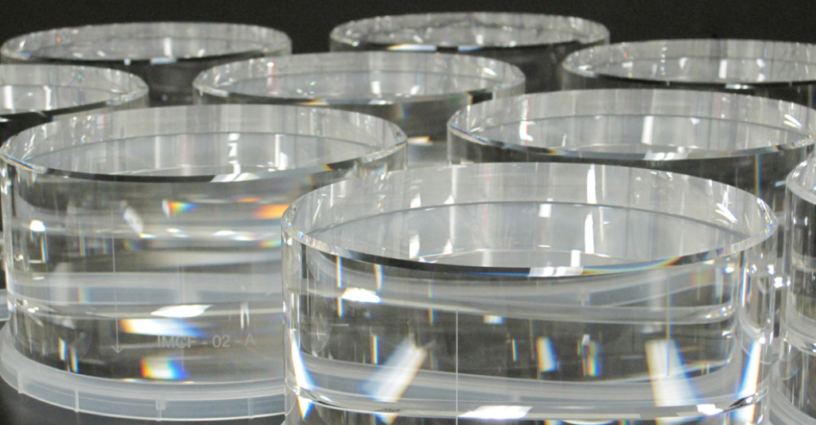
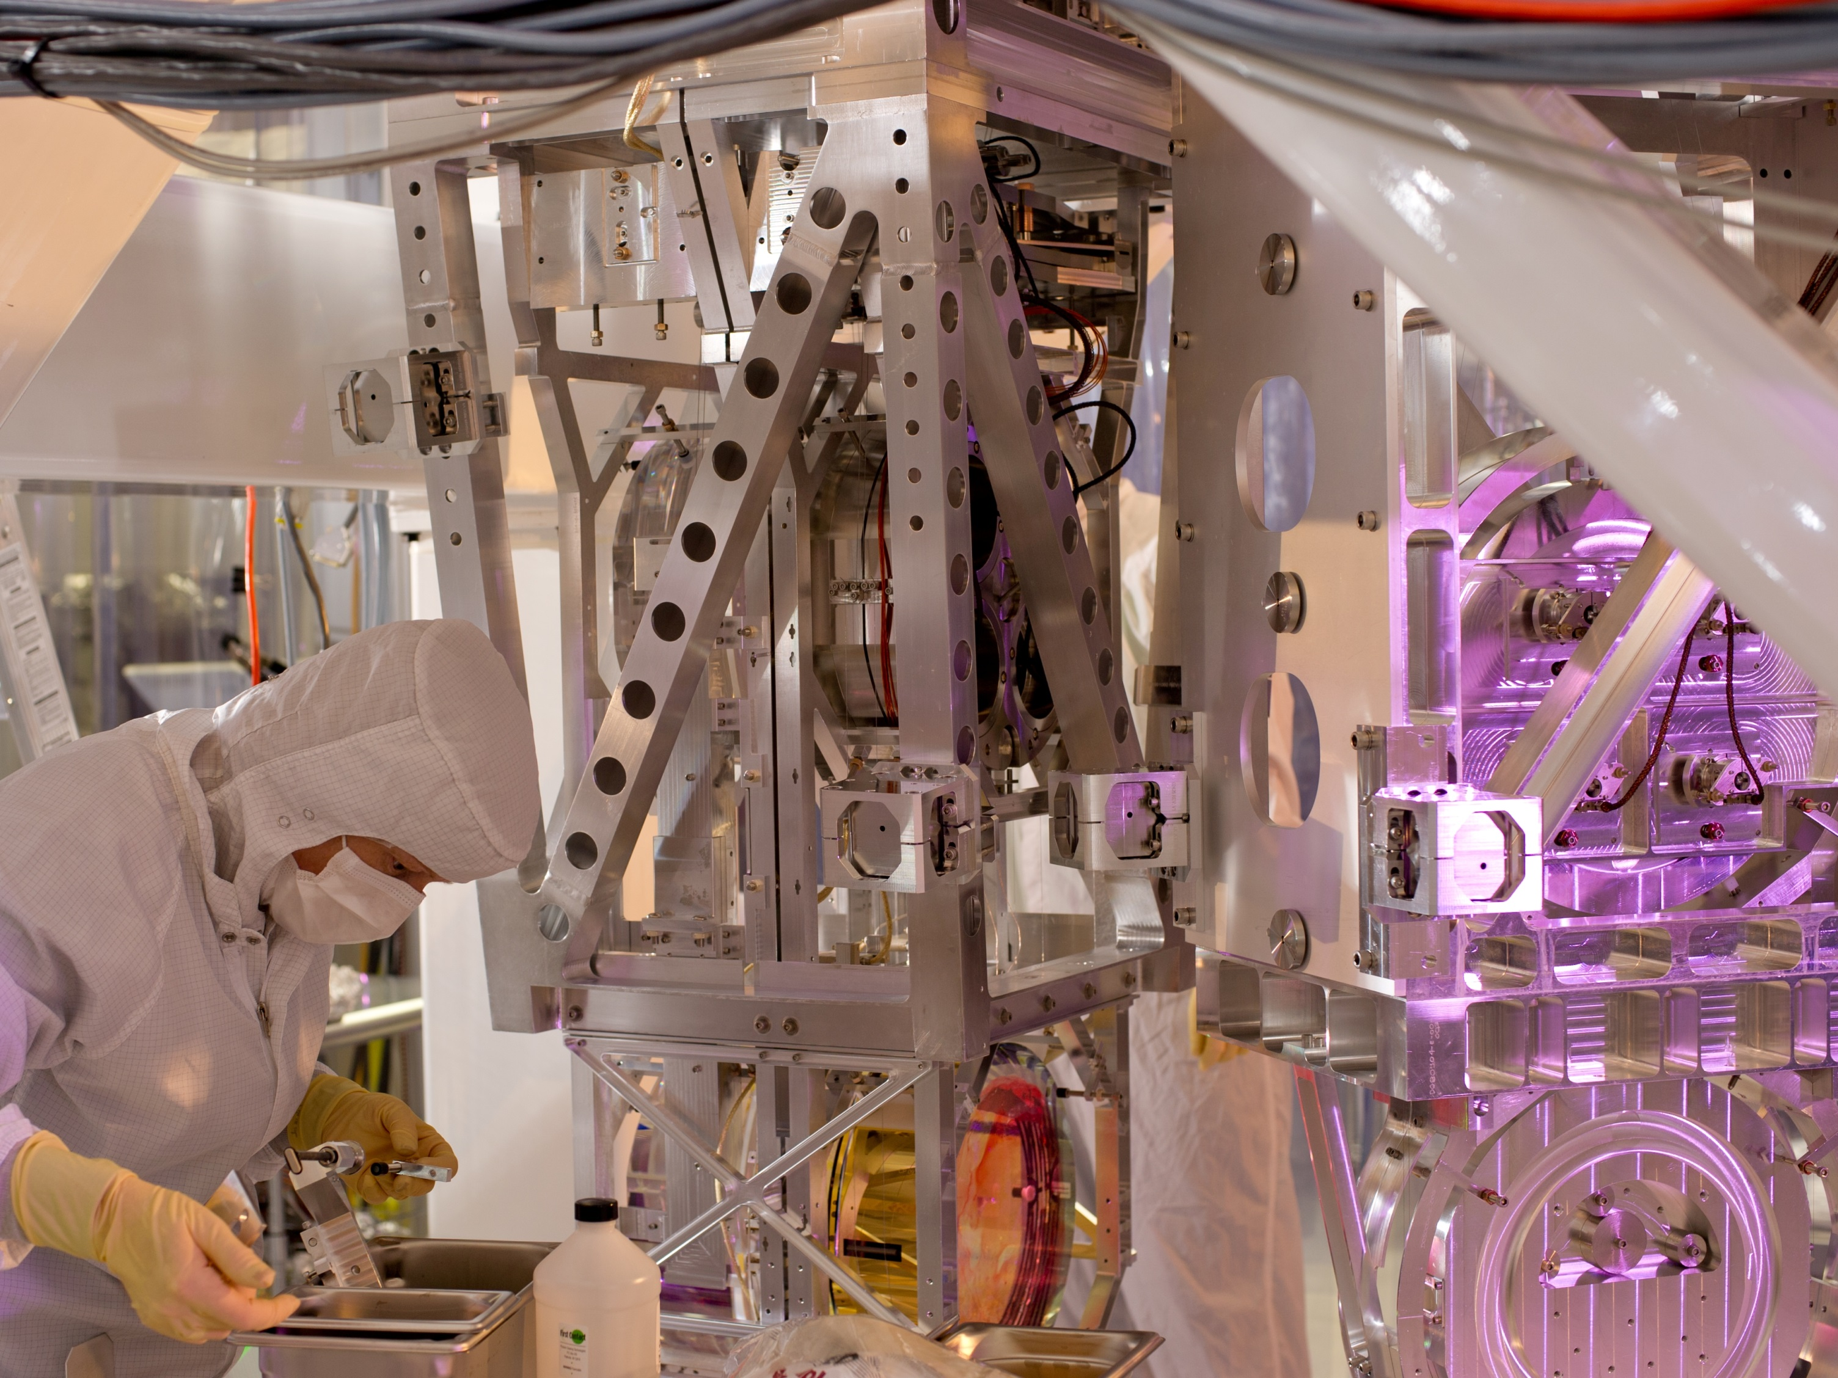
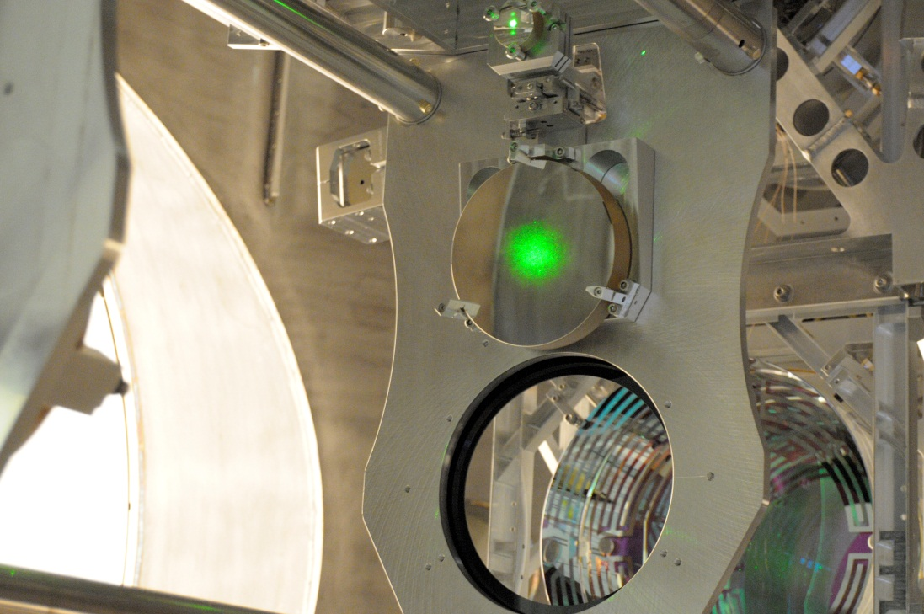
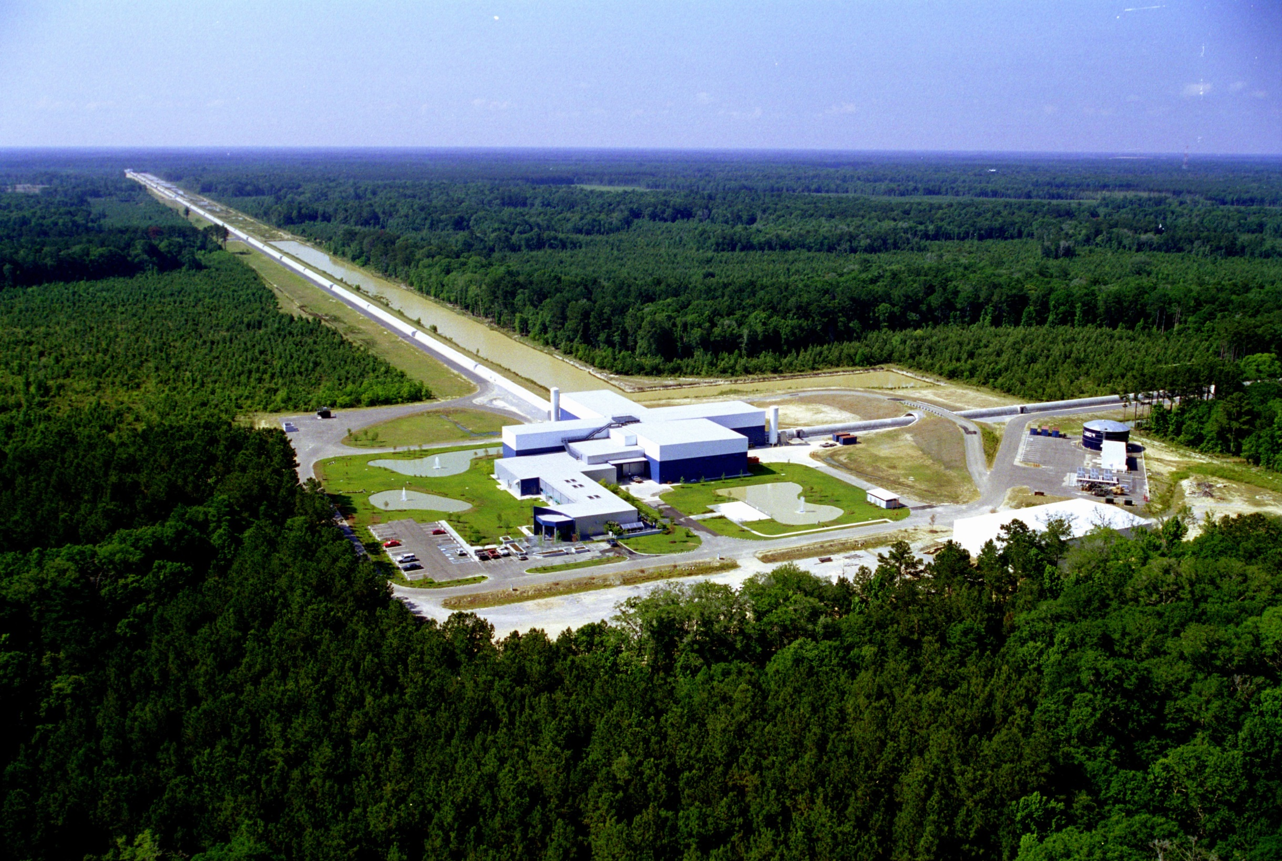
Suspension fiber
Seismic isolation table
200W laser
Vacuum chamber
Open the era of gravitational-wave astronomy through the direct detection of gravitational waves
LIGO optics
Suspended optics
Interferometer control
Credits: LIGO Laboratory, LIGO Scientific Collaboration, Caltech, MIT, AEI-Max Planck/LZH, ANU, Columbia University, Stanford University, University of Florida, University of Glasgow, NASA, NSF

