Slide 1
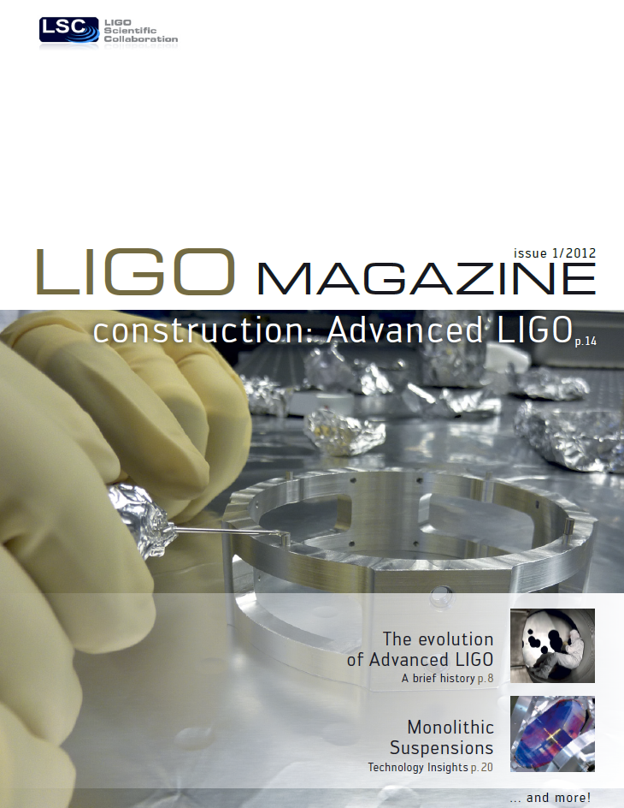

Slide 2
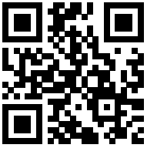
Place
Stamp
Here
Read the LIGO Magazine at:
http://www.ligo.org/magazine

