Slide 1
First Lessons from the Advanced LIGO Integration Testing
May 20, 2013
Daniel Sigg
LIGO Hanford Observatory
GWDAW, Elba, 2013

Slide 2
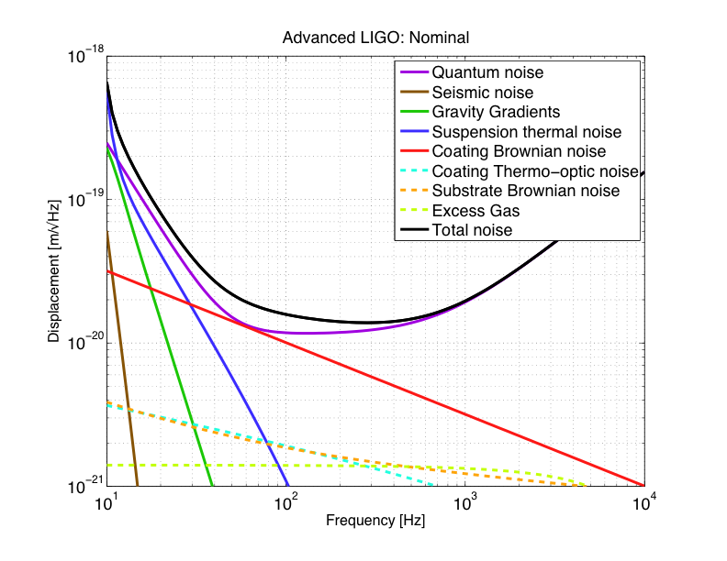
Advanced LIGO Sensitivity
Radiation pressure noise
Initial LIGO
Shot noise
Standard quantum limit

Slide 3
The Advanced LIGO Detector
Input mode cleaner:
stabilizes frequency
and cleans laser mode
4 km
Arm cavities:
Fabry-Perrot cavities store light to effectively increase length
800kW
4 km
Laser
800kW
Laser:
200W - 1064nm
Power recycling mirror: reflects light back coming from the beam splitter, increasing power in the arm cavities
Input
Test
Mass
End
Test
Mass
Signal recycling mirror: amplifies readout signal
Homodyne Readout

Slide 4
Global Timeline
October 2010: Hand-off of Observatories to Advanced LIGO for installation
February 2012: Both Observatories have decommissioned initial LIGO detectors, started in-vacuum Installation and subsystem Integration
April 2012: Recommendation to the NSF to place one interferometer in India
Aug 2014: LLO ‘L1’ Interferometer accepted (internal plan date)
Sep 2014 LHO ‘H1’ interferometer accepted (internal plan date)
LHO ‘H2’ detector was on schedule to be accepted in March 2014, but instead will go to India pending NSF Approval
Mar 2015: Data Analysis computer system completed, planned Project end

Slide 5
Sequence of Installation and Integration Testing
L1
Oct 2010
completed
Oct 2013
Feb 2014
Install
PSL/
IO table
Install
IMC
Install
DRMI
HIFO-X
HIFO-Y
Full interferometer
(non-project, risk reduction)
H1
Feb 2014
Squeezer install
Squeezing Test
Install
PSL/
IO table
Install
IMC
HIFO-Y
HIFO-X
Install
DRMI
Full interfere.
Install
Single arm cavity
(H2 OAT)
PSL/IO table
IMC
Install
Rec’ld vertex MICH
Full interferometer
H2
Deinstall/Store 3rd Interferometer
completed

Slide 6
Subsystem Testing
Subsystem testing
All components are tested before installation
All subsystems have a test and verification phase before commissioning
Paid off big time: Much faster startup of commissioning
PSL: Accepted and working
Lasers delivers stable 180W, currently running at 35W
Excess frequency, intensity and jitter noise due to water cooling flow (avoid 90 degree turns)
Lifetime of laser diodes factor 2 below specs of manufacturer
Unknown contamination reduced AR coating performance of PMC tank windows, windows could be cleaned, since tank is open no accumulation of stuff anymore

Slide 7
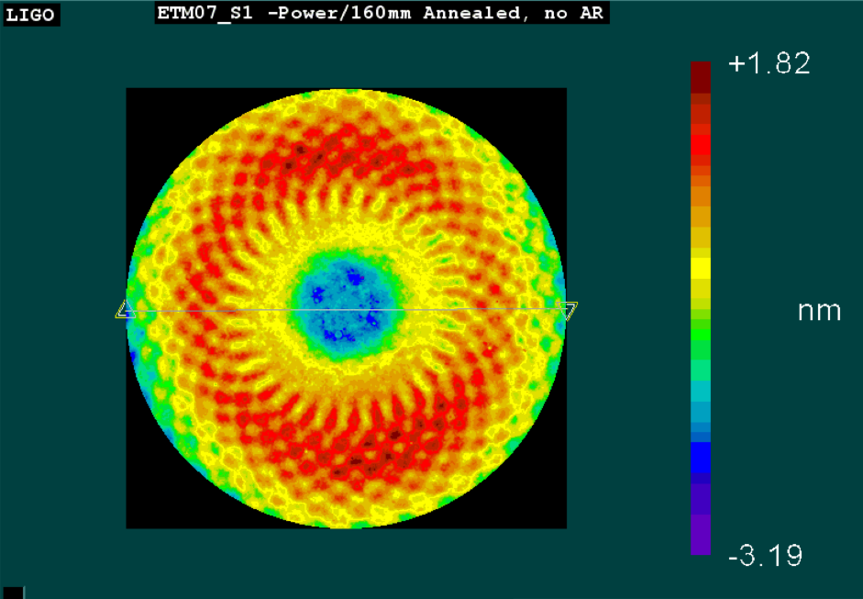
Core Optics Coatings
ETM spiral pattern generates scattered ring
Back scatter from beam tube baffles can effect <30Hz sensitivity
Spherical aberration acceptable (two ETMs are nearly identical)
Arm Cavity Loss is within budget (50 ppm achieved vs. <75 ppm spec)

Slide 8
One Arm Test Components
BSC ISI
BSC ISI
HEPI
HEPI
HEPI
HEPI
TrMon SUS
Quad SUS
Quad SUS
Triple SUS
TM
ETM
ITM
FM
Arm Cavity length & alignment sensing
ACB
ACB
Y-End
LVEA:
No PSL
Test Mass optical lever (not shown)
1064 / 532 nm NPRO
Phase locked to fiber-delivered PSL light

Slide 9
One Arm Test Summary and Actions
Verified the basic functionality of many subsystems:
Two-stage active seismic isolation system (BSC ISI)
Quadruple suspension
Initial Alignment system/procedure
Thermal compensation ring heater
Green beam cavity locking
Actions:
ALS wavefront sensors eliminated from design: alignment sufficiently stable
PZT steering control of ALS beam incorporated into design
Additional hardware was identified to support automation
Usability of various systems needs to be improved to be accessible to non-experts

Slide 10
Intermediate and Quantitative Goals of the One Arm Test
Initial alignment: Sustained flashes of optical resonance in the arm cavity | Achieved, within one week of operation
Cavity locking/ISC: Green laser locked to cavity for 10 minutes or more
TransMon/ALS: Active beam pointing error on the TransMon table below 1 urad rms in angle and below 100 um rms in transverse motion | Achieved
Calibration: ETM displacement calibration at the 20% level | Achieved
Thermal Compensation: Ring heater wavefront distortion, measured by Hartmann sensor, in agreement with model at the 10 nm rms level | Achieved
Optical levers: Long term drift below 1 urad | Diurnal motion about twice this level, possibly actual test mass motion

Slide 11
Intermediate and Quantitative Goals of the One Arm Test
Controls/SUS: Decoupling of length-to-angle drive of the quad suspension | Achieved for TOP stage
Seismic isolation: Relative motion between two SEI platforms below 250 nm rms (w/o global feedback) | Achieved
Cavity alignment fluctuations: Relative alignment fluctuations below 100 nrad rms | Achieved
Controls/ISC: Long term cavity locking; fully automated locking sequence | Long term locking achieved; automation was rudimentary
Cavity length control: Relative test mass longitudinal motion below 10 nm rms | Not possible to assess with OAT. These have become objectives for the HIFO-Y test.
ALS: Ability to control frequency offset between 1064 nm and 532 nm resonances at the 10 Hz level
ALS: Relative stability of the 1064/532 nm resonances at the 10 Hz level

Slide 12
IMC Test
Input optics in-air optical table 1
Ifo reflected port in-vac readout
Input optics in-air optical table 2

Slide 13
IMC Test Summary and Actions
Locking was as easy and reliable as expected
Seismic isolation controls for HAM ISI are straightforward
Angular stability quite good; wavefront sensor alignment control only for long term drifts
New design for low-noise Voltage-Controlled Oscillator validated
No major problems with high power operation
Issues and actions
Excess laser noise (frequency, amplitude, beam pointing). No show stoppers, but room for improvement (some already made)
PSL Intensity servo (outer stage) found to need re-engineering
Absorption in IMC mirrors. Two of the three mirrors found to absorb 2 ppm, vs 0.6-0.7 ppm nominal – relevant to contamination control

Slide 14
Intermediate and Quantitative Goals of the IMC Test
IMC availability: Locked duty cycle of >90% | Achieved, would remain locked indefinitely
Mean lock duration: > 4 hours | Achieved
Optical efficiency: Transmission from PSL output to Interferometer input (O-PRM), > 75% | Achieved, 86%
IMC visibility: > 95% (include mode-matching) | Achieved, 97-98%
IMC length/frequency control bandwidth: Goal of 40 kHz or higher | Achieved, 60 kHz
IMC frequency/length crossover: ~10 Hz | Achieved
IMC transmitted power stability: relative rms fluctuations of 1% or less | Achieved, 0.5% RIN
Pointing stability: angular motion of transmitted beam, < 1.6 urad rms | Achieved, 0.4 urad
Intensity noise: transmitted light RIN <10⁻⁷/Hz^{1/2} | Not achieved
Faraday isolation: > 30 dB at full power | Not measured in-situ

Slide 15
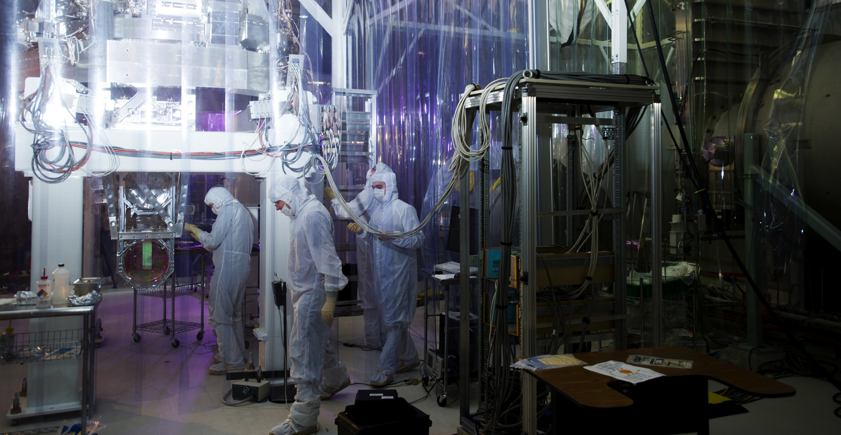
So far so good!

