Slide 1
The aLIGO Guardian
Jeff Kissel, for the ISC, SEI, SUS, etc. teams

Slide 2
Motivation
iLIGO Experience: Operators/Commissioners had to manage many control systems, but many components were passive
aLIGO has many more control loops/sensors/actuators – “modules” – of which to keep track; too difficult for one operator to manage
BUT many aLIGO modules are will be controled/managed identically
Design modular control systems to be in well-defined and verifiable states, which can then be managed hierarchically
Inspired by the VIRGO and GEO experience
Natural evolution from operation “by-hand,” to low-level scripts, to an organized well-tought-out infrastructure
Not a necessary deliverable for aLIGO, but essential for long term, robust, repeatable operation – particularly by non-experts

Slide 3
Guardian Principles
NOT responsible for protection, only reporting, verifying, and transistioning between states (“Guardian” is a mis-nomer)
Module Guardian: the lowest level state machine, directly controls a given component that can be treated identically (e.g. a Triple Suspension, or HAM-ISI)
Manager Guardian: the “puppet master” that merely demands modules be in a given state, based on upper level manager or human requests

Slide 4
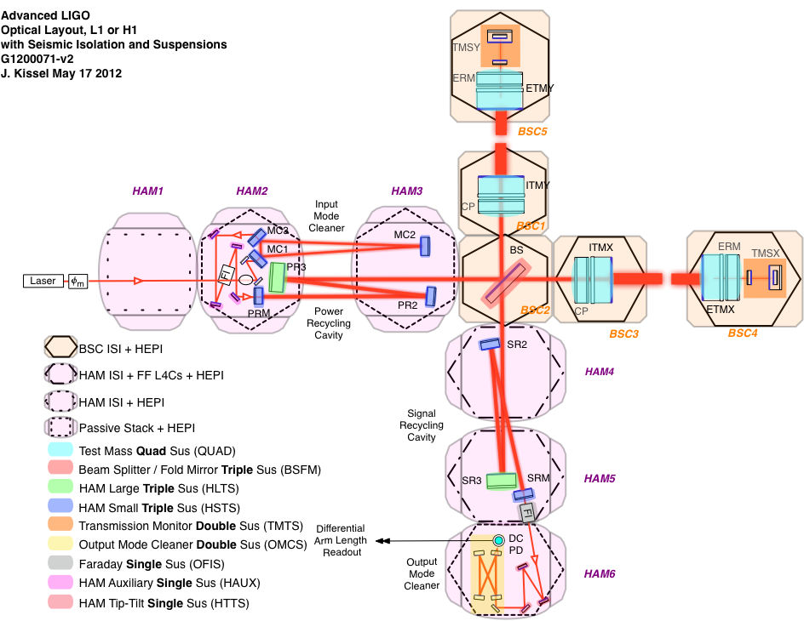
Module Examples
QUAD Suspensions
HAM-ISIs

Slide 5
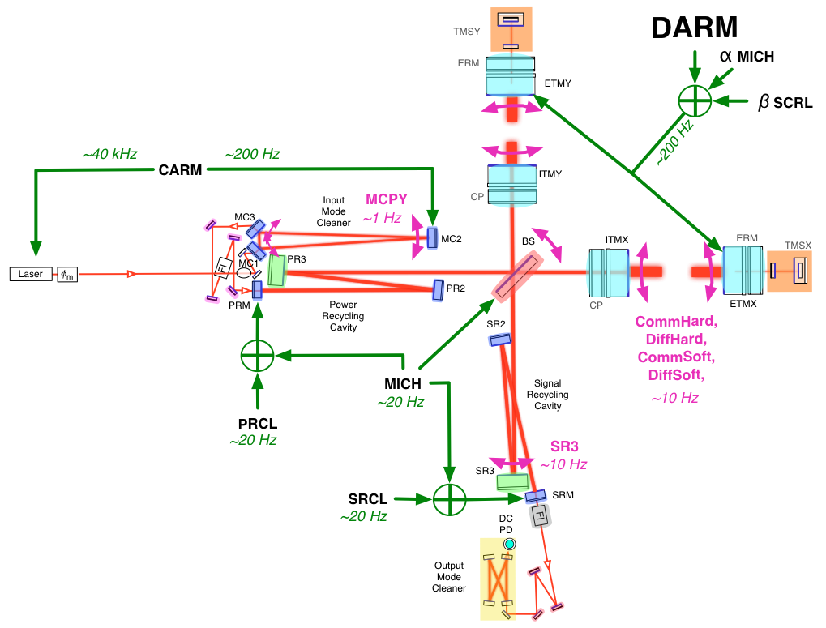
Manager Examples
(The Interferometer Sensing and Control System)
- Knowledgable about how modules must interact
- Does not want/need to know anything about the modules other than they are aligned and in their lowest noise state

Slide 6
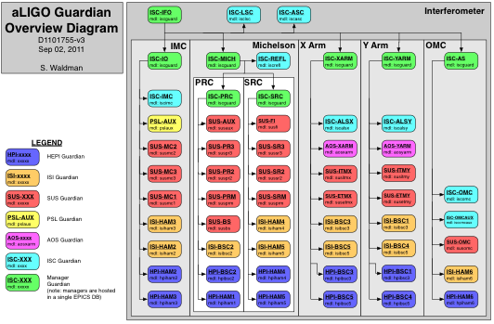
The Highest Level Organization
Modules

Slide 7
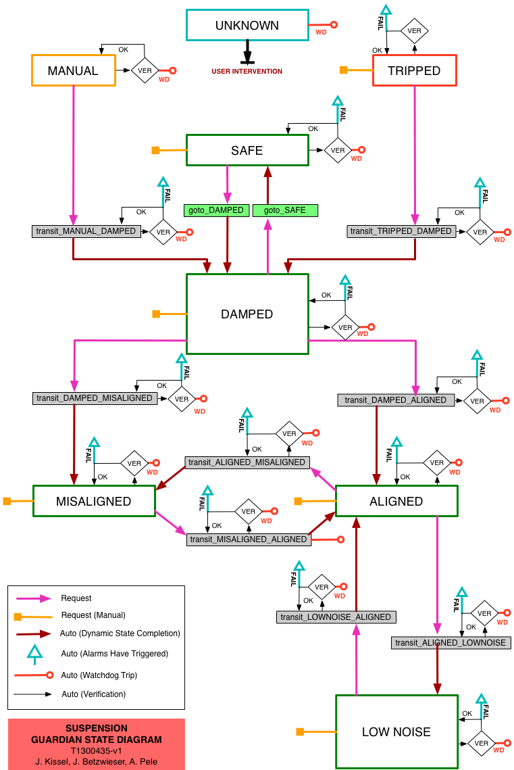
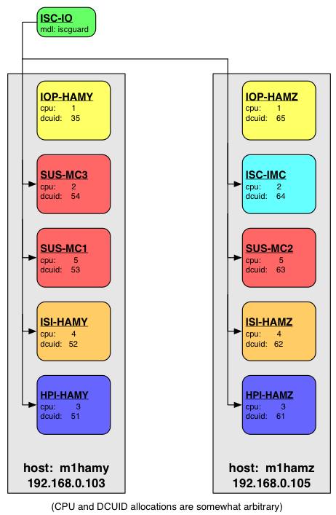
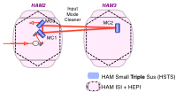
Module
(HAM Triple Suspension)
Manager

Slide 8
Progress Thus Far…
First article infrastructure created at MIT
Prototype module systems developed at MIT (SUS) and Stanford (SEI) using representative hardware
L1 Input Mode Cleaner Integrated Test Phase included prototype of IMC Manager Guardian
Very new (last week!): face-to-face meeting of subsystem leaders on the Guardian
  We’ve had enough prototyping that we can now really:
  Define Requirements
  Define common goals and infrastructure
  Software infrstructure can begin to be absorbed by CDS / Software Engineers
  Establish “czar” to ensure commonality and smooth interactions at the manager level
  All of which we accomplished/has begun

