Slide 1


The Arm Length Stabilization System for Advanced LIGO Lock Acquistion
Adam Mullavey
Louisiana State University
for the LIGO ISC
7/9/2013
Amaldi10/GR20 Conference
LIGO-G1300524

Slide 2
Acknowledgments
LIGO Hanford
  Daniel Sigg, Keita Kawabe, Kiwamu Izumi, Sheila Dwyer
LIGO Caltech
  Rana Adhikari, Koji Arai, Aidan Brooks, David Yeaton-Massey
LIGO MIT
  Peter Fritschel, Matt Evans, Lisa Barsotti, John Miller
The Australian National University
  Bram Slagmolen, Daniel Shaddock, David McClelland,
Other
  Stefan Ballmer (Syracuse University), Alexa Staley (Columbia University), Alberto Stochino

Slide 3
Lock Acquisition
Five Degrees Of Freedom To
Sense and Control:
DARM (Differential ARM)
CARM (Common ARM)
MICH (MICHelson)
PRCL (Power Recycling Cavity Length)
SRCL (Signal Recycling Cavity Length)

Slide 4
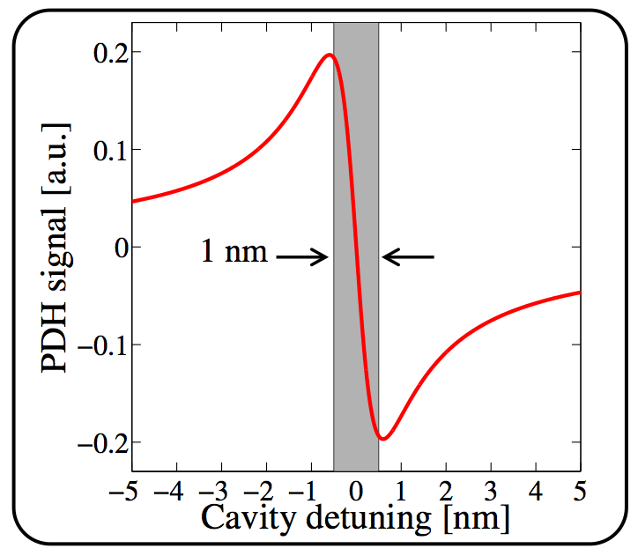
Difficulties
Narrow locking range
  Cavity swinging too fast
  Actuators too weak to catch lock
Coupled Free Swinging Cavities
  Sensing matrix in a state of flux
Dynamic
Sensing
Matrix

Slide 5
Lock Acquisition
Simplify the problem by decoupling CARM and DARM, using independent sensors.
Introducing the Arm Length Stabilization system

Slide 6
Arm Length Stabilization
Uses Auxiliary Lasers locked to the Arm Cavities
Transmitted Aux light combined with doubled PSL to form a heterodyne signals

Slide 7
End Station
Auxiliary Laser
  Dual Wavelength (532nm and 1064nm)
  First Locked to PSL
  Locked to Arm Cavity, via PDH technique and fed back to 40MHz VCO

Slide 8
ALS - Corner Station
ALS Comm
  fed back to PSL frequency (via IMC)
  Offset injected into loop for tuning of resonance
ALS Diff
  fed back differentially to ETMs

Slide 9
Prototype Experiments
Couple of experiments to test out ALS technique on single cavity:
  ANU Benchtop Experiment ([1] Mullavey et. Al)
  Caltech 40m Experiment ([2] Izumi et. al)

Slide 10
ANU Benchtop Experiment
1.3m cavity
Suspended mirrors
Beatnote from 1064nm, not 532nm
Feedback to arm length not Science Laser

Slide 11
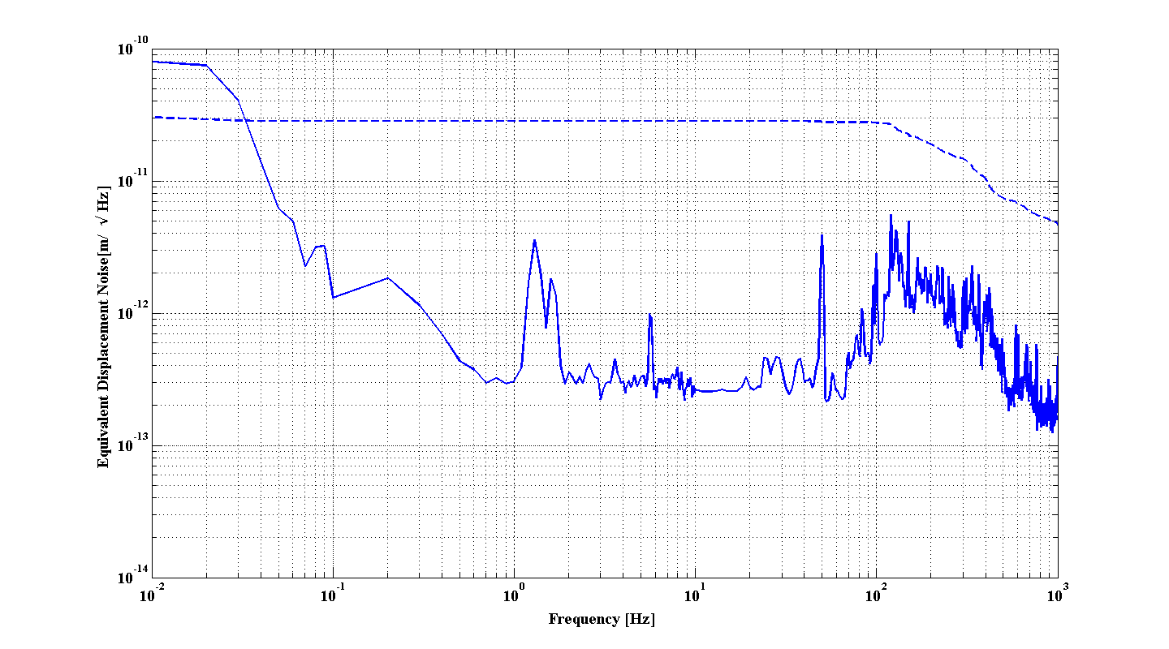
ANU Bench-top Results
30pm RMS, approx 1/30th cavity line-width
Tuneable over full free spectral range
Mullavey et al

Slide 12
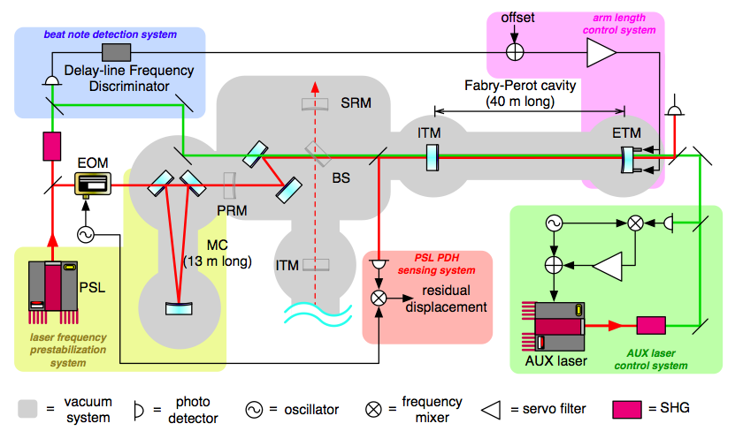
Caltech 40m Experiment
40m cavity
Beatnote from 532nm
Feedback to arm length

Slide 13
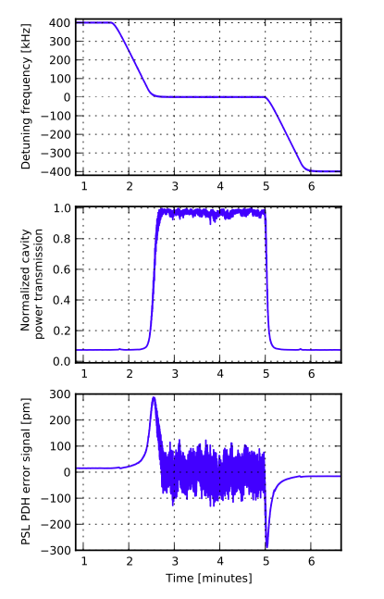
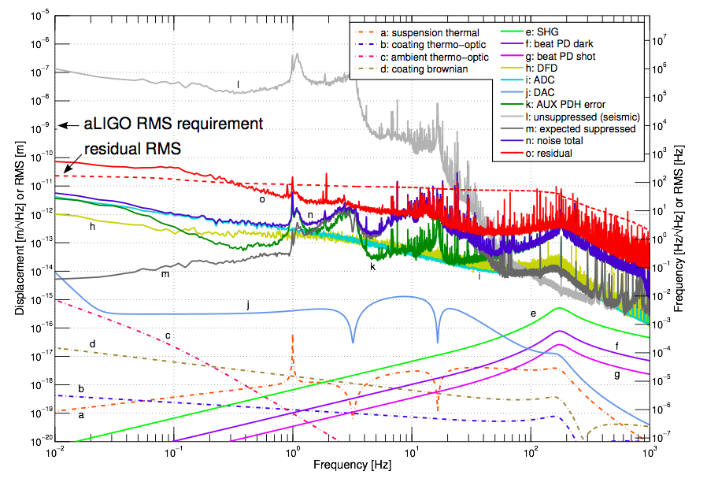
Caltech 40m Results
Tuning On and Off Resonance
24 pm RMS
24pm RMS
Izumi et. al.

Slide 14
Progress at the Sites
Hanford
  Y station ALS installed and commissioned (One Arm Test)
  Half Interferometer (HIFO) test, i.e. effectively ALS-Comm loop
Livingston
  Basically nothing yet (waiting for an arm)

Slide 15
Hanford HIFO test
Beat signal between Y-ARM and doubled PSL
Using actual LIGO ALS system: electronics, etc.
Feeding back to PSL (via IMC)

Slide 16
HIFO Residual Noise
1/10 the linewidth of the arm cavity

Slide 17
Future
Hanford
  Continue Noise Hunting, < CARM linewidth (100 times smaller than Arm Linewidth)
  HIFO X (soon)
  Full IFO (May 2014)
Livingston
  HIFO X (October 2013)
  Full IFO (February 2014)

Slide 18
References
[1] Mullavey et. al, Optics Express, Vol 20, Issue 1, pp 81-89 (2012)
[2] Izumi et. al, JOSA A, Vol. 29, Issue 10, pp. 2092-2103 (2012)

Slide 19
Backup Slides

