Slide 1
Beyond Advanced Gravitational Wave Detectors: beating the quantum limit with squeezed states of light
Session G5:
Instrumentation for Current and Future Gravitational Wave Detectors
Lisa Barsotti
LIGO/MIT
LIGO-G1300480-v2
Denver, Colorado - Apr 14, 2013

Slide 2
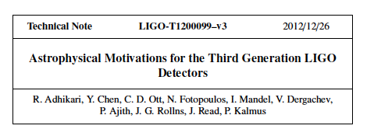
Astrophysical benefits beyond Advanced LIGO

Slide 3
Ideas for improving the astrophysical reach beyond advanced detectors
My talk
Nicolas’s talk

Slide 4
What is quantum noise?
m
SHOT NOISE: Photon counting noise produced by fluctuations of the number of photon detected at the interferometer output
➔ Limitation of the precision you can measure arm displacement
RADIATION PRESSURE NOISE: Back-action noise caused by random motion of the mirrors due to fluctuations of the number of photons impinging on the mirrors
➔ Additional displacement noise
LASER
GW
Photo
detector
Measurement frequency
Notes:
h_shot, h_rad

Slide 5
“Standard Quantum Limit”
It doesn’t depend on the optical parameters of the interferometer, just on the quantum mechanics of a harmonic oscillator mass

Slide 6
Simple Michelson, P = 10 W

Slide 7
Simple Michelson, P = 1 MW
P = 1 MW

Slide 8
“Easy” approaches to minimize quantum noise
Make your interferometer as long as possible
Make your test masses as heavy as possible, and allow as much power in the arm until quantum noise is comparable to other noises

Slide 9
More Clever: Quantum Noise in aLIGO
Arm cavities, power and signal recycling cavity
Up to ~800 kW of light stored in the arms
Notes:
Simplify equation

Slide 10
How we go beyond advanced LIGO
Again…make your interferometer longer!
Heavier test masses, more power
Already ~1 MW in the arm cavities, need to compensate for thermal effects and instabilities
(Even) more complex optical configuration which shapes the interferometer optical response
D. E. McClelland, N. Mavalvala, Y. Chen, and R. Schnabel, “Advanced interferometry, quantum optics and optomechanics in gravitational wave detectors", Laser and Photonics Rev.5, 677-696 (2011)
Injection of squeezed states of vacuum

Slide 11
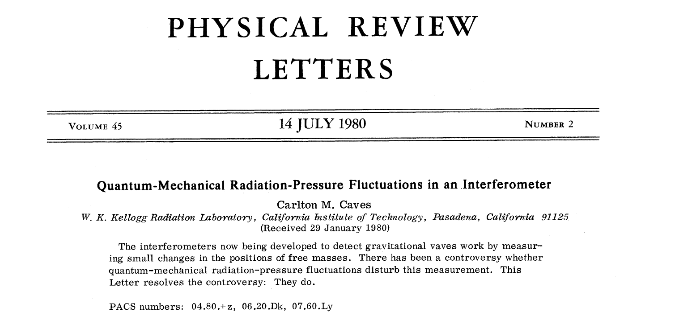
Where quantum noise REALLY comes from
Quantum noise comes from the quantization of the electro-magnetic field
→ Zero-point fluctuations
When average amplitude is zero, the variance remains
Heisenberg uncertainty principle, quadratures associated with amplitude and phase
They enter the interferometer from all the open ports of the interferometer, but the ones which matter are the one entering from the anti-symmetric port!
X1
X2
∆X₁ ∆X₂ ≥1

Slide 12
Vacuum Getting Squeezed
LASER
Phase
IFO Signal
Amplitude

Slide 13
Vacuum Getting Squeezed
Reduce quantum noise by injecting squeezed vacuum: less uncertainty in one of the two quadratures
Heisenberg uncertainty principle:
if the noise gets smaller in one quadrature, it gets bigger in the other one
One can choose the relative orientation between the squeezed vacuum and the interferometer signal (squeeze angle)
LASER
Squeezed Field
Phase
C. M. Caves, Phys. Rev. Lett. 45, 75 (1980).
C. M. Caves, Quantum-mechanical noise in an interferometer. Phys. Rev. D 23, p. 1693 (1981).
IFO Signal
Amplitude

Slide 14
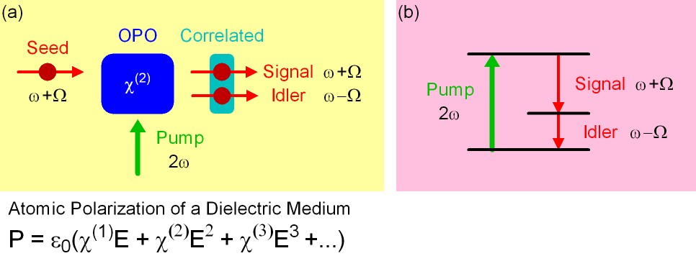
How to make squeezed fields…
…. in theory
Non linear medium with a strong second order
polarization component, pumped at 2w
Refractive index depends on intensity of light illumination
It creates correlation of upper and lower quantum sidebands
The OPO makes a “copy” of the quantum sideband, and it correlates the sidebands

Slide 15
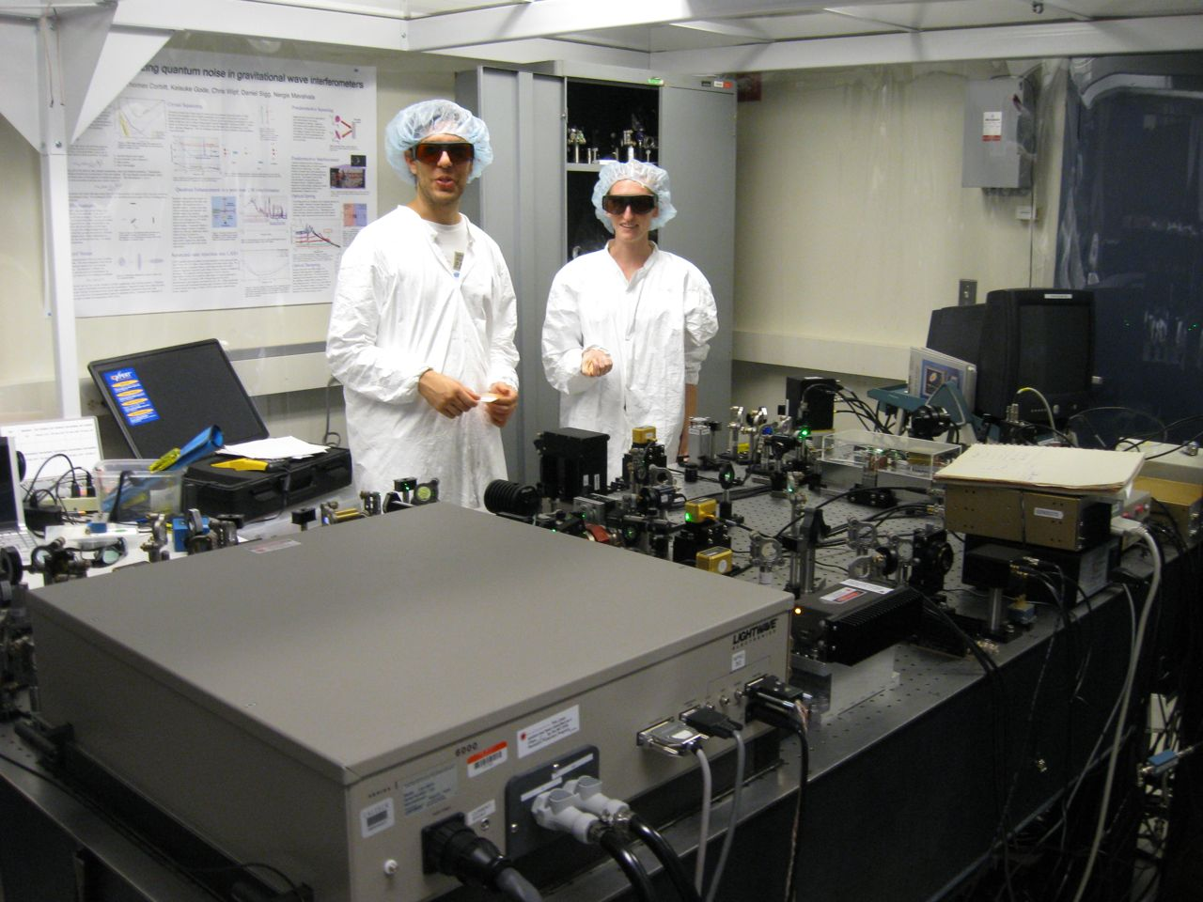
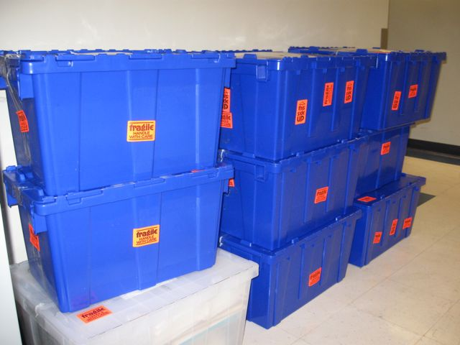
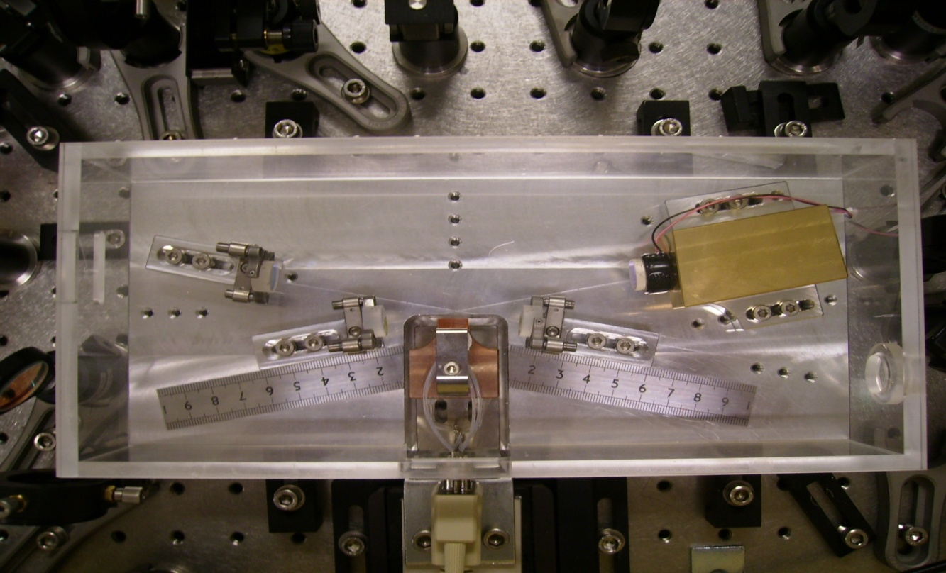
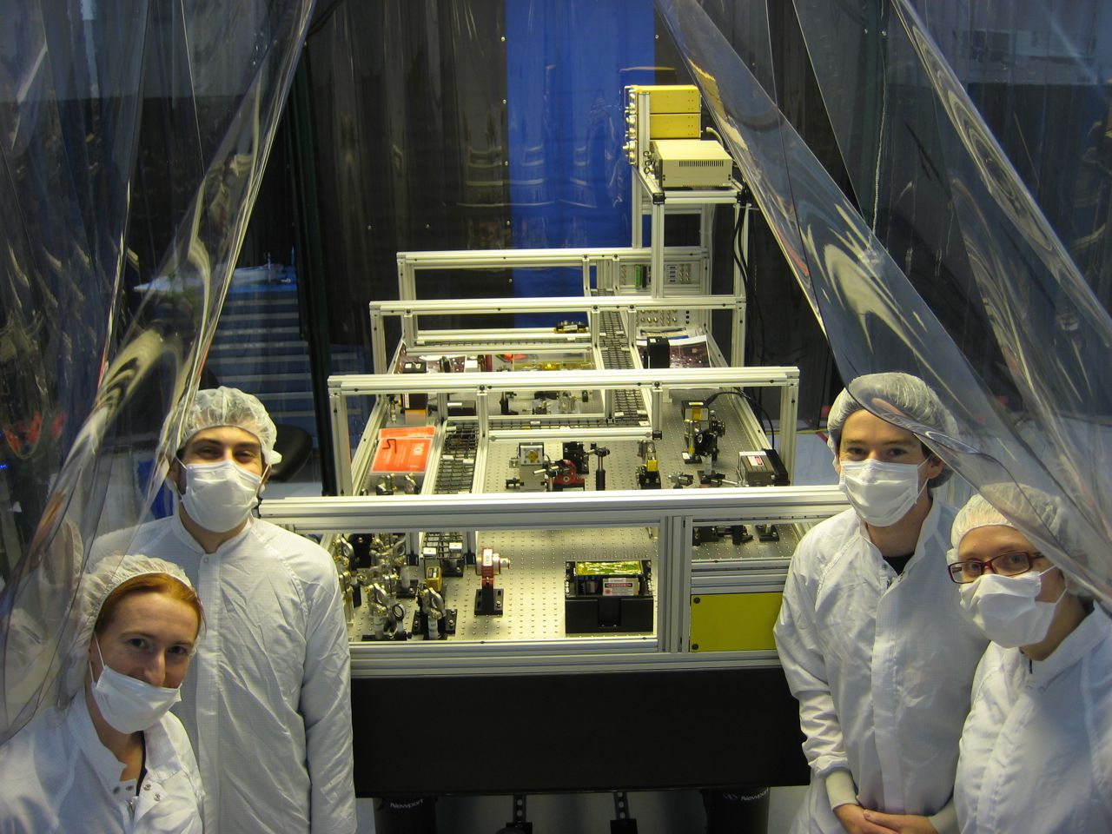
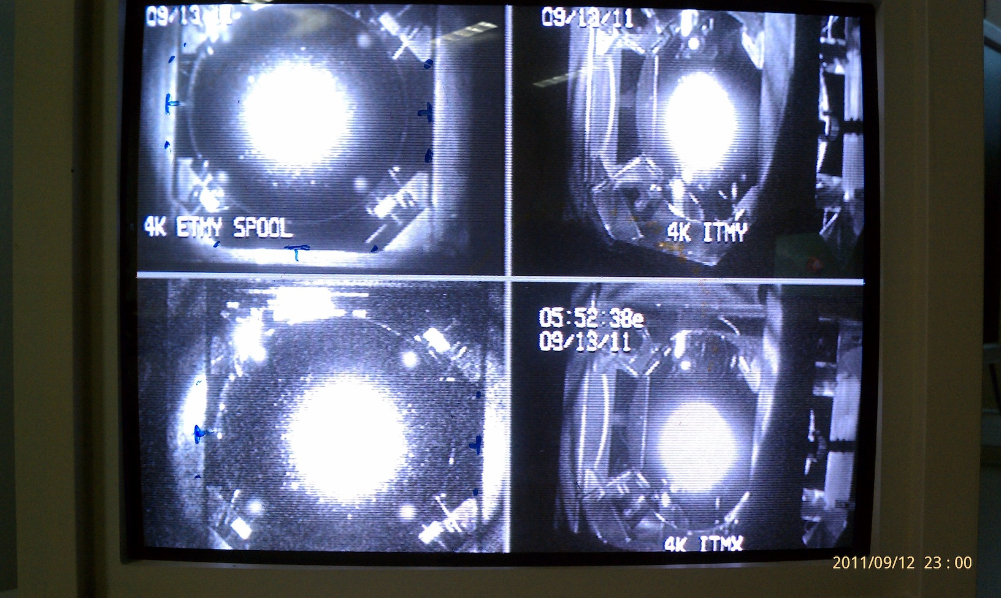
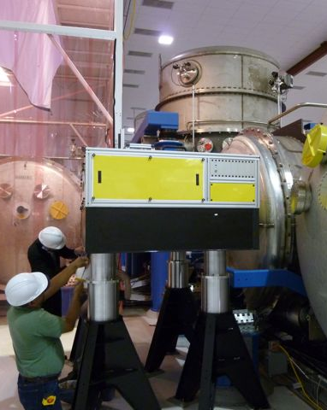
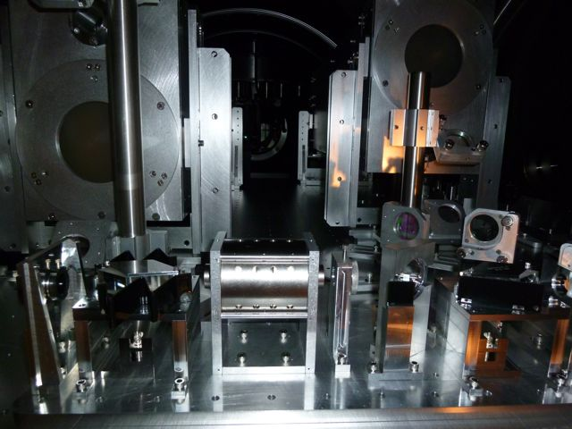
Bow-tie cavity OPO design at ANU (2008)
H1 Squeezer assembling at MIT (2009-2010)
H1 Squeezer parts shipped to LHO
(Oct 2010)
Squeezing in H1
(Oct 3 – Dec 4)
H1 Recovery
(Sept 2011)
H1 Squeezer Installation (Summer 2011)

Slide 16
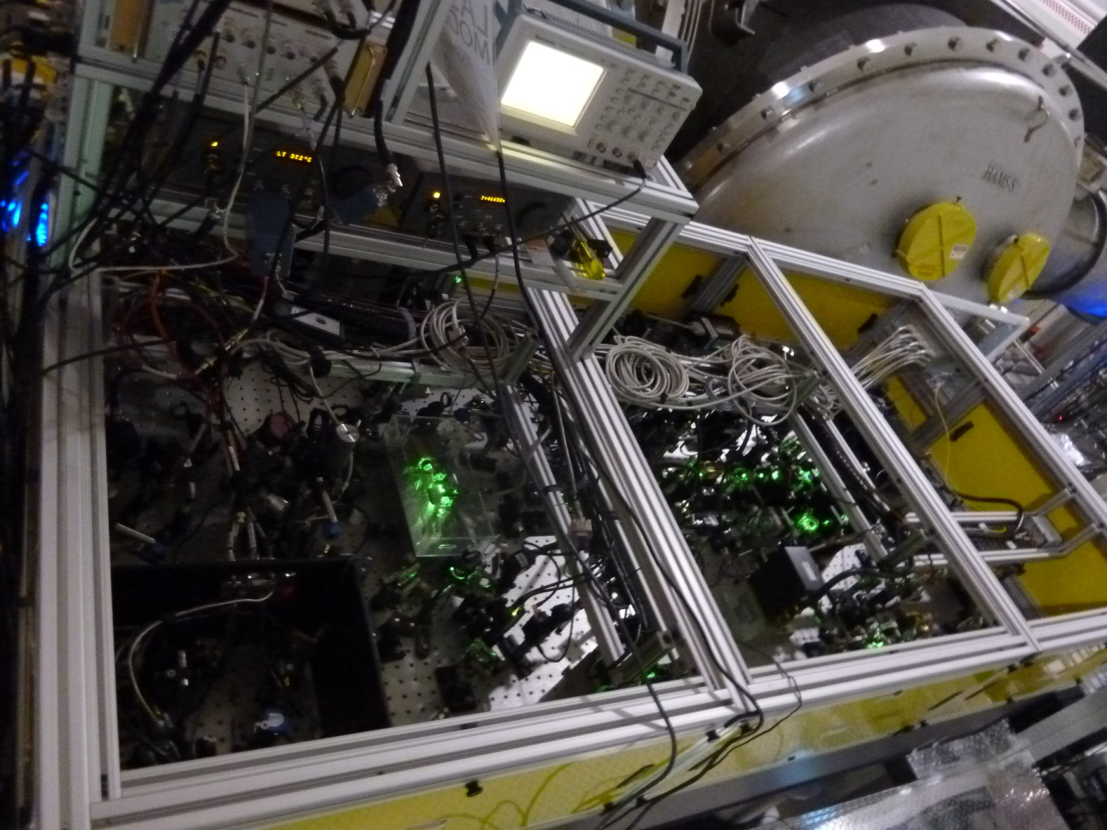
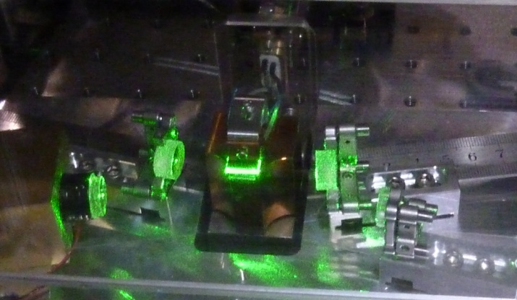
How to make squeezed fields..
…. in practice
The LIGO H1 Squeezer
World-wide effort in the last 10 years to make squeezing in the audio-frequency band

Slide 17
How to inject squeezed fields

Slide 18
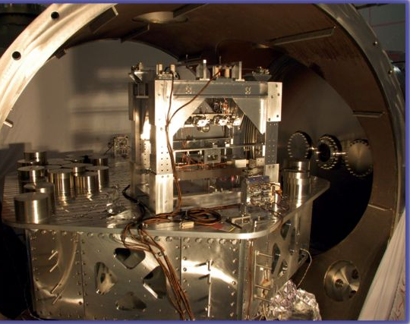
Squeezing injection into LIGO H1
Output Faraday
Squeezer Table
Output Mode Cleaner

Slide 19
LIGO H1 Squeezing Experiment Results
from the LIGO Scientific Collaboration
PRELIMINARY
2.15 dB (28%) noise reduction

Slide 20
Limit to the amount of observed squeezing
Losses are very unforgiving!
Total losses ~ 56%
Largest Losses Sources:
Mode matching
Faradays
Output mode cleaner
LIGO H1

Slide 21
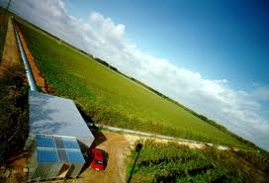
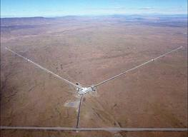
Squeezing in GEO600 and LIGO H1
Abadie et al.,
Nature Physics 7, 962 (2011)
preliminary
from the
LIGO Scientific Collaboration
GEO data are courtesy of H. Grote

Slide 22
Projections for what we could do for Advanced LIGO
GEO600
LIGO H1

Slide 23
Not only losses, phase noise too
Squeezing [dB] vs Losses and Phase Noise
X₂
φ_{sqz}
X₁

Slide 24
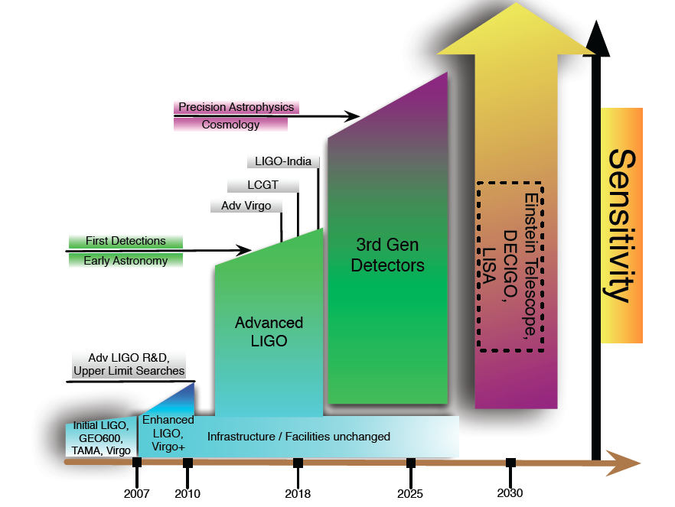
How about a “Quantum-Enhanced Advanced LIGO”?
Do we want it? YES!
Rana Adhikari,
GWADW 2012
All current ideas for upgrading aLIGO
include 10 dB of squeezing
LIGO technical note T1200008-v3 Comparison of Quantum Noise in 3G Interferometer Configurations, Haixing Miao et al.
Do we know how to make it? ALMOST!

Slide 25
Projections for a “Quantum-Enhanced Advanced LIGO”

Slide 26
aLIGO + Squeezing: NS-NS and BH-BH Ranges

Slide 27
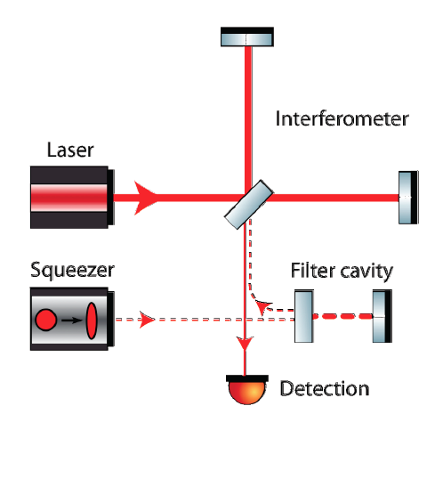
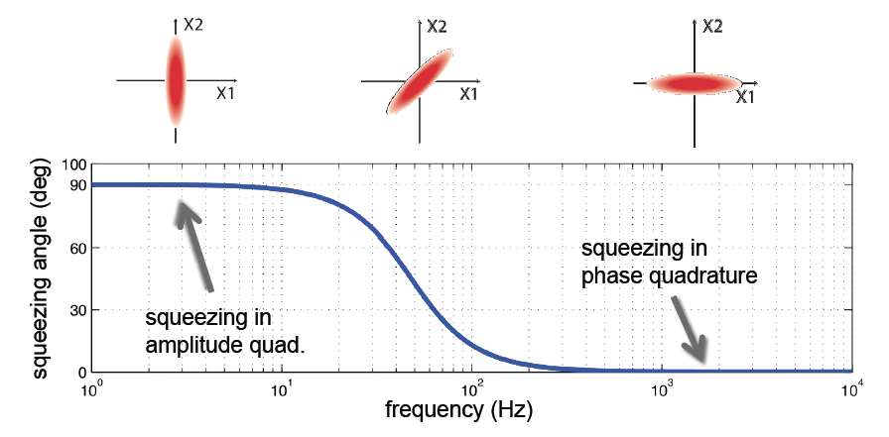
What we really want: Frequency Dependent Squeezing
High finesse detuned cavity which rotates the squeezing angle as function of frequency

Slide 28
aLIGO + Frequency Dependent Squeezing: NS-NS and BH-BH Ranges

Slide 29
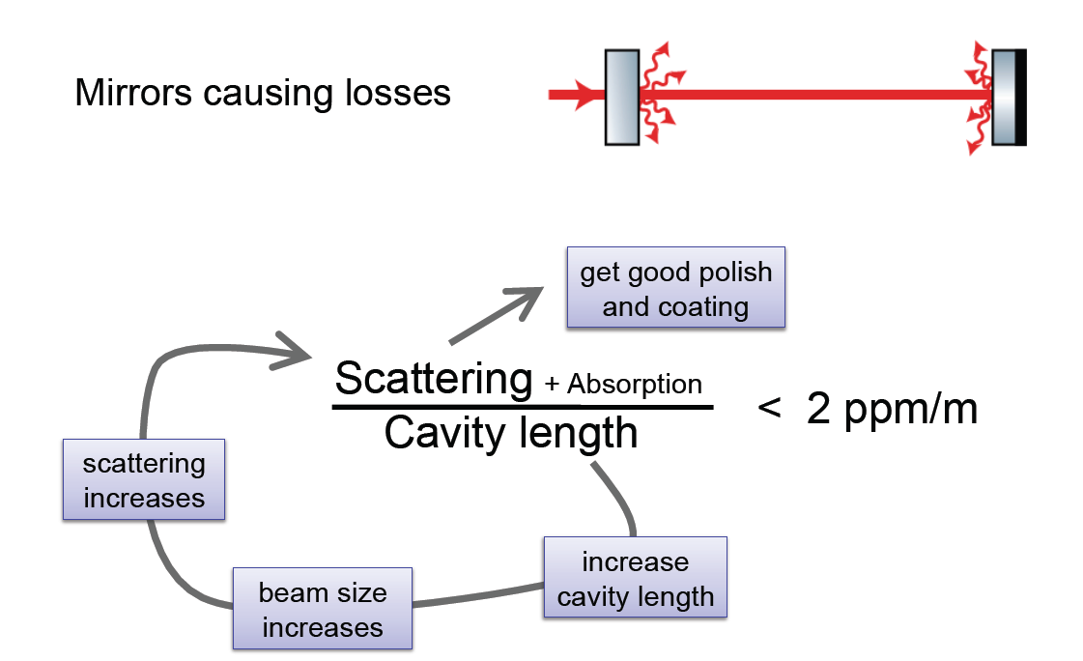
Nothing comes cheap: losses again..
Losses in a filter cavity, if too high, make the filter cavity useless…
Per-round-trip loss depends on the beam spot size
(big beam size → higher scatter losses), which depends on L
1 ppm/m

Slide 30
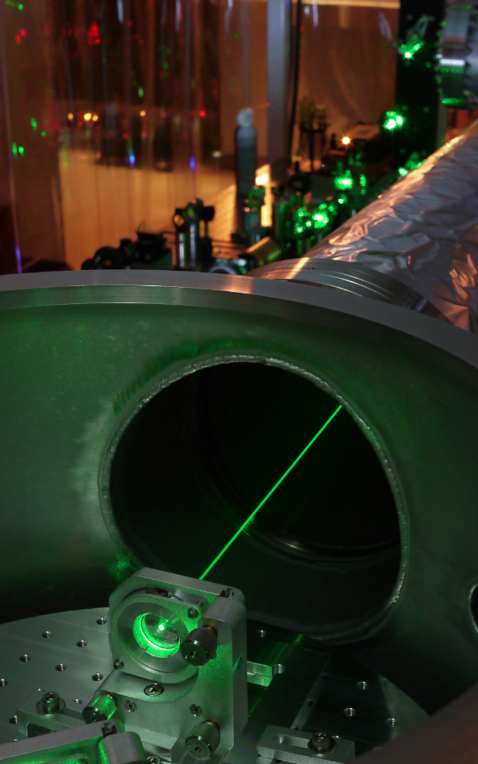
Squeezing Experiments @ MIT
FILTER CAVITY EXPERIMENT
Measuring optical losses to determine Advanced LIGO filter cavity design
Implementing practical filter cavity control scheme
Characterizing technical noises
Preparing for demonstration of audio-band frequency dependent squeezing
NEW aLIGO SQUEEZER SOURCE
Working on a new design with an
in-vacuum squeezer source cavity
Tomoki Isogai, John Miller,
Eric Oelker,
(Patrick Kwee)

Slide 31
For aLIGO, we could afford a “lossy” cavity 16m cavity, 10ppm losses round trip
In preparation

Slide 32
Beyond the “Standard Quantum Limit”

Slide 33
Ultimately, what we want is 10 dB (possibly more!) of broadband squeezing
What do we need to do to make that happen?
Understand scattering losses for the filter cavity, and cavity control scheme
Work on low loss optical components in the squeezed beam path to reduce total losses below 10% (low loss Faradays, ..)
Move squeezer source in vacuum
Improve control strategy of squeezed beam relative to the interferometer beam
Squeezing [dB] vs Losses and Phase Noise
GEO600
We are doing it!

Slide 34
Conclusions
Squeezing is not only a “promising” technique anymore…it works!
GEO600 reliably employing squeezing in normal operation
GEO600 and LIGO H1 squeezing experiment → informed design for aLIGO
To realize the full potential of squeezing, more research is needed – in progress
informed design for a filter cavity in ~ 1 year
Squeezing could potentially become a first upgrade to aLIGO
probably with squeezing at high frequency, “no harm” at low frequency
Need to keep working on final goal: more squeezing, everywhere

Slide 35
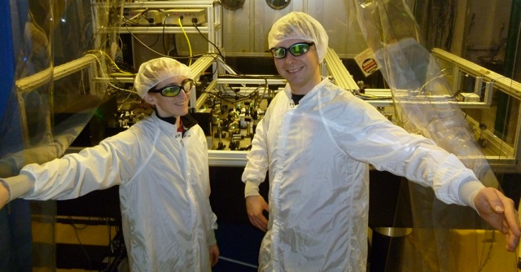
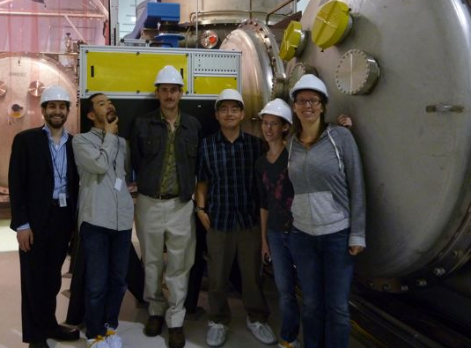
LIGO H1 Squeezing Experiment
LIGO Hanford Observatory (US)
Massachusetts Institute of Technology (US)
Australian National University (Australia)
Albert Einstein Institute (Germany)
MIT: Sheila Dwyer, L. Barsotti, Nergis Mavalvala, Nicolas Smith-Lefebvre, Matt Evans
LHO: Daniel Sigg, Keita Kawabe, Robert Schofield, Cheryl Vorvick, Dick Gustafson (Univ Mitchigan), Max Factourovich (Columbia), Grant Meadors (Univ Mitchigan),
M. Landry and the LHO staff
ANU: Sheon Chua, Michael Stefszky, Conor Mow-Lowry, Ping Koy Lam, Ben Buchler, David McClelland
AEI: Alexander Khalaidovski, Roman Schnabel

Slide 36
Spare slides

Slide 37
Something like this, maybe.…
FROM IFO
Just a cartoon!
Not a conceptual design yet!

Slide 38
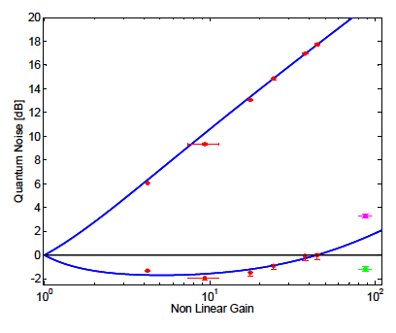
Lessons Learned (II)
Phase noise between squeezed field and interferometer was dependent on interferometer alignment:
Static misalignments will cause a change in the demodulation phase needed to detect the maximum squeezing
Beam jitter will add phase noise when beating against a static misalignment.
X₂
φ_{sqz}
X₁
OPO squeezing level
at best ~40 mrad RMS,
only ~ 25mrad from squeezer source
Fluctuations of the quantum quadrature in squeezed light application of a gravitational wave detector,
S. Dwyer et al (in preparation)

Slide 39
Lessons Learned (III)
Need better isolation from back scattering
(it was ok for LIGO H1, it won’t be enough for aLIGO)
Impact of backscattered-light in a squeezing-enhanced interferometric gravitational-wave detector, S. Chua et al.
(in preparation)

Slide 40
2.15 dB (28%) improvement over quantum noise
Squeezing improves only quantum noise, not other technical noises

Slide 41
Best broadband sensitivity ever

Slide 42
Improving H1 by 2 dB (28%) with squeezing ..without spoiling the sensitivity at 200 Hz
PRELIMINARY

Slide 43
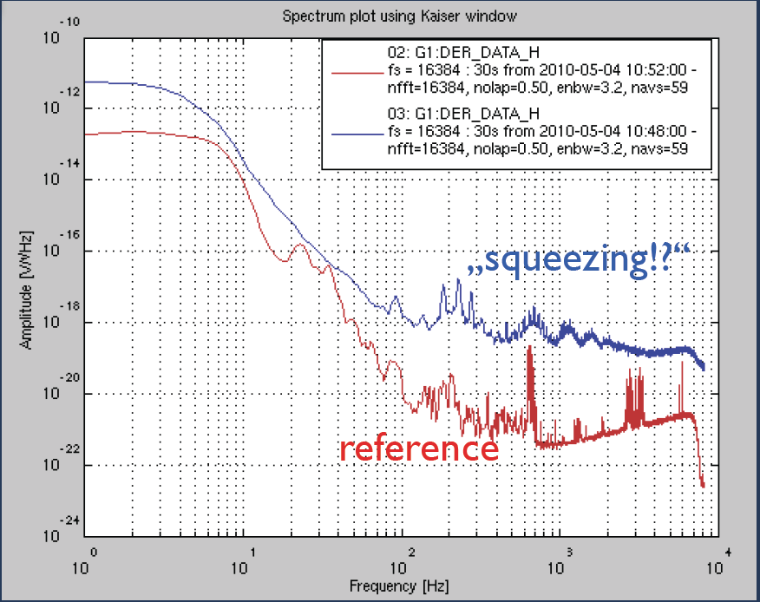
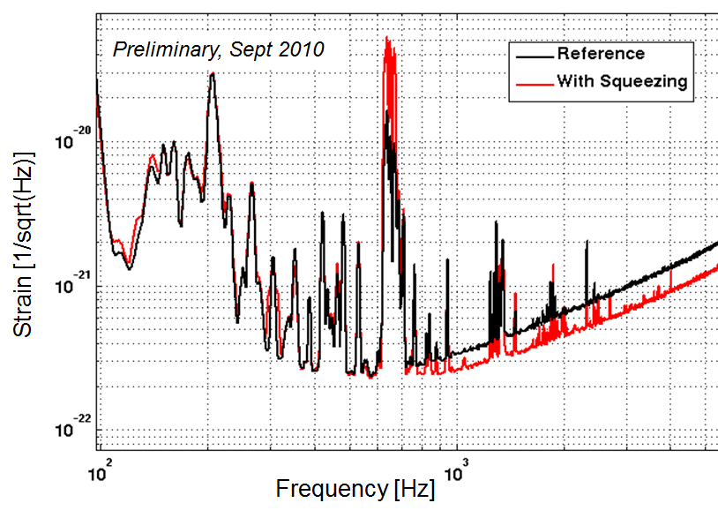
First try at squeezing in GEO
First squeezing injection: back scattered noise limits the sensitivity
Additional Faraday to reduce back scattering and measure squeezing
Courtesy of Alexander Khalaidovski (AEI)
GWADW 2010

Slide 44
Where the main losses came from
Mode matching (~30% losses)
Faradays (3 passes ~ 20% losses)
OMC transmission (18% losses)
➔ “Technical” problems, total losses should be down to 10-15% in aLIGO

Slide 45
Phase noise control
Bandwidth is limited to 10kHz by arm cavities
Need to mitigate phase noise at the source
Changes to control scheme and in vacuum OPO may be necessary for 10-15 dB of squeezing

Slide 46
Squeezing angle error signal
IFO carrier
SQZ sideband
+
x
+

Slide 47
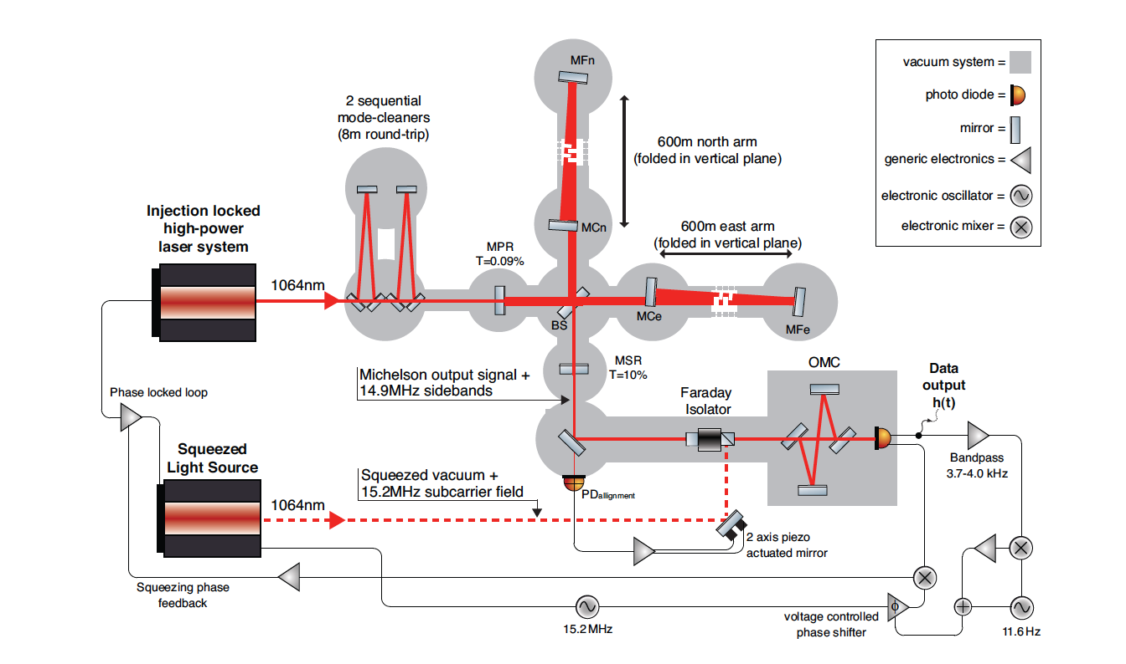
Lessons Learned (VI)
From GEO600: Squeezing angle control signals from 1% pick-off are bad
→ New “a-la-Hartmut” strategy (use transmission signals from the OMC)

Slide 49
Frequency Dependent Squeezing
High finesse detuned cavity which does the rotation for you
Broadband improvement of the quantum noise
Theoretically well understood, experimentally challenging
Low loss needed: F ~ 50,000 for 100m scale cavities
R&D in progress – MIT (P. Kwee and others)
Caltech (J. Harms and others)
H. J. Kimble, Y. Levin, A. B. Matsko, K. S. Thorne and S. P. Vyatchanin,
Conversion of conventional gravitational-wave interferometers into quantum nondemolition interferometers by modifying their input and/or
output optics. Phys. Rev. D 65, 022002 (2001).

Slide 50
Advanced LIGO configuration
Arm cavities, power and signal recycling cavity
Up to ~800 kW of light stored in the arms

Slide 51
Quantum States
Quantization of the electro-magnetic field
X₂
Quadrature Field Amplitudes
Amplitude Noise
Heisenberg uncertainty principle:
Phase Noise
∆X₁ ∆X₂ ≥1
X₁
51

Slide 52
Vacuum Fluctuations
When average amplitude is zero, the variance remains
Vacuum fluctuations are everywhere that classically there is no field….
…like at the output port of your interferometer!
X1
X2
52

Slide 53
Why not even more?

Slide 54
Have to consider phase noise too

