Slide 1
Beyond Advanced Gravitational Wave Detectors: beating the quantum limit with squeezed states of light
Lisa Barsotti
(LIGO-MIT)
GRITTS Seminar, April 3 2013
LIGO-G1300420

Slide 2
Why we talk about quantum noise

Slide 3
Where quantum noise comes from
m
SHOT NOISE: Photon counting noise produced by fluctuations of the number of photon detected at the interferometer output
➔ Limitation of the precision you can measure arm displacement
RADIATION PRESSURE NOISE: Back-action noise caused by random motion of the mirrors due to fluctuations of the number of photons impinging on the mirrors
➔ Additional displacement noise
Radiation Pressure Noise ~ P
LASER
GW
Photo
detector
Shot Noise
~ 1/P
Notes:
h_shot, h_rad

Slide 4
“Standard Quantum Limit”
It doesn’t depend on the interferometer, just on the quantum mechanics of a harmonic oscillator mass

Slide 5
Simple Michelson, P = 10 W

Slide 6
Simple Michelson, P = 1 MW
P = 1 MW

Slide 7
“Easy” ways of reducing quantum noise
Just make your interferometer longer
More power to improve shot noise + heavier test masses to compensate for radiation pressure noise

Slide 8
More Clever: Quantum Noise in aLIGO
Arm cavities, power and signal recycling cavity
Up to ~800 kW of light stored in the arms
Notes:
Simplify equation

Slide 9
How we go beyond aLIGO
Again…make your interferometer longer!
More power + heavier test masses
Already ~1MW in the arm cavities, need to compensate for thermal effects and instabilities
(Even) more complex optical configuration which shapes the interferometer optical response
D. E. McClelland, N. Mavalvala, Y. Chen, and R. Schnabel, “Advanced interferometry, quantum optics and optomechanics in gravitational wave detectors", Laser and Photonics Rev.5, 677-696 (2011)
Injection of squeezed states of vacuum

Slide 10
Quantum Noise and Vacuum
X1
Quantization of the electro-magnetic field
When average amplitude is zero, the variance remains
Heisenberg uncertainty principle:
Vacuum fluctuations are everywhere that classically there is no field….
…like at the output port of your interferometer!
X2
∆X₁ ∆X₂ ≥1
LASER
Quantum noise is produced by vacuum fluctuations entering the open ports
Vacuum fluctuations have equal uncertainty in phase and amplitude:
Phase: Shot-Noise
(photon counting noise)
Amplitude: Radiation Pressure Noise
(back-action)
Phase
IFO Signal
Amplitude

Slide 11
Vacuum Getting Squeezed
Reduce quantum noise by injecting squeezed vacuum: less uncertainty in one of the two quadratures
Heisenberg uncertainty principle:
if the noise gets smaller in one quadrature, it gets bigger in the other one
One can choose the relative orientation between the squeezed vacuum and the interferometer signal (squeeze angle)
LASER
Squeezed Field
Phase
C. M. Caves, Phys. Rev. Lett. 45, 75 (1980).
C. M. Caves, Quantum-mechanical noise in an interferometer. Phys. Rev. D 23, p. 1693 (1981).
IFO Signal
Amplitude

Slide 12
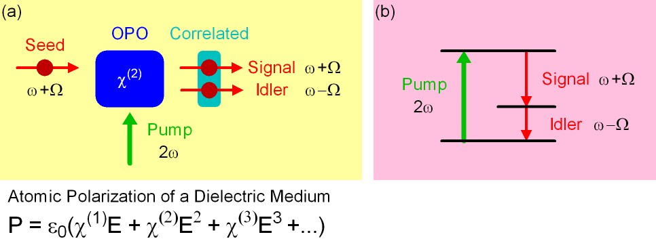
How to make squeezed fields..
…. in theory
Non linear medium with a strong second order
polarization component
Correlation of upper and lower quantum sidebands
The OPO makes a “copy” of the quantum sideband, and it correlates the sidebands

Slide 13
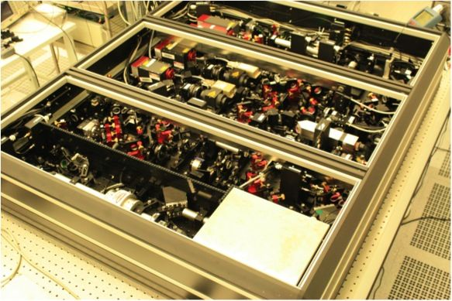
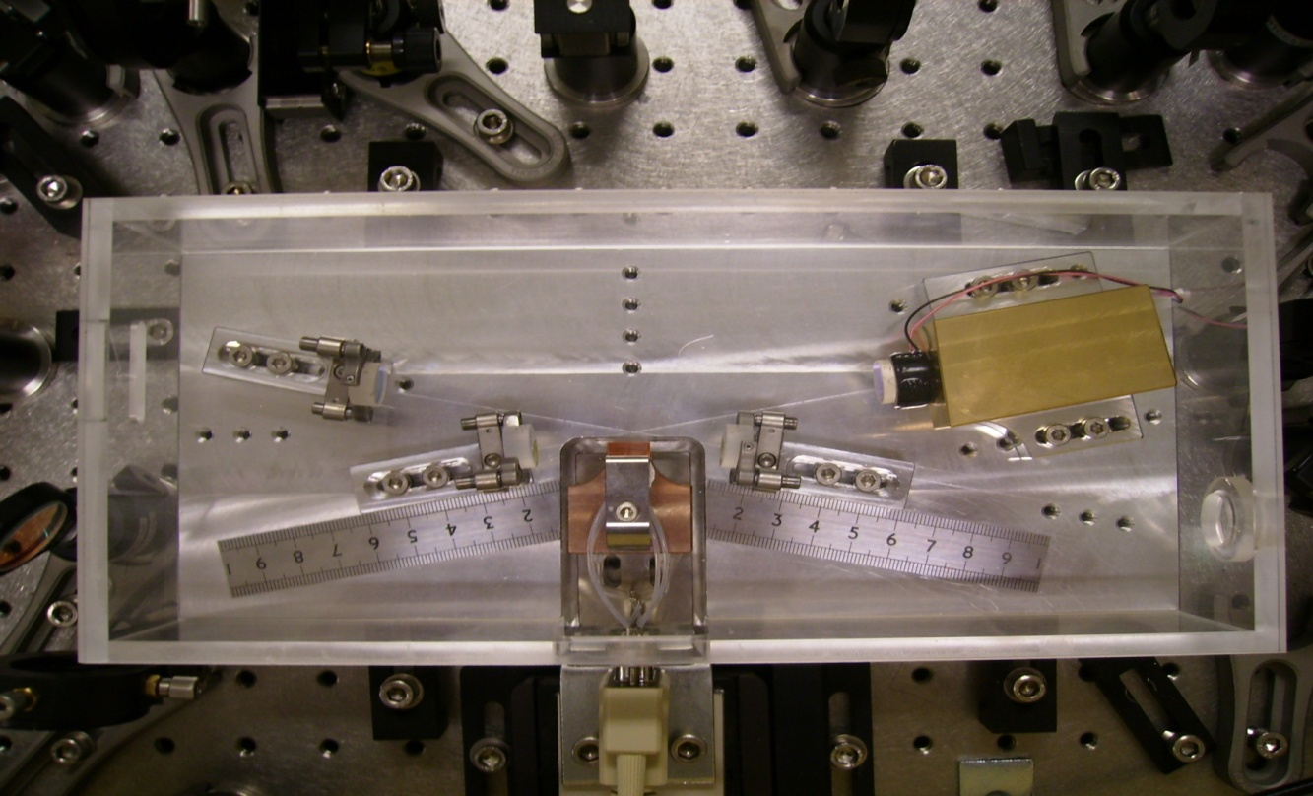
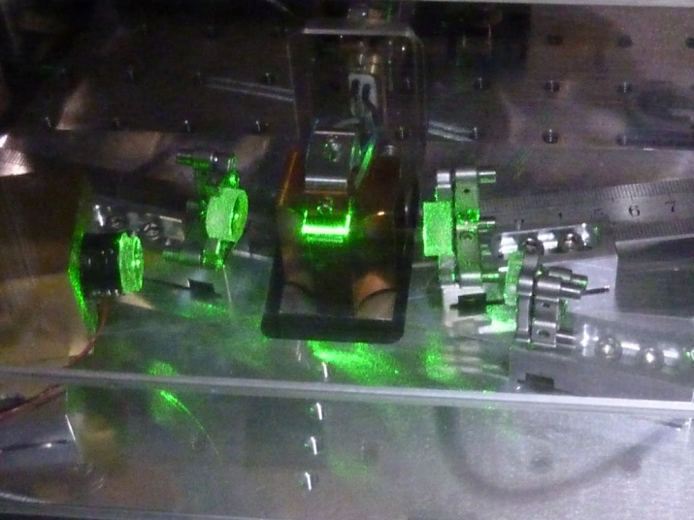
How to make squeezed fields..
…. in practice
World-wide effort in the last 10 years to make squeezing in the audio-frequency band
Lasers, mirrors, control loops,..
Courtesy of Alexander Khalaidovski (AEI)
The Squeezer of the GEO600 detector
The Optical Parametric Oscillator
of the LIGO squeezer
(ANU design)

Slide 14
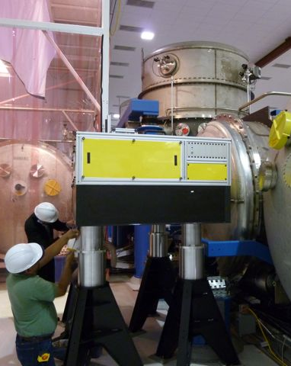
How to inject squeezed fields

Slide 15
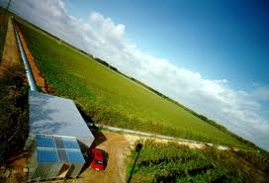
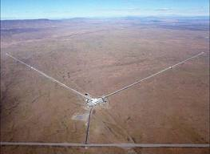
Squeezing in GEO600 and LIGO H1
Abadie et al., Nature Physics 7, 962 (2011)
GEO data are courtesy of H. Grote

Slide 16
Lessons Learned (I)
Losses are very unforgiving
GEO aimed for 6 dB → got 3.5 dB
LIGO aimed for 3 dB → got 2.15 dB
Mode matching
Faradays
OMC transmission
…
GEO600
LIGO H1

Slide 17
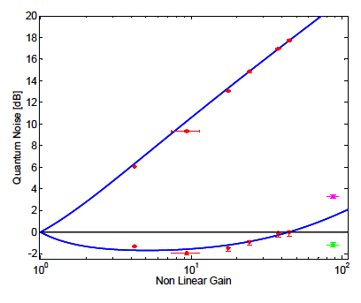
Lessons Learned (II)
Phase noise between squeezed field and interferometer was dependent on interferometer alignment:
Static misalignments will cause a change in the demodulation phase needed to detect the maximum squeezing
Beam jitter will add phase noise when beating against a static misalignment.
X₂
φ_{sqz}
X₁
OPO squeezing level
at best ~40 mrad RMS,
only ~ 25mrad from squeezer source
Fluctuations of the quantum quadrature in squeezed light application of a gravitational wave detector,
S. Dwyer et al (in preparation)

Slide 18
To keep in mind for the future
With 10% total losses, you can’t afford any phase noise at all, if you want to measure 10dB of squeezing
dB of Squeezing vs Losses and Phase Noise

Slide 19
Lessons Learned (III)
Need better isolation from back scattering
(it was ok for LIGO H1, it won’t be enough for aLIGO)
Impact of backscattered-light in a squeezing-enhanced interferometric gravitational-wave detector, S. Chua et al.
(in preparation)

Slide 20
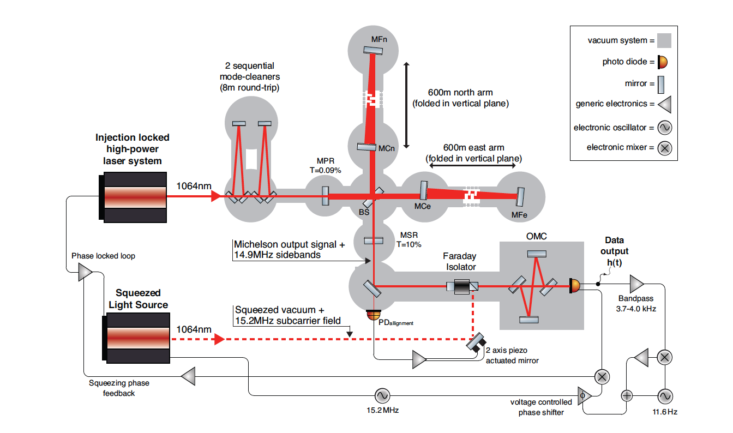
Lessons Learned (VI)
From GEO600: Squeezing angle control signals from 1% pick-off are bad
→ New “a-la-Hartmut” strategy (use transmission signals from the OMC)

Slide 21
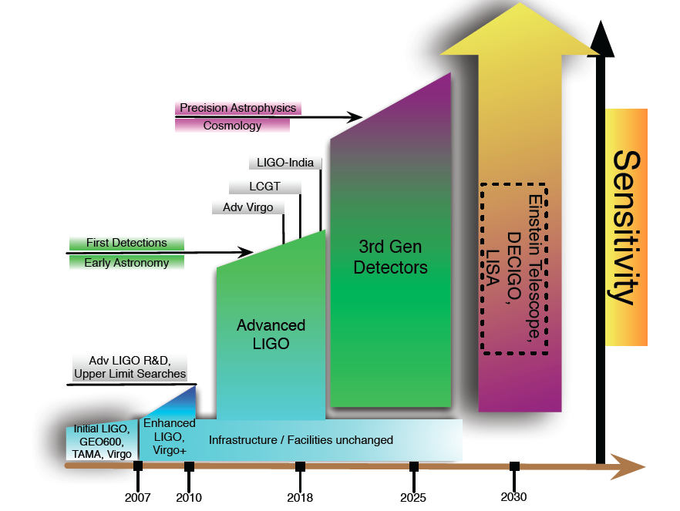
How about squeezing in aLIGO (and beyond)?
Do we want it?
Do we know how to make it? How do we incorporate all the “lessons learned” in the next generation of squeezers?
Rana Adhikari,
GWADW 2012
LIGO technical note T1200008-v3 Comparison of Quantum Noise in 3G Interferometer Configurations,
Haixing Miao et al.
➔ 10 dB of squeezing needed for all future configurations..

Slide 22
How squeezing in aLIGO would look
Projections for a “Quantum-Enhanced Advanced LIGO”
Same NS-NS as aLIGO,
better high frequency performance

Slide 23
aLIGO + Squeezing: NS-NS and BH-BH Ranges

Slide 24
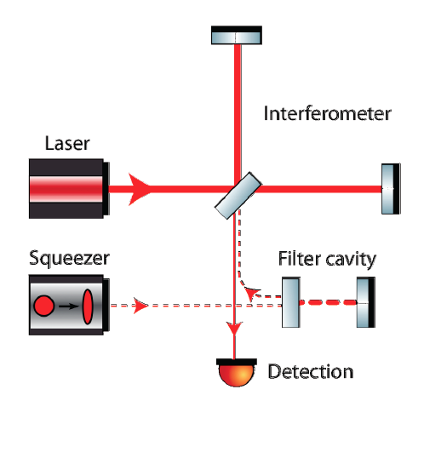
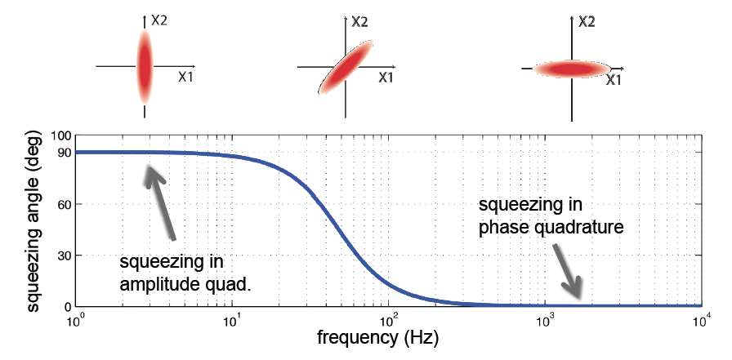
What we really want: Frequency Dependent Squeezing
High finesse detuned cavity which rotates the squeezing angle as function of frequency

Slide 25
aLIGO + Frequency Dependent Squeezing: NS-NS and BH-BH Ranges

Slide 26
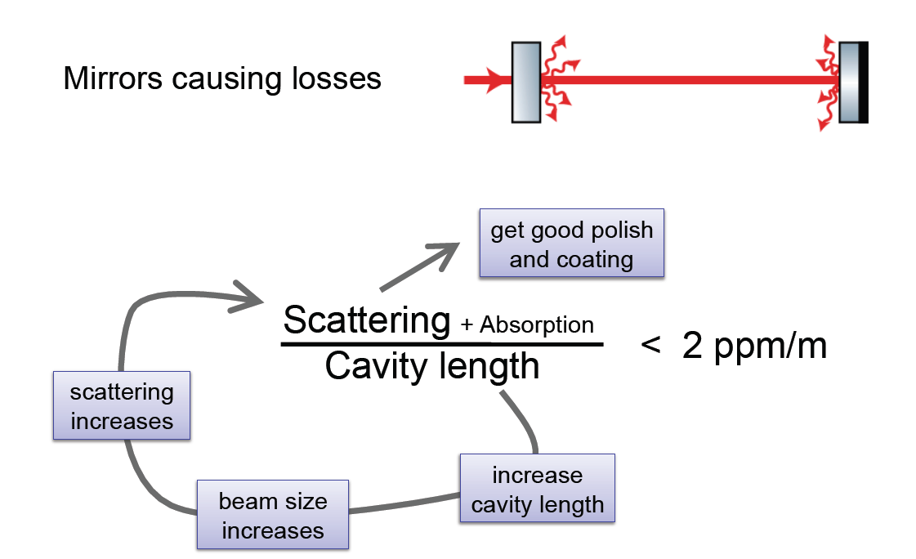
Nothing comes cheap: losses again..
Losses in a filter cavity deteriorate, if too high, make the filter cavity useless…
Per-round-trip loss depends on the beam spot size
(big beam size → higher scatter losses), which depends on L
1 ppm/m

Slide 27
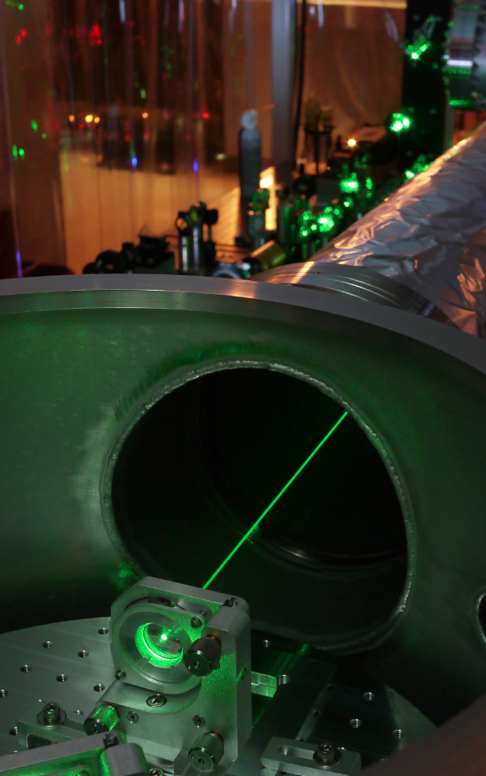
Squeezing @ MIT
FILTER CAVITY EXPERIMENT
Measuring optical losses to determine Advanced LIGO filter cavity design
Implementing practical filter cavity control scheme
Characterizing technical noises
Preparing for demonstration of audio-band frequency dependent squeezing
NEW SQUEEZER SOURCE compatible with aLIGO requirements
Tomoki Isogai, John Miller,
Eric Oelker,
(Patrick Kwee)

Slide 28
For aLIGO, we could afford a “lossy” cavity 16m cavity, 10ppm losses round trip
In preparation

Slide 29
Beyond the “Standard Quantum Limit”

Slide 30
Something like this, maybe.…
FROM IFO
Just a cartoon!
Not a conceptual design yet!

Slide 31
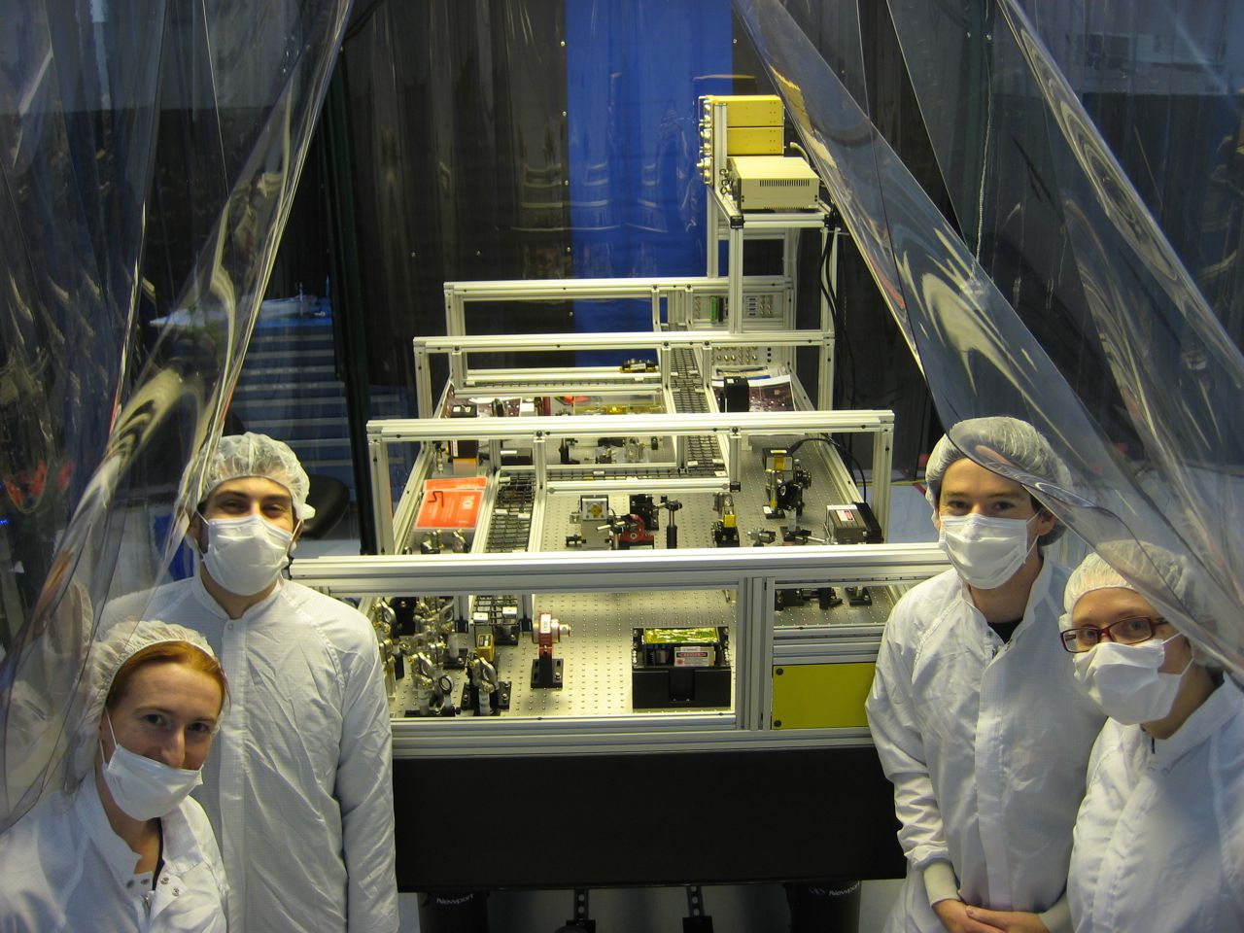
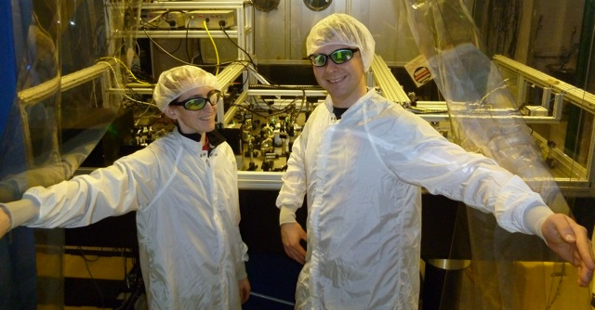
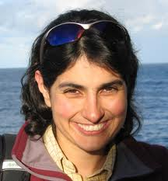
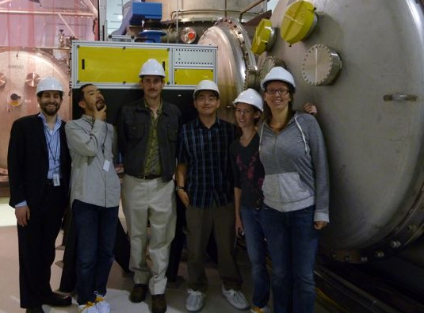
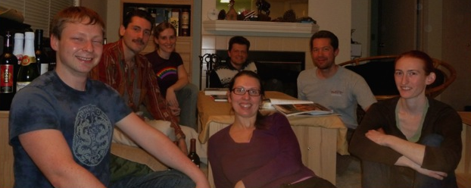
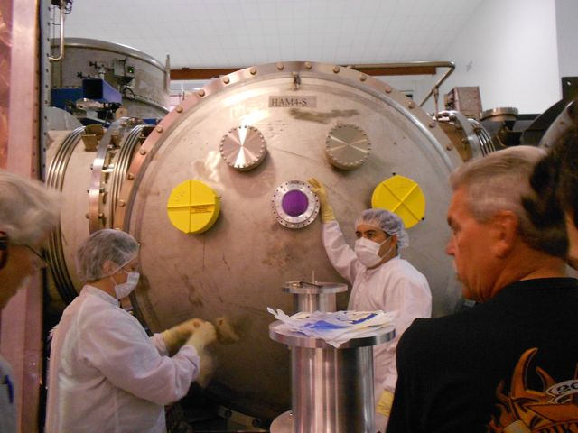
H1 Squeezing Experiment
LHO: Daniel Sigg, Keita Kawabe, Robert Schofield, Cheryl Vorvick, Dick Gustafson (Univ Mitchigan), Max Factourovich (Columbia), Grant Meadors (Univ Mitchigan), the LHO staff
MIT: Sheila Dwyer, L. Barsotti, Nergis Mavalvala, Nicolas Smith-Lefebvre, Matt Evans
ANU: Sheon Chua, Michael Stefszky, Conor Mow-Lowry, Ping Koy Lam, Ben Buchler, David McClelland
AEI: Alexander Khalaidovski, Roman Schnabel

Slide 32
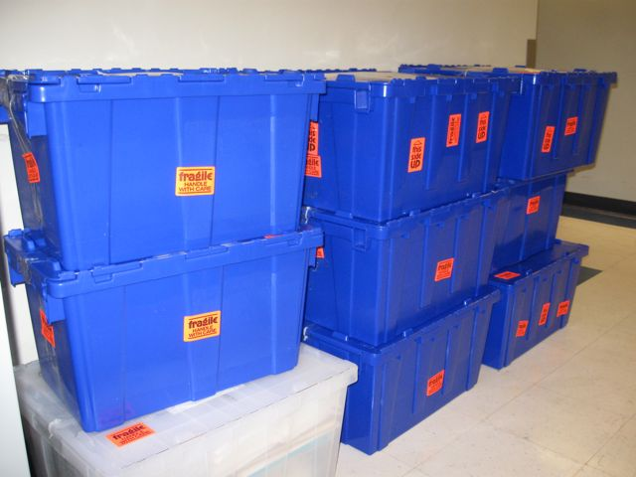
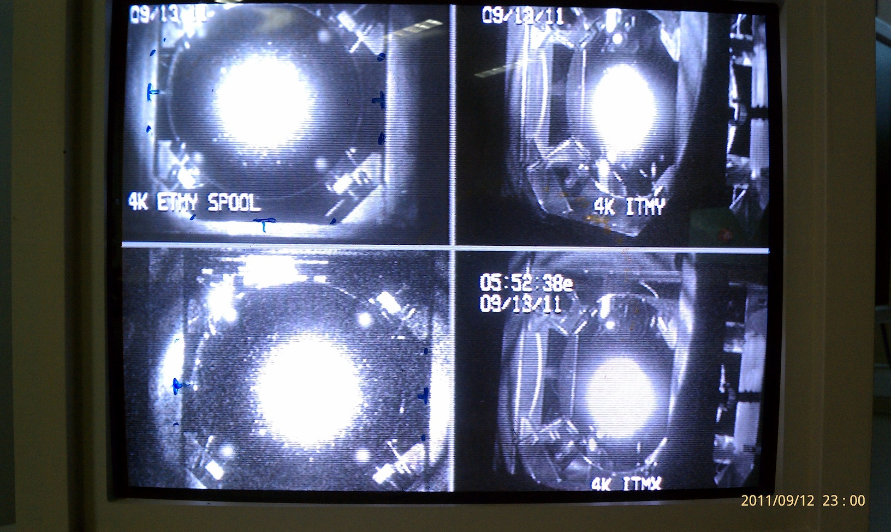
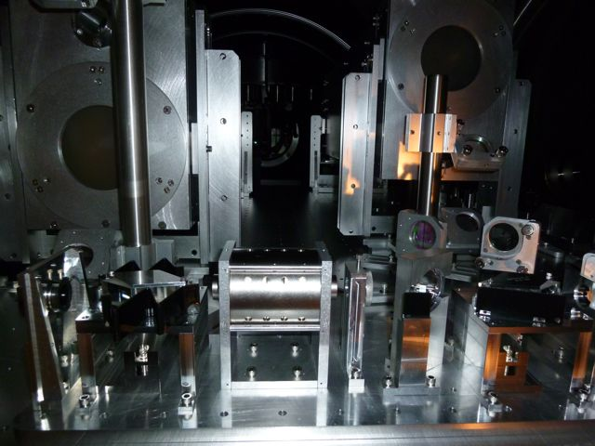
Bow-tie cavity OPO design at ANU (2008)
H1 Squeezer assembling at MIT (2009-2010)
H1 Squeezer parts shipped to LHO
(Oct 2010)
Squeezing in H1
(Oct 3 – Dec 4)
H1 Recovery
(Sept 2011)
H1 Squeezer Installation (Summer 2011)

Slide 33
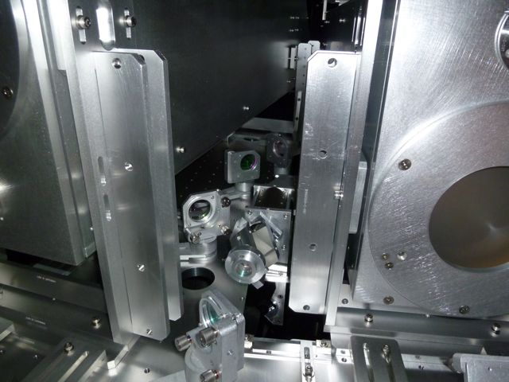
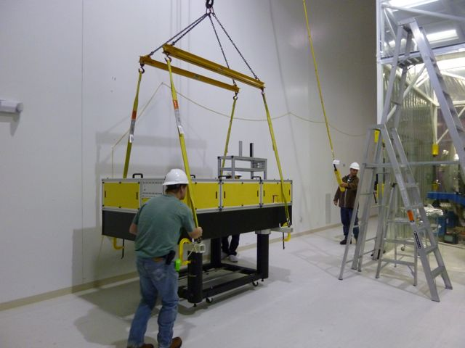
H1 Squeezing Experiment: Squeezer Installation
Additional Faraday installed in the squeezed beam path
New H1 Output Faraday
(first aLIGO unit)
Squeezer table craned to its final location

Slide 34
2.15 dB (28%) improvement over quantum noise
Squeezing improves only quantum noise, not other technical noises

Slide 35
Best broadband sensitivity ever

Slide 36
Improving H1 by 2 dB (28%) with squeezing ..without spoiling the sensitivity at 200 Hz
PRELIMINARY

Slide 37
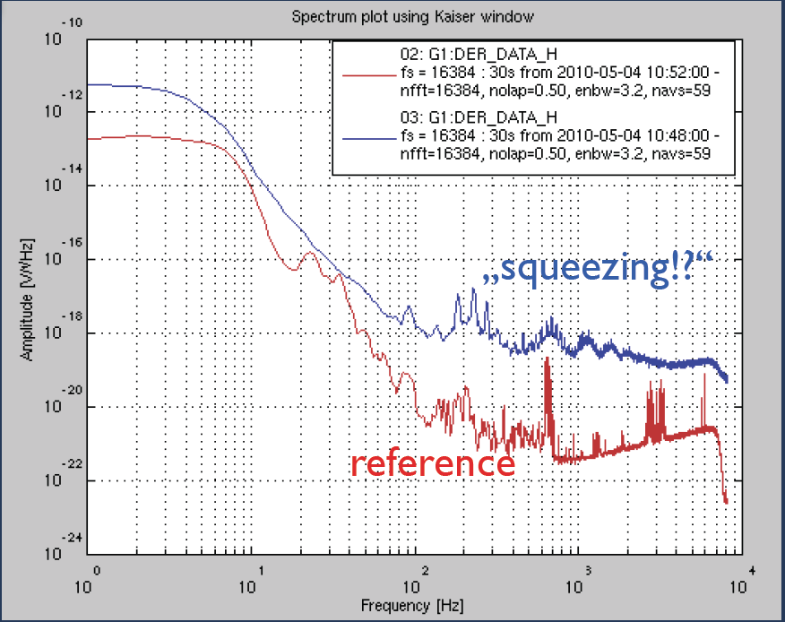
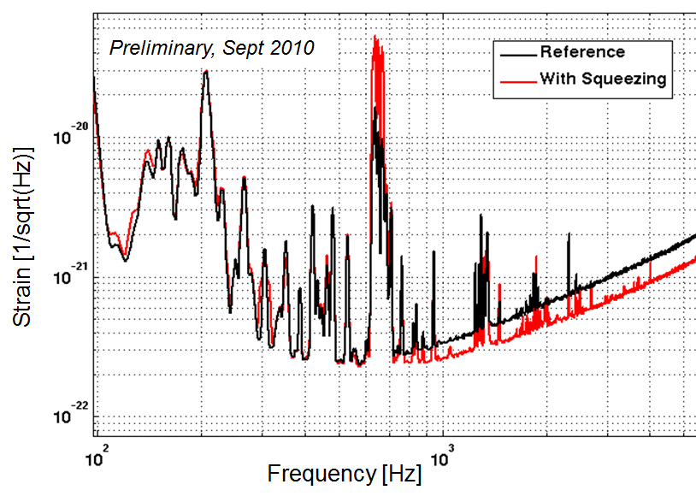
First try at squeezing in GEO
First squeezing injection: back scattered noise limits the sensitivity
Additional Faraday to reduce back scattering and measure squeezing
Courtesy of Alexander Khalaidovski (AEI)
GWADW 2010

Slide 38
Where the main losses came from
Mode matching (~30% losses)
Faradays (3 passes ~ 20% losses)
OMC transmission (18% losses)
➔ “Technical” problems, total losses should be down to 10-15% in aLIGO

Slide 39
Phase noise control
Bandwidth is limited to 10kHz by arm cavities
Need to mitigate phase noise at the source
Changes to control scheme and in vacuum OPO may be necessary for 10-15 dB of squeezing

Slide 40
Squeezing angle error signal
IFO carrier
SQZ sideband
+
x
+

Slide 42
Frequency Dependent Squeezing
High finesse detuned cavity which does the rotation for you
Broadband improvement of the quantum noise
Theoretically well understood, experimentally challenging
Low loss needed: F ~ 50,000 for 100m scale cavities
R&D in progress – MIT (P. Kwee and others)
Caltech (J. Harms and others)
H. J. Kimble, Y. Levin, A. B. Matsko, K. S. Thorne and S. P. Vyatchanin,
Conversion of conventional gravitational-wave interferometers into quantum nondemolition interferometers by modifying their input and/or
output optics. Phys. Rev. D 65, 022002 (2001).

Slide 43
Beyond aLIGO: 3rd generation Can we take another factor of 10 step?
Rana Adhikari, GWADW 2012
Basic idea is to use the same LIGO vacuum envelope
Design study happening now
Still work in progress, one thing already clear:
➔ 10 dB of frequency dependent squeezing needed!

Slide 44
The Message
Squeezing can reduce quantum noise, and improve the sensitivity of GW detectors
Large scale interferometers with squeezing: DONE!
Work needed to achieve 24/7 long term stability at maximum squeezing and reduce optical losses
H1 squeezing experiment completed, GEO600 operating with squeezing right now
In a good position to make squeezing available for Advanced detectors and beyond

Slide 45
Advanced LIGO configuration
Arm cavities, power and signal recycling cavity
Up to ~800 kW of light stored in the arms

Slide 46
Quantum States
Quantization of the electro-magnetic field
X₂
Quadrature Field Amplitudes
Amplitude Noise
Heisenberg uncertainty principle:
Phase Noise
∆X₁ ∆X₂ ≥1
X₁
46

Slide 47
Vacuum Fluctuations
When average amplitude is zero, the variance remains
Vacuum fluctuations are everywhere that classically there is no field….
…like at the output port of your interferometer!
X1
X2
47

