Slide 1
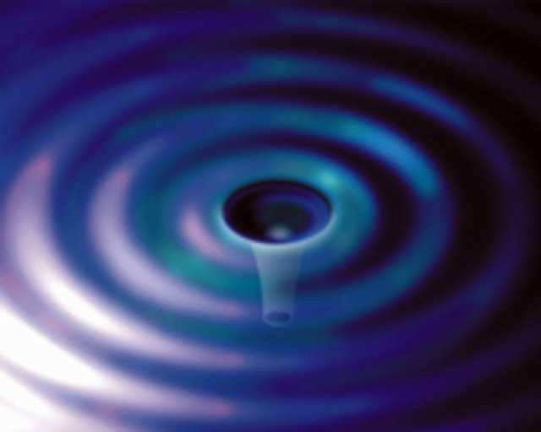
Optics Posters
Optics Working Group
LVC Meeting
Bethesda Maryland
March 18, 2013
G1300310

Slide 2
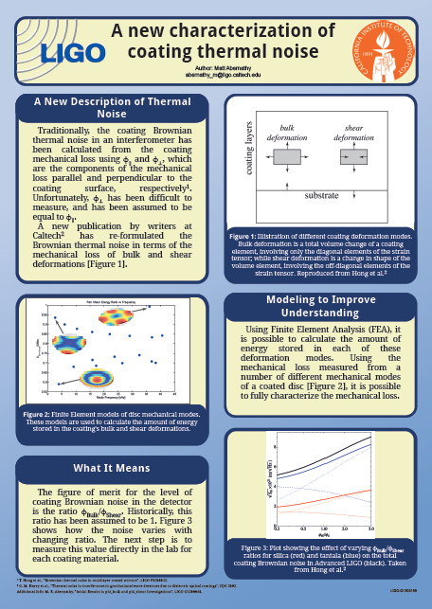
Bulk and Shear Loss in Coatings
"A New Characterization of Coating Thermal Noise”
Matt Abernathy

Slide 3
Cryogenic Q of Silicon
“Measurement of Q-factors of silicon wafers vibrational modes at low temperatures”
Valery Mitrofanov and Leonid Prokhorov

Slide 4
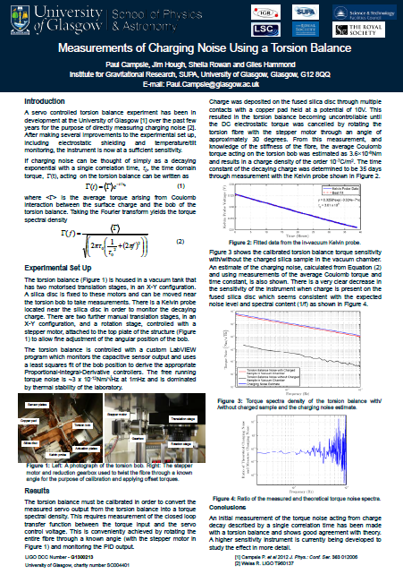
Charging Noise
"Measurements of Charging Noise with a Torsion Balance”
Paul Campsie, Giles Hammond, James Hough, Sheila Rowan

Slide 5
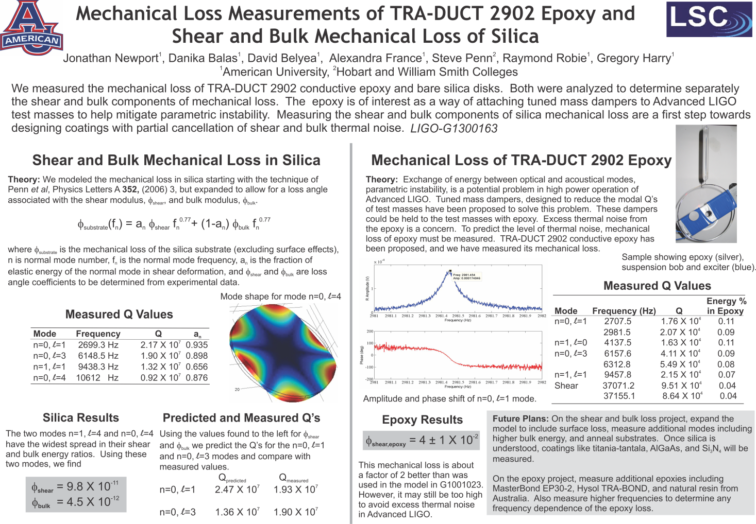
Epoxy and Silica Mechanical Loss
“Mechanical Loss Measurement of TRA-DUCT 2902 Epoxy and Shear and Bulk Mechanical Loss of Silica”
Jonathan Newport, Danika Balas, David Beyea, Alexandra France, Steve Penn, Raymond Robie – American University (and HWS)

Slide 6
Coatings and Materials
Namjun Kim, Jonathan F. Stebbins, “Structure of Amorphous Tantalum Oxide Coatings: O-17 MAS NMR Studies”
Steve Penn, “Mechanical Loss in Annealed AlGaAs Coatings”
R. Douglas, K. Haughian and M.van Veggel, “Recent optical and mechanical experiments with Sapphire”

Slide 7
Thermal Issues
Aidan Brooks, "Advanced LIGO TCS Status”
Giacomo Ciani, "Production Ring Heaters Qualification and Testing”
R Adhikari and Nic Smith, “Just Cool Enough: Ultra-LIGO”

Slide 8
Technical Noise and Modeling
Maria Pashentseva and Igor Bilenko "Measurement of mechanical excess noise from the stressed silicate bonding“
D. Kelley, J. Lough, A. Perreca, S. Ballmer "Optical Trap for Angular Degree of Freedom“
L.Carbone, D.Brown, C.Bond, P.Fulda, A.Freise "FINESSE, a numerical simulation tool for optical design and detector commissioning“

