Slide 1
Mechanical Loss in Silica substrates
Jonathan Newport
American University
Gregg Harry, Raymond Robie, David Belyea, Matt Abernathy
LIGO-G1300309
LVC Meeting
Bethesda, MD
March 18th 2013

Slide 2
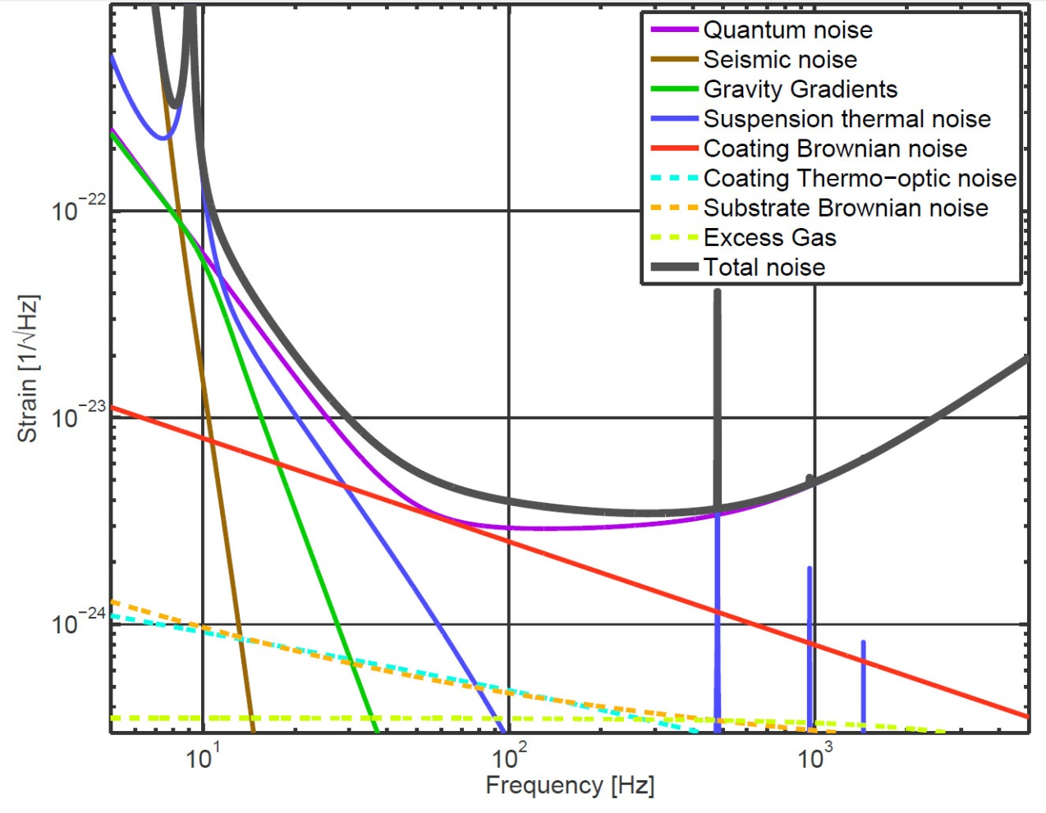
Introduction
Thermal noise from internal degrees of freedom of interferometer test masses is a limiting noise source in the sensitive mid-frequency bands.
Must quantify mechanical loss in both Silica Substrate and Coating Layers.
Notes:
Brownian Thermal Fluctuations arise from:
Thickness fluctuations of coating layers caused by bulk and shear fluctuations.
Interface fluctuations caused by bulk and shear fluctuations.
Refractive index fluctuations caused by thickness fluctuations.

Slide 3
History: Old Formalism for Loss
“Thermal noise in interferometric gravitational wave detectors due to dielectric optical coatings”
[Harry, et al., Classical & Quantum Gravity, 19 (2002) 897-917]
Derives thermal noise power spectrum in terms of $φ_{substrate}$ and coating losses $φ_{∥}$ and $φ_{⊥}$.
Assuming $σ=σ^{′}=0$,
$$S_{x}\left(f\right)=\frac{1}{wY}\frac{2k_{B}T}{fπ^{3/2}}\left\{φ_{substrate}+\frac{1}{\sqrt{π}}\frac{d}{w}\left(\frac{Y′}{Y}φ_{∥}+\frac{Y}{Y′}φ_{⊥}\right)\right\}$$
Finding $φ_{∥}$,
Measured
$$\frac{1}{Q}=φ= \frac{U_{Substrate}}{U_{Total}}{ φ}_{substrate} + \frac{U_{∥}}{U_{Total}} φ_{∥}$$
Calculated
Finding $φ_{⊥} …???$
Assumes $φ_{∥}=φ_{⊥}$
Notes:
-loss associated with energy density in parallel (transverse) coating strains as phi_|| (r and theta directions)
-loss associated with energy density in perpendicular (longitudinal) coating strains as phi_perp (z direction)
-Ringdowns to measure Q and phi
-Energy ratios calculated analytically or via a FEA

Slide 4
Impetus: New Formalism for Loss
“Brownian Thermal Noise in Multilayer Coated Mirrors”
[Hong, et al, LIGO-G1200614-v1, Submitted to Phys. Rev. D]
$φ_{∥}$ and $φ_{⊥}$ formalism of Harry, et al. can lead to erroneous values – require new formalism.
When applying a force with known pressure profile:
$$U_{coating}=U_{B}+U_{S}=\iiint_{coating}^{ }{\left(\frac{K}{2}Θ^{2}+μΣ_{ij}Σ_{ij}\right)dV}$$
New formalism for mechanical loss in coating starting from elastic energy contained in bulk energy $U_{B}$ and shear energy $U_{S}$.
loss in coating
$$φ_{coated}= \frac{U_{substrate}}{U_{Total}} φ_{substrate} +\frac{U_{B}}{U_{Total}} φ_{B} + \frac{U_{S}}{U_{Total}} φ_{S}$$
Without a coating, should be able to extend this analysis to bulk and shear loss in substrate
$$φ_{substrate}=\frac{U_{B,Sub}}{U_{Total}} φ_{B,Sub} + \frac{U_{S,Sub}}{U_{Total}} φ_{S,Sub}$$

Slide 5
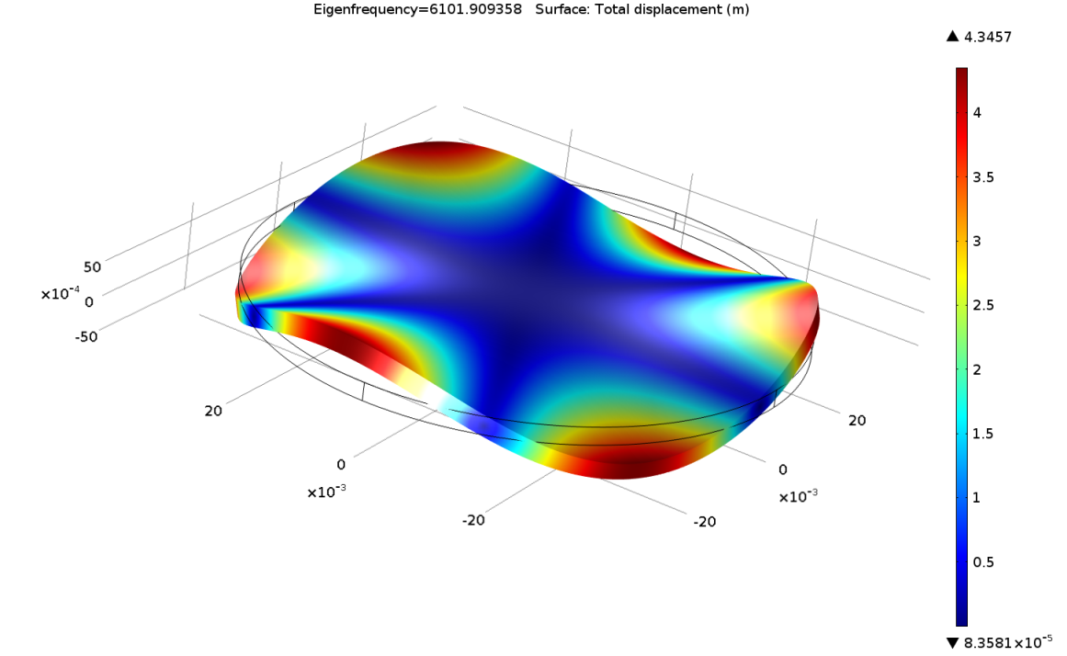
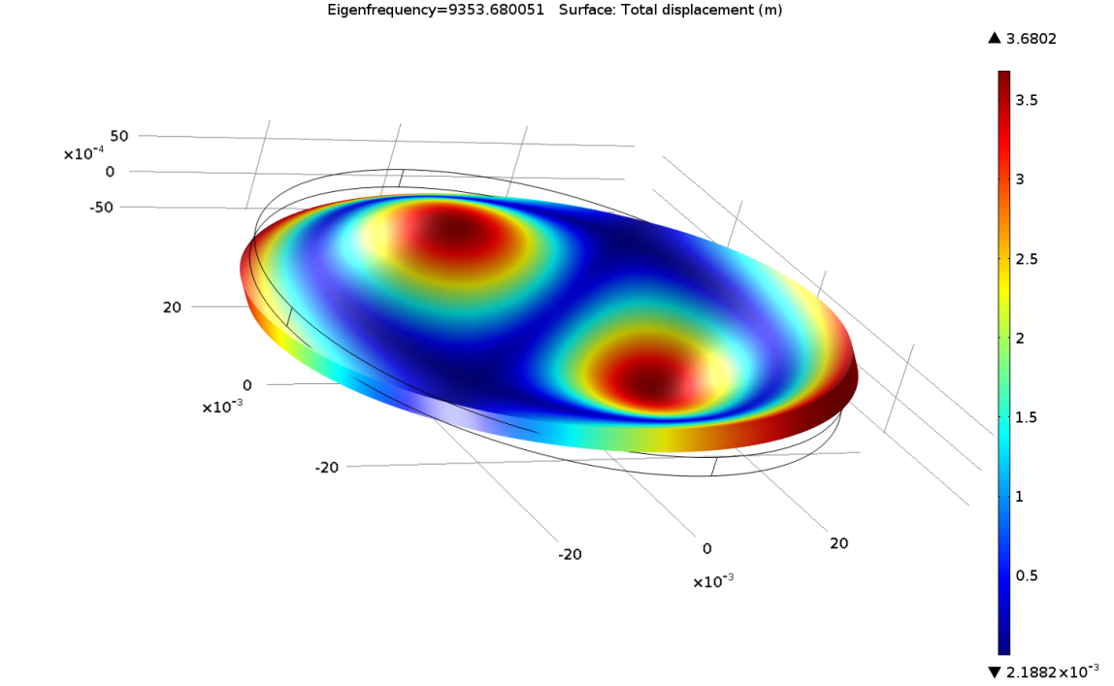
Measurement Techniques: FEA
A finite element analysis of an uncoated silica sample is used to find its approximate resonance frequencies.
$$f≈6102\text{Hz}$$
$$f≈9354\text{Hz}$$
Notes:
-Specific Geometry

Slide 6
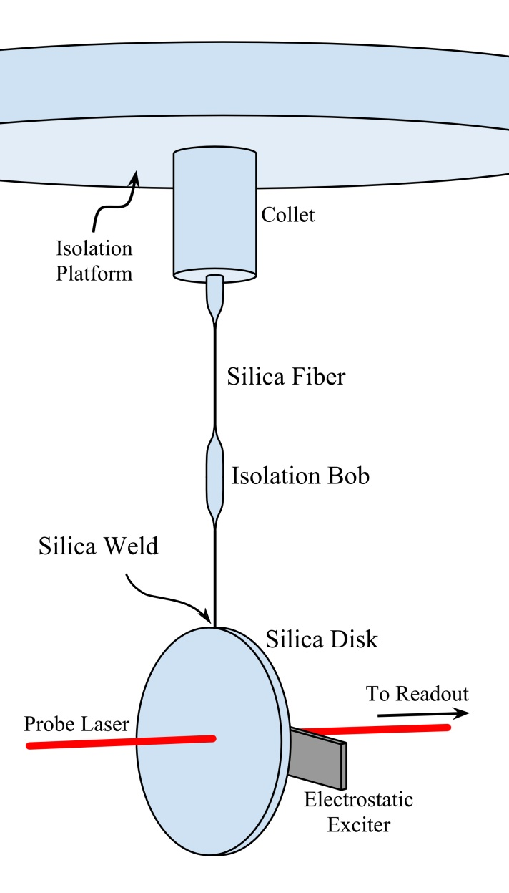
Measurement Techniques: Hanging Sample
Notes:
-Specific Geometry

Slide 7
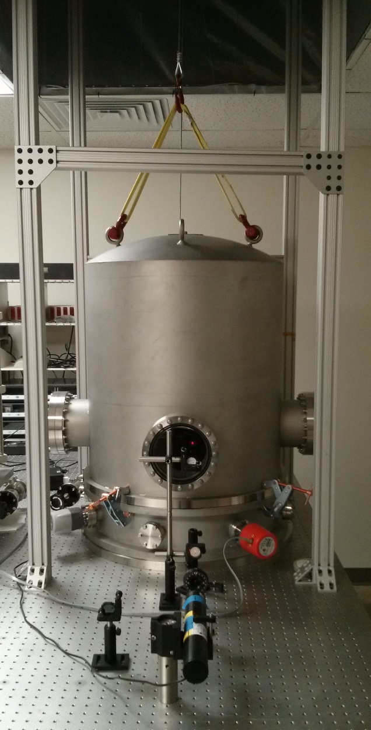
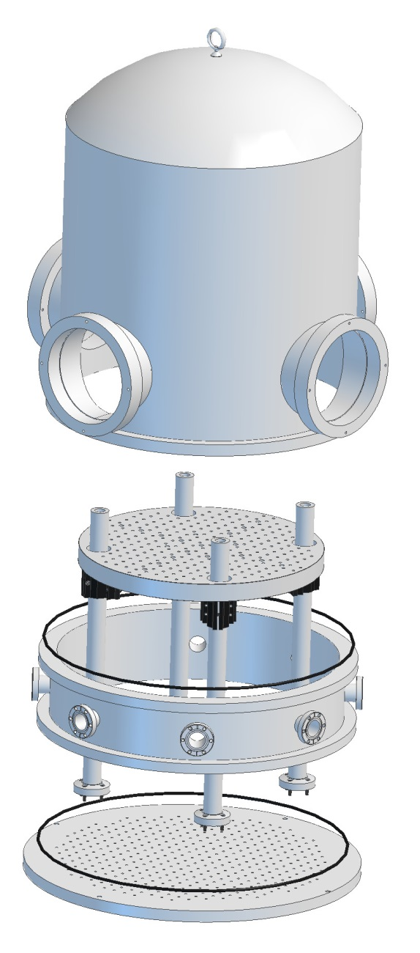
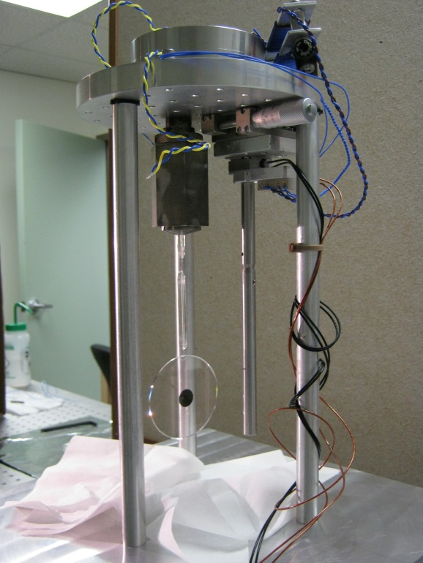
Measurement Techniques: Bell Jar Upgrade

Slide 8
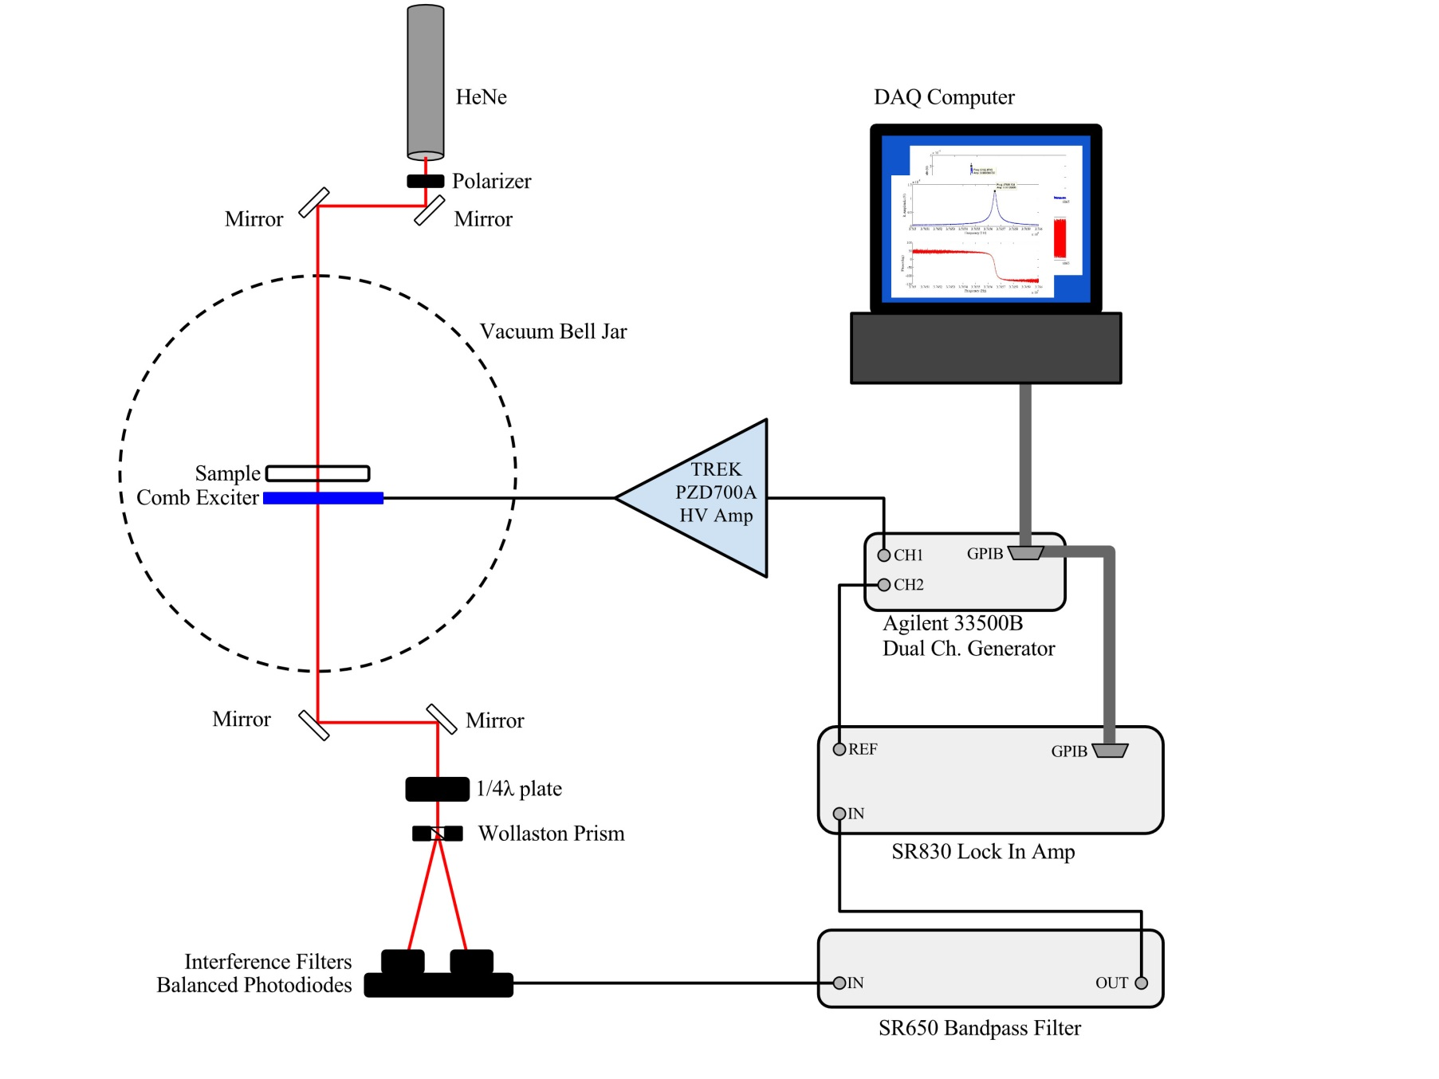
Measurement Techniques: Birefringence Sensor

Slide 9
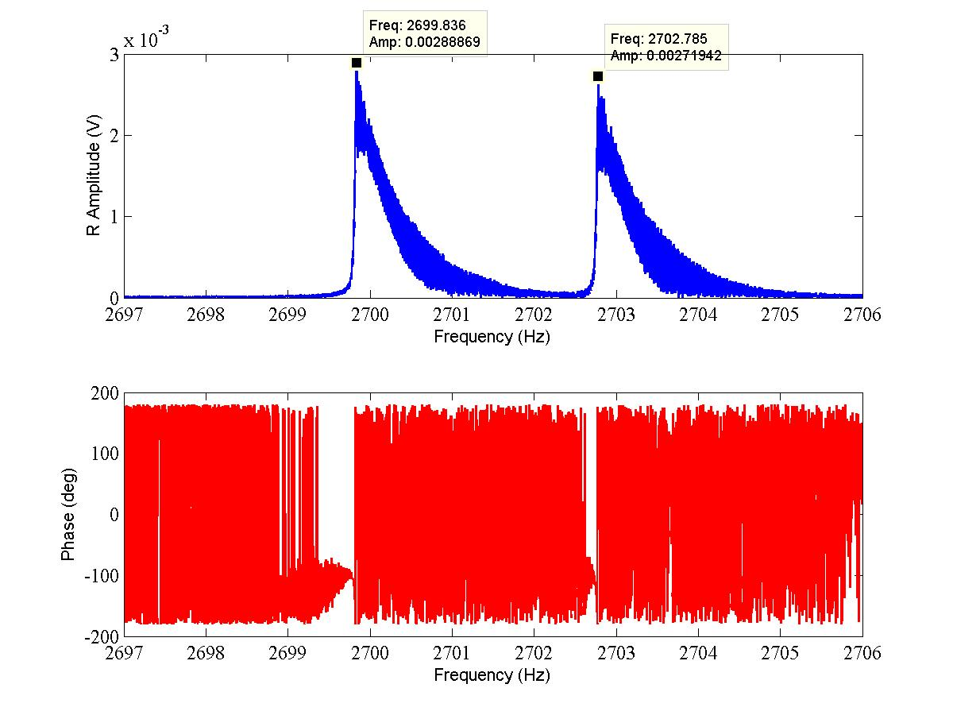
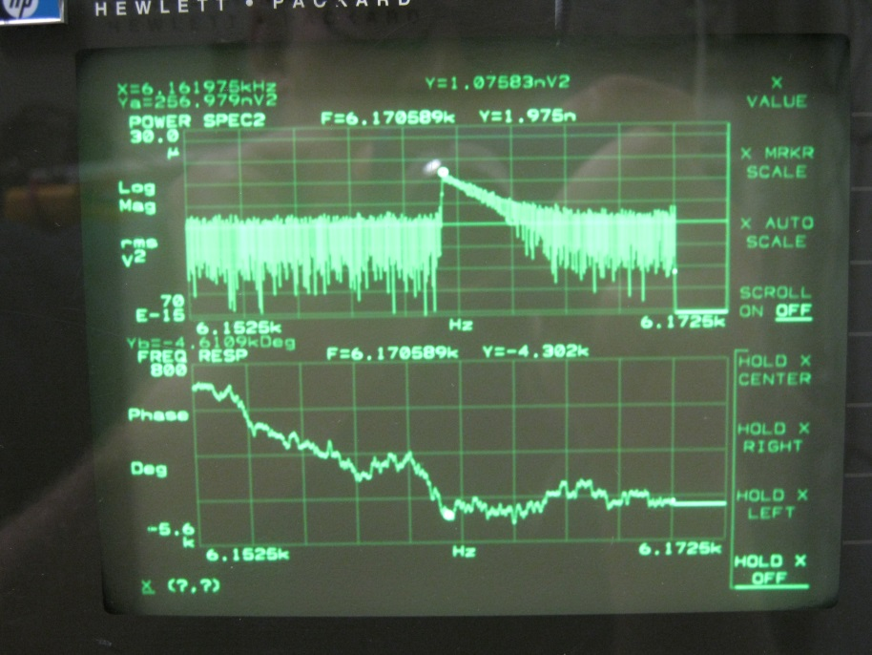
Measurement Techniques: Mode Hunting
Matlab Instrument Control
Network/Signal Analyzer
Matlab + Waveform Generator + Lockin Amplifer allows for complete control of all sweep parameters: input filter bandwidth, step time and step size down to 1µHz.

Slide 10
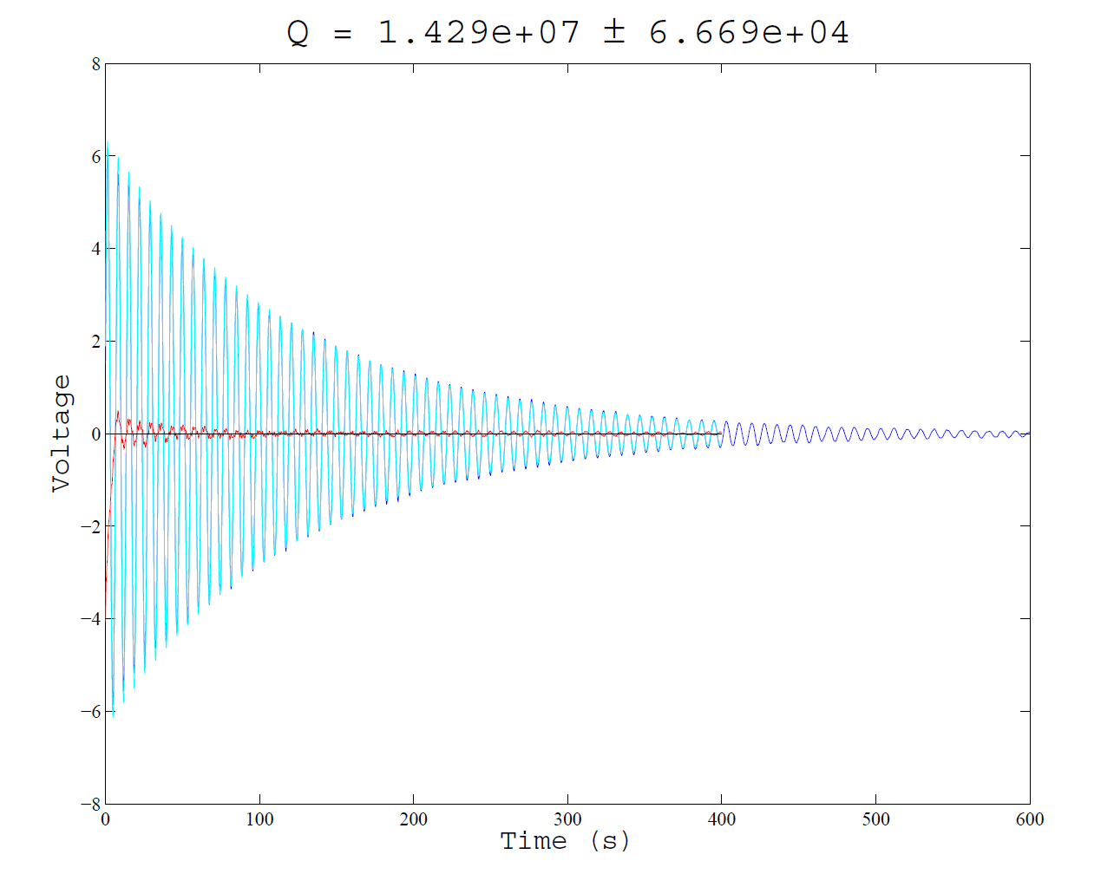
Measurement Techniques: Ringdowns
$$φ_{substrate}$$
$$A=A_{0}e^{−\frac{1}{2} φ ω_{0}t}$$
Notes:
Once a mode is found,

Slide 11
Measurement Techniques: Q Results
Sample | Mode Freq [Hz] | Q
Sample 24 | 2706.5 | 2.009×10⁷
 | 6162.4 | 1.47×10⁷
 | 9445.8 | 5.49×10⁶
Sample 25 | 2699.2 | 1.9×10⁷
 | 6149.6 | 1.89×10⁷
 | 9438.3 | 1.326×10⁷
 | 10,612.5 | 7.66×10⁶
Sample 26 | 2758.1 | 1.911×10⁷
 | 4163.2 | 8.88×10⁶
 | 37,039.1 | 1.488×10⁷
Notes:
Once a mode is found,

Slide 12
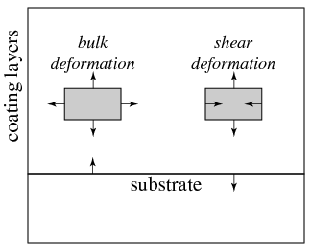
Analysis: Return to FEA with New Formalism
Elastic energy can be divided into bulk energy $U_{B}$ and shear energy $U_{S}$ when applying a force with a known pressure profile,
$$U_{Total}=U_{B,Sub}+U_{S,Sub}=\iiint_{Sub}^{ }{\left(\frac{K}{2}Θ^{2}+G Σ_{ij}Σ_{ij}\right)dV}$$
Bulk:
Shear:
$$Σ_{ij}=\frac{1}{2}\left[S_{ij}+S_{ji}\right]−\frac{1}{3}δ_{ij}Θ$$
$$Θ=S_{11}+S_{22}+S_{33}$$
FEA
$$φ_{substrate}=\frac{U_{B,Sub}}{U_{Total}} φ_{B,Sub}+ \frac{U_{S,Sub}}{U_{Total}} φ_{S,Sub}$$
Notes:
-K is the Bulk Modulus
-G is the Shear Modulus
-S is the 3x3 strain tensor

Slide 13
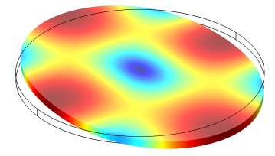
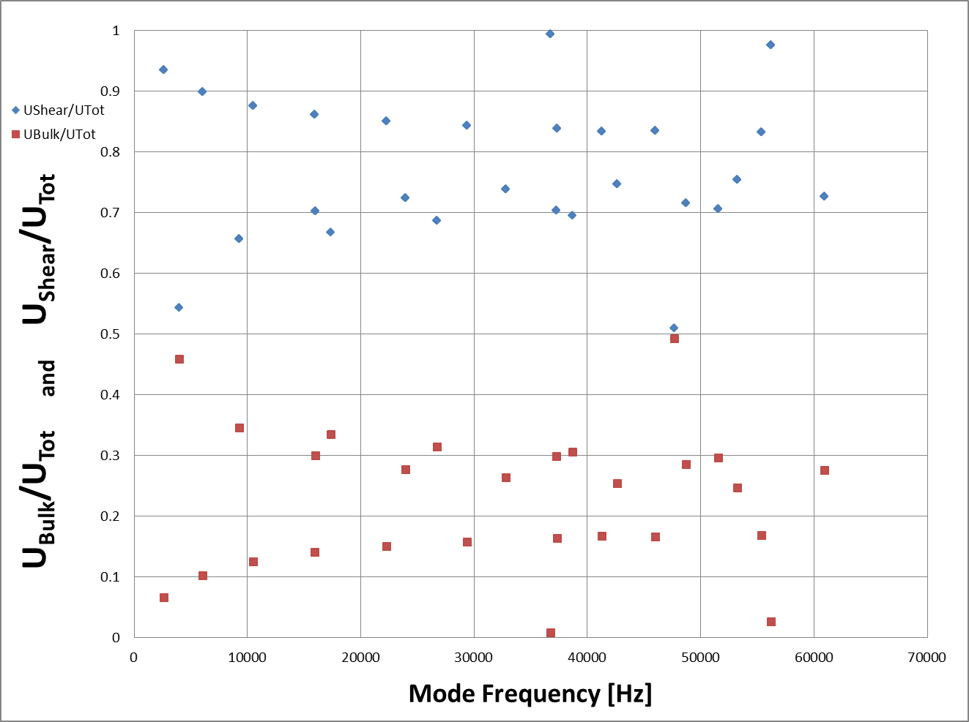
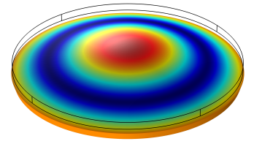
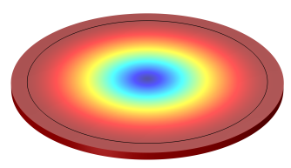
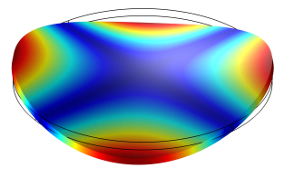
Analysis: FEA Energy Ratios

Slide 14
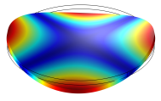
Preleminary Results
Bulk and Shear loss can be then be calculated:
$$\left[\begin{matrix}φ_{a} \\ φ_{b}\end{matrix}\right]=\left[\begin{matrix}\frac{U_{a,Bulk}}{U_{a,Tot}} & \frac{U_{a,Shear}}{U_{a,Tot}} \\ \frac{U_{b,Bulk}}{U_{b,Tot}} & \frac{U_{b,Shear}}{U_{b,Tot}}\end{matrix}\right] \left[\begin{matrix}φ_{Bulk} \\ φ_{Shear}\end{matrix}\right]$$
Sample 26 | $$φ_{Bulk}$$ | $$φ_{Shear}$$
 | $$1.96×{10}^{−7}$$ | $$4.24×{10}^{−8}$$
 | $$1.67×{10}^{−7}$$ | $$6.66×{10}^{−8}$$
Note that we lose frequency information! (or it’s buried, at least)
Notes:
Can be found using two modes, ideally with different shear/bulk energy ratios

Slide 15
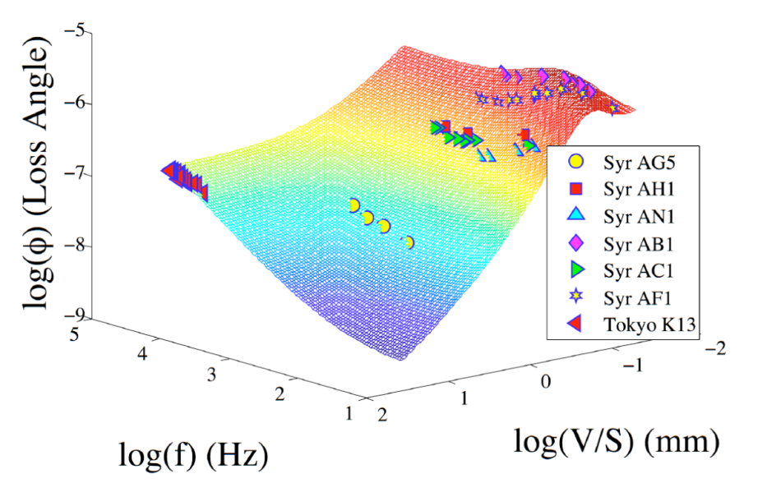
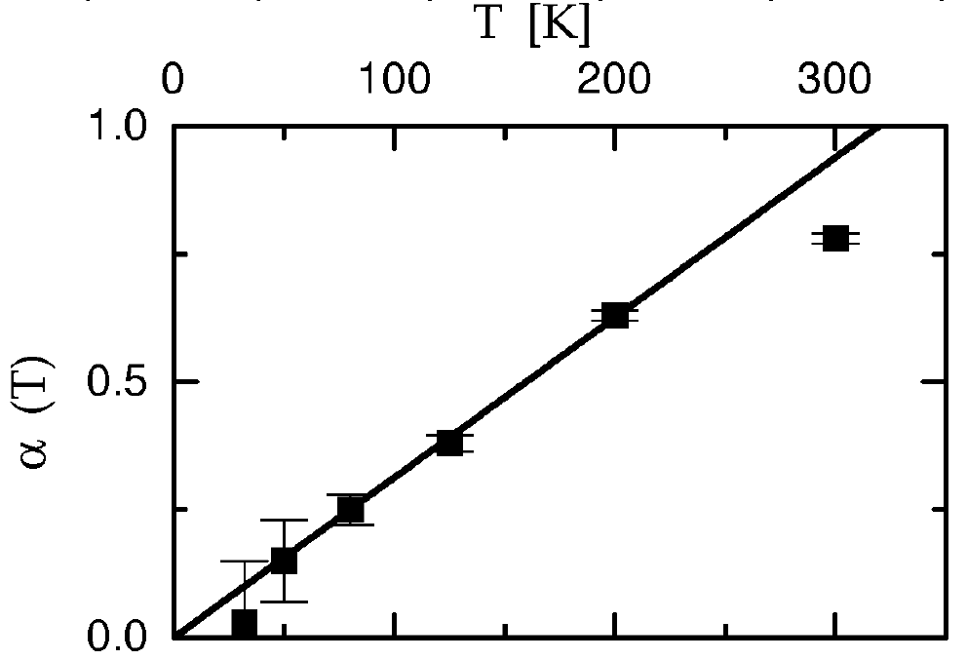
“Frequency and surface dependence of mechanical loss in fused silica”
[Penn, et al., Physics Letters A, 352 (2006) 3-6]
Shows that mechanical loss of silica substrate$φ_{substrate}$ depends on frequency and surface-to-volume ratio.
$$φ\left(f,\frac{V}{S}\right)=φ_{surf}+φ_{vol}+φ_{th} \\ =C_{1}{\left(\frac{V}{S}\right)}^{−1}+C_{2}{\left(\frac{f}{(1\text{Hz}\text{)}}\right)}^{C_{3}}+C_{4}φ_{th}$$
Type | C1 (pm) | C2 (×10⁻¹¹) | C3 | C4
Suprasil 2 | 12.1 | 1.18 | 0.77 | 0.61
Frequency dependence of loss agrees well with results of modeling asymmetric double-well potential in Si-O-Si bond angle. [Weidersich, et al., Phys. Rev. Lett. 84 (2000) 2718]
Type | C3
Suprasil 300 | ≈0.75
Notes:
-Contribution of surface loss is dependent on surface to volume ratio and is mode dependent C1=\mu\alpha_s where \mu depends on mode shape and \alpha_s is surface loss parameter.

Slide 16
Still Lots to Do!
Frequency Dependence $φ(f)$:
More Data Pairs – easier to probe higher order modes with wideband HV Amplifier and computer control
Design second sample with different energy ratios, but similar mode frequencies
Include dependence of loss on Surface to Volume ratio in analysis $φ\left(\frac{V}{S}\right)$
Include Shear/Bulk loss in Surface analysis
Compare to other theoretical models (Hai Ping Cheng, etc.)
Annealing
More modes, reanalyzing old data
$$φ\left(f,\frac{V}{S}\right)=φ_{surf}+φ_{vol}$$
$$φ\left(f,\frac{V}{S}\right)=φ_{surf,B}+φ_{surf,S}+φ_{vol,B}+φ_{vol,S}$$
Notes:
HV amp good to 125kHz for large signals

Slide 17
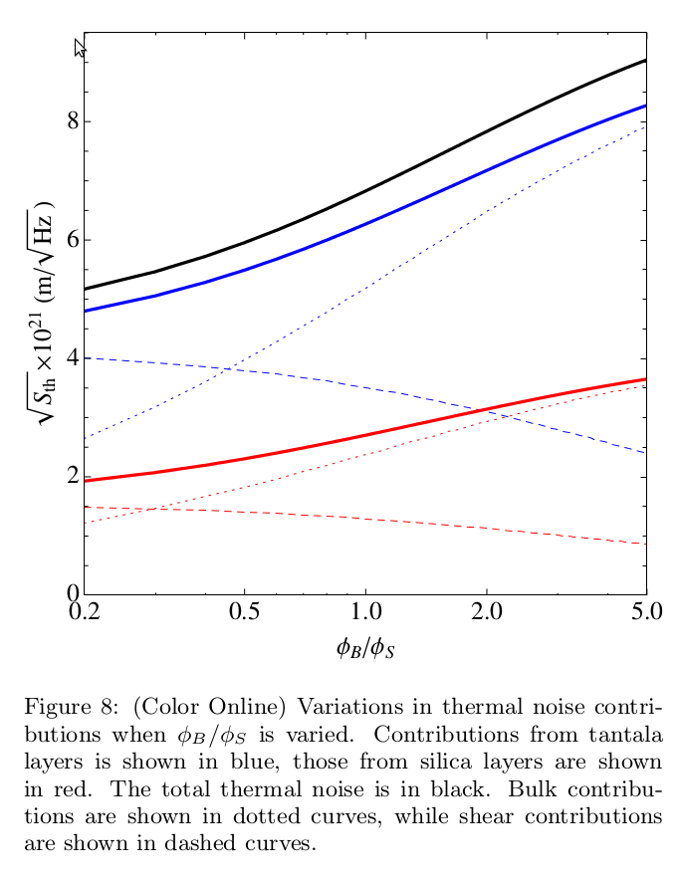
Bulk/Shear Optimization

