Slide 1
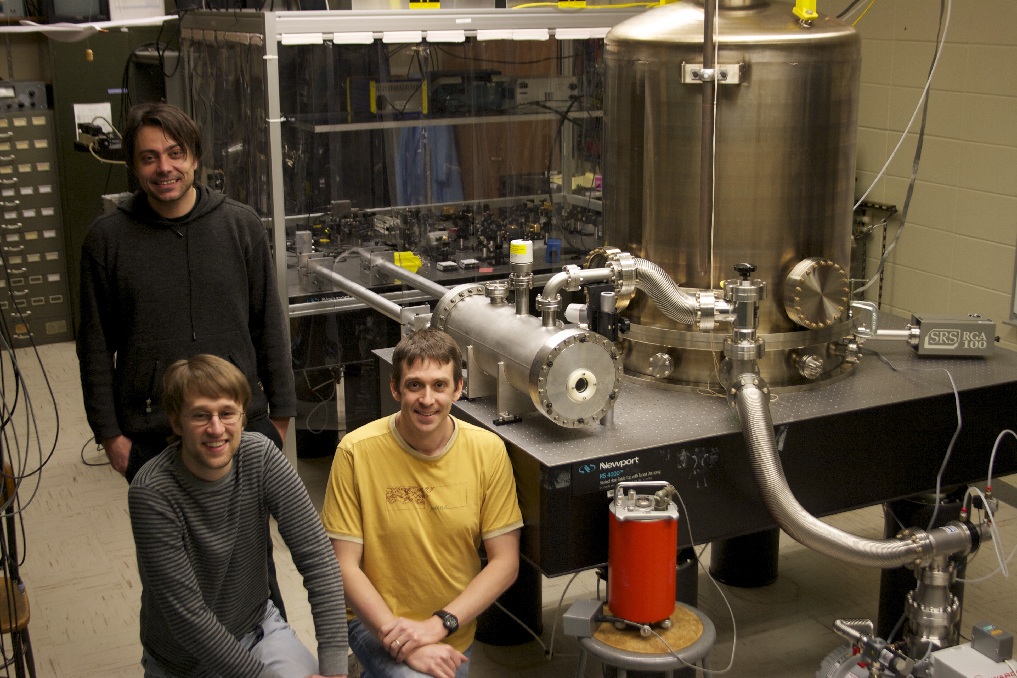

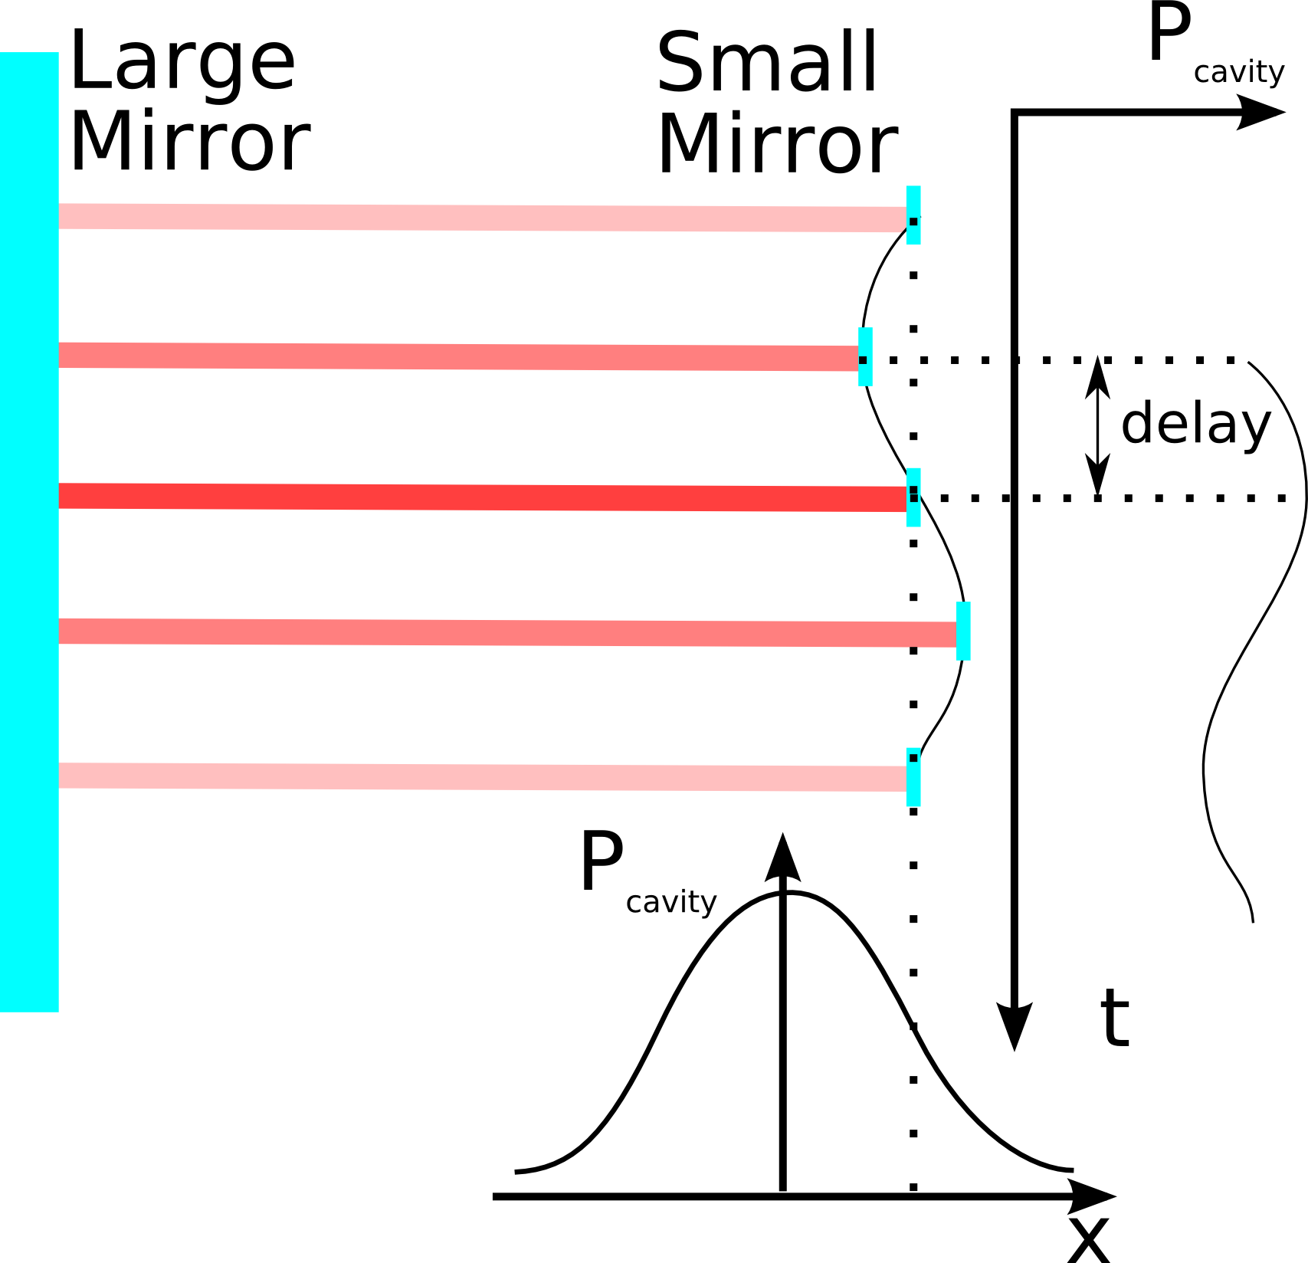
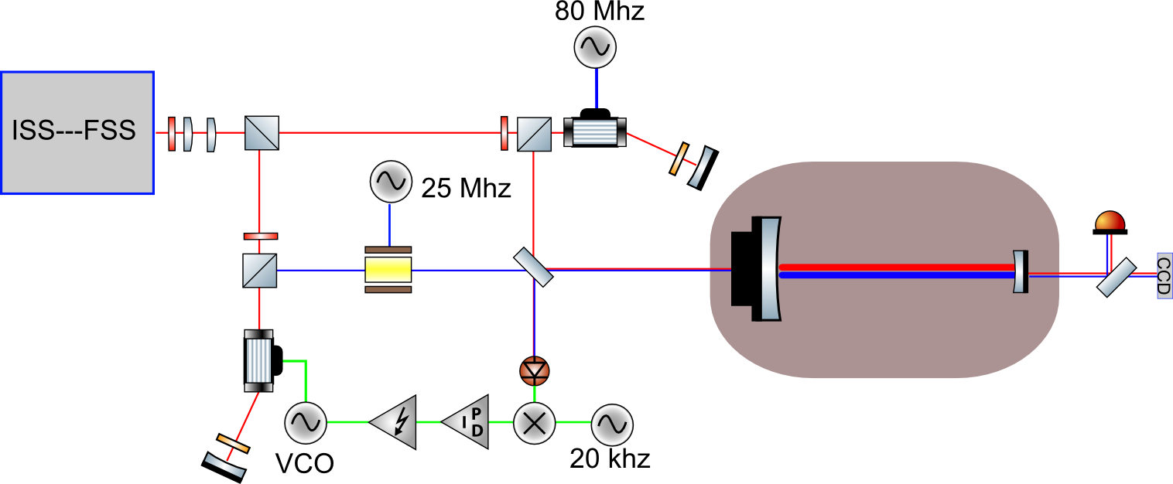
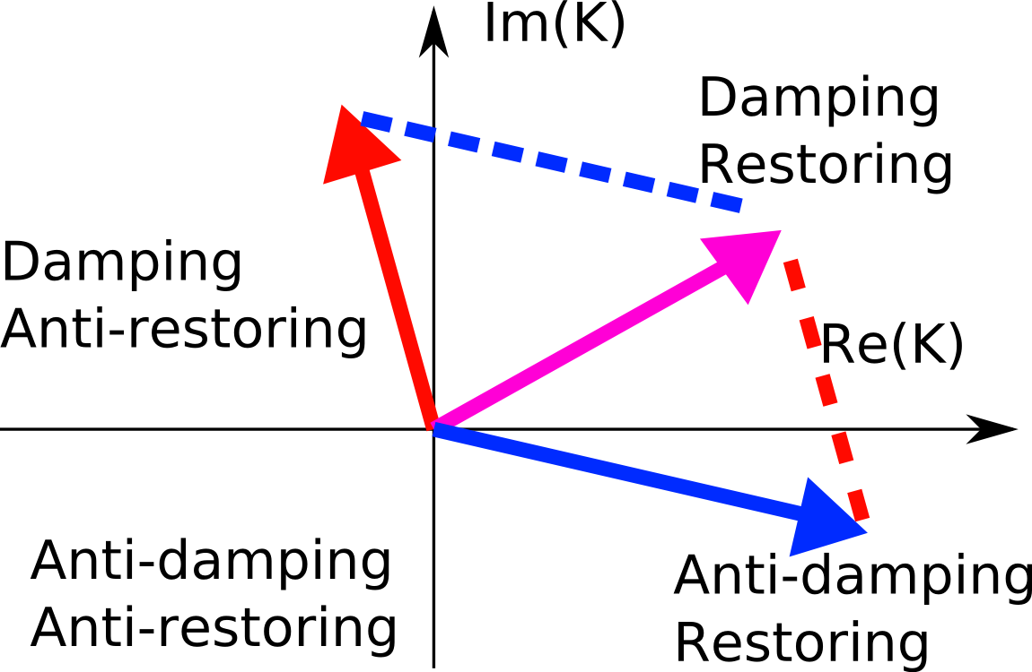
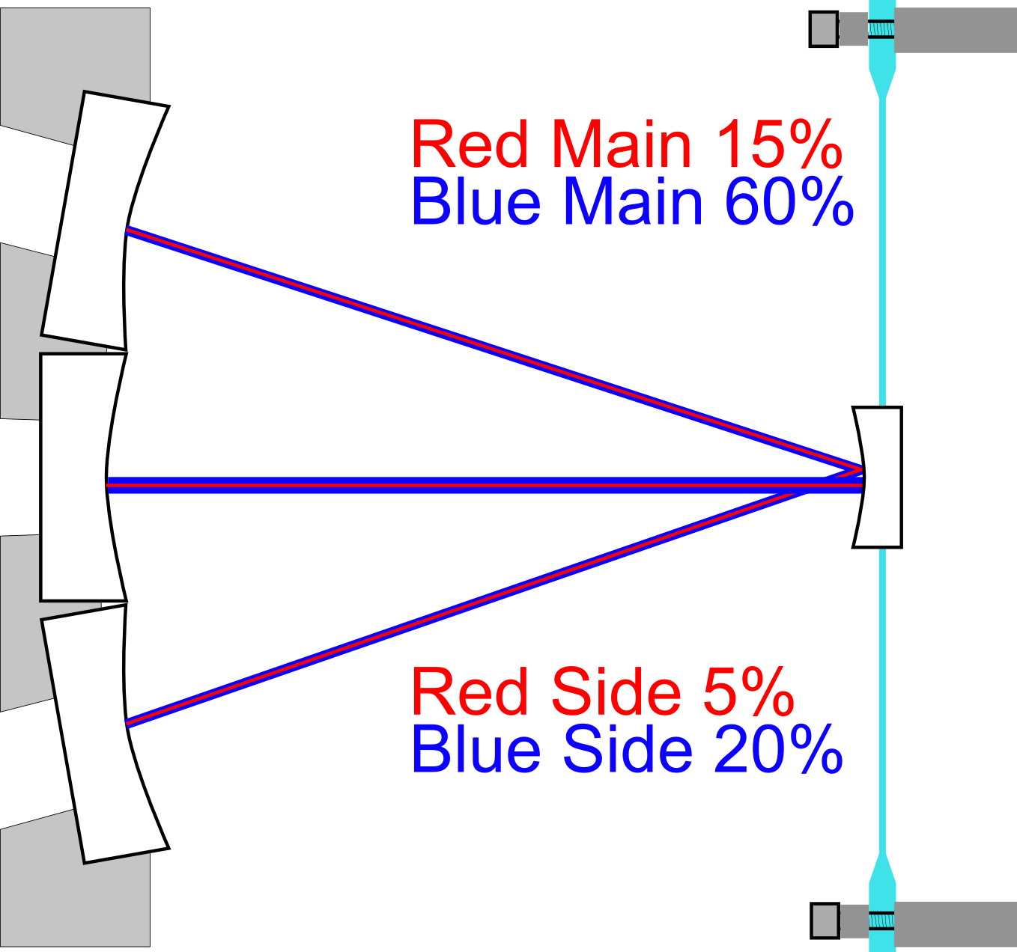
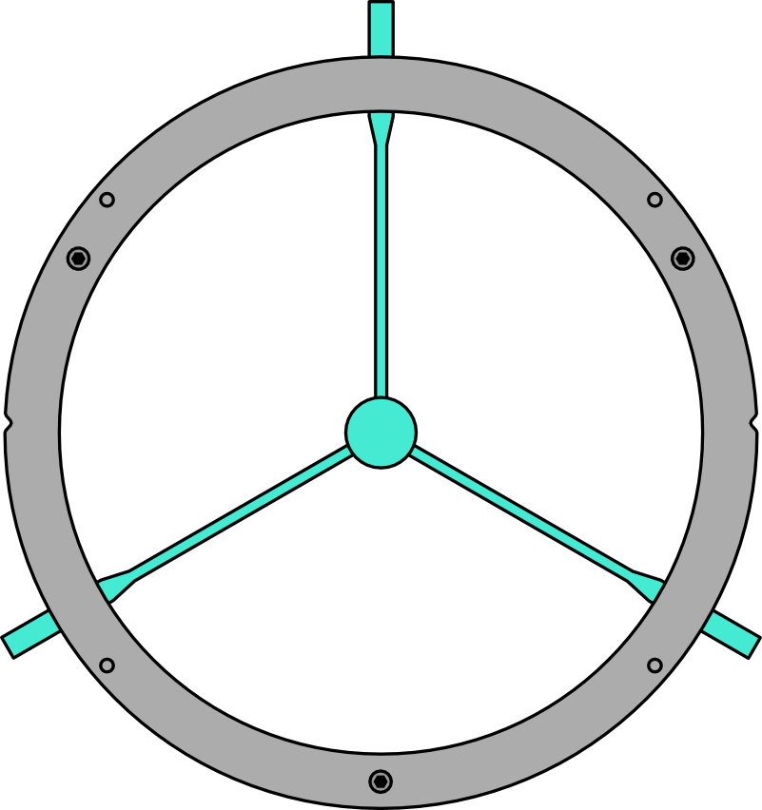
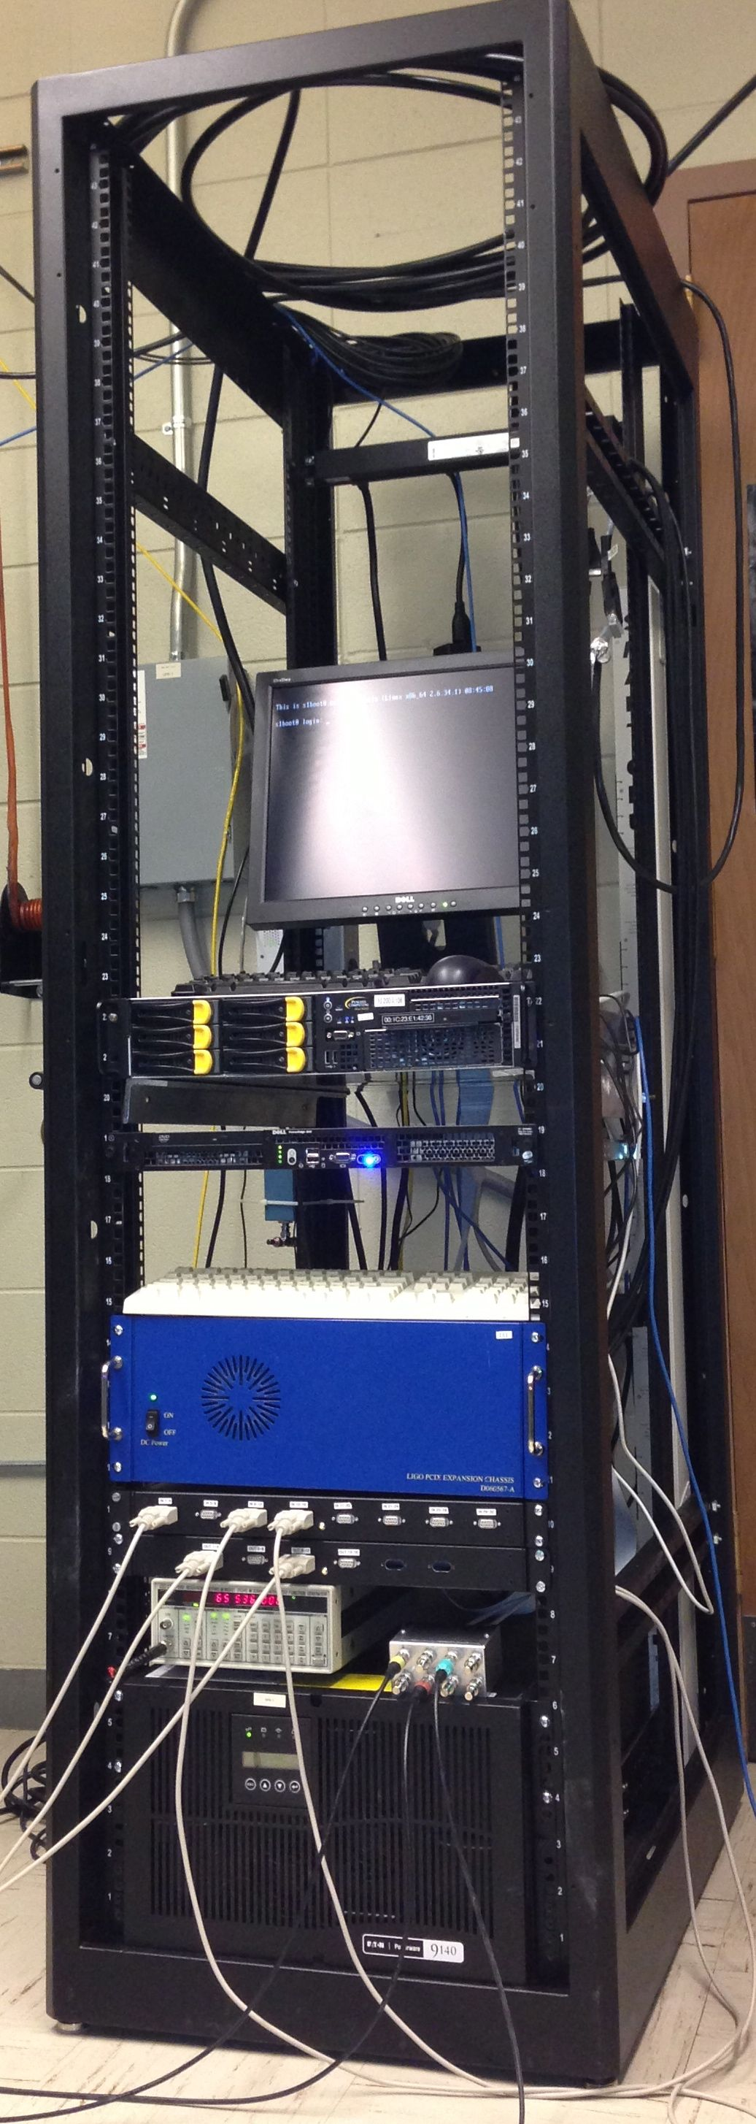
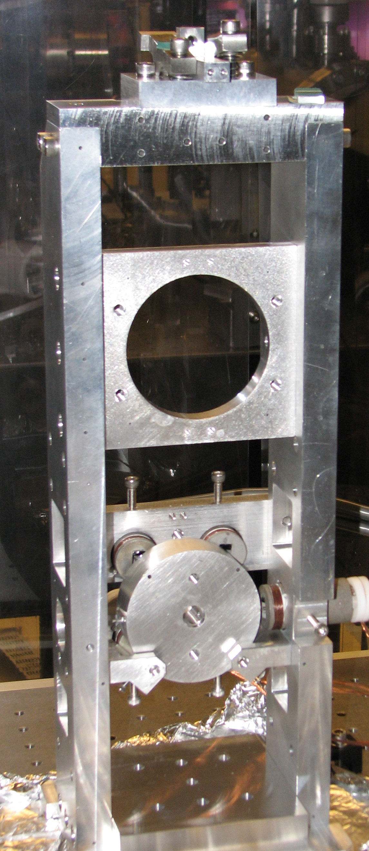
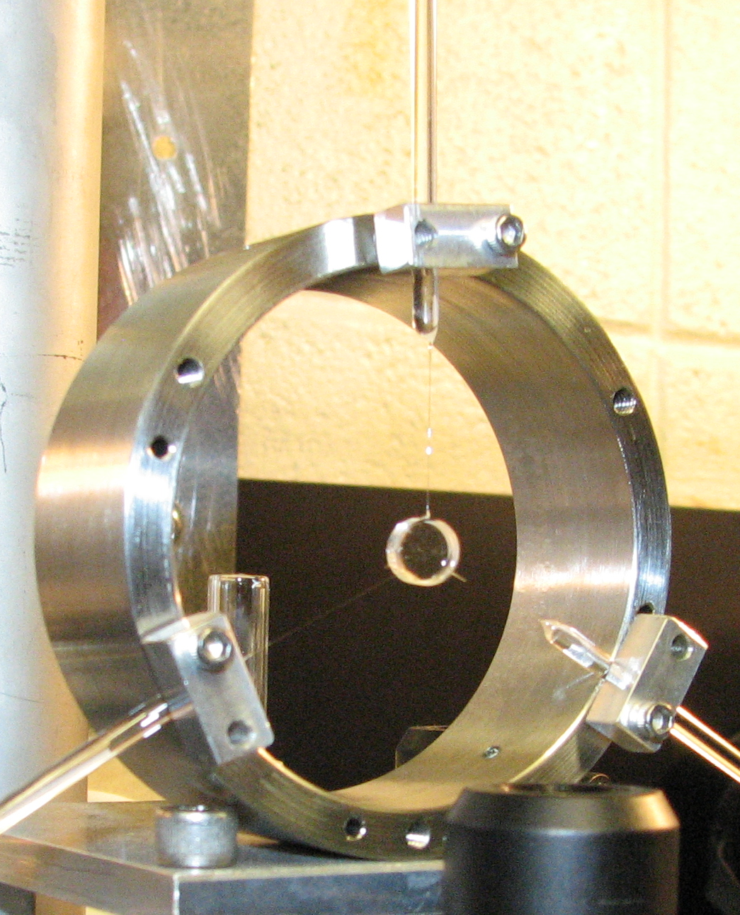
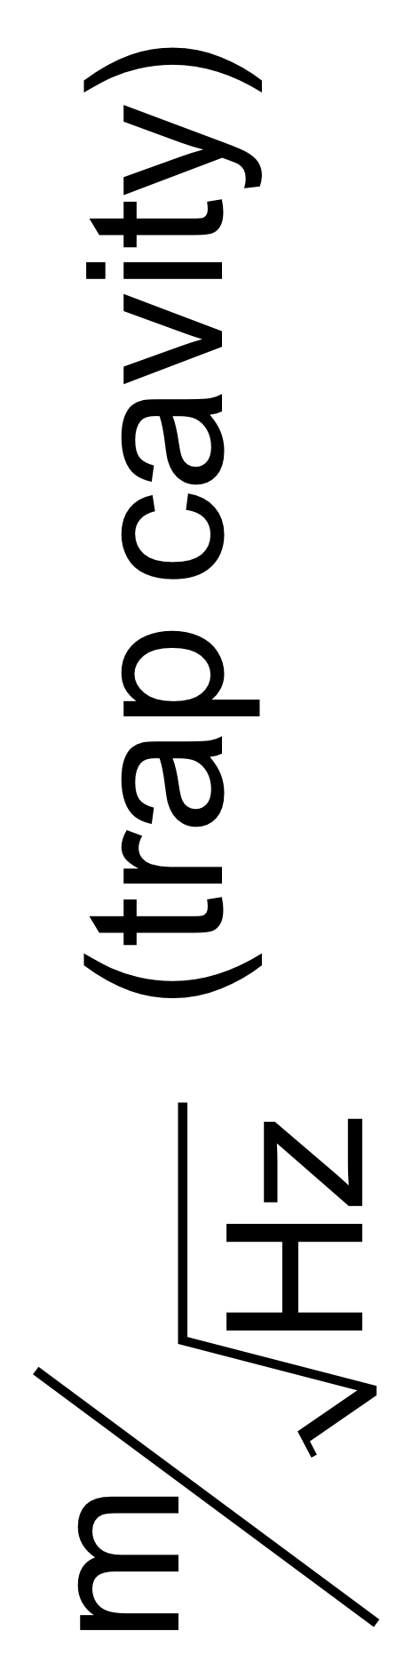
Optical Trap for Angular
Degree of Freedom
David Kelley, James Lough, Antonio Perreca, and Stefan Ballmer
Syracuse University
Abstract
The LIGO detectors are held in lock and alignment using optical error signals and magnetic actuation on the test masses. Angular control is limited by sensing noise in the feedback loops. It is possible to keep cavities locked passively using optical springs (optical traps). This will eliminate active angular controls and the associated sensing noise. We are studying the feasibility of an optical trap to stabilize a mirror in the length and angular degrees of freedom. The trap can also become a testbed to study quantum mechanics on macroscopic objects. We are currently installing and commissioning the optical trap cavity and placing some of the final optics leading to the experiment.
The radiation force on a cavity mirror is greatest when the laser is resonant in the cavity.
  In a blue-detuned cavity (cavity longer than resonance) we get a restoring force (statically stable optical spring).
  In a red-detuned cavity (cavity shorter than resonance) we get an anti-restoring force (statically unstable optical spring).
Theory
Experimental Layout
The delay due to the light storage time of the cavity results in a complex spring constant, where the imaginary part has the opposite sign of the real part. We can build a statically and dynamically stable optical spring by using two laser fields - a blue-detuned carrier and a red-detuned sub-carrier. [Corbitt et. al. Phys. Rev. Lett. 98, 150802 (2007)]
We will prepare both of the carrier-subcarrier pairs using a Mach-Zehnder interferometer. The stabilized laser beam is split into two paths. Each path is frequency shifted by different amounts and then recombined before entering the trap cavity.
Fig 1: In a blue-detuned cavity we get a restoring force, but with a delay that results in dynamic instability.
Fig 2: With a blue- and a red-detuned laser field a statically and dynamically stable optical spring can be achieved.
Fig 3: Optical Setup for 1-D Trapping. A Mach-Zehnder interferometer is used to process the individual beams.
Angular Trap
Digital Control System
The angular trap uses two different beam spots on the small mirror to control two degrees of freedom. Our setup will consist of a large composite mirror and a small mirror, each with a 5 cm radius of curvature. They will be placed about 7.5 cm apart.
We have assembled an Advanced-LIGO style real-time digital control system capable of running at a sampling frequency of 65536Hz. Its main purpose is controlling the two optics suspensions, hence we currently operate at 2048Hz .In addition the system will be used for lock acquisition and other aspects of the experiment.
The hardware consists of a four-core computer, 32 input channels on one PCI-e ADC card, 24 output channels on two PCI-x DAC cards, and a digital I/O card in an initial LIGO PCI-x expansion chassis. In addition we built in-house analog anti-imaging, anti-aliasing, whitening and de-whitening filters. Installing the LIGO real-time code required modifying a clone of an installed aLIGO front-end system, a process that we would like to see simplified.
Fig 4: Approximate beam powers and positions in final angular trap.
Fig 5: Small mirror suspension design.
Trap Cavity Suspension Construction
In addition to controlling our experiment, we plan to use this system to test and prototype Advanced LIGO frontend code.
The large mirror suspension (shown at left) holds a 0.5 inch optic inside a 300 gram aluminum ring. This ring is supported by tungsten wire from a lightly modified LIGO SOS design. The disc can be damped with initial LIGO Optical Sensing Electro-Magnets (OSEMs).
Differential Receiver
PCI-x Expansion
Lab
Coil Drivers
Binary
I/O
Satellite Amplifiers
I/O Chassis
DAC adapter
DAC
Lab
ADC adapter
Timing Distribution
The small (0.3 inch) mirror (shown at right) is suspended by three glass fibers. The fibers are welded directly to the optic and rods used for pulling are clamped to a stainless steel ring. The ring is suspended in the same manner as the large mirror.
OSEMS
Boot Computer
Front End Computer
Workstation Computer
ADC
GPS Receiver
65,536 Hz Function Generator
Fig 7: Small mirror ring prototype. The picture was taken after two fibers broke during mounting.
Fig 9: Syracuse University Digital control rack: from top to bottom it contains a front end computer, a boot server, the PXI-x expansion chassis, the in-house analog filter box, a GPS-locked clock and a UPS.
This ring suspension allows us to position the small mirror precisely with an SOS, but leaves it unconstrained above its resonant frequency, allowing the optical trap to control the mirror position and angle.
Fig 10: Digital control system layout, describing the signal flow for digital suspension control. The system is GPS synchronized. The system can also handle additional I/O tasks in the lab (orange boxes).
Fig 6: Large mirror ring suspended in an SOS.
The seismic noise is based on measured table motion, and filtered by double and triple pendulums for the large and small trap mirrors. The quantum and intensity noise are calculated with Optickle, using the expected performance of the intensity stabilization servo. The dominant noise source is the epoxy used in the FSS reference cavity.
The VCO noise would dominate the noise spectrum, but it is only needed for the commissioning of the trap.
Conclusion
We are approaching the first trapping cavity lock. We have prototyped and are currently building a monolithic glass suspension for the small mirror. The large mirror suspension is complete and we have a functional advanced LIGO digital suspension control system. We also have a frequency, intensity and spatially stabilized laser.
We would like to thank Steve Penn for his help with glass fibers and the LIGO lab for loaning us hardware for the digital system. We would also like to thank our group members at Syracuse University for their input and technical support.
Hz
Fig 8: Noise Budget for the optical trap
This work was supported by NSF grant PHY-0854812 and PHY-1068809
Syracuse University Gravitational-Wave Group
website: www.gravity.phy.syr.edu
LIGO-G1300212-v1

