Slide 1
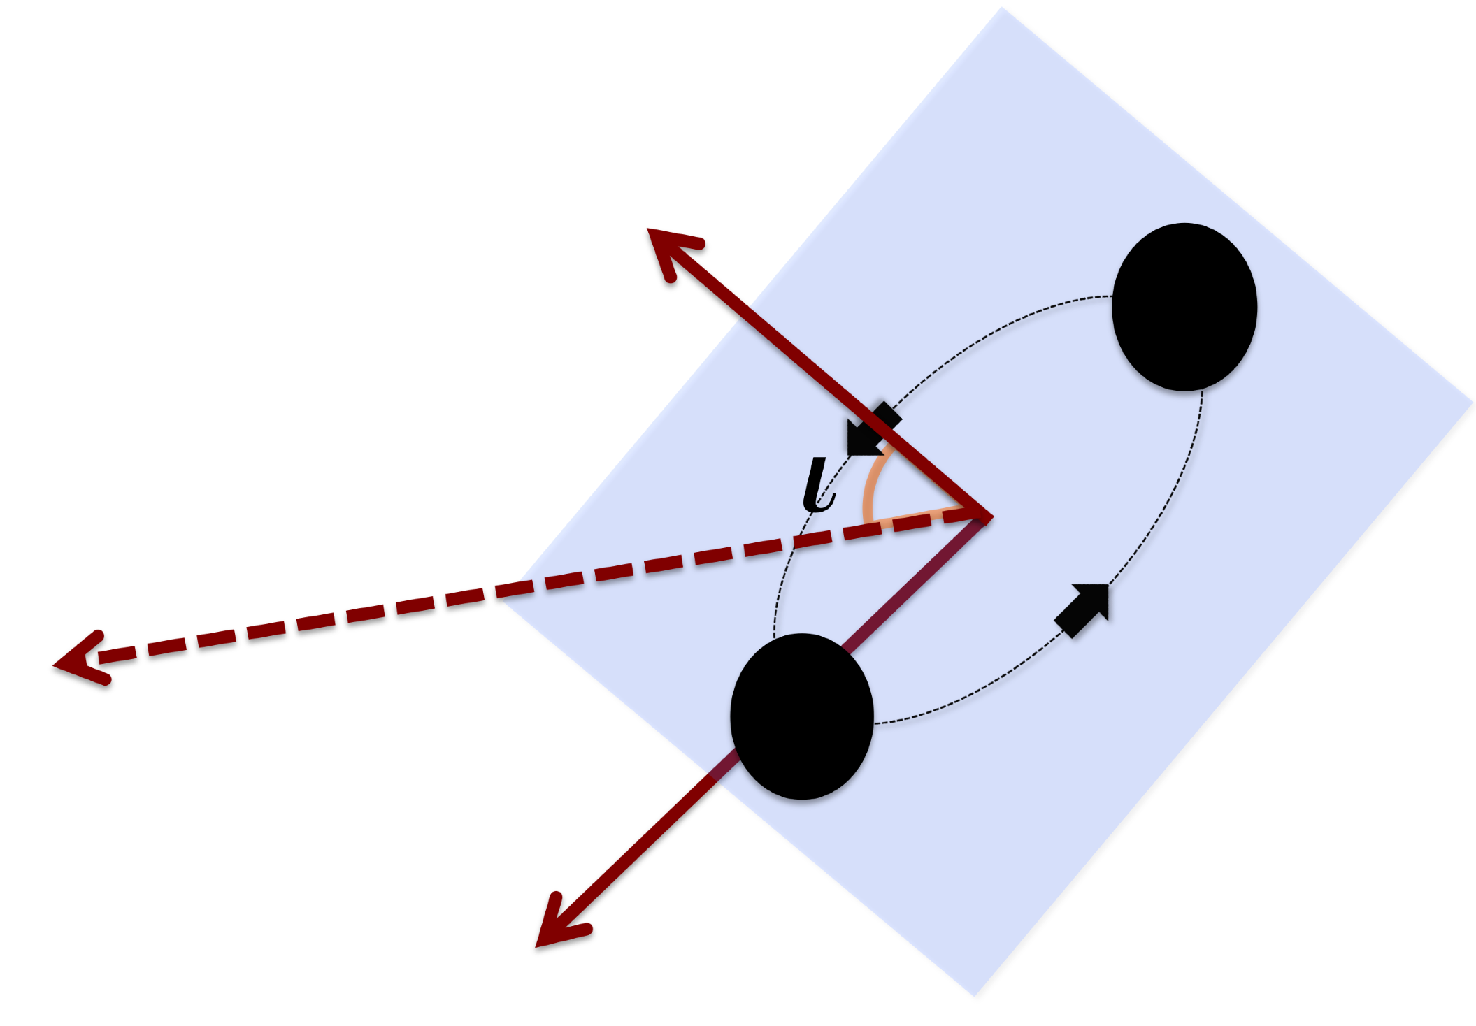
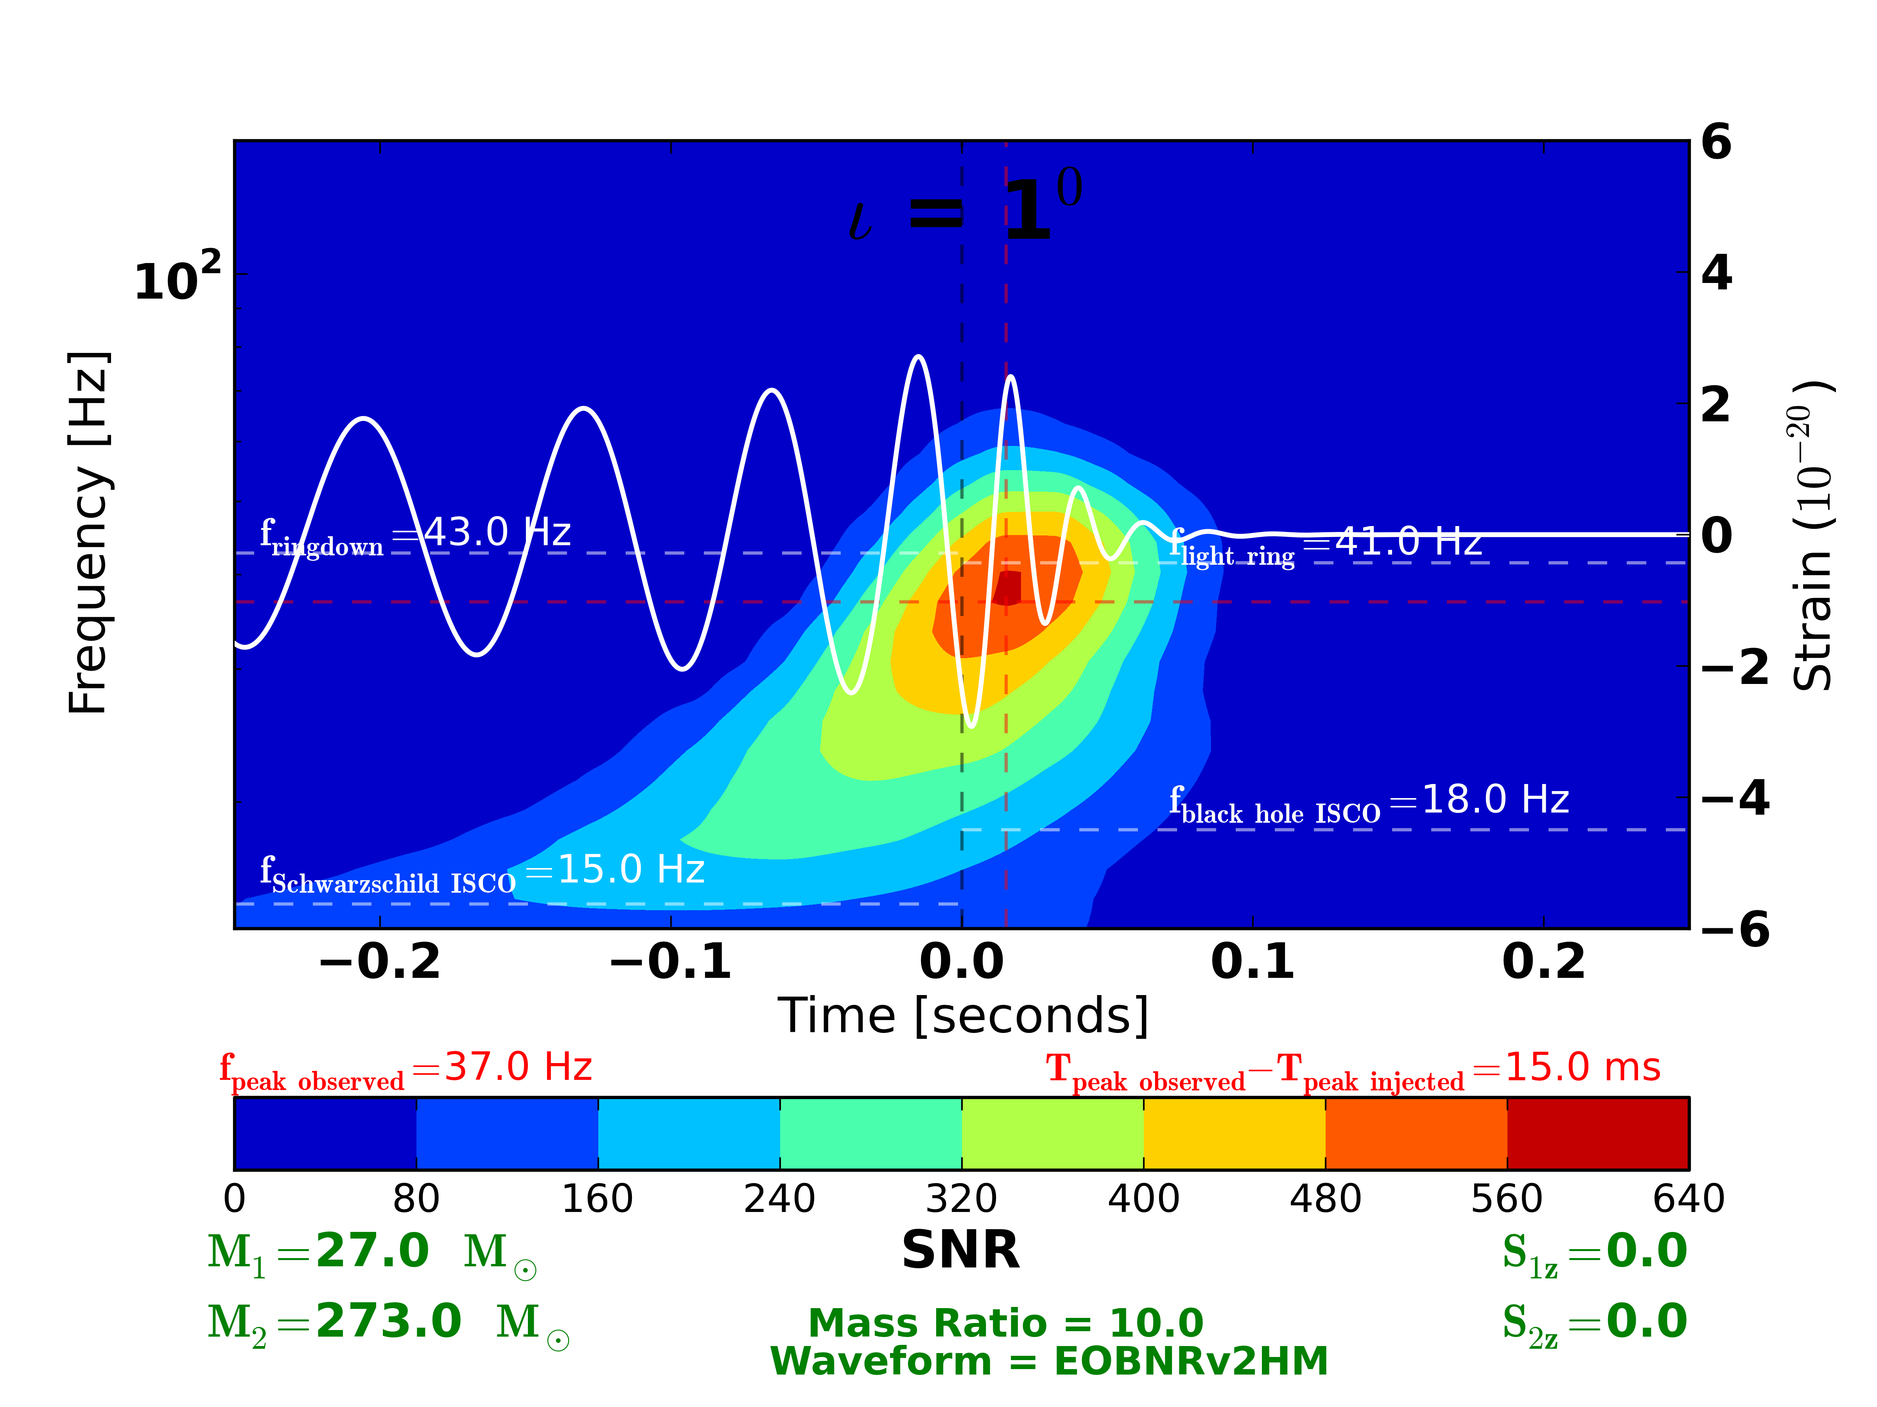
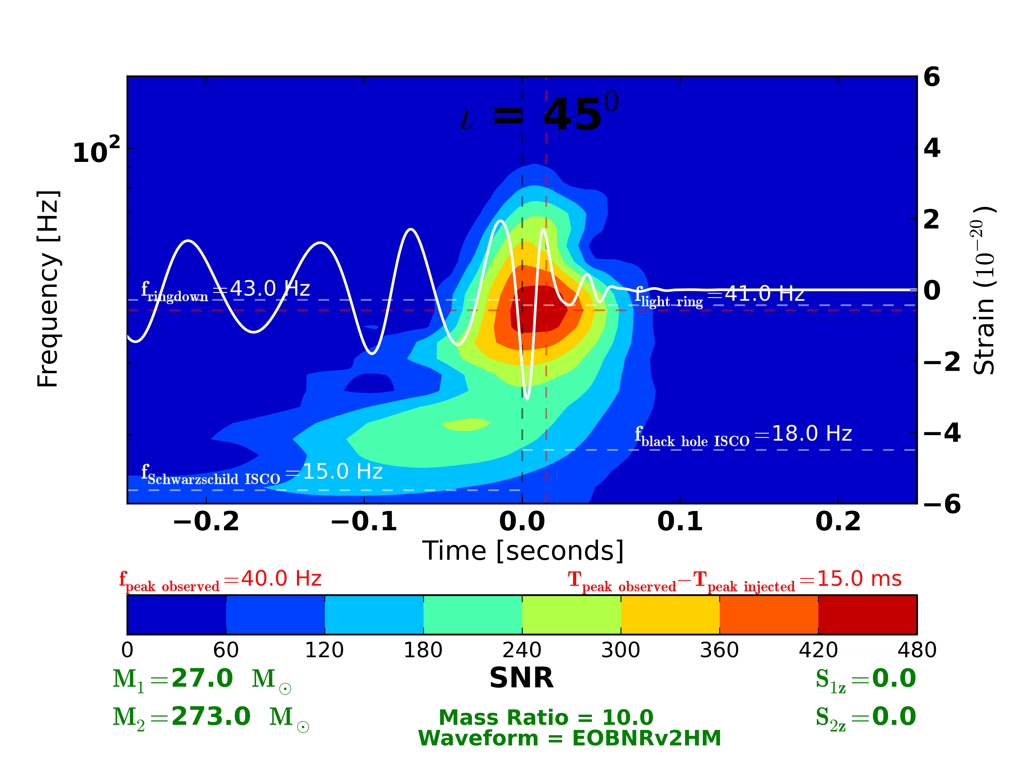
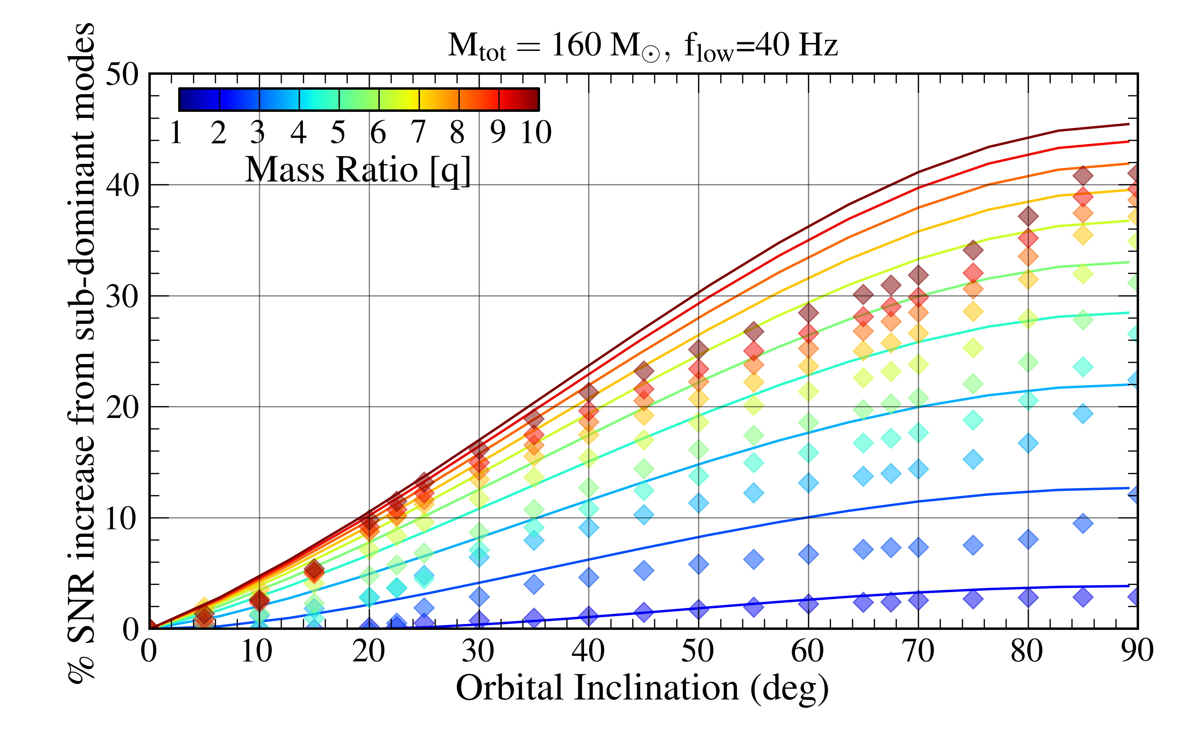
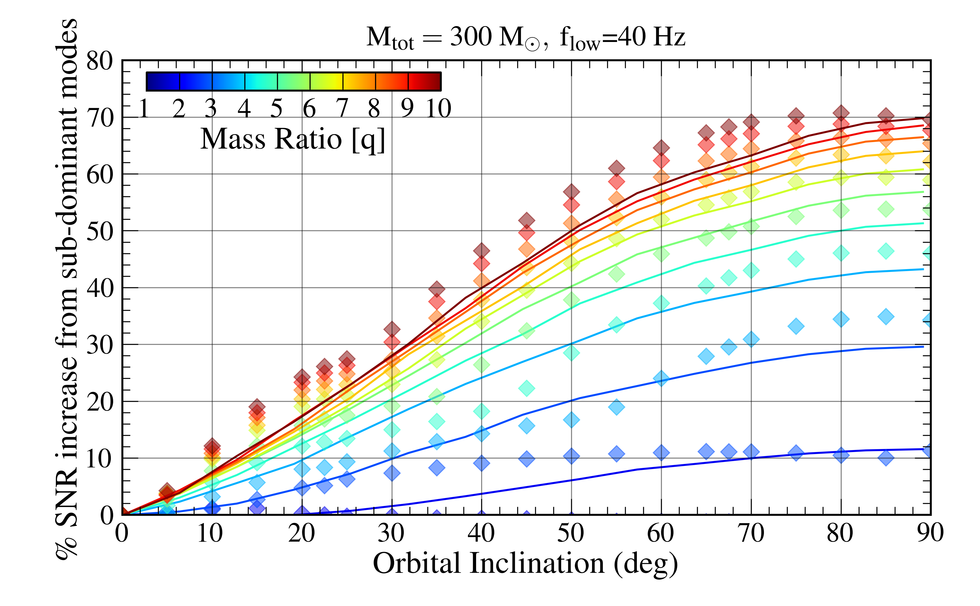
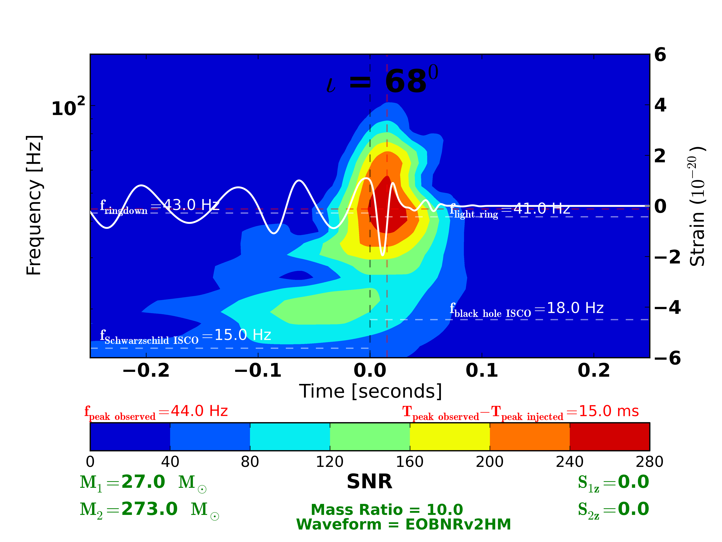
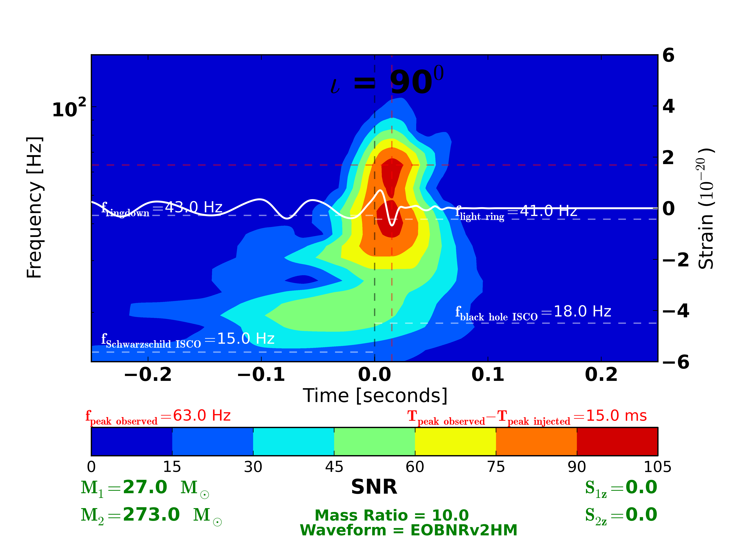
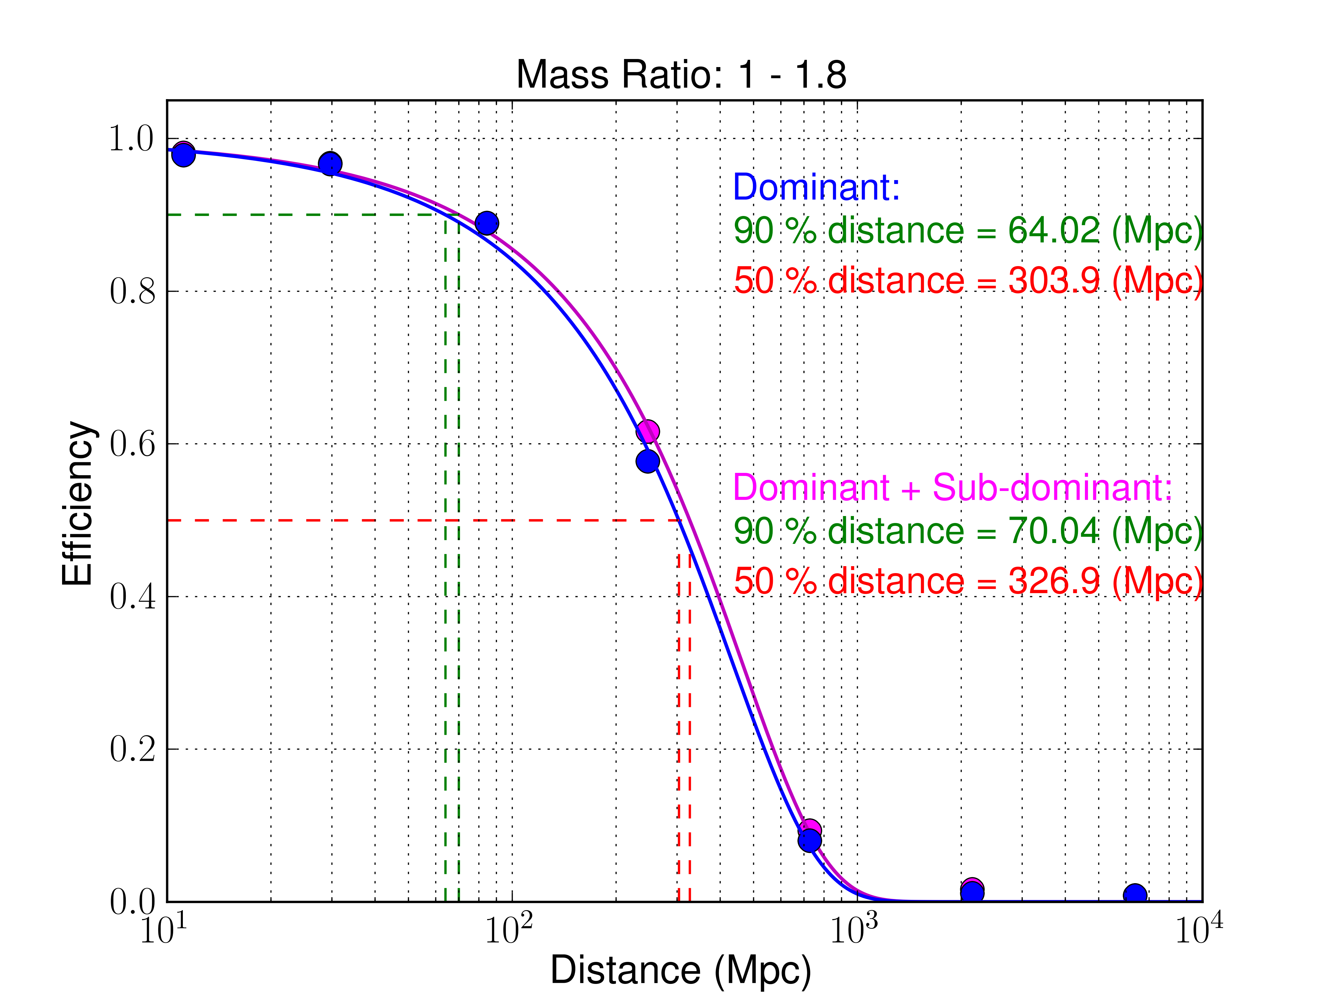
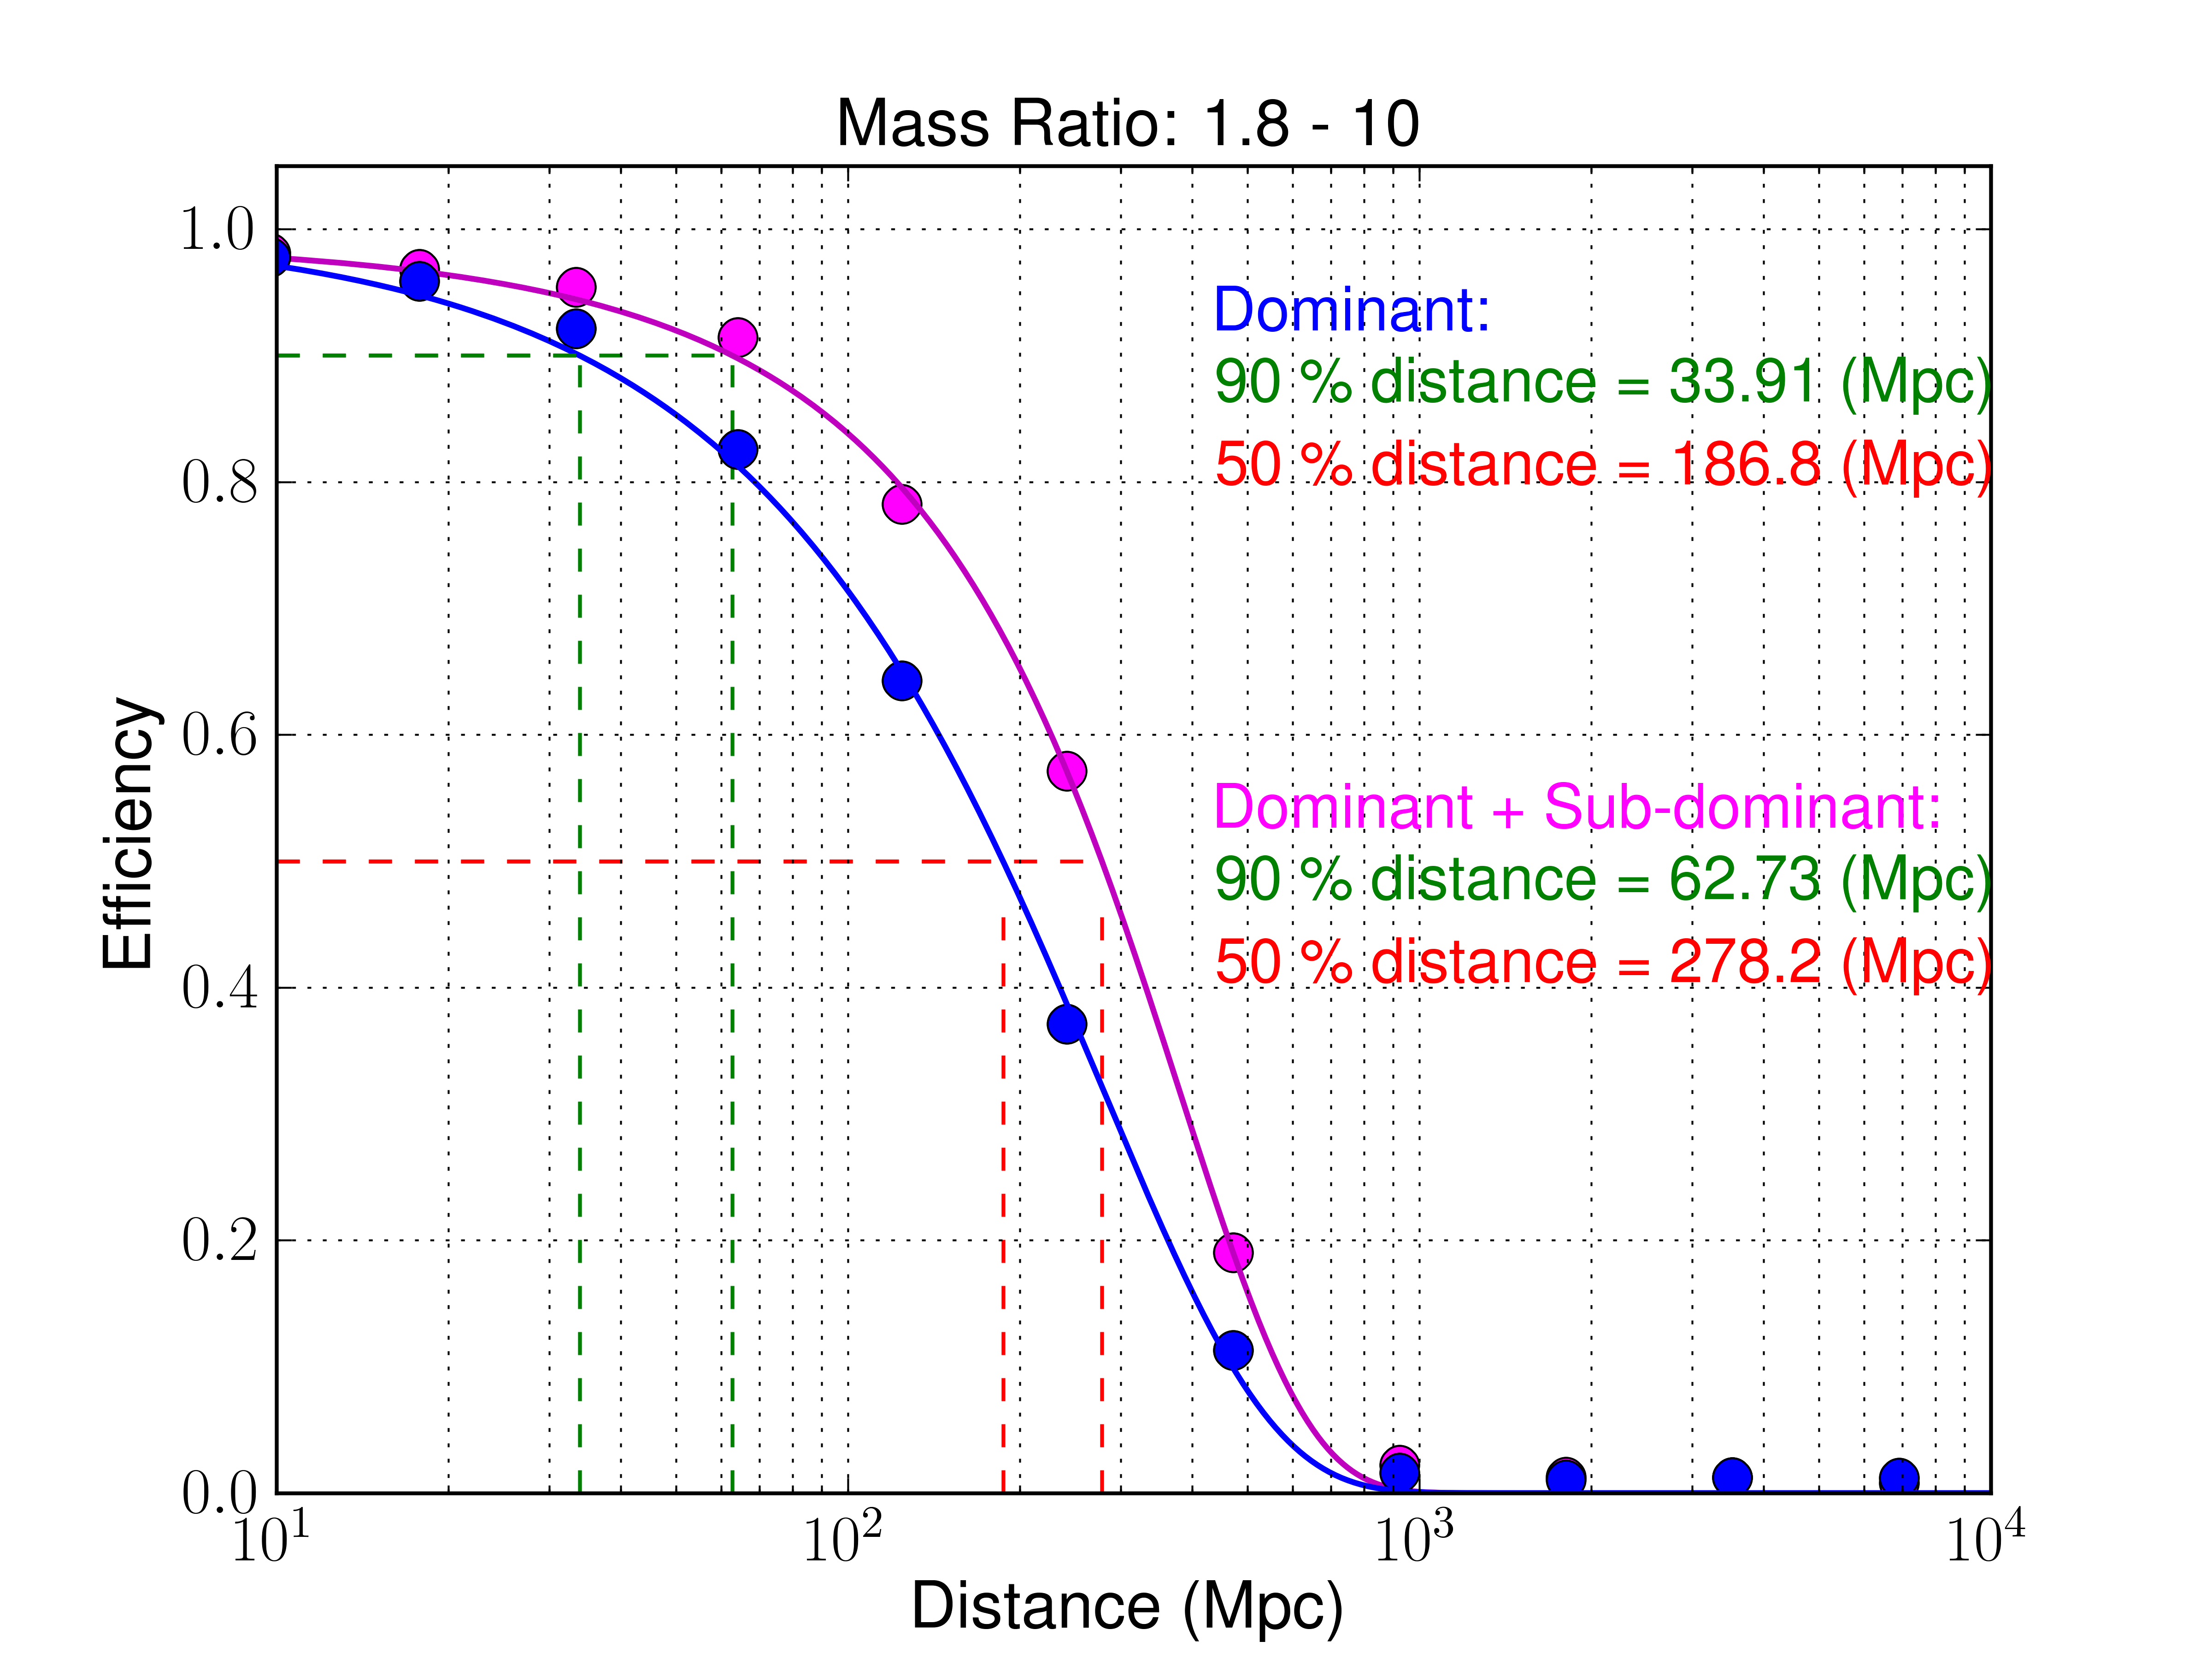
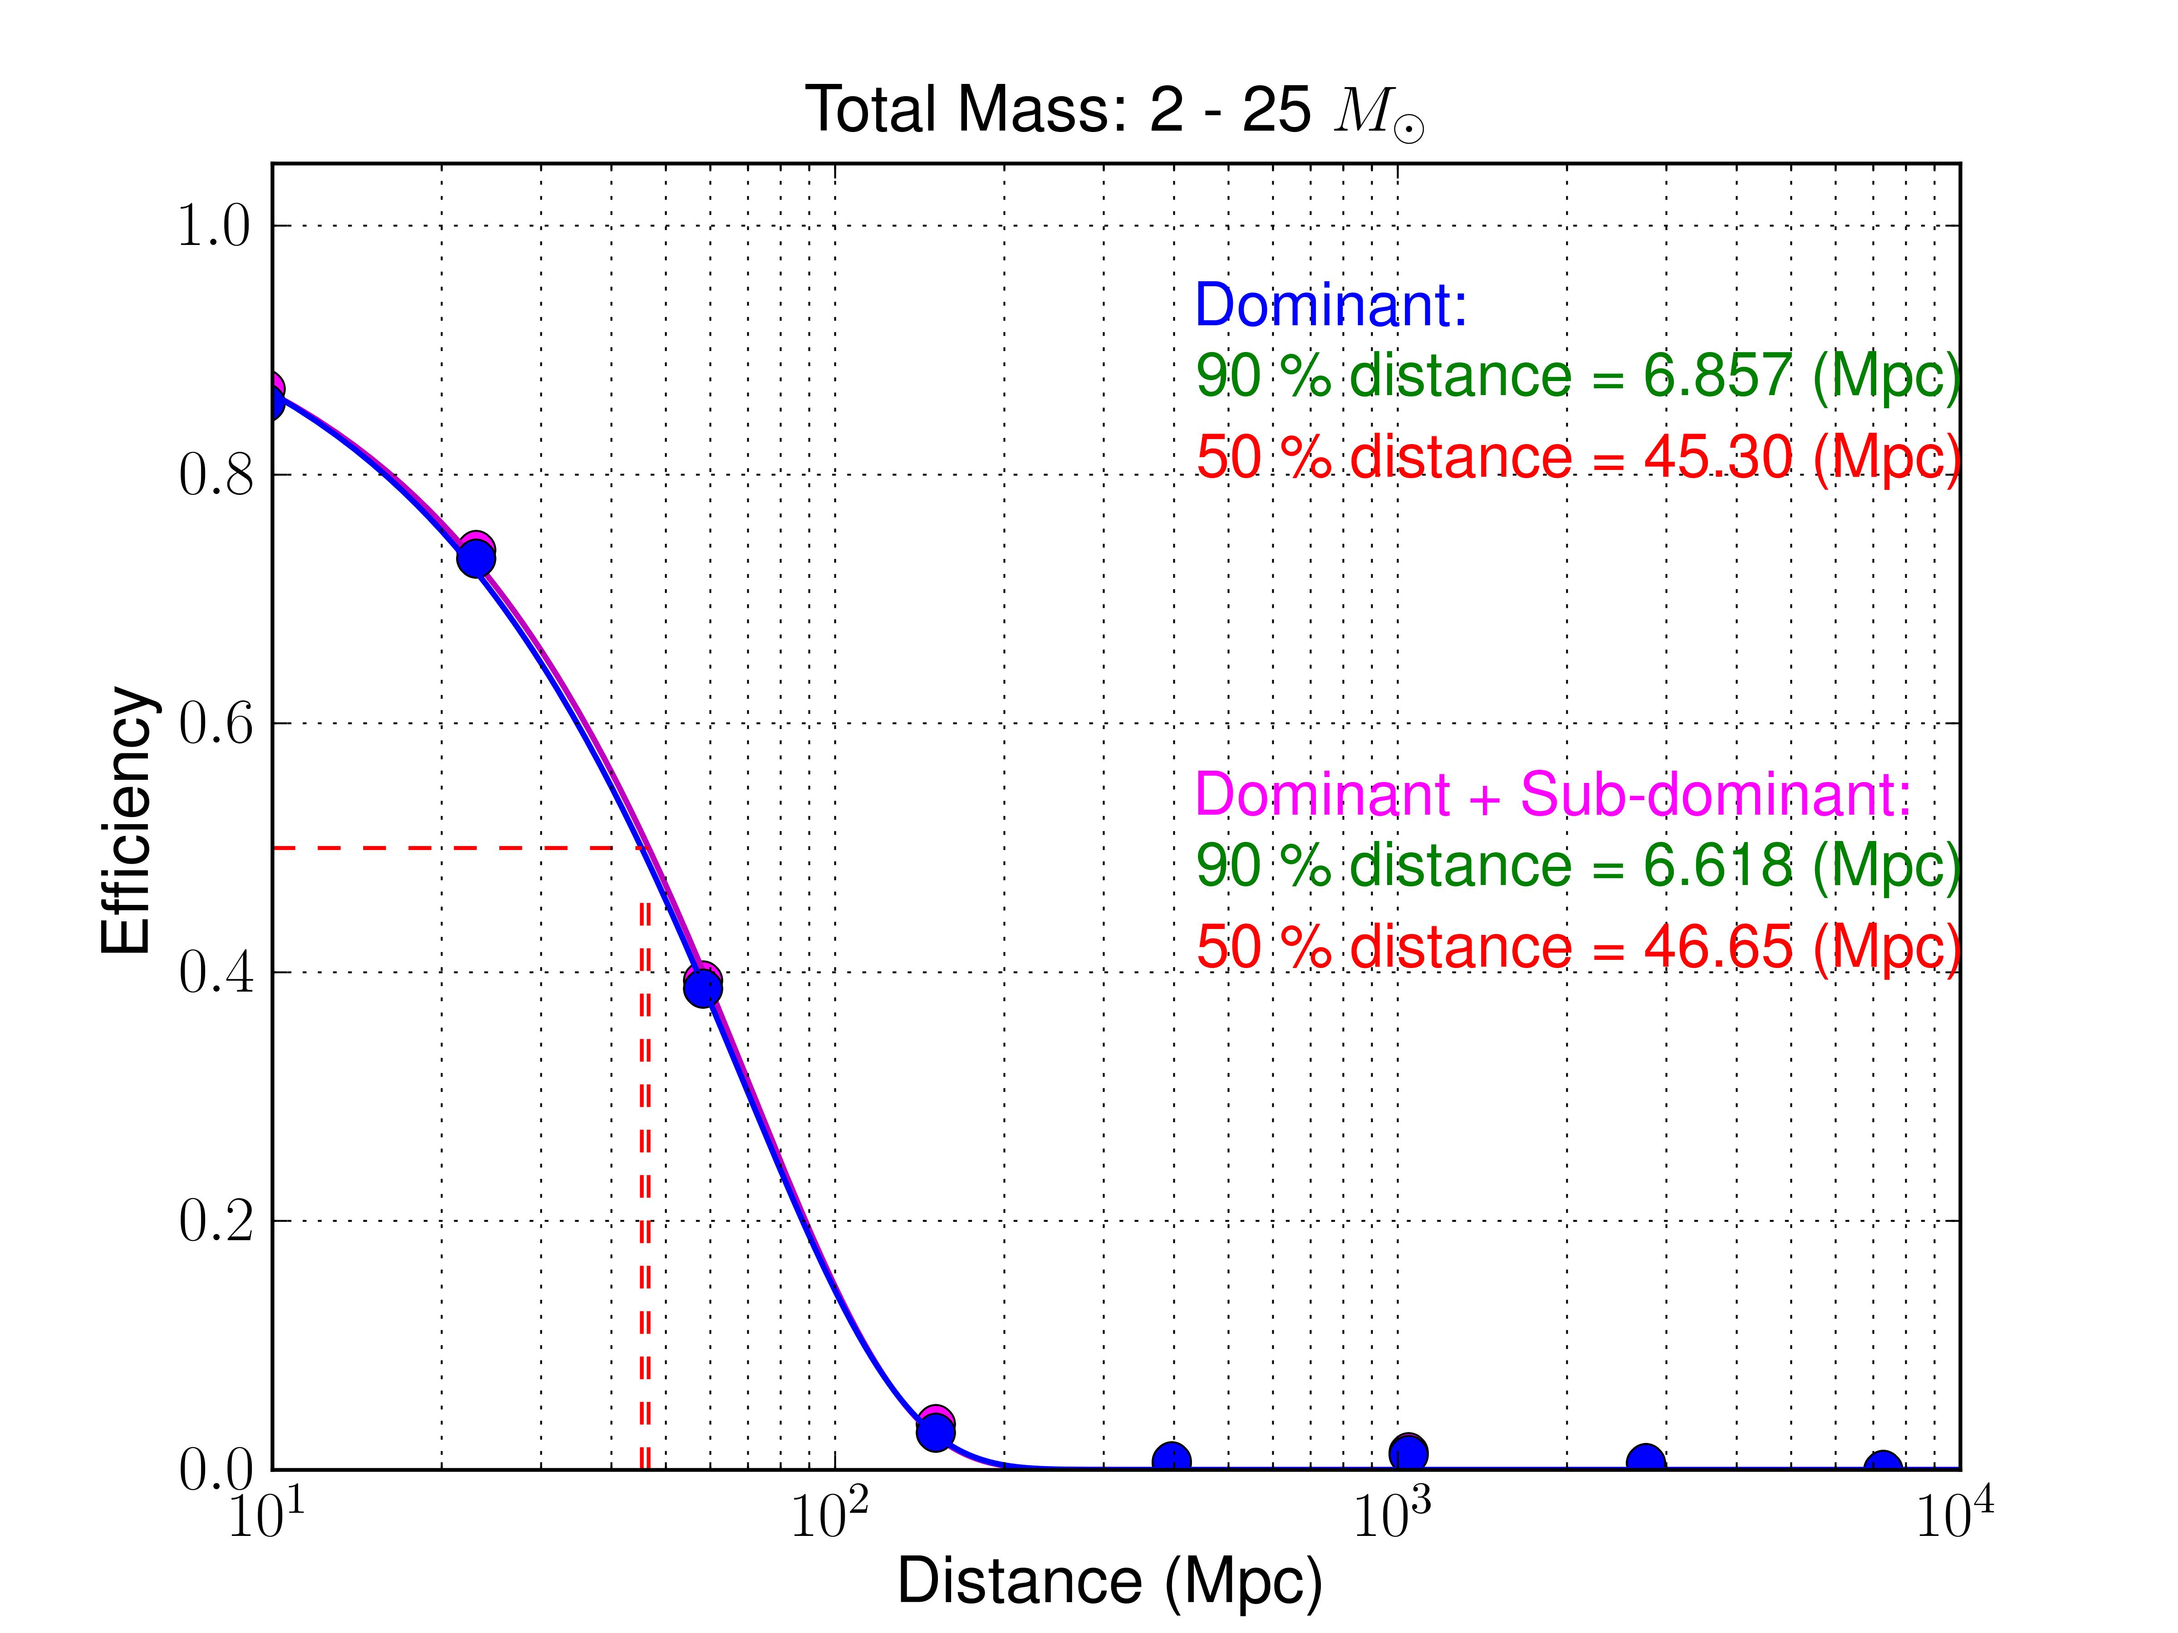
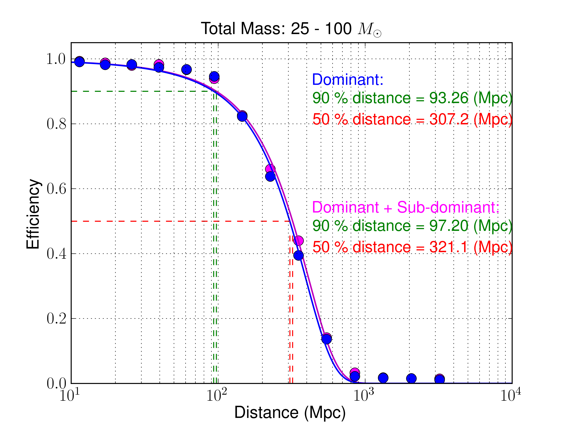
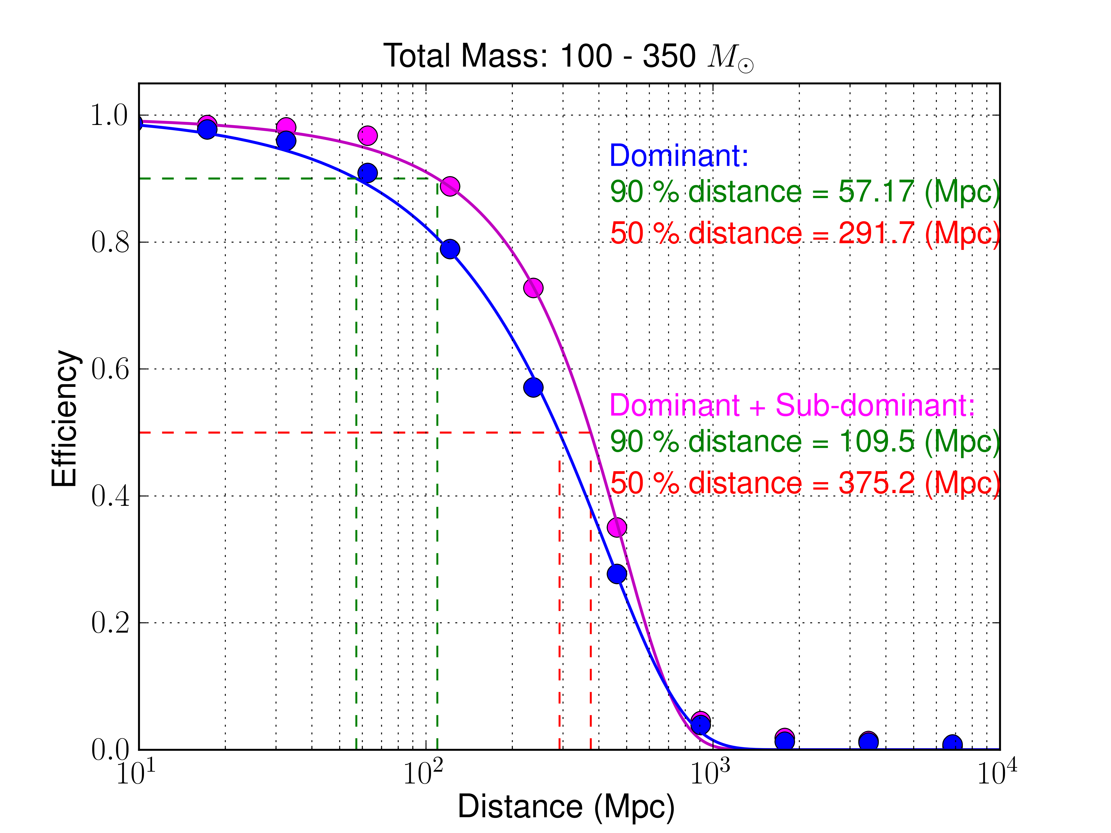
Effect of the inclusion of sub-dominant modes of gravitational-waves emitted from binary black hole mergers - measured by a gravitational-wave burst search algorithm
Amaldi 10
Warszawa 2013
GR 20
Satya Mohapatra§, James Clark¶, Laura Cadonati¶
§Rochester Institute of Technology (USA), §Syracuse University (USA), ¶University of Massachusetts – Amherst (USA)
Sub-Dominant Modes of Binary Black Hole Merger Signal
Inclination angle (ι) is the angle between the line of sight and the orbital angular momentum of a binary black hole system. In this diagram, examples are shown of observation made at different inclination angles.
Gravitational waves are expressed in the basis of spin weighted spherical harmonics, ^{s}Y_{lm} , with spin weight s = -2.
For the gravitational wave from the merger a binary black hole, the dominant contributions come from the modes: (l, m): (2 ± 2).
Until now gravitational-wave searches, have only utilized the dominant modes for the full Inspiral-Merger-Ringdown waveform model, such as the Effective One Body tuned to Numerical Relativity (EOBNRv2 - Buonanno et al. 2009) waveform.
Recently an analytical model extension of EOBNRv2 with the inclusion sub-dominant modes (up to l = 5) has become available – EOBNRv2HM (Pan et al. 2012).
Sub-dominant modes contribute towards the luminosity of the emitted gravitational wave – hence a gravitational-wave burst search can be sensitive to the inclusion of sub-dominant modes in addition to the dominant modes.
In this poster we show the effect of the inclusion of sub-dominant modes in addition to the dominant modes in a gravitational-wave burst search for binary black holes. We utilize a burst search which uses sine-Gaussian basis to filter and then finds statistically significant excess energy in the time-frequency representation of the strain data.
(l, m): (2 ± 2) : Dominant Modes
Other Modes: Sub-dominant Modes
face-on
EOBNRv2HM analytical waveform added to Gaussian noise colored to the advanced LIGO zero detuned high power (ZDHP) target design sensitivity.
Time-frequency scans in sine-Gaussian basis, super-imposed with the gravitational-wave strain from a binary black hole merger with both dominant and sub-dominant modes.
Inclination Angle and Mass Asymmetry
edge-on
Scatter points: peak SNR difference
Solid lines: matched filtering SNR difference
The amplitude of gravitational-wave strain is maximum when observed at the face-on direction . The strain amplitude decreases as the point of observation moves towards the edge-on direction.
Examples of peak SNR difference (scatter points), measured by the above mentioned burst search, between binary black hole merger gravitational-wave signal with dominant modes only and signal with both dominant modes and sub-dominant modes, added to the 5th Science run of LIGO Hanford (H1) noise, at different inclination angles.
The inclusion of sub-dominant modes in the signal brings additional modulation in the strain. This effect is visible on the time-frequency profile as measured by a burst search. The measured peak frequency by a burst search is pushed up to a higher value at the edge-on orientation compared to the face-on orientation.
Detection Efficiency: Mass Ratio
Measured detection efficiency (estimated by counting missed and found signals at a distance), averaged over inclination angle and total mass, of a burst search with simulation that includes sub-dominant modes compared with signal that includes dominant modes only. 2 months of the 5th science run of LIGO Hanford (H1) noise is used. A single detector SNR threshold of 5.5 is the criterion for found signal in this study.
Implications
The contributions from the sub-dominant modes increase with the inclination angle. No effect of the sub-dominant modes measured at the face-on direction.
The maximum contribution as measured by a burst search need not occur right at the edge-on but near the edge-on direction.
For asymmetric mass binary black hole system, sub-dominant modes are more important than symmetric mass binary black hole system.
Sub-dominant mode effect is negligible for stellar mass binary black holes. But it is important for intermediate mass binary black holes measured in a burst search.
Any burst search upper limits drawn on dominant mode models are possibly under estimated.
Time frequency properties measured by a burst search change with the inclusion of the sub-dominant modes. Measured signal energy is pushed up to higher frequency when observed away from the face-on orientation.
Detection Efficiency: Total Mass
Measured detection efficiency for the above set of signals but averaged over mass ratios and inclination angles.
LIGO DCC G1300130

