Slide 1
Friendly Power Shutdown for LLO Corner Buildings
There are two kinds of power shutdowns: Friendly, meaning we planned it, and Unfriendly, meaning the universe burped. This procedure is intended to identify Friendly power shutdown procedures. Initially, it is incomplete because eventually each subsystem using DC power must provide a procedure for that specific subsystem.

Slide 2
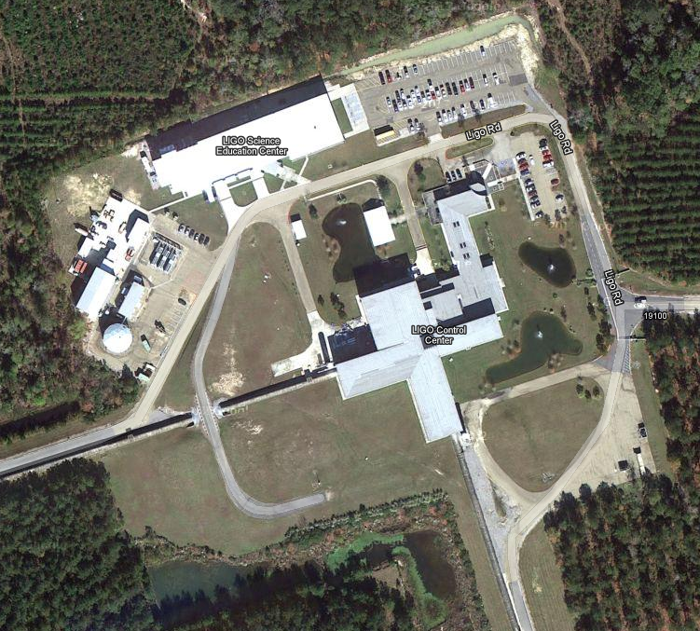
Power Shutdown Locations
LDAS Air Conditioners
Staging Building Air Conditioners
SEC MAINS Disconnect
Mechanical (Chiller) Building MAINS Disconnect
CDS DC Power Supply Transformer Disconnect
Control Room Automation Computer
Maintenance Room MAINS Disconnect

Slide 3
Mechanical (Chiller) Building Power Shutdown
<< Locations
1. Shut down the bake ovens in the VPW.
2. Shut down the LDAS computers.
3. Shut down the three air conditioners for the Staging Building.
4. Shut down the three air conditioners for the LDAS room.
5. Turn off the Chillers using the Automation Computer in the Control Room.
6. De-energize the MAINS in the Mechanical Building.
These MAINS in the Mechanical Building control power to:
The Mechanical Building
The Vacuum Processing Warehouse (VPW)
The Staging Building including:
The High Bay
The Offices
The LDAS Room
HPLF
The Banquet Room
The House Trailer

Slide 4
Mechanical (Chiller) Building Power Startup
<< Locations
1. Energize the MAINS in the Mechanical (Chiller) Building.
2. Turn on the Chillers using the Automation Computer in the Control Room.
3. Start up the air conditioners for the LDAS room.
4. Start up the air conditioners for the Staging Building.
5. Start up the LDAS computers.
6. Start up the bake ovens in the VPW.

Slide 5
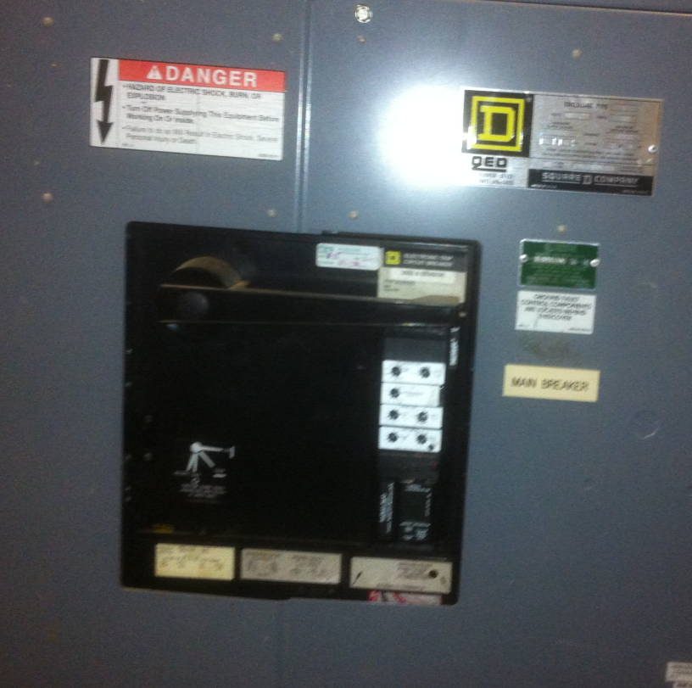
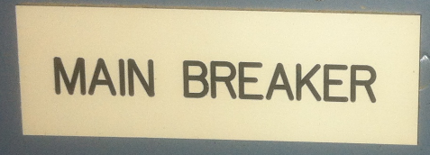
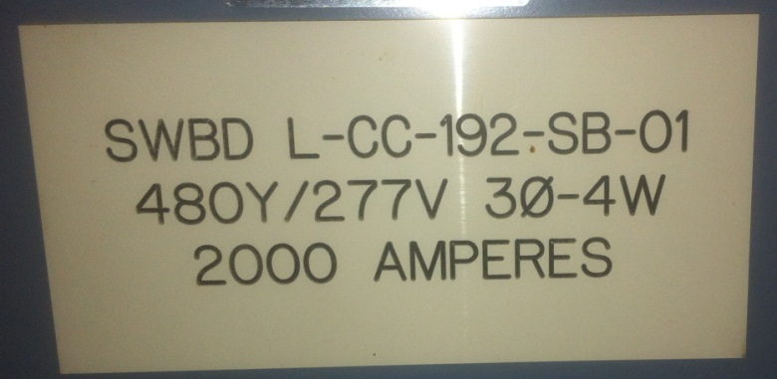
Mechanical (Chiller) Building MAINS Disconnect
<< Locations

Slide 6
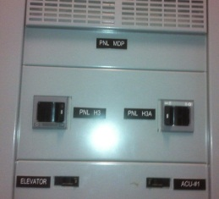
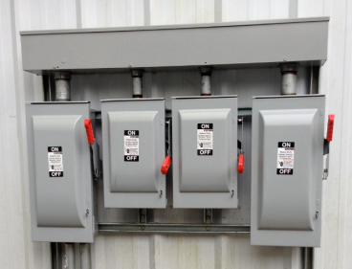
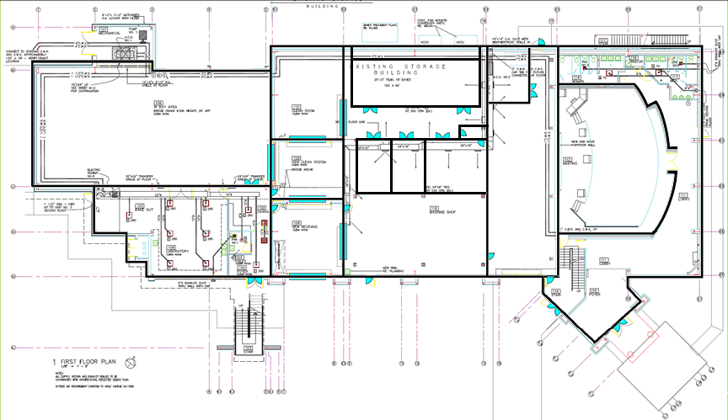
Staging Building Air Conditioners
<< Locations
<< Shutdown Instructions
<< Startup Instructions
Air Conditioner #1 is inside, in Panel PNL MDP, Circuit ACU #1
Air Conditioners #2 and #3 is outside, near the air conditioners.

Slide 7
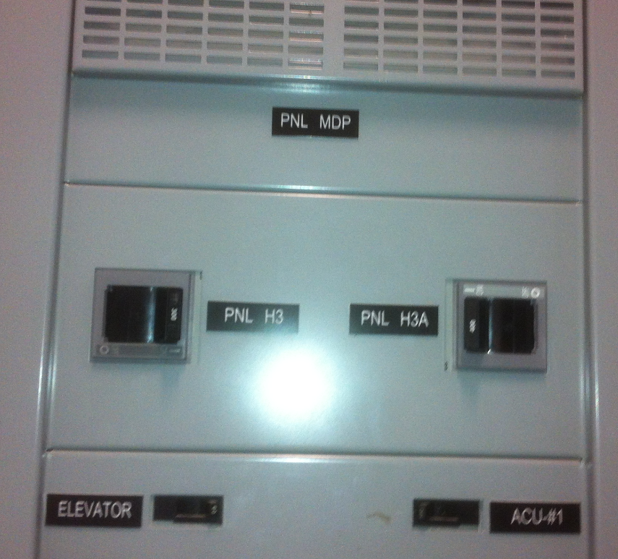
Staging Building Air Conditioner 1 Disconnect
<< Staging Building Locations
<< Shutdown Instructions
<< Startup Instructions
AC #1 – Use BREAKER to shut off.

Slide 8
Staging Building Air Conditioners 2 and 3 Disconnects
<< Staging Building Locations
<< Shutdown Instructions
<< Startup Instructions
AC #2 – Use DISCONNECT to shut off.
AC #3 – Use DISCONNECT to shut off.

Slide 9
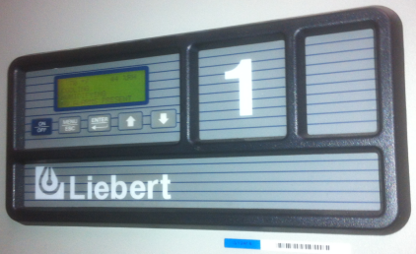
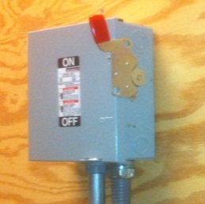
LDAS Air Conditioners
<< Locations
<< Shutdown Instructions
<< Startup Instructions

Slide 10
LDAS Air Conditioning Shutdown
<< LDAS Air Conditioners
LDAS Air Conditioners
AC #1 – Use CONTROLS to shut down.
AC #2 – De-energize with disconnect switch.
AC #3 – Use CONTROLS to shut down.

Slide 11
LDAS Air Conditioning Startup
<< LDAS Air Conditioners
LDAS Air Conditioners
AC #1 – Use CONTROLS to start up.
AC #2 – Energize with disconnect switch.
AC #3 – Use CONTROLS to start up.

Slide 12
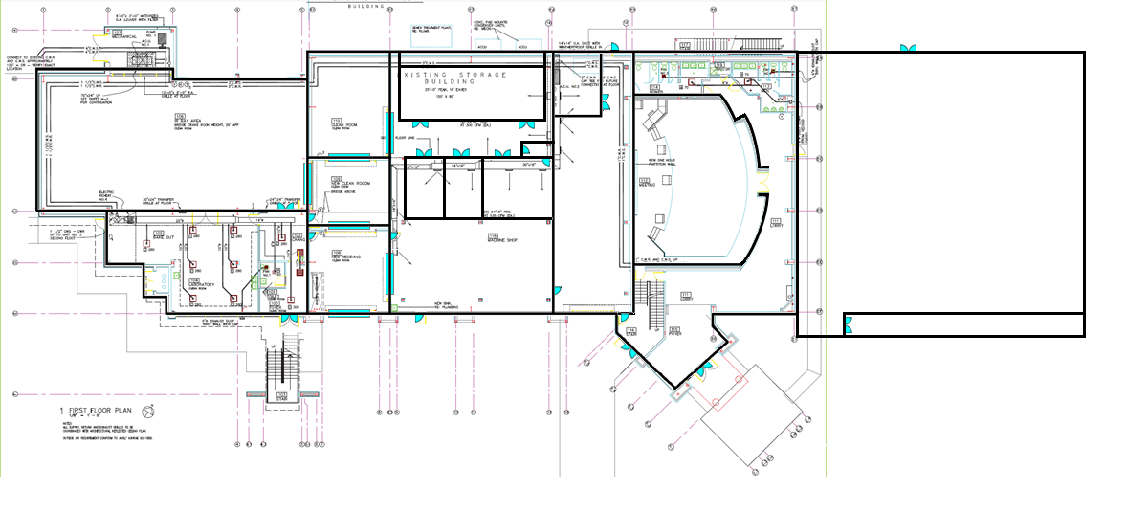
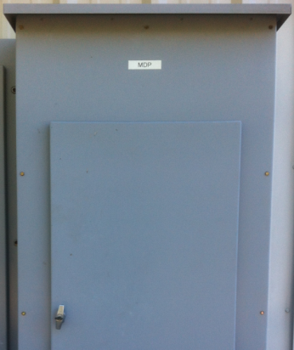
SEC MAINS Location
<< Locations
<< Shutdown Instructions
<< Startup Instructions
SEC MAINS Disconnects

Slide 13
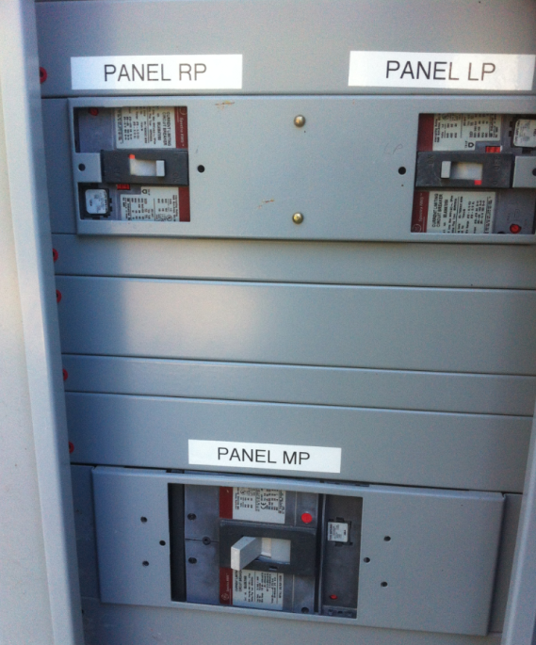
SEC MAINS Disconnects
<< SEC MAINS Location
<< Shutdown Instructions
<< Startup Instructions

Slide 14
SEC MAINS Power Shutdown
<< SEC MAINS Disconnects
1. Turn off power to the LP Panel .
2. Turn off power to the RP Panel .
3. Turn off power to the MP Panel .

Slide 15
SEC MAINS Power Startup
<< SEC MAINS Disconnects
1. Turn on power to the LP Panel .
2. Turn on power to the RP Panel .
3. Turn on power to the MP Panel .

Slide 16
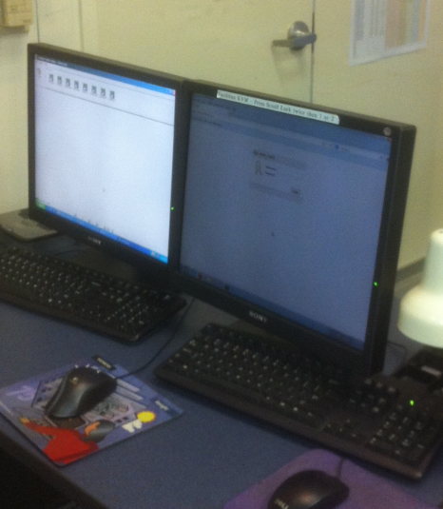
Automation System Computer in the Control Room
<< Locations

Slide 17
Maintenance Room Power Shutdown
<< Locations
1. Ramp down and turn off the LVEA fans using the Automation Computer in the Control Room.
2. Turn off air handler 4 using the Automation Computer in the Control Room.
3. De-energize the DC Transformer breaker switch.
4. De-energize the MAINS in the Maintenance Room.
5. Turn off all subsystem DC supplies. (Optional)
These MAINS in the Maintenance Room control power to:
The Office Support Building (OSB)
The Laser and Vacuum Equipment Area (LVEA)
All computers that are NOT on their own UPS systems, but note that the times for power backup vary considerably.
The Guard Shack
The DC Supplies fall into roughly three categories:
The +12VDC Supplies used for Timing Chassis
The +24VDC Supplies that power IO Extender Chassis
All the rest, which are subsystem dependent

Slide 18
Maintenance Room Power Startup
<< Locations
1. Energize the MAINS in the Maintenance Room.
2. Energize the DC Transformer breaker switch.
3. Turn on air handler 4 using the Automation Computer in the Control Room.
4. Turn on and ramp up the LVEA fans using the Automation Computer in the Control Room.
5. Turn on DC Power Supplies for each subsystem according to specific procedures for that subsystem. (Optional)

Slide 19
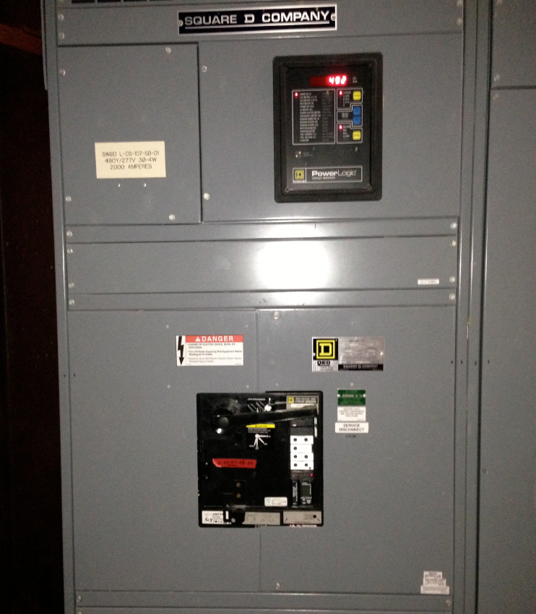
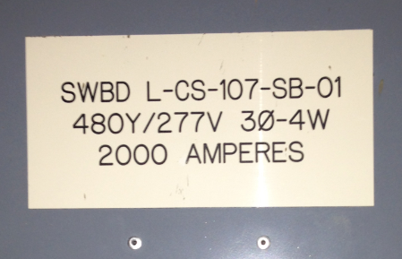
Maintenance Room MAINS Disconnect
<< Locations

Slide 20
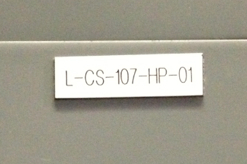
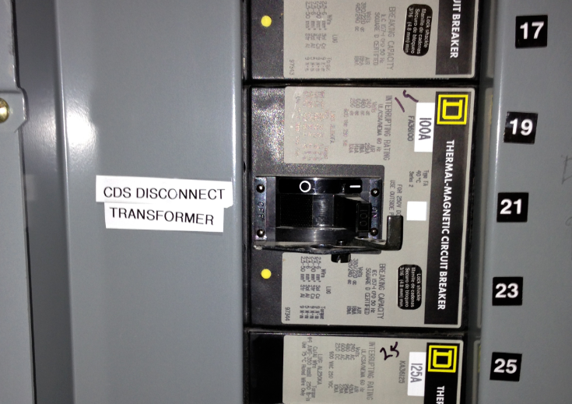
CDS DC Transformer Breaker Switch
<< Locations

Slide 21
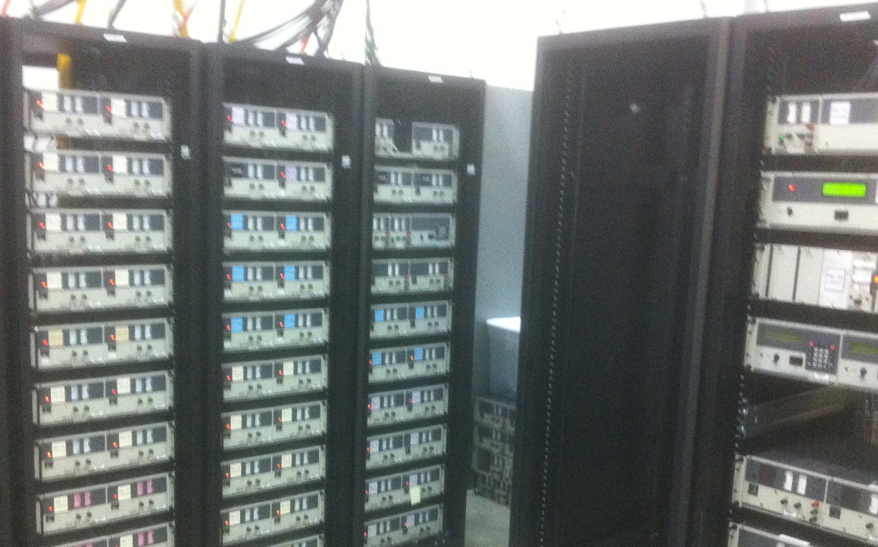
CPR - DC Power Supplies
<< Locations
ISC
PSL
SEI
SUS
TCS
DAC

