Slide 1
Quantum noise reduction using squeezed states in LIGO

Slide 2
LIGO interferometers, quantum light and quantum noise
Generation and detection of squeezing
Squeezing in Enhanced LIGO
Environmental noise couplings
Limits to the level of squeezing
Losses
Squeezing angle fluctuations
Potential benefit for Advanced LIGO and beyond

Slide 3
Michelson interferometer
Laser
Notes:
10^-18m/rtHz

Slide 4
Michelson interferometer
Laser
Notes:
10^-18m/rtHz

Slide 5
Michelson interferometer
Laser
Notes:
10^-18m/rtHz

Slide 6
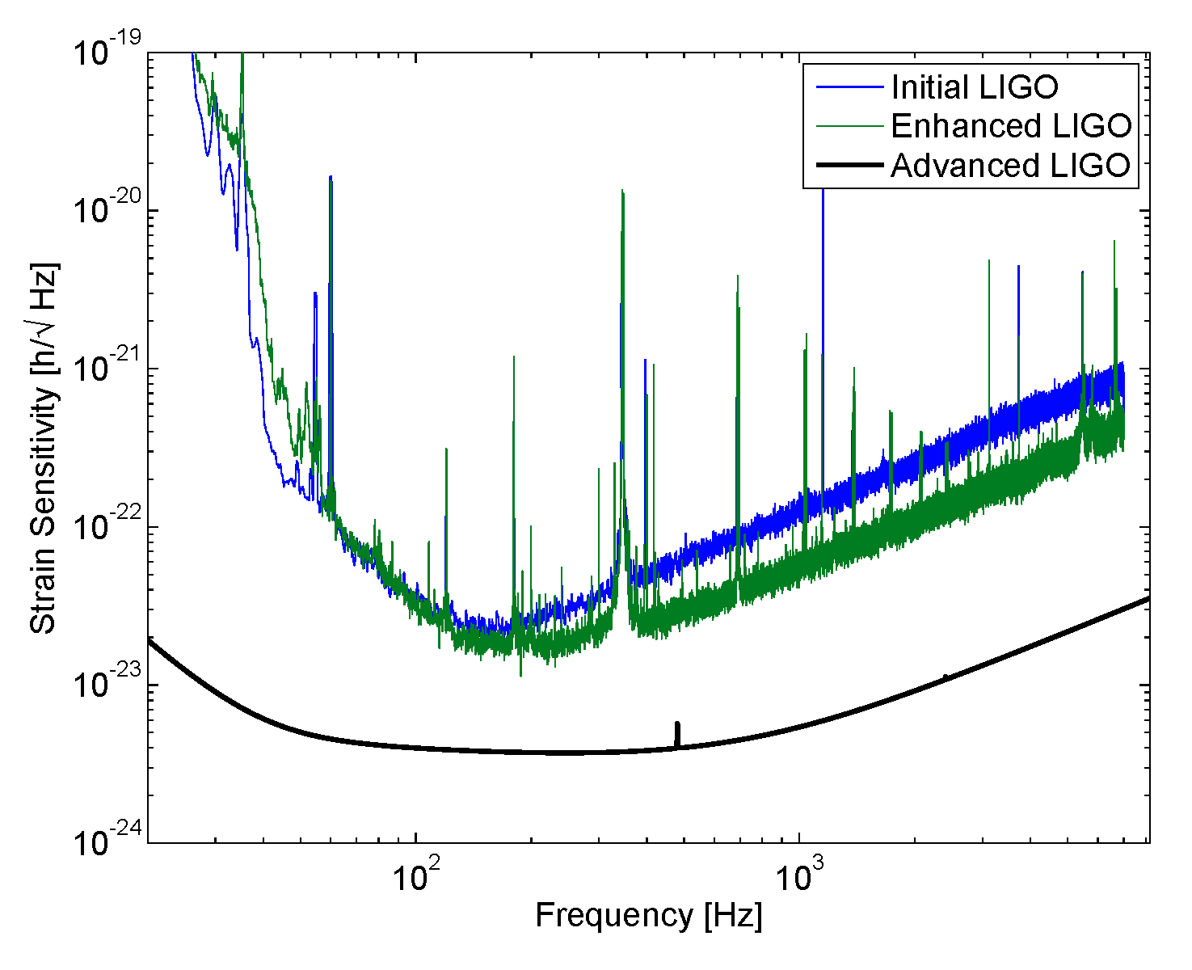
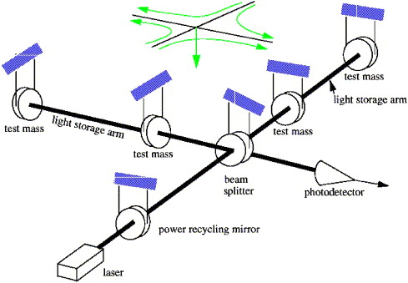
LIGO interferometers

Slide 7
Need to reduce quantum noise

Slide 8
Quantum noise in an interferometer
Radiation pressure noise:
ΔFα|E_{y}|² -|E_{x}|²
Radiation pressure noise:
ΔFαIm[E_{L} *δE_{d}]
E_{y}=E_{L}+δE_{L}+iδE_{d}
E_{y}
E_{L} +δE_{L}
E_{x}
E_{x}=iE_{L} +iδE_{L}+δE_{d}
Laser
δE_{d}
Shot noise:
δI _{PD} α Re[E_{L} *δE_{d}]
Shot noise limited sensitivity α Re[δE_{d}]/E_{L}

Slide 9
Quantum Light
X₂
∆X₂
The uncertainty principle
∆X₁ ∆X₂ ≥1
A
∆X₁
θ
X₁
9

Slide 10
Quantum Light
X₂
The uncertainty principle
∆X₁ ∆X₂ ≥1
X₁
Vacuum Fluctuations
θ_{sqz}
Squeezed vacuum
10

Slide 11
Squeezing in an interferometer
Laser

Slide 12
LIGO interferometers, quantum light and quantum noise
Generation and detection of squeezing
Squeezing in Enhanced LIGO
Environmental noise couplings
Limits to the level of squeezing
Losses
Squeezing angle fluctuations
Potential benefit for Advanced LIGO and beyond

Slide 13
Vacuum and coherent states are sums of uncorrelated sidebands
13
Notes:
This is a squeezer-
Built at MIT using design elements from ANU, AEI
Shipped piece by piece and reassembled here
OPO creates squeezing
Advanced LIGO electronics
This is where I spend most of my time!
13

Slide 14
Squeezer: Optical parametric oscillator
Classical OPO:
Phase sensitive amplifier
Quantum OPO:
Turns a vacuum state into
squeezed vacuum

Slide 15
A squeezed state is a sum of correlated sidebands
15
Notes:
This is a squeezer-
Built at MIT using design elements from ANU, AEI
Shipped piece by piece and reassembled here
OPO creates squeezing
Advanced LIGO electronics
This is where I spend most of my time!
15

Slide 16
A squeezer table
SHG
Homodyne
Detector
Interferometer
Dark Port
Laser
OPO

Slide 17
Balanced Homodyne Detection
Noise of local oscillator is subtracted
Local Oscillator

Slide 18
Balanced Homodyne Detection
Local Oscillator amplifies noise on the squeezed field
Vacuum fluctuations
Local Oscillator

Slide 19
Balanced Homodyne Detection
Local Oscillator amplifies noise on the squeezed field
Local Oscillator noise is subtracted
Squeezed State
Local Oscillator

Slide 20
Unbalanced Homodyne Detection
High reflectivity beam splitter
Requires low noise local oscillator
Notes:
Change this tomorrow!!!

Slide 21
Unbalanced Homodyne Detection
High reflectivity beam splitter
Requires low noise local oscillator
Laser
Notes:
Change this tomorrow!!!

Slide 22
LIGO interferometers, quantum light and quantum noise
Generation and detection of squeezing
Squeezing in Enhanced LIGO
Environmental noise couplings
Limits to the level of squeezing
Losses
Squeezing angle fluctuations
Potential benefit for Advanced LIGO and beyond

Slide 23
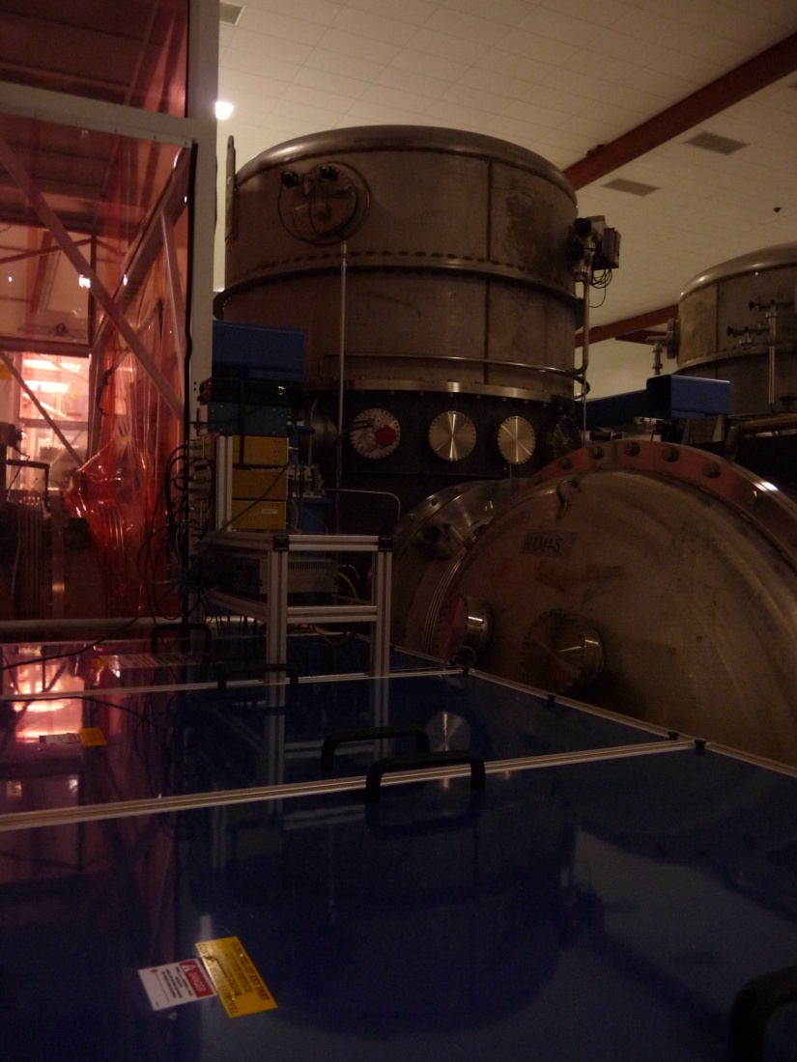
H1 squeezing experiment
Demonstrate that squeezing does not add noise in the LIGO band
Study environmental noise couplings
Understand limits to measured squeezing in order to plan for aLIGO+ squeezing

Slide 24
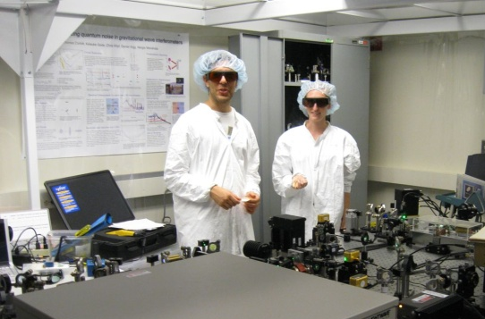
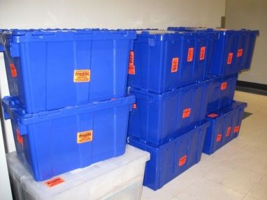
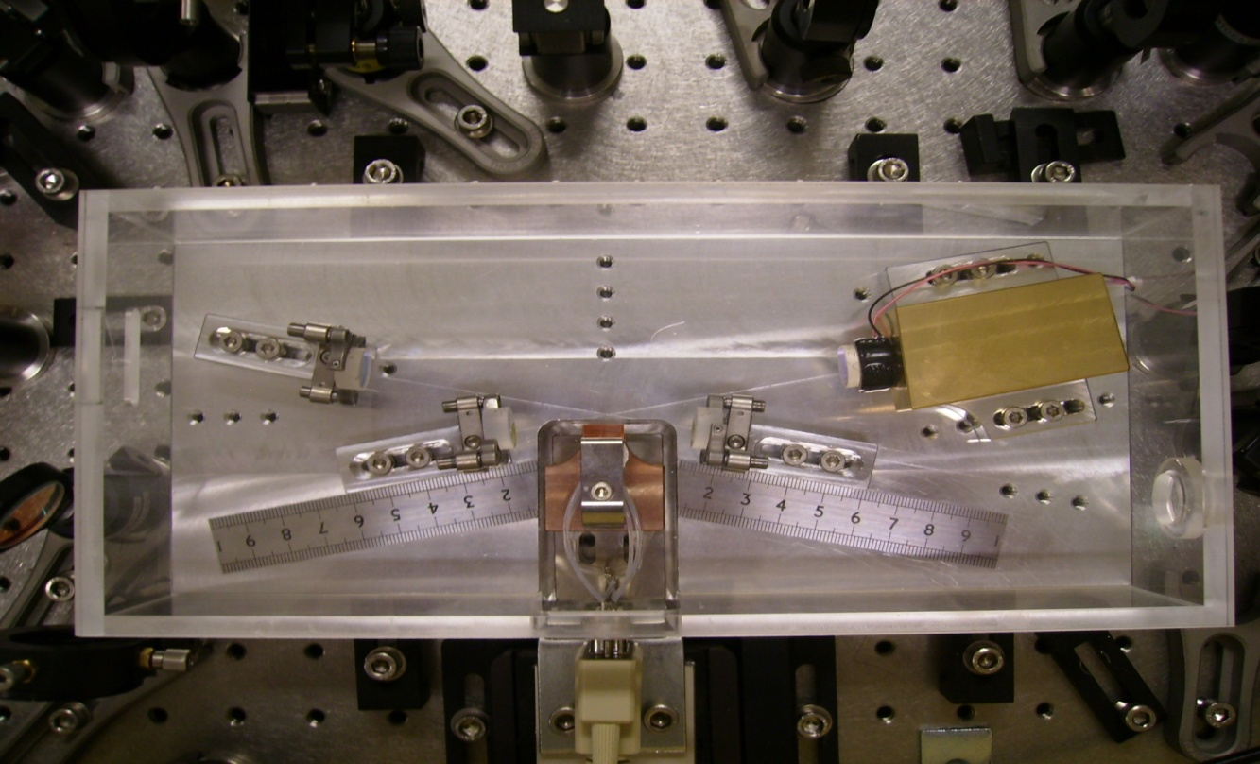
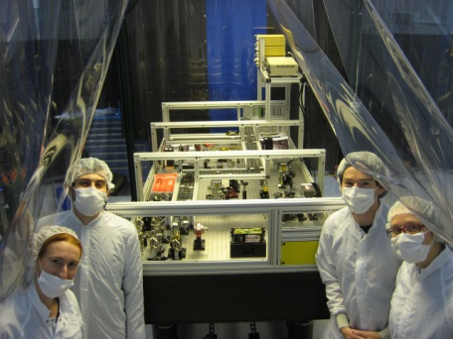
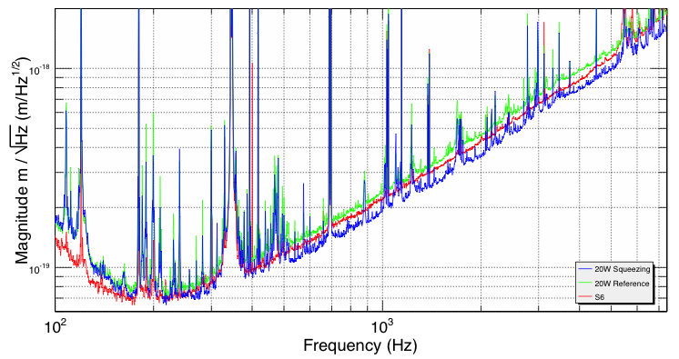
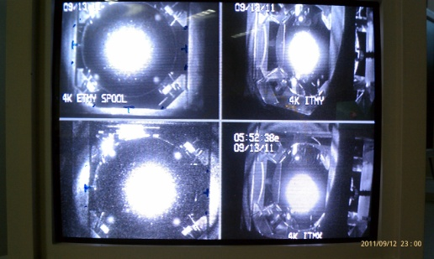
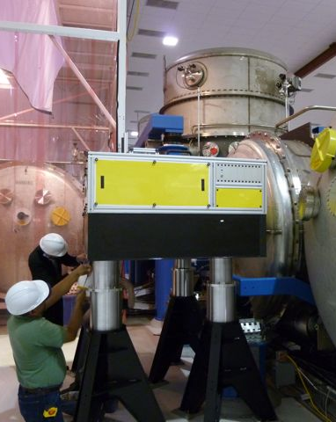
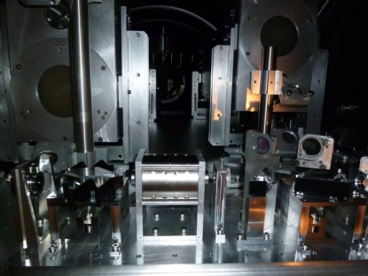
Bow-tie cavity OPO design from ANU (2008)
H1 Squeezer built at MIT (2009-2010)
H1 Squeezer shipped to LHO (Oct 2010)
Squeeze injection in H1 (Nov – Dec 4 2011)
H1 Recovery
(Sept 2011)
H1 Squeezer Installation (Summer 2011)

Slide 25
Experiment Layout

Slide 26
Squeezing in Enhanced LIGO
2.1dB
20% improvement in SNR

Slide 27
Best broadband sensitivity to date

Slide 28
Squeezing in Enhanced LIGO
1Mpc range added to NS range
24% increase in volume

Slide 29
LIGO interferometers, quantum light and quantum noise
Generation and detection of squeezing
Squeezing in Enhanced LIGO
Environmental noise couplings
Limits to the level of squeezing
Losses
Squeezing angle fluctuations
Potential benefit for Advanced LIGO and beyond

Slide 30
Backscatter noise
Light from interferometer is sent towards OPO
A second scattering event in OPO sends light back towards IFO
Spurious interferometer adds noise
LASER

Slide 31
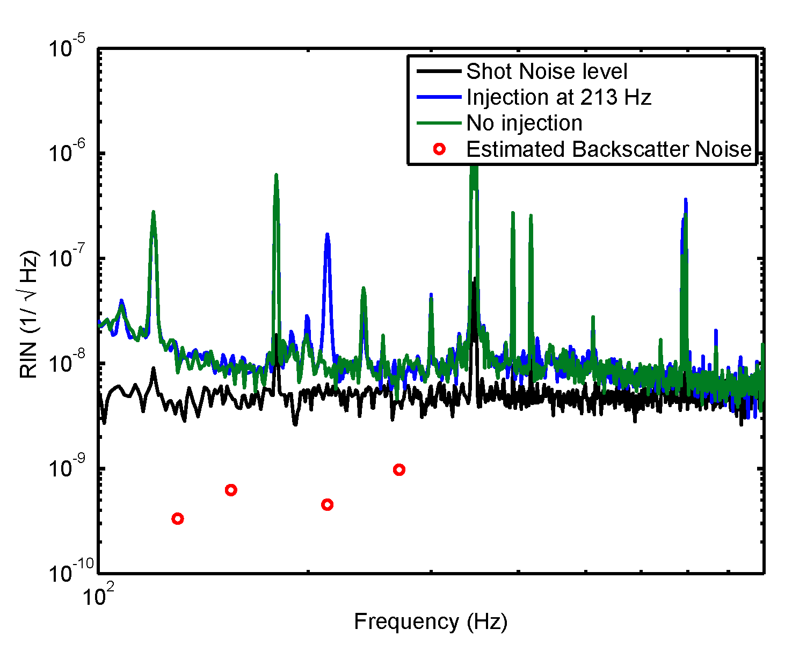
Noise Coupling
Around 100 fW of backscattered power at detector

Slide 32
Backscatter in Advanced LIGO
Better
Acoustic enclosure (factor of 10 above 100 Hz)
Lower OPO finesse (needed anyway)
Good Faraday performance in vacuum
Worse
More power
6 dB of squeezing
Better detection efficiency
Possibly better matching of scattered beam into OPO
Backscatter noise 40-80x below shot noise above 100 Hz.
Out of vacuum OPO is compatible with Advanced LIGO sensitivity, in vacuum OPO probably needed for a third generation interferometer.

Slide 33
LIGO interferometers, quantum light and quantum noise
Generation and detection of squeezing
Squeezing in Enhanced LIGO
Environmental noise couplings
Limits to the level of squeezing
Losses
Squeezing angle fluctuations
Potential benefit for Advanced LIGO and beyond

Slide 34
Losses destroy squeezing
Every loss can be seen as a beamsplitter with power transmission η_{loss}

Slide 35
Losses destroy squeezing
Every loss can be seen as a beamsplitter with power transmission η_{loss}
A loss allows vacuum state to “leak” into the beam

Slide 36
Losses destroy squeezing
Every loss can be seen as a beamsplitter with power transmission η_{loss}
Beamsplitter mixes the squeezed state with vacuum state
Resulting state has higher noise in squeezed quadrature

Slide 37
Losses limit squeezing

Slide 38
Loss budget and goals
 | Enhanced LIGO squeezing | Advanced LIGO assumptions
3 faraday passes | 5% each | 3% each
Mode matching | 30% | 4%
Output mode cleaner | 19% | 3%
Total losses | 55-60% | 20-25%
Based on a tally of 11 different loss sources

Slide 39
Losses degrade the purity of the squeezed state
∆X₂=e^{r}
=10dB
∆X₂=7dB
∆X₁=e^{-r}
=-10dB
∆X₁=-2dB
55% loss

Slide 40
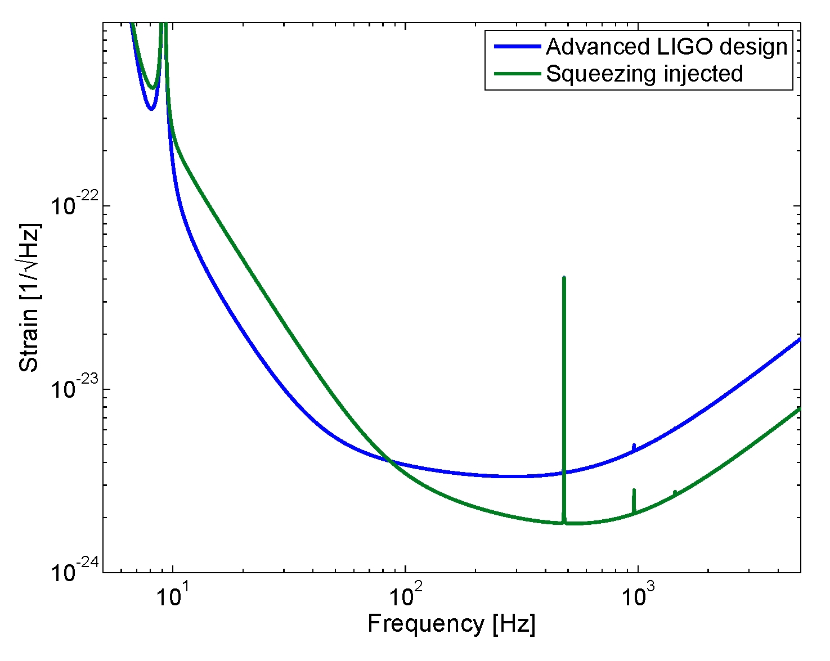
Squeezing with a radiation pressure limited interferometer

Slide 41
LIGO interferometers, quantum light and quantum noise
Generation and detection of squeezing
Squeezing in Enhanced LIGO
Environmental noise couplings
Limits to the level of squeezing
Losses
Squeezing angle fluctuations
Potential benefit for Advanced LIGO and beyond

Slide 42
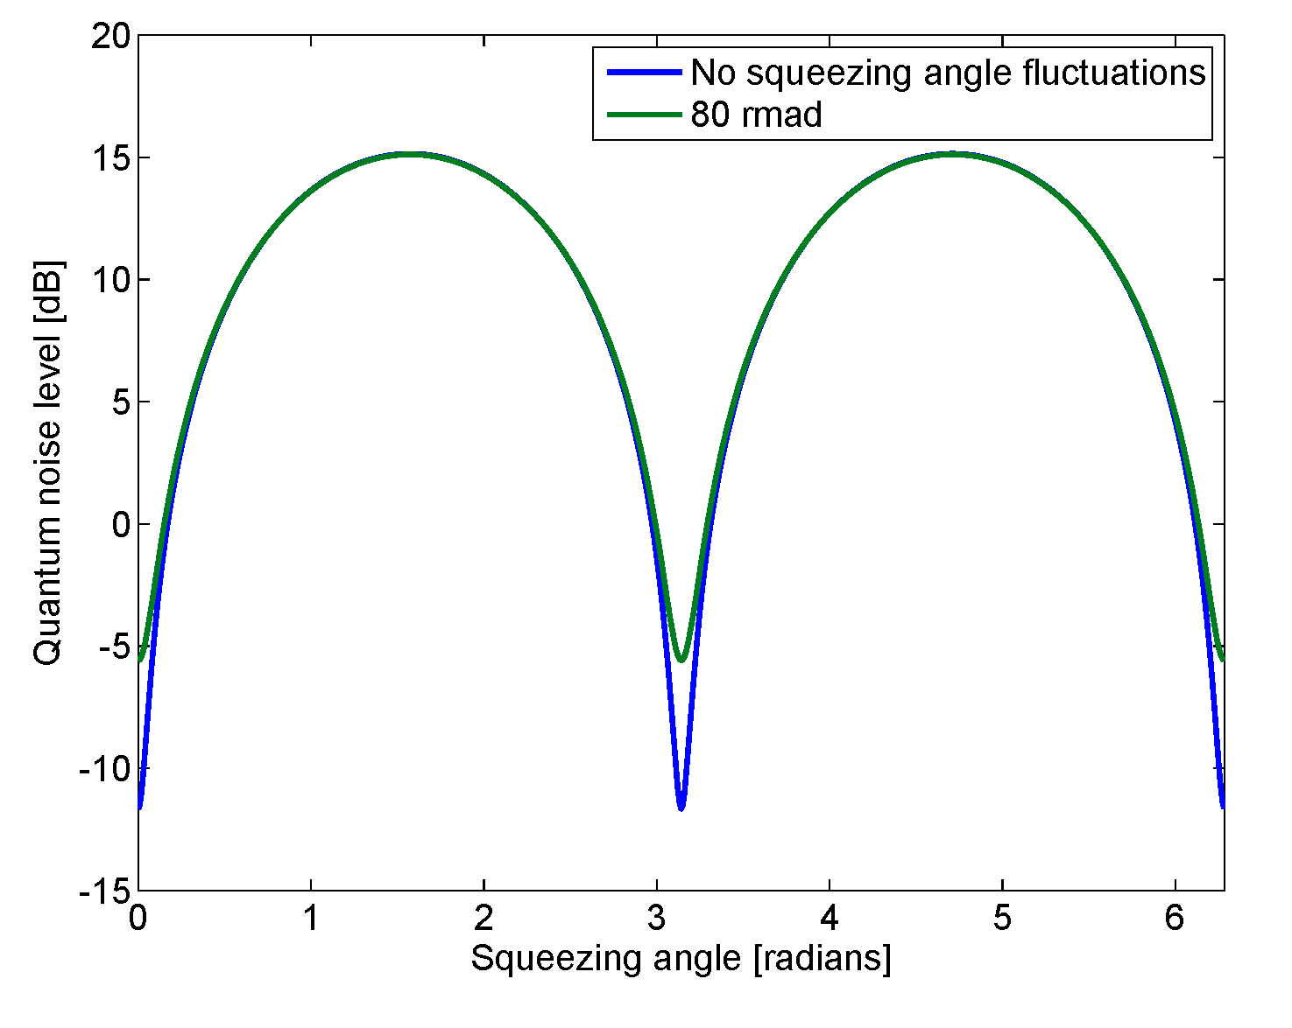
Squeezing Angle Fluctuations
X₂
X₁

Slide 43
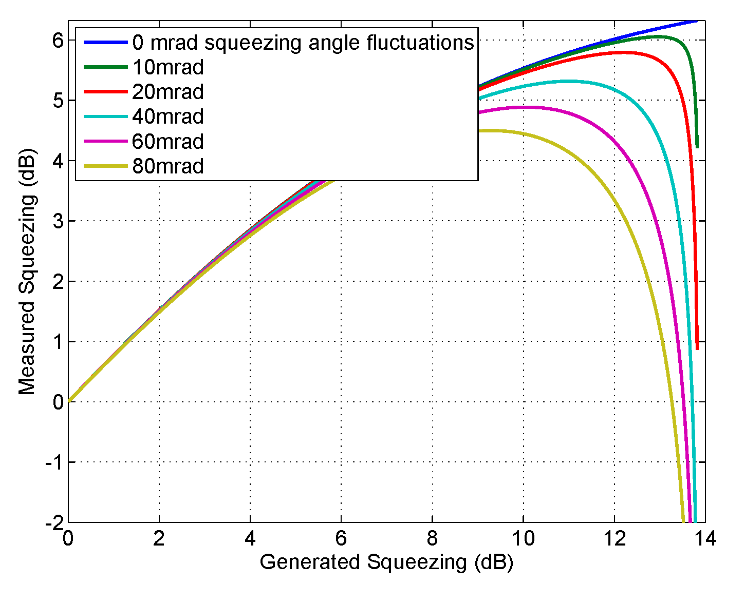
Squeezing Angle Fluctuations

Slide 44
Squeezing angle fluctuations

Slide 45
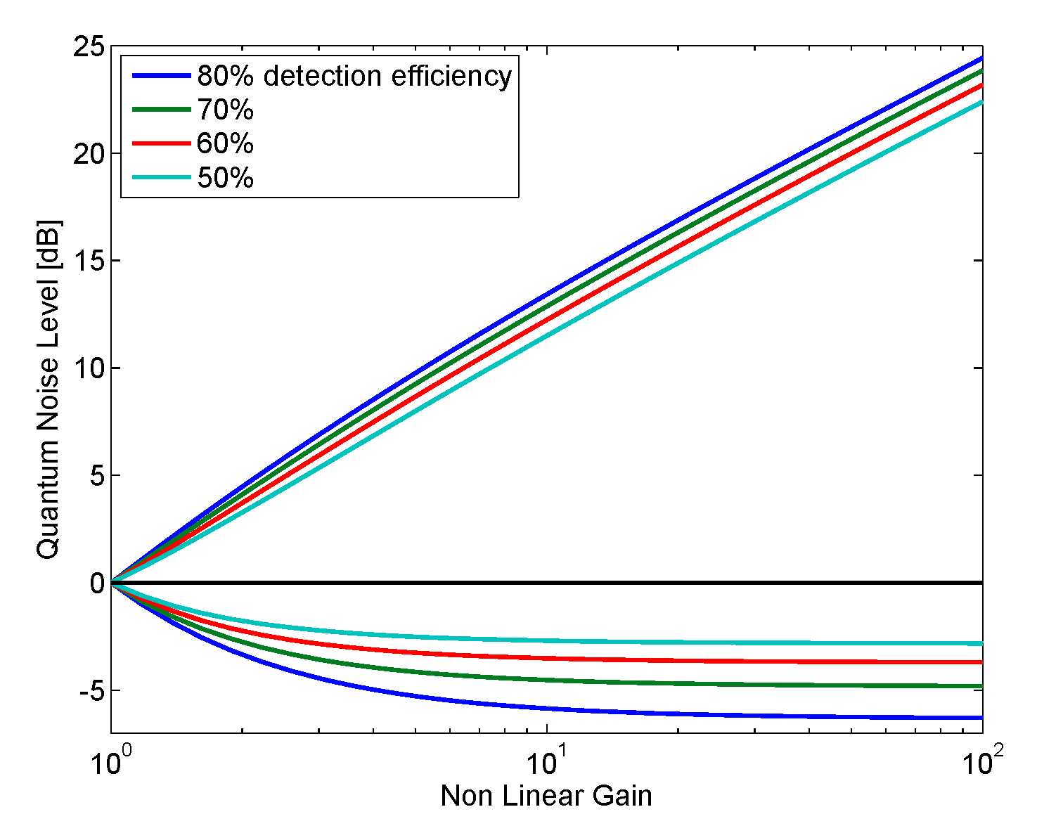
Measurement of squeezing angle fluctuations and losses

Slide 46
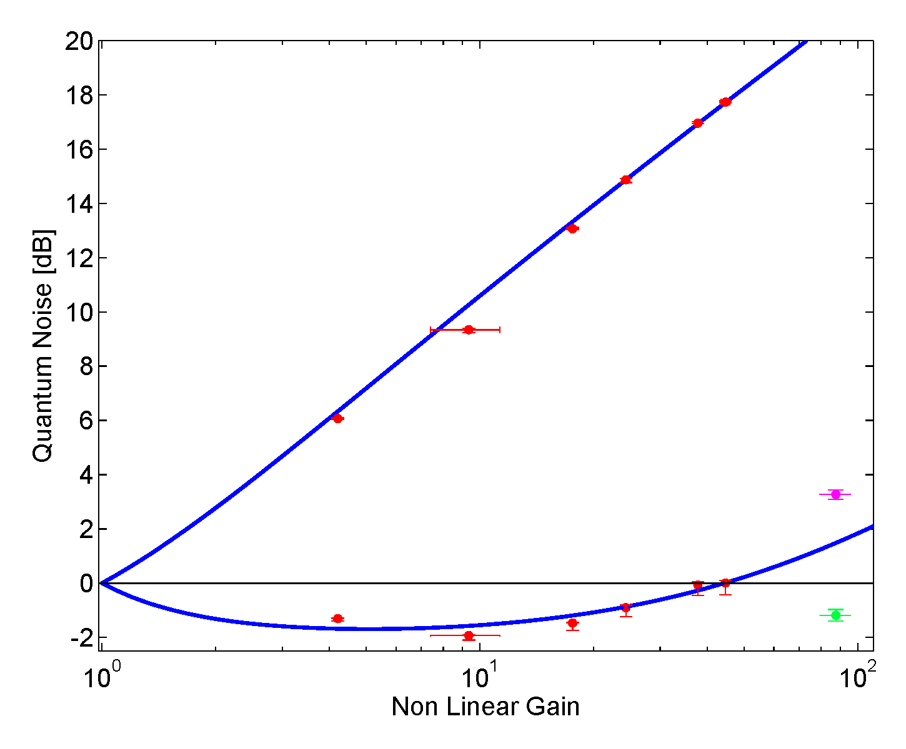
Squeezing angle fluctuations
Fit: 62% losses
81±13 mrad
109±9 mrad
37±6 mrad
Notes:
Log scale!!

Slide 47
LIGO interferometers, quantum light and quantum noise
Generation and detection of squeezing
Squeezing in Enhanced LIGO
Environmental noise couplings
Limits to the level of squeezing
Losses
Squeezing angle fluctuations
Potential benefit for Advanced LIGO and beyond

Slide 48
An alternative to high power operation in Advanced LIGO

Slide 49
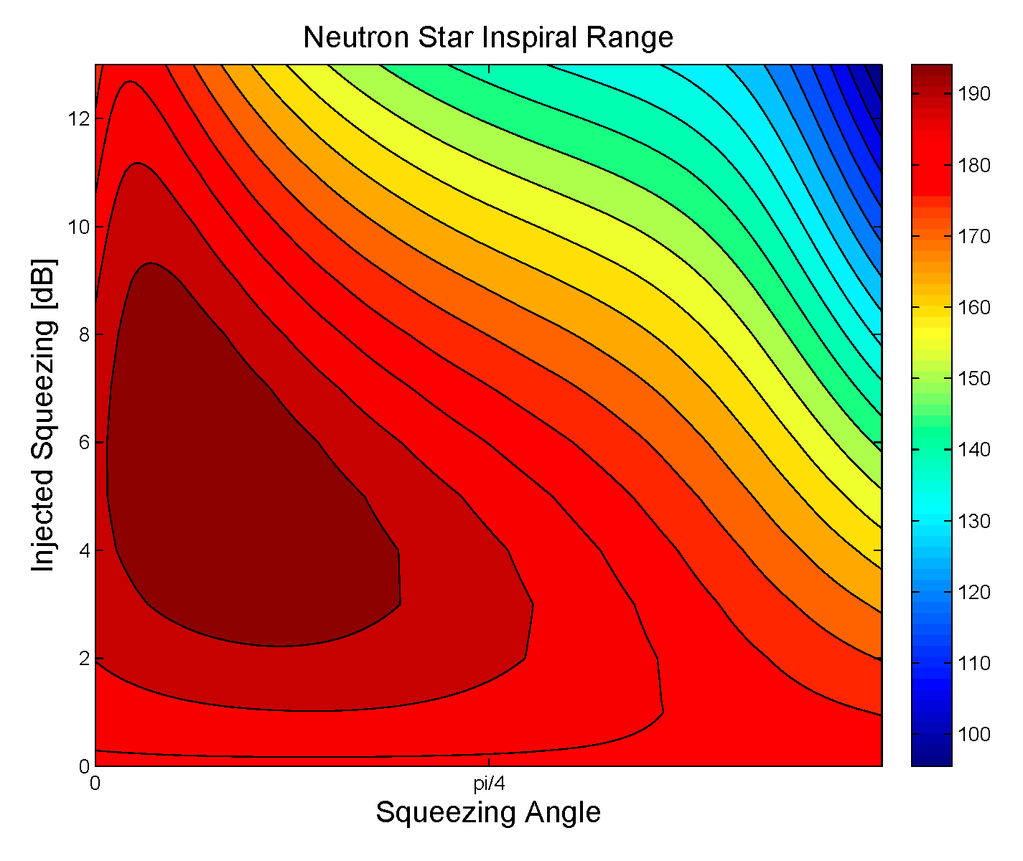
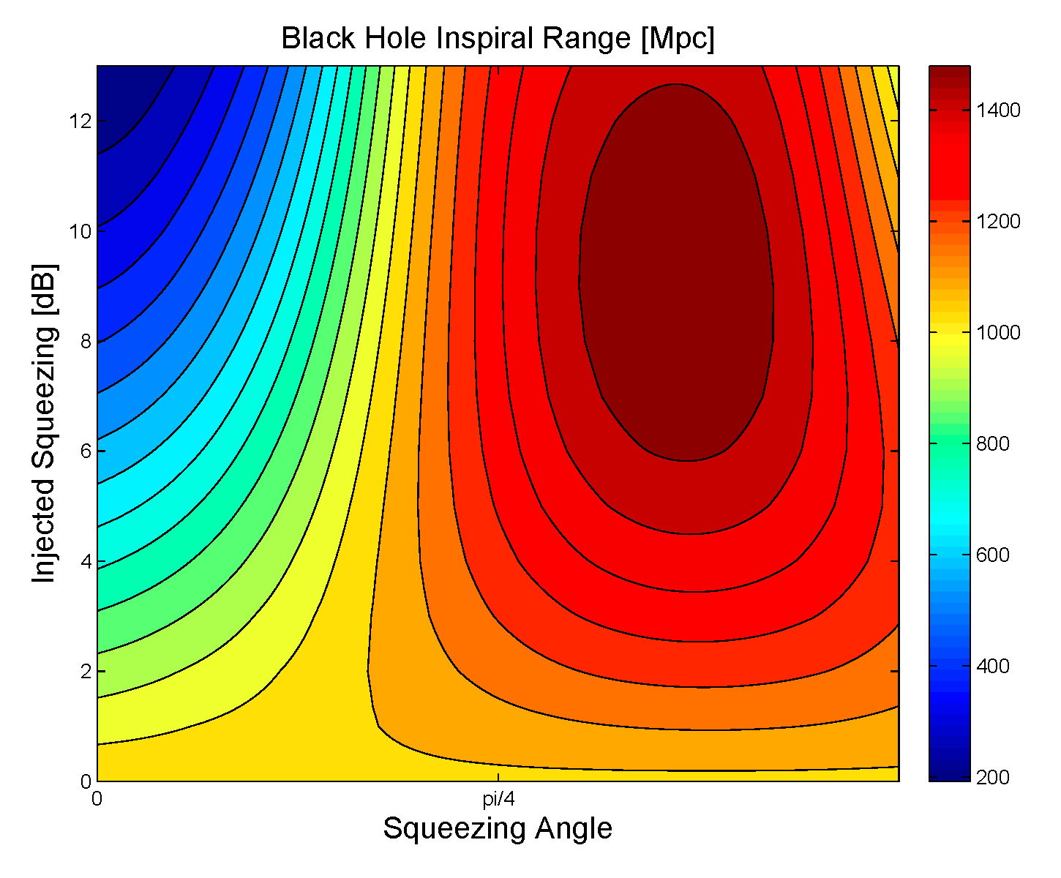
Squeezing in Advanced LIGO

Slide 50
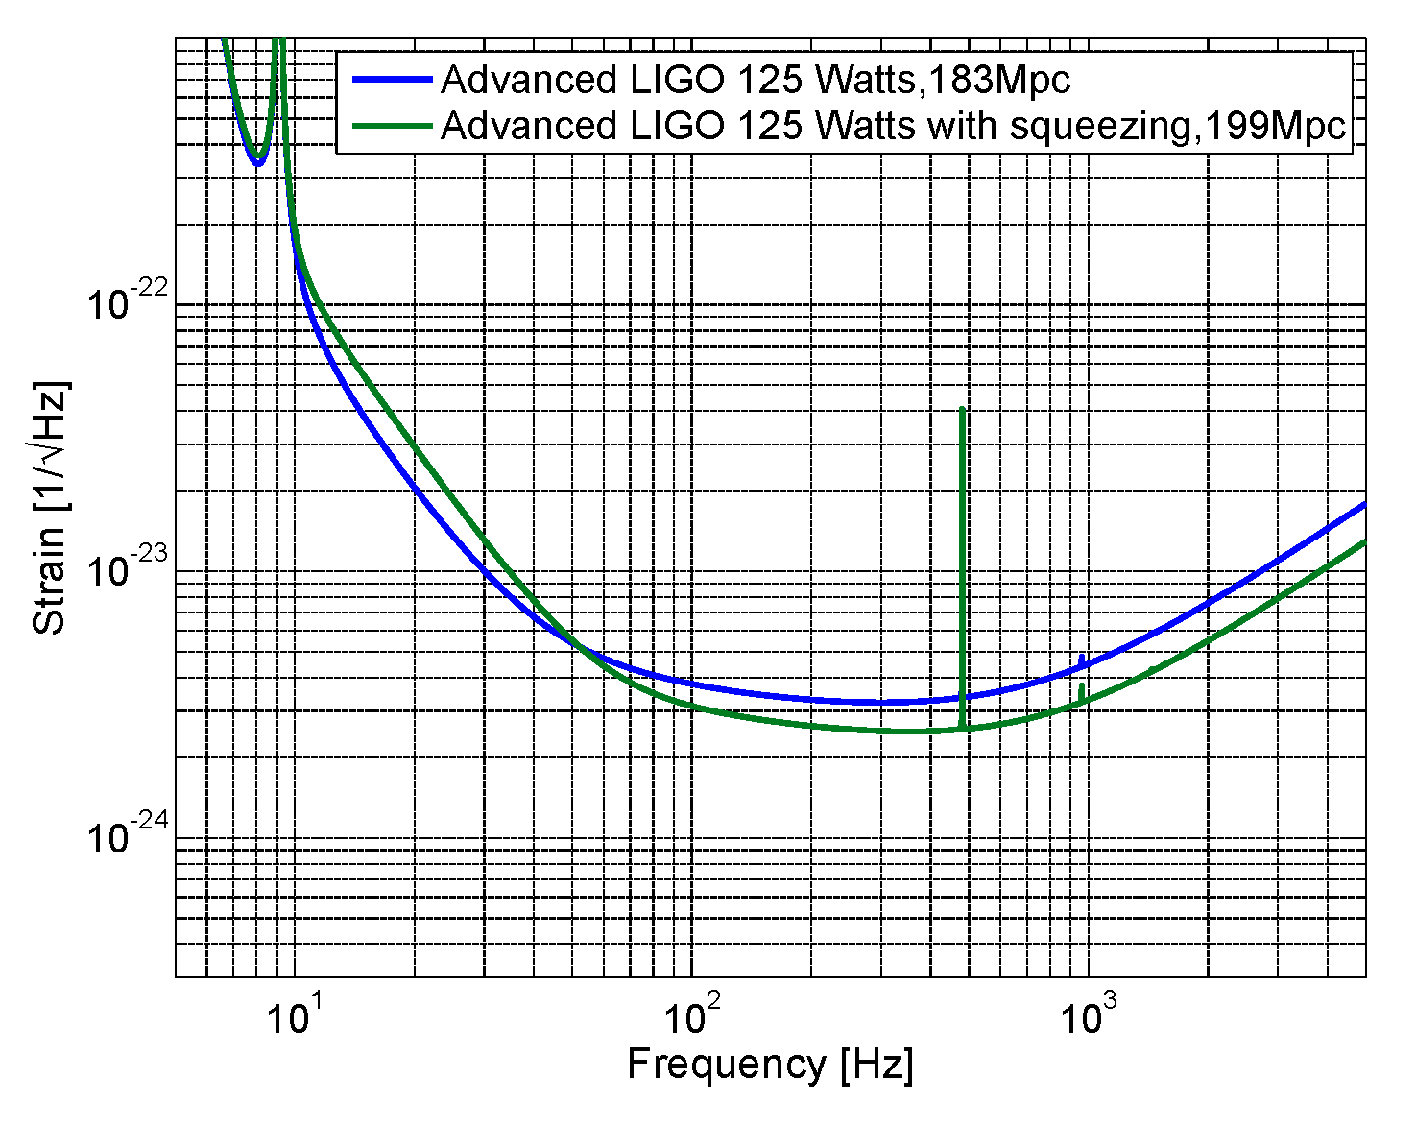
Squeezing with full power
28% increase in volume
Notes:
10-22-10-24

Slide 51
Frequency Dependent Squeezing

Slide 52
Paths to better squeezing
Non linear gain optimized for shot noise limited interferometer, maximum pump power 80% of threshold

Slide 53
Summary
2dB of squeezing in Enhanced LIGO
Squeezing compatible with low frequency sensitivity
Backscatter should not be a problem for aLIGO
To get higher levels of squeezing we will need to reduce interferometer losses and squeezing angle fluctuations
Squeezing will soon be the simplest way to improve LIGO’s sensitivity

Slide 54
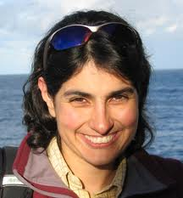
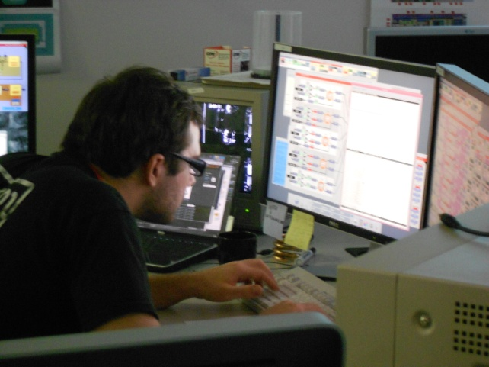
Thank you!
My committee
Mentors: Nergis Mavalvala, Lisa Barsotti, Daniel Sigg
LIGO Lab at MIT, staff at Hanford, and all the squeezers

Slide 55
Coherent locking of squeezing angle inject frequency shifted sideband with coherent amplitude
IFO carrier
SQZ sideband
x

Slide 56
Squeezing angle error signal
IFO carrier
SQZ sideband
IFO carrier
SQZ sideband
x
x

Slide 57
Squeezing angle error signal
IFO carrier
SQZ sideband
+
x
+

Slide 58
Squeezing angle error signal
IFO carrier
SQZ sideband
x
+
+
Static misalignments will cause a change in the demodulation phase needed to detect the maximum squeezing
Beam jitter will add phase noise, especially when beating against a static misalignment.

