Slide 1
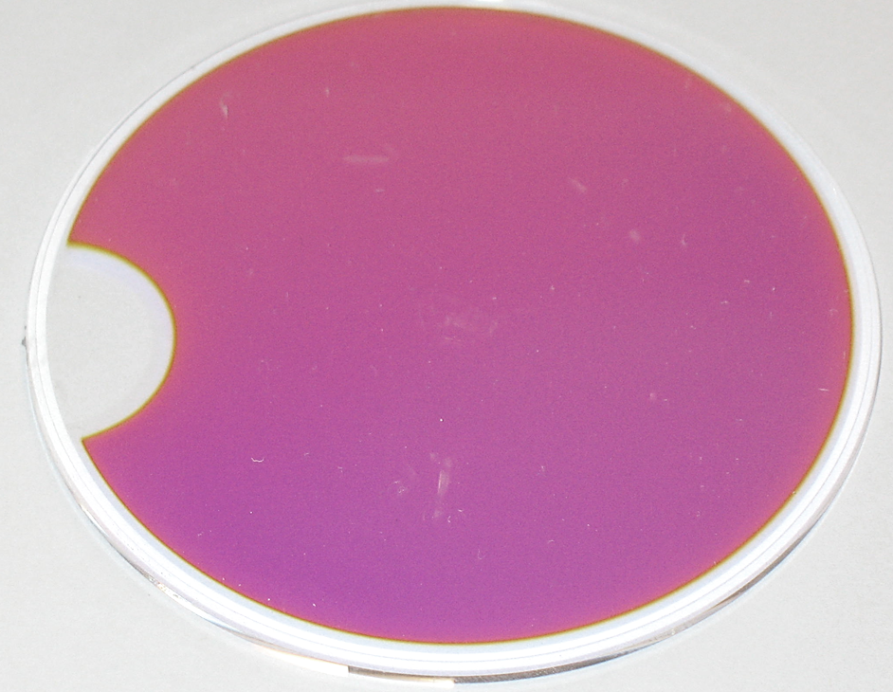




Thermal Noise, Optics, and Gravitational Wave Detection
National Institute of Science and Technology
November 5, 2012
Gregory Harry
American University
LIGO-G1201134

Slide 2
Outline
Introduction to Thermal Noise
  History and background
Coating Thermal Noise
Applications Limited by Coating Thermal Noise
Gravitational Wave Detection and Advanced LIGO
Optics in the Advanced LIGO Detectors
  Issues arising during design, construction, and installation
Optics Projects of Potential Mutual Interest

Slide 3
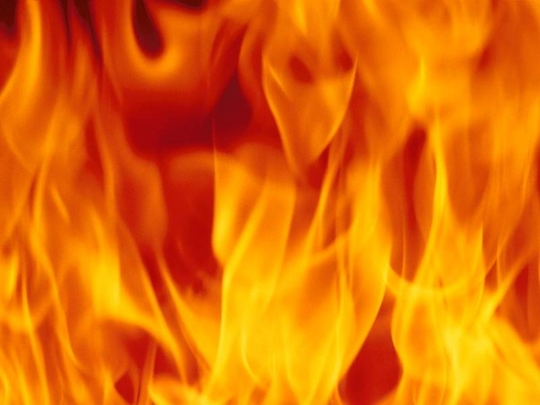
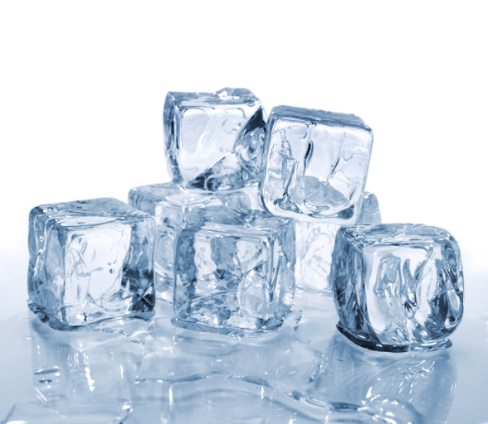
Thermal Noise
Random motion when not at 0 Kelvin
  Can also appear as random voltage, force, pressure, optical properties, etc.
Energy in thermal noise increases with temperature
  Cooling is a way, but not the only way, to reduce these thermal fluctuations
Thermal Energy
These random motions set a lower limit on measuring signals
  This is the “noise” part of thermal noise
Not random fluctuations in temperature
  Although these can play a role in thermal noise (thermo-optic, thermoelastic, etc.)
Cooling

Slide 4
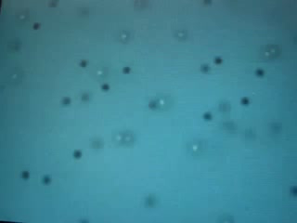
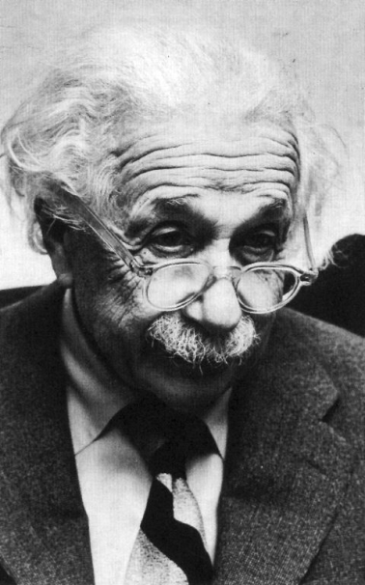
Brief History of Thermal Noise: I
Robert Brown: Botanist (1827)
Microscope pioneer
Observed pollen moving in water
Saw dust from Sphinx moving as well
Brownian Motion
Albert Einstein: Physicist (1905)
Mathematics of Brownian motion
Linked motion to fluid viscosity
Most cited of Einstein’s papers
Einstein

Slide 5
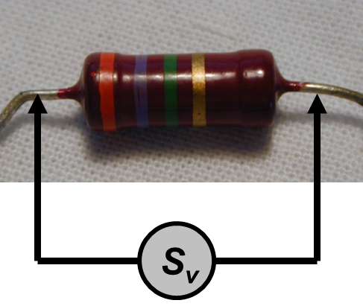
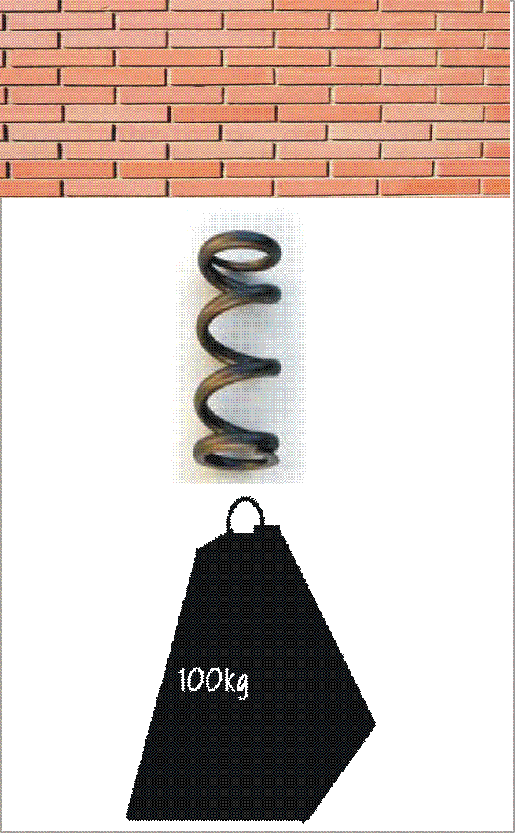
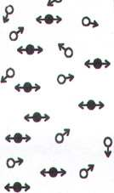
Brief History of Thermal Noise: II
Johnson Noise
Johnson and Nyquist (1926)
Voltage noise around resistors
Seemingly separate to Brown’s motion
Callen, Welton, and Greene (1950s)
Tie everything together
Relates random motion to energy loss
Fluctuation-Dissipation Theorem
Fluctuation
Dissipation
Fluctuation-Dissipation Theorem

Slide 6
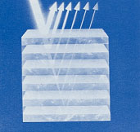
Optical Coatings
Often made of alternating layers of different materials
Layer reflections interfere to cause coating reflection
  Optimize layer thicknesses
  Depends on indices of refraction
  Can design for transmission
Coating Reflectivity
Higher reflection
  Increased number of layers
  Bigger index (n) separation
Scatter causes loss of light
Absorption causes heating
High n
Low n
Alternating Layers

Slide 7
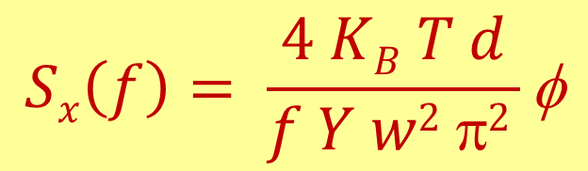
Coating Thermal Noise I
Levin’s Formula
From Fluctuation-Dissipation Theorem
Describes random motions of surface of coating relative to mirror center of mass
$$Sx\left(f\right)= \frac{4 KB T d}{f Y w2 π2 }\text{f}$$
K_{B}: Boltzmann’s constant
T: temperature in Kelvin
f: frequency
d: coating thickness
Y: Young’s modulus
w: beam width
φ : mechanical loss

Slide 8
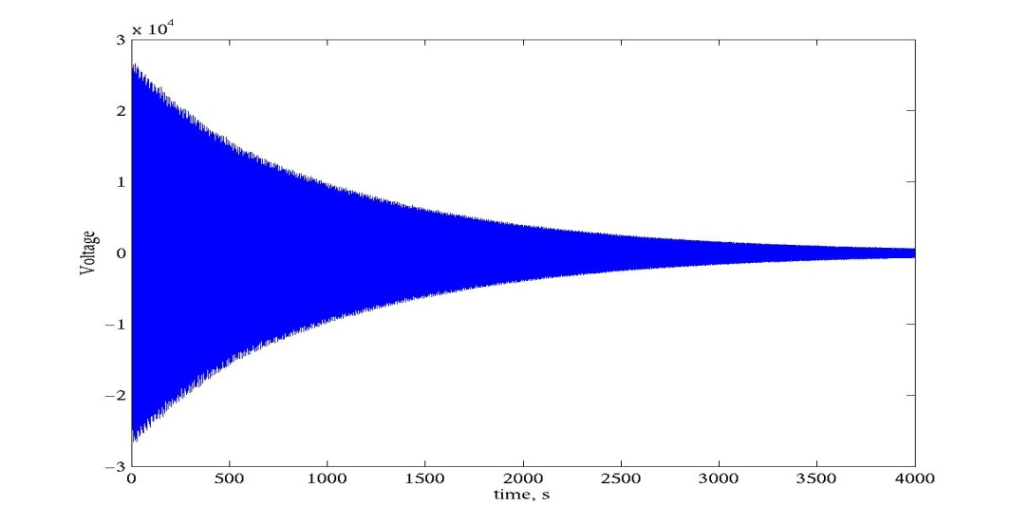
Measurements of Coating φ
Q Measurement
Mechanical loss φ also causes ringdown of normal modes
  Test samples rings like a bell
  Energy slowly leaves ringing
  Measure modal Q’s
Can measure φ more easily than measuring thermal noise
e^{-π f tφ} Sin(2 π f t)
Ringdown

Slide 9
Direct Thermal Noise Measurements
Coating Thermal Noise Data
Interferometer can directly measure coating thermal noise
Very difficult
  Years to perfect
  Months to measure
See 1/f dependence
Tantala
Titania-Tantala
Clear improvement from tantala to titania-tantala
  Reasonable agreement with Q measurements
Seen improvement from using less tantala
Can (and have) also study substrate thermal noise

Slide 10
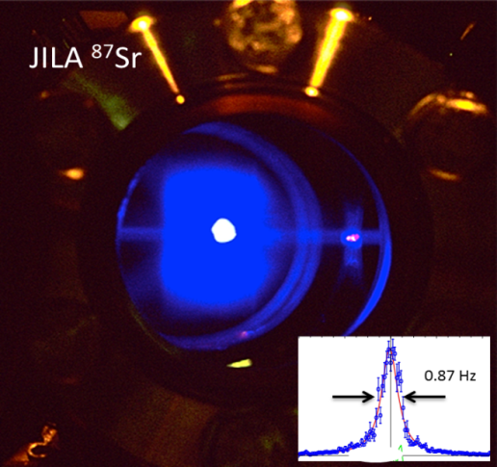
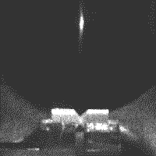
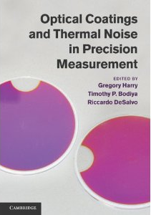
Applications Limited by Coating Thermal Noise
Frequency stabilization
  Precise timing measurements
  Frequency combs
  Work done at NIST-Boulder
Sr Atomic Clock
Atom in Cavity
Quantum optomechanics
  Quantum behavior of macroscopic objects
Cavity quantum electrodynamics
  Single atom-photon interactions
Gravitational Wave Detection
  First research on coating thermal noise
  Focus of American University efforts
Book on coatings and applications

Slide 11
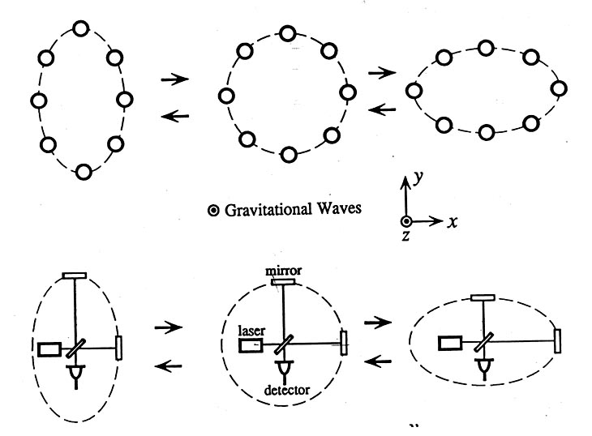
Gravitational Wave Detection
Measure prediction of Einstein’s theory of gravity
  Moving masses produce waves in space and time
Astronomical sized objects needed
  Still very tiny effect, about 10⁻¹⁸ m at Earth
Interferometer measures separation between coated optics; need to boost signal
  High laser power: hundreds of kilowatts
  Long arms: 4 kilometers
Effect of Gravitational Waves
Livingston LA
Hanford WA
LIGO Gravitational Wave Detectors

Slide 12
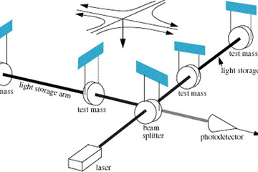
LIGO Detectors
Initial LIGO had two 4-km long and one 2-km long interferometers
  Livingston Louisiana and Hanford Washington
Advanced LIGO has three 4-km interferometers under construction
Simplified LIGO Interferometer
One each in Livingston, Hanford, one in India
Michelson configuration with Fabry-Perot arms
  Also signal and power boosting mirrors
Mirrors hang as pendulums
Full 8-km optical path in vacuum

Slide 13
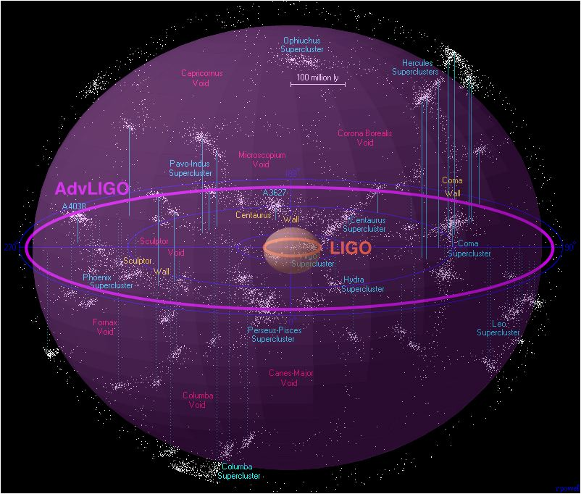
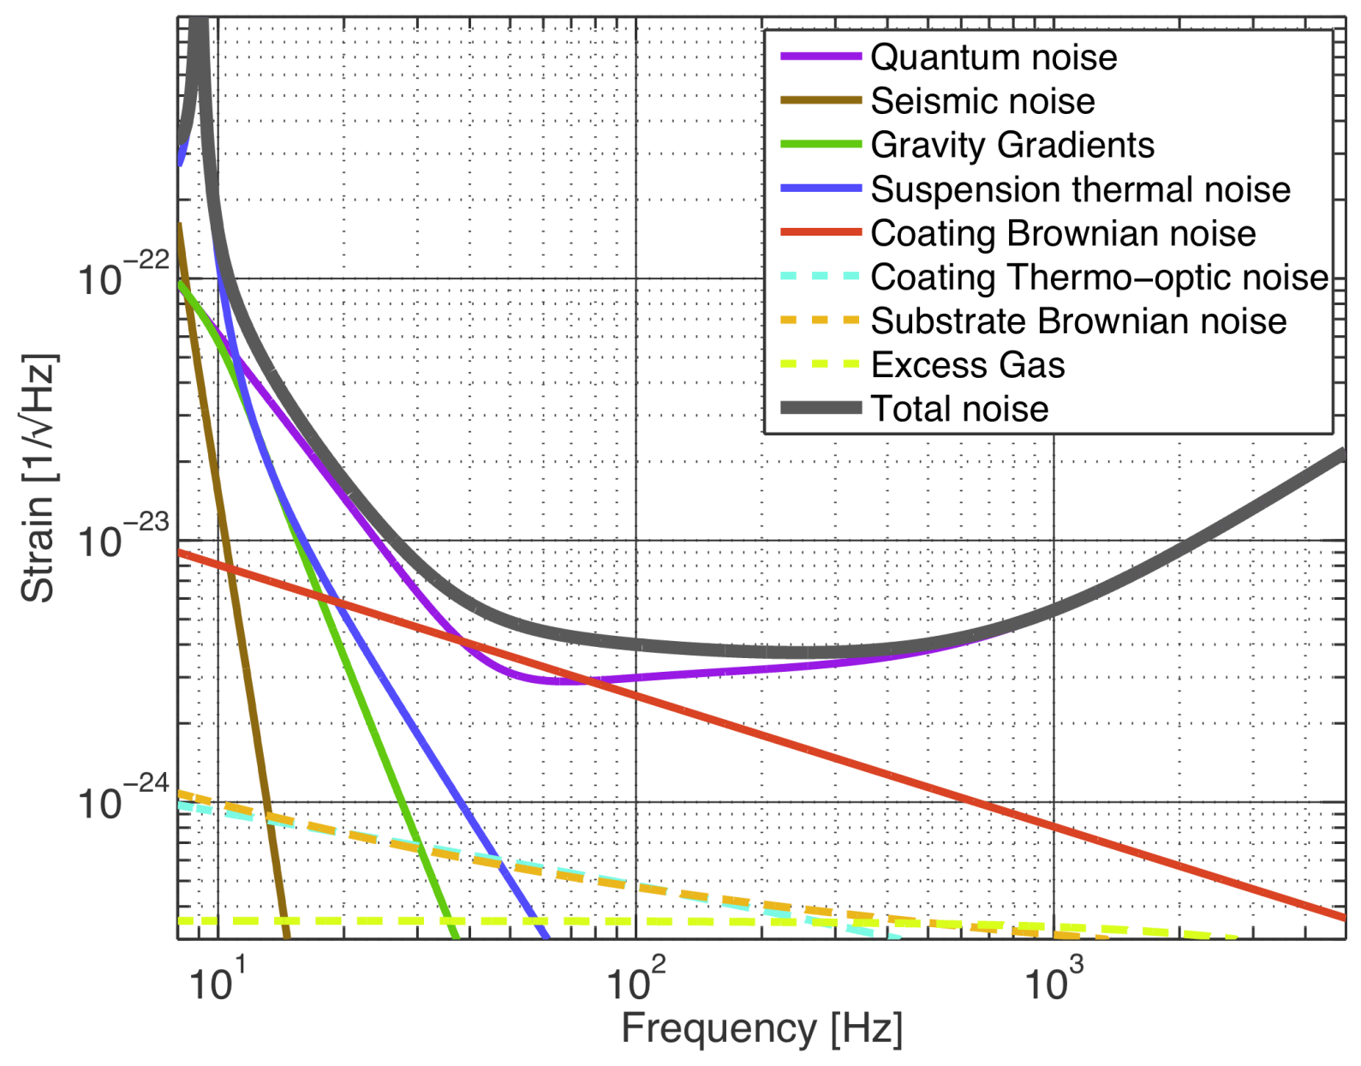
Advanced LIGO
October 2010, installation began on Advanced LIGO (aLIGO)
Most hardware procured
Installation of mirrors and other hardware in progress
Astronomical Reach
Enhanced LIGO
Initial LIGO
100 million light years
Advanced LIGO Sensitivity
Advanced LIGO
Sensitivity designed to be 10X initial LIGO
  Initial LIGO saw no signals
Limited in sensitive band by coating thermal noise
Early data in 2015

Slide 14
Advanced LIGO Optics Types
Test masses
  Define Fabry-Perot cavities
  End test mass and input test masses
  Highest optical power on coatings
  Most stringent requirements
  Laboratoire des Matériaux Avancés (LMA)
Beamsplitters
  Divide the beam into two arms
  Equal stress on both sides
  Commonwealth Scientific and Industrial Research Organization (CSIRO)
Compensation plates
  Secondary optic behind input test masses
  Used to adjust thermal lensing
  CSIRO
40 kg
Test Masses:
34cm φ x 20cm
40 kg
Compensation plates:
34cm φ x 10cm
BS:
37cm φ x 6cm
PR3
ITM
T = 1.4%
Recycling Mirrors:
26.5cm φ x 10cm
SR3
Recycling mirrors
  Reflect both optical power and signals back into interferometer
  CSIRO

Slide 15
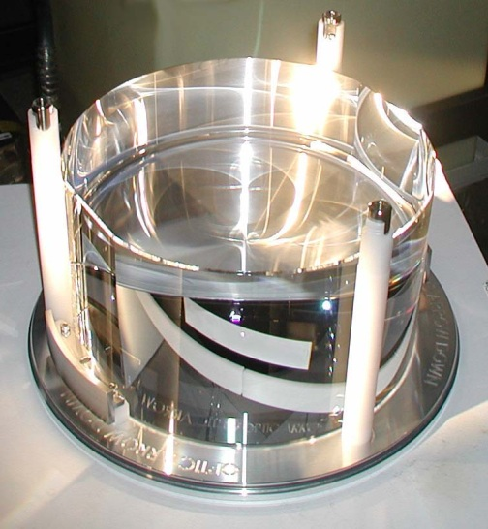
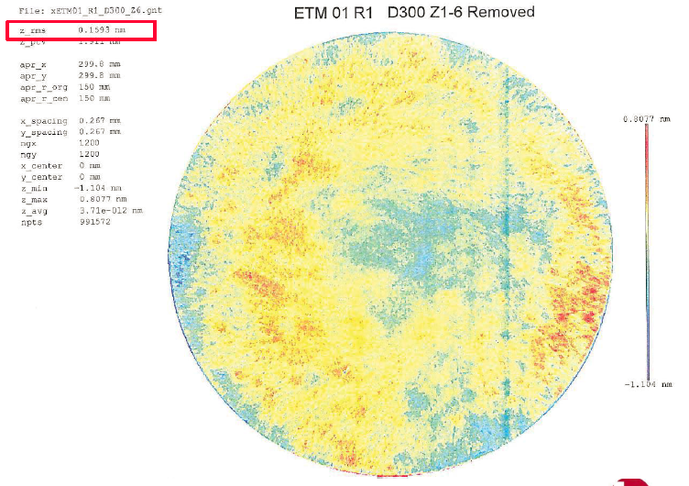
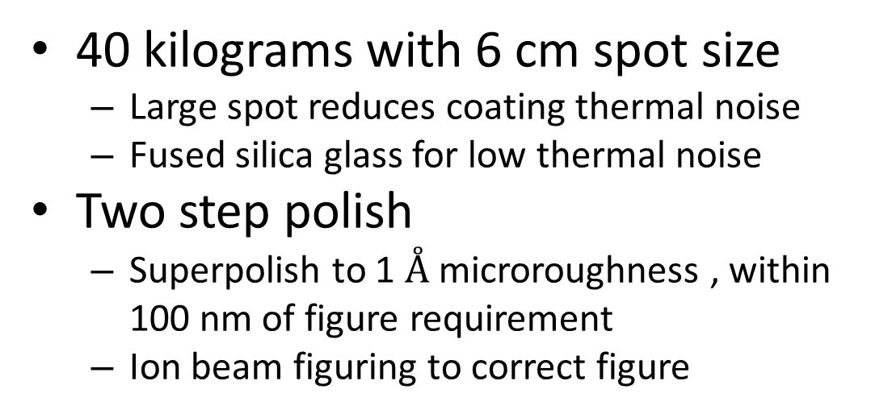
Advanced LIGO Test Masses
40 kilograms with 6 cm spot size
  Large spot reduces coating thermal noise
  Fused silica glass for low thermal noise
Two step polish
  Superpolish to 1 $Å$ microroughness , within 100 nm of figure requirement
  Ion beam figuring to correct figure
LIGO Test Mass
  Polishing done at Coastline and Zygo Extreme Precision Optics
Metrology
Property | Requirement | Measurement
Microroughness | 0.16 nm rms | 0.11 nm rms
Radius of Curvature | 2245-5+15 m | 2249.8 m
Surface Figure Error | 0.3 nm rms | 0.12 nm rms
Astigmatism | 3 nm rms | 0.04 nm rms
Surface Figure

Slide 16
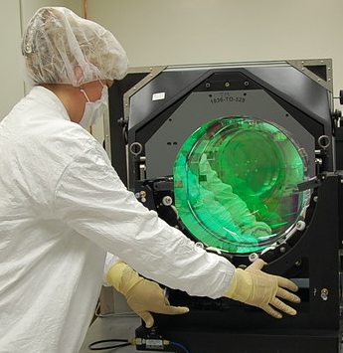
Advanced LIGO Optics Coatings
Property | Requirement | Measurement
Scatter | 10 ppm | 6.5 ppm
Absorption | 0.5 ppm | 0.5 ppm
Uniformity of reflectivity | 0.2% | 0.2%
End Mirror Transmission | 5 ± 1 ppm | 4.8 ppm
Input Mirror Transmission | 1.4 ± 0.1 % | 1.38%
Transmission Matching | 1% | TBD
Thermal Lensing
Coatings
Ion beam deposition coating
Titania doped tantala/silica
  Lower thermal noise
  Large index contrast, low coating thickness
  Reduced absorption, low scatter
Design to preserve reflectivity but reduce amount of titania-tantala
Coated LIGO Optic

Slide 17
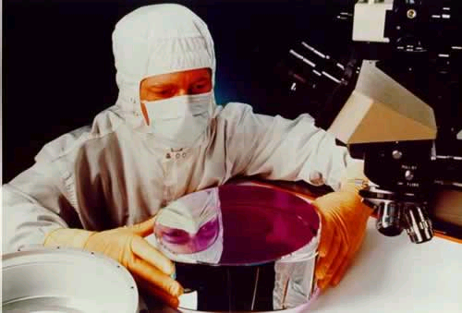
Advanced LIGO Optics Issues
Absorption of AR coatings
  Inexplicably large in some samples, overall high
  Annealing bringing down close to specifications
Figure change with annealing
  Significant distortion in optic shape
  Only some optics, mostly Corning glass
Polishing effects on thermal noise
  Ion beam etching used with superpolish
  Both techniques demonstrated to not adversely effect thermal noise; details unknown

Slide 18
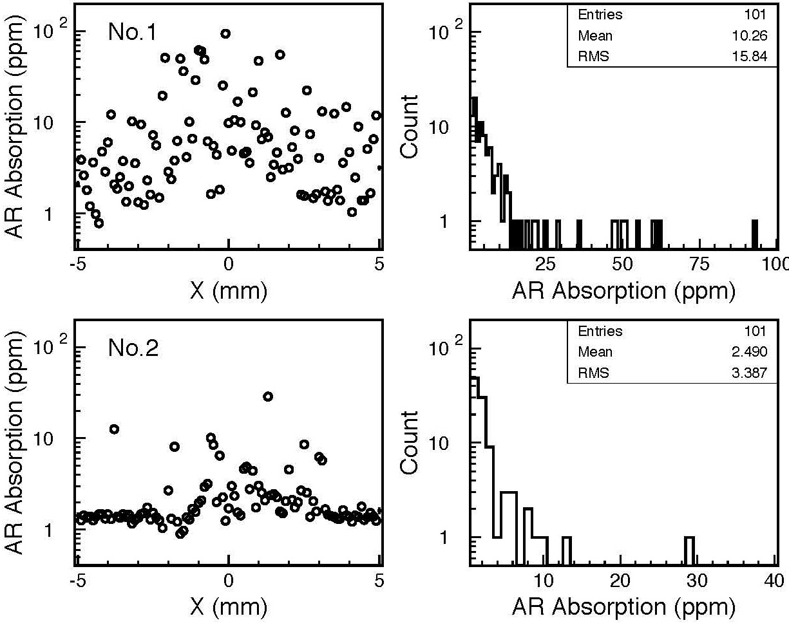
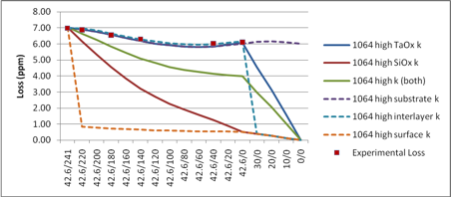
AR Coating Absorption
Possibly related to thin tantala layer
  Only seen on beamsplitters and compensation plates; have thin layers
Consistent with tantala, substrate and/or interlayer absorption
Improves with annealing
  Can take > 100 hours at > 450 C
Humidity while annealing may play role
Absorption with Annealing
Models of Absorption vs Depth

Slide 19
Figure Change with Annealing
Change in surface figure with annealing observed in some Advanced LIGO optics
Primarily in Corning 7980 fused silica
Corning optics replaced with Heraeus glass
Recently seen in Heraeus as well
  About 10% of Corning change
No understanding of cause or cure
8 nm stability required

Slide 20
Polishing and Thermal Noise
Mechanical loss of glass surfaces worse than bulk
Flame polished silica surfaces well characterized
No large thermal noise effects from super- or ion beam polish
Silica Mechanical Loss vs Surface to Volume Ratio
  Details unstudied
  Might be able to improve with annealing, chemical treatment, or other processes
  Trade offs between roughness and mechanical loss?
Magneto-rheological polishing another option
  Experience has microroughness high

Slide 21
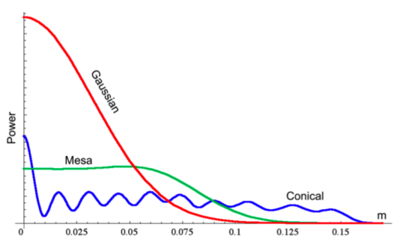
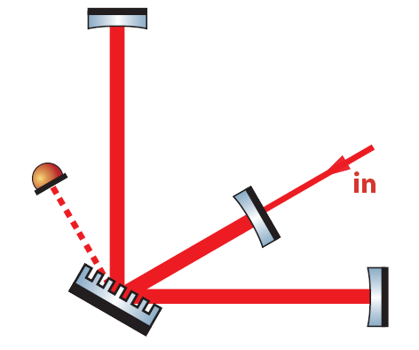
Improved Coatings for Next Generation Detectors
Reducing temperature
  Lowers T in thermal noise equation
  Properties (φ, Y, etc.) can change
Beam shaping
  Effectively increase beam size
  Strict figure requirements
Different Beam Shapes
All reflective optics
  Diffractive coatings
  Improved thermal lensing
Coating free mirrors
  Eliminate need for coatings
  Hard to get high reflectivity
Diffractive Beamsplitter

Slide 22
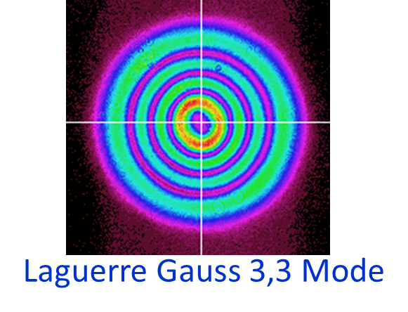
Next Generation Polishing Issues
Mesa beam or other unusual beam shapes allow for larger spot sizes
  Reduce thermal noise, better averaging
  Difficult to polish, may require new techniques
Gauss-Laguerre modes allow spherical polish but require extreme figure
Coating-free mirrors may have strict roughness and figure needs
  Also require AR coatings so absorption is important

Slide 23
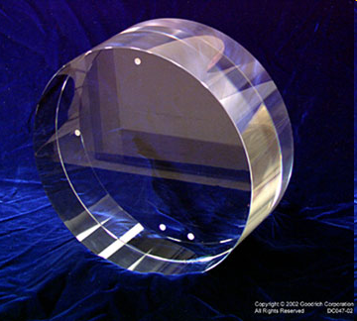
Next Generation Optics Materials
Cryogenic silicon or sapphire mirrors
  Thermal noise lower at low temperatures
  What figure/microroughness is possible?
  What homogeneity can silicon have at 1550 nm?
  How does polish effect thermal noise?
  What coatings are possible?
40 kg Sapphire Optic
Tantala and Hafnia vs Temperature
New coating materials
  Silica /tantala increase mechanical loss at low temperature
  Hafnia improves mechanical loss
  Crystalline coatings promising: AlGaAs, AlGaP

Slide 24
Conclusions
Coating thermal noise limitation in many precision optical measurements
  Gravitational wave detectors prime example
Advanced gravitational wave detectors coming soon
  Improved technology will provide greater sensitivity
aLIGO mirrors are larger with bigger spot sizes, finer polish, lower absorption, and lower thermal noise
aLIGO optics issues during fabrication include high absorption and figure change with annealing
Next generation detectors need optics research
Many areas of mutual interest with NIST

Slide 25
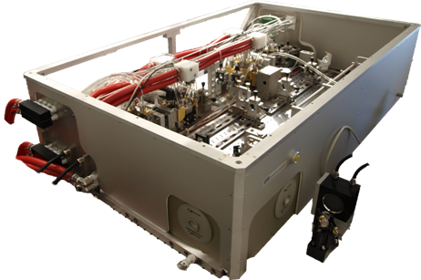
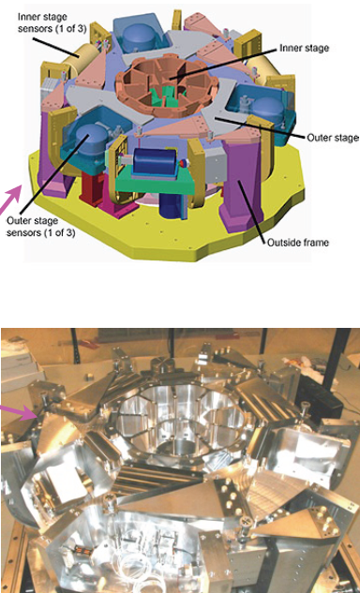

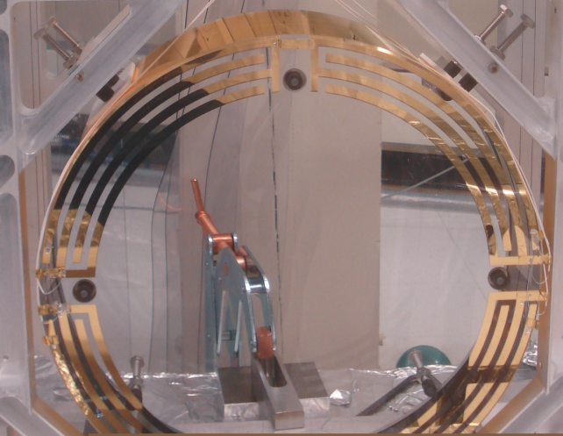
Advanced LIGO Technology
180 W Nd:YAG Laser
Multistage Active Seismic Isolation
Optics Table Interface
(Seismic Isolation System)
Feedback and Control
Damping Controls
Hierarchical Global
Controls
Electrostatic
Actuation
Quadruple Pendulum Suspension

Slide 26
Questions on Figure and Annealing
Does type of glass matter?
  Primarily seen in Corning 7980 fused silica
  Also in one Heraeus glass optic
Is type or quality of polish important
  Heraeus optic that changed had spotty surface with high microroughness
Are there correlations between figure change and molecular level issues in glass
  Impurities
  Bond angle changes
  Can these be studied with X-ray or other techniques
Preliminary interest in this issue from Corning

Slide 27
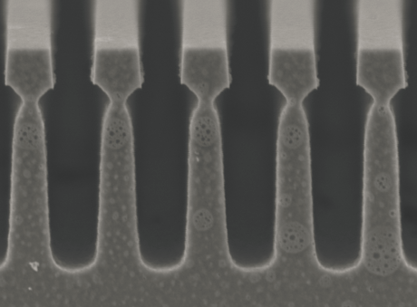
Diffractive Optics
Primary value of diffractive optics improved thermal lensing
  No transmission in substrates
Can be made of opaque material
  Silicon at 1064 nm
Diffraction Grating Coating
Thermal noise needs more research
  Surface quality may be important
Mirror size needs development
Noise from lateral displacement needs solution
Exact topology to be determined
Silicon Waveguide Grating

Slide 28
Projects of Mutual Interested between LIGO and NIST
Causes and cures of absorption in AR coatings
Causes and cures of figure change in silica with annealing
Thermal noise, microroughness, and figure from polishing techniques
Polish and thermal noise in sapphire and silicon substrates
Microroughness, figure, and thermal noise in crystalline coatings and diffractive optics

Slide 29
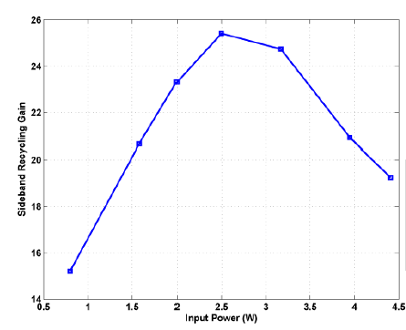
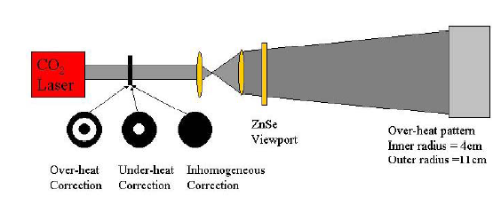
Thermal Lensing In aLIGO Optics
Initial LIGO optics polished assuming thermal lens forms
Point design assume particular absorption values
Needed to go to feedback system with CO₂ laser
Cavity Gain in Initial LIGO
Advanced LIGO designed with compensation
Minimize CO₂ laser power to reduce noise
Thermal Compensation System

Slide 30
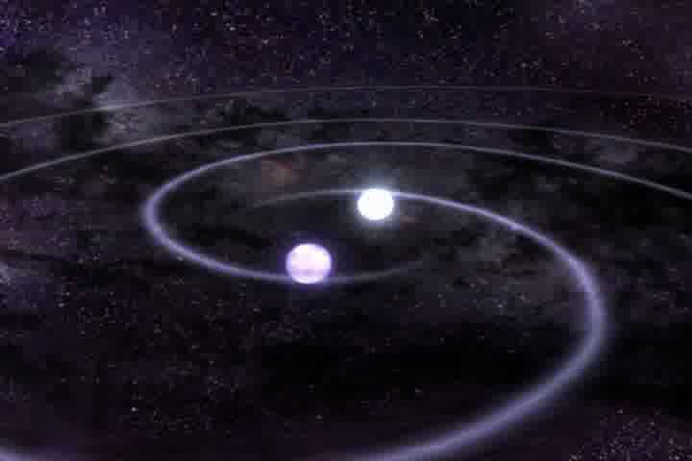
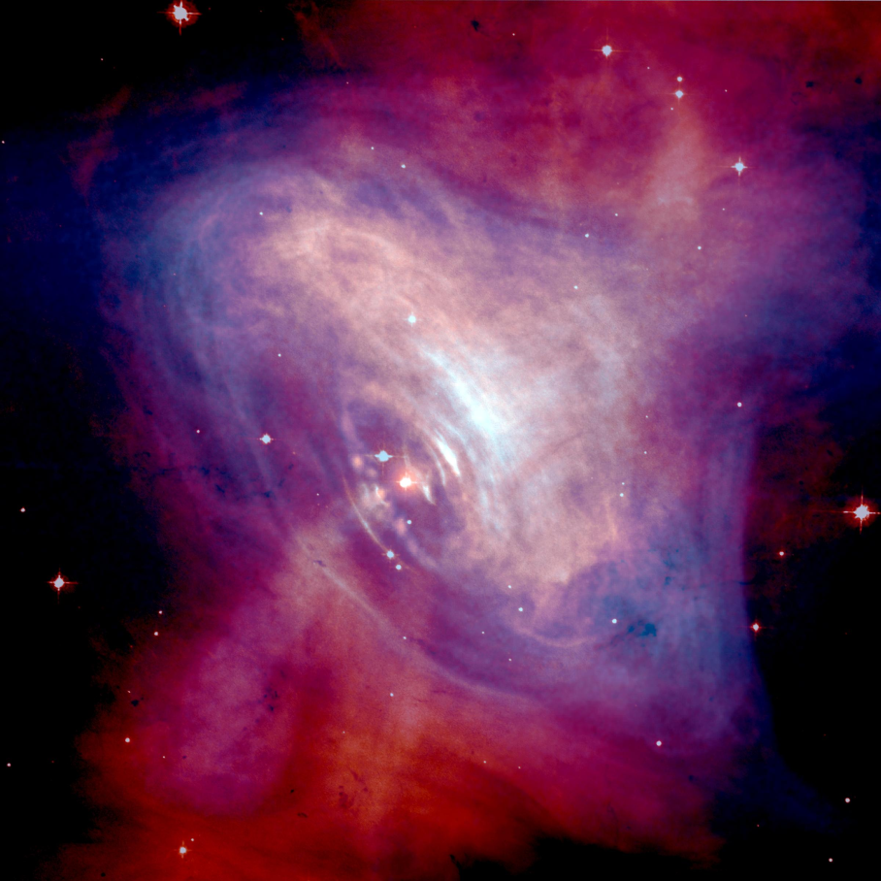
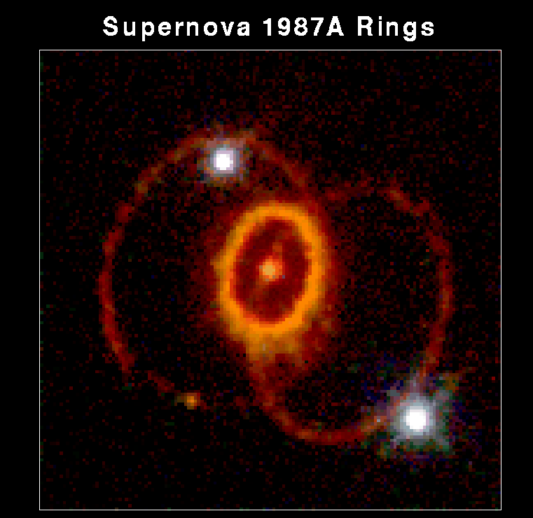
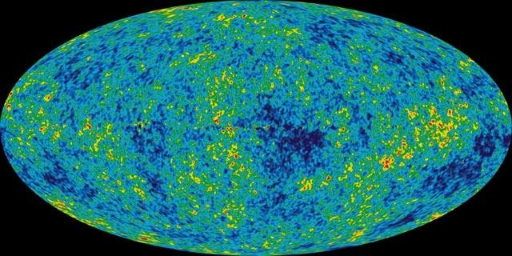
Astronomical Sources of Gravitational Waves
Inspiral Sources:
Neutron Stars
Periodic Sources:
Rotating Neutron Stars
Burst Sources:
Supernova
Stochastic Sources:
Gravitational Wave Background

Slide 31
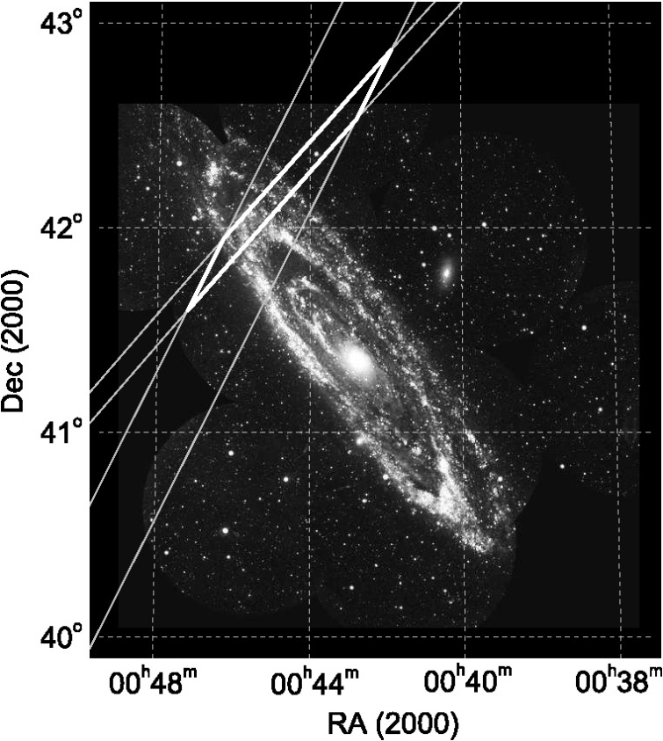
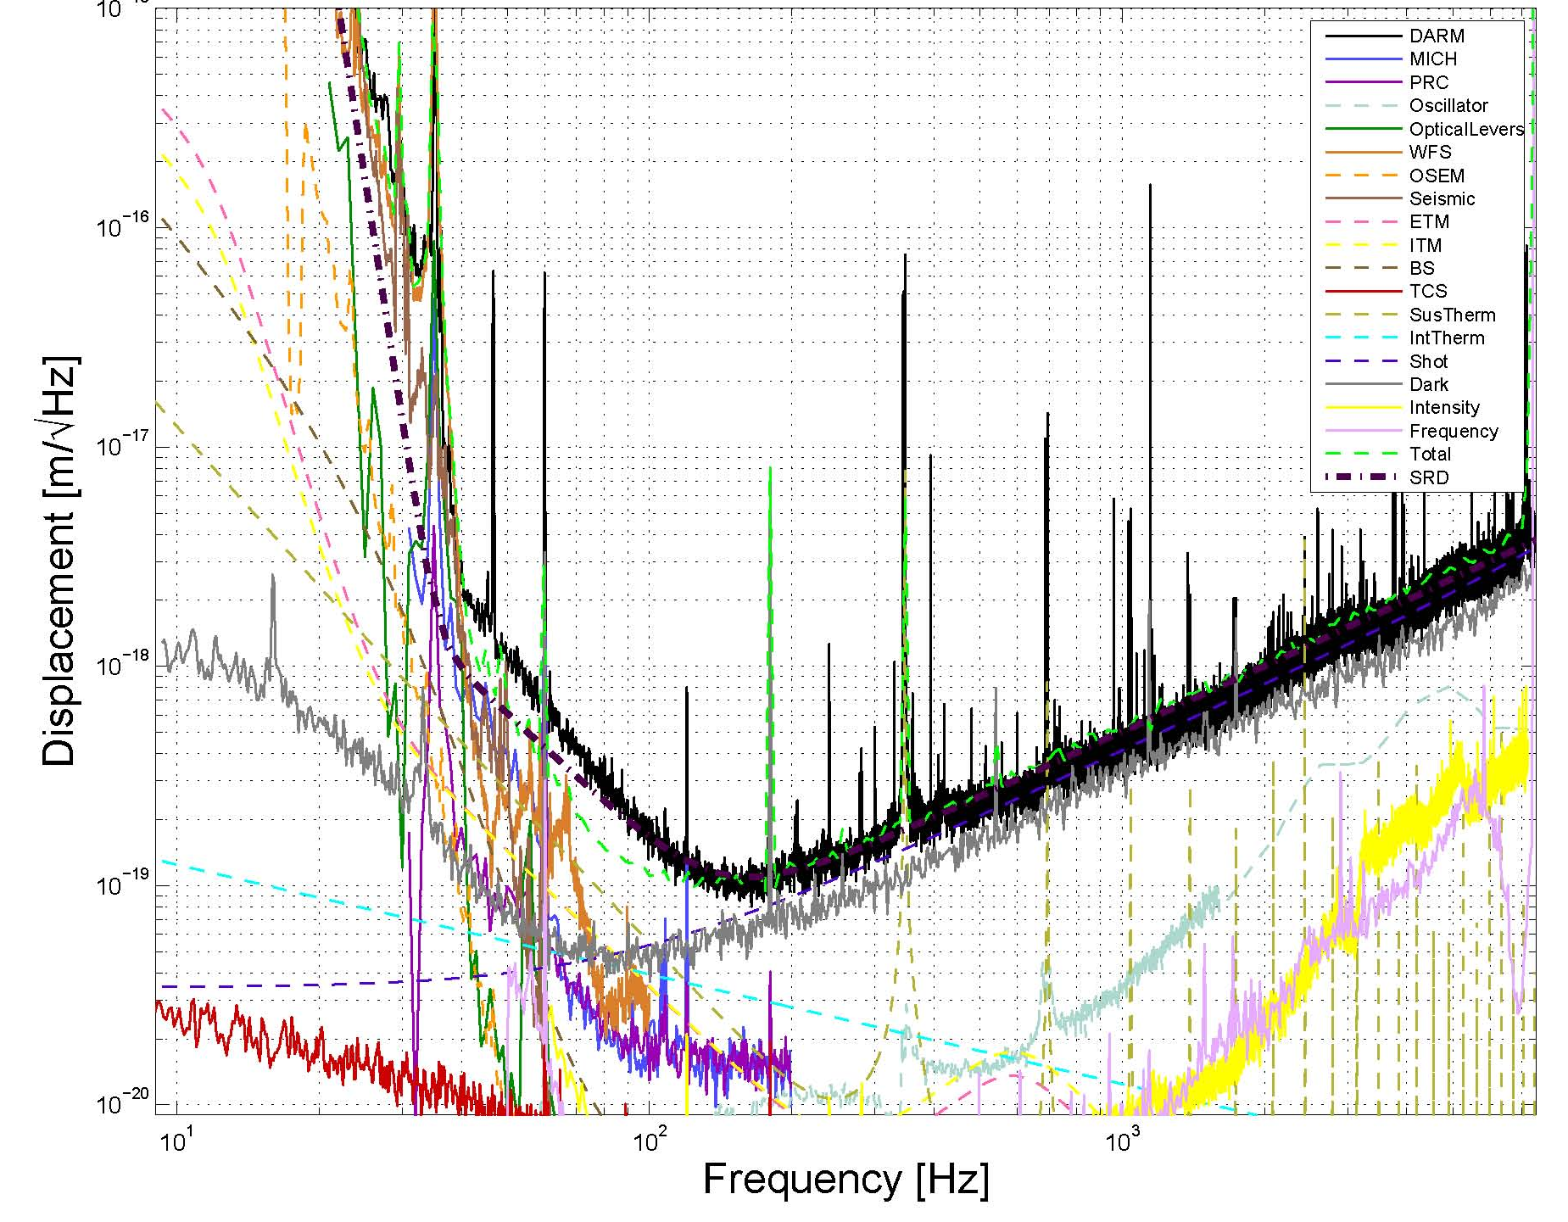
Results from Initial LIGO
Initial LIGO at design sensitivity from November 2005 to October 2007
No gravitational waves detected
Interesting /notable non-detections
Initial LIGO Detector
Initial LIGO Sensitivity
Crab Pulsar
  Energy loss due to gravitational waves less than 6%
  Ellipticity limit < 3 10⁻⁴
GRB070201
  Either not in Andromeda or not neutron star inspiral
Stochastic background below theoretical limits

Slide 32
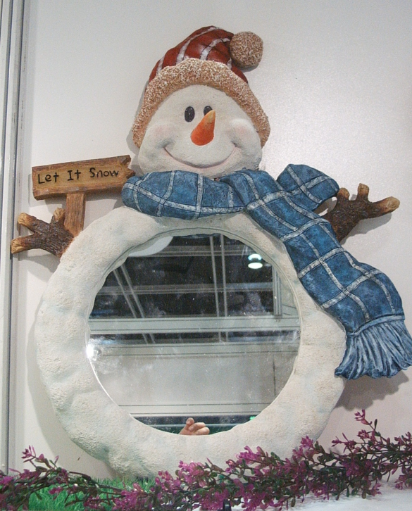
Cryogenics
Reduction in T directly lowers thermal noise
Need to study materials at low temperatures
  Properties can improve, worsen, or stay same
  New materials may become possible
Engineering challenges
High thermal conductivity materials to get heat out
High light power can add heat to optics
Refrigerators can cause vibration and other noise
Cooled Mirror

Slide 33
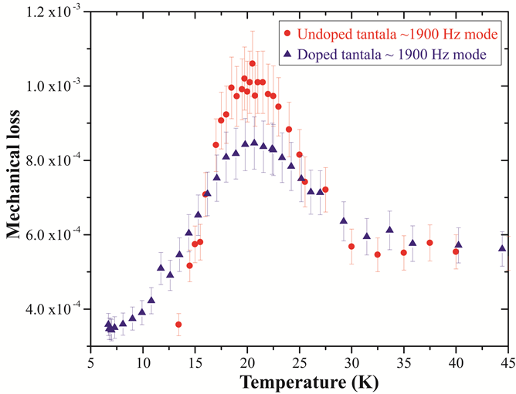
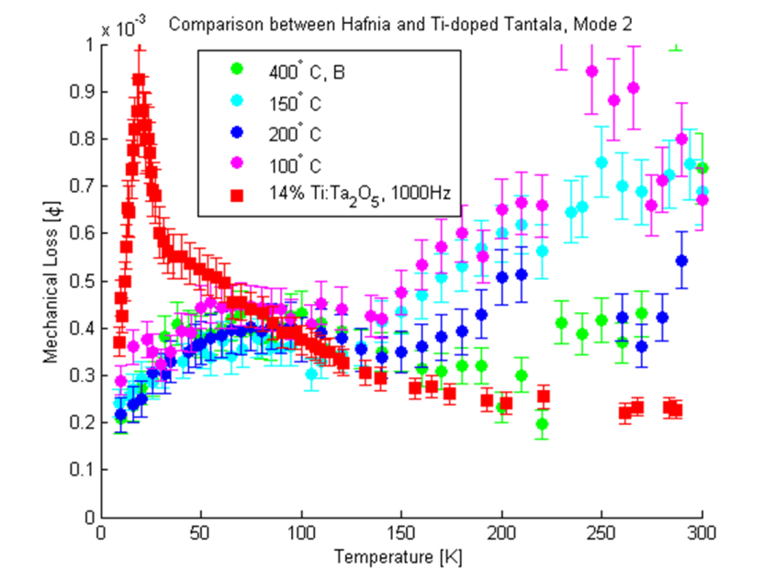
Cryogenics and Materials
Loss Peaks in Ta and Ti-Ta
Material φ’s change with T
Often have loss peaks
  Tantala, titania-tantala, silica
  Help understand source of mechanical loss
Very low T, φ’s become low
Many loss peaks different with annealing/doping
Hafnia (HfO₂) poor at room temperature but continually improves with low T
Hafnia Mechanical Loss

Slide 34

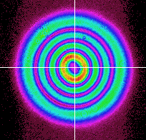
Beam Shaping
Different Shaped Beams
Averaging across mirror gives lower thermal noise
Effectively increasing w value
Brings up optical problems
  Optical loss at edge of mirror
  Cavity stability at high power
Many experimental attempts
Mesa beams
  Requires special shaped mirror
Laguerre Gauss beams
  Use spherical mirrors
  Plans for use in prototype
Laguerre Gauss 3,3 Mode

Slide 35
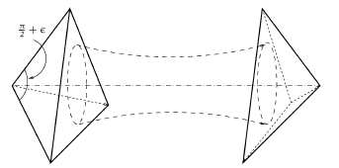
Coating Free Mirrors
Coating Free Mirrors
Can use total internal reflection effect for mirror
Need an anti-reflective coating on face
  Much thinner than reflective
Beam travels inside mirror
  Scatter, absorption concerns
Mostly theory and modeling work
Concerns with level of reflectivity achievable
Experiment using Brewster angle mirror
Brewster’s Angle Reflector

Slide 36
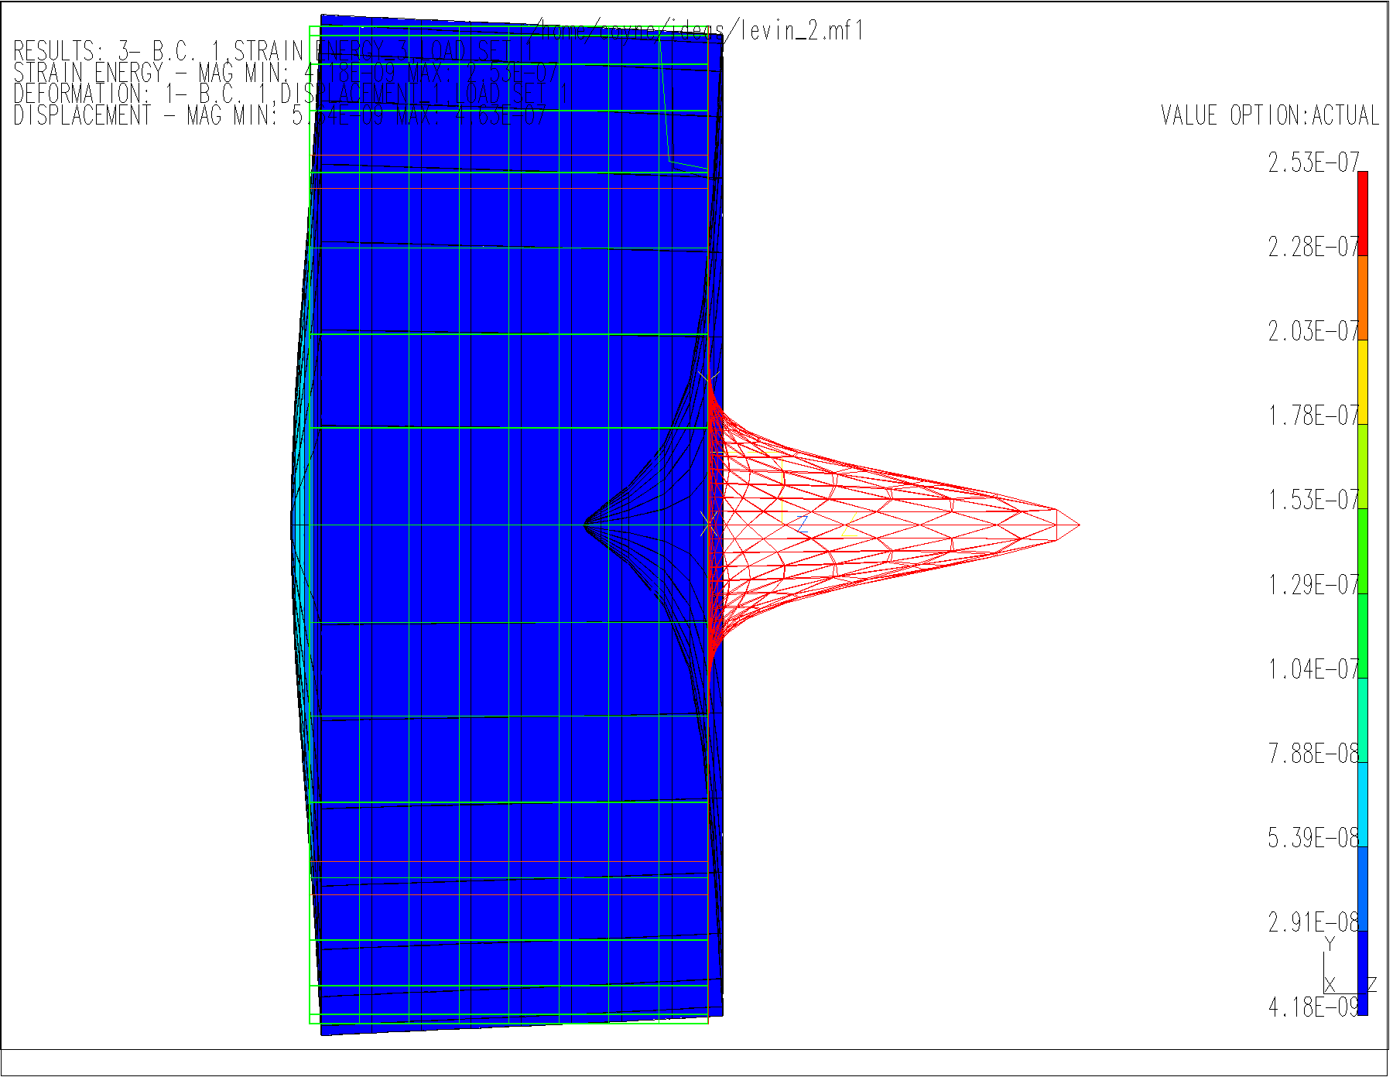
Coating Thermal Noise II
Side View of Optic
w: how well noise is averaged
d: how much coating
Y: how stiff is the coating
φ: how much heat energy can affect coating motion
w
Coating
d
Y,φ
Substrate

Slide 37
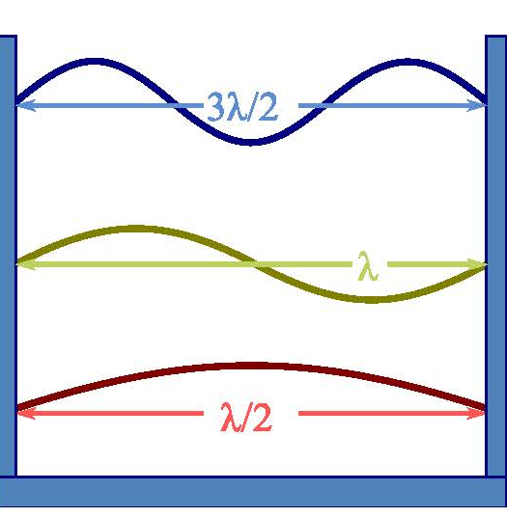
Frequency Stabilization
Optical cavities used as frequency reference
  Cavities have coated mirrors on each end
Light of certain frequency will resonate in cavity
Length stability determines frequency stability
Coating thermal noise will limit cavity length
  Currently limited to proton radius over 1 second
Optical Cavity
Cavity Resonance

Slide 38
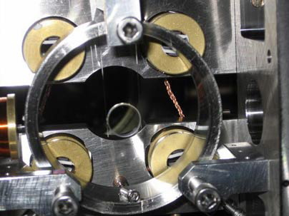
Cavity Optomechanics
Measure motion of small, but macroscopic objects
  Nano to milli grams
Some samples made by etching
  Only coatings, no substrates
  Coating properties crucial
Often cryogenic
Mini-mirror in Suspension
Light acts as spring
  Radiation pressure
Exchange energy between mirrors and light
  Doppler shift
Micron Scale Oscillator

Slide 39
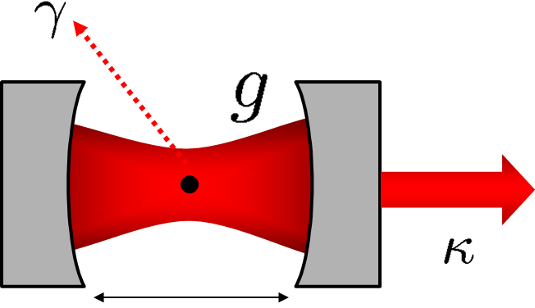

Cavity QED
Single atom (ion) in cavity
  Also quantum dot
  Bose Einstein condensate
Secondary beam traps atom
Thermal noise can influence trapping
Cavity with Single Atom
Coating scatter very low
  Chance of interaction with atom >> chance of scatter
Can use optical fibers to define cavity
Generate single photons
Fiber Optic Cavity

Slide 40


Frequency Stabilization Applications
Atomic clocks
Metrology of optical surfaces
Improved spectroscopy
Global positioning (GPS) technology
Gravitational redshift measurement over 1 meter
Sr Atomic Clock
Frequency combs
Link across frequencies
Connects atomic clocks based on different species
Optical frequency comparison to microwave standards
Study changes in fundamental constants
Frequency Comb

Slide 41

Cavity Optomechanics Experiments
Single electron spin detection
Quantum information theory (Qubits)
Quantum limits of force, mass, and position
Quantum mechanical behavior of large objects
  Coupling of large resonator to single atom
  Schrödinger’s cat experiments
Schrödinger’s Cat
Radioactive decay breaks poison bottle or not
Macroscopic state depends of quantum event
Just thought experiment until recently
Schrödinger’s Cat Experiment

Slide 42

Cavity QED Applications
Study fundamental quantum systems
  Interaction of light and matter
Single atom lasers
Single Atom Loaded Into Cavity
Measure entanglement between different atoms
  Secure quantum cryptography
Quantum computation
Quantum networks
Quantum Computer

Slide 43

Young’s Modulus Measurement
Thermal noise is a force noise
Stiffness converts force to position
Young’s modulus of both coating and substrate important
Water
1” dia. optic
Coating
Glass Slide
Spacer
Transducer
Y Experiment
Work at ERAU on Y
Green trace from silica
Blue trace from sapphire
Also studying high index coating materials
Pulse from Young’s Modulus Measurement

Slide 44

Thermo-optic Noise
Different form of coating thermal noise
Thermal fluctuations cause change in index of refraction and layer thickness
Does not depend on φ, but on dn/dT and dL/dT
Generally less than Brownian thermal noise
ERAU center of thermo-optic noise research
Measuring dn/dT from changing reflectivity with temperature
Difficult data analysis from multiple layers
Experimental Setup at ERAU

Slide 45


Khalili Cavities
Make one mirror of cavity itself a cavity
Thick coating (EETM) sensed by less light
Thin coating (IETM) sensed by more light
Khalili Cavity
Planned for use in prototype interferometer
Added complexity due to additional mirror
Hope to study quantum noise and squeezed light
10 m Interferometer Prototype

Slide 46
Initial and Advanced LIGO Sensitivity

