Slide 1
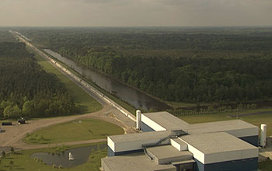
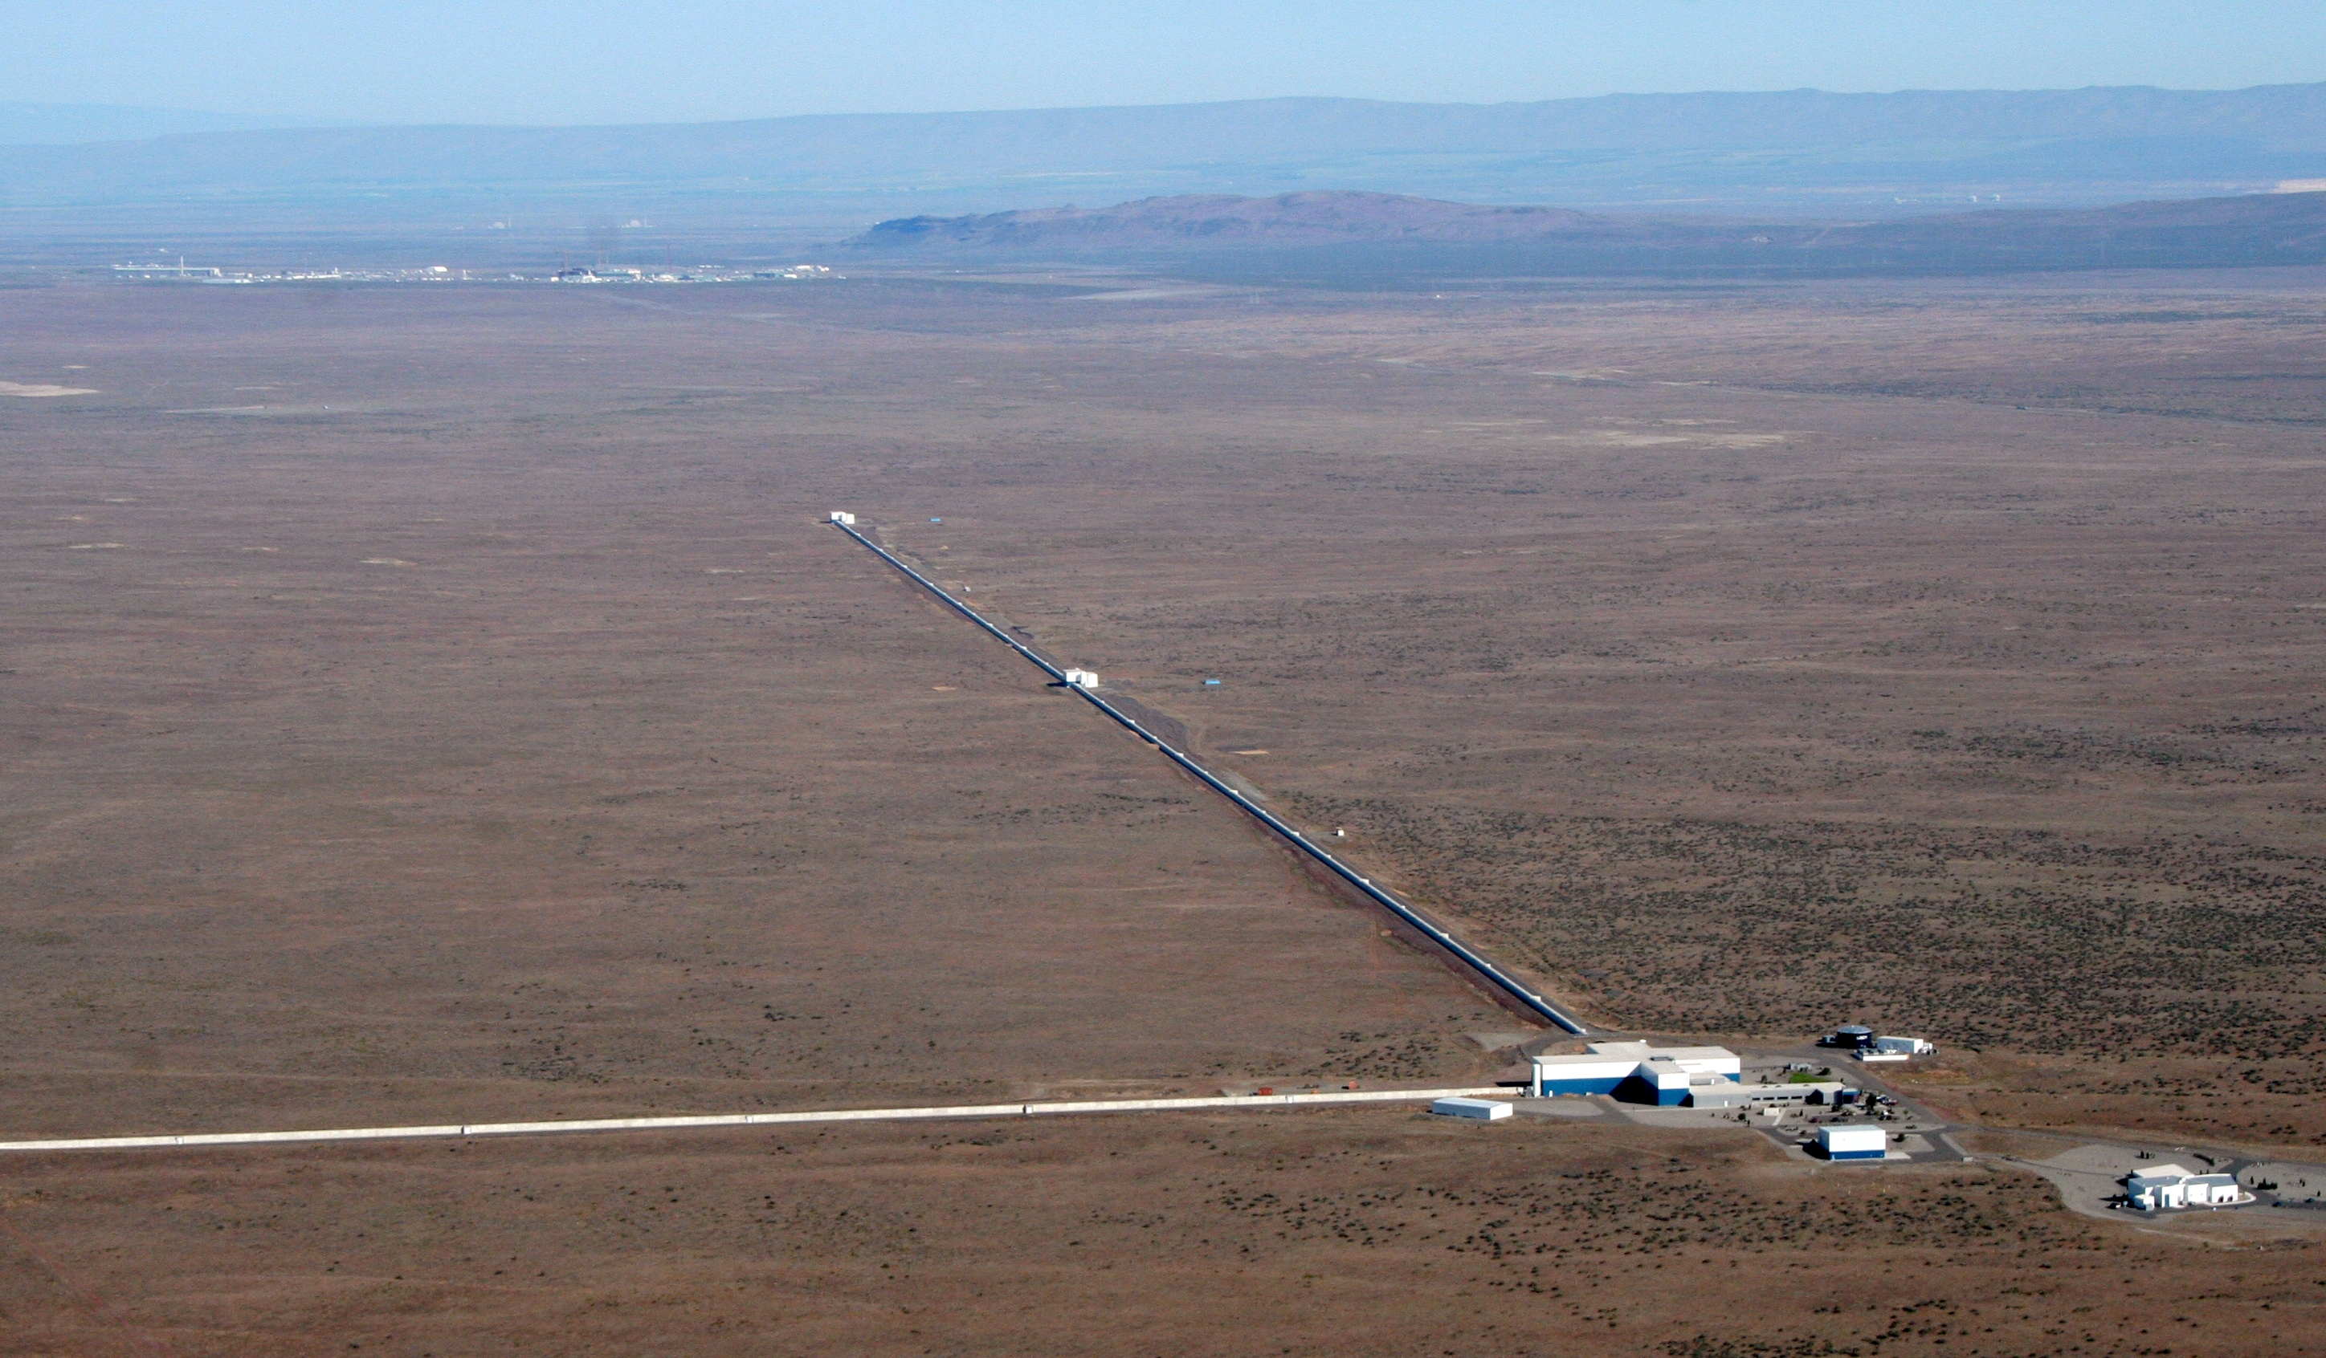
Complexities in Operating Large-scale Gravitational Wave Interferometers
Corey Gray
Lead Operator
Siksika Nation
Mike Landry
Lead Scientist
LIGO Hanford Observatory/Caltech
for the LIGO Scientific Collaboration
Oct 12, 2012
SACNAS National Conference
Notes:
Interferometer & MAINLY working at an observatory
Be QUICK!! 15sec!

Slide 2
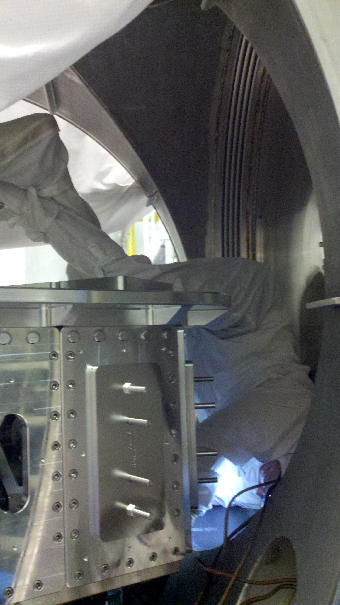
Outline
WHO works at LIGO?
THE WORK at a LIGO observatory
Building
Commissioning
Operating
Running an Interferometer
What it takes
Investigations/problems
Tweak, perfect, & be quick!
Goal
In-Chamber Work
Notes:
Cleanroom suit
Table
No dust on optics!
Headaches: What we do for science!

Slide 3
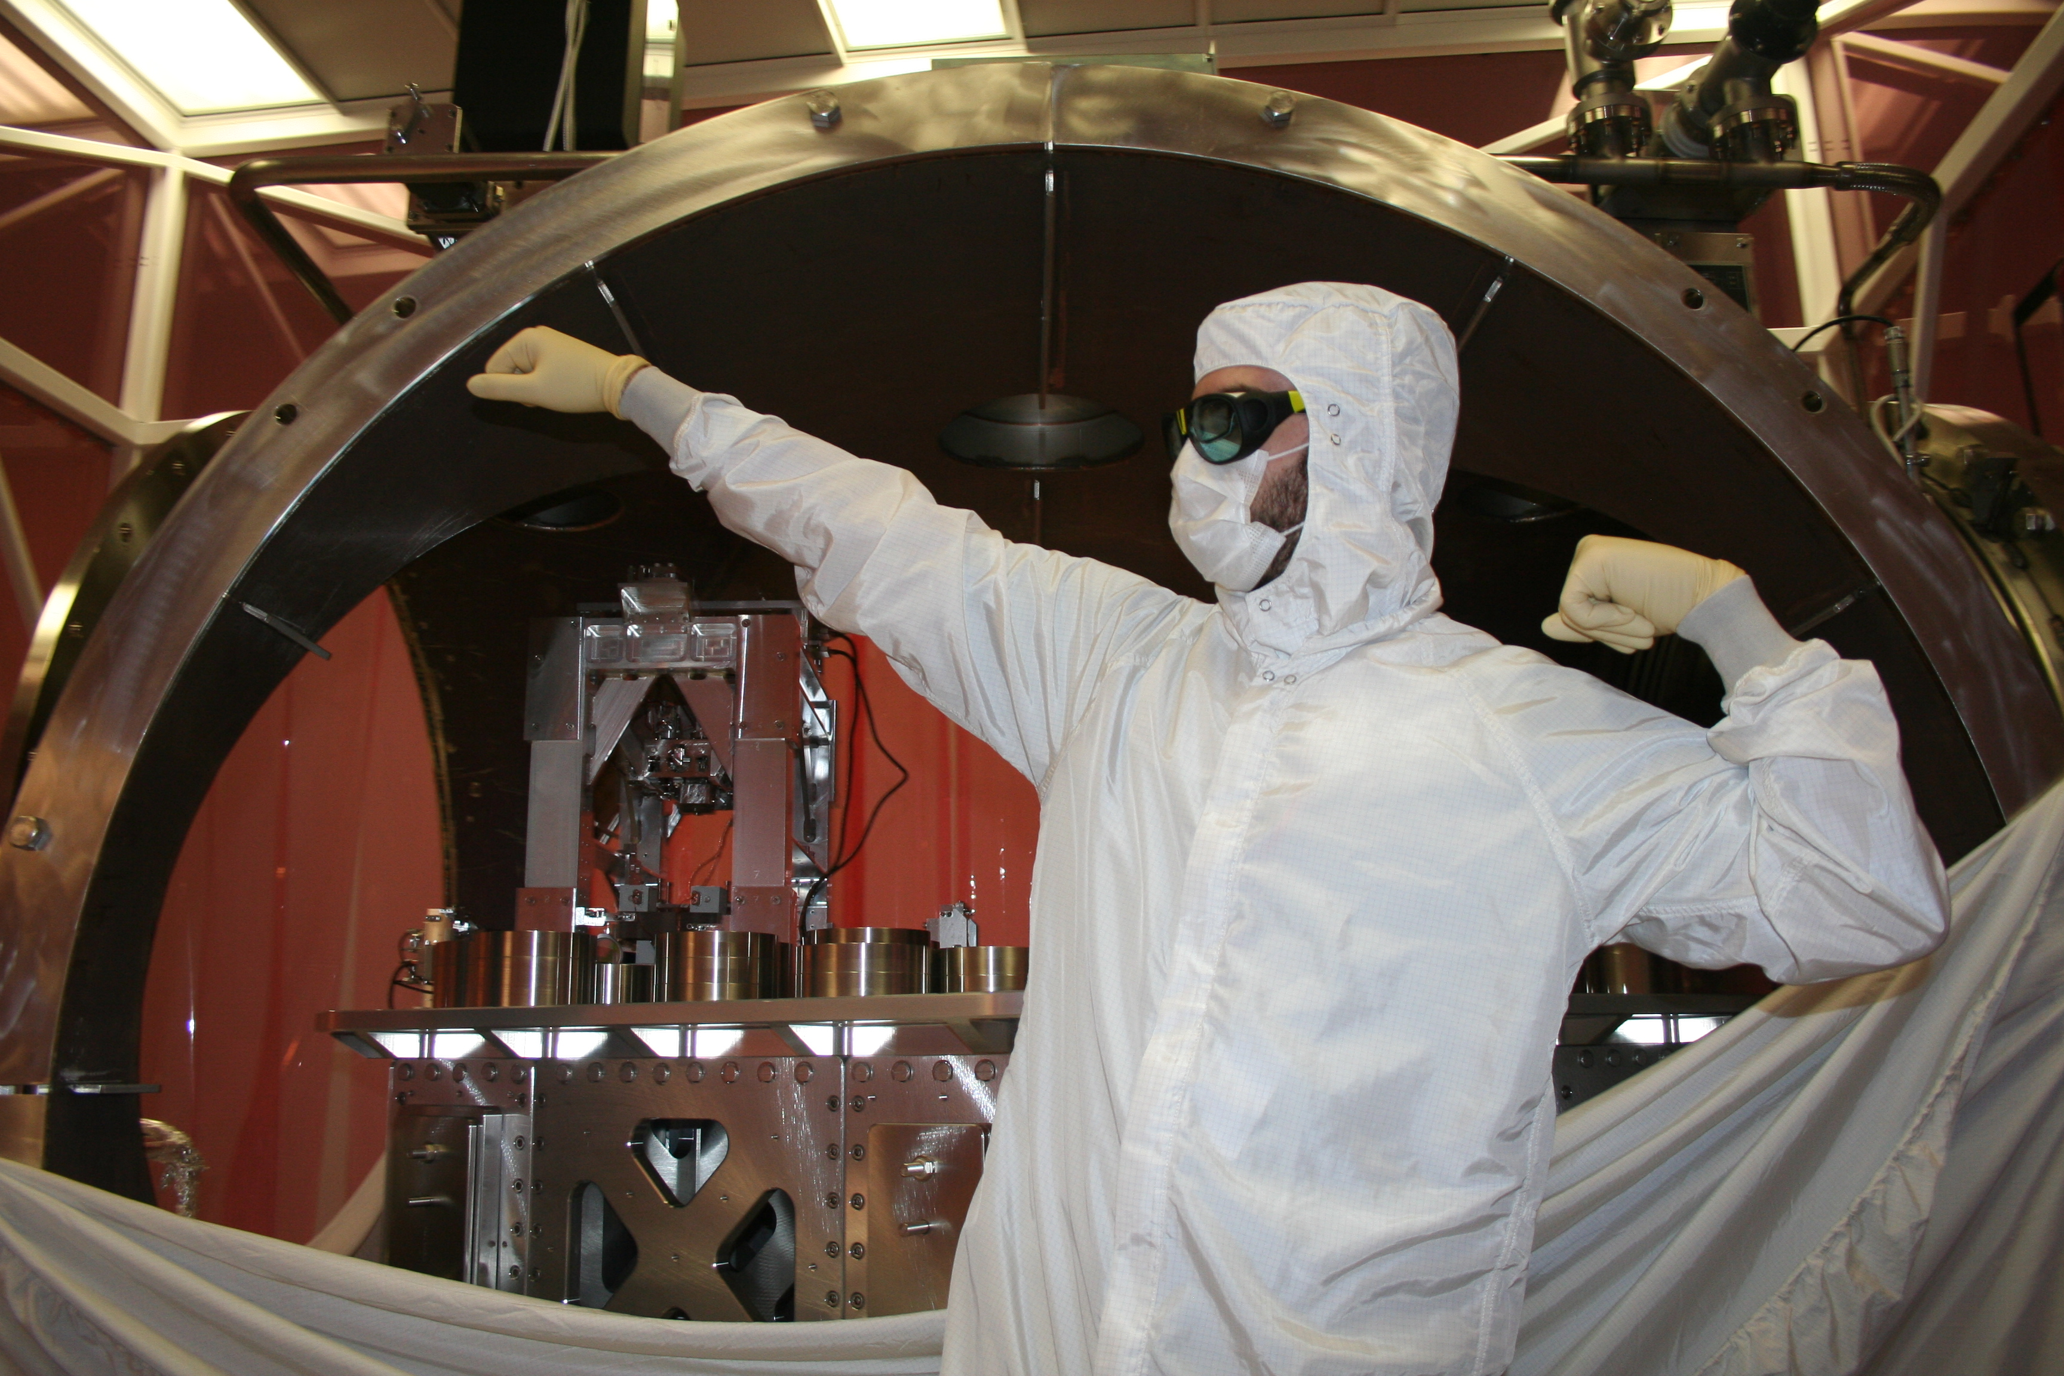
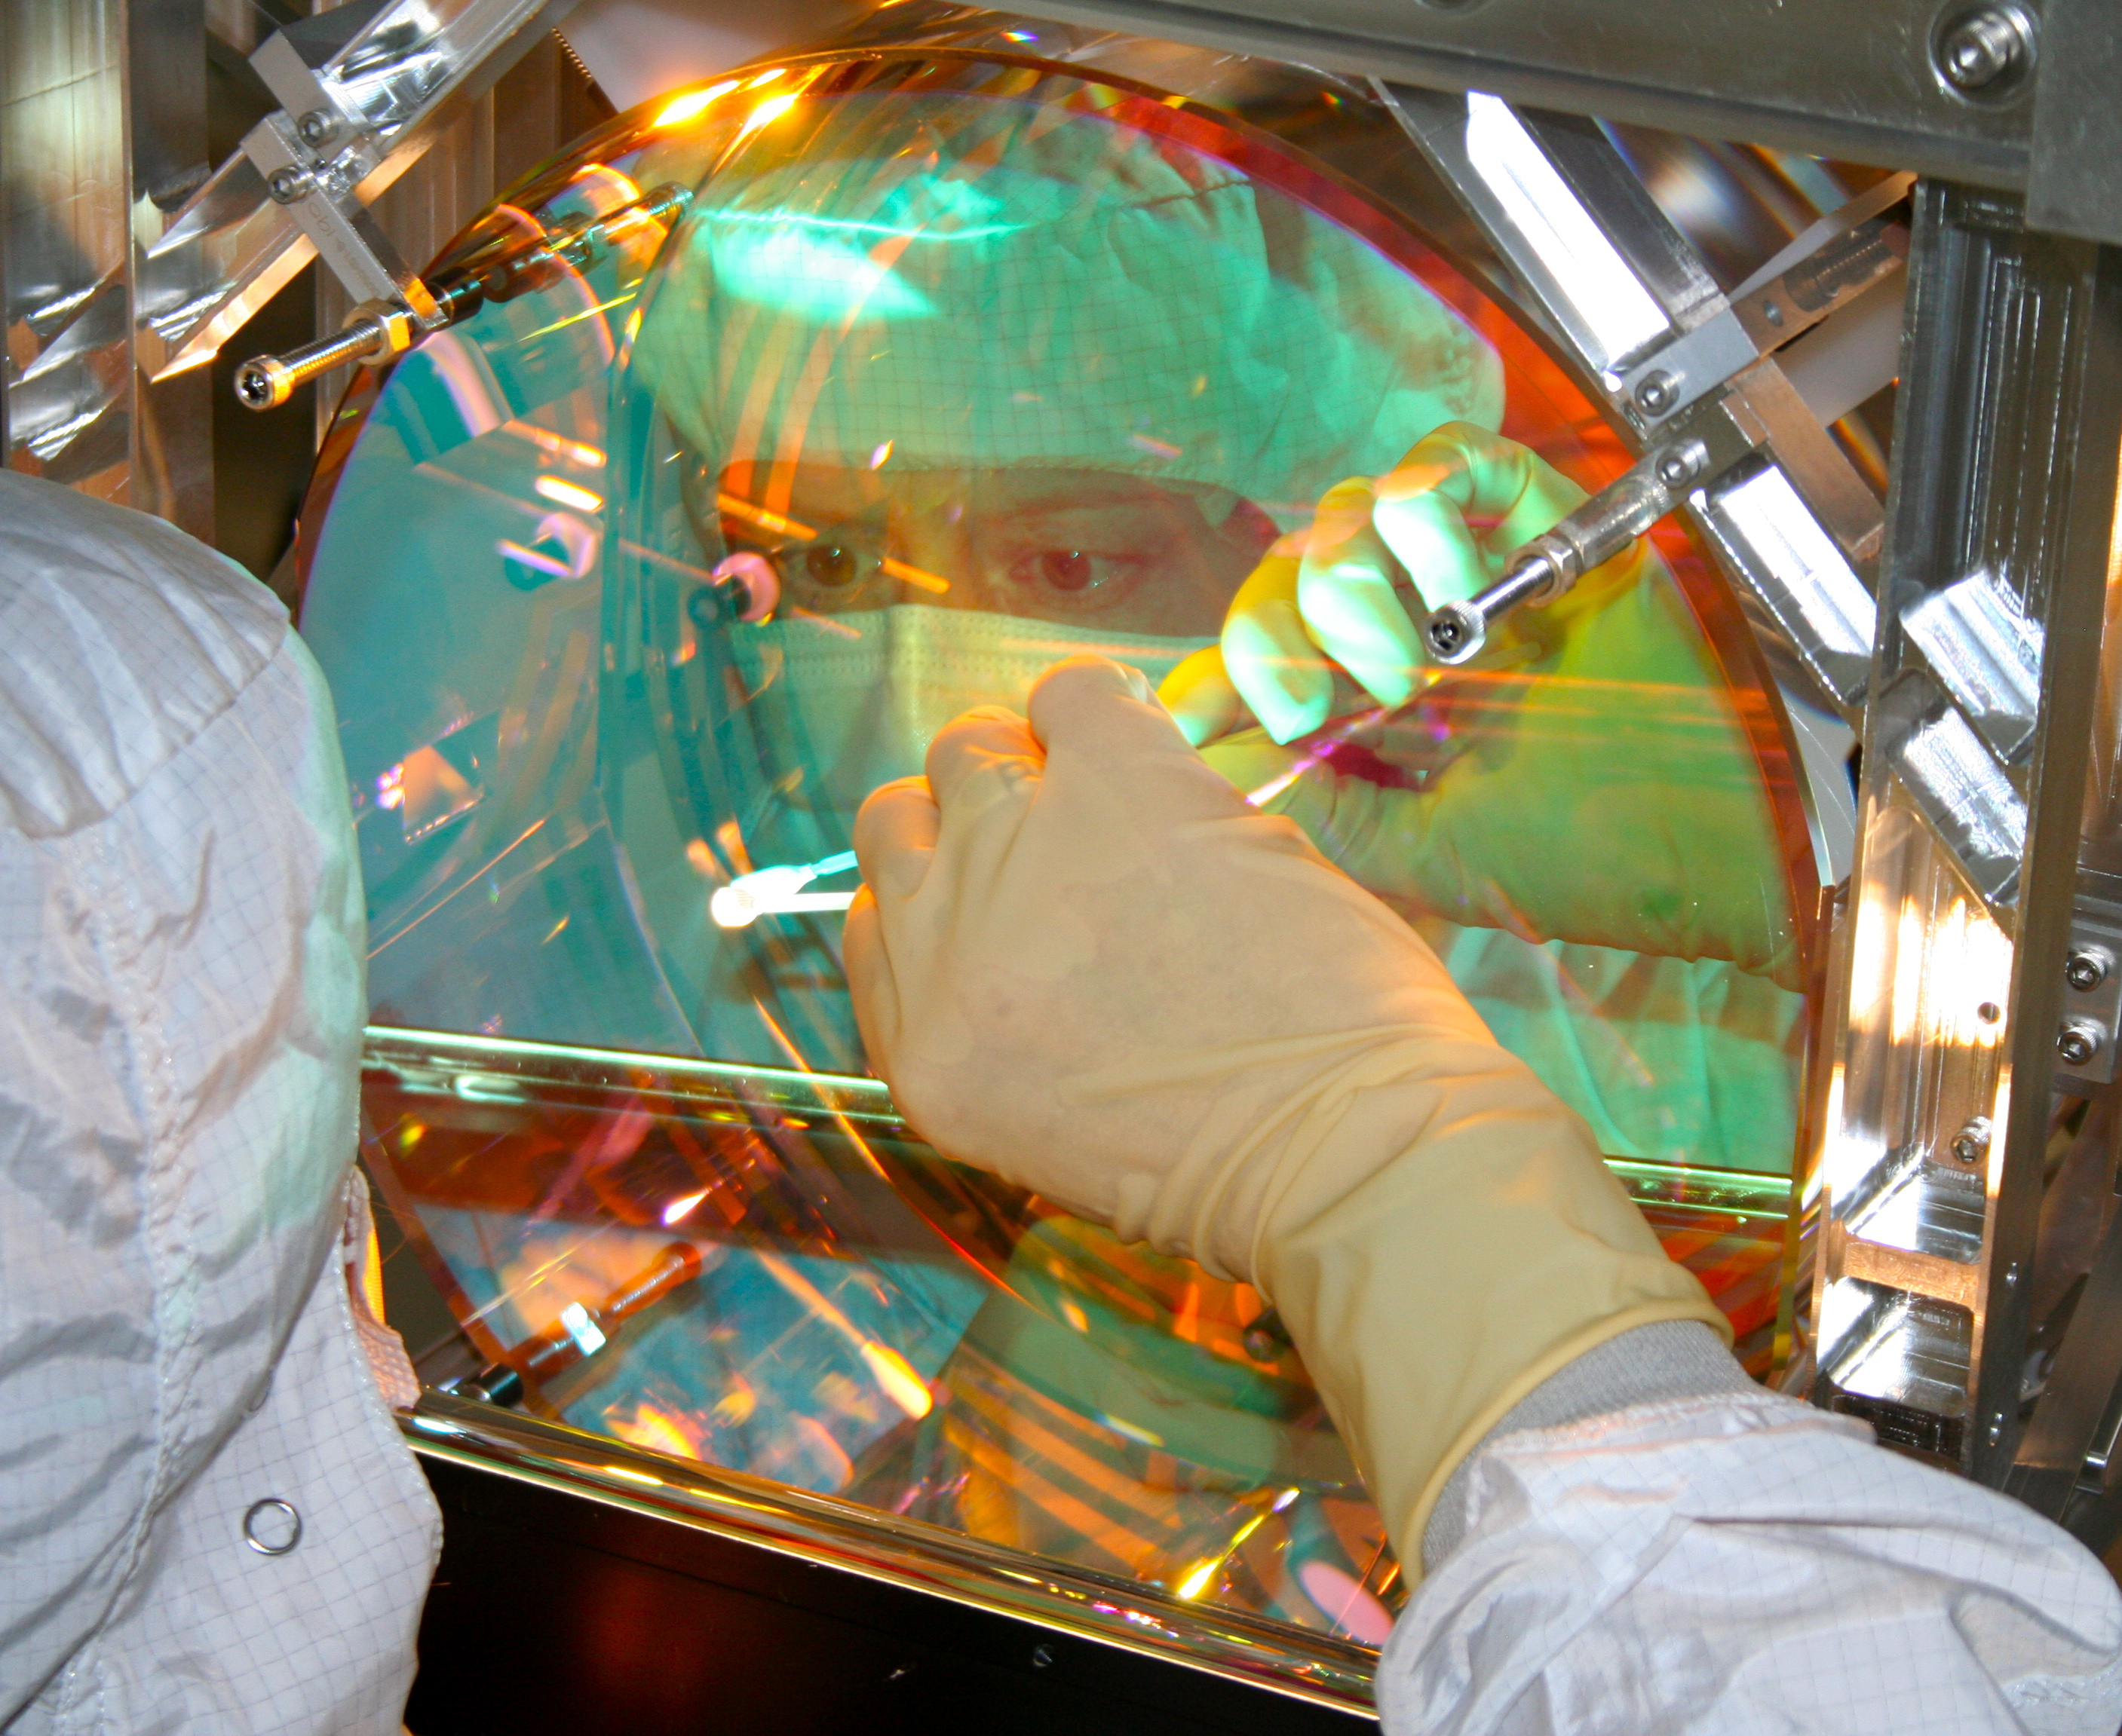
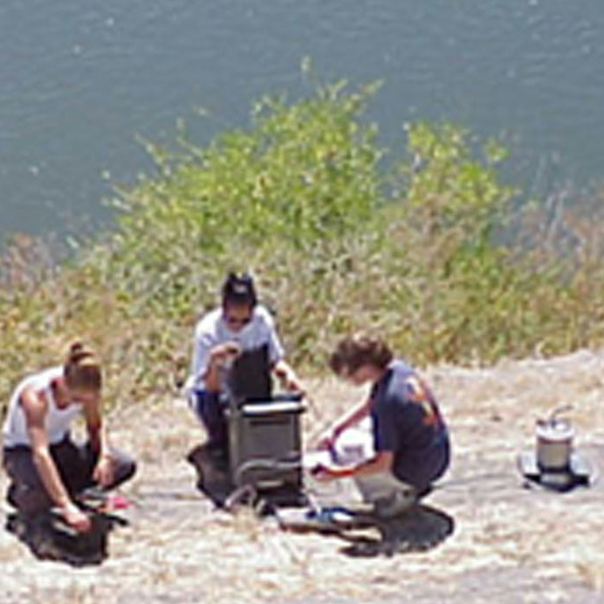
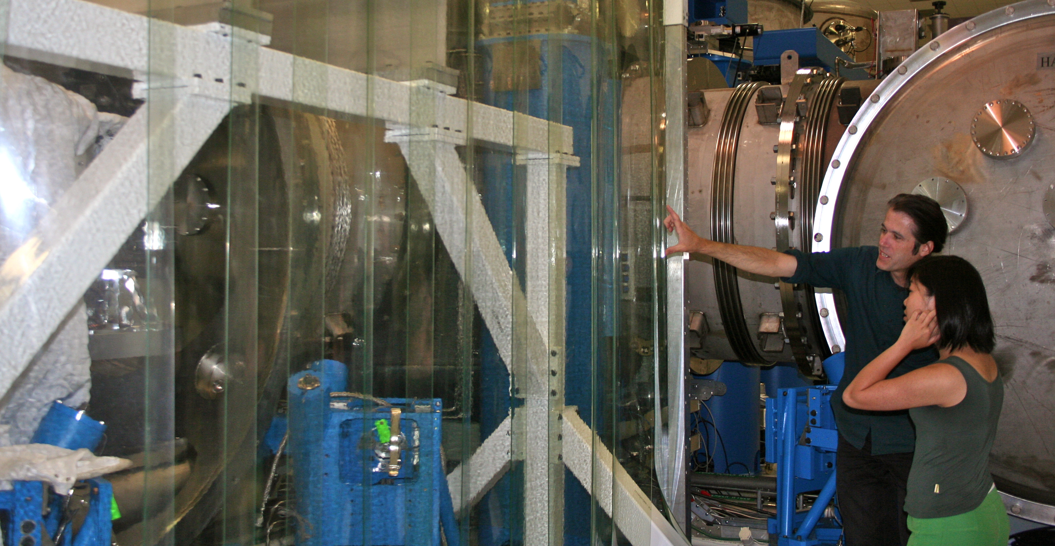
WHO Works At The Observatory
LIGO encompasses a wide array of fields
(Physicists, engineers, technicians, post docs, grad students, interns)
Site Population: 40-90
Notes:
Don’t forget POPULATION!
Cleaning a Mirror!

Slide 4
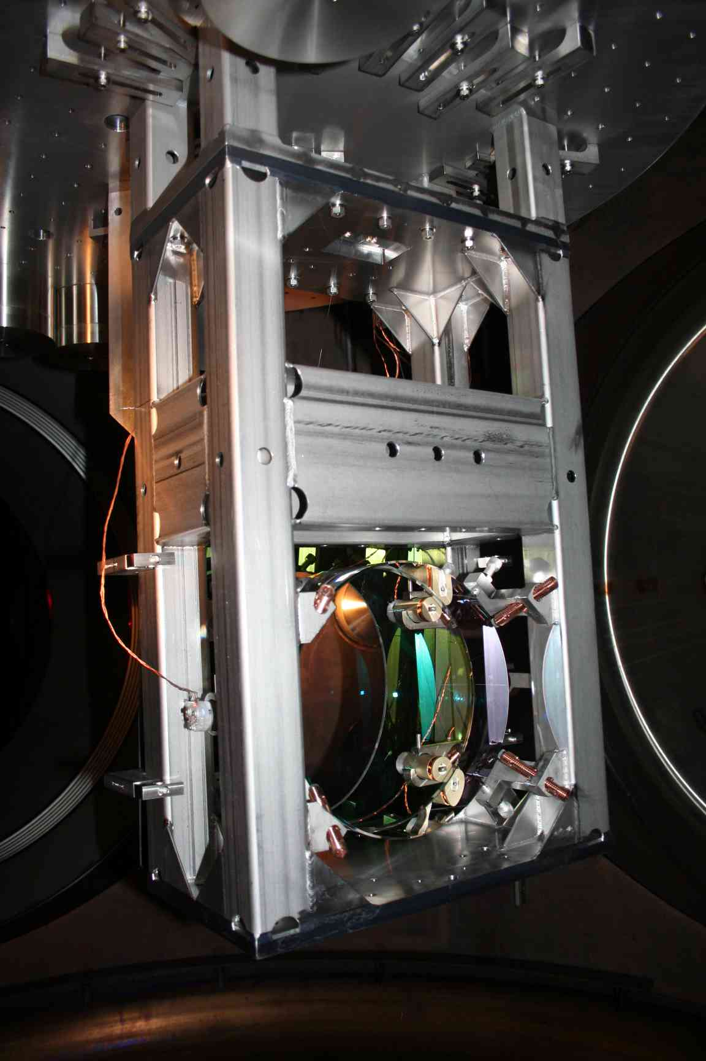
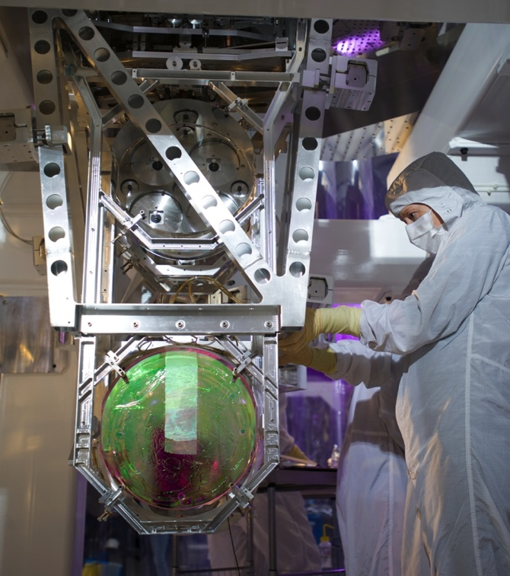
The Work: Assembly 10X more sensitive, >10X harder…
14 unique fabricated parts
68 fabricated parts total
165 total including machined parts and hardware
188 unique fabricated parts
1569 fabricated parts total
3575 total including machined parts and hardware
Test mass suspension
From Initial LIGO
Test mass suspension
From Advanced LIGO
Notes:
20x more parts!
Finish by 4:00!

Slide 5
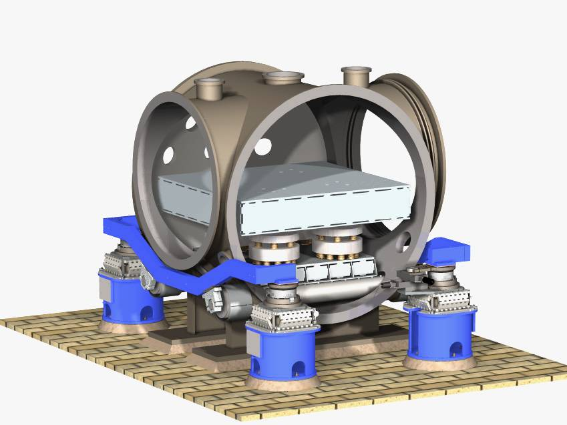
The Work:
iLIGO seismic isolation table
Assembly &
Installation
Building a Seismic Isolation Table
Installation
Notes:
snapshots of installation
Bolts: 22 vs 2368! Two orders of magnitude
1 Month To Build
Installation: 24 sec

Slide 6
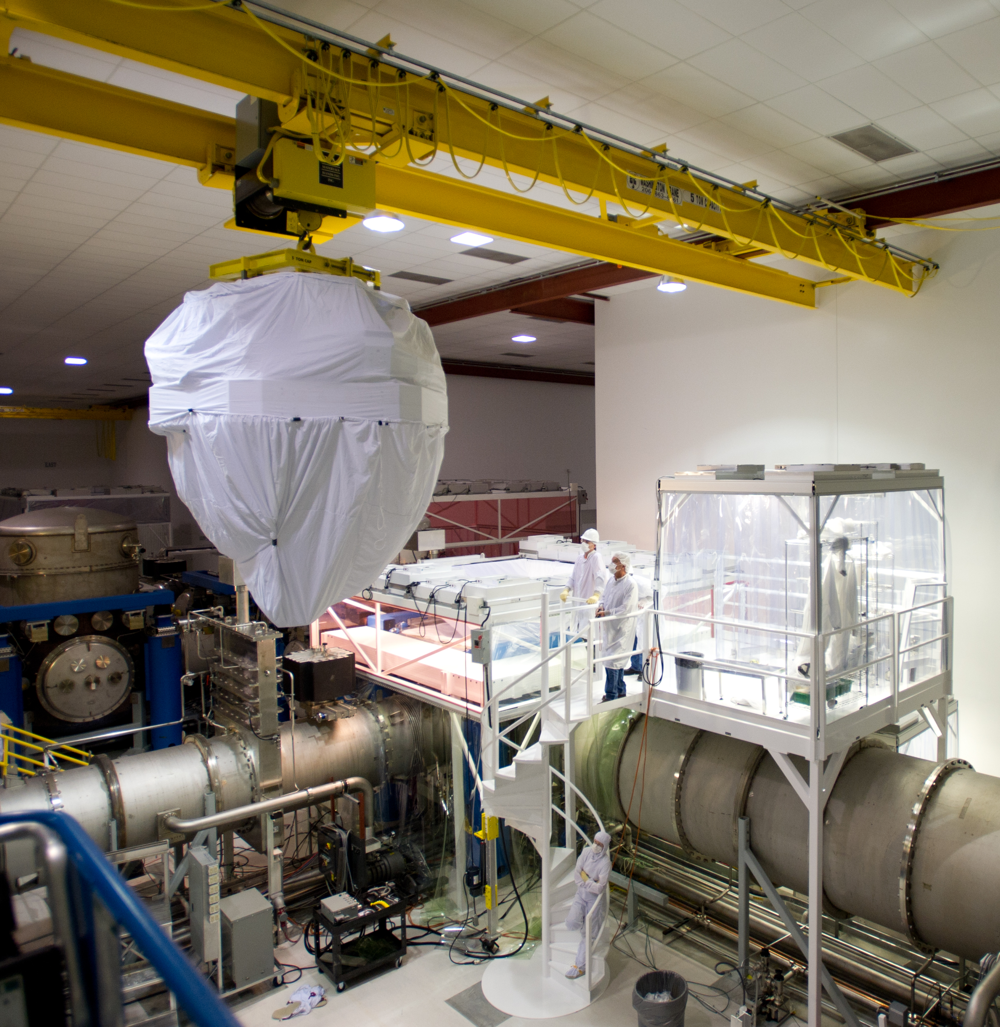
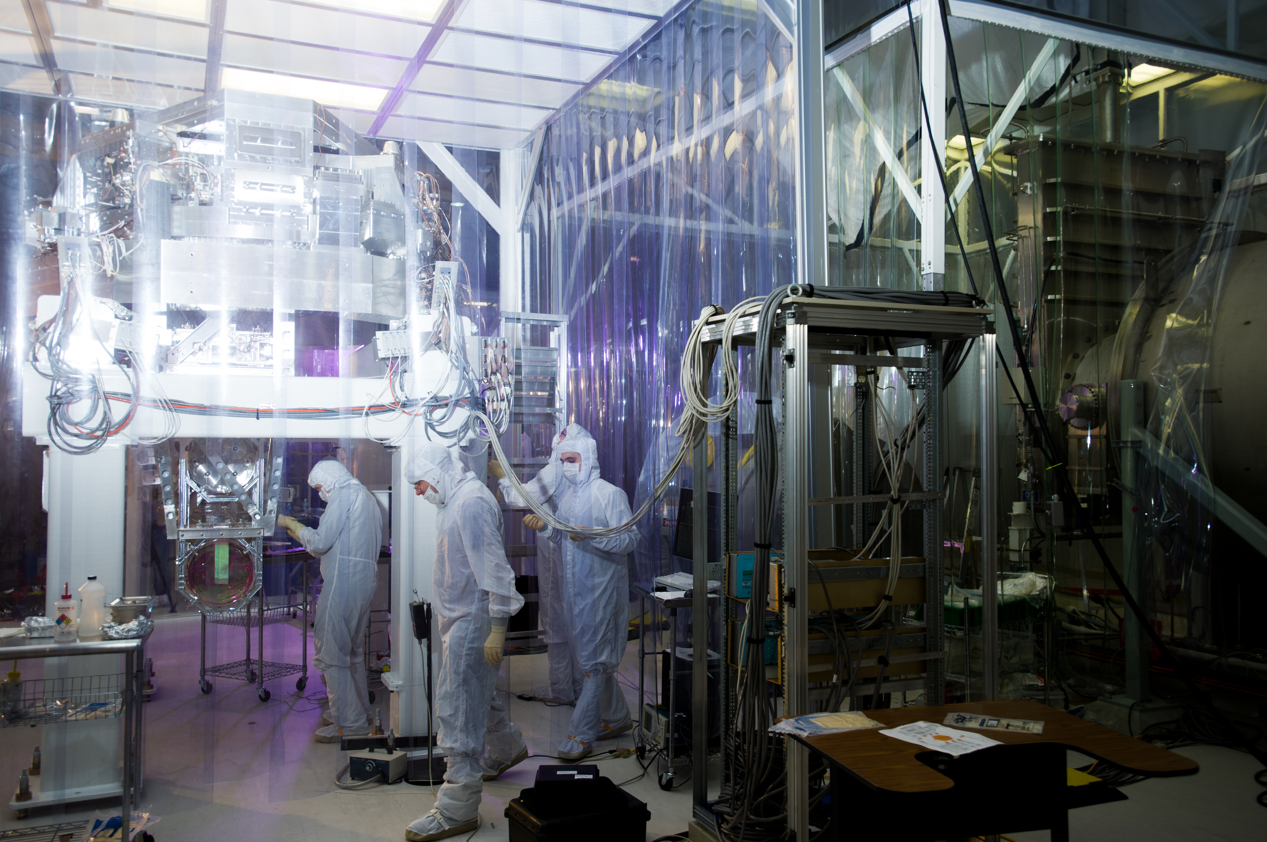
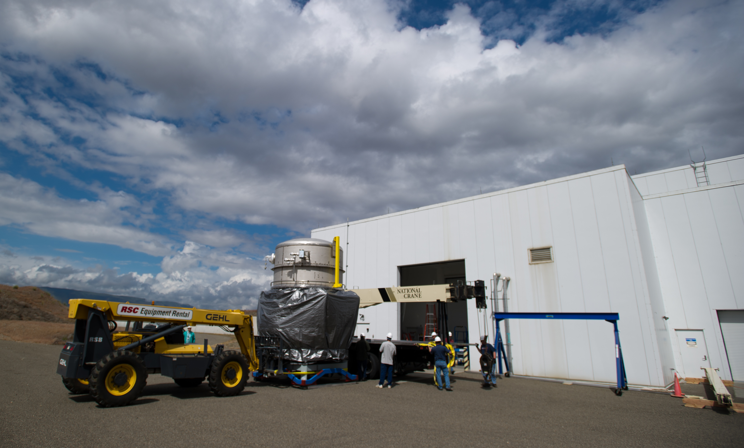
The Work: Installation
Building a gravitational wave detector:
One piece at a time.
Notes:
Be quick!!
BSC ISI: 10k lbs!
BSC Chamber: 20k lbs!

Slide 7
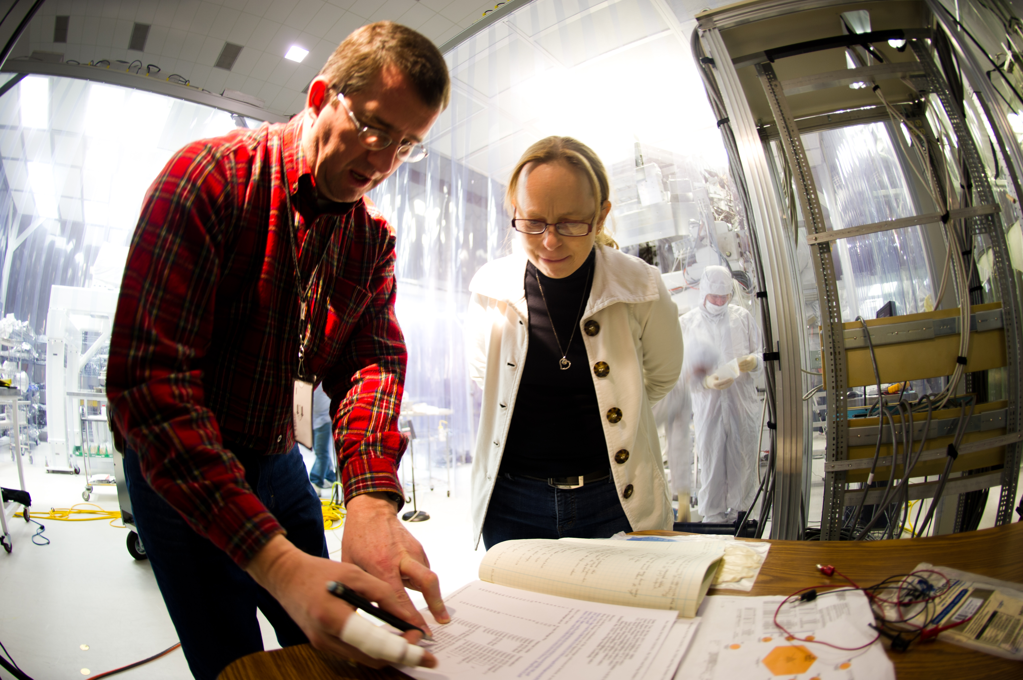
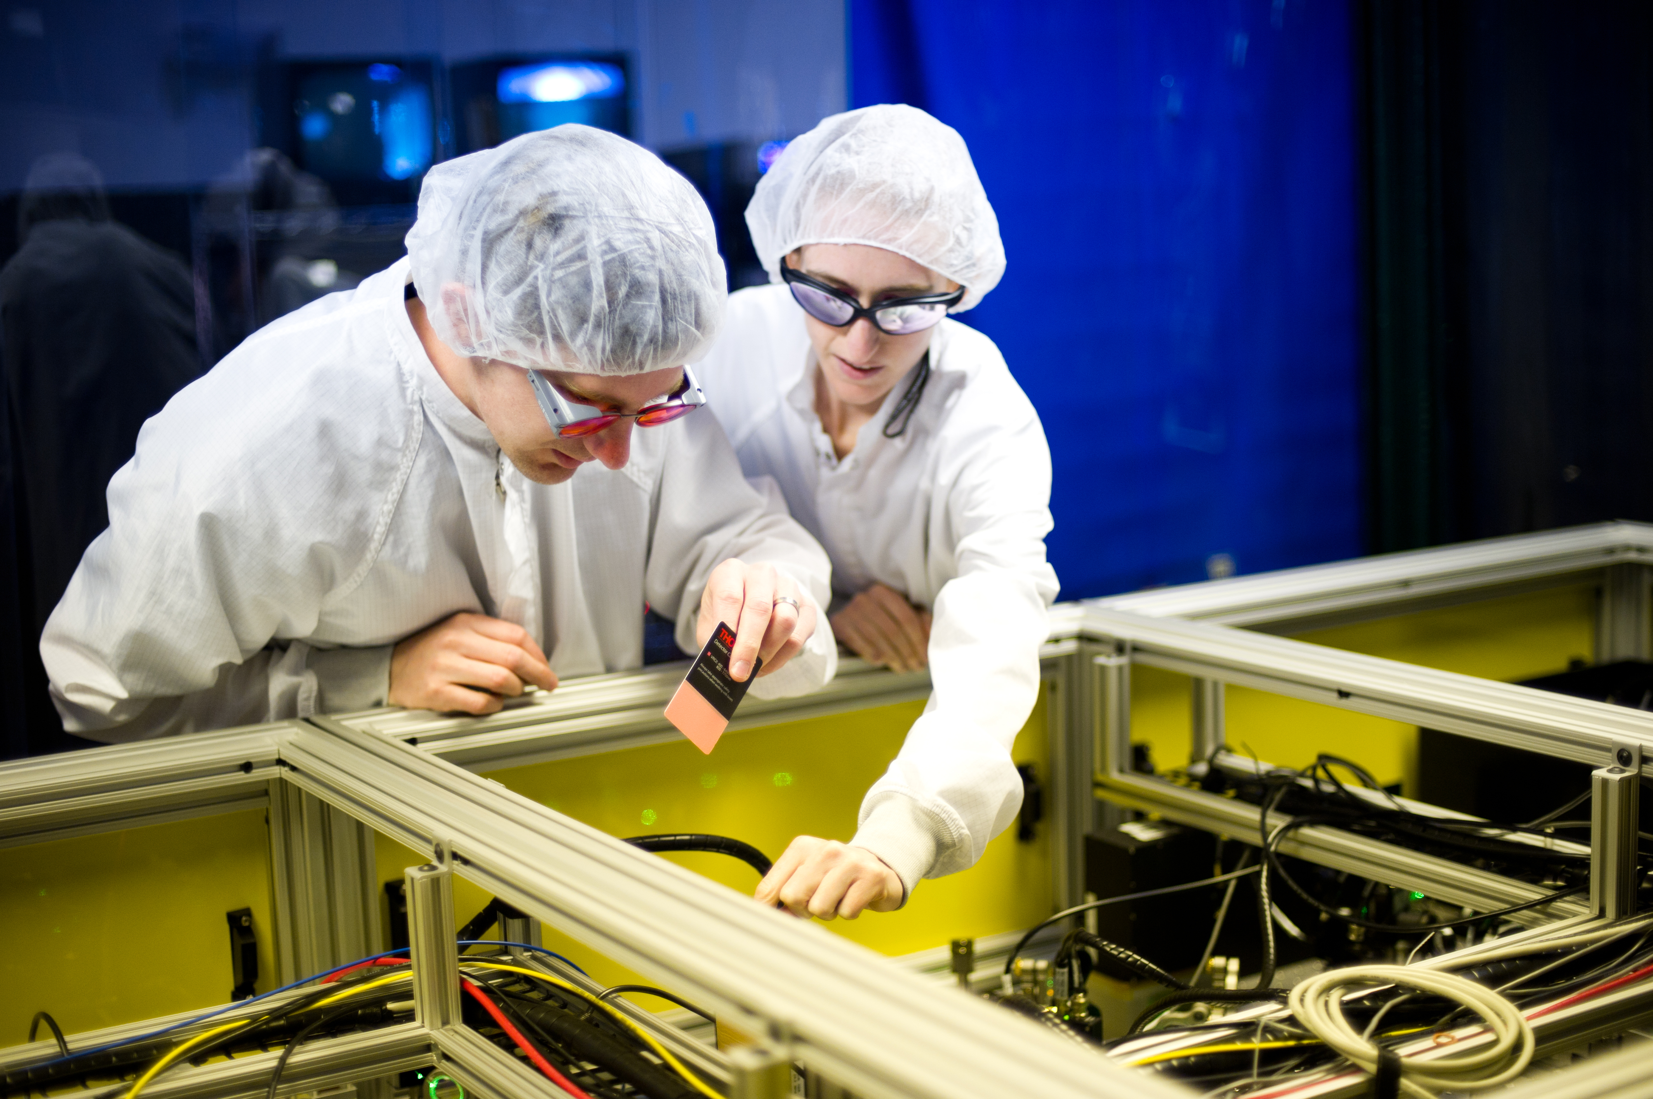
The Work: Commissioning
Commissioning a gravitational wave interferometer:
Putting it all together.
Simplify & automate
Reduce noise
Make ready for detections
Notes:
HALFWAY!!!

Slide 8
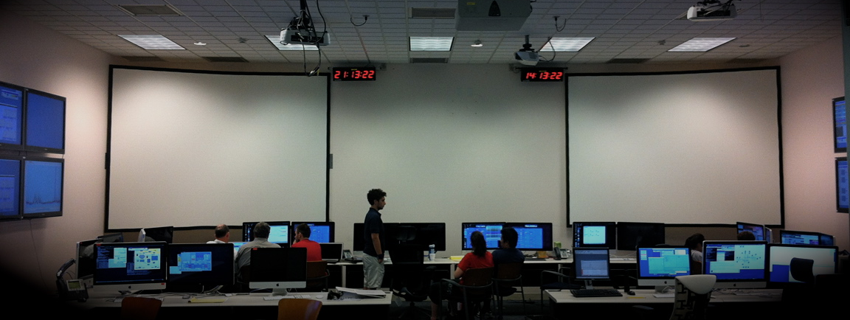
Running An Interferometer
What It Takes
24hrs a day Operation
Want a boring shift!
Interferometer Arch Enemies:
Environmental Issues (earthquakes, wind, ocean storm, etc.)
Cultural “Noise” (traffic, dams, logging, etc.)
Equipment (computers, laser, liquid nitrogen tanks, …)

Slide 9
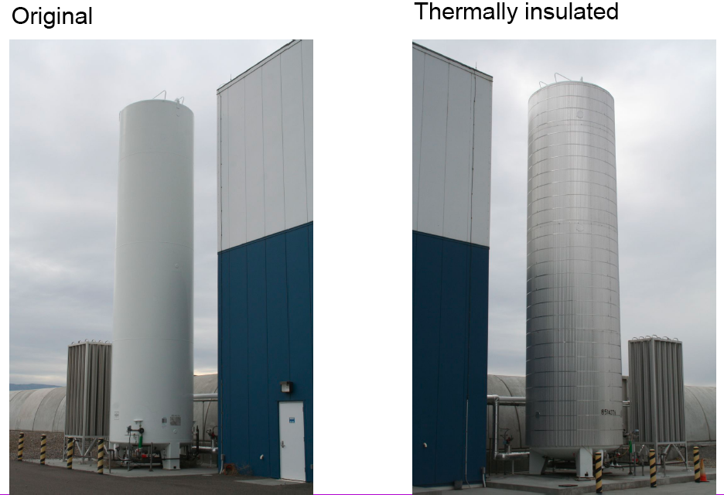
Problem Solving, An Example: Liquid Nitrogen Tank Jolts
Liquid Nitrogen Tanks
Notes:
Mystery
Temperature effect (sunrise/sunset)
Didn’t Expect!
Time Series & Power spectrum

Slide 10
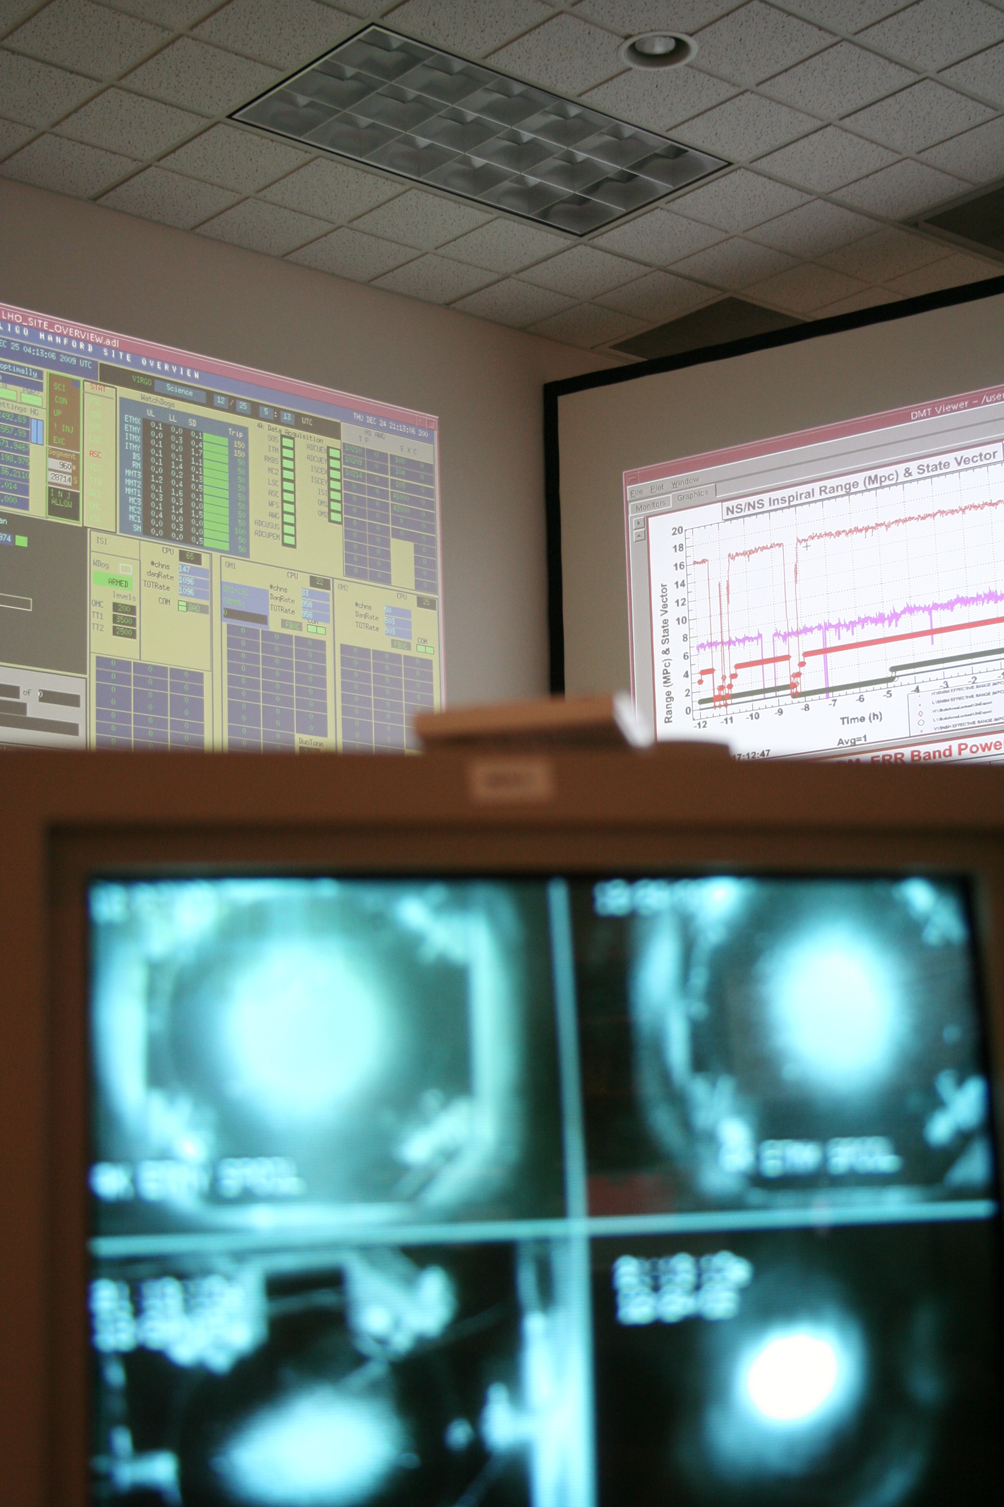
Running An Interferometer
Tweak, Perfect, & Be Quick
Real ways to optimize your interferometer:
Alignment
Optimized damping
Monitoring/minimizing site activities
Consistency
Long & quiet stretches are always what you want
Notes:
EFFICIENT
Data Analysts

Slide 11
A Quiet Night In LIGO Control Room
Dec 27, 2009 Evening shift
Notes:
A Treat
Hearing light
Wire resonances
Look forward to being here in a few years with ALIGO
Quiet shift, ready & waiting for detection!
46 sec
Other stories: sense nuances—Gerardo is the best

Slide 12
Ultimate Goal: Gravitational Wave Detections!
Keep an eye out for LIGO when we bring our new detector online
Visit one of our observatories in Washington or Louisiana (or India)
And drop by our booth today and tomorrow!!

Slide 13
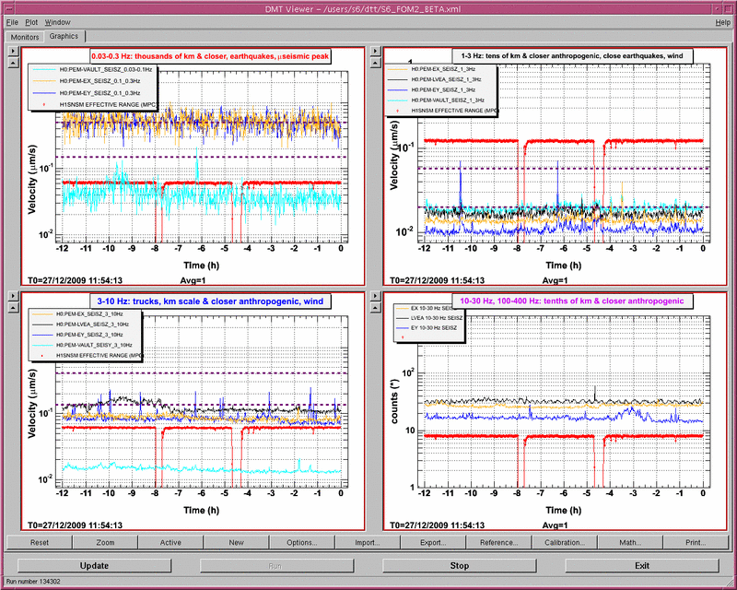
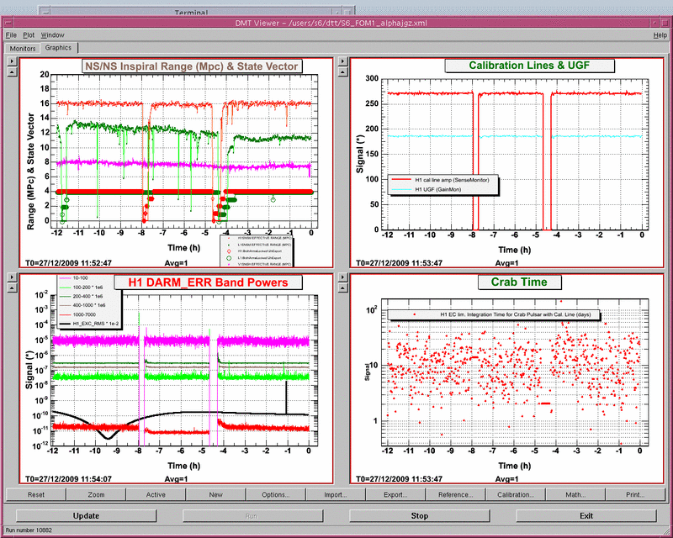
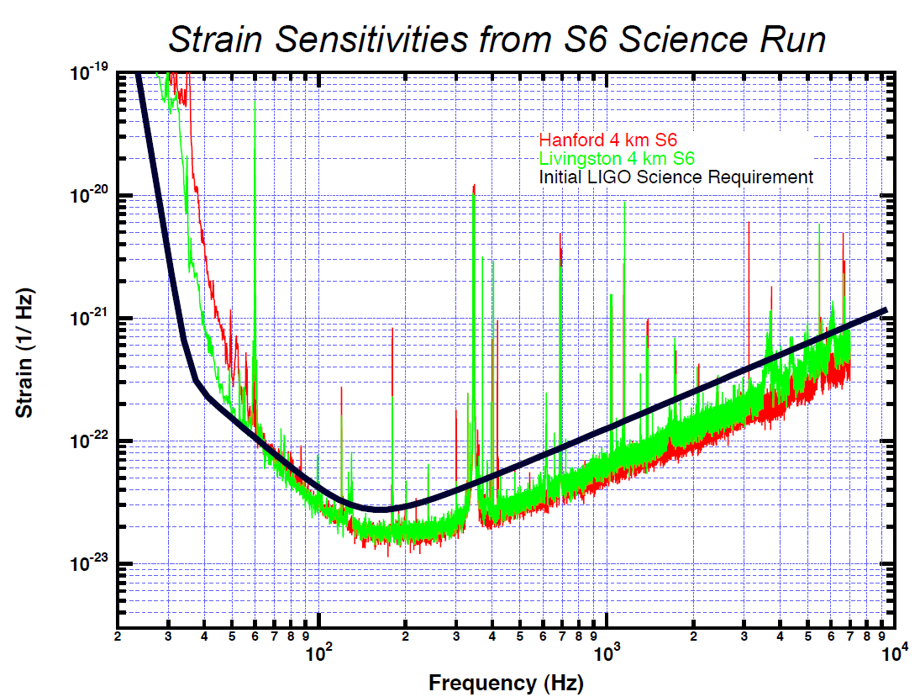
Important Plots

