Slide 1
Cavity Error Calibration Notes for a Damped Triple Pendulum
Brett Shapiro
G1201058-v1

Slide 2
Purpose
To show the basic theory for generating a noise budget for a locked cavity in a simple, yet complete way.
Disclaimer: This is meant to be a simple overview. The implementation details such as electronic filters, input/output matrices, software gains, etc. are not included. Nonetheless, the theory may be considered complete because the aforementioned details can be thought of as part of the control elements and/or the plant.

Slide 3
Contents
Cavity Schematic with damping and hierarchical control
Block diagram of the hierarchical sus in cavity
Noise budget calibration steps
Structure of the damped elements of the block diagram
MATLAB code to build a damped pendulum model
Simulated noise budget calibration plot
Extras: simulated hierarchical loop gain

Slide 4
Schematic Diagram (no noise)
-
-
-C_{damp}
top
top
-C_{damp}
C_{mid_control}
mid
mid
C_{bot_control}
bot
bot
e: cavity error signal
-1

Slide 5
Block Diagram (hierarchical sus, noise)
OSEM sensor noise, n
P_{osem_noise_to_cav}
Other noise & suspensions, w
Seismic noise, d
P_{seis_to_cav}
+
Noise
Plant
P_{mid_to_cav}
v
Equations to calibrate cavity signal
+
Measured closed Loop Error Signal
P_{bot_to_cav}
e
-1
C_{bot_control}
C_{mid_control}
Calibrated error signal e_{c} for noise budget
control

Slide 6
Steps to Calibrate the Closed Loop Error for the Noise Budget
Generate a multi-input-multi-output damped pendulum model P (if damping is applied)
Generate a model of the loop gain transfer function L using the damped model P and the hierarchical feedback filters C
The calibrated error e_{c} is e times (1+L), e_{c}=e(1+L).
The noise components of the noise budget (e.g. OSEM noise, seismic noise) are simply filtered by the damped plant P as appropriate without the loop gain L. These noises are suppressed by (1+L) in the closed loop, but then the calibration would undo it by multiplying by (1+L), so the (1+L) cancels out.

Slide 7
Damped Pendulum Elements
P
bottom mass out
top mass out
=
OSEM sensor noise, n
P_{osem_noise_to_cav}
top mass in
-C_{damp}
+
OSEM sensor noise, n
Seismic noise, d
seismic input in
P
bottom mass out
top mass out
=
Seismic noise, d
P_{seis_to_cav}
top mass in
-C_{damp}

Slide 8
Damped Pendulum Elements
middle mass in
P
bottom mass out
top mass out
=
middle mass in
P_{mid_to_cav}
bottom mass out
top mass in
-C_{damp}
bottom mass in
P
bottom mass out
top mass out
=
bottom mass in
P_{mid_to_cav}
bottom mass out
top mass in
-C_{damp}

Slide 9
MATLAB to build a damped L-P model
A very similar process occurs in svn/sus/trunk/Common/MatlabTools/TripleModel_Production/generate_Triple_Model_Production.m
% Longitudinal and Pitch Damping filters
Damping.longitudinal = zpk(0,-2*pi*30*[1;1],2e5); % or whatever damping you like
Damping.pitch = zpk(0,-2*pi*30*[1;1],2e3); % or whatever damping you like
% HSTS Model
mbtrip = ssmake3MBf('hstsopt_metal');
TripMod.LP.undamped = model_cut_triple(mbtrip,'lp'); % simplify to 6x8 L-P model
% Building a damped long-pitch SUS model: TripMod.LP.damped
SusPlusDamp = append(TripMod.LP.undamped,Damping.longitudinal,Damping.pitch); % merge % SUS model and damping into temporary lumped state space system.
% Making input-output connections between SUS and damping. cnxnMatrix defines which inputs % go to which outputs and with what signs. The left column is the input indices of % SusPlusDamp, the right is the output indices. See MATLAB help on the append and % connect pair of commands for more details.
cnxnMatrix = [ 3 -7 % L damping filter output to top mass L force input
9 1 % top mass L output to L damping filter input
4 -8 % L damping filter output to top mass L force input
10 2]; % top mass L output to L damping filter input
inputs = 1:10; % L seismic, pitch seismic, all 6 SUS long-pitch force inputs, L % damping filter input for sensor noise, P damping filter input for sensor noise
outputs = 1:6; % all 6 long-pitch SUS outputs
TripMod.LP.damped = connect(SusPlusDamp,cnxnMatrix,inputs,outputs); % 6x10 damped L-P SUS

Slide 10
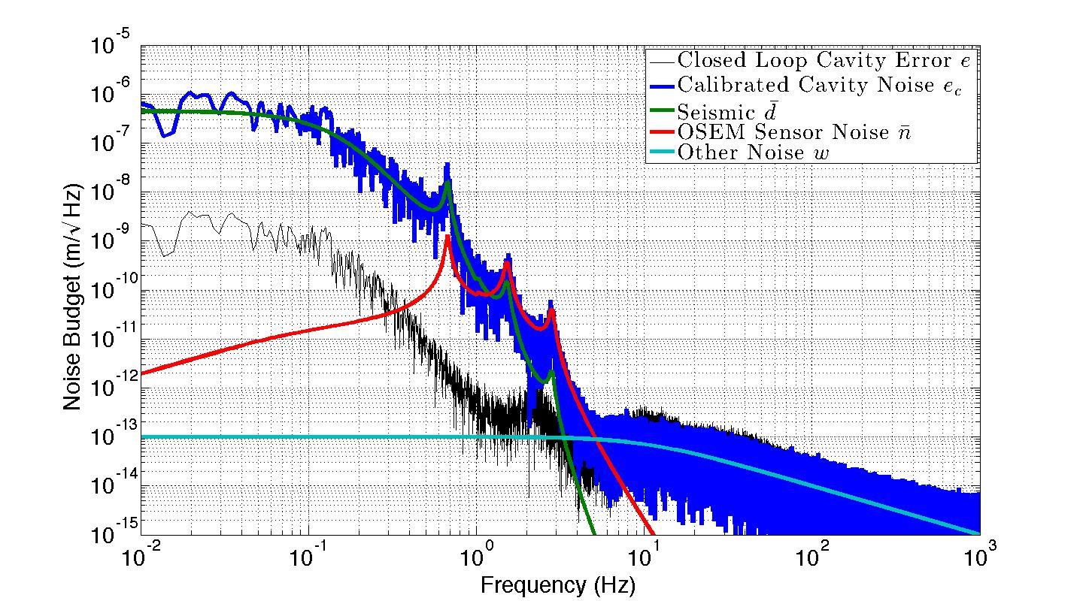
Simulated Noise Budget Calibration
Note: All noises except OSEM sensor noise are arbitrary

Slide 11
Extras

Slide 12
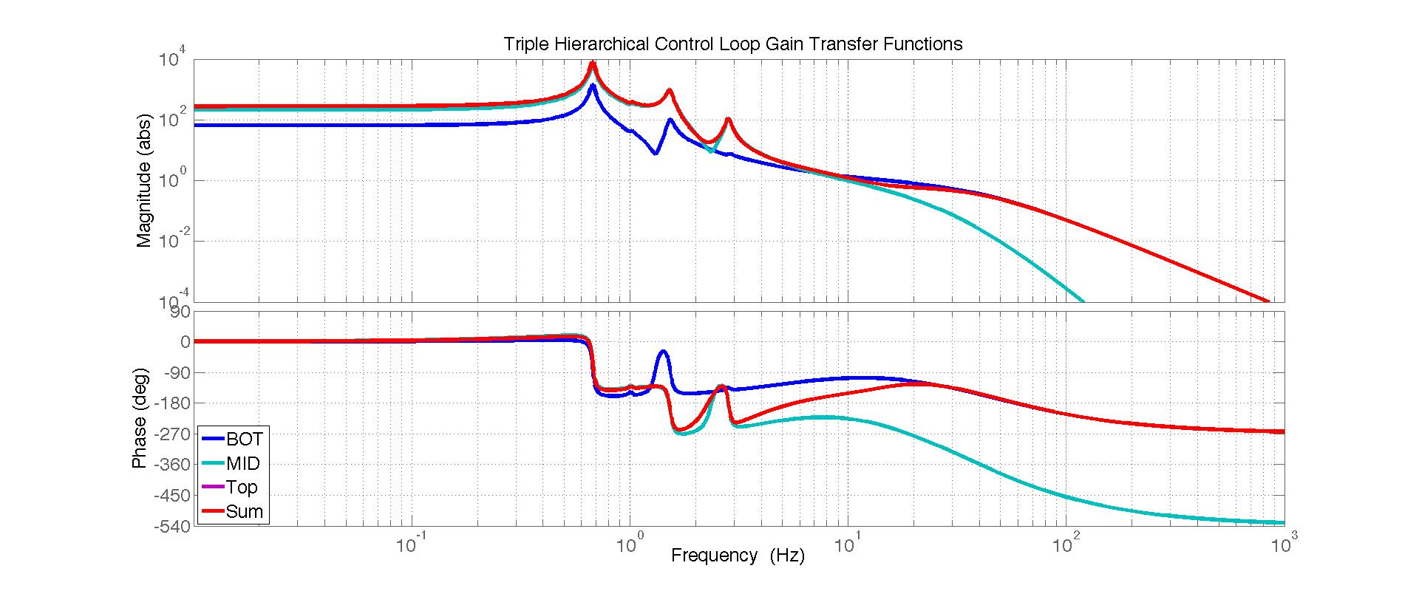
Hierarchical loop gain used in simulation

