Slide 1
Advanced LIGO Seismic Isolation Status
G1200910-v4
LVC Meeting Rome 2012
Céline Ramet, for the Seismic Isolation team
September 11th, 2012

Slide 2
Overview
Different aLIGO Seismic Isolation Systems
Assembly & Installation Status
LIGO Livingston (LLO), LIGO Hanford (LHO), LIGO India (Assembly only)
Commissioning Status
BSC-ISI & BSC-HEPI (LHO), HAM-ISI (LLO), HAM-HEPI (LASTI)

Slide 3
Different aligo SEIsmic isolation SySTEMs

Slide 4
Different aLIGO Seismic Isolation Systems
From the ground to the optical table
Passive isolation (mass-spring) systems with active control (in contrast to iLIGO)
Sensing loops made of blended inertial and capacitive/inductive position sensors (super sensors)
Goal : Isolating optics + provide positioning & alignment
1 Pre-Isolator (present under all chambers)
HEPI
Two in-vacuum Seismic Isolation systems (ISI)
HAM-ISI
BSC-ISI

Slide 5
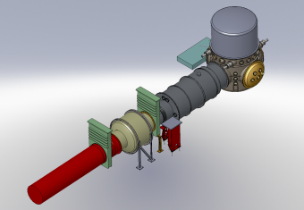
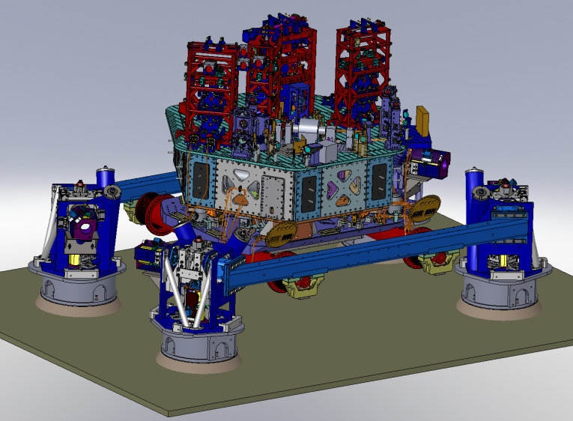
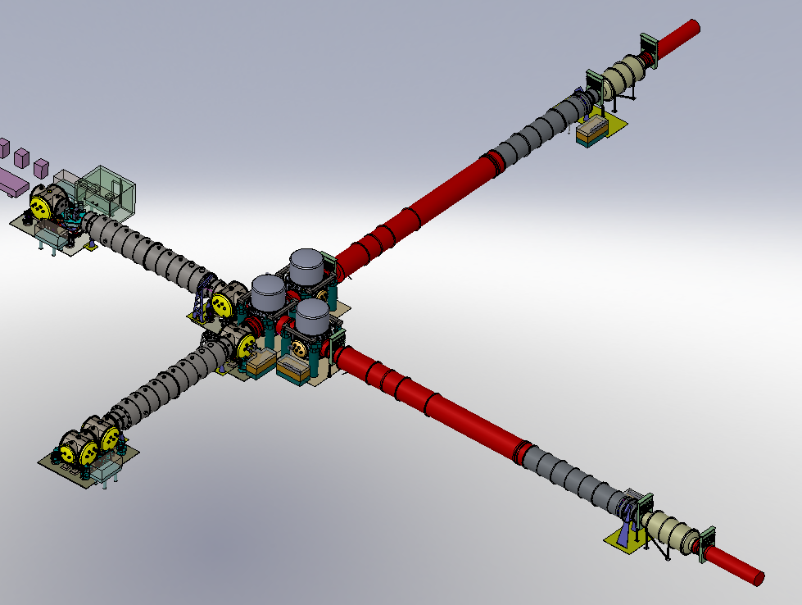
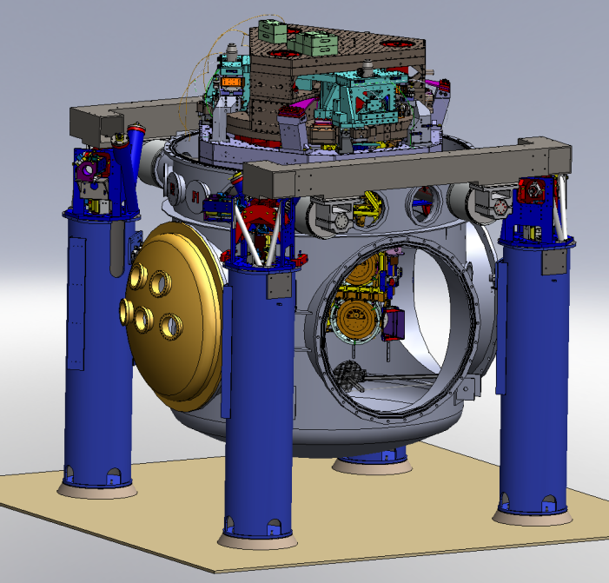
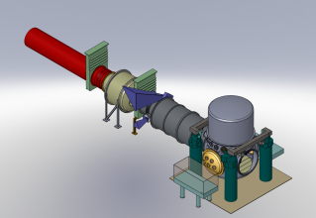
LIGO Livingston (LLO)
6 HAM Chambers:
6 HEPI, 5 ISI
5 BSC Chambers:
5 HEPI, 5 ISI
LLO Layout
Courtesy: F. Matichard

Slide 6
HEPI
One stage of isolation
Isolation from 0.1 Hz to ~ 10 Hz
Out of vacuum
16 sensors
Divided in 4 piers, connected by the support tubes
Hydraulic actuation

Slide 7
HEPI
HAM-HEPI
BSC-HEPI

Slide 8
HAM-ISI
One stage of isolation
Effective > ~ 0.2 Hz
In Vacuum
12 sensors
2 per IFO have additional sensors on Stage 0 for feed-forward
Optical table facing up
Carrying Auxiliary Optics
Stage 1
Stage 0

Slide 9
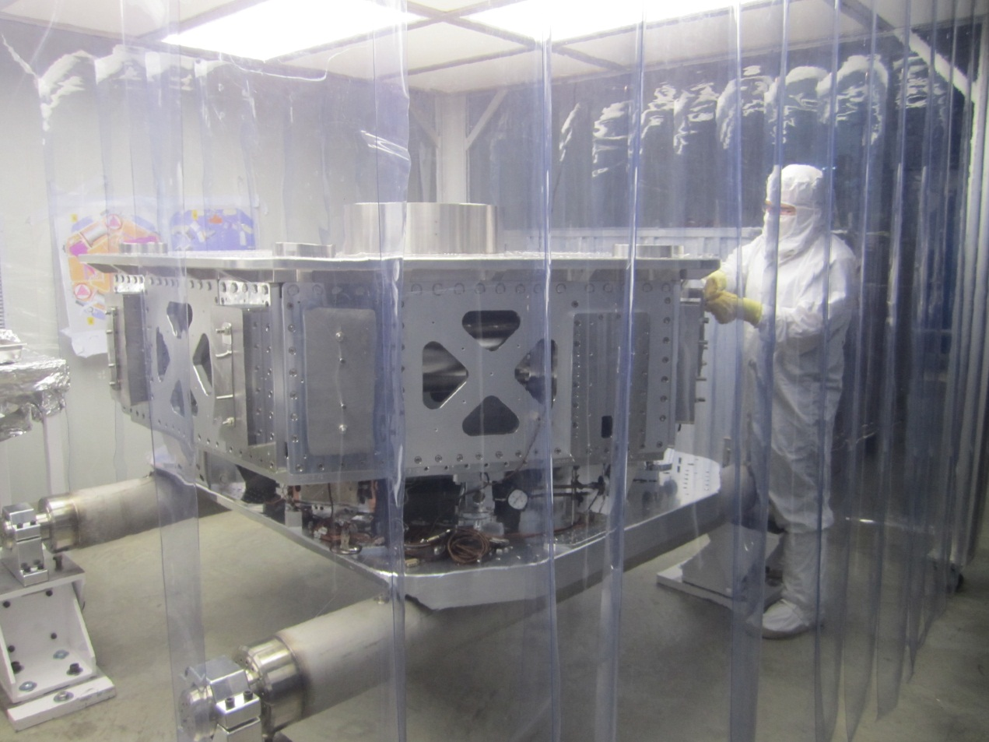
HAM-ISI

Slide 10
BSC-ISI
Stage 2
Stage 1
Two stages of isolation
Effective > 0.2 Hz
In vacuum
33 sensors
Optical table facing down
Carrying Core Optics
Stage 0

Slide 11
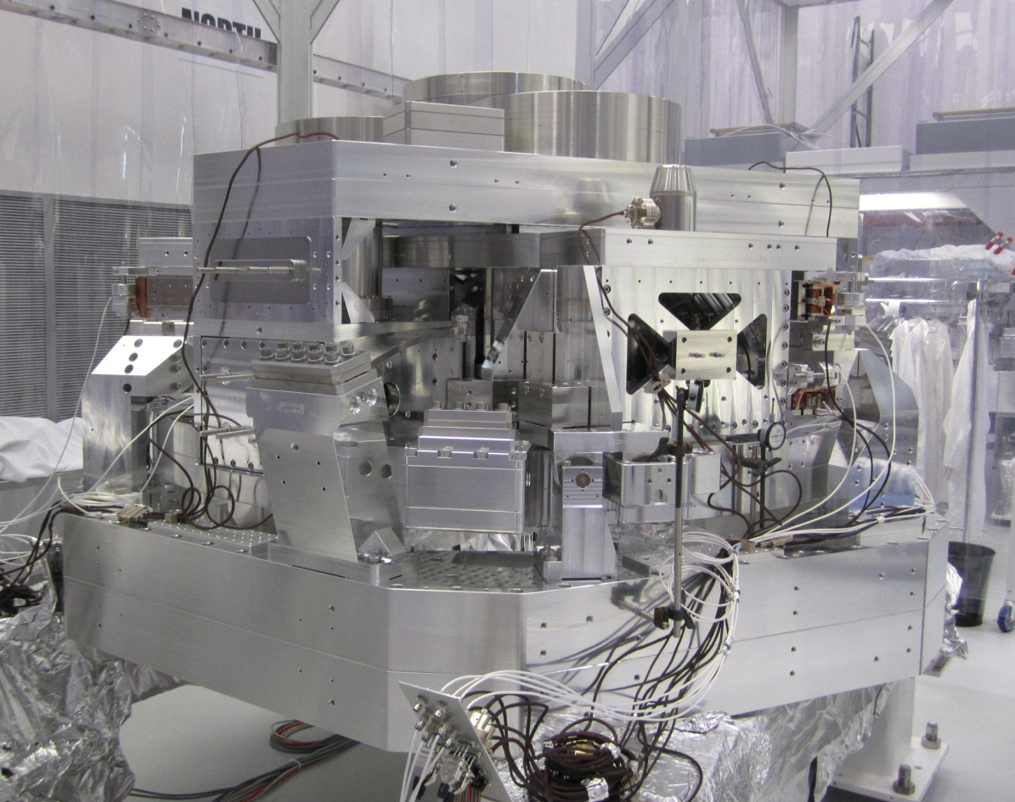
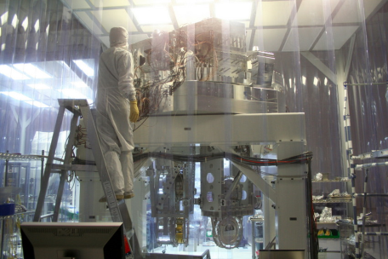
BSC-ISI

Slide 12
Assembly & Installation status
LIGO Livingston (Louisiana, USA), LIGO Hanford (Washington St, USA), LIGO India

Slide 13
LLO + LHO + India Status
HEPI
ISI
HAM
Assembled: 6/6
6/6
6/6
Installed: 6/6
5/6
Controlled: 0/6
0/6
Assembled: 5/5
5/5
3/5
Installed: 5/5
3/5
Controlled: 4/5
0/5
BSC
Assembled: 5/5
5/5
5/5
Installed: 5/5
2/5
Controlled: 0/5
2/5
Assembled: 3/5
3/5
0/5
Installed: 1/5
2/5
Controlled: 0/5
2/5

Slide 14
LIGO Livingston (LLO)
represent ISI+HEPI assembly & installation complete
LLO Layout

Slide 15
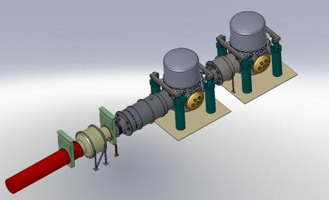
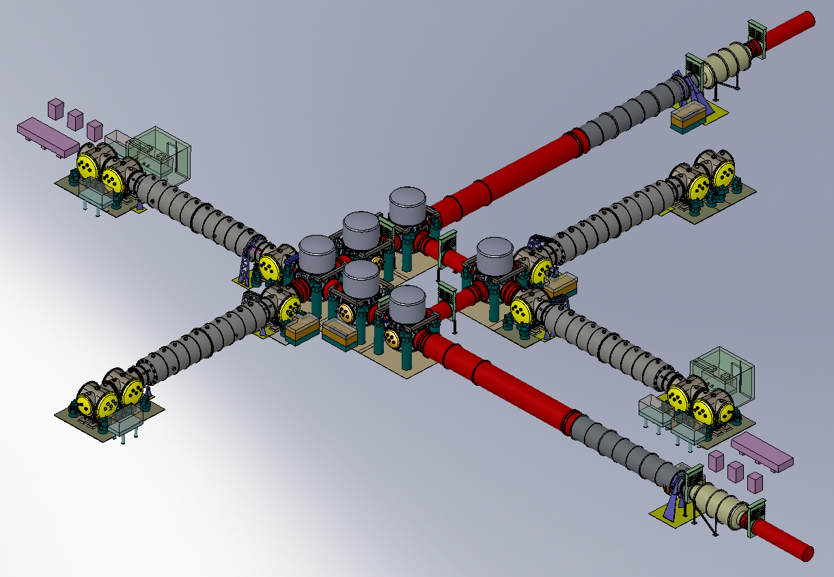
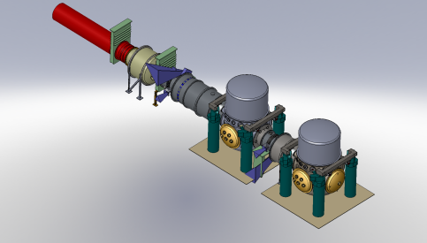
LIGO Hanford (LHO)
represent ISI+HEPI assembly & installation complete
LHO Layout

Slide 16
Commissioning
LIGO Livingston, LIGO Hanford, LASTI (Cambridge, Massachusetts, USA)

Slide 17
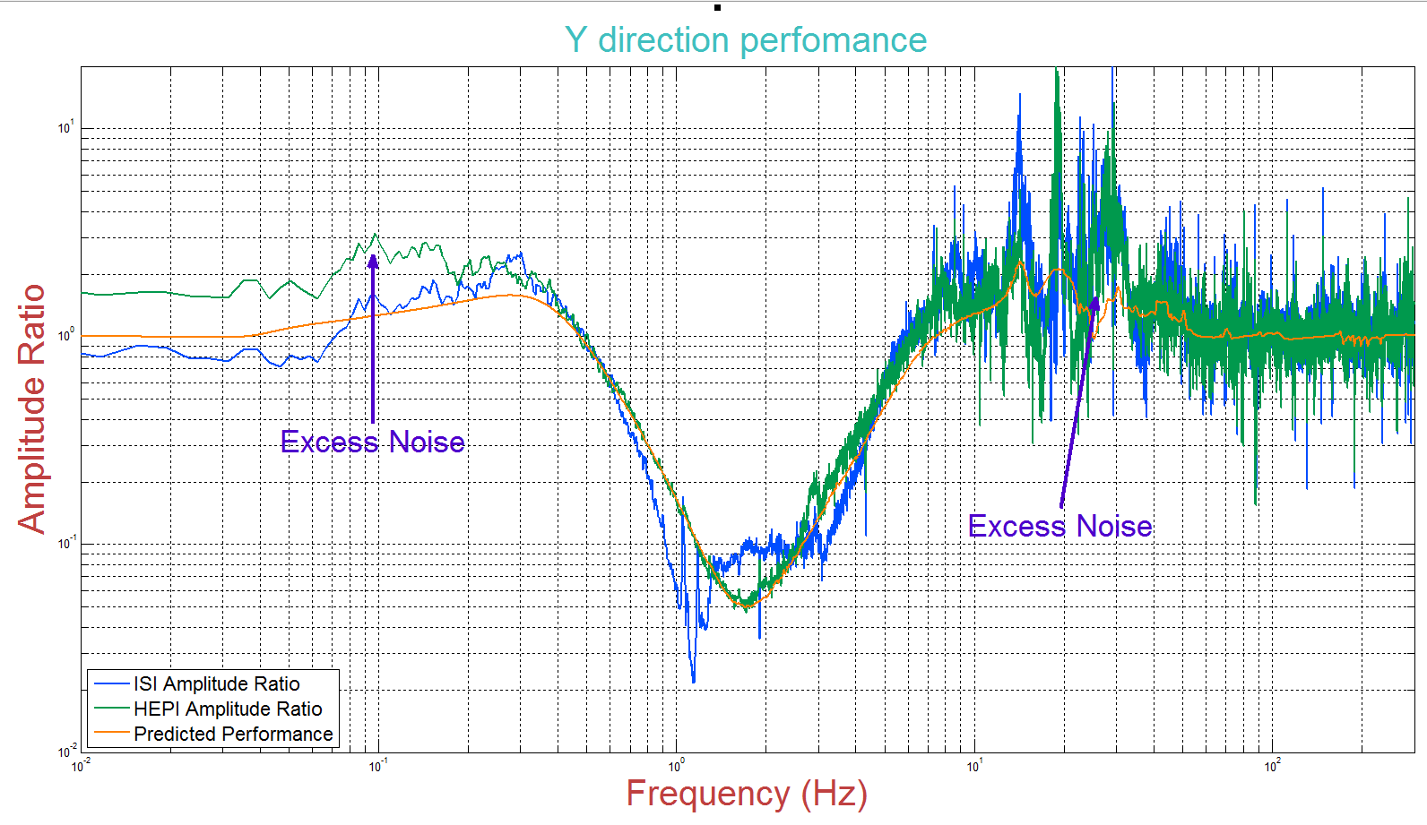
HAM-HEPI Commissioning (LASTI)
Courtesy: R. Mittleman
(cavity axis)

Slide 18
Tracking HAM-ISI Evolution (LLO) L1-HAM 3 Story

Slide 19
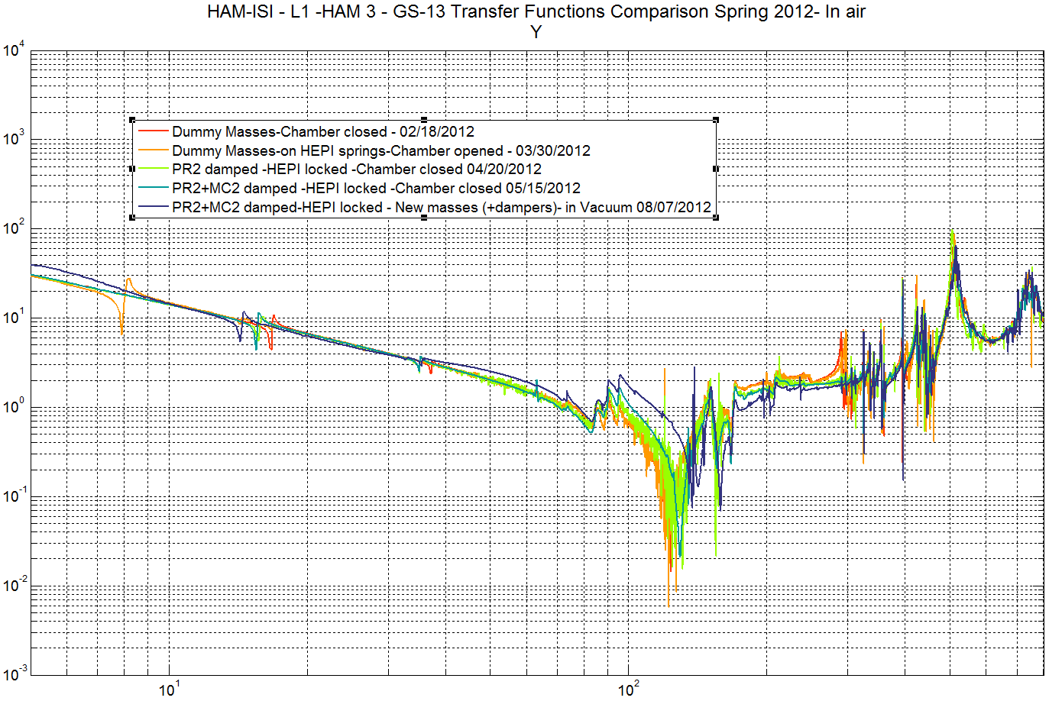
Tracking HAM-ISI Evolution (LLO) L1-HAM 3 Story

Slide 20
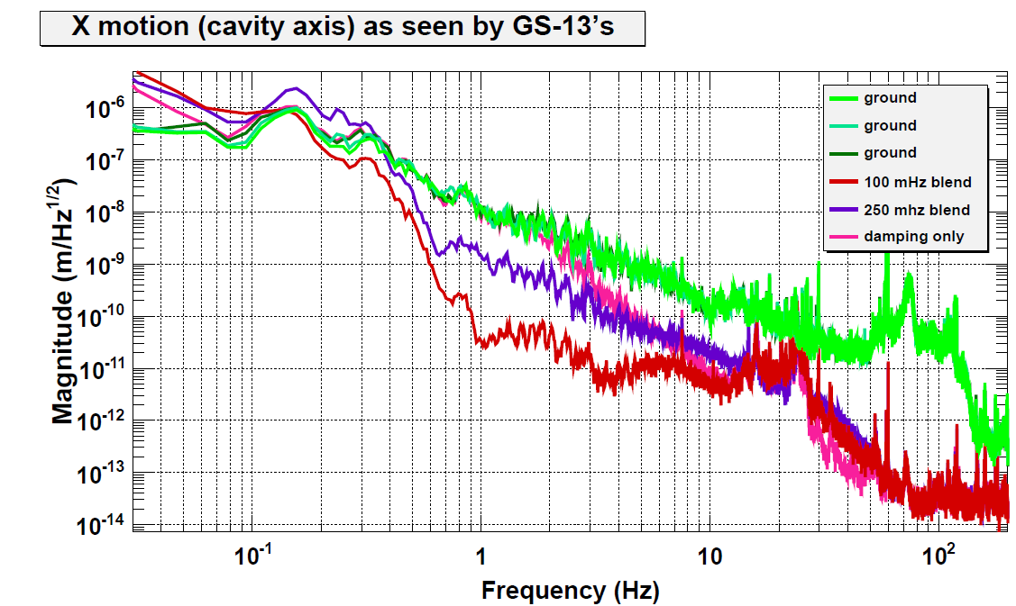
HAM-ISI Commissioning (LLO)
Courtesy: R. De Rosa

Slide 21
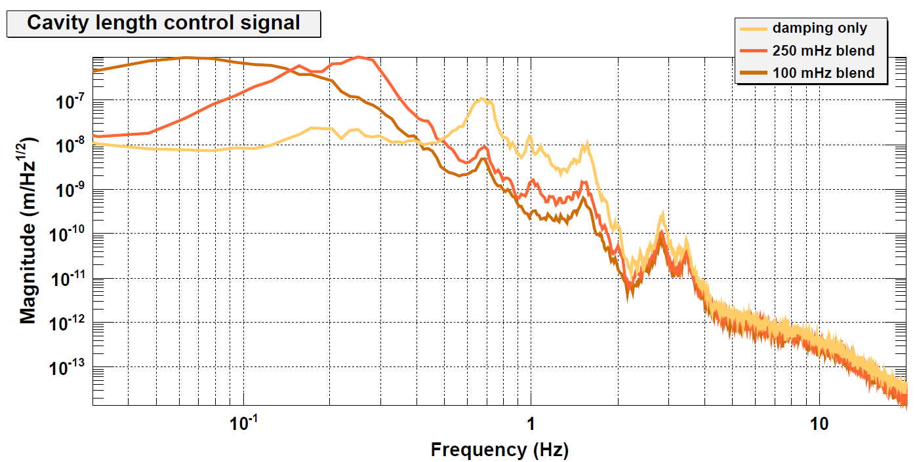
IMC Commissioning (LLO)
Courtesy: R. De Rosa
Input Mode Cleaner

Slide 22
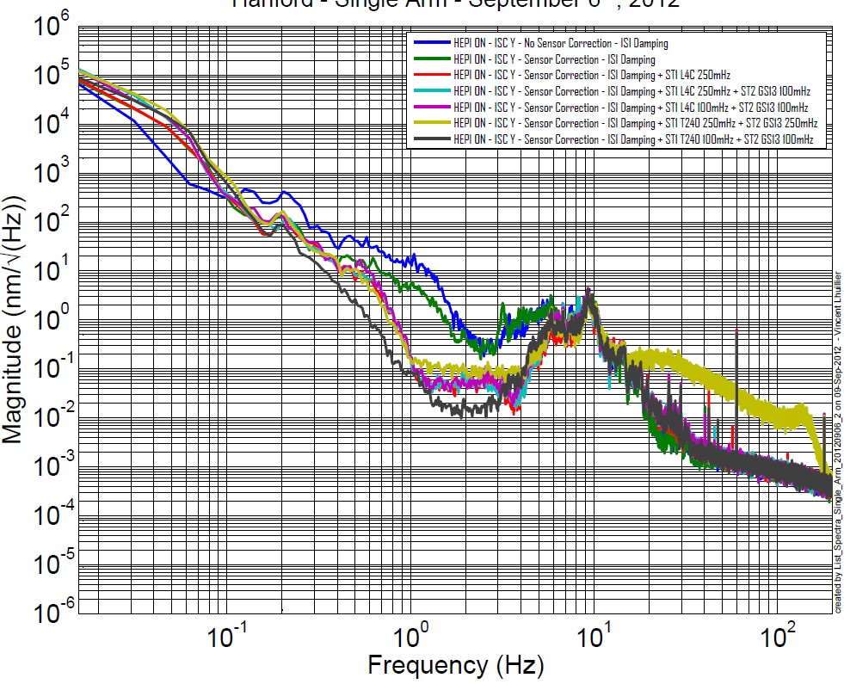
BSC-ISI+HEPI Commissioning (LHO) Stage 1
Courtesy: V. Lhuillier

Slide 23
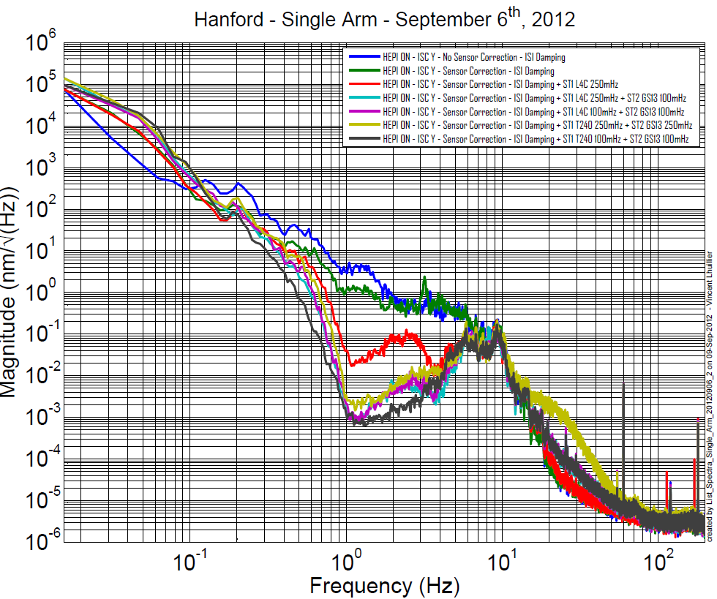
BSC-ISI+HEPI Commissioning (LHO) Stage 2
Courtesy: V. Lhuillier

Slide 24
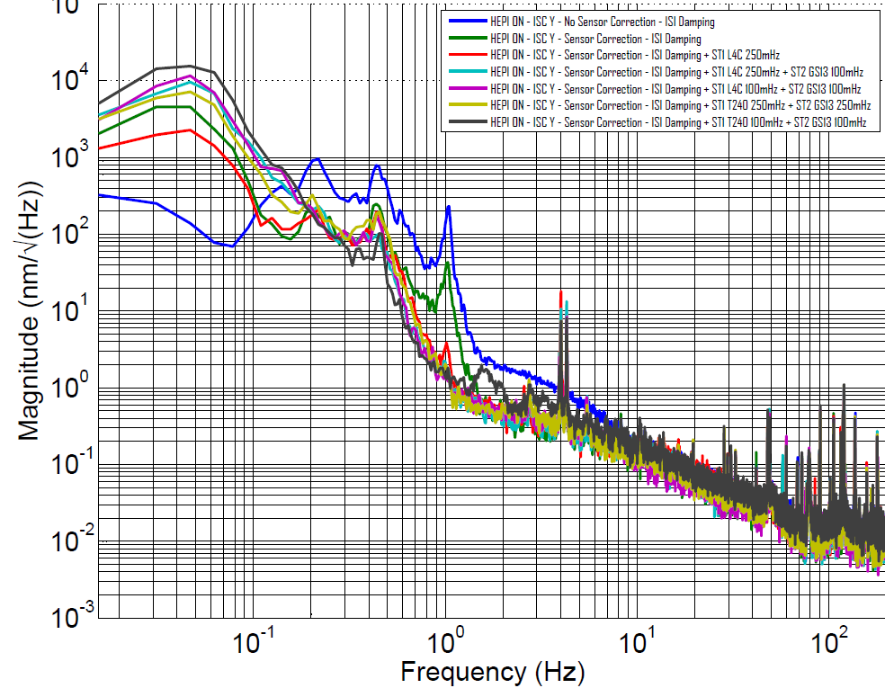
Single Arm Commissioning (LHO) Cavity length control signal
Courtesy: V. Lhuillier

Slide 25
Conclusion
Currently 63% of aLIGO SEI in vacuum components and 100 % of pre-isolators are built
1/3 of all components will not be installed until India is ready.
Several of each different system (HAM-ISI, BSC-ISI, HAM-HEPI, BSC-HEPI) are installed and under control at either LHO, LLO or LASTI.
About to approve chambers to go through OPS control
Still learning!!!... But closing in on aLIGO requirements

Slide 26
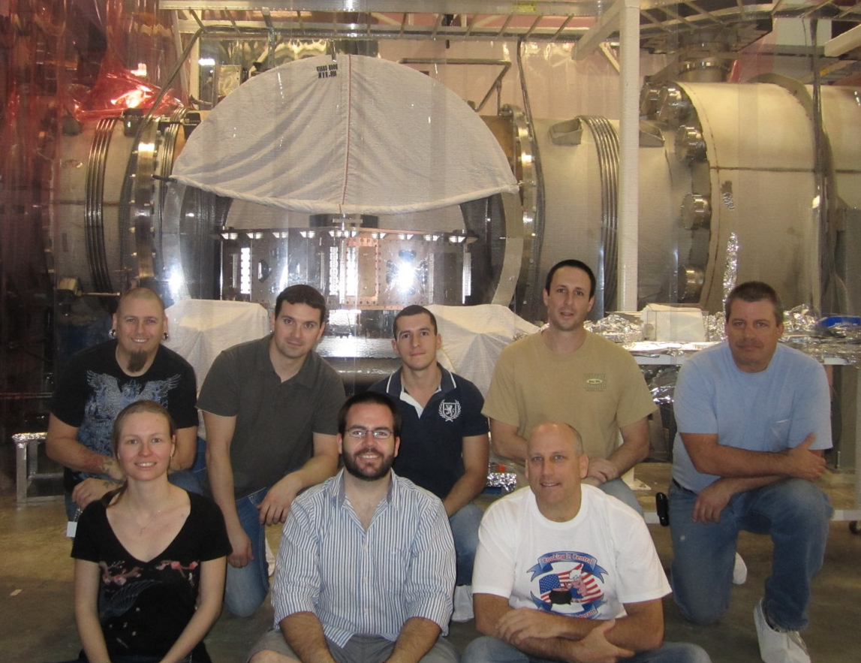
Thanks / Grazie
All Seismic team at LLO, LHO, LASTI, Stanford, Caltech
Fabrice Matichard, Vincent Lhuillier, Richard Mittleman, Hugh Radkins, Ryan DeRosa
LLO team:
Y’all

Slide 27
Questions ?

Slide 28
Extra Slides

Slide 29
LIGO Hanford (LHO)
Courtesy: F. Matichard
Auxiliary Optics:
10 + 2 Chambers
H1 HAM Chambers
H1 BSC Chambers
LHO Layout
H2 HAM Chambers
H2 BSC Chambers
Core Optics:
10 Chambers

Slide 30
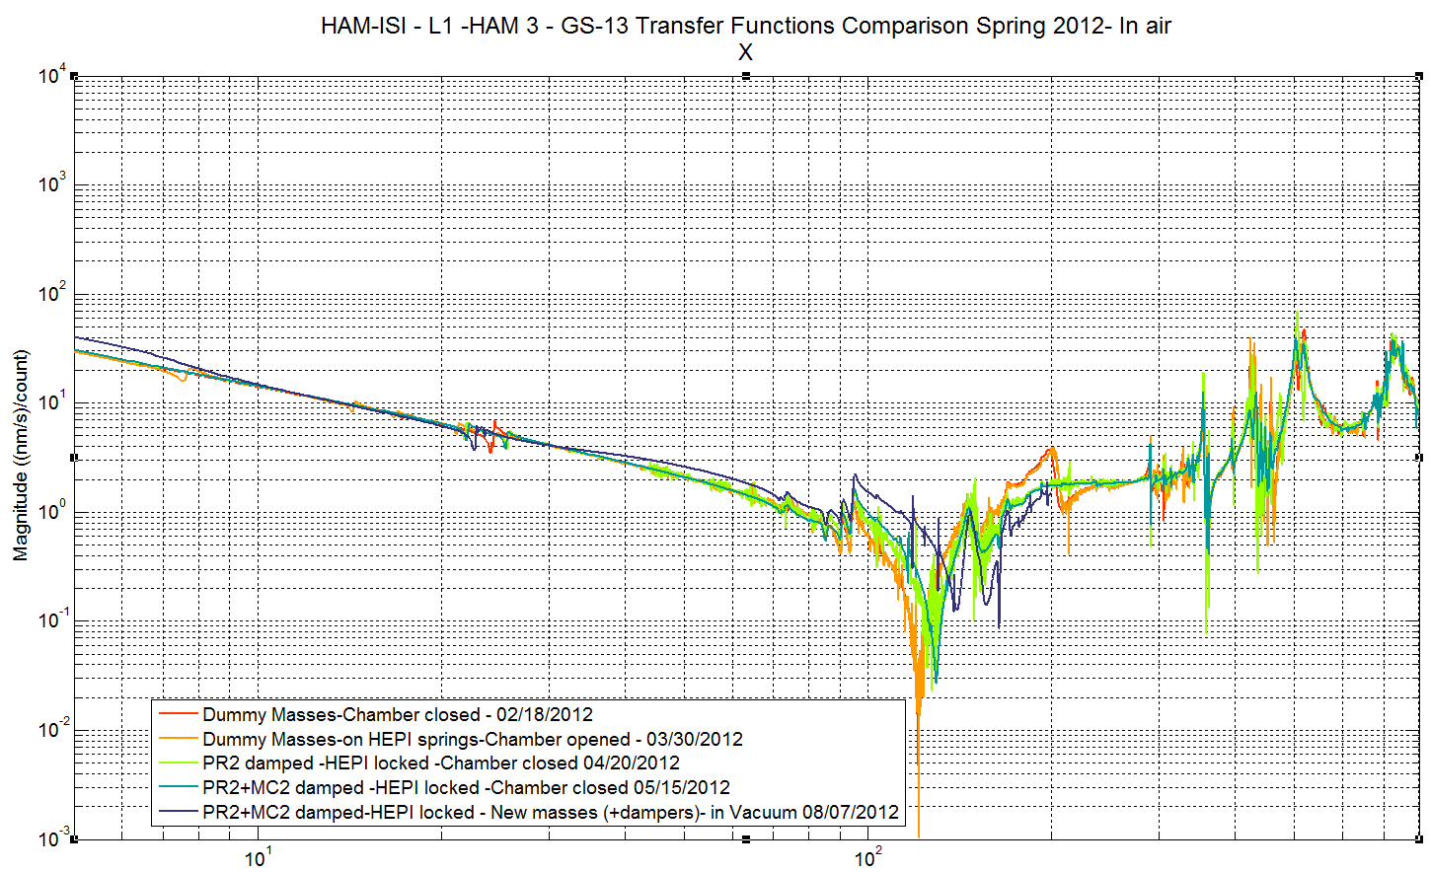
Tracking HAM-ISI Evolution (LLO) L1-HAM 3 Story

Slide 31
HAM-ISI Commissioning (LLO)
HAM-ISIs without pre-isolation (HEPI not running yet)
Starts right after testing after install is approved
Damping (only with seismometer signals)
Blend filters
Isolation
Level 1 (identical to all chambers and sites)
Level 2 (minor adjustments for actual resonances)

Slide 32
HAM-HEPI Commissioning (LASTI)
HEPI limitation?… Non linearity of low amplitude drives
Courtesy: R. Mittleman

