Slide 1
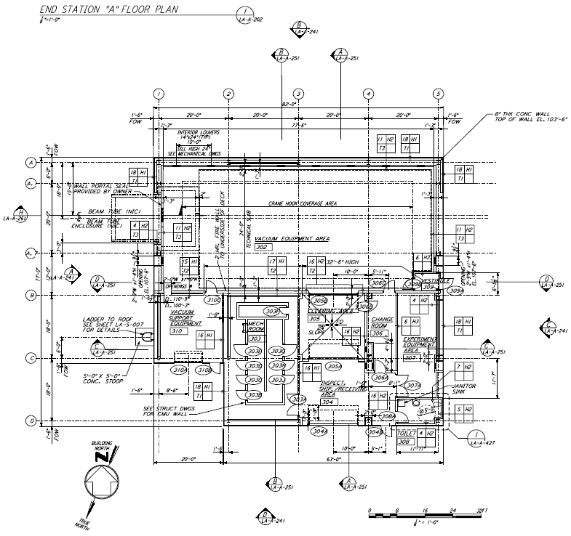
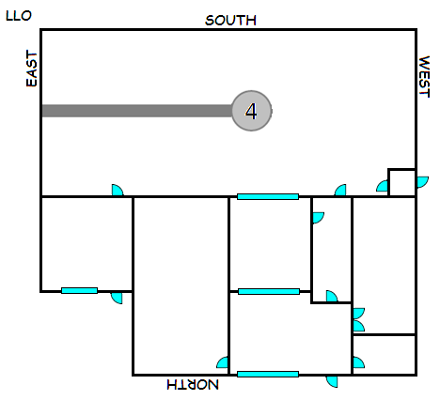
LLO X-End
¾” QuickEdge
PVC – 6” Cap
PVC – 6” x 10
PVC – 6” Cap
5/8” QuickEdge
VEAX
6+” hole centered 24” up, 39” over
CERX

Slide 2
VEAX LLO Existing Cable Piers Locations
94.5
96
1.5
24.0
Waterfall
88.5
← Corner Station
12.0
426.0
Waterfalls
41.0
331.5
60.0
86.5
34.0
Hole
186.0
123.0
205.5
126.0
= 10.0 x 10.0
50.5
= 4.0 d
36.0
64.5
22.5
22.5
← Reference (0)
402.0
115.0
Cargo Door

Slide 3
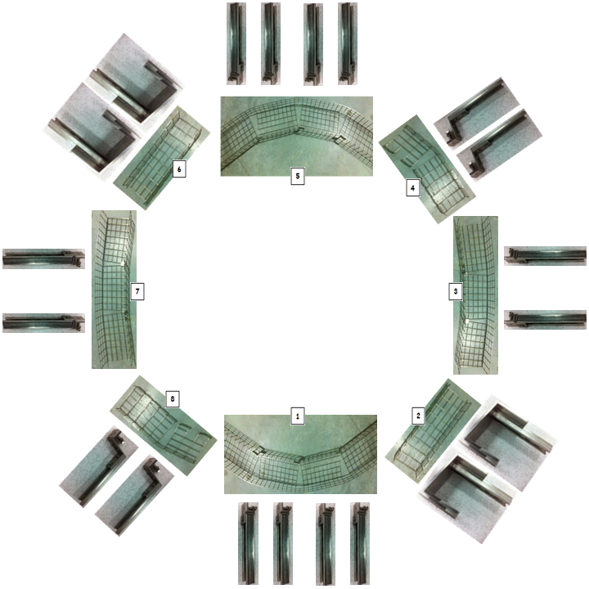
Baskets
Vertex
BSC4

Slide 4
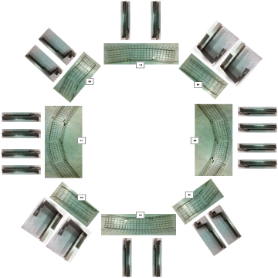
VEAX LLO Existing Cable Piers Locations
96
1.5
24.0
88.5
← Corner Station
12.0
426.0
VE Pump
26 x 56.5
Waterfall
SUS
ISC
ISCB4L
72 x 48
81.0
Hole
126.0
144.0
= 10.0 x 10.0
VAC
= 4.0 d
36.0
402.0
115.0
← Reference (0)
Cargo Door

Slide 5
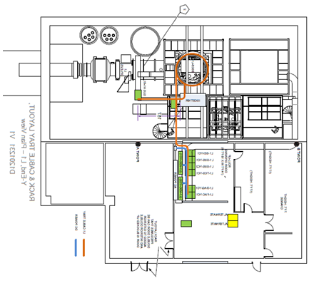
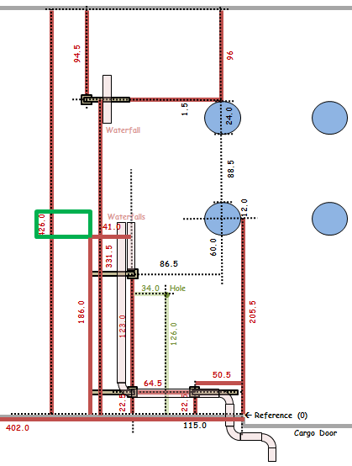
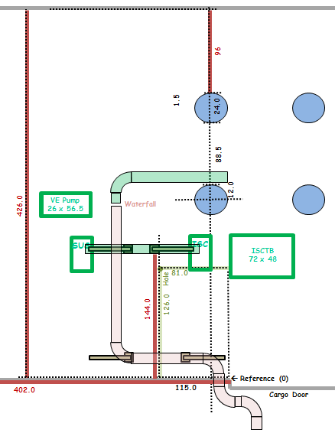
VEAX Overlay
Questions and comments:
1) Where does 11U Short Rack (D1001423-v11) go? (Ignore)
2) Where does L1-AOS-XR1 (if it needs to exist) go? (Does not exist)
3) What does pentagon-2 mean regarding tray removal? Is there tray across the beam tube from L1-SUS-XR1? (Ignore)
4) Is the called-out 10’ height important for some reason? LLO height is 8’. (OK)
5) What are the double doors in the note all about? (Ignore)
6) A door is missing from the garb room to the VEA. (Ignore)
7) The doors are missing from the mechanical room. (Ignore)
8) L1-VAC-XR1 is missing. (Shown)
9) All cabling that currently uses under-beam tray and the waterfall is missing. (Kurt)
10) The Photon Calibrator is missing. (Mounted to tube – part of OPLEV))
11) VE Pumps are not shown. (Shown)
12) Size of ISCB4L is not specified. (72 x 48)
Things that can be done: (Note: Blue trace is (mostly) existing tray.)
1) Remove old cable tray and pier that interferes with dome parking.
2) Locate L1-ISC-XR1 farther away from existing pier for clearance.
3) Suggest joining basket around BSC to existing cable tray at waterfall.
4) Used removed pier to extend cable tray to L1-ISC-XR1.
5) Add cable tray to reach L1-SUS-YR1.
6) Remove parallel waterfall, move ‘T’ to primary waterfall.
OBSOLETE
1
3
6
4
5
2
Existing layout
New layout
NOTE: This drawing is NOT correct yet. It was made by mirroring the VEAY drawing D1201231-v1. Its ultimate purpose is to show the existing cable tray and piers relative to the as-built IFO.

Slide 6
CDS Electronics Room X-End (CERX) Rack Layout
<< X-End Racks
It is 70’ from the L1-FAC-XC1 Rack to the knee of the waterfall in the VEAX.
The height of the cable trays is 8’.
Signals and Fiber
(L1-SUS-XC1)
DC Power
(L1-SUS-XC2)
(L1-VDC-XC1)
(L1-ISC-XC1)
(L1-TCS-XC1)
AC Power
(L1-SEI-XC1)
(L1-VDC-XC2)
CERX
(L1-DAQ-XC1)
(L1-FAC-XC1)

Slide 7
Suggested Phone Locations (20121114)
<< X-End Racks
Phone
Fire Alarm System
Phone

Slide 8
X-End
<< X-End Racks

