Slide 1
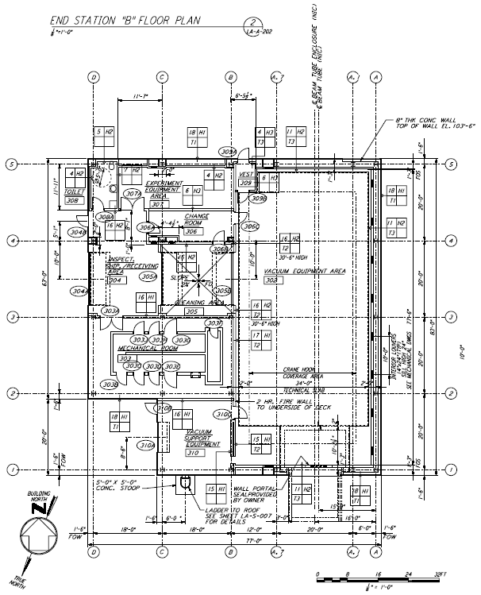
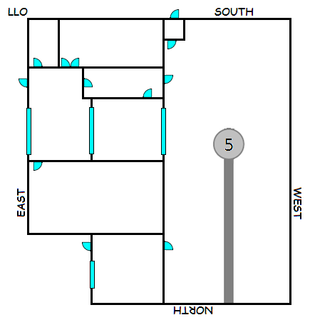
LLO Y-End
¾” QuickEdge
PVC – 6” Cap
PVC – 6” x 10
PVC – 6” Cap
5/8” QuickEdge
6+” hole centered 24” up, 39” over
VEAY
CERY

Slide 2
VEAY LLO Existing Cable Piers Locations
95.0
92.5
144.0
24.0
12.0
Waterfall
115.0
12.0
Corner Station →
Waterfall
426.0
43.0
84.0
95.0
20.0
47.0
44.0
Hole
149.0
184.0
192.0
119.0
145.5
46.5
48.0
= 10.0 x 10.0
17.5
= 4.0 d
Reference (0) →
Cargo Door
408.0

Slide 3
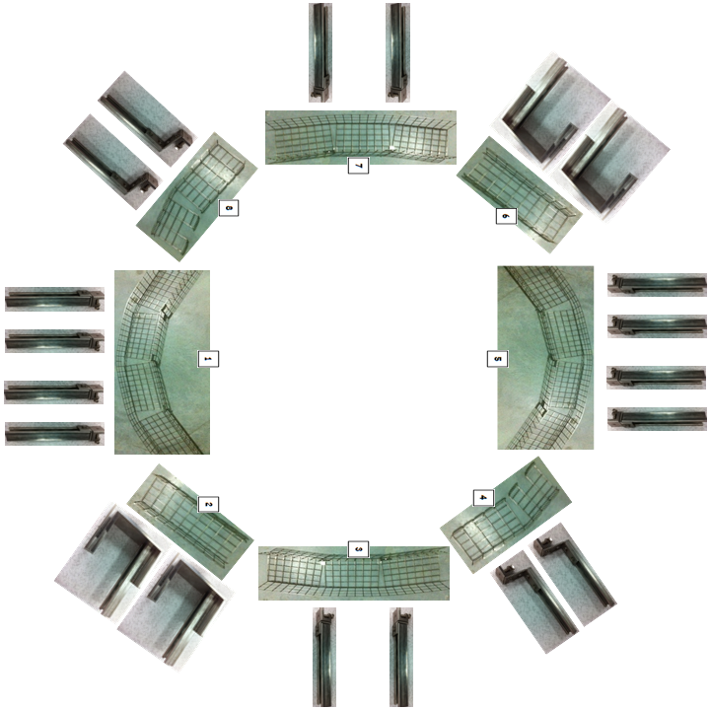
Baskets
BSC5
Vertex

Slide 4
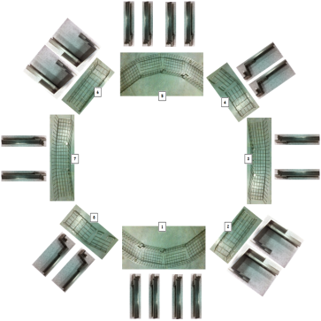
VEAY LLO Existing Cable Piers Locations
95.0
24.0
12.0
115.0
Waterfall
VE Pump
26 x 56.5
Corner Station →
426.0
ISCB5R
72 x 48
ISC
SUS
91.0
Hole
144.0
119.0
VAC
48.0
= 10.0 x 10.0
= 4.0 d
Reference (0) →
Cargo Door
408.0

Slide 5
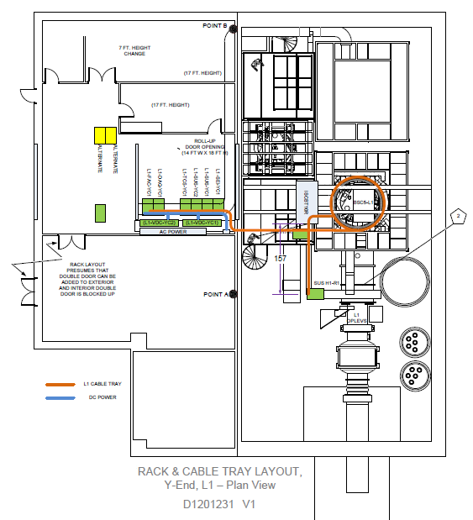
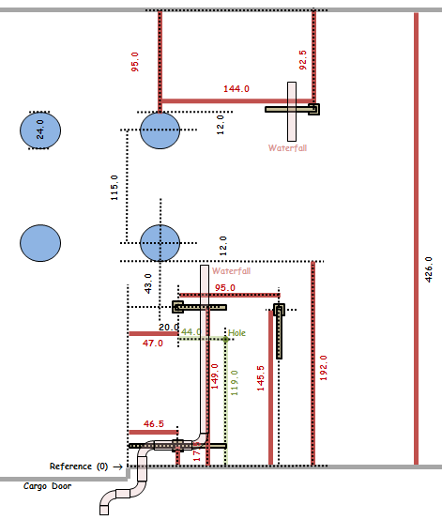
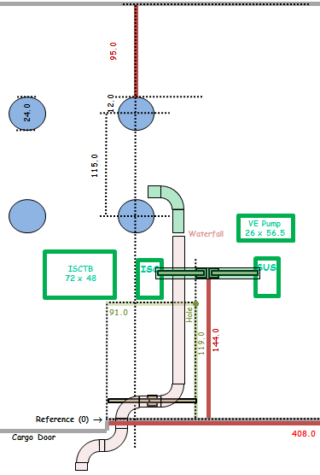
VEAY Overlay
Questions and comments:
1) Where does 11U Short Rack (D1001423-v11) go? (Ignore)
2) Where does L1-AOS-YR1 (if it needs to exist) go? (Does not exist)
3) What does pentagon-2 mean regarding tray removal? Is there tray across the beam tube from L1-SUS-YR1? (Ignore)
4) Is the called-out 10’ height important for some reason? LLO height is 8’. (OK)
5) What are the double doors in the note all about? (Ignore)
6) A door is missing from the garb room to the VEA. (Ignore)
7) The doors are missing from the mechanical room. (Ignore)
8) L1-VAC-YR1 is missing. (Shown)
9) All cabling that currently uses under-beam tray and the waterfall is missing. (Kurt)
10) The Photon Calibrator is missing. (Mounted to tube – part of OPLEV)
11) VE Pumps are not shown. (Shown)
12) Size of ISCB5R is not specified. (72 x 48)
Things that can be done: (Note: Green trace is new tray.)
1) Remove old cable tray and pier that interferes with dome parking.
2) Relocate existing piers to support cable tray to L1-SUS-YR1.
3) Locate L1-ISC-YR1 farther away from existing pier for clearance.
4) Suggest joining basket around BSC to existing cable tray at waterfall.
5) Add cable tray to reach L1-SUS-YR1.
OBSOLETE
1
4
2
3
5
Existing layout
New layout

Slide 6
CDS Electronics Room Y-End (CERY) Rack Layout
<< Y-End Racks
It is 65’ from the L1-FAC-YC1 Rack to the knee of the waterfall in the VEAY.
The height of the cable trays is 8’.
(L1-FAC-YC1)
(L1-DAQ-YC1)
(L1-ISC-YC1)
(L1-TCS-YC1)
(L1-SUS-YC2)
(L1-SEI-YC1)
(L1-SUS-YC1)
DC Power
(L1-VDC-YC2)
(L1-VDC-YC1)
Signals and Fiber
AC Power
CERY

Slide 7
Suggested Phone Locations (20121114)
<< Y-End Racks
Phone
Fire Alarm System
Radio Phone

Slide 8
Y-End
<< Y-End Racks

