Slide 1
Global longitudinal quad damping vs. local damping
G1200774-v8

Slide 2
Summary
Background: local vs global damping
Simulation: enhanced isolation of damping noise by damping global rather than local coordinates.
Designing cavity length control loops that simultaneously apply damping.
Reference Material
  Jeff K.’s IFO control diagram: G1200632
  Supporting math

Slide 3
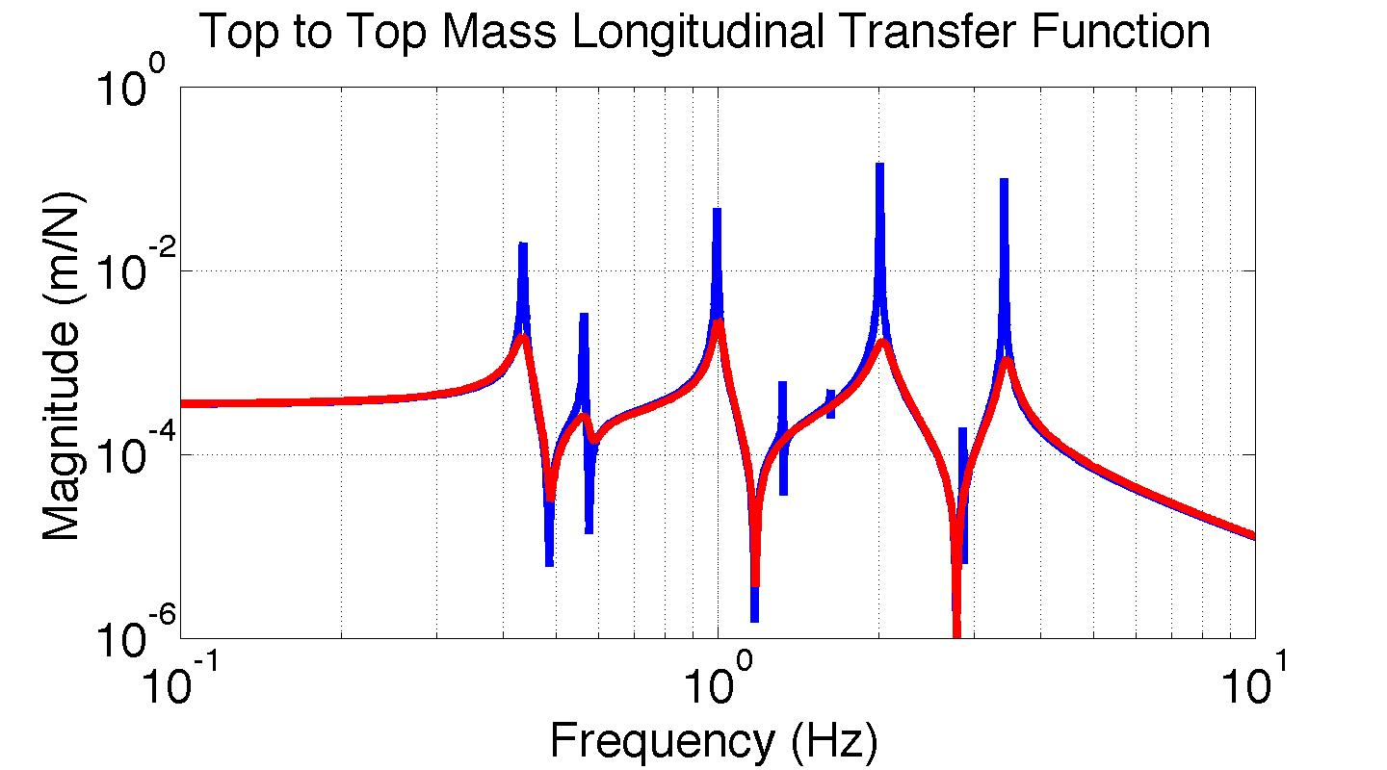
Usual Local Damping
ETMX
ETMY
-1
-1
u_{1,2}
u_{2,2}
Local damping
Local damping
u_{1,3}
u_{2,3}
The nominal way of damping
OSEM sensor noise coupling to DARM is non-negligible for these loops.
u_{1,4}
u_{2,4}
0.5
Control Law
0.5

Slide 4
Common Mode Damping is Isolated from DARM
ETMX
ETMY
The common mode damping injects the same sensor noise into both pendulums
Since both pendulums are the same, this noise enters the test masses along only the common mode
Thus, no damping noise to DARM from this loop!
Warning: If one pendulum get’s bumped, the other will in part feel it too since both pendulums receive the same damping signal. Note that similar coupling already exists through DARM control.
0.5
+
0.5
u_{1,2}
u_{2,2}
Common mode damping
u_{1,3}
u_{2,3}
u_{1,4}
u_{2,4}
0.5
Control Law
0.5

Slide 5
Cavity Control Influence on Damping
- Case 3: Cavity control split evenly between both pendulums
ETMX
ETMY
*
*
0.5
+
0.5
longitudinal
u_{1,2}
u_{2,2}
* Common top to common top transfer function
u_{1,3}
u_{2,3}
The common top mass longitudinal DOF behaves just like a free quad.
Assumes identical quads (ours are pretty darn close).
See Supporting Math slides.
u_{1,4}
u_{2,4}
0.5
Control Law
0.5

Slide 6
Cavity Control Influence on Damping
- Case 3: Cavity control split evenly between both pendulums
ETMX
ETMY
*
*
0.5
-
0.5
longitudinal
u_{1,2}
u_{2,2}
* Differential top to differential top transfer function
u_{1,3}
u_{2,3}
The differential top mass longitudinal DOF behaves just like a cavity-controlled quad.
Assumes identical quads (ours are pretty darn close).
See `Supporting Math’ slides.
u_{1,4}
u_{2,4}
0.5
Control Law
0.5

Slide 7
Comments up to this point
The common and differential top TFs are not actually so surprising; the DOF that has the cavity control is the one that gets altered dynamics.
So, if we rotate the quad longitudinal damping from local damping of each quad to global common and differential damping…
Then, common mode damping noise is effectively eliminated since it is independent from the differential mode (where we measure GWs…).
  Assumption: quads are identical.
  Real life: noise is suppressed by how well the quads match. Ours are really close. See `Supporting Math’ slides. Residual differences might be tuned away by locally scaling the top mass damping for frequencies we care about.

Slide 8
Simulated Damping Noise to DARM
ETMX
ETMY
Realistic quads - errors on the simulated as-built parameters are:
Masses: ± 20 grams
d’s (dn, d1, d3, d4): ± 1 mm
Rotational inertia: ± 3%
Wire lengths: ± 0.25 mm
Vertical stiffness: ± 3%
0.5
+
0.5
u_{1,2}
u_{2,2}
Common mode damping
u_{1,3}
u_{2,3}
u_{1,4}
u_{2,4}
0.5
Control Law
0.5

Slide 9
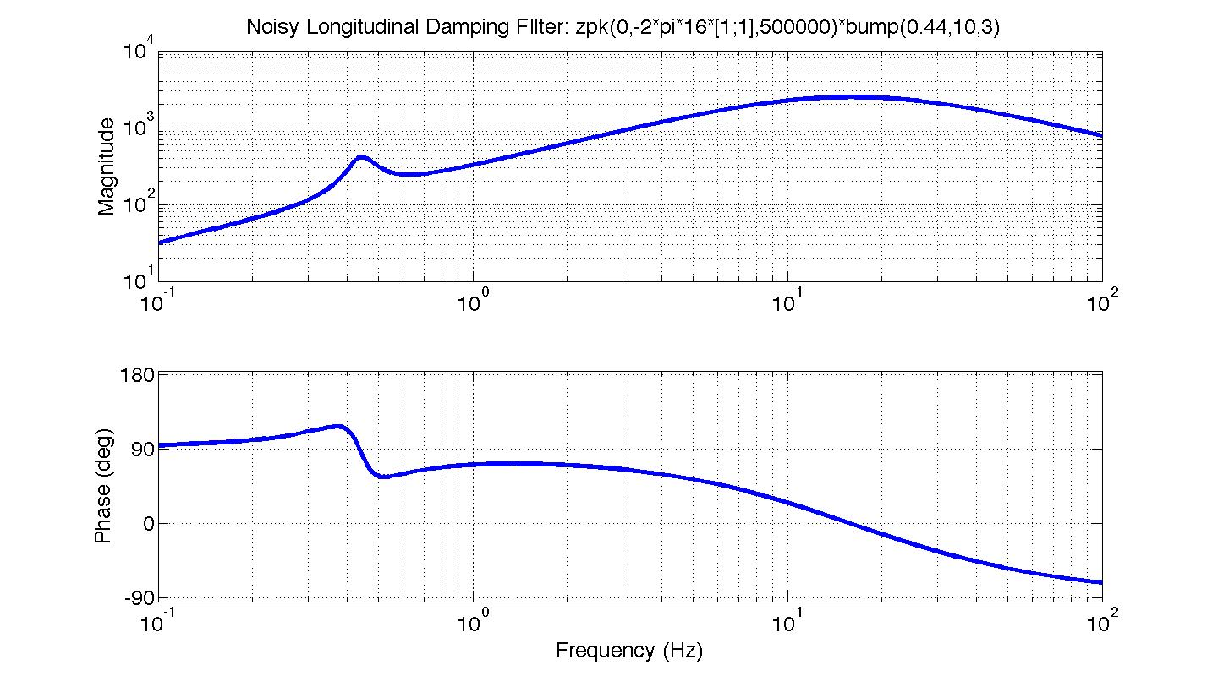
Simulated Damping Noise to DARM

Slide 10
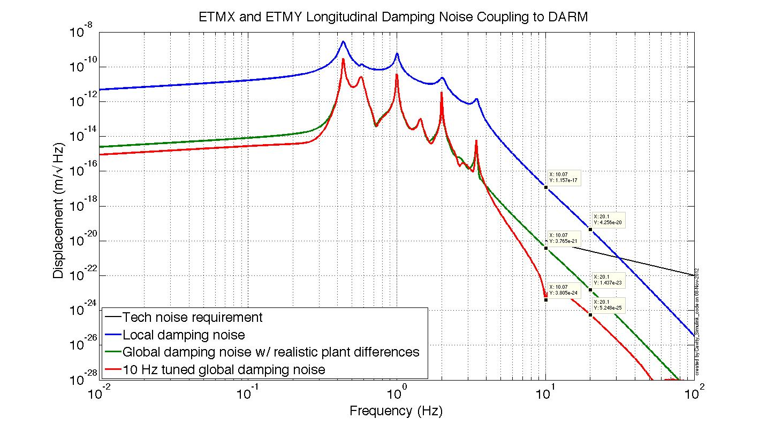
Simulated Damping Noise to DARM
Red curve achieved by scaling top mass actuators so that TFs to cavity are identical at 10 Hz.

Slide 11
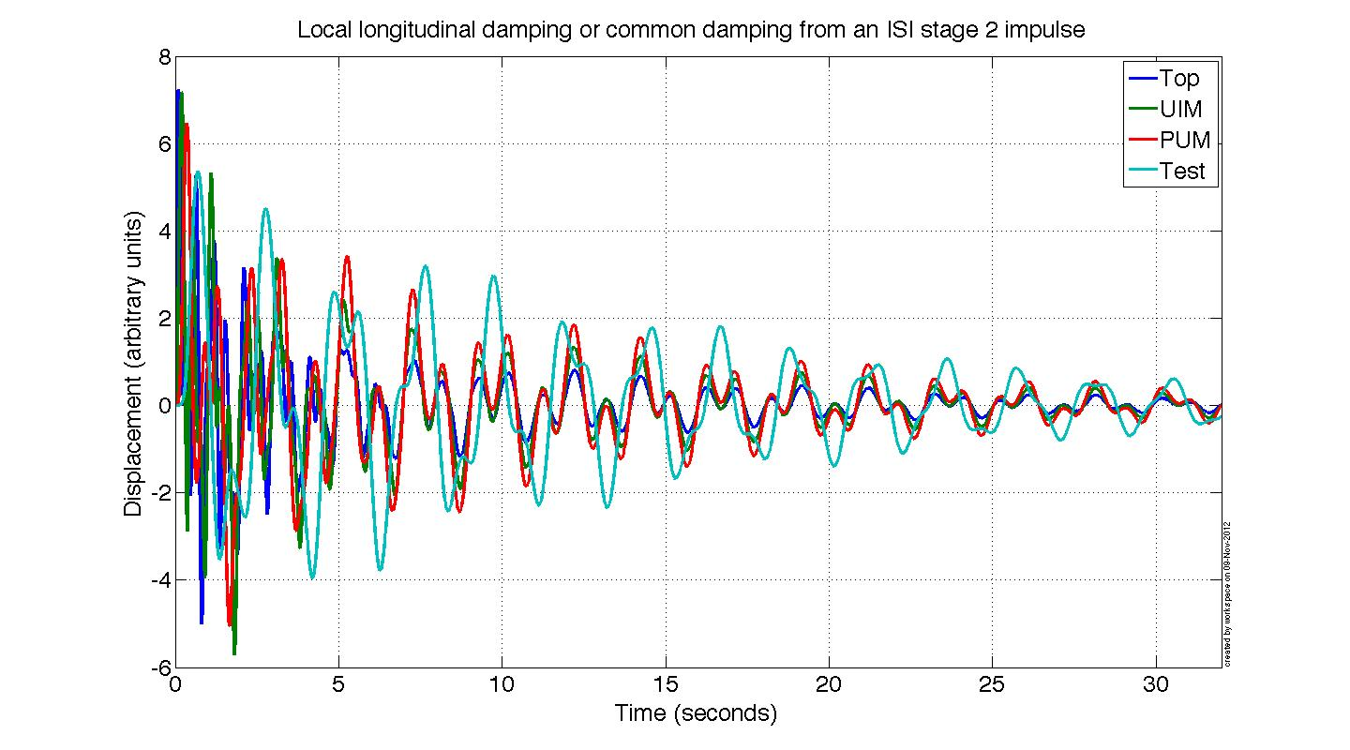
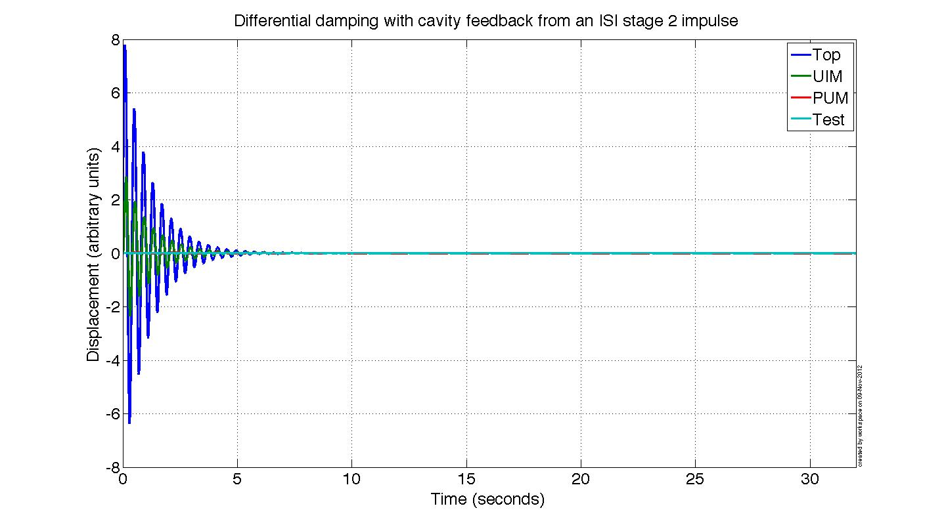
Local or global common damping to each stage
Global differential damping damping to each stage

Slide 12
Where does the lonely differential long. mode come from?
If we understand how the hierarchical control produces this mode, might we be able to design a hierarchical controller that also damps it?
If so, then we can eliminate differential mode damping noise by turning this damping off.
Since common mode damping couples weakly to DARM, virtually all longitudinal damping noise from these two quads would be gone from DARM.
longitudinal
?
Remaining top mass differential longitudinal mode.

Slide 13
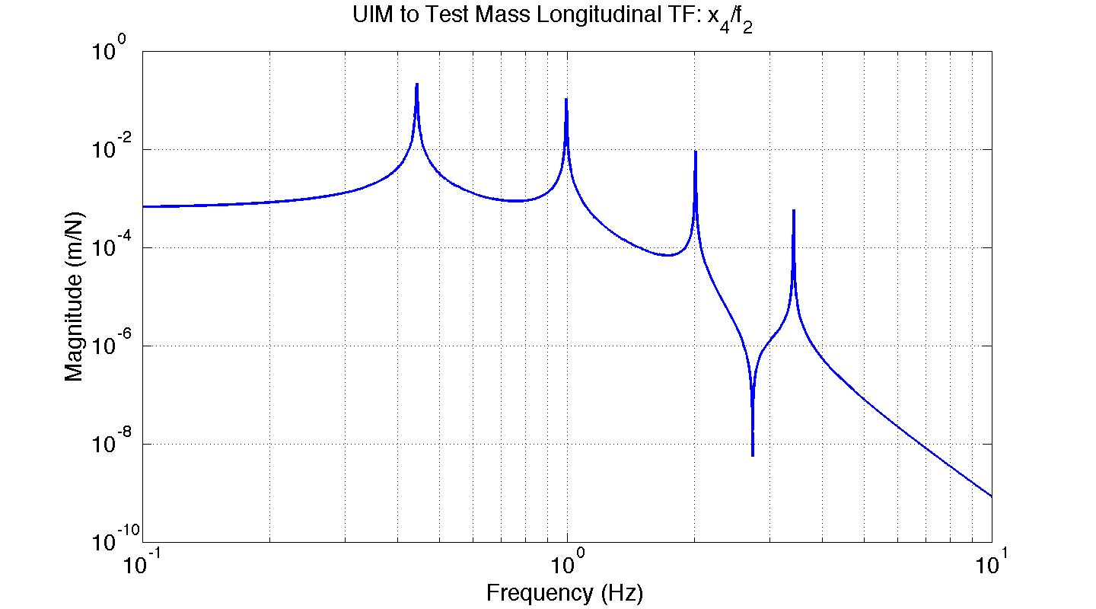
Where does the lonely differential long. mode come from?
Pendulum 1
f₂
x₄
The new top mass modes come from the zeros of the TF between the highest stage with large cavity UGF and the test mass. See more detailed discussion in the ‘Supporting Math’ section.
This result can be generalized to the zeros in the cavity loop gain transfer functions (based on observations, no hard math yet).

Slide 14
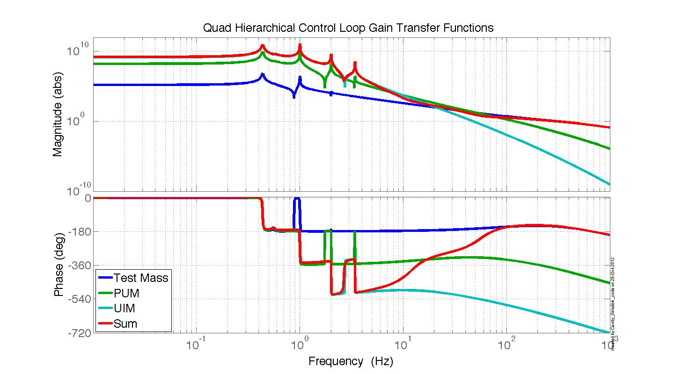
Where does the lonely differential long. mode come from?
Test UGF: 300 Hz
PUM UGF: 50 Hz
UIM UGF: 10 Hz

Slide 15
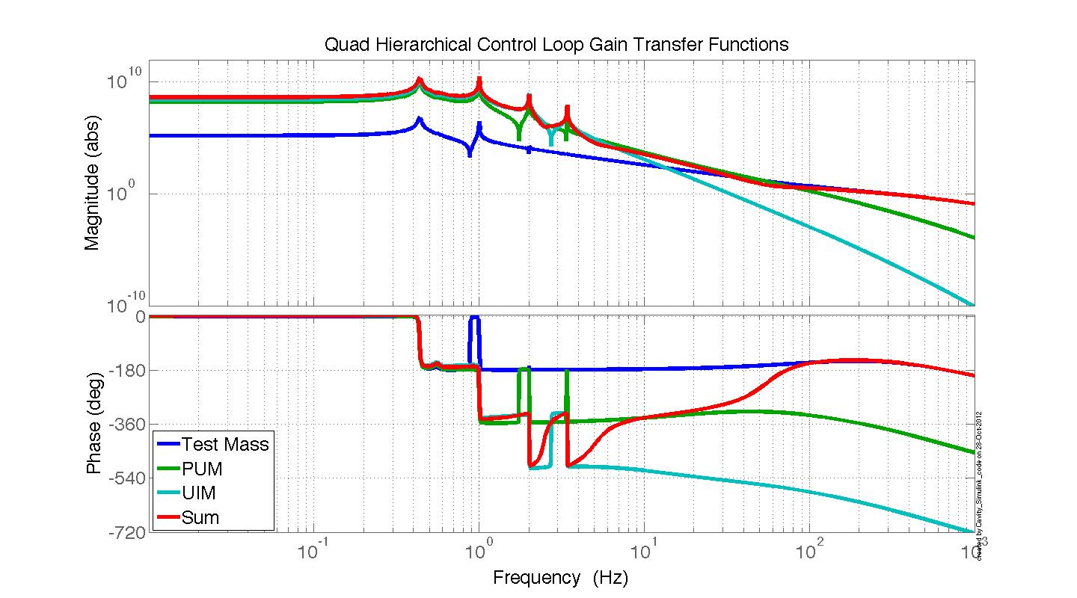
Where does the lonely differential long. mode come from?
Test UGF: 300 Hz
PUM UGF: 50 Hz
UIM UGF: 5 Hz

Slide 16
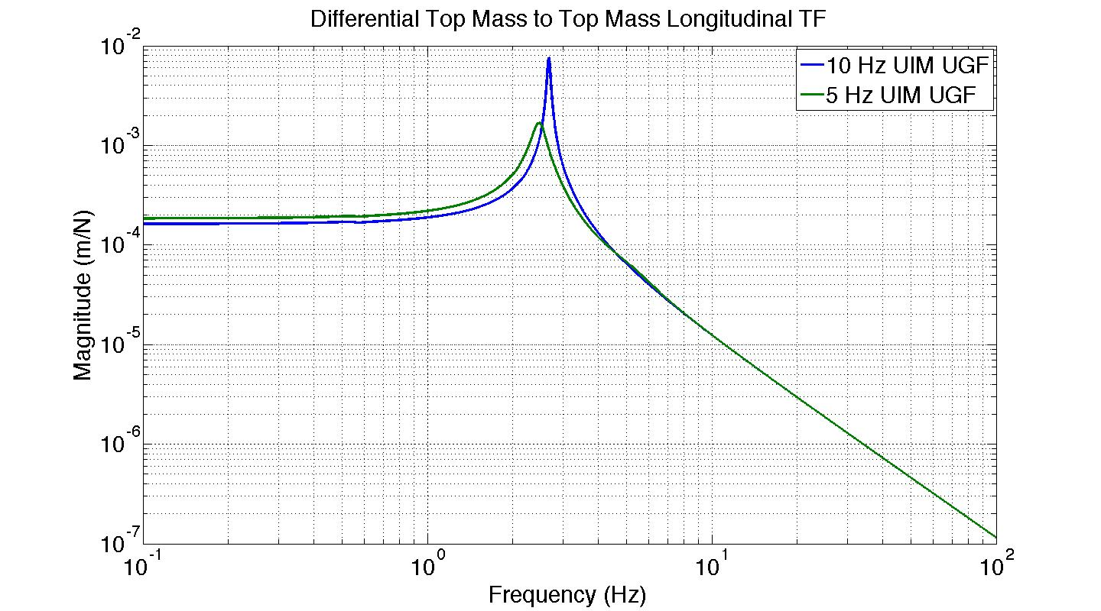
Where does the lonely differential long. mode come from?
The top mass longitudinal differential mode resulting from the cavity loop gains on the previous slides. Damping is OFF!

Slide 17
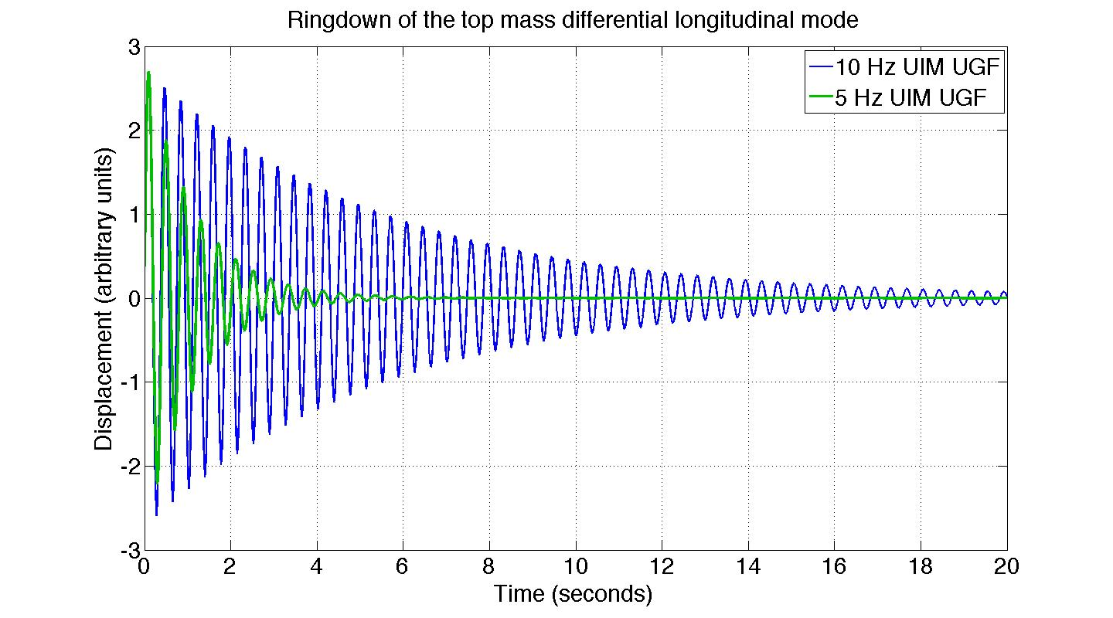
Where does the lonely differential long. mode come from?
The top mass longitudinal differential mode ringdown from the cavity loop gains on the previous slides. Damping is OFF!

Slide 18
Conclusions
Overall, OSEM sensor noise injection is minimized in 2 ways:
  1: some damping loops are removed entirely
  2: the remaining damping loops are applied to DOFs that couple weakly to DARM.
1) For the quads participating in DARM control (ETMs), you can design DARM to simultaneously damp the differential longitudinal modes. This removes the need for 1 out of 4 damping loops.
2) Quad common mode motion couples very weakly to DARM, so we can damp this separately from differential mode motion.
If DARM control is extended to include all 4 quads, in principal we could isolate virtually ALL longitudinal damping noise from DARM.

Slide 19
Conclusions cont.
If DARM control cannot be extended to all 4 quads, we could still do common-differential mode damping between the ITMs. That would leave us with just 1 out of 4 longitudinal loops coupling to DARM, the differential mode ITM loop.
Might design the damping of other DOFs and/or other cavities to include at least a subset of the 2 points above. E.g. Quad pitch damping, IMC length, etc.
ESD not important to diff. damping ringdown for high UIM ugf. Noise, performance may not matter either…more analysis to be done on that point.

Slide 20
Supporting Math
Dynamics of common and differential modes
  Rotating the pendulum state space equations from local to global coordinates
  Noise coupling from common damping to DARM
  Double pendulum example
Change in top mass modes from cavity control – simple two mass system example.

Slide 21
Dynamics of common and differential modes

Slide 22
Rotating all ETMX and ETMY local long. DOFs into global diff. and comm. DOFs
R = sensing matrix
n = sensor noise
Local to global transformations:

Slide 23
Rotating all ETMX and ETMY local long. DOFs into global diff. and comm. DOFs
Determining the coupling of common mode damping to DARM
Now, substitute in the feedback and transform to Laplace space:
Grouping like terms:

Slide 24
Rotating all ETMX and ETMY local long. DOFs into global diff. and comm. DOFs
Solving c in terms of d and :
Plugging c in to d equation:
Defining intermediate variables to keep things tidy:
Then d can be written as a function of :

Slide 25
Rotating all ETMX and ETMY local long. DOFs into global diff. and comm. DOFs
Then the transfer function from common mode sensor noise to DARM is:
As the plant differences go to zero, N goes to zero, and thus the coupling of common mode damping noise to DARM goes to zero.

Slide 26
Simple Common to Diff. Coupling Ex.
To show what the matrices on the previous slides look like.
ETMX
Common damping
ETMY
k_{x1}
u_{x1}
c₁
u_{y1}
k_{y1}
m_{x1}
x₁
0.5
+
0.5
x₂
m_{y1}
k_{x2}
k_{y2}
m_{x2}
d₂
m_{y2}
DARM Error

Slide 28
Simple Common to Diff. Coupling Ex

Slide 29
Simple Common to Diff. Coupling Ex
Plugging in sus parameters for N:

Slide 30
Change in top mass modes from cavity control – simple two mass system example.

Slide 31
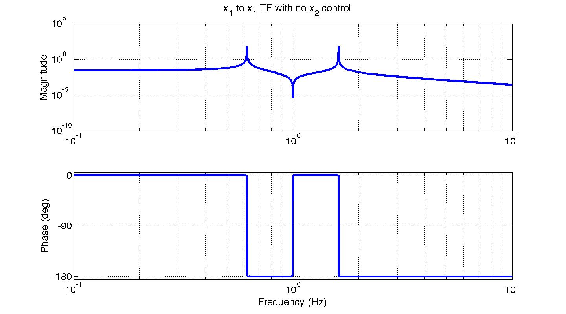
Change in top mass modes from cavity control – simple two mass ex.
Question: What happens to x₁ response when we control x₂ with f₂?
x₁
x₂
k₁
k₂
f₂
m₁
m₂
When f₂ = 0,
the x₁ to x₁ TF has two modes

Slide 32
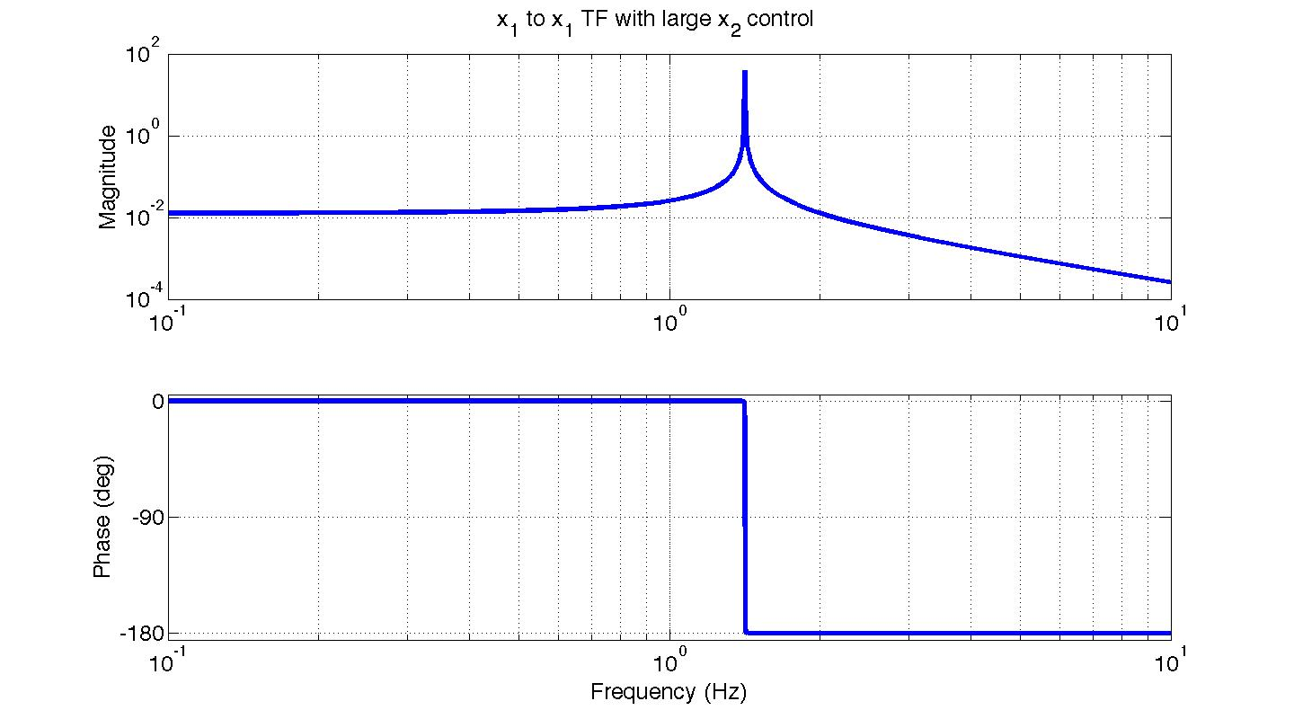
Change in top mass modes from cavity control – simple two mass ex.
The x₁ to x₁ TF has one mode. The frequency of this mode happens to be the zero in the TF from f₂ to x₂.
This is equivalent to
x₁
x₂
k₁
k₂
C
m₁
m₂
As we get to C >> k₂, then x₁ approaches this system
x₁
k₁
k₂
m₁

Slide 33
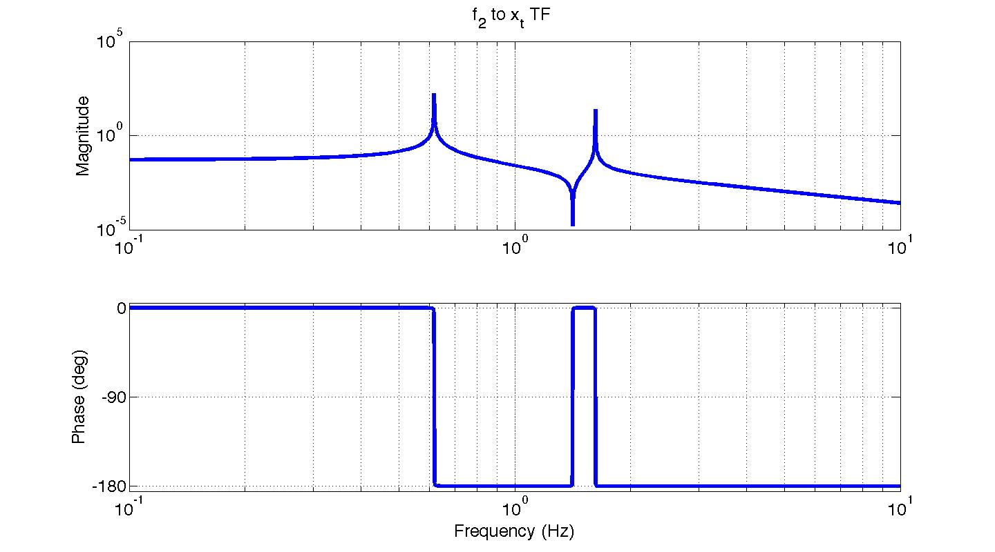
Change in top mass modes from cavity control – simple two mass ex.
Discussion of why the single x₁ mode frequency coincides with the f₂ to x₂ TF zero:
The f₂ to x₂ zero occurs at the frequency where the k₂ spring force exactly balances f₂. At this frequency any energy transferred from f₂ to x₂ gets sucked out by x₁ until x₂ comes to rest. Thus, there must be some x₁ resonance to absorb this energy until x₂ comes to rest. However, we do not see x₁ ‘blow up’ from an f₂ drive at this frequency because once x₂ is not moving, it is no longer transferring energy. Once we physically lock, or control, x₂ to decouple it from x_{1,} this resonance becomes visible with an x₁ drive.
The zero in the TF from f₂ to x₂. It coincides with the x₁ to x₁ TF mode when x₂ is locked.
x₂
f_{k2}
k₂
f₂
…
m₂

Slide 34
Backups

Slide 36
Cavity Control Influence on Damping
- Case 1: All cavity control on Pendulum 2
ETMX
ETMY
*
* Top to top mass transfer function
longitudinal
u_{1,2}
u_{2,2}
u_{1,3}
u_{2,3}
What you would expect – the quad is just hanging free.
Note: both pendulums are identical in this simulation.
u_{1,4}
u_{2,4}
0
Control Law
1

Slide 37
Cavity Control Influence on Damping
- Case 2: All cavity control on Pendulum 1
ETMX
ETMY
*
* Top to top mass transfer function
longitudinal
u_{1,2}
u_{2,2}
u_{1,3}
u_{2,3}
The top mass of pendulum 1 behaves like the UIM is clamped to gnd when its ugf is high.
Since the cavity control influences modes, you can use the same effect to apply damping (more on this later)
u_{1,4}
u_{2,4}
1
Control Law
0

Slide 38
Cavity Control Influence on Damping
- Case 3: Cavity control split evenly between both pendulums
ETMX
ETMY
*
* Top to top mass transfer function
longitudinal
u_{1,2}
u_{2,2}
u_{1,3}
u_{2,3}
The top mass response is now an average of the previous two cases -> 5 resonances to damp.
Control up to the PUM, rather than the UIM, would yield 6 resonances.
aLIGO will likely behave like this.
u_{1,4}
u_{2,4}
0.5
Control Law
0.5

Slide 39
Scratch

Slide 41
Scratch: Rotating all ETMX and ETMY local long. DOFs into global diff. and comm. DOFs
Now, substitute in the feedback and transform to Laplace space:
For DARM we measure the test masses with the global cavity readout, no local sensors are involved. The cavity readout must also have very low noise to measure GWs. So make the assumption that n_{x}-n_{y}=0 for cavity control and simplify to:

