Slide 1
Squeezing in
Gravitational Wave Detectors
LIGO-G1200769
Lisa Barsotti
(LIGO-MIT)
Fermilab Particle Astrophysics Seminars
June 25th, 2012

Slide 2
Outline
Gravitational waves and their detection
Quantum noise in GW ground-based interferometric detectors
Squeezed states of light
The LIGO H1 squeezing experiment
  Squeezing in GEO600
Squeezing in next generation of detectors

Slide 3

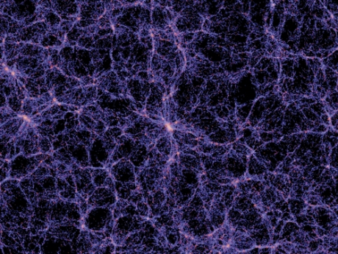
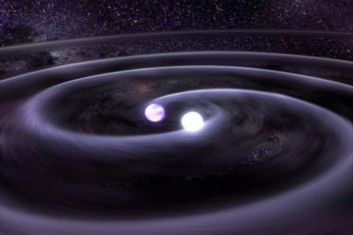
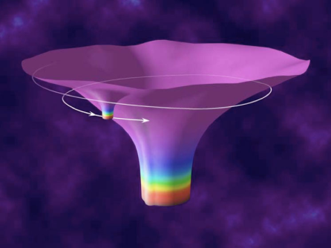

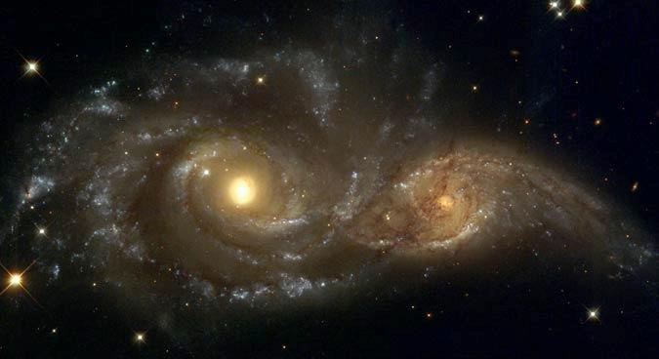

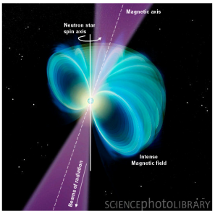
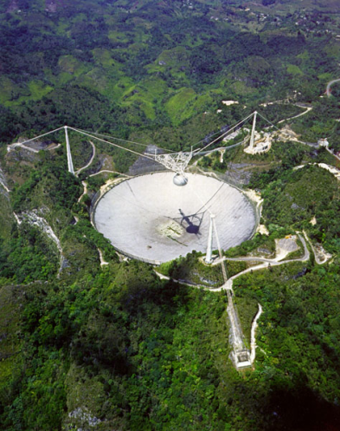

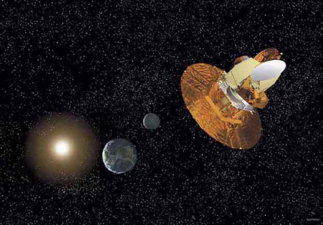
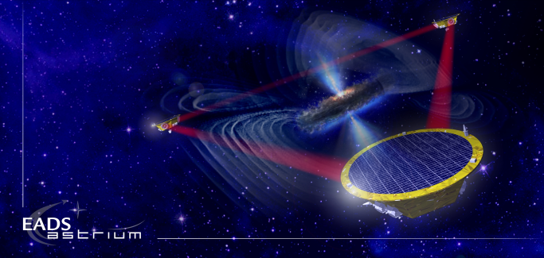
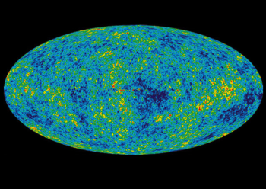
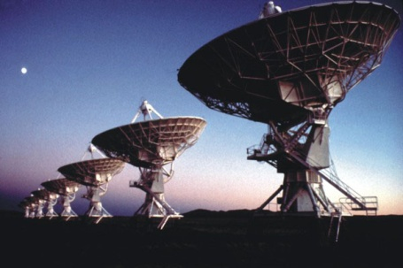
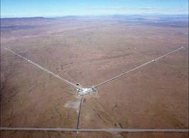
Gravitational Waves
?
?
?
BH and NS Binaries
Supernovae
Cosmic Strings
Relic radiation
?
?
Extreme Mass Ratio
Inspirals
?
Supermassive BH Binaries
Binaries coalescences
Spinning NS
10⁻¹⁶ Hz
10⁻⁹ Hz
10⁻⁴ Hz
10⁰ Hz
10³ Hz
Inflation Probe
Pulsar timing
Space detectors
Ground interferometers
?
Laser Interferometer
Gravitational Wave
Observatory

Slide 4
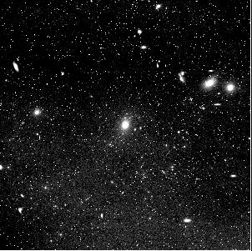
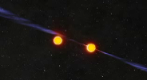

Ground Based Detection
VIRGO cluster
Virgo Cluster
h
h
Binary NS coalescence
M ≈ 1.4M☼
R ≈ 20 km
forb ≈ 400 Hz ➔ h ~10⁻²²
r ~ 18 Mpc

Slide 5
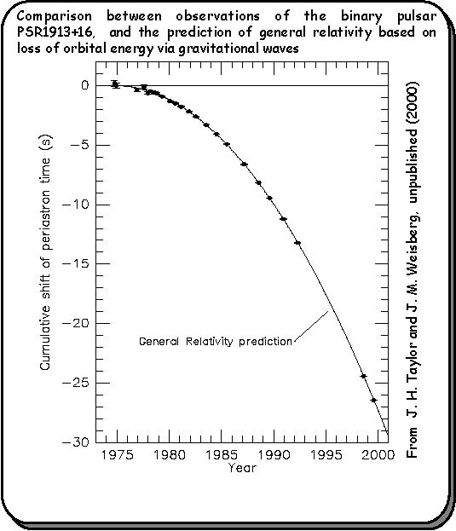
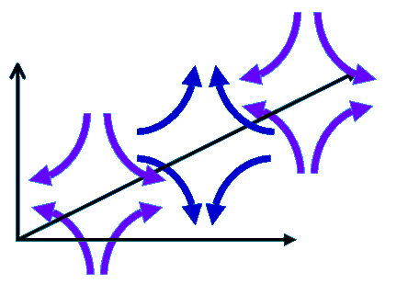
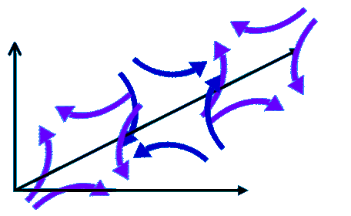
Gravitational Waves Detection
Seeking for a direct measurement
Indirect measurement
Hulse & Taylor (Nobel Prize 1993)
BH and NS Binaries
Gravitational waves: ripples in the space-time propagating at the speed of light
h = GW amplitude
~ 4km
LASER

Slide 6
Quantum noise
m
SHOT NOISE: Photon counting noise produced by the uncertainty in the arrival time of the photons on a photo-detector (Poissonian statistics):
RADIATION PRESSURE NOISE: Back-action noise caused by fluctuations in the power impinging on the mirrors:
LASER
Photo-detector

Slide 7
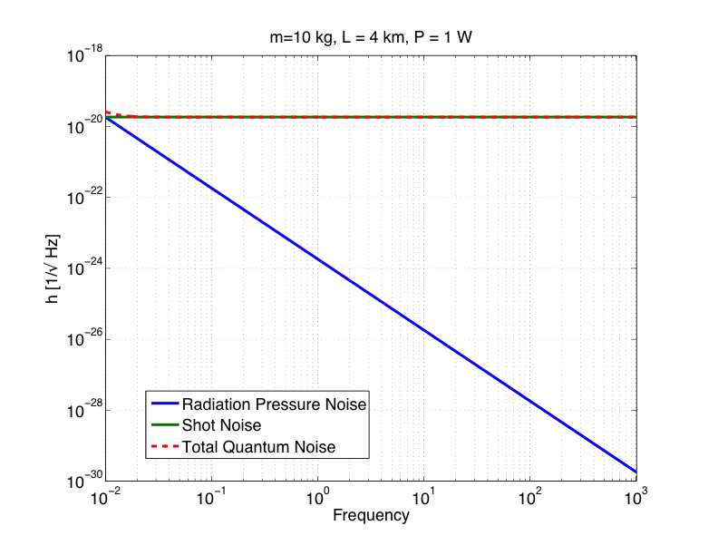
Quantum noise
SHOT NOISE: Photon counting noise produced by the uncertainty in the arrival time of the photons on a photo-detector (Poissonian statistics):
RADIATION PRESSURE NOISE: Back-action noise caused by fluctuations in the power impinging on the mirrors:

Slide 8
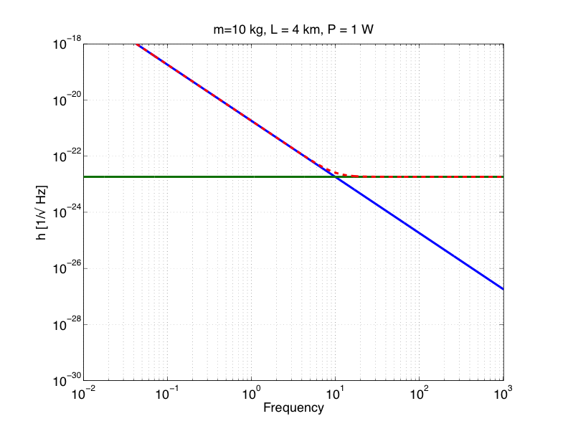
Quantum noise
SHOT NOISE: Photon counting noise produced by the uncertainty in the arrival time of the photons on a photo-detector (Poissonian statistics):
RADIATION PRESSURE NOISE: Back-action noise caused by fluctuations in the power impinging on the mirrors:
P = 1 MW

Slide 9
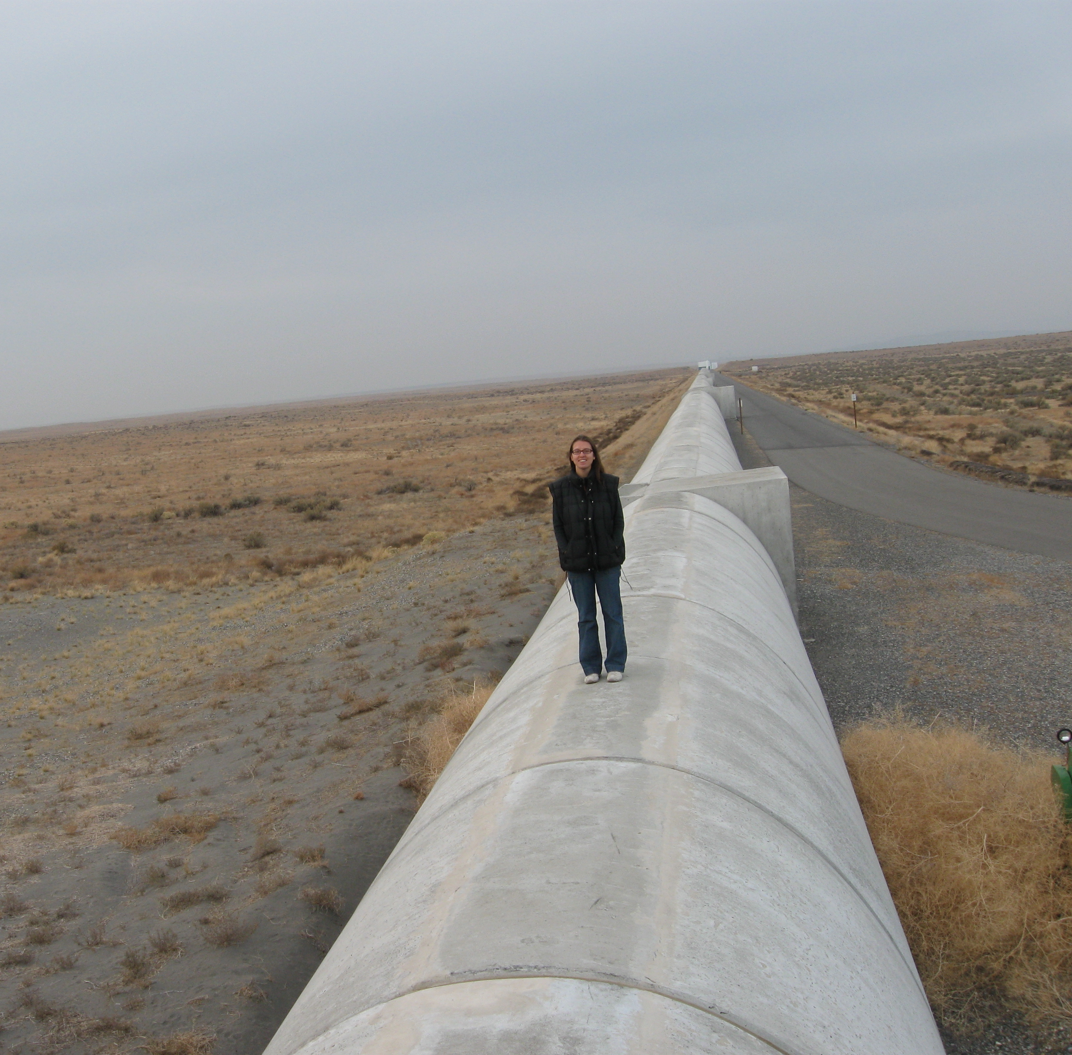
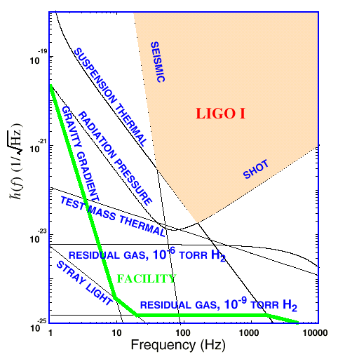
The LIGO detector
4 km tubes
Ultra high vacuum
Audio-frequency region
SUSPENDED MIRRORS
Seismic Noise
Thermal (Brownian) Noise
LASER
photodiode
Radiation pressure
"Shot" noise
Quantum Noise

Slide 10
How to reduce quantum noise
Increase the power to reduce shot noise (and increase the mirror mass to minimize radiation pressure noise)
More complex optical configuration which shapes the interferometer optical response
Re-think of where quantum noise comes from…
  D. E. McClelland, N. Mavalvala, Y. Chen, and R. Schnabel, “Advanced interferometry, quantum optics and optomechanics in gravitational wave detectors", Laser and Photonics Rev.5, 677-696 (2011)

Slide 11
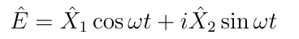
Quantum States
Quantization of the electro-magnetic field
X₂
Quadrature Field Amplitudes
Amplitude Noise
Heisenberg uncertainty principle:
Phase Noise
∆X₁ ∆X₂ ≥1
X₁
11

Slide 12
Vacuum Fluctuations
When average amplitude is zero, the variance remains
Vacuum fluctuations are everywhere that classically there is no field….
…like at the output port of your interferometer!
X1
X2
12

Slide 13
Quantum Noise and Vacuum
Quantum noise is produced by vacuum fluctuations entering the open ports
Vacuum fluctuations have equal uncertainty in phase and amplitude:
  Phase: Shot-Noise
(photon counting noise)
  Amplitude: Radiation Pressure Noise
  (back-action)
LASER
Phase
IFO Signal
Amplitude

Slide 14
Vacuum Getting Squeezed
Reduce quantum noise by injecting squeezed vacuum: less uncertainty in one of the two quadratures
Heisenberg uncertainty principle:
if the noise gets smaller in one quadrature, it gets bigger in the other one
One can choose the relative orientation between the squeezed vacuum and the interferometer signal (squeeze angle)
LASER
Squeezed Field
Phase
C. M. Caves, Phys. Rev. Lett. 45, 75 (1980).
C. M. Caves, Quantum-mechanical noise in an interferometer. Phys. Rev. D 23, p. 1693 (1981).
IFO Signal
Amplitude

Slide 15
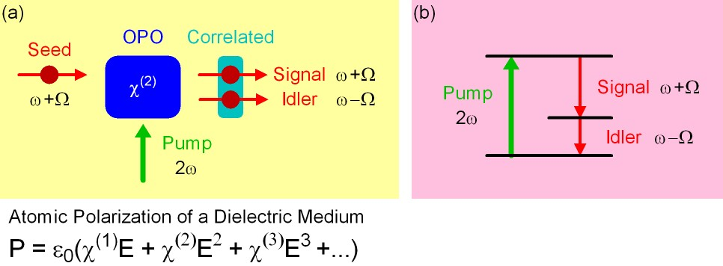
How to make squeezed fields..
…. in theory
Non linear medium with a strong second order
polarization component
Correlation of upper and lower quantum sidebands
The OPO makes a “copy” of the quantum sideband, and it correlates the sideband

Slide 16
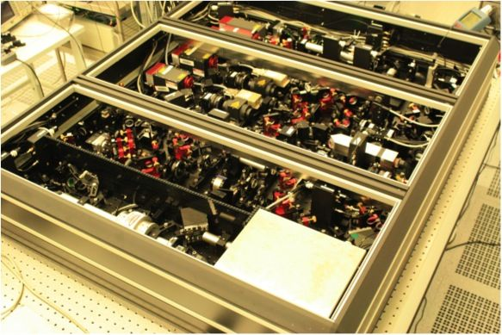
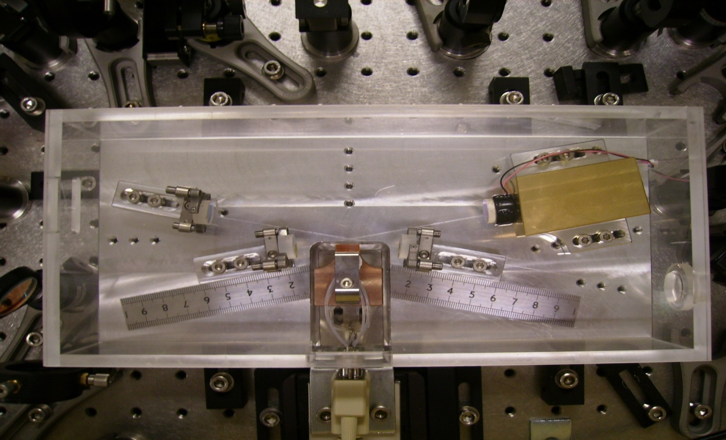
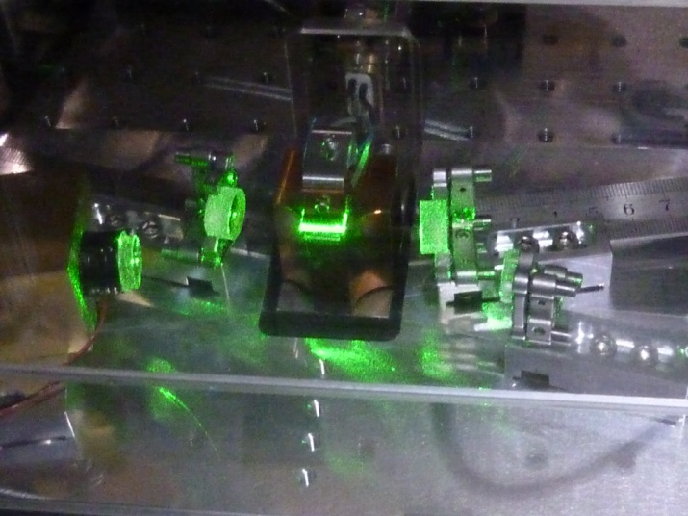
How to make squeezed fields..
…. in practice
AEI, ANU, MIT, Caltech → big effort in the last 10 years to make squeezing in the audio-frequency band
Lasers, mirrors, control loops,..
Courtesy of Alexander Khalaidovski (AEI)
The Squeezer of the GEO600 detector
The Optical Parametric Oscillator
of the LIGO squeezer

Slide 17
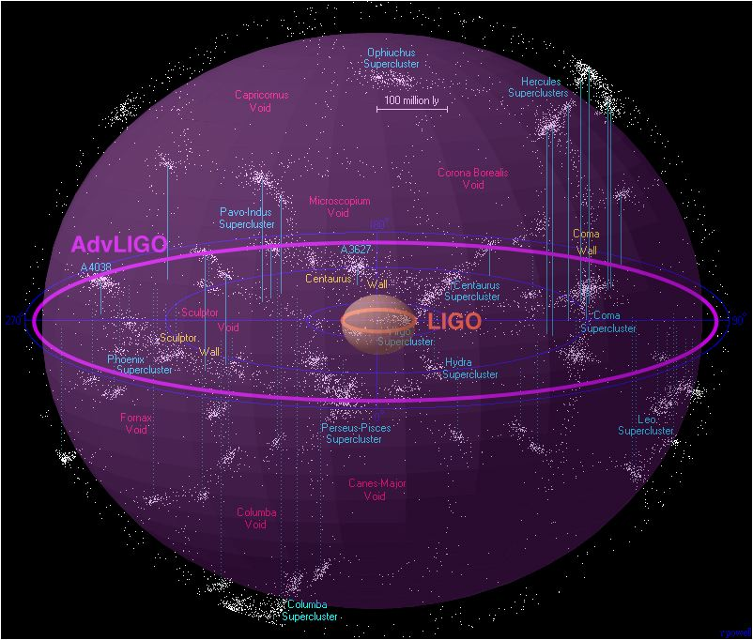
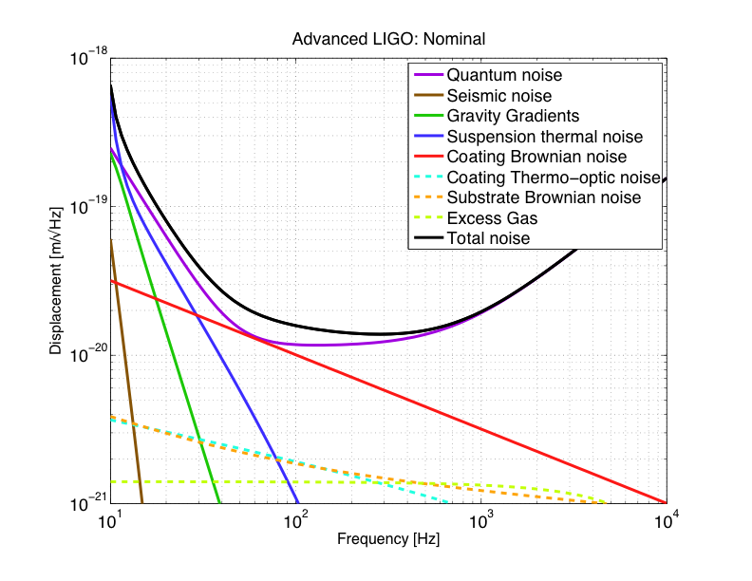
Quantum Noise will limit the Sensitivity of GW Detectors for a long time…
2nd Generation (Advanced LIGO)
Enhanced LIGO 2009
Initial LIGO 2007
100 million light years
Credit: R.Powell, B.Berger
Advanced LIGO ~2015
x10 better sensitivity
X1000 detection rate
Squeezing can reduce quantum noise..let’s try!

Slide 18
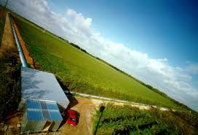
Squeezing at GEO600 (Germany)
3.5 dB of squeezing
First implementation of squeezing in a GW observatory
3.5 dB of squeezing measured!
Not close to quantum limit in the 200 Hz region ➔ injection in a LIGO detector as well
-
-
-
Abadie et al.
Nature Physics 7, 962 (2011)

Slide 19
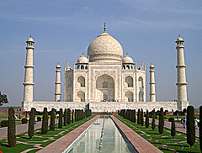
LIGO Past & Future
2009
2010
2011
2012
2013
2014
2015
2016
L1
Science Run S6
installation
full lock
noise hunting
SCIENCE RUNS
?
H2
installation
One Arm Test
H1
Science Run S6
H1 Squeezing
experiment
installation
full lock
noise hunting
SCIENCE RUNS
LIGO
1st generation
Advanced LIGO
2nd generation

Slide 20
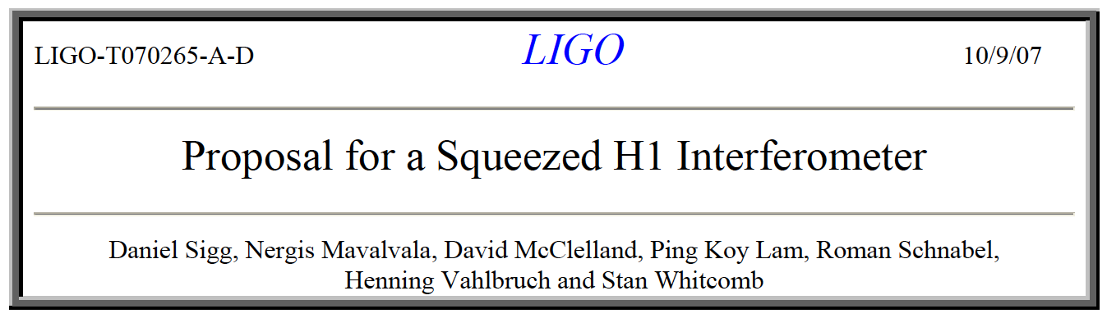
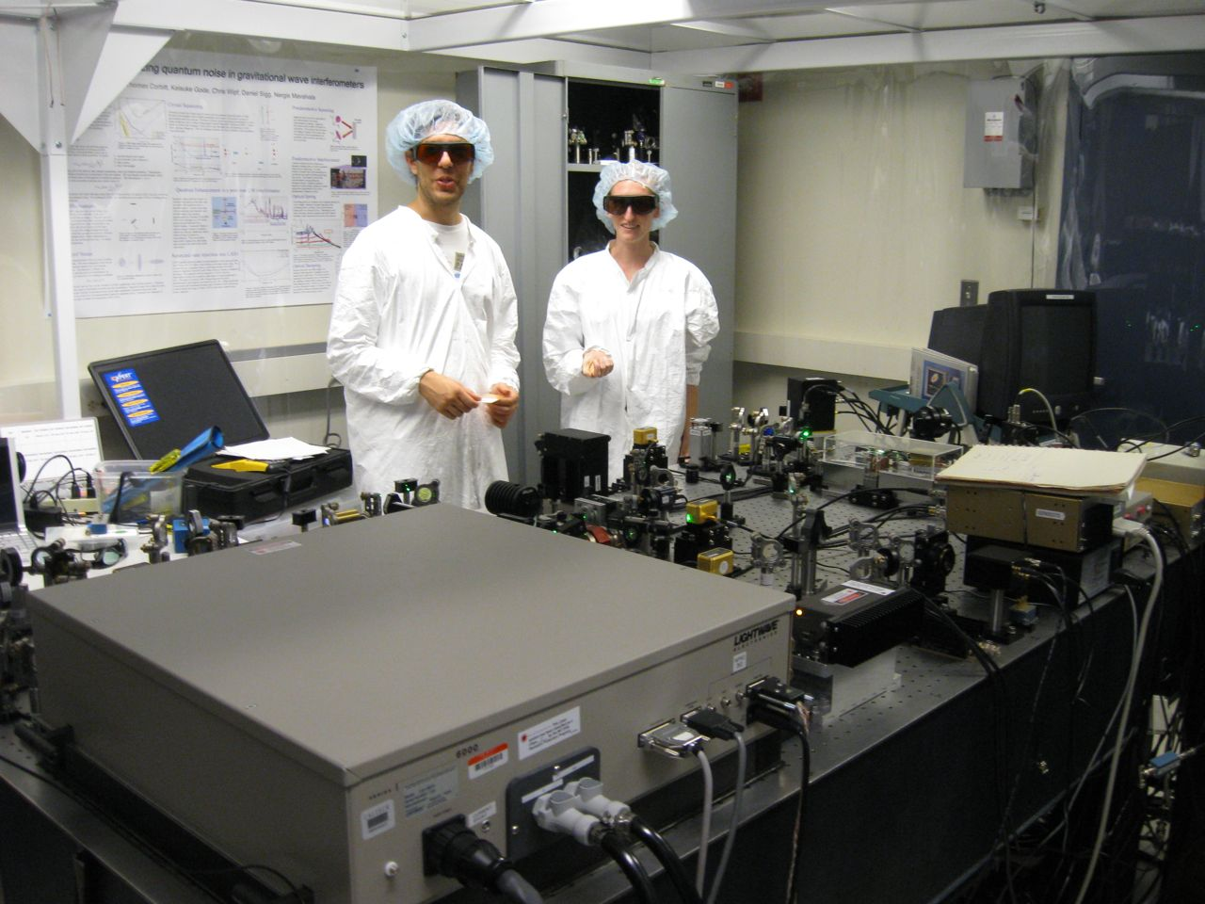
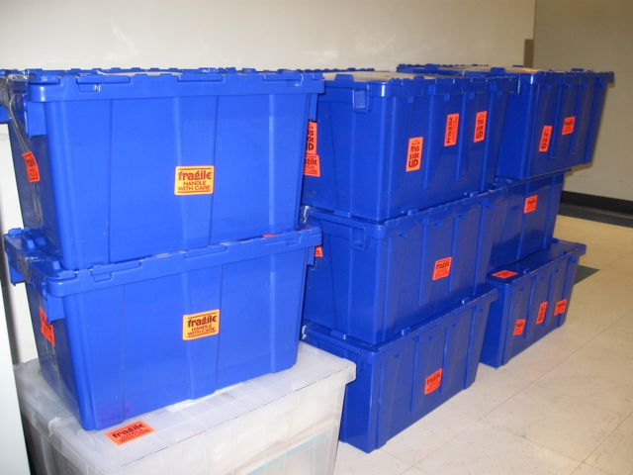
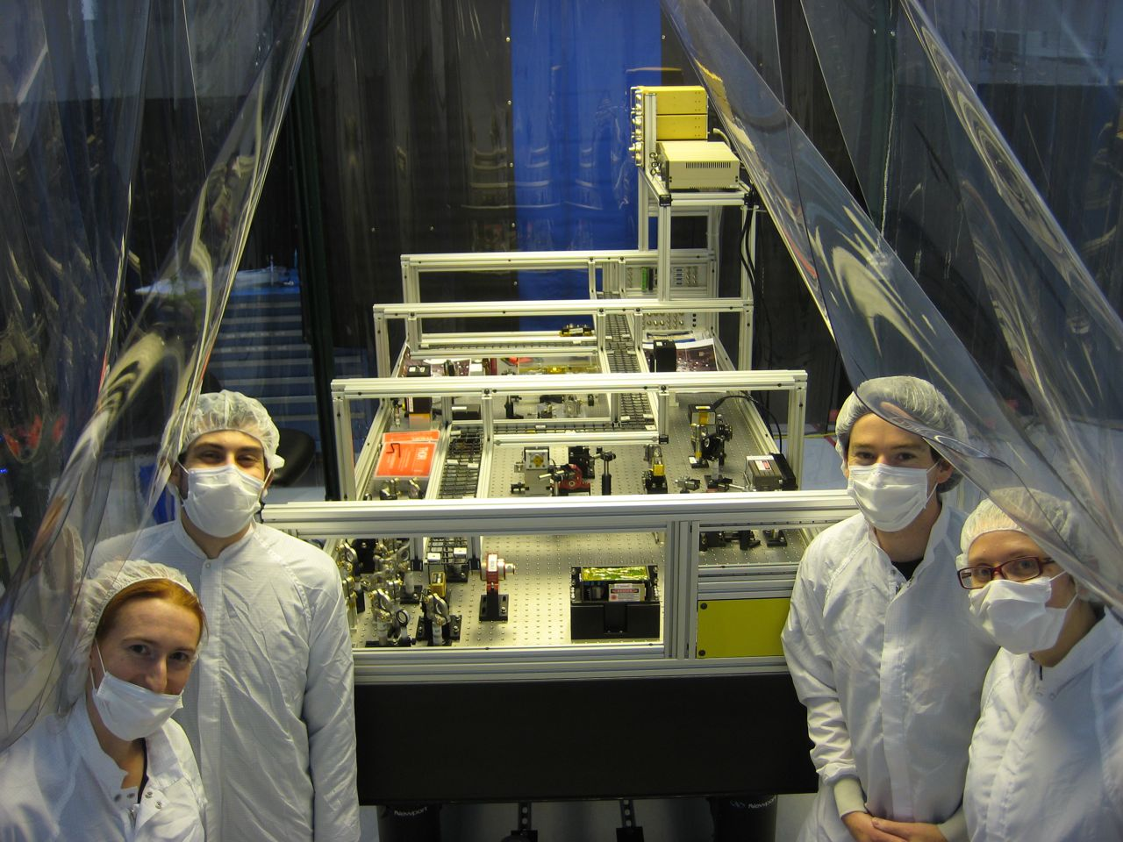
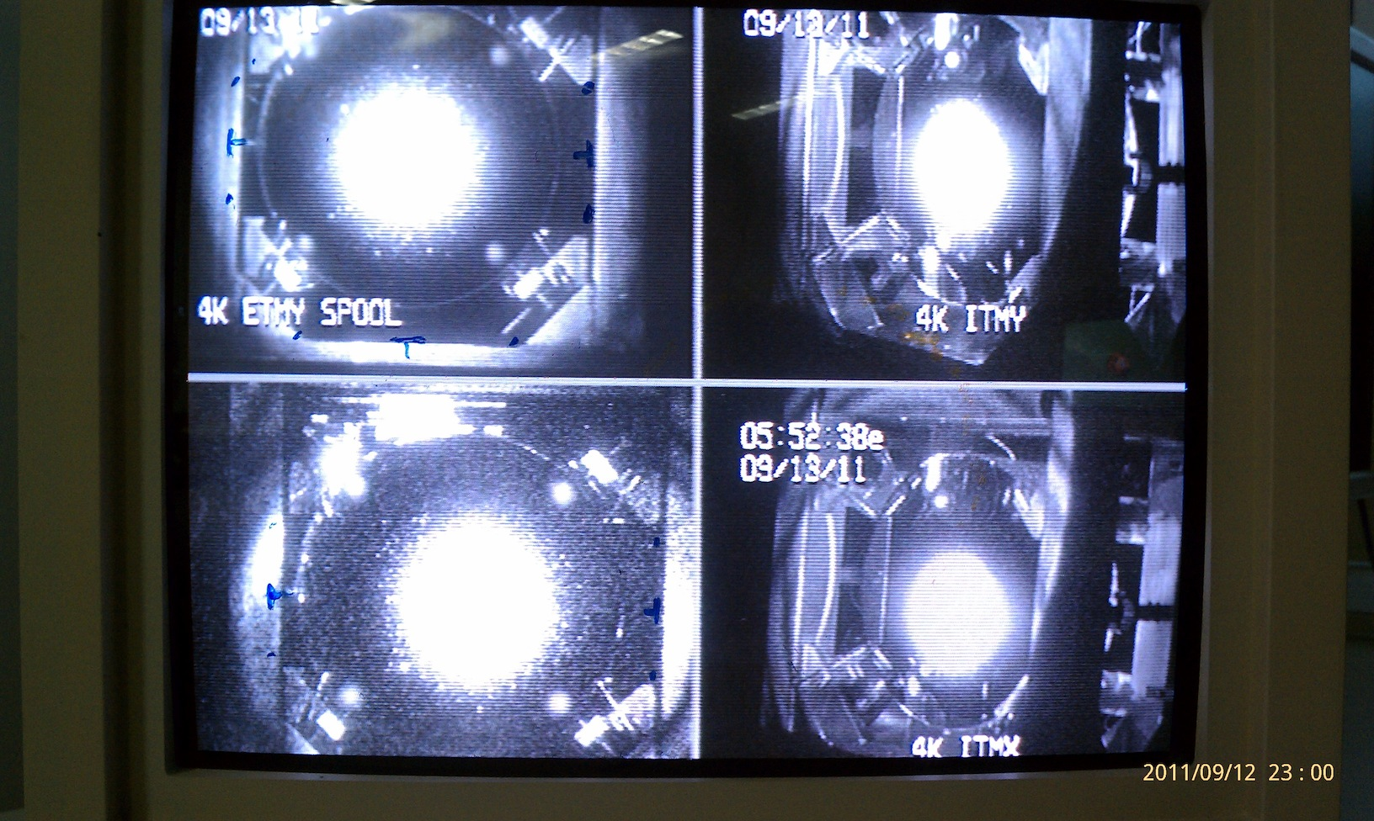
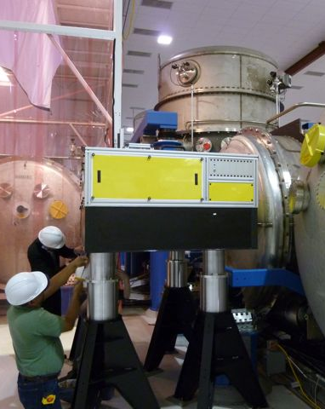
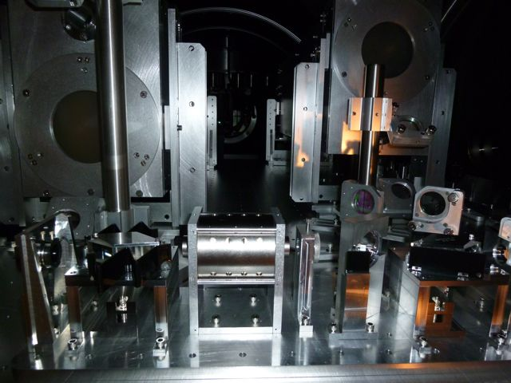
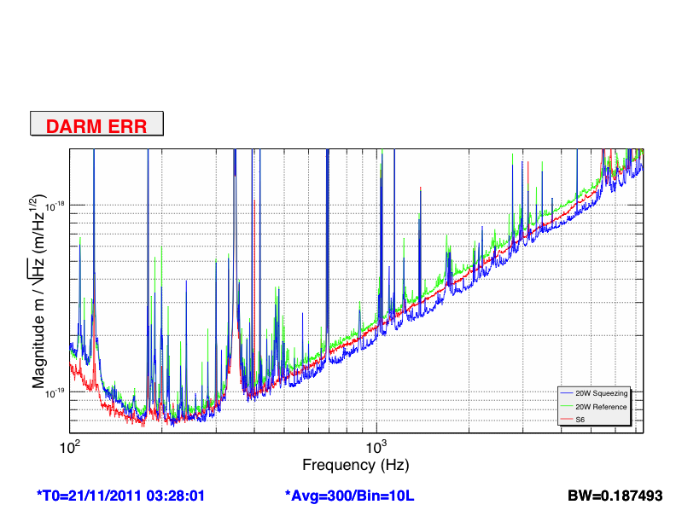
Bow-tie cavity OPO design at ANU (2008)
H1 Squeezer assembling at MIT (2009-2010)
H1 Squeezer parts shipped to LHO
(Oct 2010)
Squeezing in H1
(Oct 3 – Dec 4)
H1 Recovery
(Sept 2011)
H1 Squeezer Installation (Summer 2011)

Slide 21
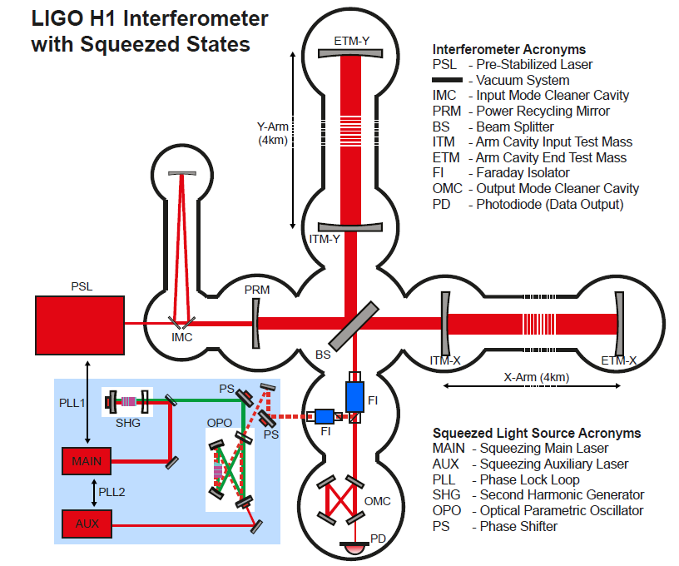
Squeezing Injection in LIGO H1

Slide 22
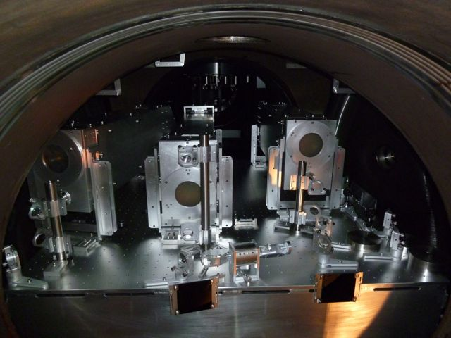
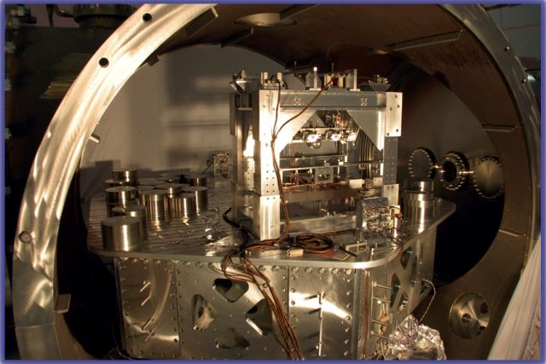
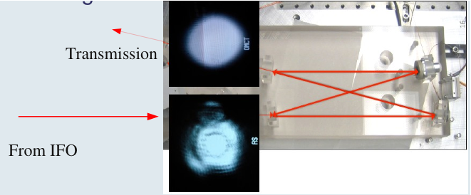
H1 Squeezing Experiment:
(Old) Readout In-Vacuum Layout
from the IFO
Output Mode Cleaner

Slide 23
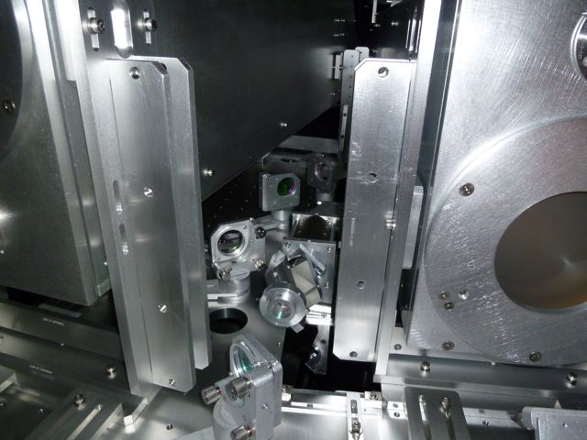
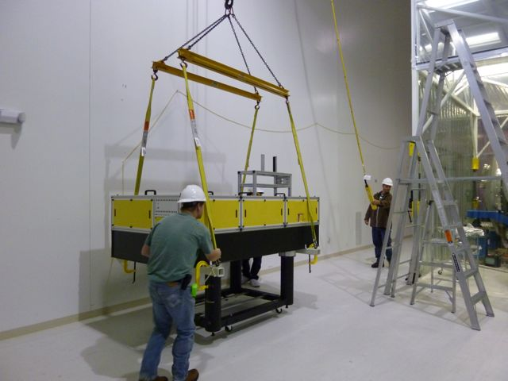
H1 Squeezing Experiment:
Squeezer Installation
Additional Faraday installed in the squeezed beam path
New H1 Output Faraday
(first aLIGO unit)
Squeezer table craned to its final location

Slide 24
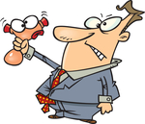
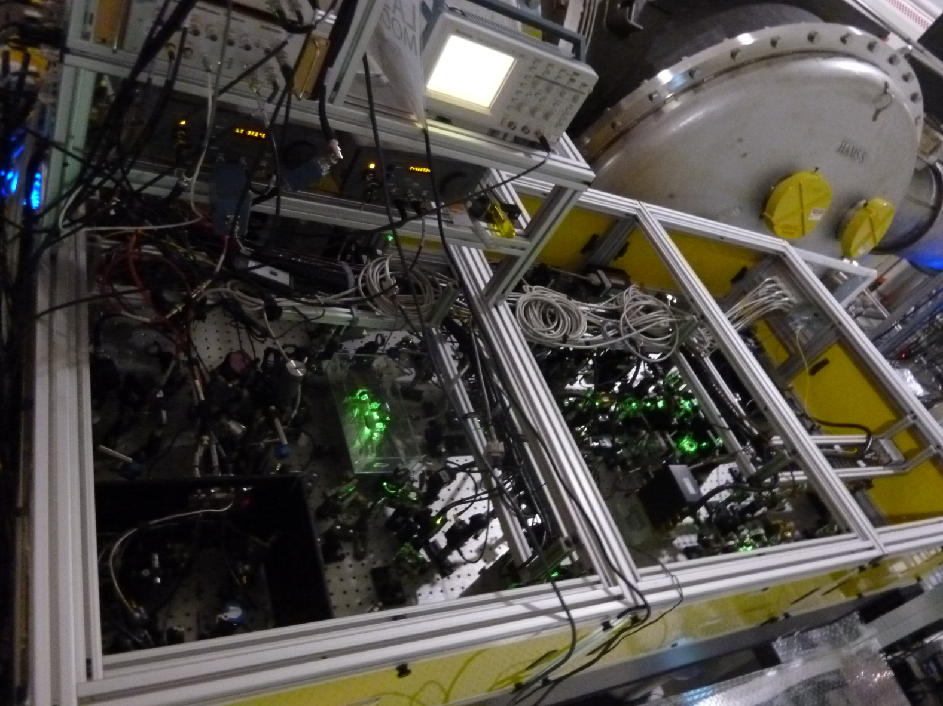
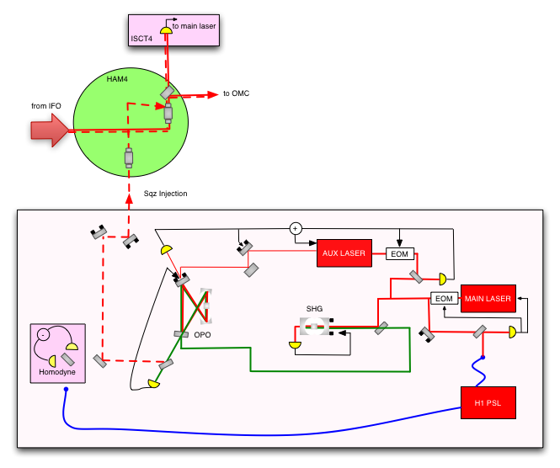
Squeezing Injection

Slide 25
Squeezing Injection
Coherent beam @ 29MHz injected for controlling the squeeze angle
X₂
φ_{sqz}
X₁

Slide 26
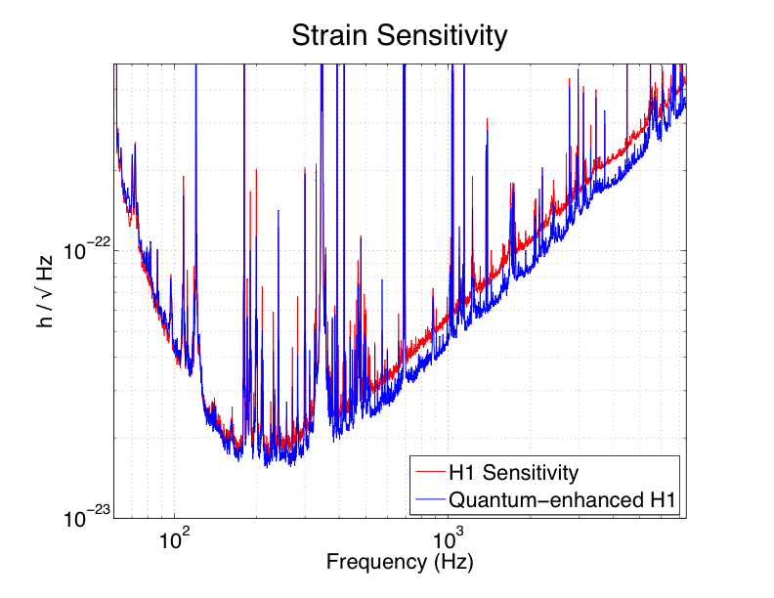
Improving H1 with squeezing
PRELIMINARY

Slide 27
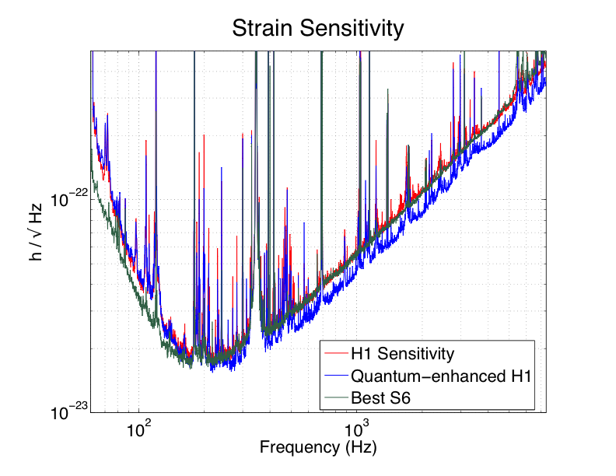
Best broadband sensitivity ever
PRELIMINARY

Slide 28
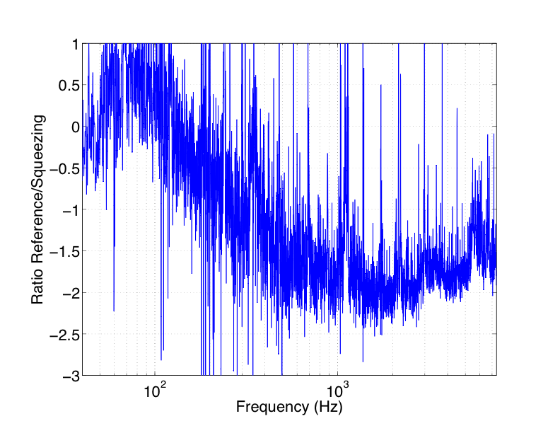
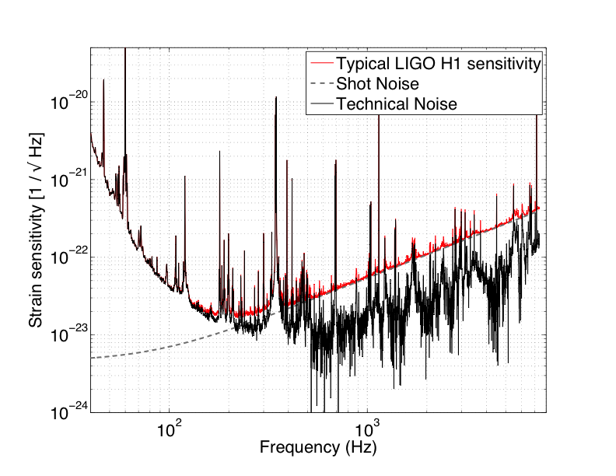
2.15 dB (28%) improvement over quantum noise
Squeezing improves only quantum noise, not other technical noises

Slide 29

Improving H1 by 2 dB (28%) with squeezing
..without spoiling the sensitivity at 200 Hz
PRELIMINARY

Slide 30
Noise couplings
Everything you can think of has the potential of spoiling the sensitivity of LIGO around 200 Hz
Squeezing injection is not an exception
One mechanism: spurious light from the interferometer reaches the squeezer, and it is scattered back to the interferometer, modulated by the motion of the squeezer table
LIGO OPO is a bow-tie cavity to provide an intrinsic
isolation to back scatter
LASER
S. Chua et al., Backscatter tolerant squeezed light source
for advanced gravitational-wave detectors.
Optics Letters 36, 4680 (2011).

Slide 31


First try at squeezing in GEO
First squeezing injection: back scattered noise limits the sensitivity
Additional Faraday to reduce back scattering and measure squeezing
Courtesy of Alexander Khalaidovski (AEI)
GWADW 2010

Slide 32

Why only 2 dB? Losses…
Losses degrade squeezing (“un-squeezed” vacuum gets in causing dechoerence of the squeezed state)
Vacuum fluctuations destroy the squeezed states
At some point it doesn’t matter how much squeezing you can produce…you can’t measure it!
During the H1 squeezing experiment, we measured a total of 56% losses, and we injected 10 dB…so it makes sense!

Slide 33
Where the main losses came from
Mode matching (~30% losses)
Faradays (3 passes ~ 20% losses)
OMC transmission (18% losses)
➔ “Technical” problems, total losses should be down to 10-15% in aLIGO

Slide 34







Advanced LIGO configuration
HAM-ISI
BSC-ISI
PSL
QUAD
TRANSMON
Increased optical layout complexity
Up to 125W input power

Slide 35


Slide 36

Projections for a “Quantum-Enhanced Advanced LIGO”
Target:
6 dB
Same NS-NS as aLIGO,
better high frequency performance

Slide 37


Slide 38

Frequency Dependent Squeezing
What we want is a frequency dependent rotation of the squeeze angle, to achieve a broadband improvement of the quantum noise

Slide 39

Frequency Dependent Squeezing
High finesse detuned cavity which does the rotation for you
Broadband improvement of the quantum noise
Theoretically well understood, experimentally challenging
Low loss needed: F ~ 50,000 for 100m scale cavities
R&D in progress – MIT (P. Kwee and others)
        Caltech (J. Harms and others)
H. J. Kimble, Y. Levin, A. B. Matsko, K. S. Thorne and S. P. Vyatchanin,
Conversion of conventional gravitational-wave interferometers into quantum nondemolition interferometers by modifying their input and/or
output optics. Phys. Rev. D 65, 022002 (2001).

Slide 40

Beyond aLIGO: 3rd generation
Can we take another factor of 10 step?
Rana Adhikari, GWADW 2012
Basic idea is to use the same LIGO vacuum envelope
Design study happening now
Still work in progress, one thing already clear:
➔ 10 dB of frequency dependent squeezing needed!

Slide 41
The Message
Squeezing can reduce quantum noise, and improve the sensitivity of GW detectors
Large scale interferometers with squeezing: DONE!
    Work needed to achieve 24/7 long term stability at maximum squeezing and reduce optical losses
    H1 squeezing experiment completed, GEO600 operating with squeezing right now
In a good position to make squeezing available for Advanced detectors and beyond

Slide 42





H1 Squeezing Experiment
LHO: Daniel Sigg, Keita Kawabe, Robert Schofield, Cheryl Vorvick, Dick Gustafson (Univ Mitchigan), Max Factourovich (Columbia), Grant Meadors (Univ Mitchigan), the LHO staff
MIT: Sheila Dwyer, L. Barsotti, Nergis Mavalvala, Nicolas Smith-Lefebvre, Matt Evans
ANU: Sheon Chua, Michael Stefszky, Conor Mow-Lowry, Ping Koy Lam, Ben Buchler, David McClelland
AEI: Alexander Khalaidovski, Roman Schnabel

