Slide 1

HAM-ISI
Medm Screens and Troubleshooting
(introduction)
Hugo Paris for the SEI team

Slide 2
MEDM Screens

Slide 3
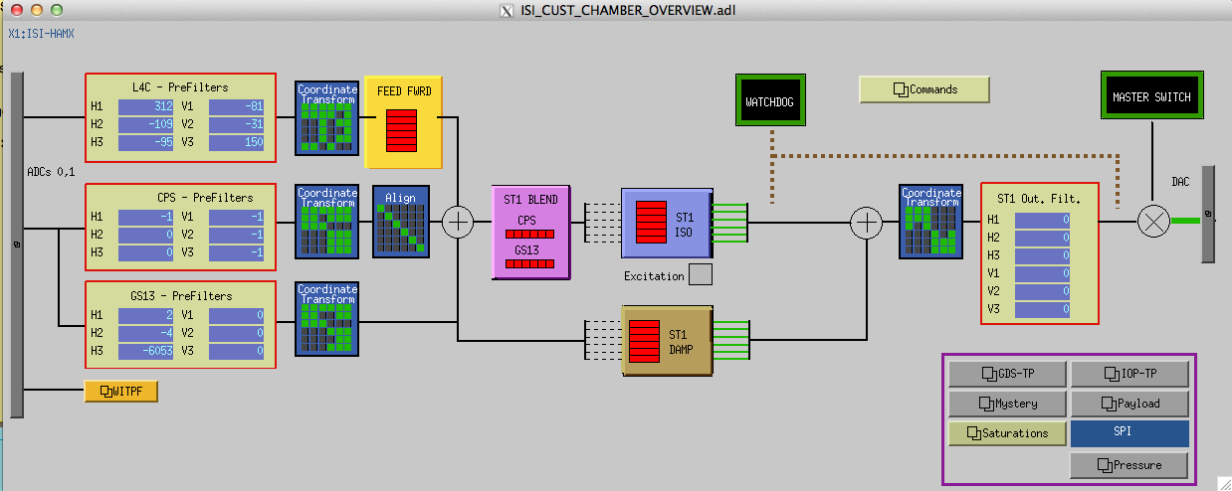
Main
Safety
ON/OFF
Sensors
L4C
CPS
GS13
Basis change
Local => Cartesian
Processing
Sensor blend
Damping
Isolation
Basis change
Cartesian => Local
Actuators
Notes:
MEDM
Motif Editor and Display Manager (GUI for control screens)
GUI
Graphical User Interface
MEDM screens will change a bit. FFW line must be changed
Presentation from left to right

Slide 4
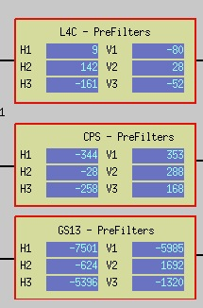
Sensors
Calm environment:
L4C 0 ⁺/₋ 400cts
CPS 0 ⁺/₋ 400cts
GS13 ⁺/₋ 12000

Slide 5
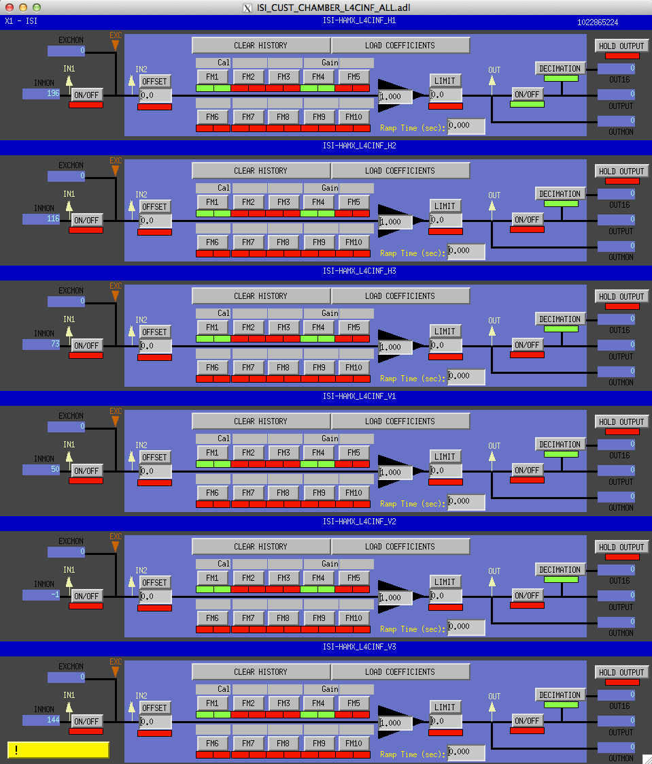
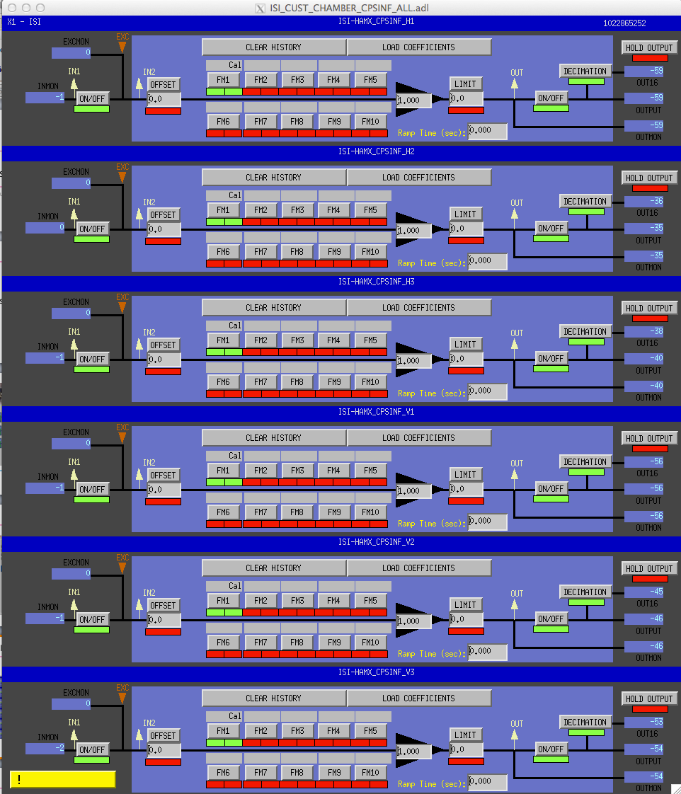
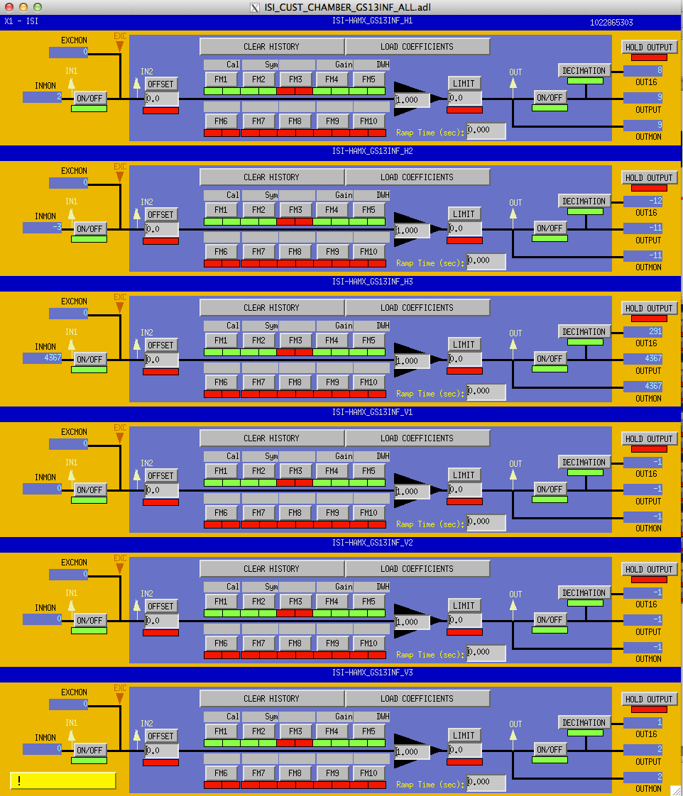
Input Filters (INF)
L4C
CPS
GS13
Calibration
Gain
Calibration
Calibration
Symmetrization
Gain
Dewhitening

Slide 6
Input Filters (INF)

Slide 7
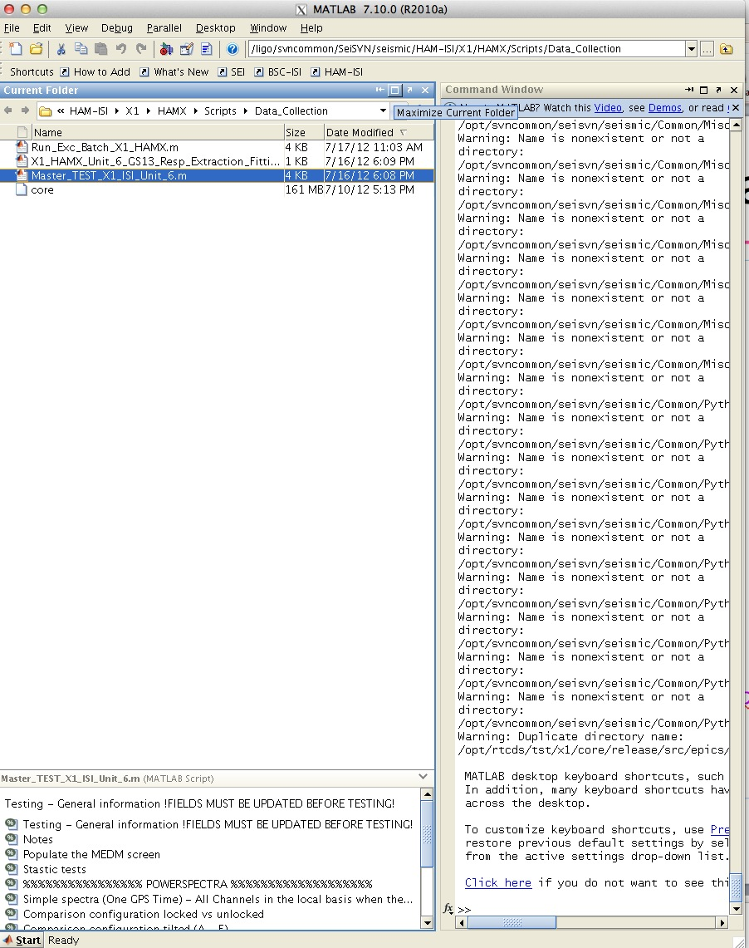
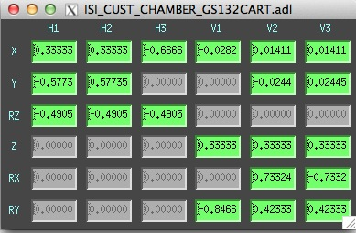
Coordinate Transform Matrices
Open Matlab®
Load Paths:
HAM-ISI
SEI
Set Variables:
  IFO = 'X1';
  Chamber = 'HAMX';
  Direction = 'X';
  Set_Gains = 1;
Run:
  Populate_MEDM_Screen_HAM_ISI(IFO,Chamber,Direction,Set_Gains)

Slide 8
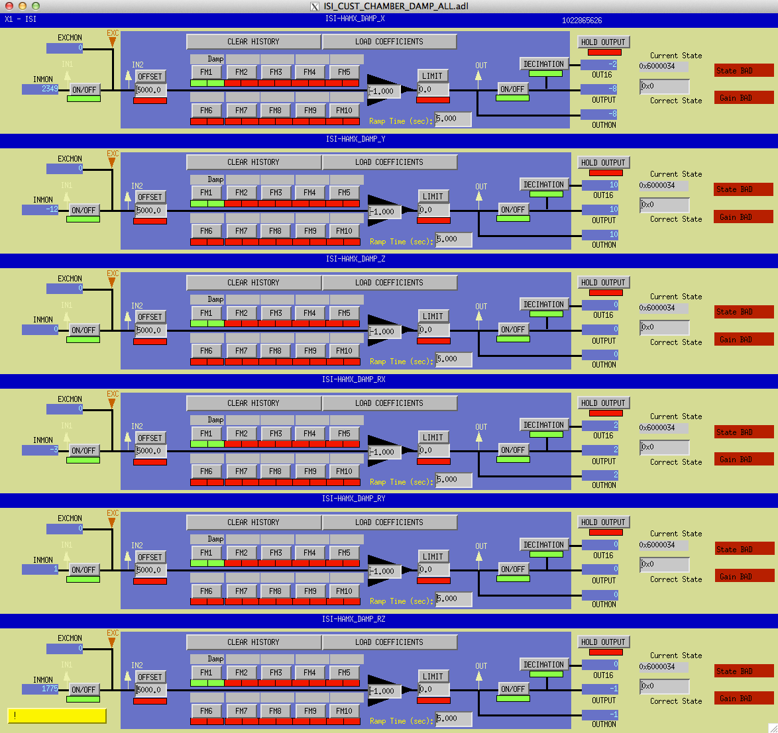
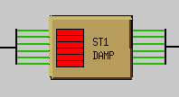
Damping

Slide 9
Blend
Seismometer
CPS

Slide 10

Blend
¥
Notes:
MEDM
Motif Editor and Display Manager (GUI for control screens)
GUI
Graphical User Interface

Slide 11
ISO Loops
We don’t know the perturbation:???
Measure the motion of the platform: Blend
Counteract with actuators: ISO Loops
???
Platform motion
ISO Loops
+ High performances
- Risks of Instability

Slide 12
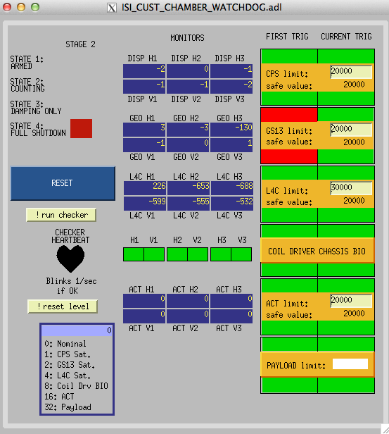
Watchdogs
Notes:
GS13 tripped
Look @ excitation
Look @ Damping/Isolation. Stable???
L4C limit is over safe value
Make sure no “special measurement” is running and correct

Slide 13
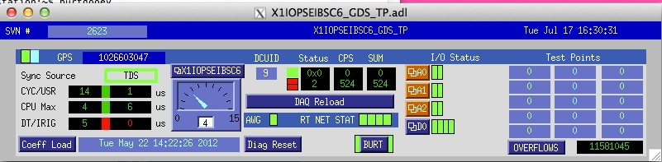
CPU check

Slide 14
Conclusion
We want:
Input filters - ON
Coordinate Transform Matrices - Loaded
Damping loops - ON
Isolation filters - ON
WD - Safe
CPU - OK state
Guardian will help
Notes:
MEDM
Motif Editor and Display Manager (GUI for control screens)
GUI
Graphical User Interface

Slide 15
Troubleshooting

Slide 16
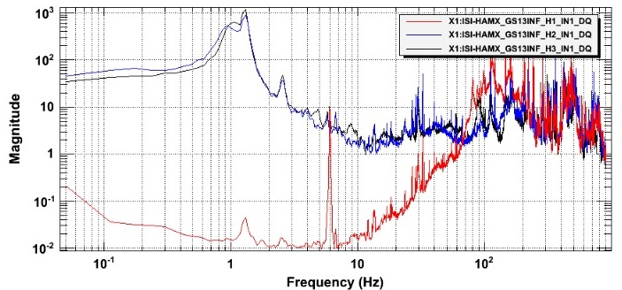
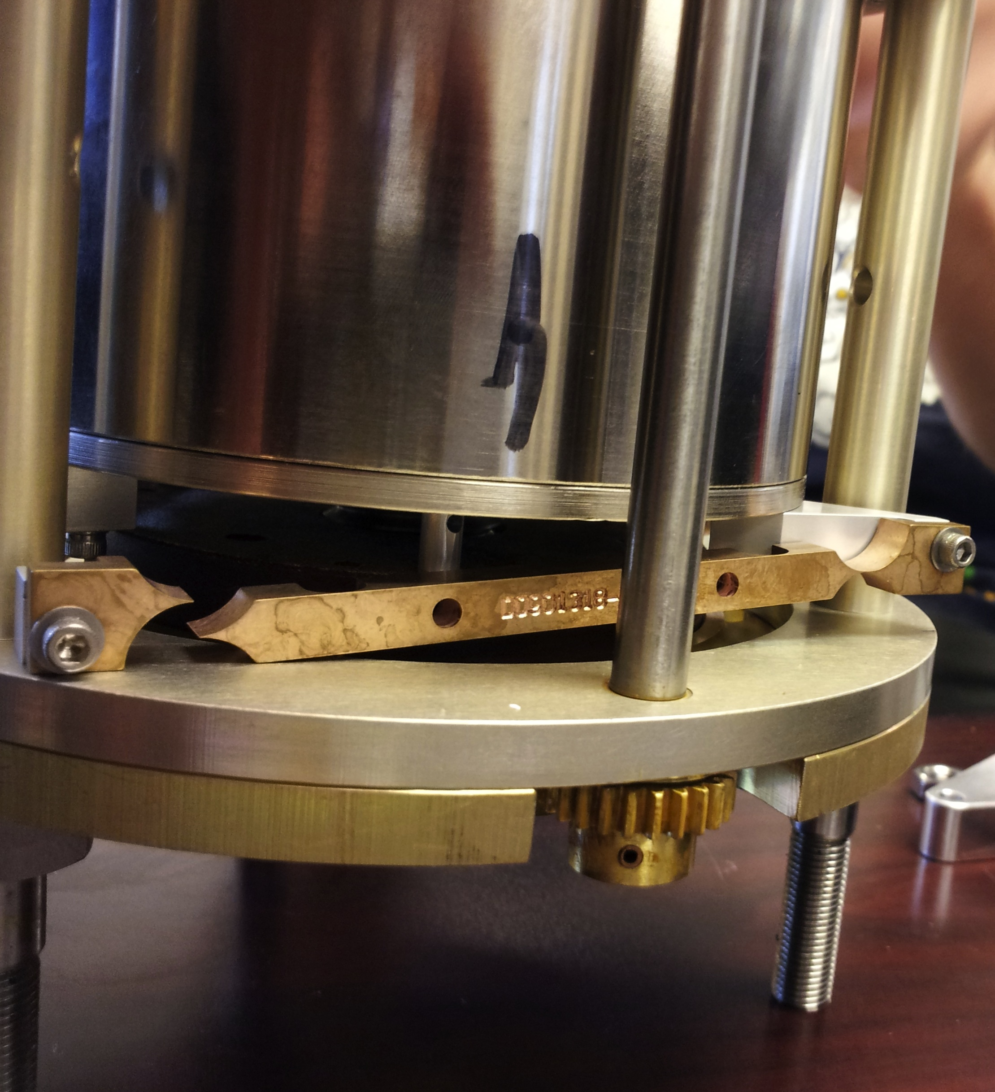
Power Spectra
DTT or Matlab®
Broken Flexure…
Notes:
MEDM
Motif Editor and Display Manager (GUI for control screens)
GUI
Graphical User Interface

Slide 17
Transfer Functions
Measured/processed via Matlab®
More details in E1000309
    Run/Save excitation: Run_Exc_Batch_X1_HAMX.m.
    Retrieve time series + Process/Save TF data: Run_Get_Batch.m
    Concatenate/display/save TFS: Step_1_Plot_TF_Loc_to_Loc_X1_ISI_HAMX.m
We want
Symmetry
Low noise
Results comparable to reference
Notes:
MEDM
Motif Editor and Display Manager (GUI for control screens)
GUI
Graphical User Interface

Slide 18
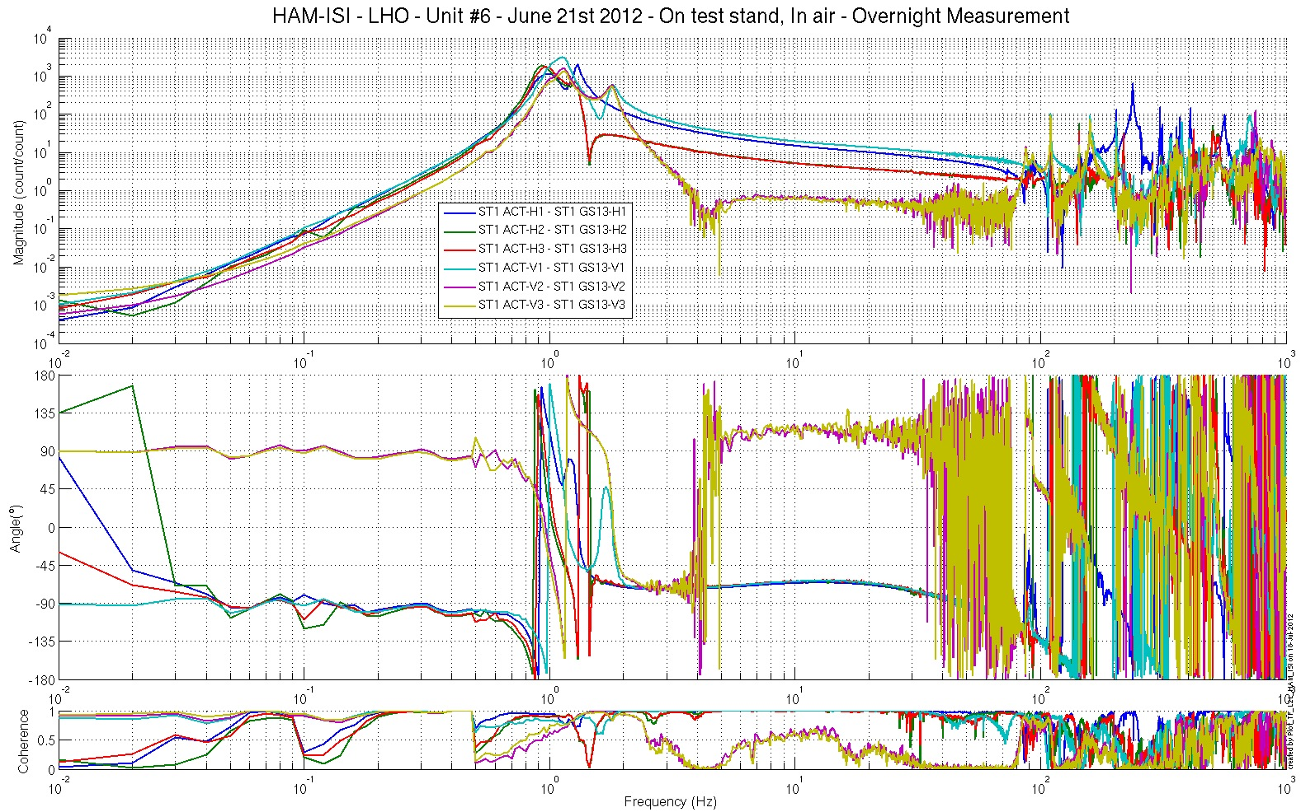
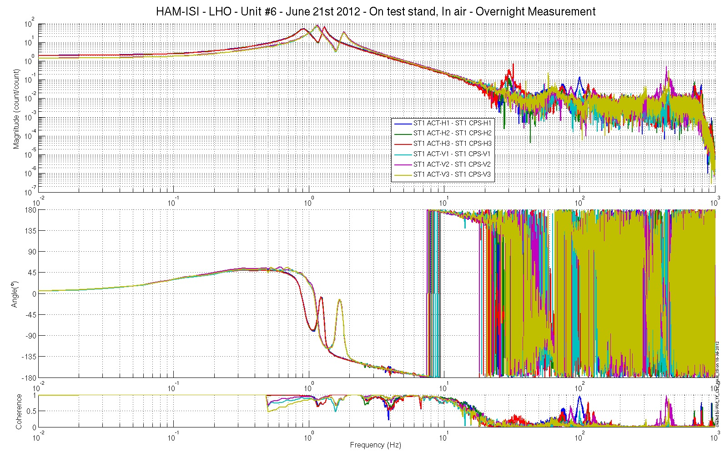
Example #1
IN-Field cables misconnected
Bad connection on GS13 cables => Gain of ¹/₂
GS13 connections mismatched => reading cross-coupling
Notes:
MEDM
Motif Editor and Display Manager (GUI for control screens)
GUI
Graphical User Interface

Slide 19
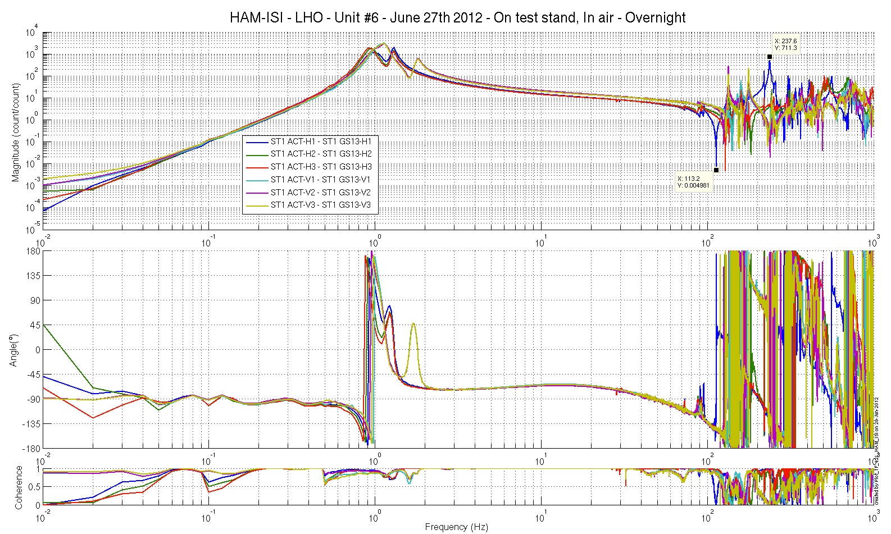
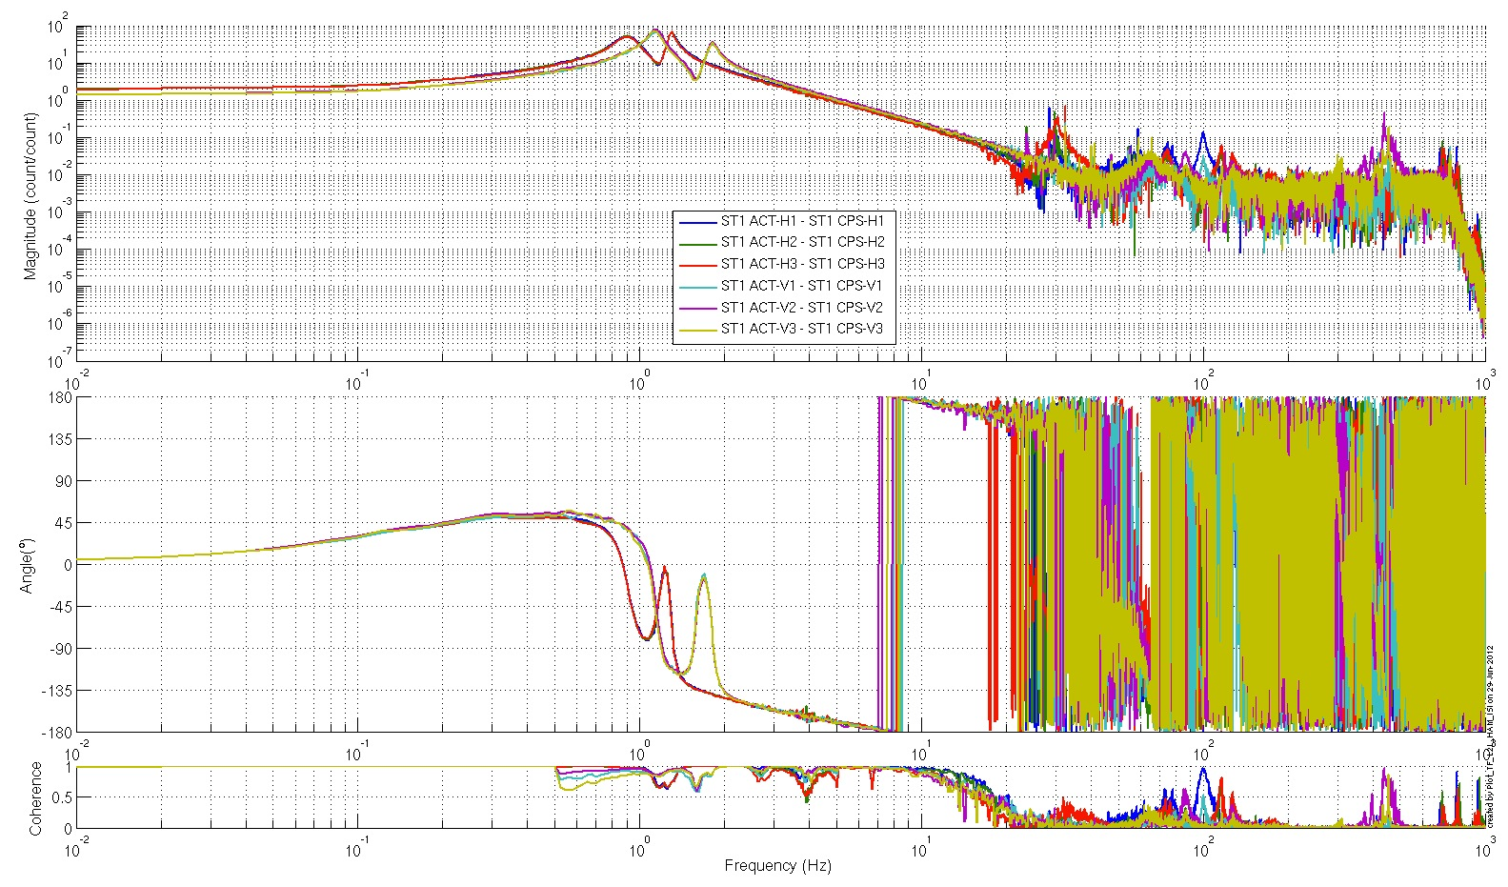
Example #2
Mechanical issue
GS13 not torqued against the ISI
Notes:
MEDM
Motif Editor and Display Manager (GUI for control screens)
GUI
Graphical User Interface

Slide 20
Thank you

