Slide 1
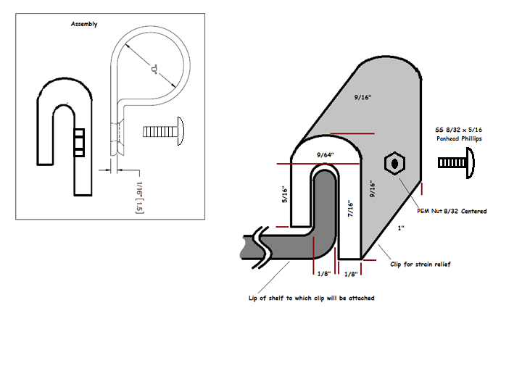
Strain Relief Clip for DC Power Supply Shelves

Slide 2
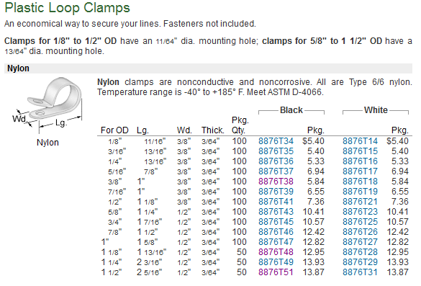
Plastic Loop Clamps for Strain Relief Clip
8876T38

Slide 3
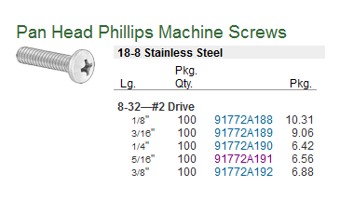
Screws for Strain Relief Clip
91772A191

Slide 4
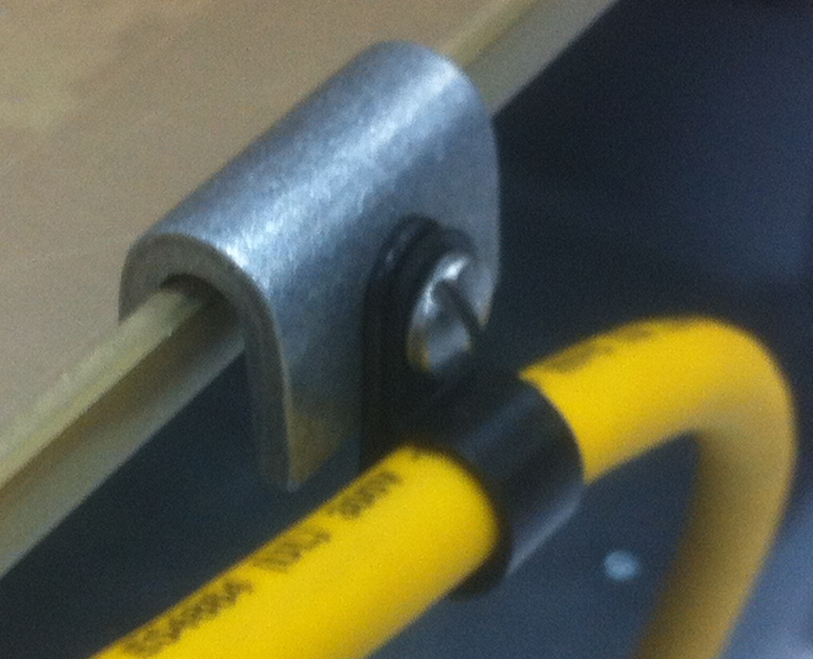
Strain Relief Clip for DC Power Supply Shelves

