Slide 1
Modal Damping of a Quad Pendulum for Advanced Gravitational Wave Detectors
Brett Shapiro
Nergis Mavalvala
Kamal Youcef-Toumi
ACC 2012 – Montreal
June 27
Massachusetts Institute of Technology
Notes:
My name is Brett Shapiro and I am going to speak to you about the sizing of actuators for a quadruple pendulum used in advanced gravitational waves

Slide 2
Abstract
Motivation: Observe gravitational waves from astrophysical sources (supernovae, pulsars, black hole mergers, etc) using the LIGO observatories.
Problem: Multi-DOF isolation systems enhance ground motion at high Q resonances. Damped using active feedback. This control introduces additional noise. Optimal control required achieve adequate trade-off.
Solution: Modal damping to simplify and decouple optimization of each mode’s damping. Also permits real-time tuning.

Slide 3
Outline
LIGO and gravitational waves
Seismic (vibration) isolation
Competing damping control goals
Method of modal damping
Optimization of modal damping
Results

Slide 4


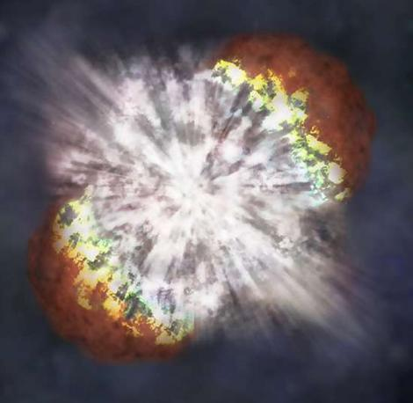
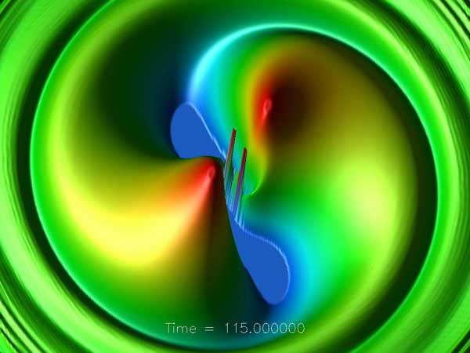
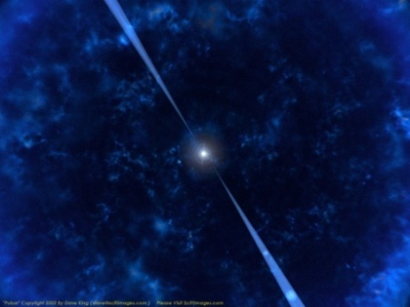
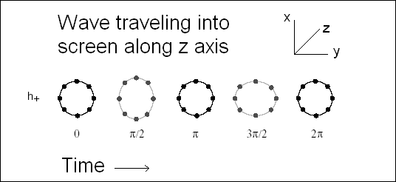
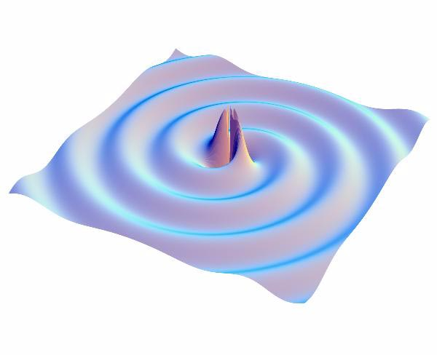
Gravitational Waves
Supernova
Merging Black Holes
Pulsar
Wave of strain amplitude h
Supernovae
  Asymmetry required
Coalescing Binaries
  Black Holes or Neutron Stars
  Mergers
Pulsars
    Asymmetry required
Stochastic Background
(Big bang, etc.)

Slide 5


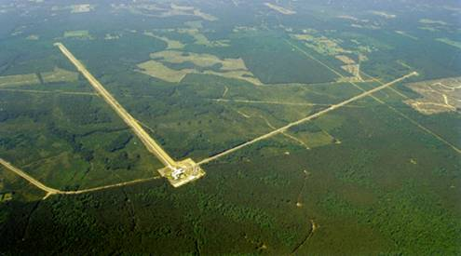
The Laser Interferometer
Gravitational-wave Observatory (LIGO)
Funded by
ETM
Test Masses
:
fused silica
4 km
34
cm diam x
,
20
cm thick
Input
Mode
Cleaner
40
kg
,
T = 3%
ITM
PRM
CP
Laser
Φ
m
FI
ITM
ETM
125 W
BS
815 kW
5.7 kW
Not to scale
Hanford, WA
Advanced LIGO configuration
Under construction until ≈2015
Upgrade to Initial LIGO
SRM
FI
PD
GW readout
Output
Mode
Cleaner
3, 4 km interferometers at 2 sites in the US
Michelson interferometers with Fabry-Pérot arms
Optical path enclosed in vacuum
Sensitive to strains around 10⁻²² -> 10⁻¹⁹m_{rms}
LIGO Budget ≈ $60 Million per year from NSF.
Operated by MIT and Caltech.
Livingston, LA

Slide 6
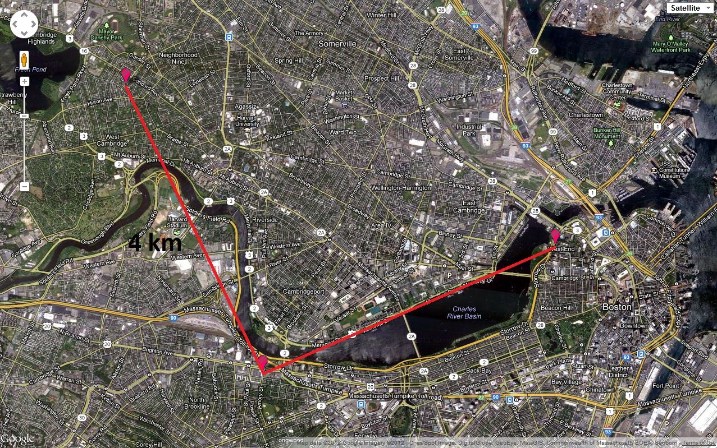
If we put LIGO in Cambridge, MA
Porter Square
Harvard
MGH
MIT
Kenmore Square
LIGO spans 16 km². Cambridge, MA covers 16.65 km² (wikipedia http://en.wikipedia.org/wiki/Cambridge,_Massachusetts).

Slide 7



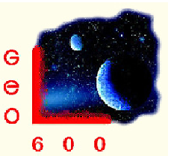





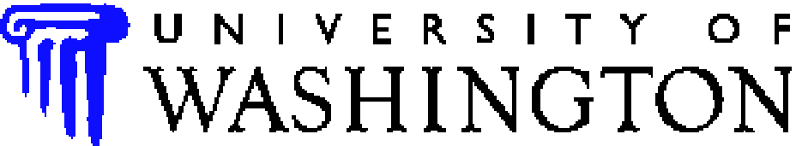

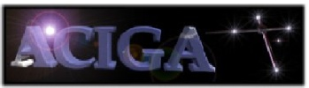

















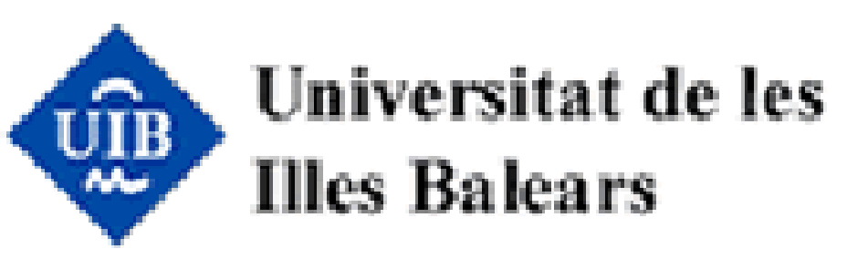





























LIGO Scientific Collaboration
University of Michigan
University of Minnesota
The University of Mississippi
Massachusetts Inst. of Technology
Monash University
Montana State University
Moscow State University
National Astronomical Observatory
of Japan
Northwestern University
University of Oregon
Pennsylvania State University
Rochester Inst. of Technology
Rutherford Appleton Lab
University of Rochester
San Jose State University
Univ. of Sannio at Benevento,
and Univ. of Salerno
University of Sheffield
University of Southampton
Southeastern Louisiana Univ.
Southern Univ. and A&M College
Stanford University
University of Strathclyde
Syracuse University
Univ. of Texas at Austin
Univ. of Texas at Brownsville
Trinity University
Tsinghua University
Universitat de les Illes Balears
Univ. of Massachusetts Amherst
University of Western Australia
Univ. of Wisconsin-Milwaukee
Washington State University
University of Washington
Australian Consortium
for Interferometric
Gravitational Astronomy
The Univ. of Adelaide
Andrews University
The Australian National Univ.
The University of Birmingham
California Inst. of Technology
Cardiff University
Carleton College
Charles Sturt Univ.
Columbia University
CSU Fullerton
Embry Riddle Aeronautical Univ.
Eötvös Loránd University
University of Florida
German/British Collaboration for
the Detection of Gravitational Waves
University of Glasgow
Goddard Space Flight Center
Leibniz Universität Hannover
Hobart & William Smith Colleges
Inst. of Applied Physics of the Russian Academy of Sciences
Polish Academy of Sciences
India Inter-University Centre
for Astronomy and Astrophysics
Louisiana State University
Louisiana Tech University
Loyola University New Orleans
University of Maryland
Max Planck Institute for Gravitational Physics

Slide 8
Projected Sensitivity for Advanced LIGO

Slide 9

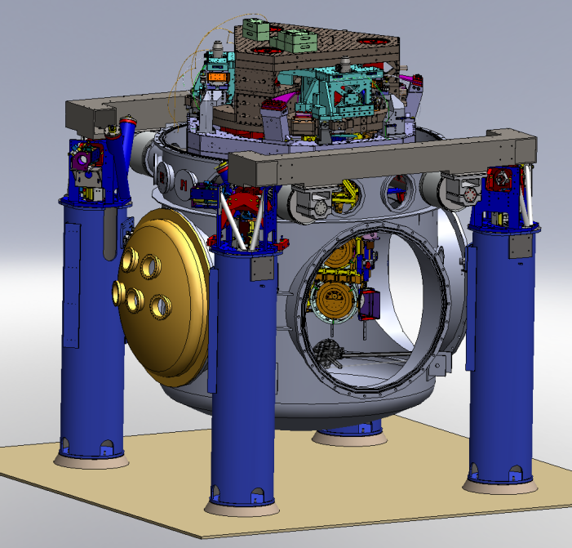
Suspensions and Seismic Isolation
Advanced LIGO test mass isolation
active isolation platform (2 stages of isolation)
hydraulic external pre-isolator (HEPI) (one stage of isolation)
quadruple pendulum (four stages of isolation) with monolithic silica final stage
Ref: LIGO-G1000469-v1; Kissel PhD thesis

Slide 10
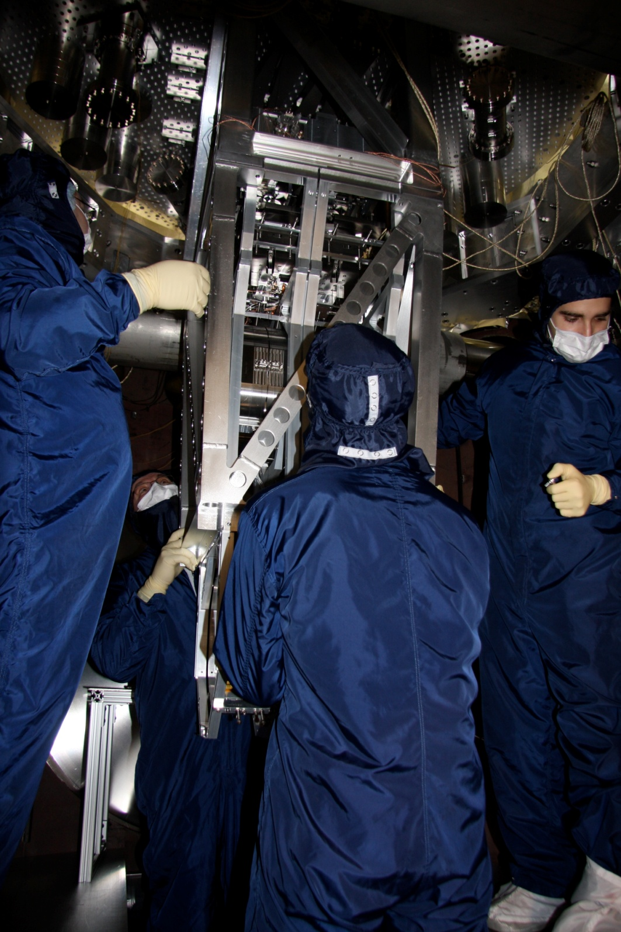
active isolation platform (2 stages of isolation)
quadruple pendulum (four stages of isolation)
Installing prototype quad pendulum with glass optic on metal wires, Jan 2009 at MIT.

Slide 11
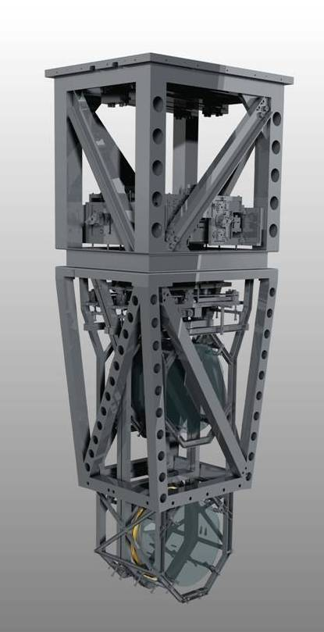
Quadruple Pendulum
Reaction Chain
Main (test) Chain
Purpose
Test mass (stage 4) isolation.
the test mass consists of a 40 kg high reflective mirror
Stage 1
Control
Damping –stage 1
Cavity length - all stages
Sensors/Actuators
BOSEMs at stage 1 & 2
AOSEMs at stage 3
Opt. levs. and interf. sigs. at stage 2
Electrostatic drive (ESD) at stage 4
Stage 2
Stage 3
Stage 4
IR laser

Slide 12
Multi-stage Isolation Performance
1/f²
1/f⁴
1/f⁶
Each stage provides 1/f² isolation
1/f⁸

Slide 13
Two Competing Goals
Damp modes
sensor noise amplification beyond 10 Hz
Along laser beam axis

Slide 14
Modal Damping with State Estimation
= pendulum
eigenvector matrix
= Cartesian coordinates
= sensor sig.
= estimated modal coord.
= Cartesian damping forces
= modal damping forces
mode damping filter
mode damping gain
Cartesian
Coordinates
(coupled
dynamics)
Pendulum
Estimator
Modal
Coordinates
(decoupled
dynamics)

Slide 15
Modal Feedback Design
approximate damping ratio
,
,
,

Slide 16
Damped Response to Impulse from Gnd.
Impulse Response Simulation
10 second damping requirement
Assuming perfect state estimation
Modes | 1 | 2 | 3 | 4
Freq (Hz) | 0.443 | 0.996 | 2.001 | 3.416
 | 0.040 | 0.018 | 0.009 | 0.001

Slide 17
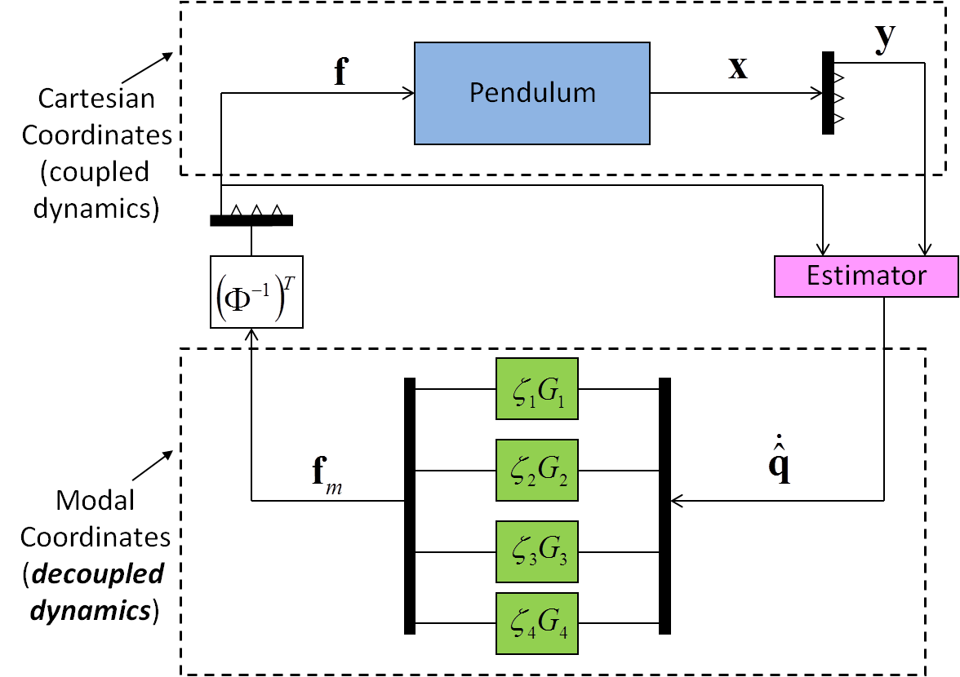
Estimator Design
Linear Quadratic Regulator (LQR) design
?
Weight cost of using noisy sensor
Weight cost of estimation error

Slide 18
Choosing Q and R: Not Unique
R is still to be determined

Slide 19
Solving the R matrix for MIMO Modal Damping
Try a bunch of R matrices and see what works best
Measure ‘best’ with an auxiliary cost function.
z
DOFs i are: x, y, z, yaw, pitch, roll
x

Slide 20
Modal Estimation Cost
(x is the laser axis)

Slide 21
Optimal Noise Amplification
simulation
Noise requirement

Slide 22
Conclusions
Modal damping provides an intuitive way to optimize a highly coupled, many DOF system, with strict noise performance.
Real-time or adaptive tuning possible by adjusting gains on each mode.
Future work to involve implementation on a true Advanced LIGO interferometer.

Slide 23
Backups
Porter Square
Harvard
MGH
MIT
Kenmore Square
LIGO spans 16 km². Cambridge, MA covers 16.65 km² (wikipedia http://en.wikipedia.org/wiki/Cambridge,_Massachusetts).

Slide 24
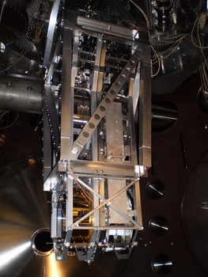
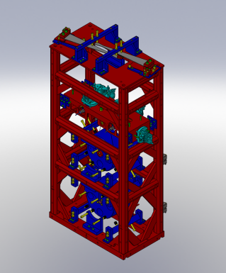
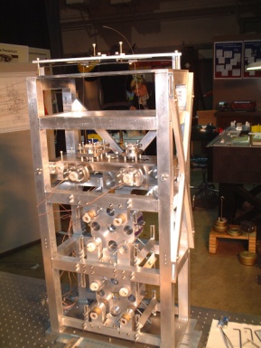
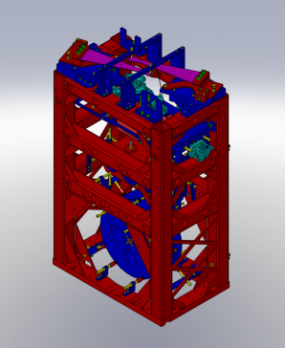
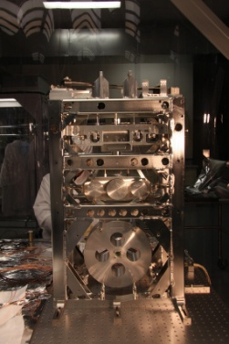
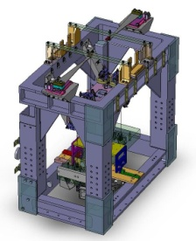
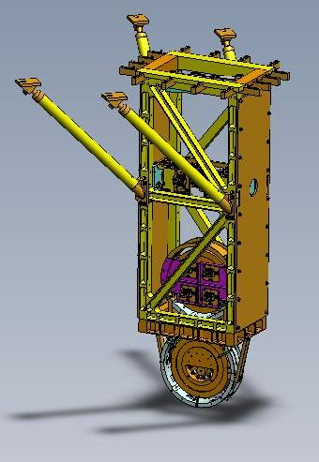
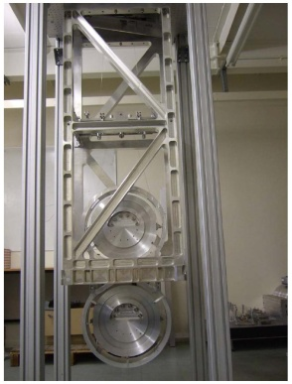
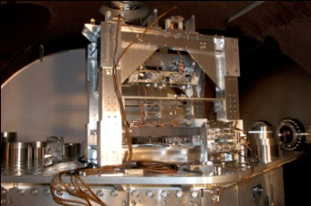
Five Pendulum Designs
ETM
Test Masses
:
fused silica
4 km
34
cm diam x
,
20
cm thick
Input
Mode
Cleaner
40
kg
,
T = 3%
ITM
PRM
Laser
Φ
m
FI
CP
ITM
ETM
125 W
BS
815 kW
5.7 kW
SRM
FI
PD
GW readout
Output
Mode
Cleaner
Ref: G1100434

Slide 25
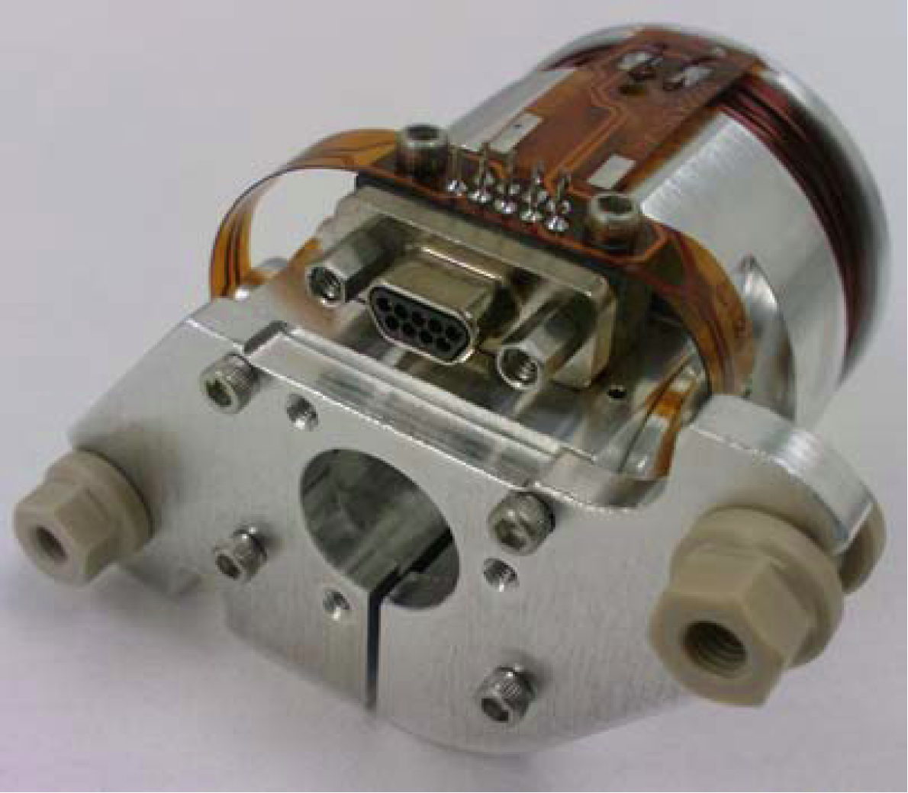
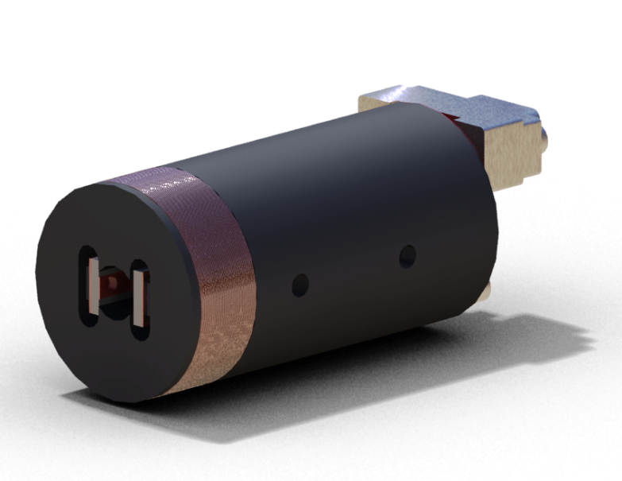
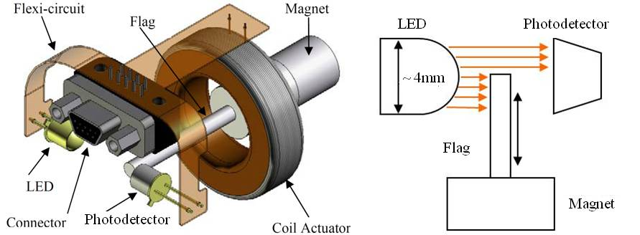
Backups: Optical Sensor ElectroMagnet (OSEM)
Birmingham OSEM (BOSEM)
Advanced LIGO OSEM (AOSEM)
- modified iLIGO OSEM
Magnet Types (M0900034)
BOSEM – 10 X 10 mm, NdFeB , SmCo
10 X 5 mm, NdFeB, SmCo
AOSEM – 2 X 3 mm, SmCo
    2 X 6 mm, SmCo
    2 X 0.5 mm, SmCo
BOSEM Schematic

Slide 26
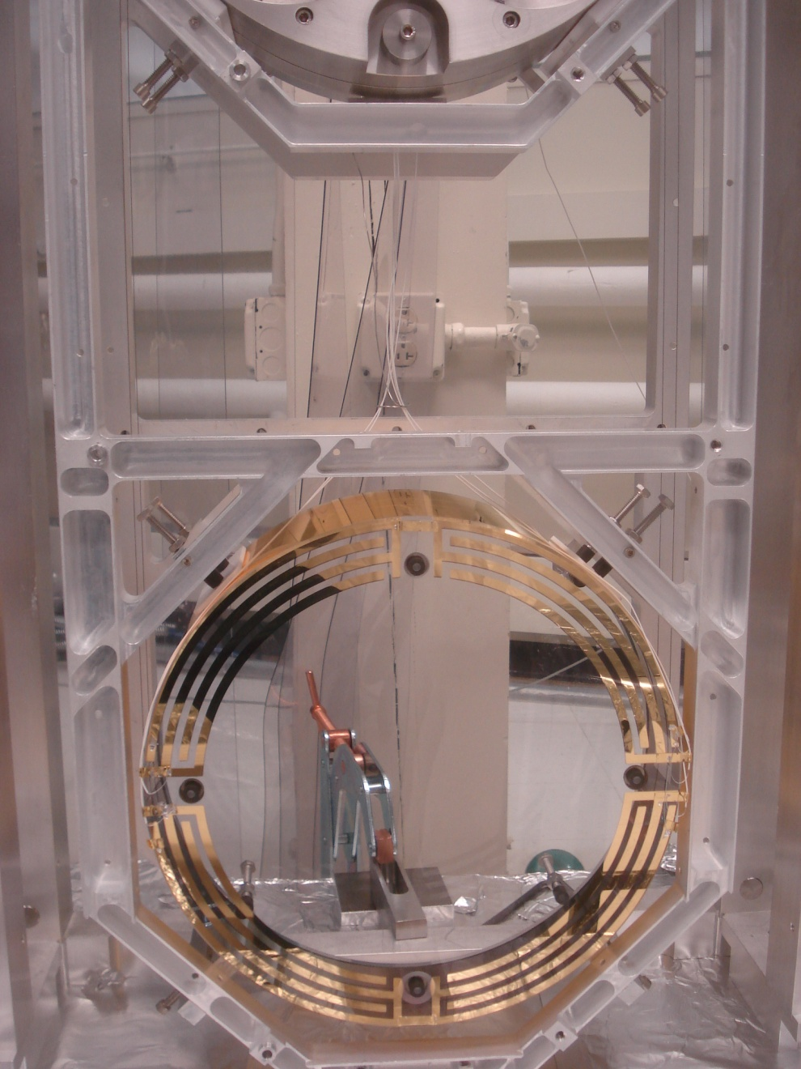
Backups: Quadruple Suspension ESD
Reaction Chain
Main (test) Chain
The electrostatic drive (ESD) acts directly on the test ITM and ETM test masses.
± 400 V (ΔV 800 V)
  ≈ 100 μN
Each quadrant has an independent control channel
Common bias channel over all quadrants
UR
UL
LR
LL

Slide 27
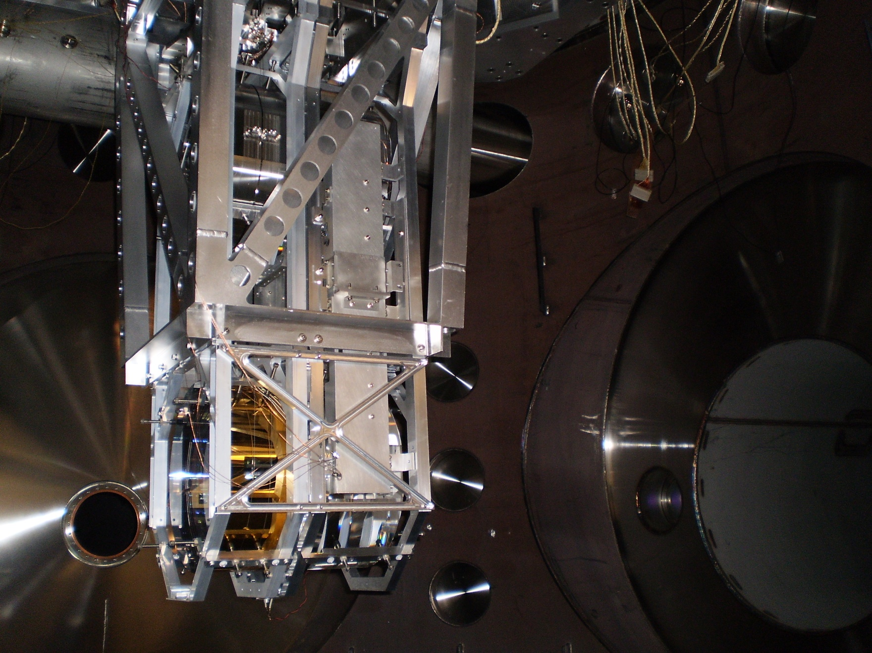
Backups: Quadruple Suspension
MIT monolithic quad in BSC
June 2010

