Slide 1
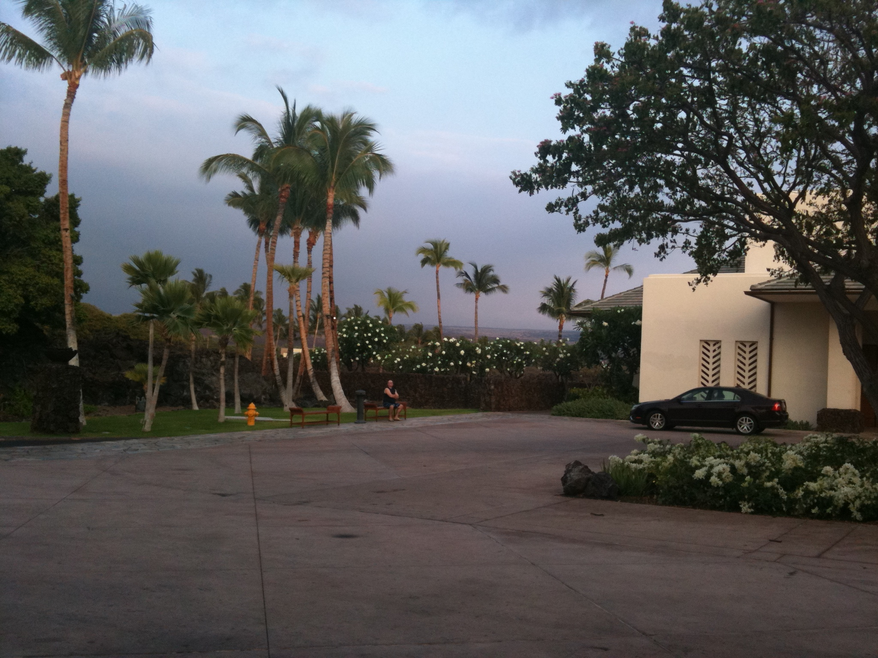
Summary of GWADW2012
Kazuaki Kuroda
ICRR, University of Tokyo

Slide 2
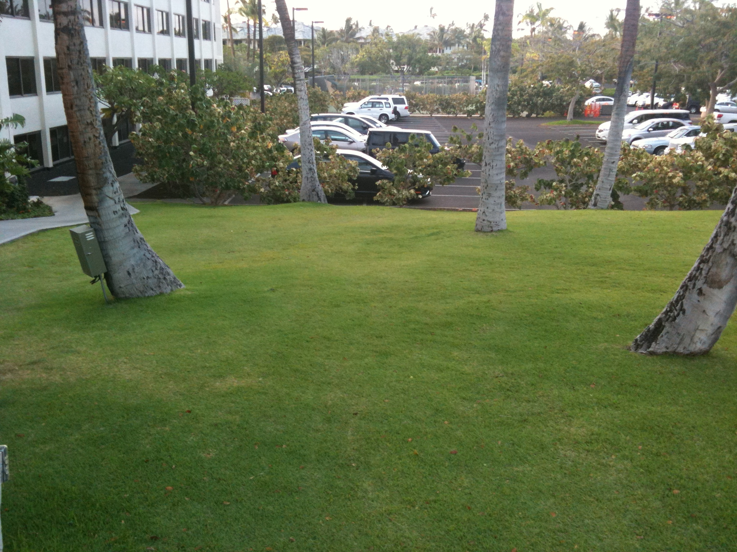
Monday AM (1): Welcome by Syd and chaired by Sathya
Dave (Caltech) set the stage
Cole Miller (Maryland) reviewed GW sources and mentioned massive WD & IMBH as new sources
Sathya (Cardiff) summarized the significance of the detection of BNS coalescence to solely determine the apparent cosmological distance by chirp mass, which leads to the determination of the red-shift by estimating its intrinsic mass by Messenger-Read Method or by Taylor-Gair-Mandel Method
C. Van Den Broeck (NIKHEF) stressed BNS coalescence signal is the genuine test of strong field dynamics of gravitation field and summarized the TIGER analysis pipeline for practice

Slide 3
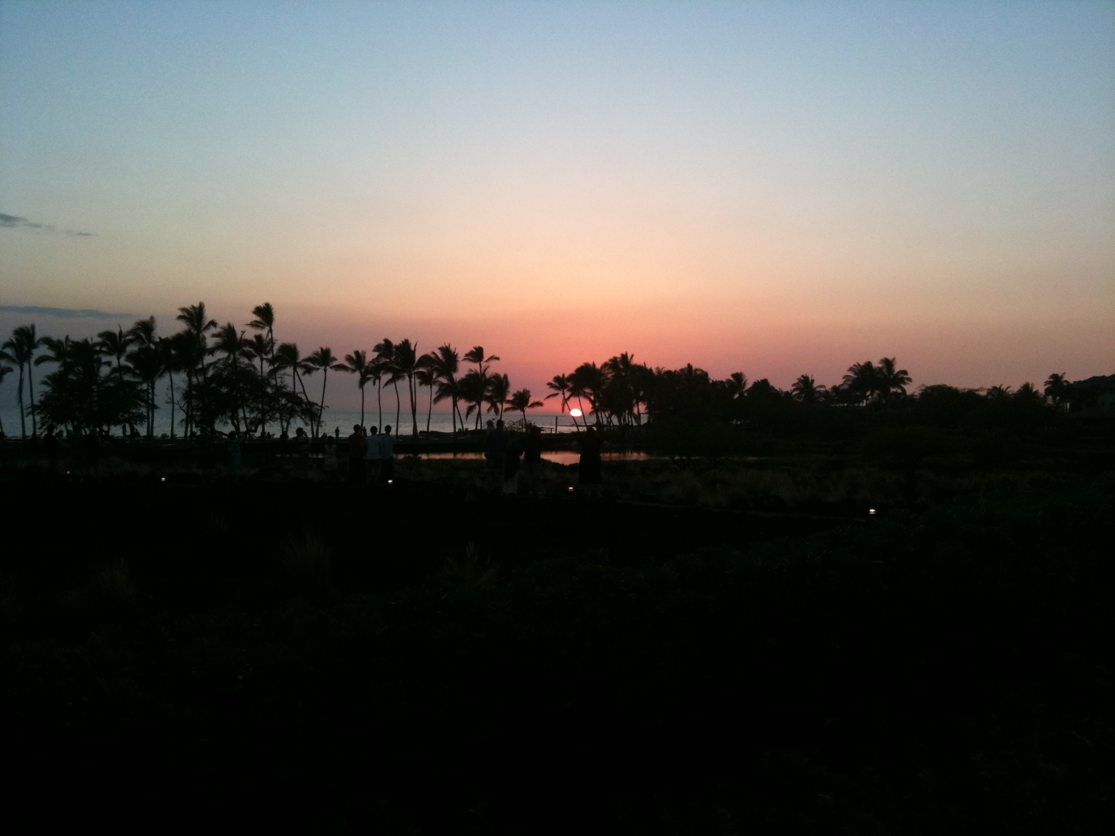
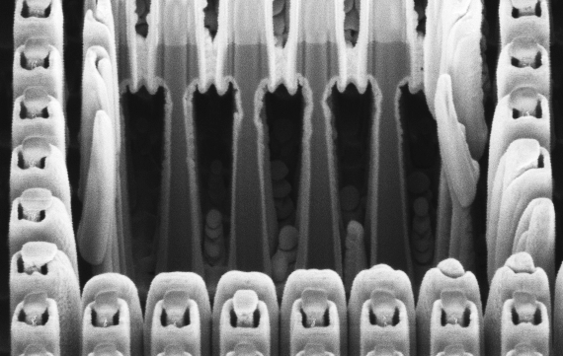
Monday AM(2): chaired by Eric and Sheila
Stephanie (FSU) talked the achievement of waveguide grating mirrors
Garrett Cole (VCQ) presented the progress of transferred crystalline coating
Angie (Stanford) reported the success of epitaxial integration of III-V coating on Si and got preliminary result of high reflectivity
Tobias (AEI) summarized the effort of coating TNI to reach TN level.
Andreas (Birmingham) produced 21W, LG33 (>95%) from 120W LG00 mode by improving optical system
Huan Yang mentioned the two kinds of coating thermal noise with estimation
measured
simulated

Slide 4
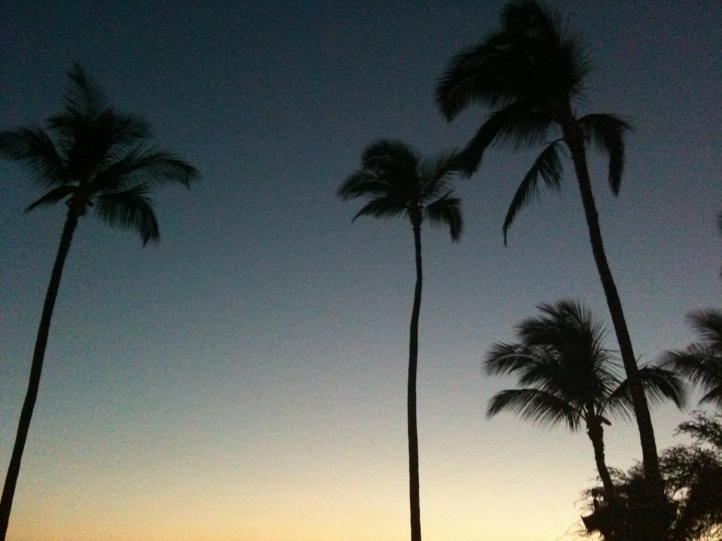
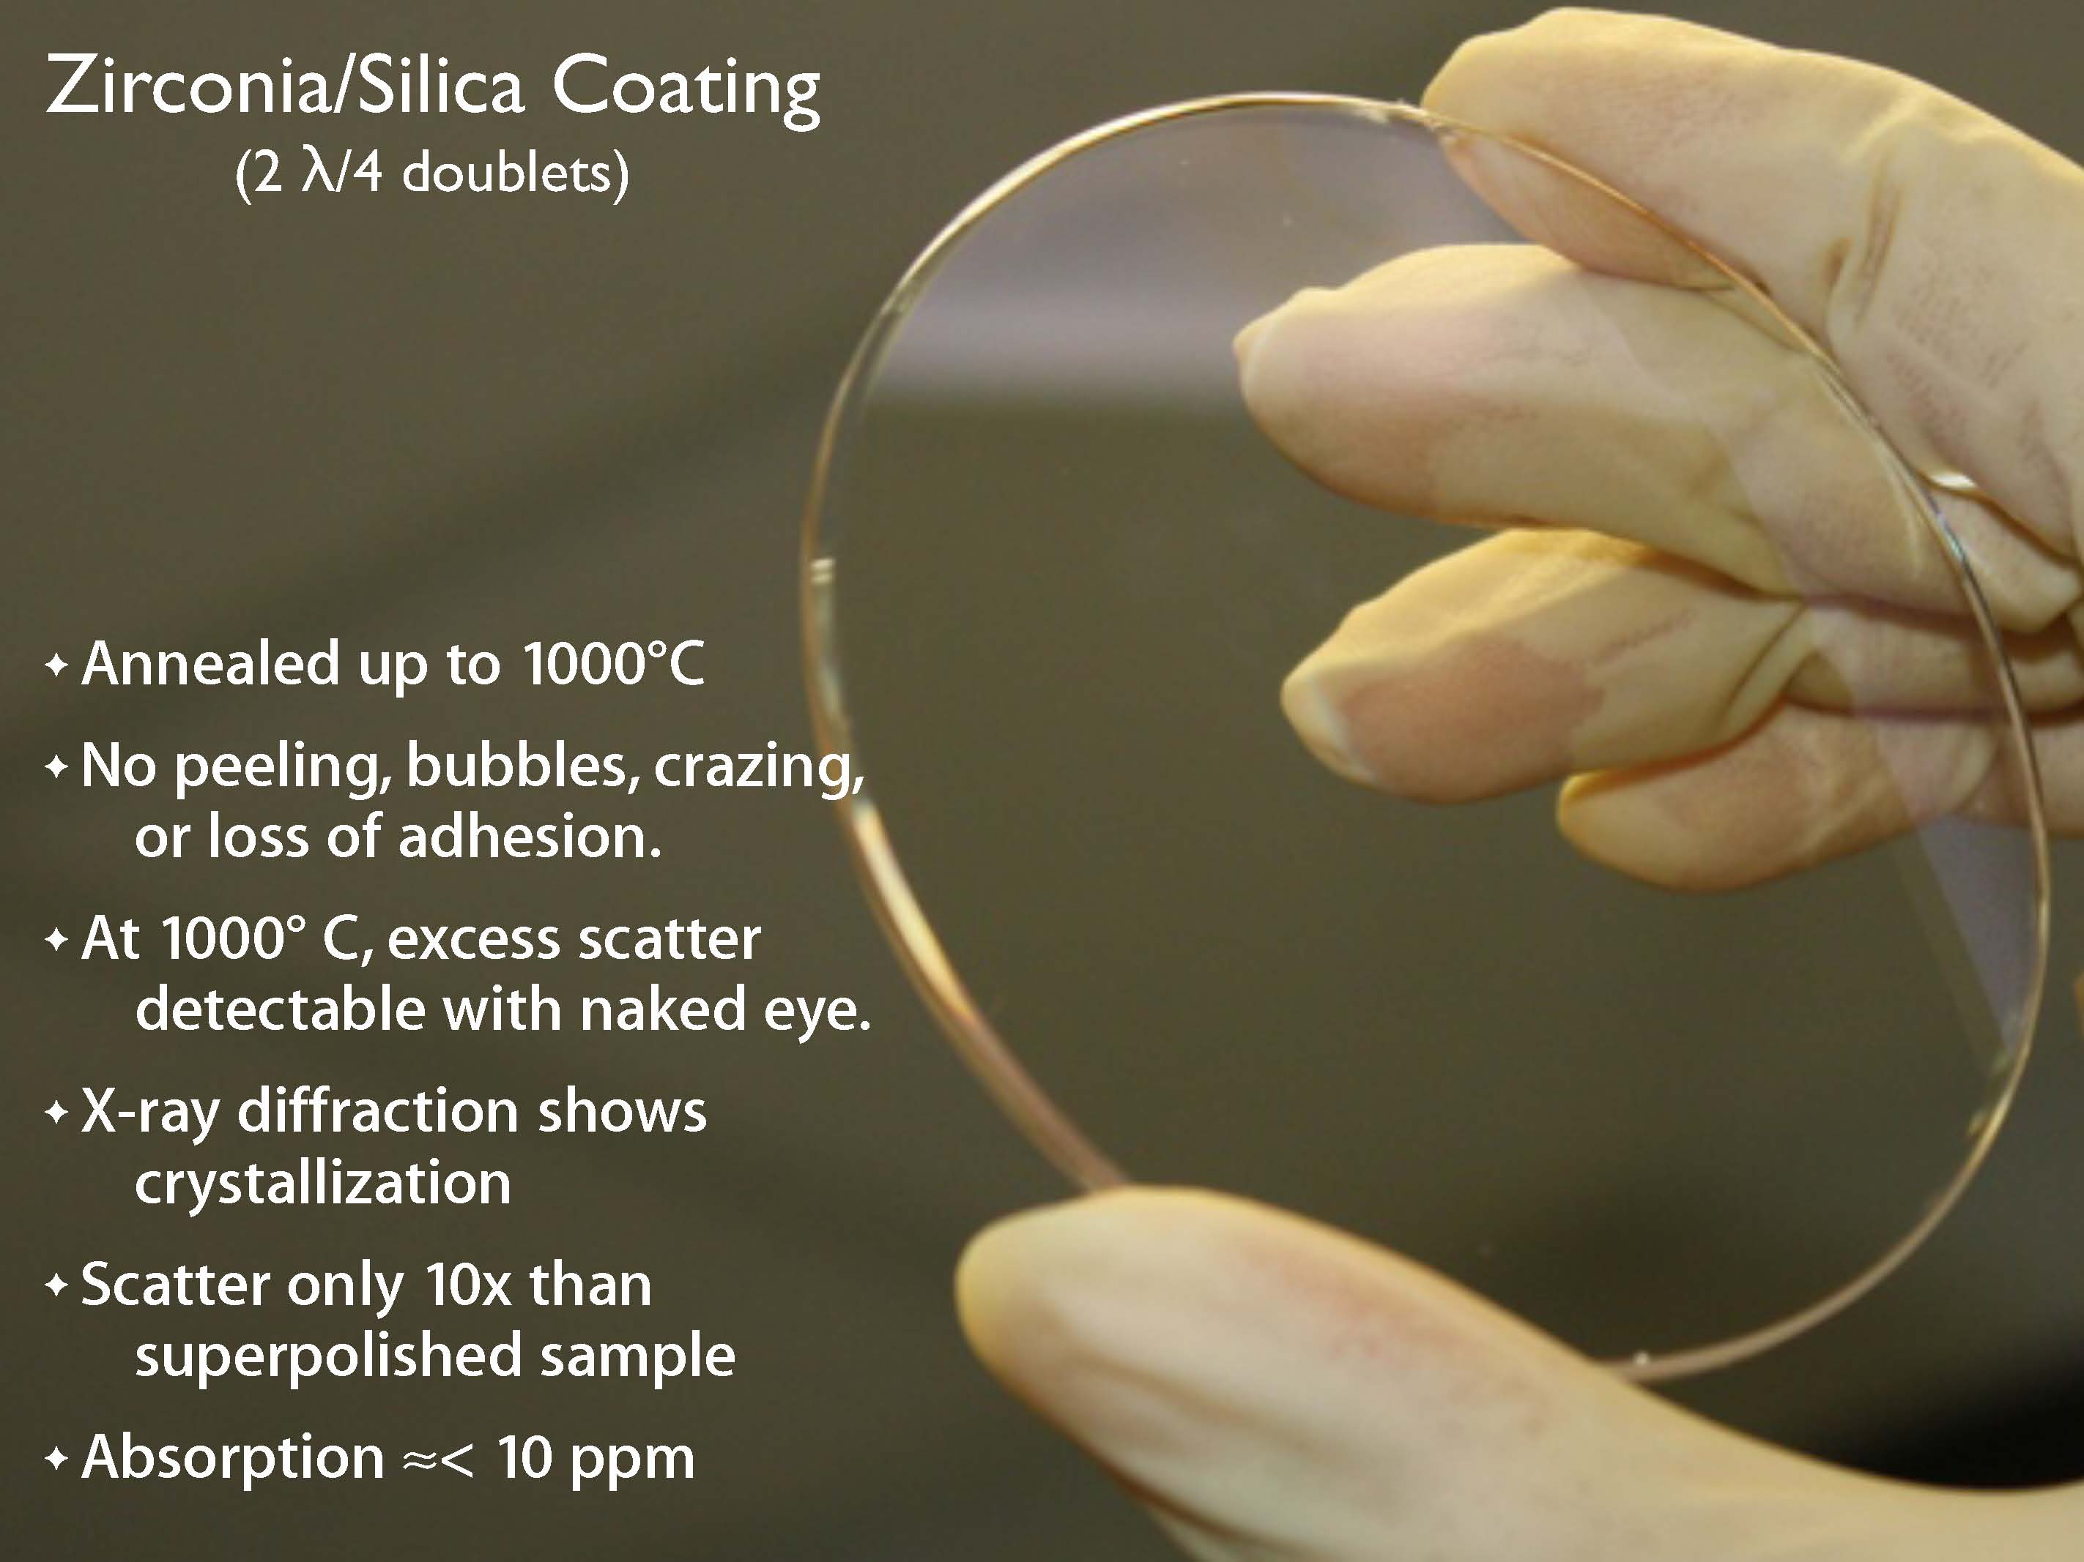
Monday PM chaired by Sheila
R. Bassiri (Stanford) reported on the optical absorption measurement from the viewpoint of atomic structure and presented deeper understanding
Riccardo (Sannio) introduced the importance of nano-coating technology and the possibility of reduction of mechanical loss by stressed coating
Steve (H&W College) showed big improvement of silica-doped zirconia amorphous coating
Ian Martin (Glasgow) summarized the progress of Glasgow with Stuart’s aggressive non-coated grating surface development

Slide 5
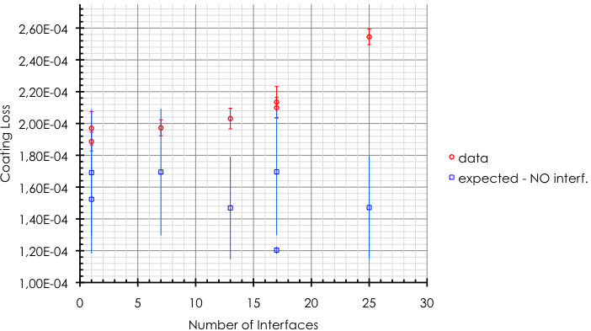

Massimo (LMA) presented recent result on multi-layer coating loss and described the update of atomic layer deposition
interfaces only partly fill the gap

Slide 6
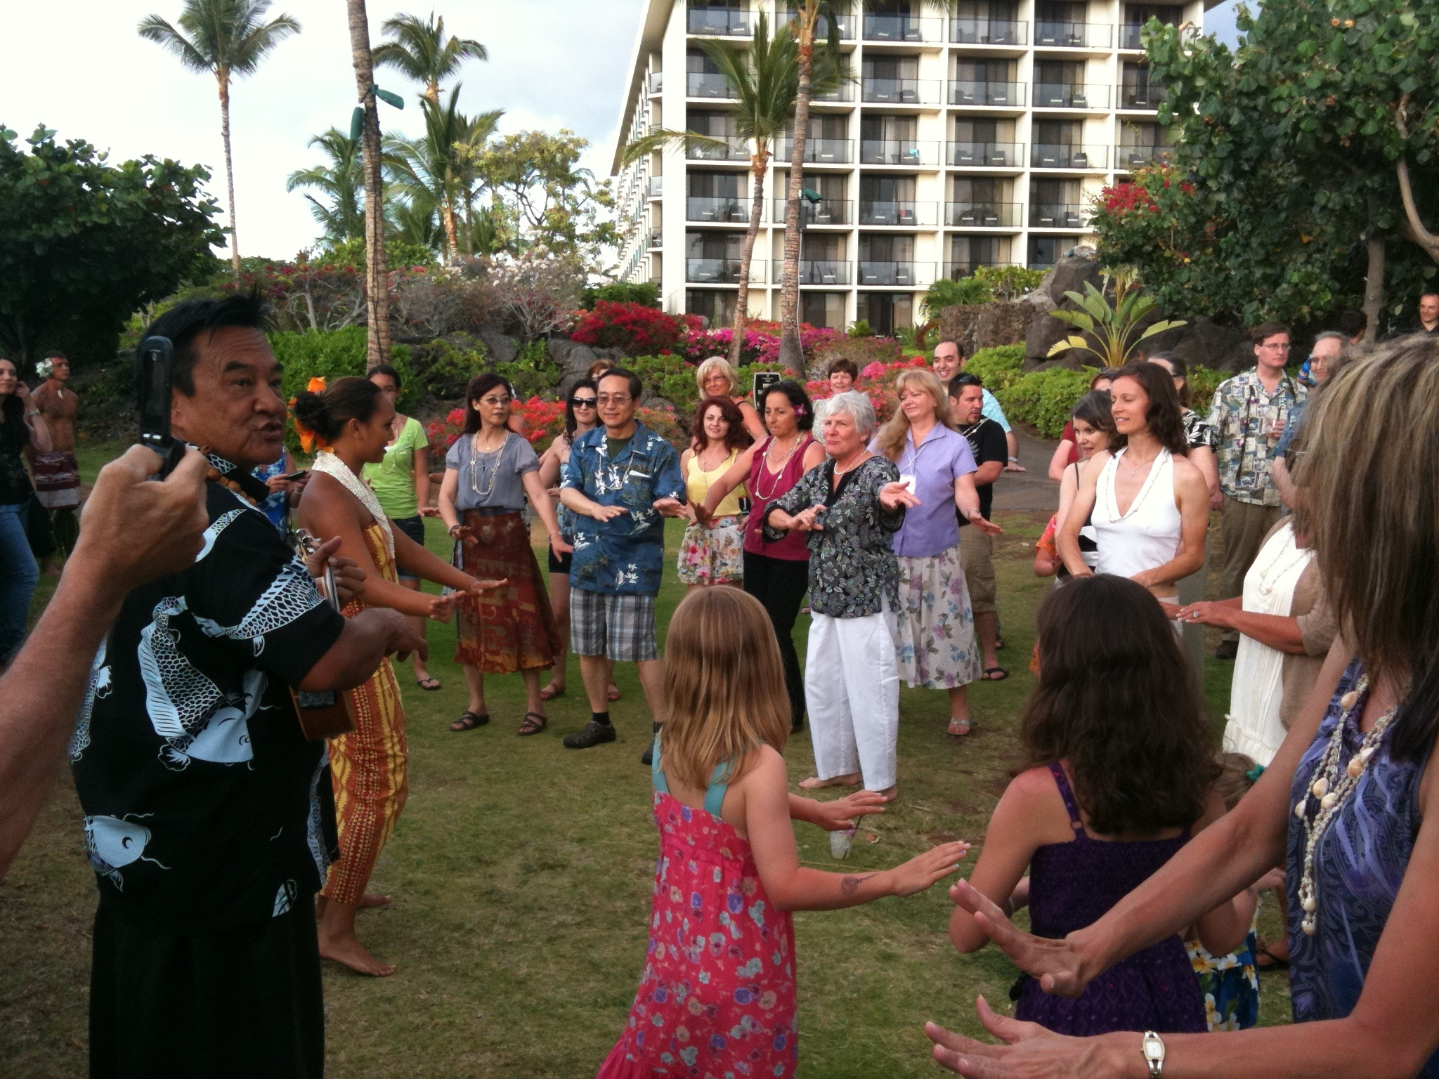
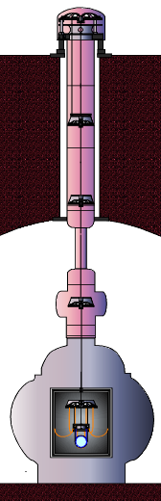
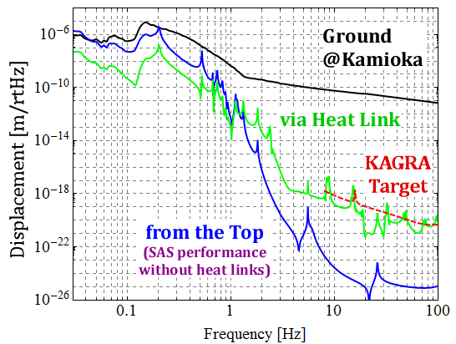
Tuesday AM(1) chaired by F
Takanori (UT) showed the design of KAGAR SAS for cryogenic interferometer with a rid body simulation

Slide 7
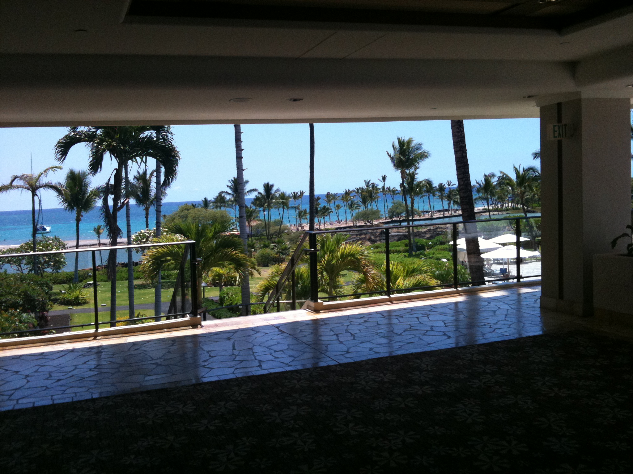
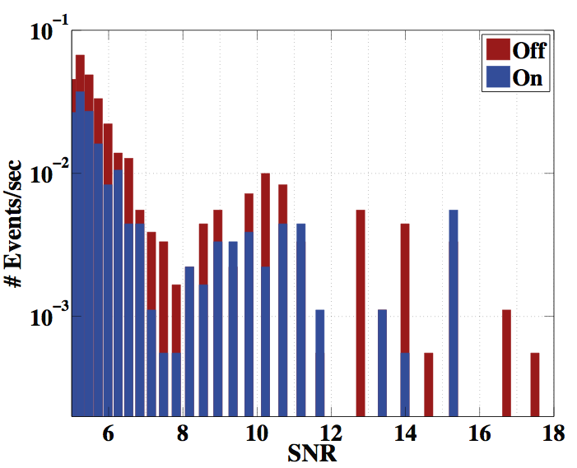
Ryan (LSU) tackled to suppress seismic peaks by feed-forward subtraction at S5/S6 showing transient rate improvement
On/off test reveals effect of reducing the control signal at low frequencies (only triggers between 50 and 200 Hz shown)
Stationary noise level did not significantly change during test
~2x fewer transients in this band
Ryan DeRosa

Slide 8
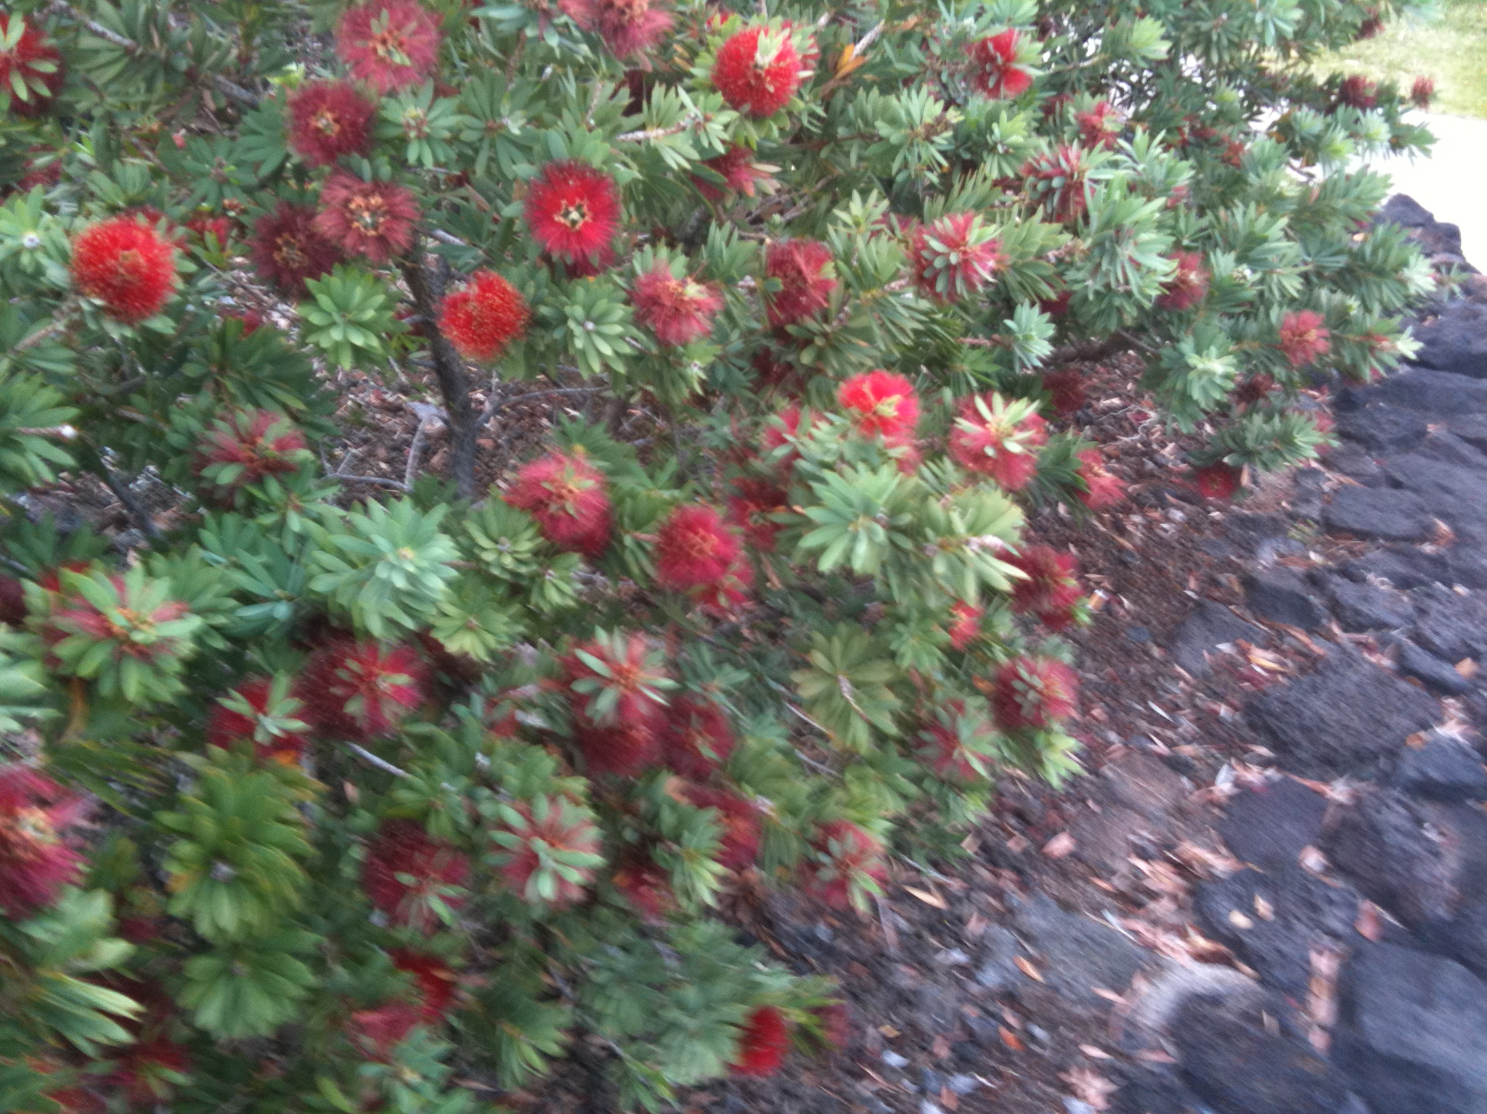
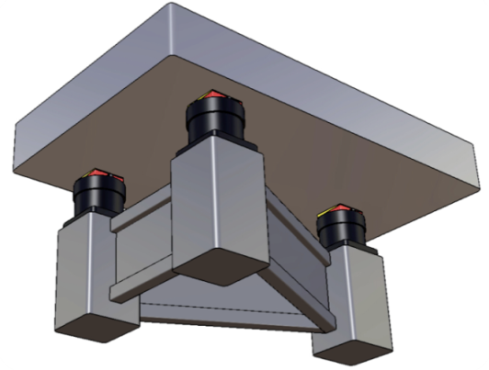
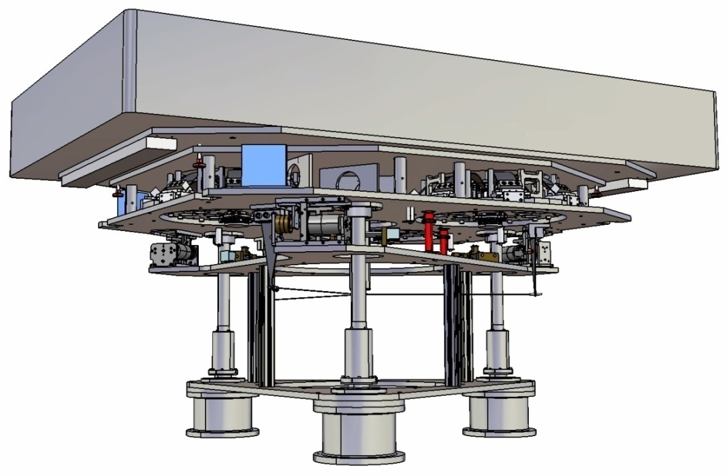
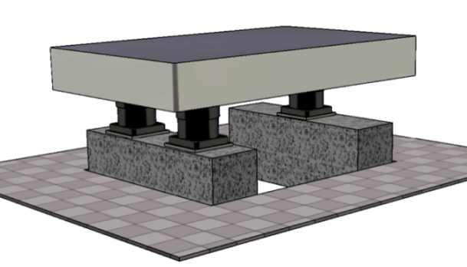
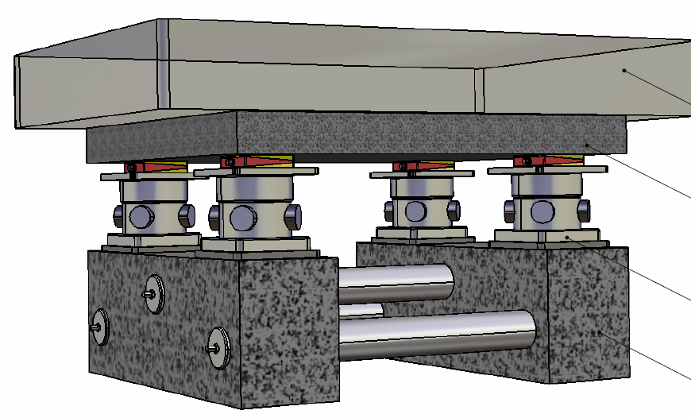
Eric (NIKHEF)reported EIB-SAS, multi-SAS and high sensitive thermally limited accelerometer
  EIB-SAS Solution option history
  Chosen solution:
  Highly-compliant suspension
  Stiffer legs
  Stiffer support
  Active isolation (TMC-Stacis)
Eric (NIKHEF)

Slide 9
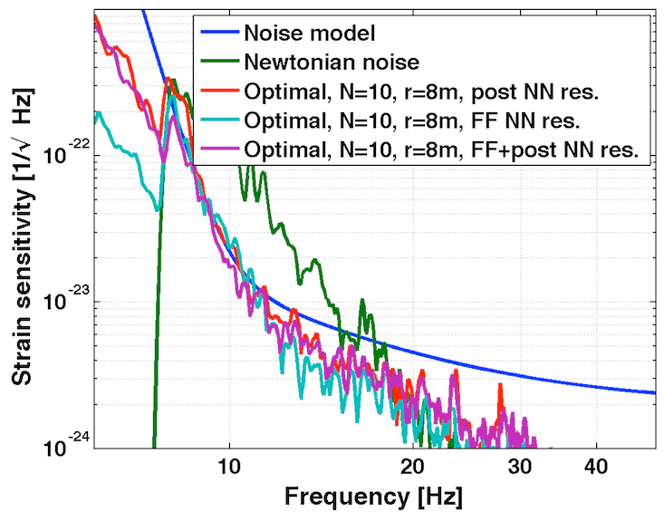
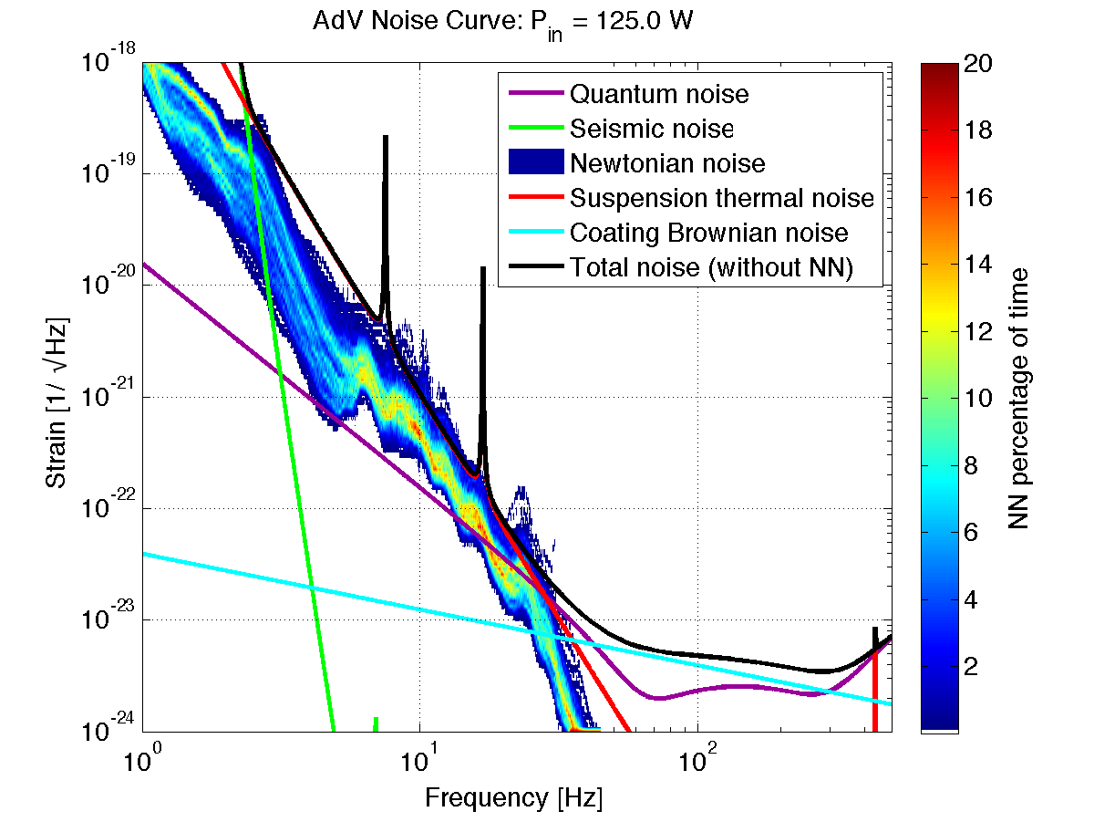
Tuesday AM(2) chaired by Jan
Sergey (UF) removed line noise with bi-linear coupling using wavelet analysis for S5/S6 data
Nick (Strathclyde) reviewed multi-pole expansion of gravity field by test mass for simpler calculation
Jenne (Caltech) measured Newtonian noise against simulation
Mark (NIKHEF) analyzed Newtonian noise by simulation and subtracted for ET and aVirgo.

Slide 10
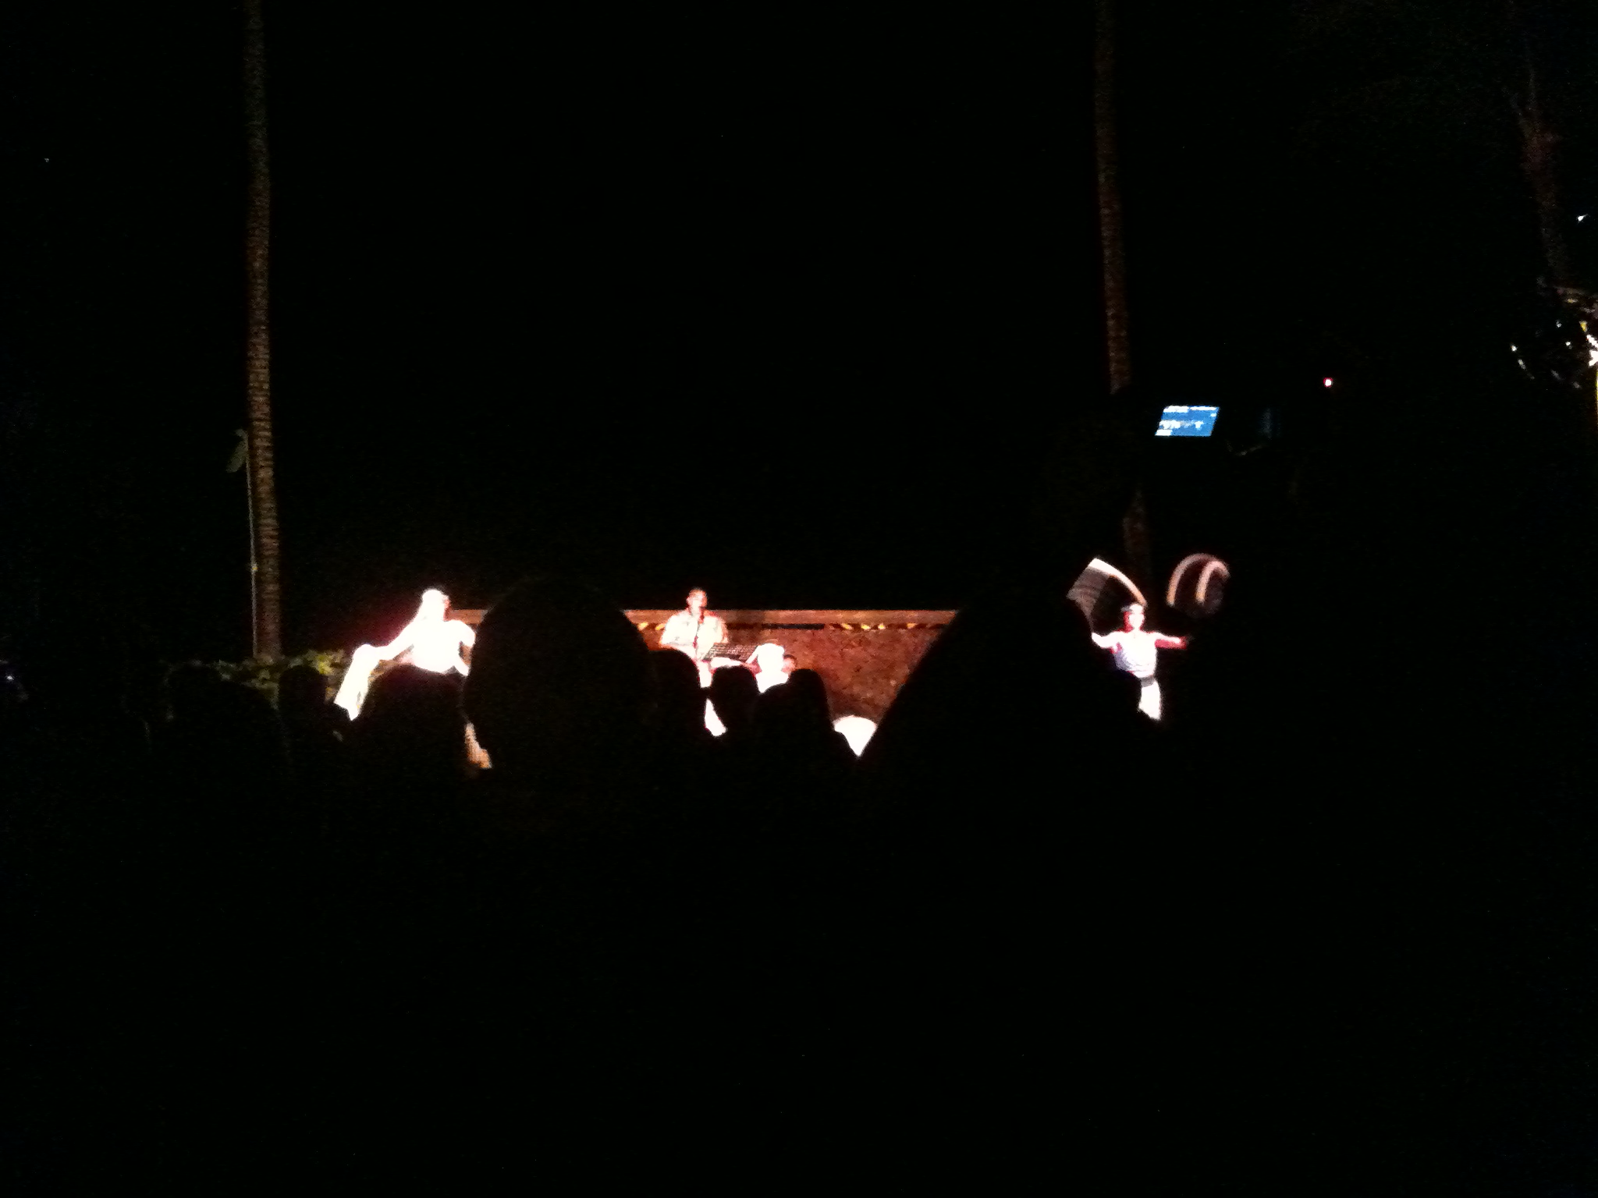
Tuesday PM chaired by Hiro and Andreas
GariLynn (Caltech) talked the reality of mirror
Jan (Caltech) estimated scattered loss in cavities and concluded loss changes as function of length
Antonio (EGO) made FFT calculation for baffles to reduce scattered noise in a cavity
Daniel (Birmingham)) reviewed the characteristic features of FFT, mode models and rigorous simulations (FDTD)
Richard (EGO) developed FFT simulator: FOG
Marie (LAL) devised TDM for adaptive optics
R. Bonnard (LMA) presented corrective coating that satisfies aVirgo specification

Slide 11
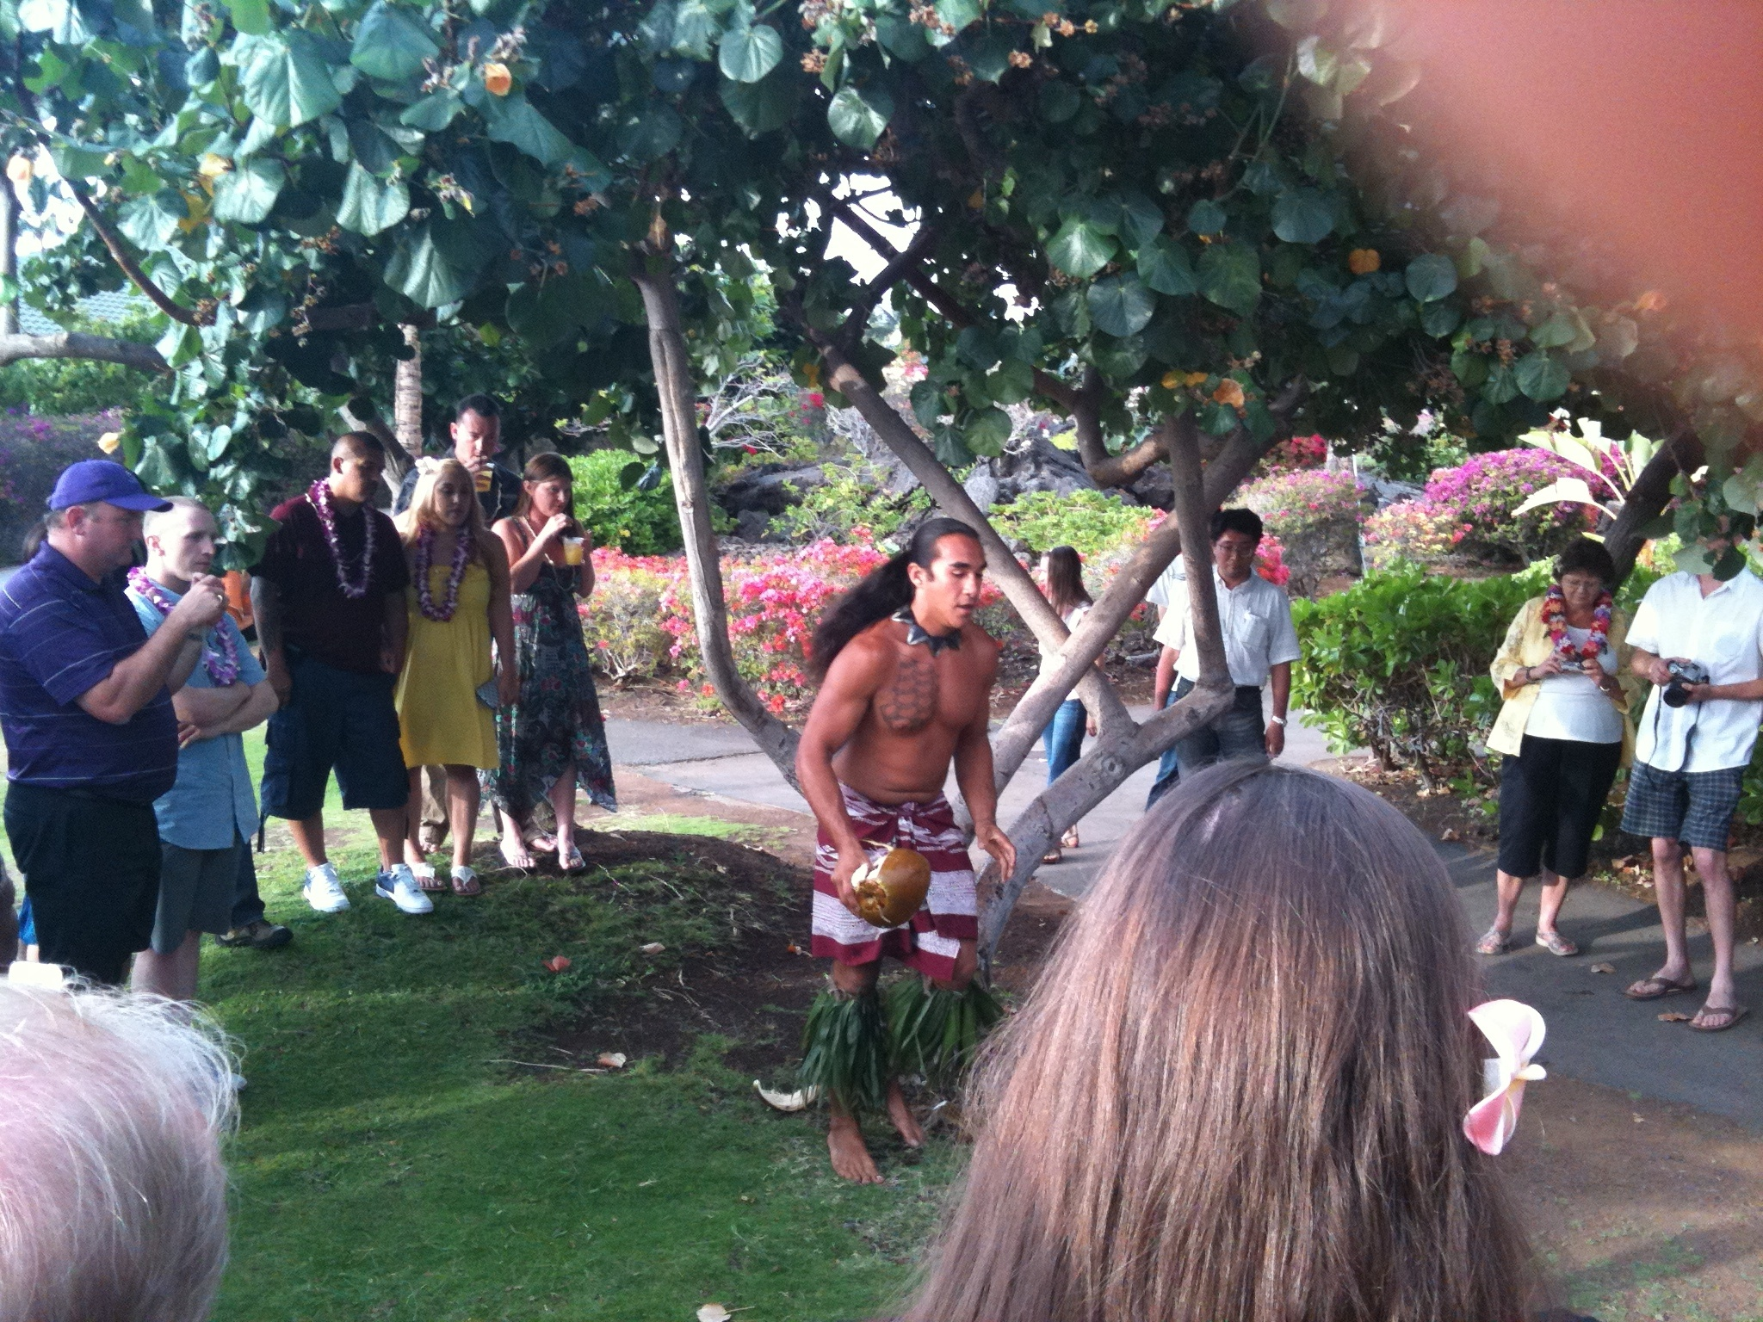
Cavity loss – 2 surfaces (ppm) | Budget 2010 based on specs (ppm) | Actuals 2012 based on (n of 20) (ppm)
Microroughness scatter | 8 | 2.2 (avg. of 20)
Defects (Polish, Coating, Contamination) | 26 | 15 (sample of 2) pol, coat
Coating Absorption* | 0.6 | 0.6 (sample of 2)
Surface Figure Error & Diffraction | 24 | 3 ppm on coated ITM 21 ppm estimated on coated ETM
ETM Transmission | 5 | No data yet
Total ( required < 75 ppm) | 64 | 42+ ETM trans.
GariLynn

Slide 12
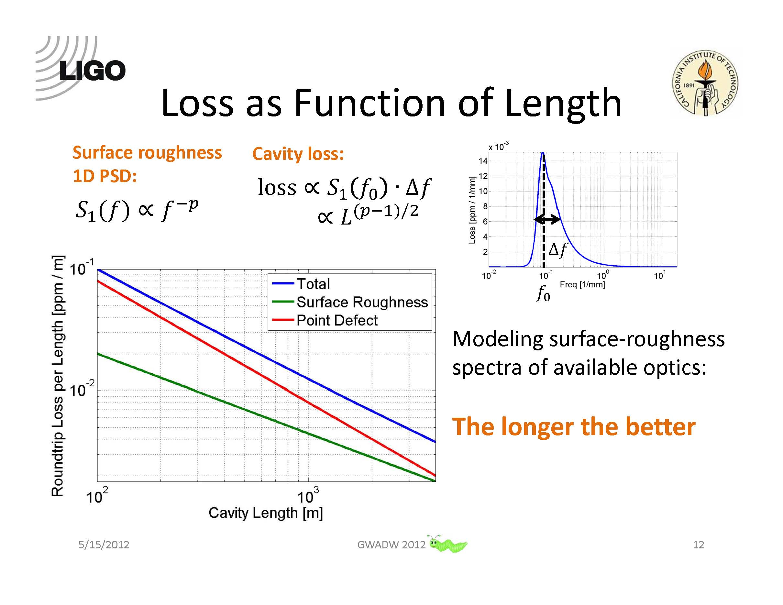
Jan

Slide 13
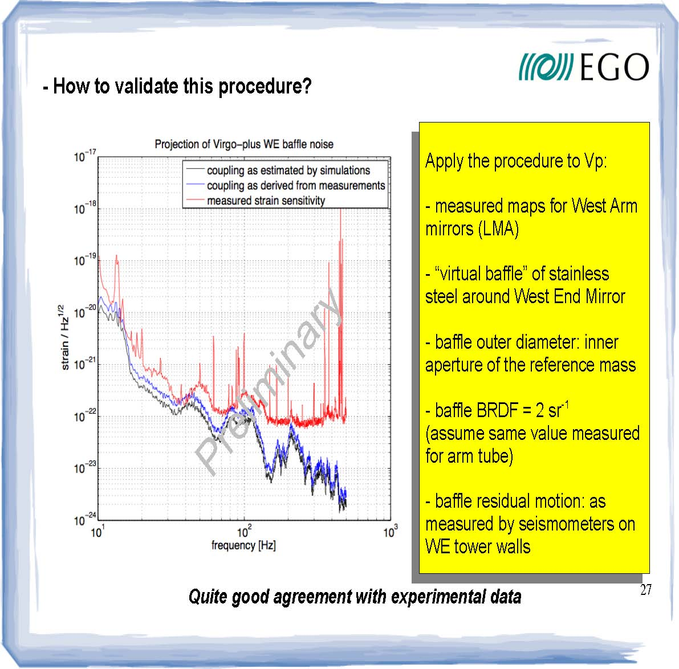
Antonio

Slide 14
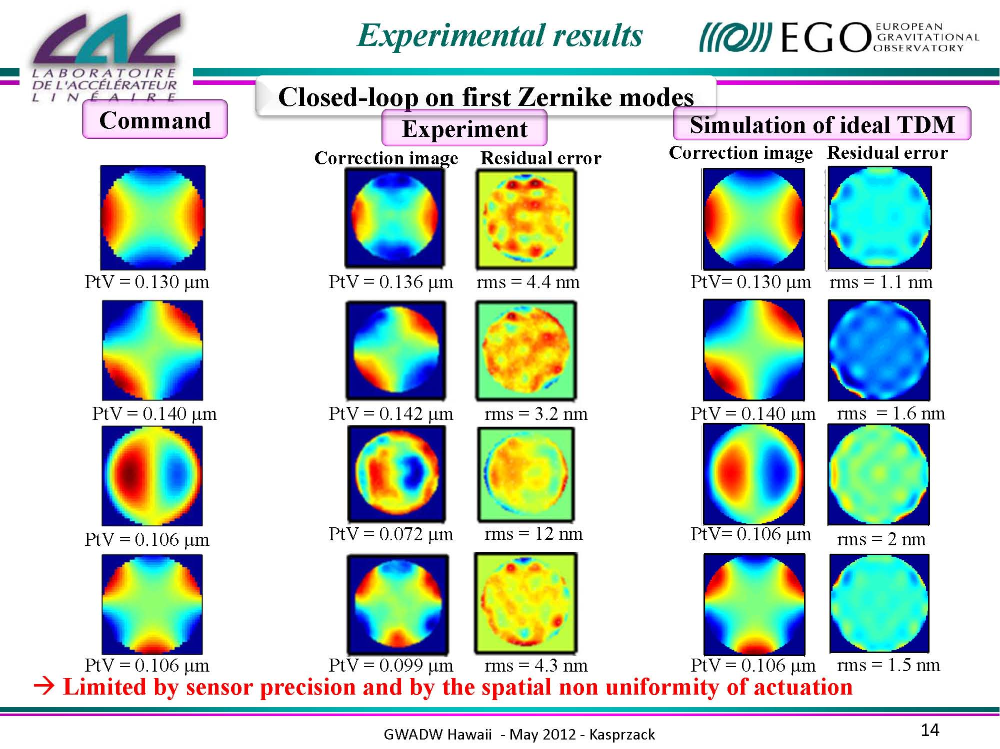
Marie

Slide 15
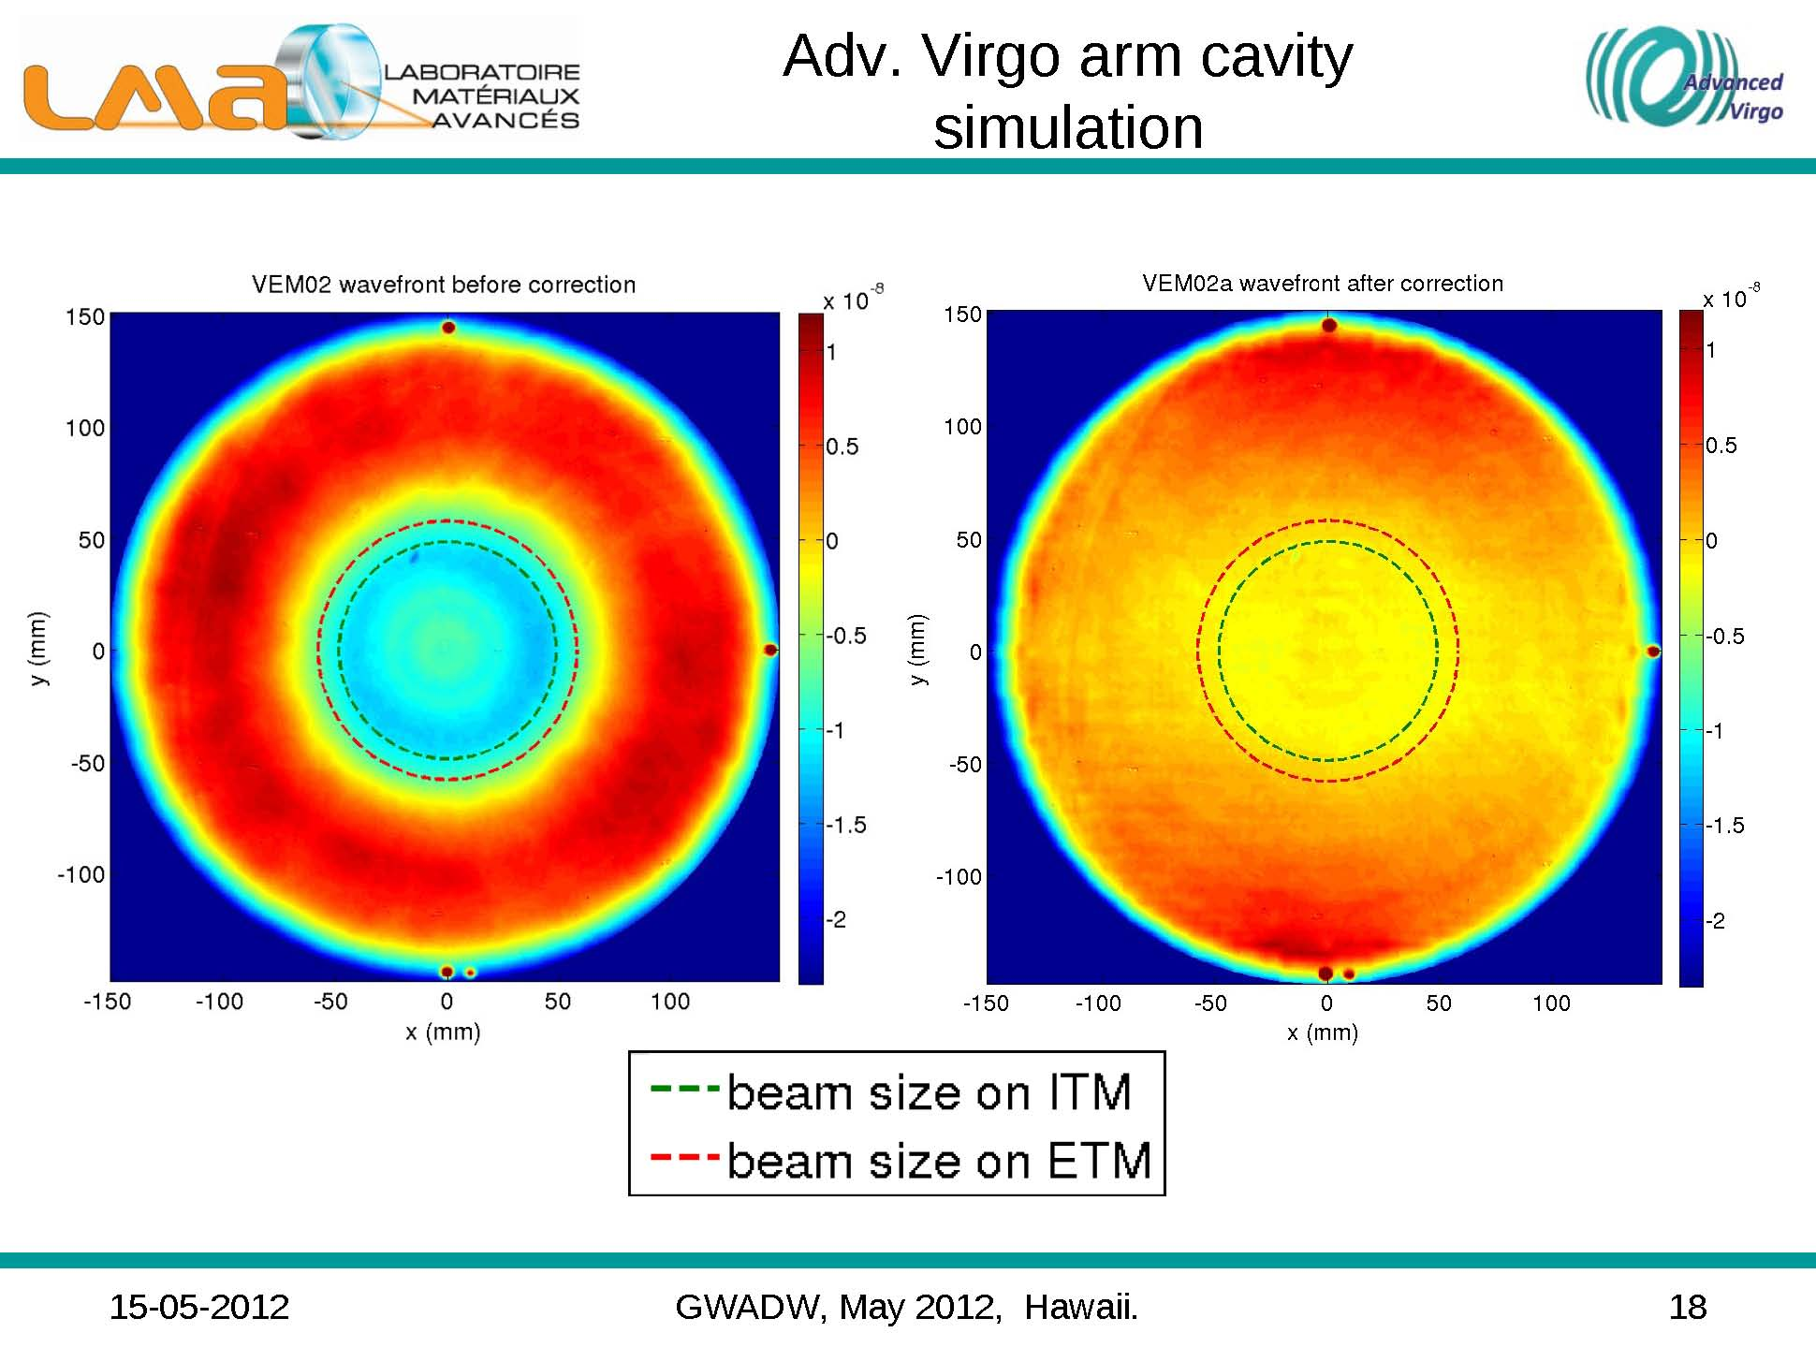

Slide 16
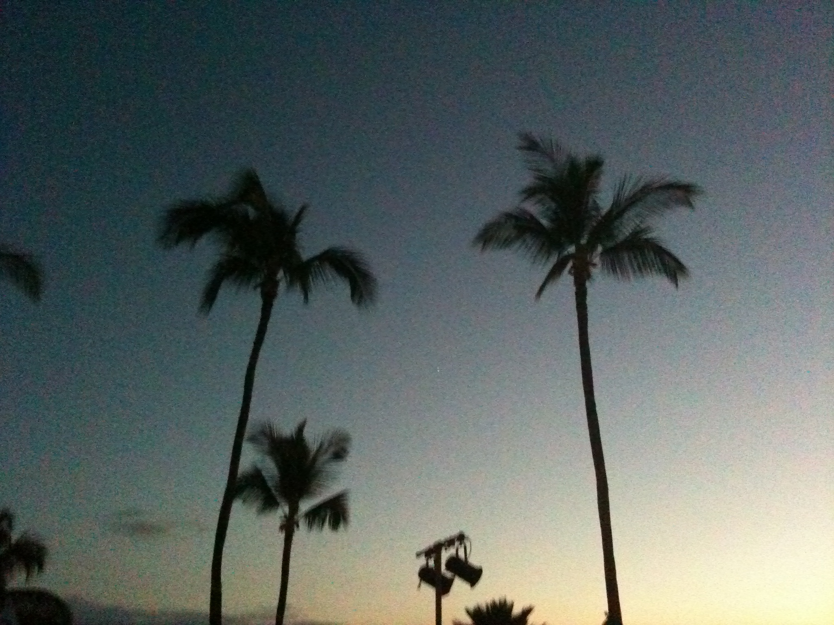
Wednesday AM chaired by Roman
Roman (AEI) introduced why SQ is remarkable
Sheila (MIT) summarized H1 SQ experiment
Hartmut (AEI) reviewed squeezing GEO600
Miao (Caltech) pointed the evidence of QRP
Patrick (MIT) experimentally challenges a filter cavity
Robert (ANU) presented an opto-mechanically coupled filter for SQ
Zach (Caltech) analyzed OMIT
Bryan (Glasgow) tries to observe optical spring by 10m interferometer
Garrett (VCQ) summarized QOM
Henning (AEI) showed optical cooling by 50ng membrane
Agatsuma (ICRR) precisely calibrated optical power
Daniel (ICRR) tries to measure QRPN using 20mg tiny mirror suspended by 10miron silica fiber

Slide 17
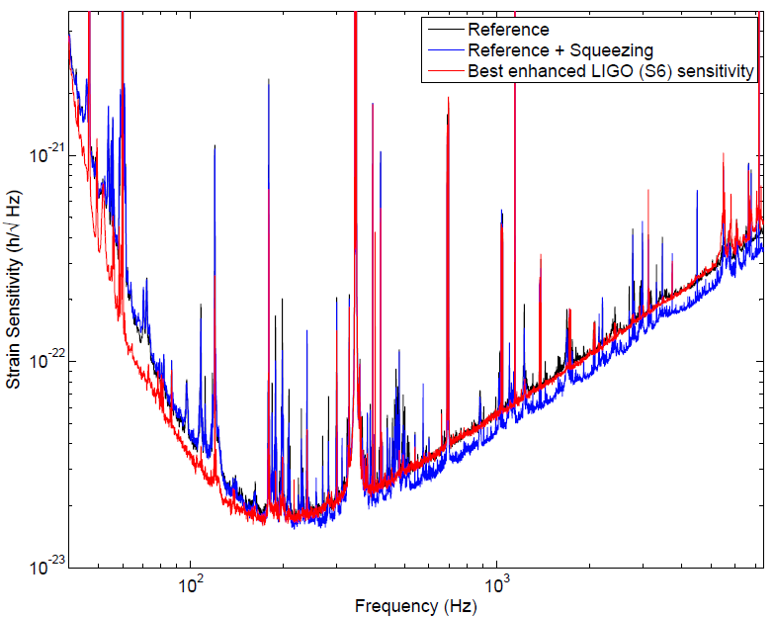
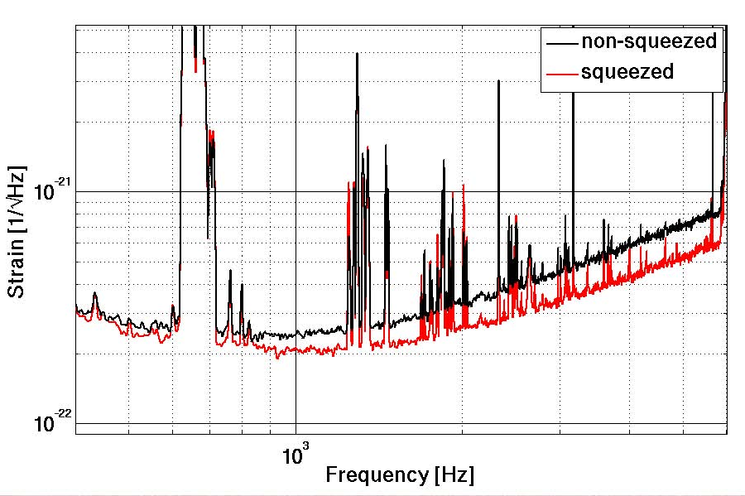
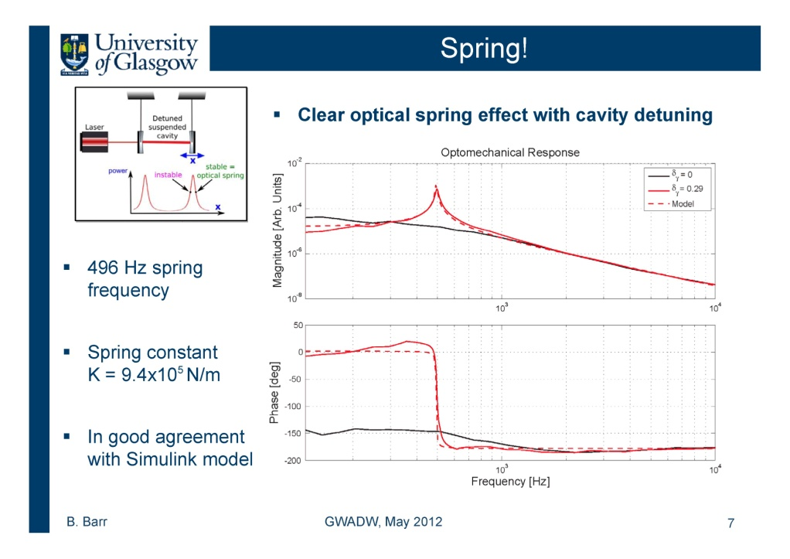
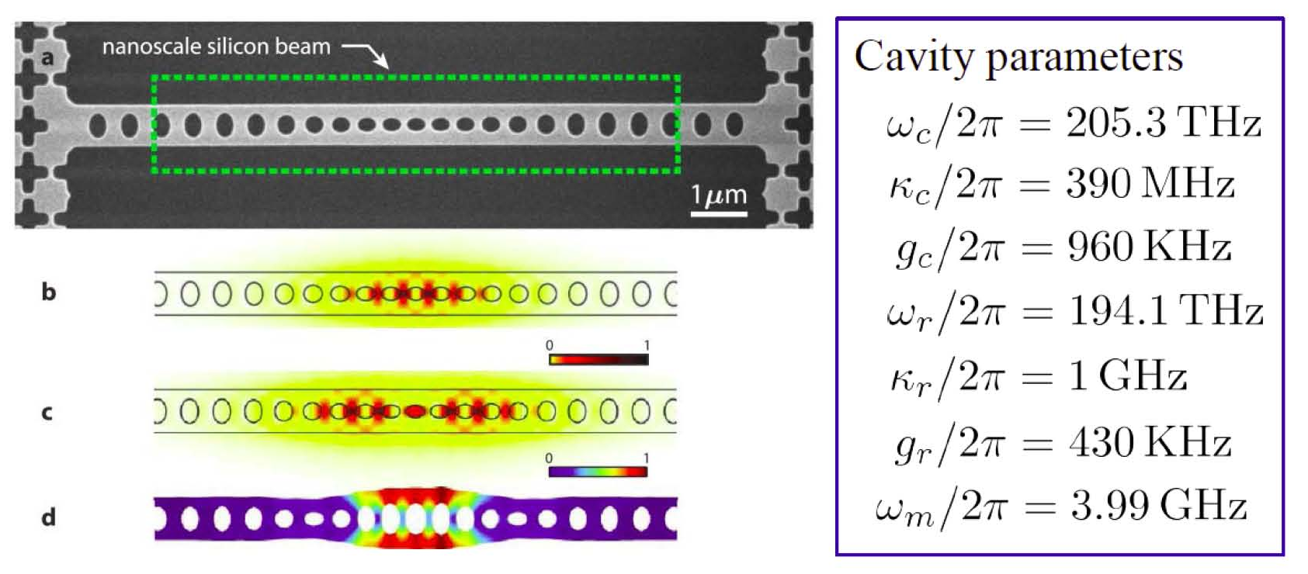
Broadband sensitivityLIGO: H1 - 2.1dB
Recent sensitivity GEO600 -2.8dB
Experimental Evidence for QRP

Slide 18
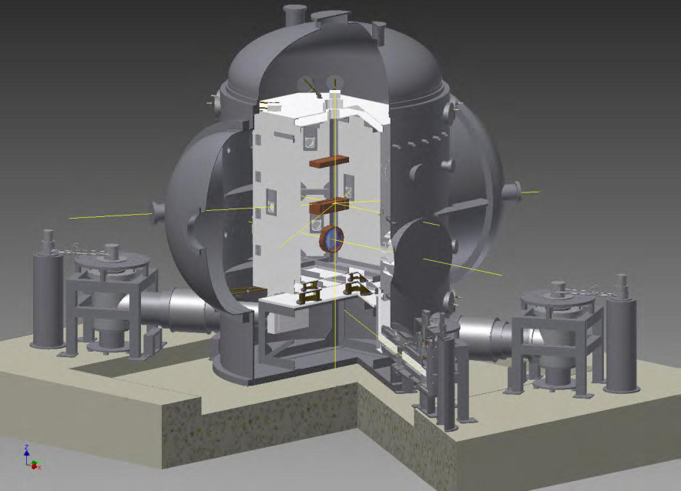
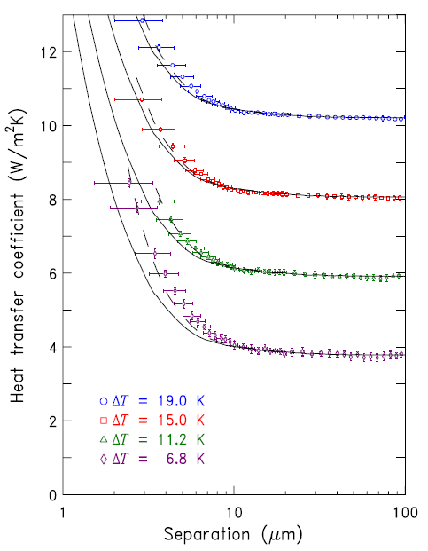
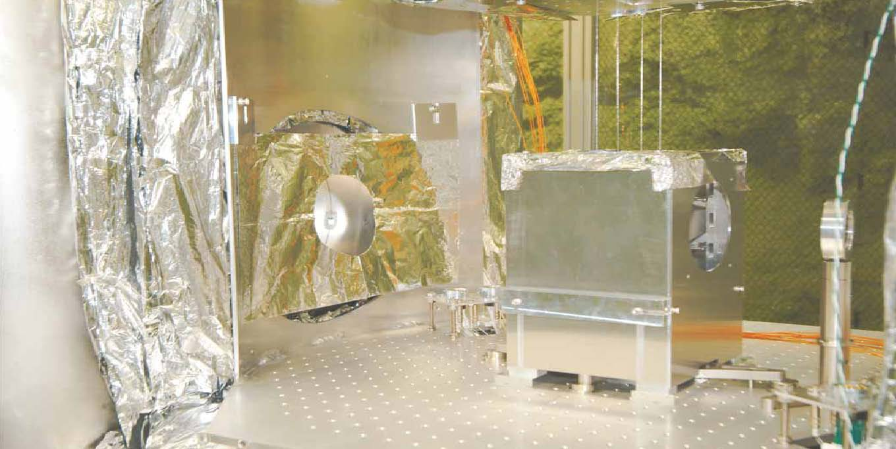
Wednesday PM chaired by Ronny & Kazuhiro
Kazuhiro (ICRR) summarized KAGRA cryogenics
Richard (Florida) devised new technique of heat transfer by evanescent waves
Masatake Ohashi presented the lessons from CLIO

Slide 19
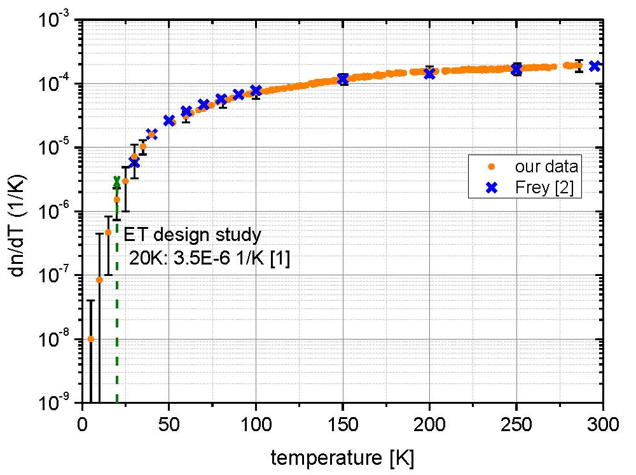
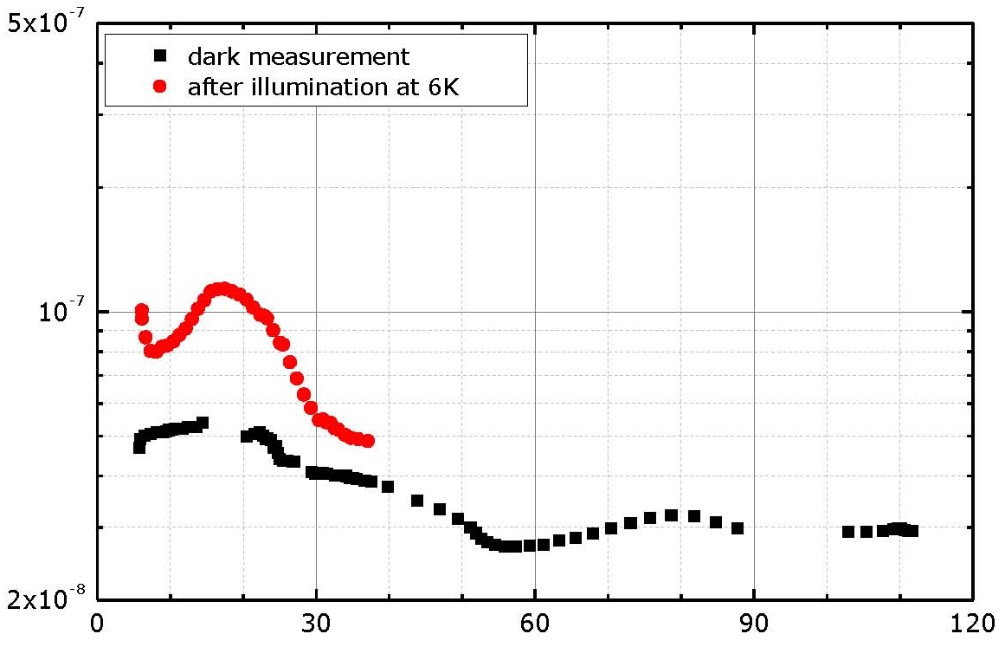
Karen (Glasgow) described hydro-catalysis bonding
J. Komma (Jena) measured dn/dT at cryogenic temperature
Gerd (Glasgow) introduced silicon-sapphire-gallium arsenide

Slide 20
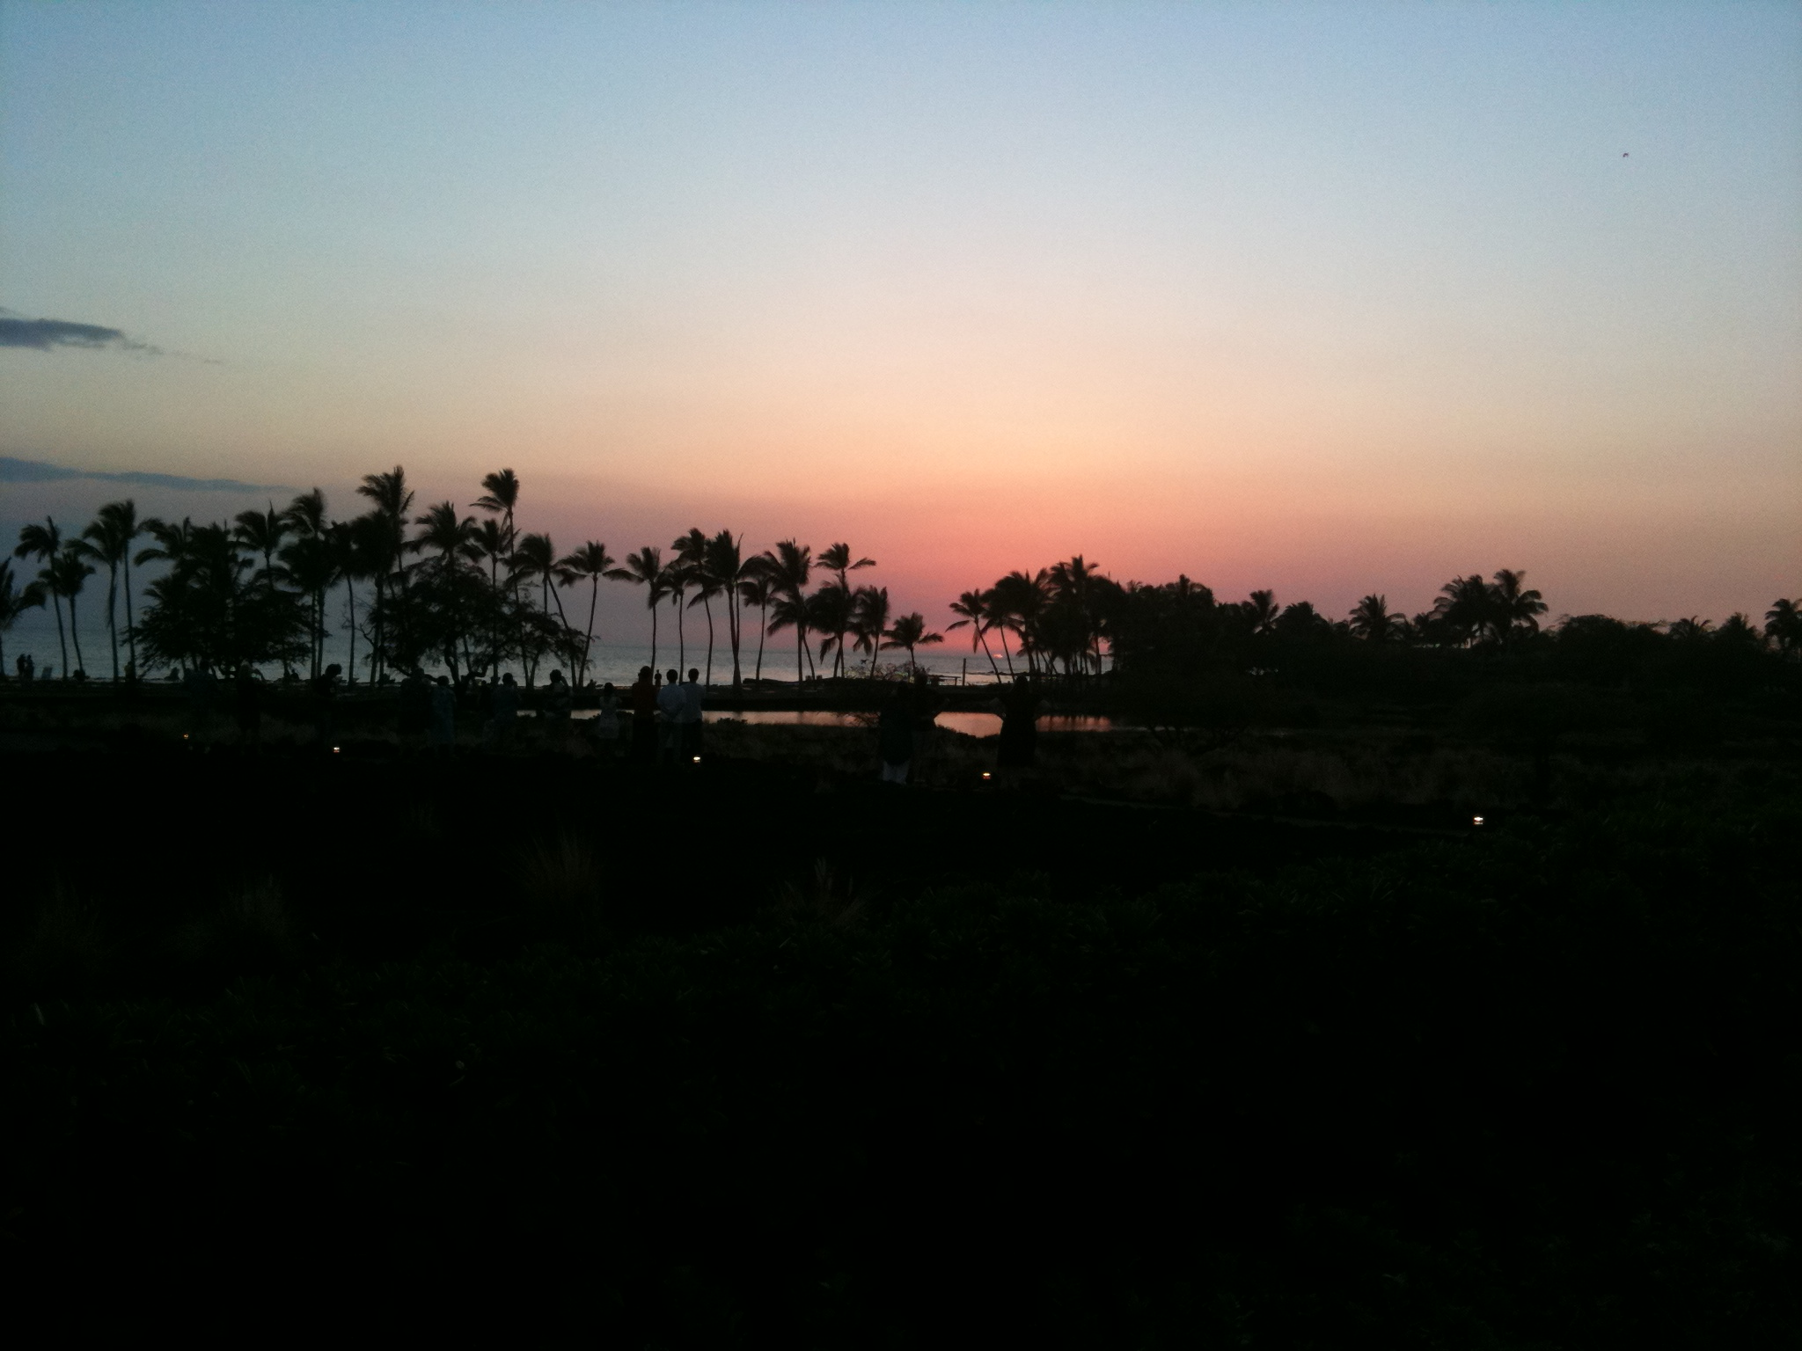
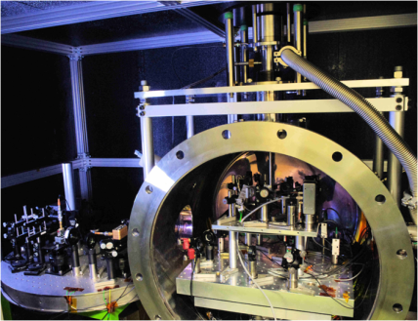
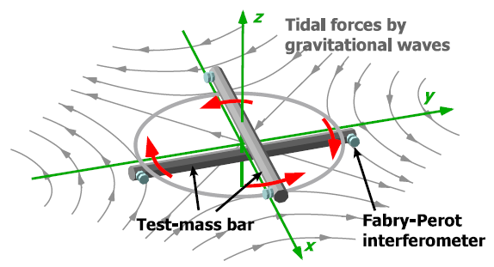
Thursday AM chaired by David
Ando(Kyoto) plans TOBA covering frequencies between ground and space
Ayaka (UT) summarized observational result by prototype system

Slide 21
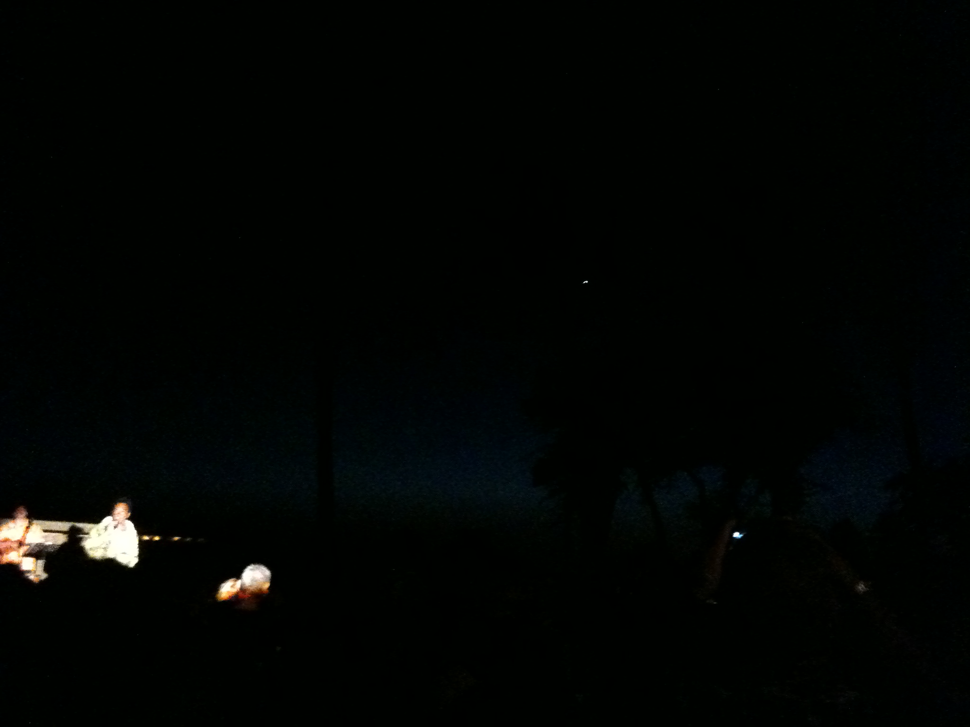
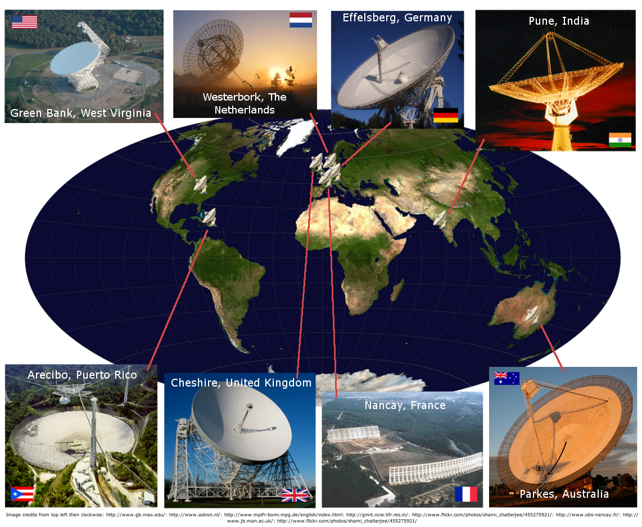
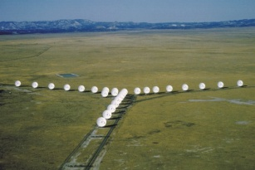
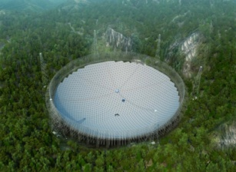
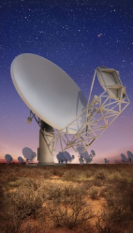
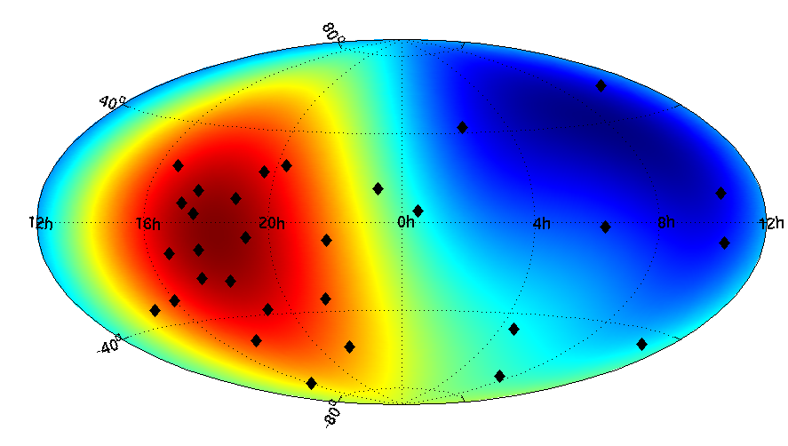
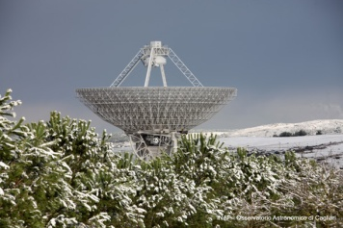
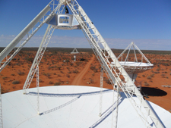
Thursday AM chaired by David
Lee (PSU) summarized the detection of nano-hertz GW by pulsar timing
James (Cornell) analyzed physics and techniques of pulsar timing GW detection
Joseph (JPL) scoped the global array

Slide 22
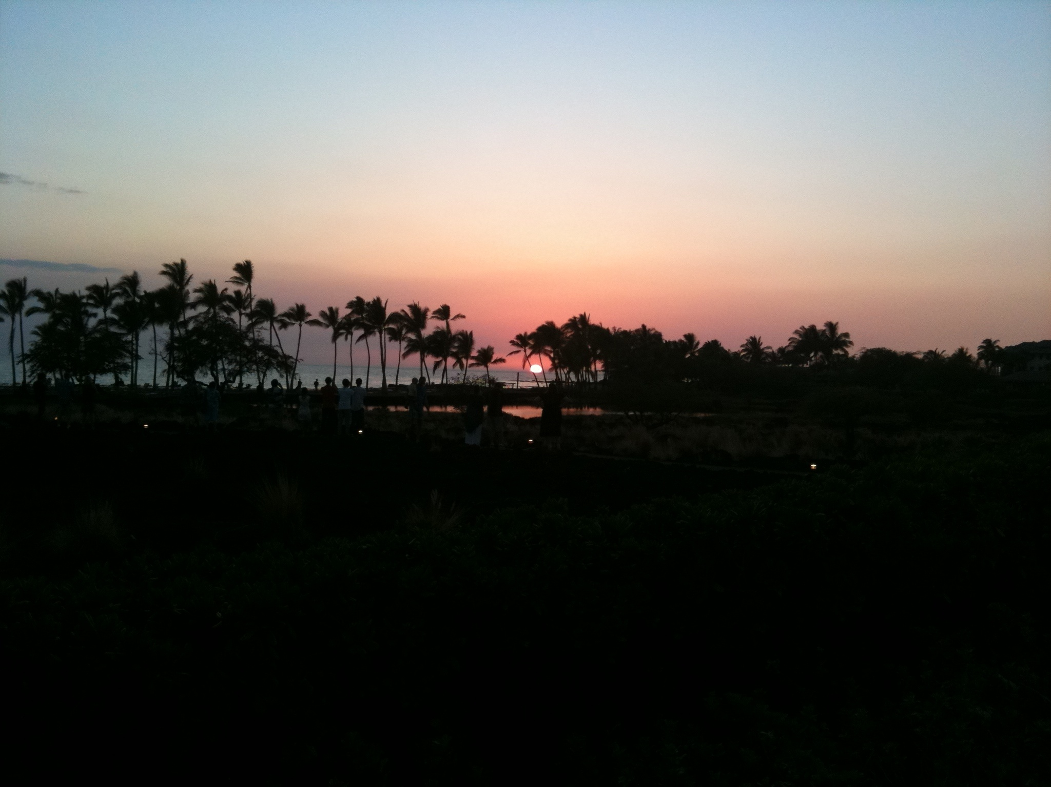
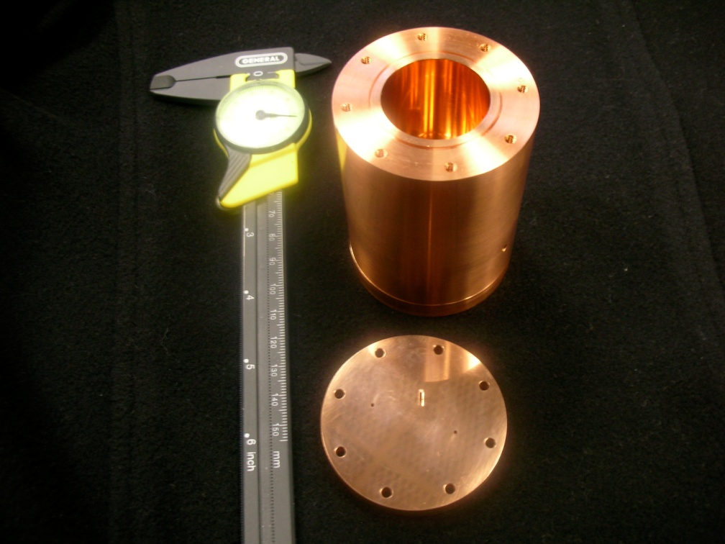
Thursday AM chaired by David
Keith (Caltech) proposed a new antenna using superfluid ⁴He
Holger (Berkeley) reviewed Atomic wave interferometer

Slide 23
Thursday AM chaired by Sathya
Lisa (MIT) summarized current status of SQ
  toward 6dB
  10dB is not easy
  15dB is a dream
Stefan reviewed Jun’s theorem
  tradeoff among bandwidth, power, and wave length “you can’t take both”

Slide 24
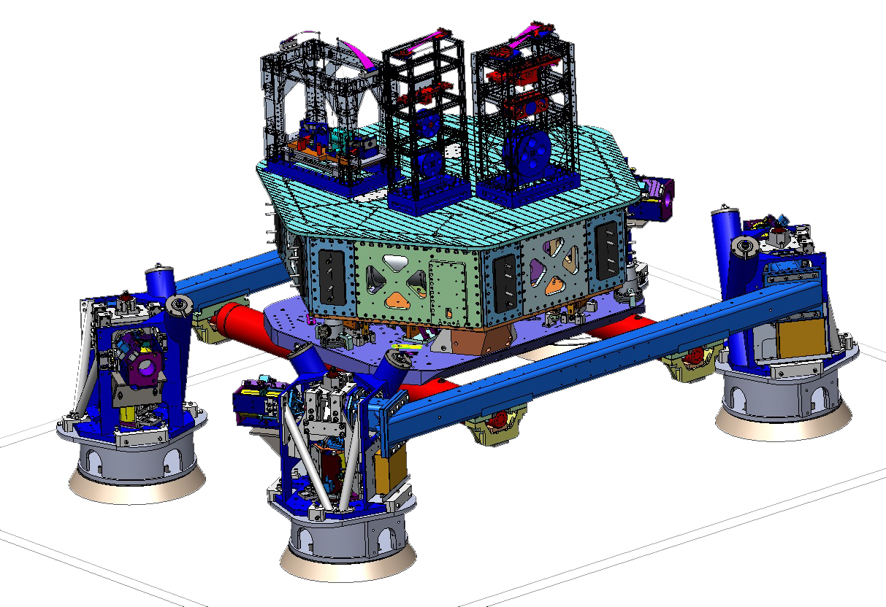
Thursday PM chaired by David
Jeff (MIT) talked about seismic system in advanced LIGO
7stage
1-3 sensor noise
4-7 direct coupling
800kg payload
HAM5
Lots of practical stuff removed for demonstration
Vacuum chamber
SUS sensors
EQ stops, Lockers

Slide 25
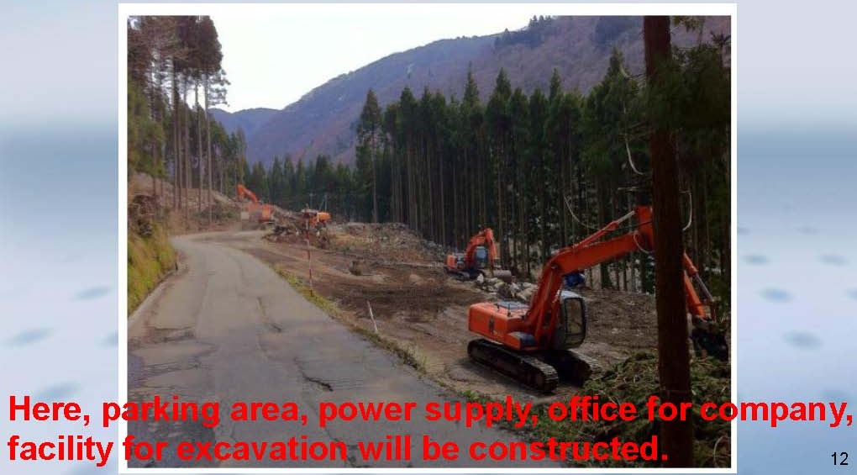
Thursday PM chaired by David
Kazuhiro (ICRR) introduced the construction of KAGRA struggling for chasing aLIGO/AdVirgo

Slide 26

Thursday PM chaired by David
Gabriele summarized the design and R&D for AdVirgo

Slide 27
Thursday PM(2) chaired by Daniel
K. McKenzie (JPL) introduced new mission concept succeeding LISA
S. Sato (Hosei) summarized DECIGO and its pathfinder
Robert (ANU) presented Laser Ranging Mission, GRACE, with its scientific & useful result
Eric Hultgren (Stanford) advertized “LAGRANGE” project of space laser interferometer mission

Slide 28



Friday AM chaired by Rana
Miao (Caltech) summarized interferometer configurations with possible frequency bandwidths
Stefan Hild (Glasgow) talked about LIGO-3G red design
  Xylophone: cryogenic at low frequencies/high power at high frequencies
Rana (Caltech) introduced LIGO-3G blue design
  Xylophone is nonsense! 120K silicon mass, AlGaX coat, 3MW, 1/30 GGN
Stefan Ballmer (Syracuse) took LIGO-3G green design
Frequency dependent loss
RGB sensitivity comparison

Slide 29


Friday AM (2) chaired by Rana
Harald (AEI) summarized ET
  Full review of presentations
  1dB / year improvement in SQZ (Lisa Barsotti)
Matt (MIT) proposed MANGO
  2Mg TMs
  10dB SQZ
  300m
  2mHz SUS

Slide 30

Summary of this summary
Steady advancement of improving sensitivity
Extensive discussion for 3G detector --- more novel ideas
Convincing funding agency by continuous effort --- Never give up !!
Open GW astronomy by first detection !!
See you in Elba next year

