Slide 1
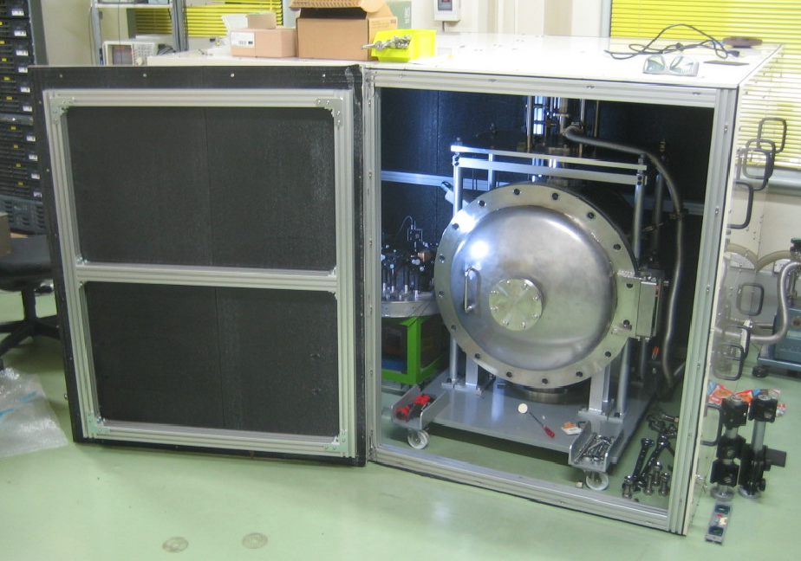
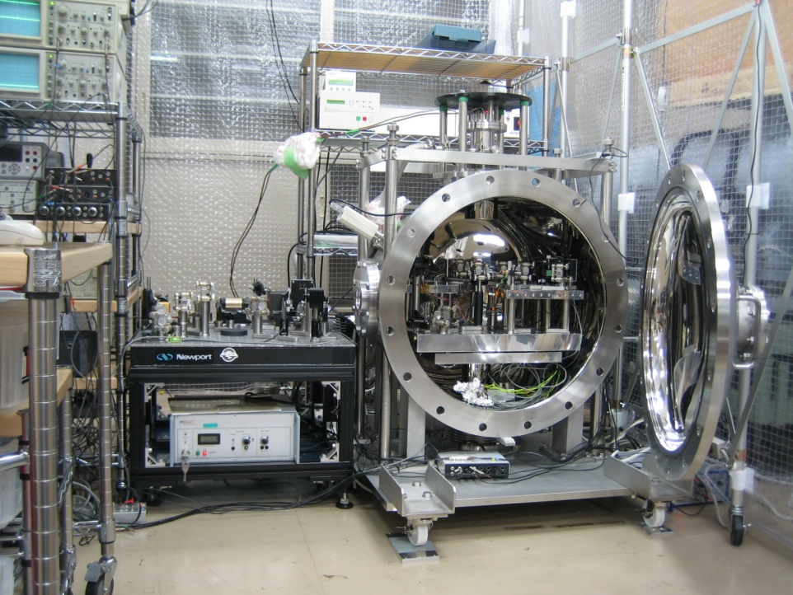
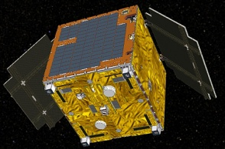
TOBA: Torsion-Bar Antenna
Small-scale TOBA at Tokyo
Small-scale TOBA at Kyoto
SWIM on SDS-1 satellite
Masaki Ando (Kyoto University)
Ayaka Shoda (University of Tokyo)
K. Ishidoshiro, K. Okada, W. Kokuyama, K. Yagi, K. Yamamoto,
H. Takahashi, N. Kanda, Y. Aso, N. Matsumoto, K. Tsubono, A. Takamori
Special thanks to the MANGO members

Slide 2
Motivation
Low-freq. GW observation → New sciences
・Large amplitude and/or stationary GWs radiated
by sources with large masses and long time-scales.
・Difficult with ground-based detectors because of
fundamental limitation and seismic disturbances.
・Space-borne detector requires large resources.
Novel approach : TOBA (Torsion-Bar Antenna)
・Low-freq. GW obs. even with ground-based config.
・Unexplored band observation with space detector.

Slide 3
Introduction
Prototype results
- Ground-based TOBA
- Rotating TOBA in space
Next steps
(A. Shoda)
Reference:
- M.Ando, et. al, Phys. Rev. Lett. 105, 161101 (2010)
- K.Ishidoshiro, et. al, Phys. Rev. Lett. 106, 161101 (2011)
- A. Shoda, presentation at GWPAW2011
- W.Kokuyama, in preparation

Slide 4
TOBA Introduction
Reference: MA+, Phys. Rev. Lett. 105, 161101 (2010)

Slide 5
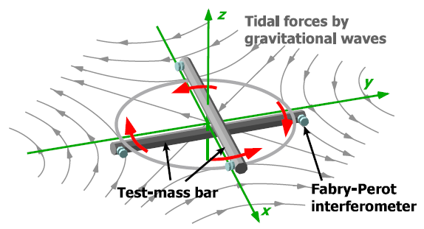
TOBA
TOBA : Torsion-Bar Antenna
Monitors tidal-force fluctuation caused by GWs.
MA+, Phys. Rev. Lett. 105, 161101 (2010)

Slide 6

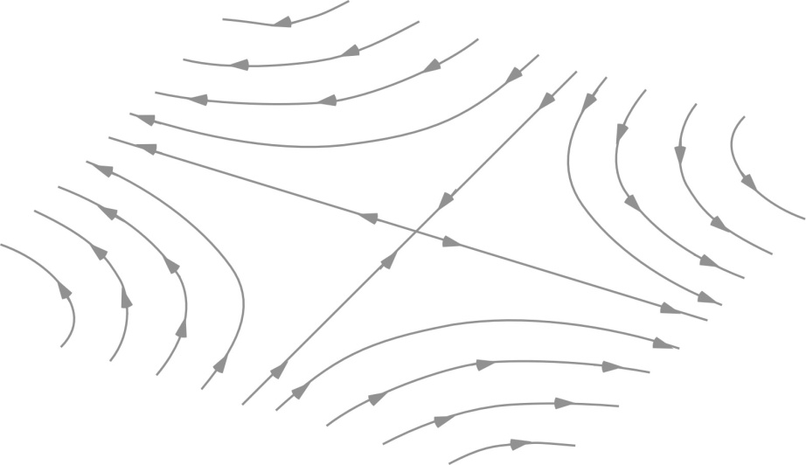
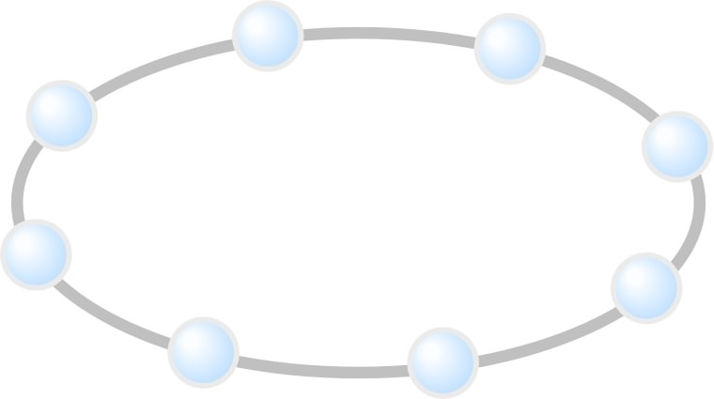

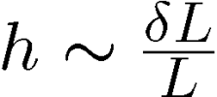
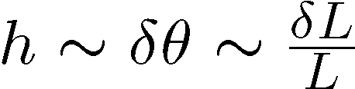
Detection principle
Conventional IFO antenna
Torsion-bar antenna
Detect differential length change
Detect differential rotation
z
GWs
z
GWs
y
y
x
x
Strain
Angle
Changes in tidal forces using free test masses

Slide 7

Comparison
Conventional IFO
TOBA
Obs. band 10Hz-1kHz
Obs. band 10mHz-1Hz
Suspended as pendulum
(Res. Freq. ~1Hz)
Torsion pendulum
(Res. freq ~1mHz)
Long baseline
→ High sensitivity
Shorter length
→ Simple config.
Common-mode rejection

Slide 8

Fundamental noise level of TOBA
Practical parameters
(at 0.1 Hz)
Bar length : 10m, Mass : 7600kg
Laser source : 1064nm, 10W
Cavity length : 1cm, Finesse : 100
Bar Q-value : 10⁵ , Temp: 4K
Support Loss : 10⁻¹⁰
Laser Freq. noise < 10Hz/Hz^{1/2},
Freq. Noise CMRR>100
Intensity noise < 10⁻⁷/Hz^{1/2},
Bar residual RMS motion < 10⁻¹² m

Slide 9
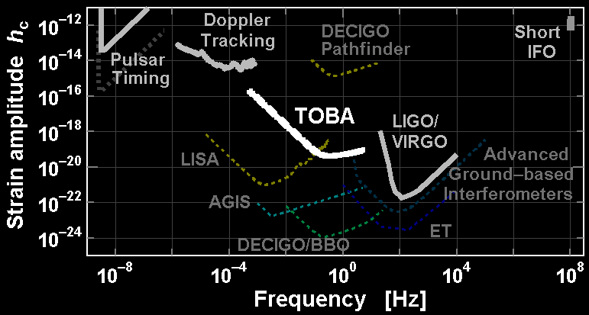

TOBA Sensitivity
Comparison with the other detectors
DECIGO/BBO band: Between ground-based detectors and LISA bands
SQL
Characteristic amplitude :
(Dimensionless strain)

Slide 10

Observable range
GWs from binary BH mergers
Obs. Range ~10Gpc ( )
ET
Calculation by K.Yagi : BH merger hybrid waveform, spin 0.5/0.5

Slide 11
And more…
Al bar, Length : 10m, Mass : 7.6 ton
Laser source : 1064nm, 10W
Cavity length : 1cm, Finesse : 100
Bar Q-value : 10⁵ , Temp: 4K
Support Loss : 10⁻¹⁰
Si bar, Length : 25m, Mass : 90 ton
Laser source : 1550nm, 10W
Squeezing 10dB, Finesse : 100
Bar Q-value : 10⁹ , Temp: 4K
Support Loss : 10⁻⁹
>10 times better!

Slide 12
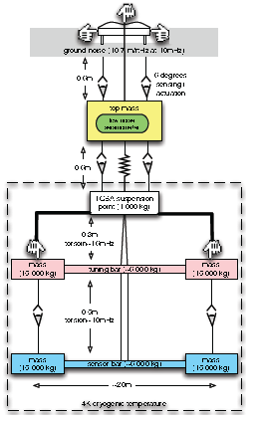
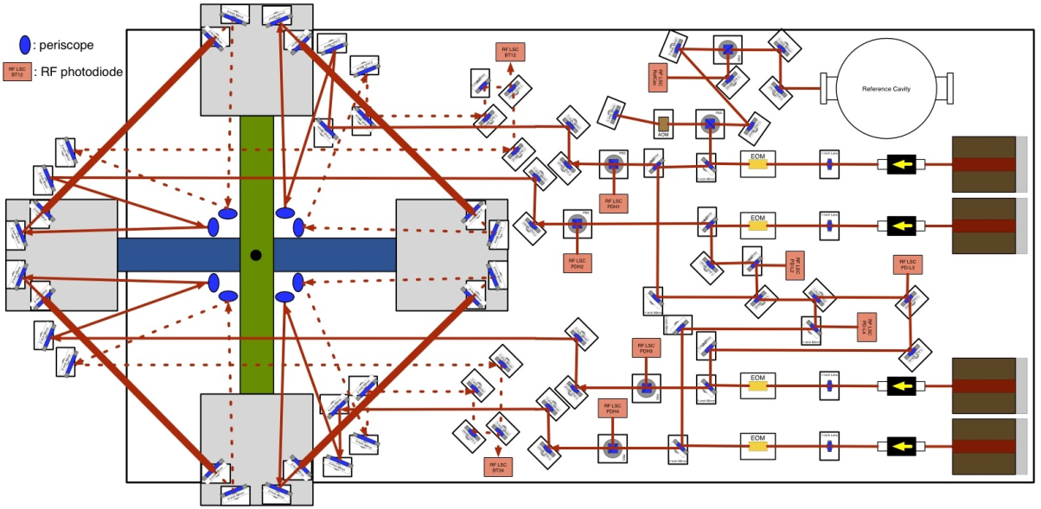
Schematic design
・Example of extreme design
(By Bram Slagmolen)
Si bar, Length : 10m, Mass : 11 ton
Laser source : 1550nm, 100mW
Squeezing 10dB, Finesse : 300
Bar Q-value : 10⁹ , Temp: 4K
Support Loss : 10⁻⁹

Slide 13
Rotating TOBA
Rotate the detector along its axis
ω_{rot}
- Up-conversion of low-freq. GWs
Low-freq. GW appears at 2 ω_{rot}
Tidal force
by GW
- Avoid low-freq. noises
Observer rotates with the detector
Noises at ω_{rot} : not important
Rotating
TOBA
・Two independent polarization of GW.
・Allow intermitted observation.

Slide 14
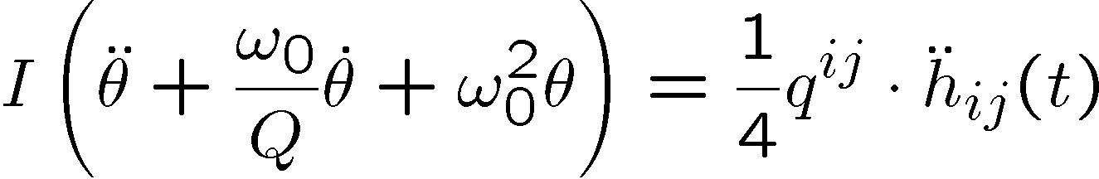


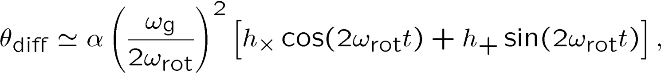
Rotating TOBA
Equation of Motion of a test-mass bar
: Moment of Inertia
: Dynamic quadrupole moment
Rotation
GW with very-low freq. (ω_{g}) appears
as high freq. (2ω_{rot}) signal by up-conversion.

Slide 15
Sensitivity by R-TOBA
Sensitivity example
(Rotation freq. 5x10⁻⁵ Hz, Laser power 1mW)
Bar length : 10m, Mass : 7600kg
Laser source : 1064nm, 1mW
Cavity length : 1cm, Finesse : 1
Bar Q-value : 10⁵ , Temp: 4K
Support Loss : 10⁻¹⁰
Bridge the Pulsar-timing and LISA
Rot. Freq.
5x10⁻⁵ Hz

Slide 16
Results from Prototypes
→ A.Shoda’s file
Reference:
- K.Ishidoshiro+, Phys. Rev. Lett. 106, 161101 (2011)
- A. Shoda, presentation at GWPAW2011

Slide 17
Rotating TOBA prototype
( SWIM on SDS-1 satellite )
Reference: W. Kokuyama, Ph.D thesis

Slide 18



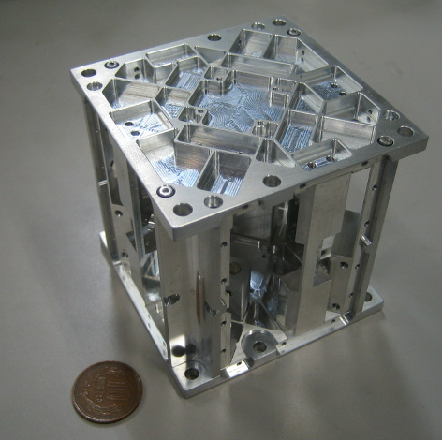


Rotating TOBA : SWIMμν
Small Module SWIMμν on SDS-1
Launched Jan. 2009, Terminated Sept. 2010
Photo：
JAXA
TAM: Torsion Antenna Module with free-falling test mass
(Size : 80mm cube, Weight : ~500g)
Test mass
~47g Aluminum, Surface polished
Small magnets for position control
Spin Axis
(46.5mHz)
Coil
Photo sensor
Reflective-type optical
displacement sensor
Separation to mass ~1mm
Sensitivity ~ 10⁻⁹ m/Hz^{1/2}
6 PSs to monitor mass motion
80mm

Slide 19
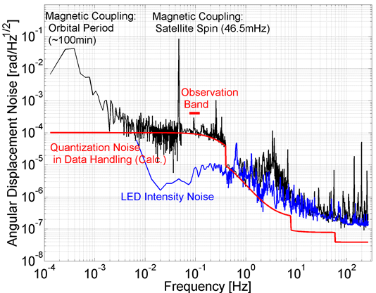
Sensitivity
Though limited by non-fundamental noises,
best as a space-borne GW detector.
By W.Kokuyama

Slide 20
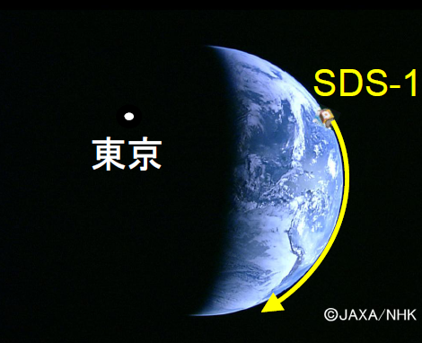
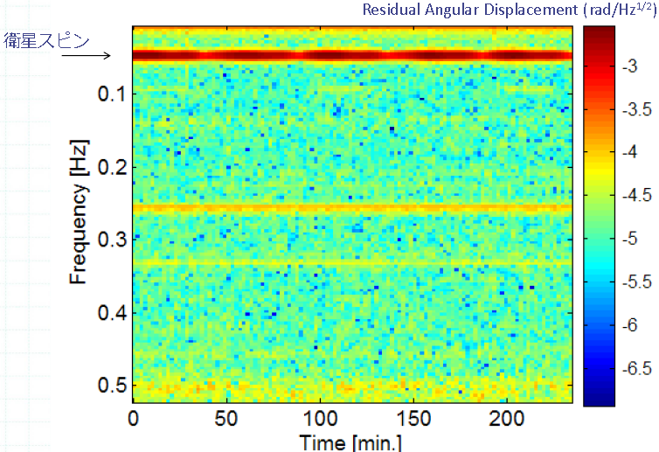
Observation by SWIM
Continuous data taking
Tokyo
Kyoto
Jun 17, 2010 ~120 min.
July 15, 2010 ~240 min.
Orbital period
~100min.
Observation band
Orbital Period
10mHz LPF
By W.Kokuyama

Slide 21
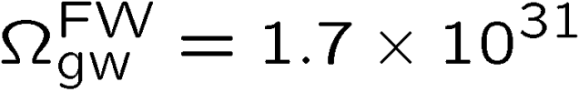
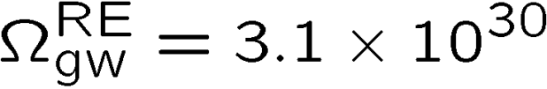
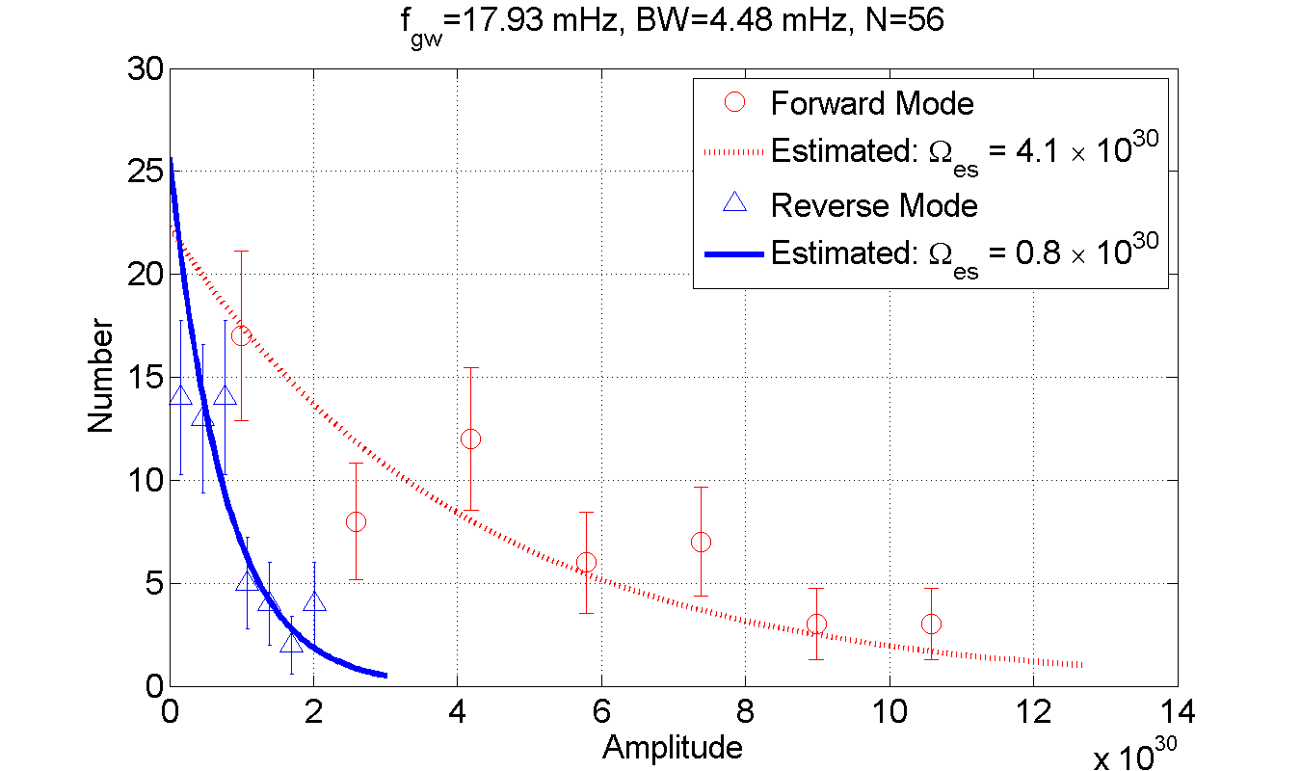
Upper Limit on GWB
Upper Limit at two frequencies (two polarizations)
‘Forward’ mode
‘Reverse’ mode
(C.L. 95%, f0 18mHz, BW 4mHz)
By W.Kokuyama

Slide 22
Next Prototype plan

Slide 23
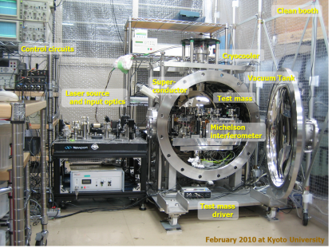
TOBA next plan
・Results from two small-scale TOBAs at Tokyo and Kyoto,
and rotating TOBA in space.
One more prototype step
before the 10-m scale TOBA.

Slide 24
Concepts
・Design concepts
- Should be intermediate step for the 10-m scale TOBA.
- Scientific outcomes.
- Common techniques with KAGRA, ET, …
- Realistic both in technology and the budget.
Medium-scale TOBA for Newtonian noise observation.
- NN monitor sensor
- Take the most advantages of R&Ds
for the next generation detectors.

Slide 25

Gravity gradient noise
・Newtonian noise by ground motion.
- Coherent plane wave with long wavelength
Velocity 5km/s, Frequency 0.1Hz
→ wavelength ~ 50km
TOBA
Same effect as km-scale interferometer
Plane wave
- NN estimation (by Jan Harms)
Newtonian Noise
Assumption:
Infinite plane wave
Homestake mine seismic level
Atmospheric NN may be larger; should be considered.

Slide 26
Medium-scale TOBA candidates
・Sensitivity estimation (only with fundamental noises)
- Silicon test mass, room-temp. or cryogenic
- Laser 1550nm for two orthogonal bars.
- Readout by interferometers.
- Isolation system : KAGRA technology.
Length Diameter Mass MoI Sensitivity Max IR
10 0.3 1646 1.37x10⁴ 3x10⁻¹⁸ 800
Room temp.
(300K)
3 0.2 219 164 3x10⁻¹⁷ 150
1 0.15 41 3.4 3x10⁻¹⁶ 20
10 0.3 1646 1.37x10⁴ 4x10⁻¹⁹ 3500
Cryogenic
(4K)
3 0.2 219 164 6x10⁻¹⁸ 350
1 0.15 41 3.4 3x10⁻¹⁷ 50
[m] [m] [kg] [kg・m²] [1/Hz^{1/2} @0.1Hz] [Mpc]
※ Gravity-gradient noise : ~10⁻¹⁷ [1/Hz^{1/2}] at 0.1Hz

Slide 27
Sensitivity estimation
Bar length : 3m, Mass : 219kg
Laser source : 1550nm, 10W
Cavity length : 1cm, Finesse : 100
Silicon bar, Q-value : 10⁹ , Temp: 300K
Pendulum Q-value : 10¹⁰
Pendulum resonance 0.1mHz

Slide 28
Medium-scale TOBA design
・Under discussion, but may be … Cryo. with 1-m scale
- Same direction as KAGRA, ET, …
→ Effective use of resources and technologies.
(Cryo-system, Suspension, Isolators, Materials)
Length Diameter Mass MoI Sensitivity Max IR
10 0.3 1646 1.37x10⁴ 3x10⁻¹⁸ 800
Room temp.
(300K)
3 0.2 219 164 3x10⁻¹⁷ 150
1 0.15 41 3.4 3x10⁻¹⁶ 20
10 0.3 1646 1.37x10⁴ 4x10⁻¹⁹ 3500
Cryogenic
(4K)
3 0.2 219 164 6x10⁻¹⁸ 350
1 0.15 41 3.4 3x10⁻¹⁷ 50
[m] [m] [kg] [kg・m²] [1/Hz^{1/2} @0.1Hz] [Mpc]
※ Gravity-gradient noise : ~10⁻¹⁷ [1/Hz^{1/2}] at 0.1Hz

Slide 29
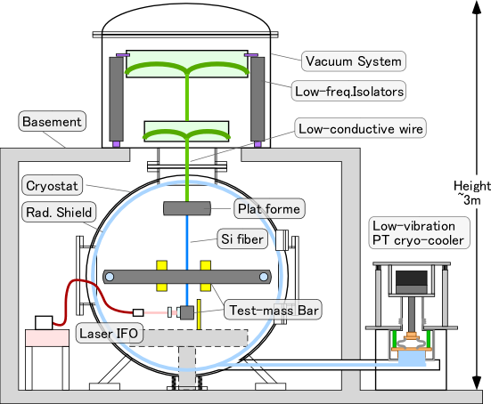
Medium-scale TOBA design
・Under discussion, but probably … Cryo. with 1-m scale

Slide 30
Summary

Slide 31
Summary (1/2)
・Novel type GW detector : TOBA
→ Low-freq. observation (~10⁻⁸ – 1 Hz) .
- Observable Range >10Gpc for BH inspirals.
- Rotating TOBA for lower freq. (<1mHz) GWs.
・First prototypes
- Small-scale TOBAs at Tokyo and Kyoto
→ First upper limits on GWB at 0.1-0.2Hz band.
- SWIM as a space-borne rotating TOBA
→ Upper limit on GWB at 18mHz.

Slide 32
Summary (2/2)
・Next prototype plan
- Medium-scale TOBA with length ~1m.
- Low-freq. GW detector and also a NN sensor.
- Common techniques with KAGRA, ET, …
・Another plan by Australian group
- Medium-scale TOBA at room temp.
- Please ask Bram Slagmolen!
Any suggestions are welcome!

Slide 33
End

Slide 34
Backups

Slide 35
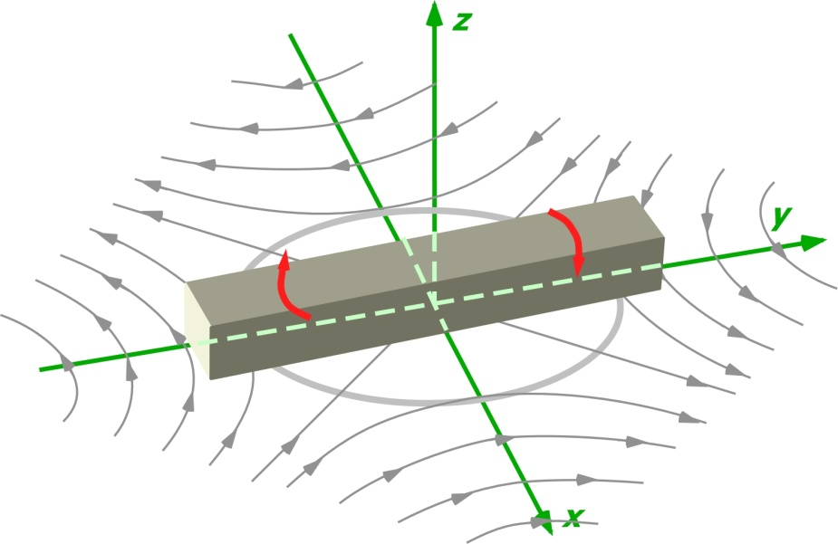
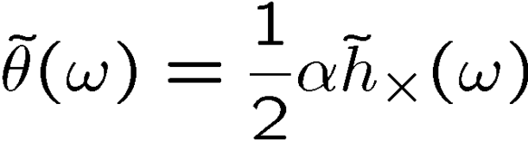

Detector response
Equation of Motion of a test-mass bar
GWs
: Moment of Inertia
: Dynamic quadrupole moment
Bar rotation
α : shape factor, between 0 to 1
Dumbbell or thin bar → α = 1
Dimension less,
Independent of matter density
Tidal force
by x-mode GW

Slide 36
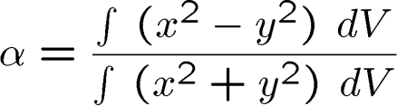






Bar shape
・Design of bar shape
- Detector response to GW
Shape factor
Thin bar or dumb-bell
along x-axis → α=1
- Standard quantum limit
Cylindrical bar
Moment of Inertia
Dumb-bell
- Bar thermal noise
When mass is kept,
Shorter is better.
- Suspension thermal noise
When mass is kept,
Longer is better.

Slide 37
Bar material
・Selection of bar material
- Bar thermal noise
- Electro-magnetic properties
- Availability (production, cost)
Silicon is promising.
Young’s
modulus
Q-factor
Density
Availability
Thermal noise
Aluminum
<10⁷
72 GPa
2700 kg/m³
○
8x10⁻²⁰ Hz^{-1/2}
Sapphire
10⁸
335 GPa
3970 kg/m³
△
1x10⁻²⁰ Hz^{-1/2}
Silicon
10⁹
185GPa
2329 kg/m³
○
5x10⁻²¹ Hz^{-1/2}
(L=10m, φ=0.3m)

Slide 38
Interferometer configuration
・Readout from reference plate
- Readout by short FP cavities at the bar edge.
- Reference mirrors fixed to isolated base plate.
- Independent measurement
→ Linear combination for GW signals.
- Require a seismic-isolated reference plate.
・MI fixed at bar edges
- Form Michelson interferometer at the bar edge.
- Direct angular measurement
- Do not need reference mirrors.
- Coupling from bar displacements.
→ Room for improvements

Slide 39
Seismic noise
・Rotational ground motion
・Coupling from displacement DoF
Coupling 10⁻³ or CMRR 10⁻³
→ <10⁻⁹ isolation is required
at 0.1Hz freq. band.
Horizontal : IP (10mHz) x 5 stages
Vertical : GASF ???

Slide 40
Bar thermal noise
・Thermal noise of bar mode
Differential readout at the edges
→Contribution of odd modes
Readout
Aluminum bar (7.6 ton)
length 10 m, φ0.3 m
Temp. 4K, Q 10⁷
8x10⁻²⁰ 1/Hz^{1/2} at 0.1Hz
By keeping the total mass,
- High Q and low T is better
- Shorter is better
- High Young's modulus is better

Slide 41
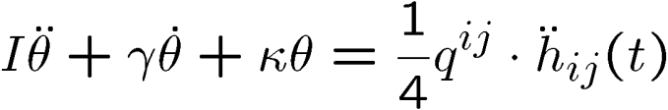

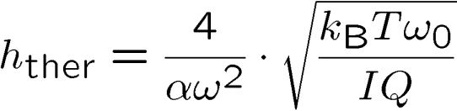

Suspension thermal noise
・Thermal noise of suspension system
Detector response
- Torque by dissipation (one bar)
- Mechanical loss in suspension fiber
Steel wire
Tungsten wire
Silica fiber
Cryogenic sus.
Superconductor sus.
Cryogenic suspension, Temp. 4K, γ 10⁻¹⁰
- Momentum of inertia

Slide 42
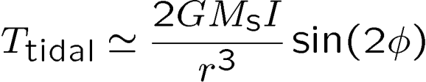
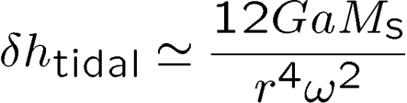
Gravity gradient noise
・Newtonian noise by point-like source.
- Assume a dumb-bell mass
and a point-like source mass
φ
DC torque
r
Ms
Equivalent noise
(Radial motion, Max. direction, a: amplitude, a, L << r)
(Ex.) Human activity
Ms=100 kg, r=10m,
φ=π/2, f=0.1Hz, a= 0.1m
δh ~ 2x10⁻¹²

Slide 43

Open questions…
・Readout scheme
- Better setup to reduce couplings from the other DoF?
- Non-optical readout, such as SQUID?
・Gravity gradient noise
- What happens at an underground site?
- Propagation of seismic waves?
(Cancelation, Scattering, Diffraction)
・Seismic noise
- Design of isolation system.
- Active controls.
・Other fancy ideas….
- Detector configuration.
- QND measurement.

Slide 44
TOBA prototype example (2)
・Space TOBA
- Silicon test mass, tune at 1mHz.
- Differential measurement using two orthogonal bars.
Length diameter mass MoI Sensitivity Max IR
10 0.3 1646 1.37x10⁴ 2x10⁻¹⁷ 70
Room temp.
(300K)
3 0.2 219 164 2x10⁻¹⁶ 7
1 0.15 41 3.4 1x10⁻¹⁵ 1
[m] [m] [kg] [kg・m²] [1/Hz^{1/2} @1mHz] [Gpc]
※ Acceleration noise is not included.

Slide 45
Discussions
New motivations for GW research field…
・Optical readout noise
・Low freq. seismic isolation and reduction of Newtonian noise.
・Material, bar shape, and thermal noise
・Cryogenic system
・New possibility as a space mission
・GW sources at different freq. band
- Between pulsar timing and LISA
- Between LISA and ground-based detectors
・Data analysis schemes
- Rotating TOBA configuration
- Distributed multiple detectors

Slide 46
TOBA prototype plan
・We have two small-scale TOBAs at Tokyo and Kyoto.
- Aluminum test mass, length ~20cm, mass ~300g.
- Room temperature, poor seismic isolation.
- Magnetic levitation using superconductor bulk.
・Next plan concepts
(A) Medium-scale TOBA at room temperature.
- Silicon test mass, length ~1m, mass ~100kg.
- Differential measurement using two orthogonal bars.
- Better isolation system.
(B) Medium/small-scale TOBA at cryogenic temperature.
- Similar configuration to (A), but with a cryogenic system.
- Resonant detector configuration???
(C) Medium-scale TOBA development for a space mission.
- Low-freq. observation by a rotation configuration.
- Several options:
Resonant?, Cryogenic?, Orbit?

Slide 47
TOBA prototype example (1)
・Medium-scale TOBA
- Realistic configuration with current technology.
- Also works as a gravity-gradient noise monitor,
or a test bench for quantum noise investigation.
※ Gravity-gradient noise : ~10⁻¹⁷ [1/Hz^{1/2}] at 0.1Hz
- Silicon test mass,
- Differential measurement using two orthogonal bars.
- Isolation system : LCGT type-B SUS, placed at an under ground site.
Length diameter mass MoI Sensitivity Max IR
10 0.3 1646 1.37x10⁴ 3x10⁻¹⁸ 800
Room temp.
(300K)
3 0.2 219 164 3x10⁻¹⁷ 150
1 0.15 41 3.4 3x10⁻¹⁶ 20
10 0.3 1646 1.37x10⁴ 4x10⁻¹⁹ 3500
Cryogenic
(4K)
3 0.2 219 164 6x10⁻¹⁸ 350
1 0.15 41 3.4 3x10⁻¹⁷ 50
[m] [m] [kg] [kg・m²] [1/Hz^{1/2} @0.1Hz] [Mpc]

Slide 48
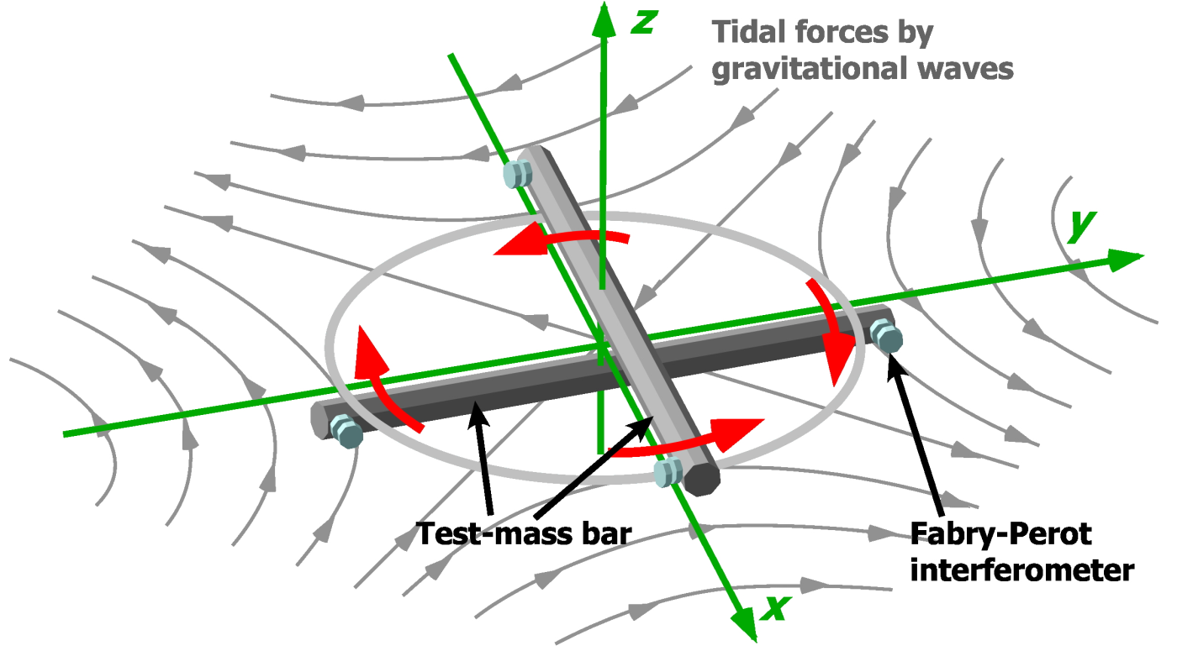
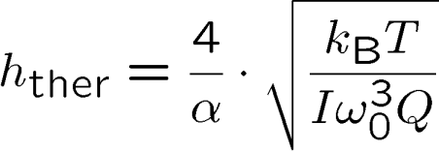
Resonant detector
・Connect two bars by a shaft
→ resonant torsion detector
- GW signal is enhanced
at resonant frequency by Q.
- Requirements for readout and
bar-thermal noise are relaxed.
- Detector noise is mainly limited
by thermal noise of the shaft.
Shaft
・Thermal noise level
At resonant freq.
f₀=0.1Hz, Q=10⁹, T=4K,
M=7600kg, L=10m
7.5x10⁻¹⁸ [1/Hz^{1/2}]

Slide 49
Fundamental noise level of TOBA
Practical parameters
(at 0.1 Hz)
Bar length : 10m, Mass : 7600kg
Laser source : 1064nm, 10W
Cavity length : 1cm, Finesse : 100
Bar Q-value : 10⁵ , Temp: 4K
Support Loss : 10⁻¹⁰
Laser Freq. noise < 10Hz/Hz^{1/2},
Freq. Noise CMRR>100
Intensity noise < 10⁻⁷/Hz^{1/2},
Bar residual RMS motion < 10⁻¹² m

Slide 50
Optical readout noise
・Optical readout noise
- Readout by short FP cavities at the bar edge.
- Reference mirrors fixed to isolated base plate.
Shot noise + Rad. Pressure noise
Nd:YAG 1064nm, Power 10W,
Short FP cavity, Finesse 100

Slide 51
TOBA Sensitivity
Comparison with the other detectors
DECIGO/BBO band:
Between ground-based detectors and LISA bands
SQL
Characteristic amplitude :
(Dimensionless strain)

Slide 52
Fundamental noise level of TOBA
Practical parameters
(at 0.1 Hz)
Bar length : 10m, Mass : 7600kg
Laser source : 1064nm, 10W
Cavity length : 1cm, Finesse : 100
Bar Q-value : 10⁵ , Temp: 4K
Support Loss : 10⁻¹⁰
Laser Freq. noise < 10Hz/Hz^{1/2},
Freq. Noise CMRR>100
Intensity noise < 10⁻⁷/Hz^{1/2},
Bar residual RMS motion < 10⁻¹² m

Slide 53
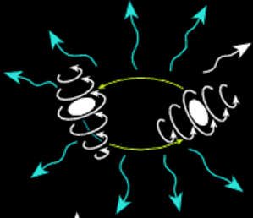
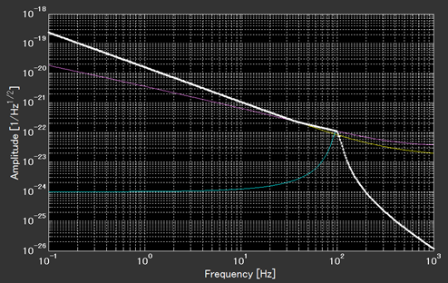
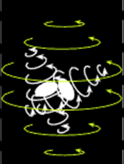
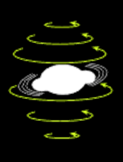
Chirp waveform
・Phenomenological waveform by numerical simulation
(Ajith+ arXiv 0909.2867)
- For BH inspiral (no tidal deformation).
- Include chirp, merger, and ring-down.
- Include spin effect.
GW from BH merger
- 100 Msolar equal mass
- Spin parameter 0.5
- Distance 100 Mpc
Inspiral
Merger
Ringdown

Slide 54
Observable range
GWs from binary BH mergers
Obs. Range ~10Gpc ( )
Calculation by K.Yagi

Slide 55
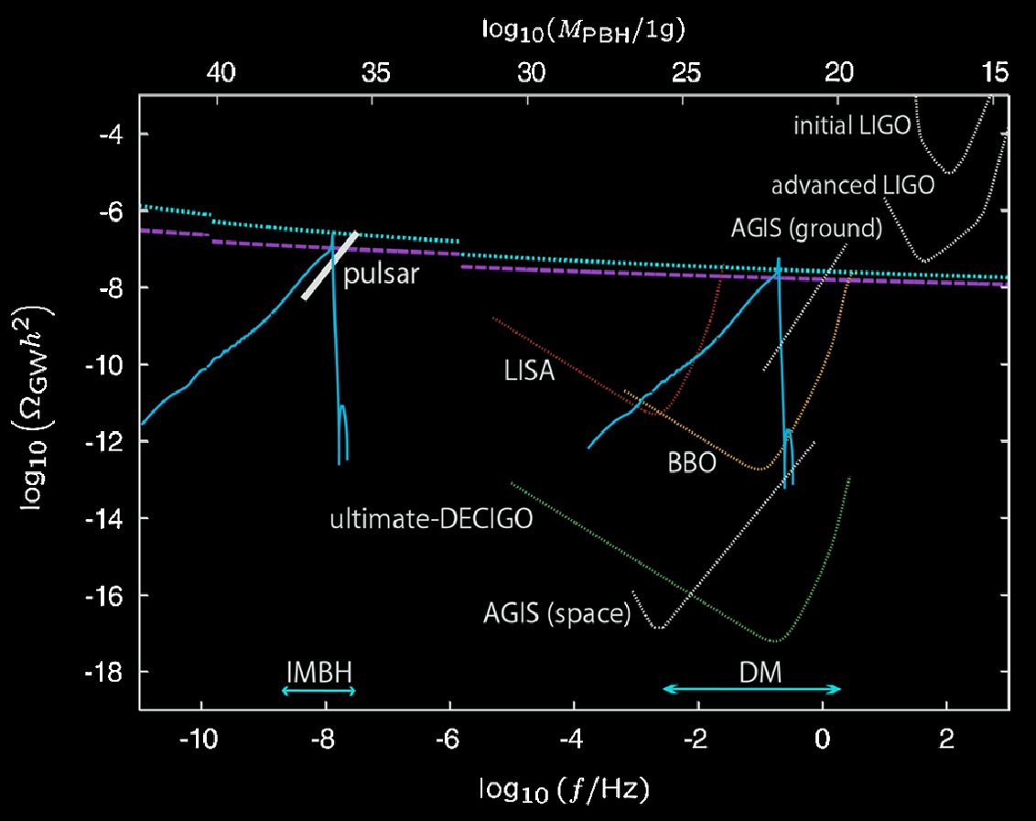
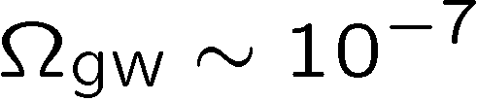
Background GWs
Observable GW
energy density ratio
(1-yr obs. by 2 TOBAs)
TOBA
Beat BBN upper limit
GW by primordial
tensor perturbation
R.Saito and J.Yokoyama,
PRL 102, 161101 (2009)

Slide 56
Sensitivity by R-TOBA
Sensitivity example
Rotation freq. 5x10⁻⁵ Hz
Laser power 1mW
Bar length : 10m, Mass : 7600kg
Laser source : 1064nm, 1mW
Cavity length : 1cm, Finesse : 1
Bar Q-value : 10⁵ , Temp: 4K
Support Loss : 10⁻¹⁰
Bridge the Pulsar-timing and LISA bands
Rot. Freq.
5x10⁻⁵ Hz

Slide 57
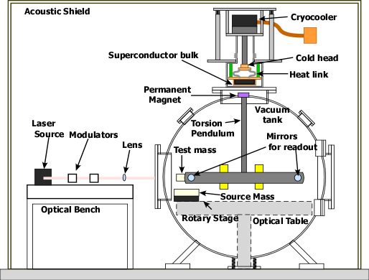
Small-scale TOBA
・Optical readout
Mirrors at both edges of the test-mass bar
→ Form Michelson interferometer
Sensitive angular sensor
Nd:YAG laser source
Wavelength 1064nm
Power 50mW
・Vacuum system
Pressure 10⁻⁵ Pa by TMP+RP
Acoustic shield enclosure
・Test-mass bar
Length ~200mm, Weight 160g
Made of Aluminum
Room temperature
・Suspension
Magnetic levitation by pinning
effect of type-II superconductor
Superconductor bulk
φ600mm, t 20mm, Tc ~92K
Low-vibration cryo-cooler
Operation temp. ~65K
Gd₁Ba₂Cu₃O_{6.9} : 70.9%
Gd₂Ba₁Cu₁O₇ : 19.2%

Slide 58
Small-scale TOBA at Tokyo
University of Tokyo
Superconductor bulk
(inside a chamber)
Low-vibration
Pulse-tube cryo-cooler
Vacuum pump
(TMP + RP)
Optical bench
1366mm
Vacuum tank
φ600mm
1932mm
1498mm
Acoustic shield

Slide 59

Small-scale TOBA at Kyoto
Clean booth
Control circuits
Cryocooler
Super-
conductor
Vacuum Tank
Laser source
and input optics
Test mass
Michelson
interferometer
Test mass
driver
February 2010 at Kyoto University

Slide 60

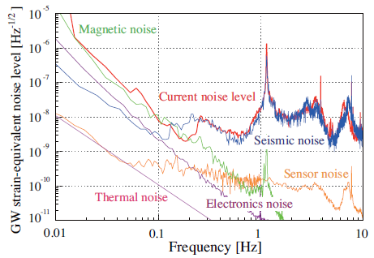
Sensitivity of small TOBA
Small-scale TOBA at University of Tokyo
Sensitivity
at 0.2Hz
K.Ishidoshiro et al.,
PRL 106, 161101 (2011)
Limited by magnetic disturbances and seismic coupling

Slide 61
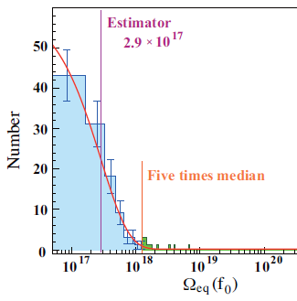
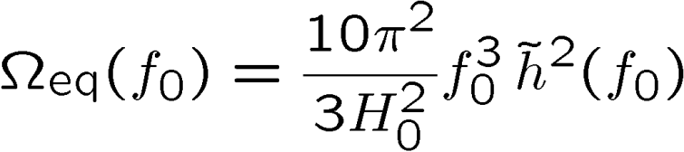
GWB observation by small TOBA
・Observation run by small-scale TOBA at the University of Tokyo
One-night observation → 7.5 hours’ data
Use stable 3.5 hours’ data
・Data analysis for stochastic background GW
Assume isotropic, unpolarized GWB
GWB energy density ratio
Hubble constant H₀ = 70 [km/s/Mpc ]
Divide obs. data into 120 segments
→ Average and distribution

Slide 62


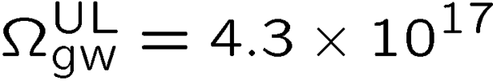
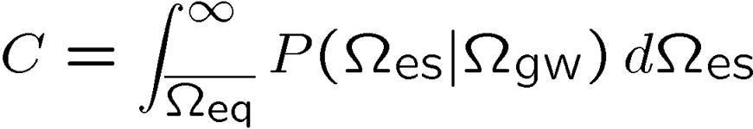

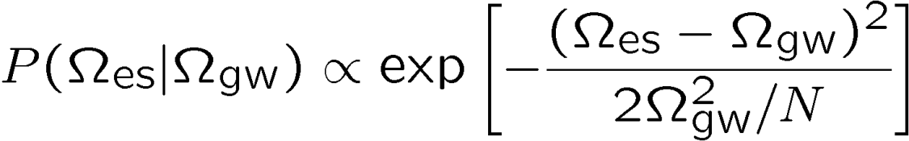
Upper limit on GWB
・Distribution → Averaged power at 0.2Hz
Upper limit on
(C.L. 95%)
Conservative upper limit including
calibration error (δh/h ~ 10%)
and the other systematic errors.
Some details…
Probability to have
larger result than
Distribution with
assuming Gaussian dist.

Slide 63
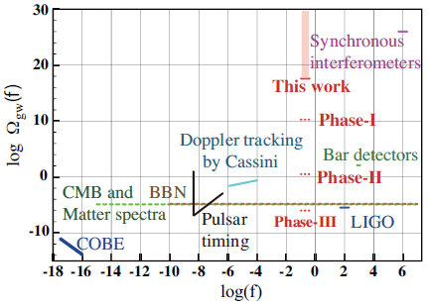

Comparison with previous results
New upper limit at unexplored frequency band of 0.2Hz
10m TOBA

Slide 64

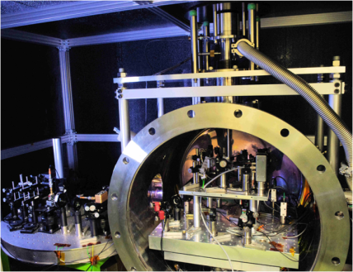
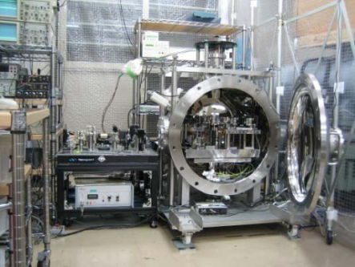
Observation with two detectors
Observation with two detectors places at Tokyo and Kyoto, Japan.
Comparable sensitivity, Separation : 370km
Better upper limit on GWB
Possible detection
Tokyo
Kyoto
On-line calibration
(for monitoring the gain):
10 Hz signal
Monitored GPS signal:
1pps signal
Temperature: ~70K
Tokyo
Kyoto
On-line calibration
(for monitoring the gain):
8.7 Hz signal
Monitored GPS signal:
1pps and serial signal
Temperature: ~40K
370km
DATE: 0:00 – 5:00, July 20, 2010
Sampling frequency: 1kHz
Direction of Test-mass bar: north-south
Original fig. by
A.Shoda
(GWPAW 2011)

Slide 65
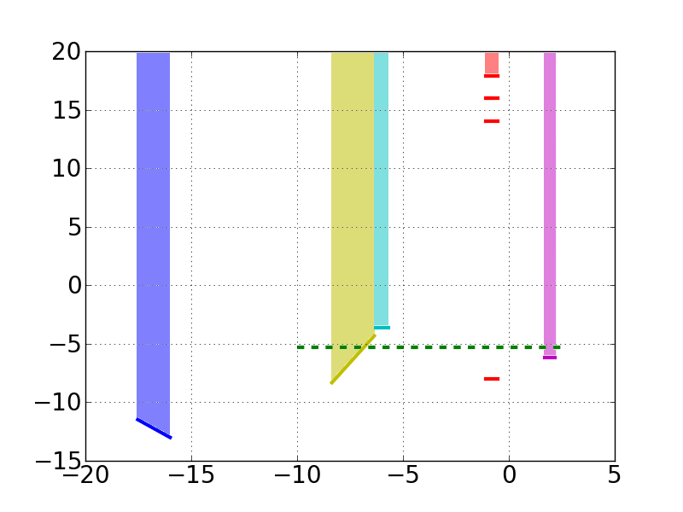
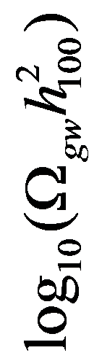

Observation with two detectors
1台の観測では, 背景重力波の検出は極めて困難.
検出器の雑音と背景重力波を区別できない.
Fig. By A.Shoda
プロトタイプ2台で
5時間同時観測
複数台での
同時観測, 相関解析を行う.
信号と雑音を区別できる.
感度を向上できる.
程度の向上.
プロトタイプ2台で
1年間同時観測
10mスケールのアンテナ
2台で1年間同時観測

Slide 66
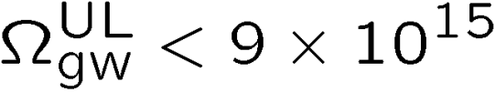

Sensitivities
One-night observation runs x three times
Data analysis underway → is expected
(1/50 better upper limit than that by one detector)
10⁻⁴
10⁻⁵
10⁻⁶
10⁻⁷
Tokyo
strain [Hz^{-1/2}]
10⁻⁸
Kyoto
10⁻⁹
10⁻¹⁰
10⁻¹¹
10⁻² 10⁻¹ 1 10
frequency [Hz]
Fig. By A.Shoda

Slide 67


結果の見通し
観測データ (2010年7月) 解析の暫定結果.
20
Single TOBA
15
preliminary
The estimate
of this work
10
5
Doppler Tracking
by Cassini
0
-5
BBN
Pulsar timing
LIGO
-10
COBE
-15
-20 -15 -10 -5 0 5
Fig. By A.Shoda

Slide 68


プロトタイプ
2つの地上装置, 1つの衛星搭載モジュール
ねじれ型重力波検出器A
ねじれ型重力波検出器B
ねじれ型重力波検出器C
(地球周回軌道, 2009年-)
(東京大学, 2008年-)
(京都大学, 2010年-)
SDS-1/SWIM
試験マス
質量 50g, 長さ 5cm
質量 150g, 長さ 20cm
質量 340g, 長さ 25cm
無重力浮上 +制御
超電導磁気浮上 +制御
超電導磁気浮上 +制御
変動検出
反射型フォトセンサ
レーザー干渉計
レーザー干渉計
位置・姿勢
スピン + 軌道運動
地上静置観測
地上静置観測

Slide 69
Rotating TOBA
Rotate the detector along its axis
Very low-freq. GW signal (~10⁻⁸ – 10⁻⁴ Hz) is
up-converted to 2 x (Rotation freq.)

Slide 70
Fundamental noise level of TOBA
Practical parameters
(at 0.1 Hz)
Bar length : 10m, Mass : 7600kg
Laser source : 1064nm, 10W
Cavity length : 1cm, Finesse : 100
Bar Q-value : 10⁵ , Temp: 4K
Support Loss : 10⁻¹⁰
Laser Freq. noise < 10Hz/Hz^{1/2},
Freq. Noise CMRR>100
Intensity noise < 10⁻⁷/Hz^{1/2},
Bar residual RMS motion < 10⁻¹² m

Slide 71
TOBA Sensitivity
Comparison with the other detectors
DECIGO/BBO band:
Between ground-based detectors and LISA bands
SQL
Characteristic amplitude :
(Dimensionless strain)

Slide 72
Optical readout noise
・Optical readout noise
- Readout by short FP cavities at the bar edge.
- Reference mirrors fixed to isolated base plate.
Shot noise + Rad. Pressure noise
Nd:YAG 1064nm, Power 10W,
Short FP cavity, Finesse 100

Slide 73
Bar thermal noise
・Thermal noise of bar mode
Differential readout at the edges
→Contribution of odd modes
Readout
Aluminum bar (7.6 ton)
length 10 m, φ0.3 m
Temp. 4K, Q 10⁷
8x10⁻²⁰ 1/Hz^{1/2} at 0.1Hz
By keeping the total mass,
- High Q and low T is better
- Shorter is better
- High Young's modulus is better

Slide 74
Chirp waveform
・Phenomenological waveform by numerical simulation
(Ajith+ arXiv 0909.2867)
- For BH inspiral (no tidal deformation).
- Include chirp, merger, and ring-down.
- Include spin effect.
GW from BH merger
- 100 Msolar equal mass
- Spin parameter 0.5
- Distance 100 Mpc
Inspiral
Merger
Ringdown

Slide 75

TOBA Sensitivity
Sensitivity example
Bar length : 10m, Mass : 7600kg
Laser source : 1064nm
Bar Q-value : 10⁵ , Temp: 4K
Support Loss : 10⁻¹⁰
1mW
Rot. Freq.
5x10⁻⁵ Hz
0.3W
10W, F 100

Slide 76


Topic
Homodyne detection
Ideas of :
Bar rotation by tidal acceleration by GW
Detection of Circularly polarized GWs
Heterodyne detection method
V.B.Braginsky, Ya.B.Zel’dovich, and V.N.Rudenko
Sov. Phys.- JETP Lett. 10 (1969) 280.
Being introduced in:
C.W.Misner, K.S.Thorne, J.A.Wheeler,
‘Gravitation’ W.H.Freedman (1973) pp.1016.
Observation with torsion antenna :
Cryogenic torsion antenna to observe
continuous GWs from Grab pulsar
S.Owa, et al.,
‘Cryogenic Detector for Gravitational
Radiation from the Crab Pulsar’
Proceedings of the fourth Mercel Grossmann
Meeting on General Relativity (1986).

Slide 77


SDS-1衛星での実証
SDS-1 (Small Demonstration Satellite - 1)
JAXA開発による100kg級の技術実証衛星
SDS-1 and GOSAT
(Press Release, November 4, 2008)
Photo from Mainich Newspaper Web
Size : 70x70x60cm,Weight : 100kg
Power : >100W, Downlink : ~5kbps
Orbit : SSO (~660km)
Spin stabilization and 3-axis attitude control
Mission Lifetime : ~Half year (nominal)
http://www.iat.jaxa.jp/info/prm/2007/019/01.html

Slide 78


SDS-1/SWIM
SDS-1/SWIM
2005年 検討・開発開始.
2009年 1月23日打上げ.
2011年 9月 運用停止.
全ての機器で
full success以上を達成.
写真：JAXA
SpaceCube2: Space-qualified Computer
SWIMμν : User Module
CPU: HR5000
(64bit, 33MHz)
System Memory:
2MB Flash Memory
4MB Burst SRAM
4MB Asynch. SRAM
Data Recorder:
1GB SDRAM
1GB Flash Memory
SpW: 3ch
Processor test board
GW+Acc. sensor
FPGA board
DAC 16bit x 8 ch
ADC 16bit x 4 ch
→ 32 ch by MPX
Torsion Antenna x2
~47g test mass
Data Rate : 380kbps
Size: 124 x 224 x 174
Weight: 3.5 kg
Power: ~7W
Size: 71 x 221 x 171
Weight: 1.9 kg
Power: 7W
Photo by JAXA
Photo by JAXA

Slide 79



SWIMμν GW sensor
Tiny GW sensor : Test-mass length ~ 50mm
Launch in Jan. 2009, Decommission in Sept. 2010
Successful operation and data-taking
TAM: Torsion Antenna Module with free-falling test mass
(Size : 80mm cube, Weight : ~500g)
Test mass
SWIMmn Module
~47g Aluminum, Surface polished
Small magnets for position control
2 TAMs
in the frame
Coil
Used for test-mass
position control
Max current ~100mA
Photo sensor
Reflective-type optical
displacement sensor
Separation to mass ~1mm
Sensitivity ~ 10⁻⁹ m/Hz^{1/2}
6 PSs to monitor mass motion

Slide 80

SWIMμν 軌道上実証
SWIM
In-orbit operation
z control on
Test mass controlled
Error signal → zero
Damped oscillation
(in pitch DoF)
yaw control on
Free oscillation
in x and y DoF
Signal injection
→ OL trans. Fn.
Operation: May 12, 2009
Downlink: ~ a week
By
W.Kokuyama

Slide 81
Sensitivity
Observation by SWIM and ground-based detectors
1st run June 17 2010, 2nd run July15 2010

Slide 82




Dynamic Quadrupole moment
Dynamic quadrupole moment
: Mode pattern function
In case of bar rotation…

